Slide 1
Introduction to the Global Innovation Partners team
Dr Charlie Ellis
Senior Partnerships Manager, Global Innovations Partners team

Slide 2
Overview
Aims and objectives of the Global Innovation Partners team
Overview of Faculty performance
Review of support offered
Current and Future opportunities

Slide 3
1. Global Innovation Partners: Aims and objectives
Aims:
Global Innovation Partners team is committed to:
Promoting Queen Mary as a leading research institute
Growing Queen Mary’s international research and innovation income by encouraging collaboration between researchers and external organisations
Objectives:
Developing strategic partnerships for international R&I initiatives, and aligning this with the Faculty’s research strategy
Supporting the development of international research and innovation funding applications
Promoting international commercialisation
Supporting in-country funding led by key overseas partners

Slide 4
2. Overview of Faculty performance
Current key countries (by volume) for the Faculty (2017-present)
 | Country | No. Projects
1 | China | 119
2 | USA | 72
3 | India | 40
4 | Japan | 30
5 | Brazil | 26
6 | Canada | 23
7 | Thailand | 21
8= | Singapore | 18
8= | Indonesia | 18
10 | Mexico | 9

Slide 5
Current key countries (by value) for the Faculty
 | Country | Value
1 | USA | 6,277,412.88
2 | China | 2,513,494.39
3 | Japan | 2,022,877.58
4 | India | 469,150.5
5 | Indonesia | 384,244.4

Slide 6
Distribution of international partners per School

Slide 7
International contract research
EECS SBCS SEMS

Slide 8
3. Review of support offered
The GIP and the GCRF teams can help support you in a number of different ways, to include:
Scope international partners
Conduct market analysis
Bid review, including ODA & impact statements
Feedback on int. IP & collaboration agreements
Notes:
[LINK]
The GIP team undertake a process of:
Horizon scanning, identifying opportunities
Promoting upcoming calls with faculties/academics
Assisting interested academics with proposal alignment with funding scope
Facilitating new partnerships
Assessing ODA compliance
Providing value-added feedback on proposals

Slide 9
GIP support process
Scanning major funding sources
Horizon scanning, identifying opportunities
Promoting upcoming calls with faculties/academics
Assisting interested academics with proposal alignment with funding scope
Facilitating new partnerships
Assessing ODA compliance
Providing value-added feedback on proposals
Monthly bulletin
Targeted communications
Research international landscape
Use networks to identify new partners
Support coordination of large bids
Provide advice for grant writing and development
Notes:
Developed knowledge and experience of new funding schemes such as UK-PACT (Partnering for Accelerated Climate Transitions) e.g.
recently work on a few UK PACT Green Recovery Challenge Fund (GRCF) applications.

Slide 10
4. Current and Future Opportunities
Perform regular scanning exercises of international research and innovation funding opportunities
Collate opportunities in a monthly bulletin sent to Faculty and School Research Managers for distribution
Attended relevant funding call webinars
Organise workshops and sandpits to discuss funding opportunities

Slide 11
Call | Closing Date | Funds available/duration
BBSRC-FAPESP joint research funding | 28 April 21; & 21 September 21. | up to £2 million for up to five years, Brazil
Royal Society International exchanges scheme | 10 June (Italy) & 29 Sept 21 (Japan, China, Taiwan) | £3,000 - £12,000 for single or multiple visits from 3 months -2 years
Royal Society Wolfson Visiting Fellowships | 14 July 21 | Up to £125,000 for 1-2 years
BBSRC Brazil pump-priming award | Open (no deadline) | up to £35,000 for two years, Brazil
EPSRC Working with overseas scientists (EoI) | Open (no deadline) | no funding limit, Brazil/US
NERC-FAPESP joint funding | Open (no deadline, and proposals will be accepted on an ongoing basis until expiry of the MoU on 31 December 2025) | TBD, Brazil
NERC-NSF joint funding | Open (with deadlines for full applications in mid-July each year; a Letter of Intent is required three months before the closing date) | TBD, US
UKRI-SBE lead agency opportunity | Open (no deadline) | up to £1 million, US
Notes:
The majority of current opportunities are from Lead agency programmes – open calls

Slide 12
Funds of interest
Fund for International Collaboration (FIC)
Newton Fund
UK PACT Fund
Ayrton Fund
Global Challenges Research Fund
Horizon Europe
Notes:
The FIC is a cross-UKRI fund launched in 2018 to enable the UK to develop strategic partnerships with leading R&D nations, to support:
World-leading research and innovation which delivers new knowledge, and societal and economic impact, to the mutual benefit of the UK and partner countries.
BEIS and wider Government objectives, including science diplomacy, enabling the UK to strengthen its collective voice in research and innovation policy
There are 20 partner countries involved in bilateral and multilateral programmes, including the USA, Canada, Japan, South Korea and India
The FIC is generally co-funded on a 1:1 basis by partner countries.
The Ayrton Fund is a commitment by the UK Government to spend £1bn of Official Development Assistance (ODA) funding on research, development and demonstration (RD&D) into clean energy technology and business models for low and middle income countries. It will run over five years from April 2021.
Originally announced in September 2019 it is styled as a way to “develop and test new technology targeted at tackling climate change in developing countries”. The commitment will address development challenges in low-carbon energy (supply), low-carbon societies (demand), and smart and flexible energy delivery and storage to meet a range of Sustainable Development Goals (SDGs), such as Goals 7 and 13. The fund will form a £1bn ODA programme supported by the UK’s international climate finance (ICF), which will be increased to at least £11.6bn over the same period. For comparison the Global Challenges Research Fund (GCRF) promised £1.5bn over a similar timeframe.

Slide 13
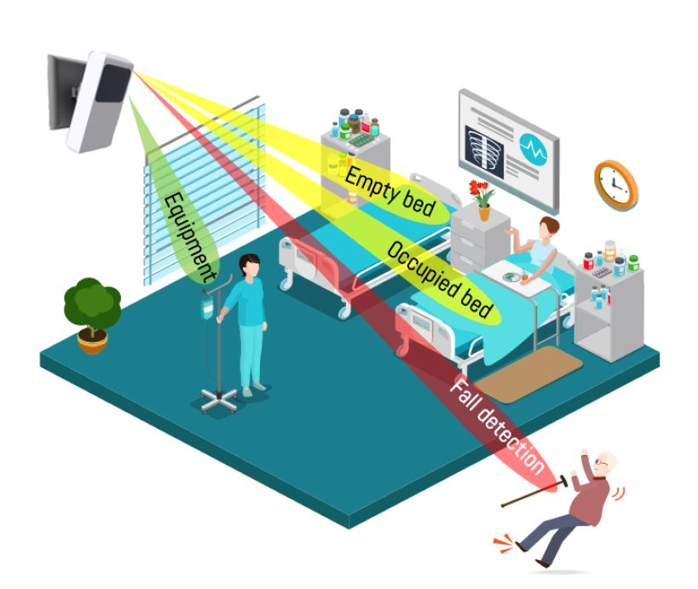
Future Commercialisation Opportunities
Impact Fund
Investigation of UKRI translational funding
Marketing QM technologies through partners and networks
Potential to attract international companies to the incubator site for biopharma at Whitechapel

Slide 14
Other contacts
Technology Transfer at QMI – Adam Daykin (a.daykin@qmul.ac.uk)
EU Section - Vicky Byers (v.byers@qmul.ac.uk)
GCRF – John Nightingale (j.nightingale@qmul.ac.uk)
BD - Joanne Chamberlain (j.chamberlain@qmul.ac.uk)
Consultancy/Contract research - Andrew Shaw (a.shaw@qmul.ac.uk)
Impact Fund – Michal Filus (m.filus@qmul.ac.uk)
Impact – Natalie Wall (n.wall@qmul.ac.uk)

Slide 15
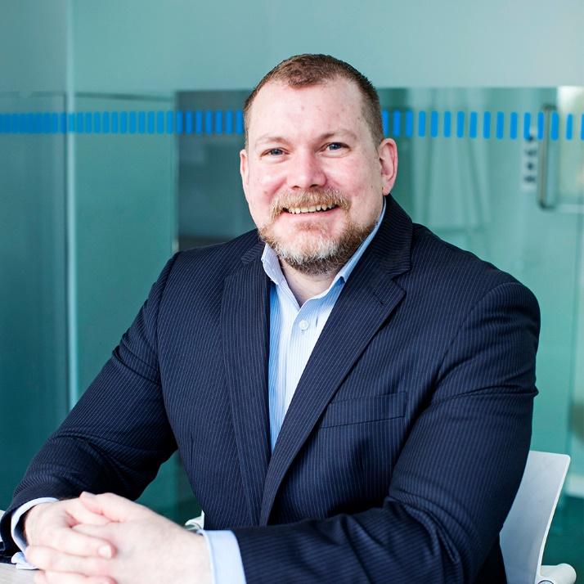
Dr Charlie Ellis
Senior Partnerships Manager Global Innovations Partners
QMI
E: c.d.ellis@qmul.ac.uk
T: 07866490044

