Slide 1
School of Mathematical Sciences
Research landscape
September 2021
1

Slide 2
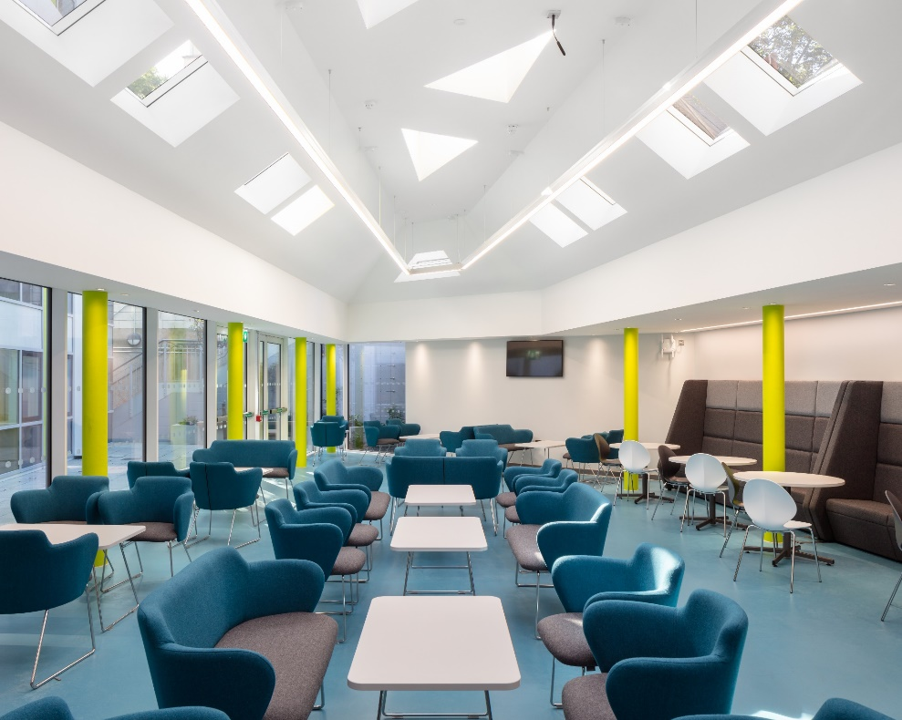
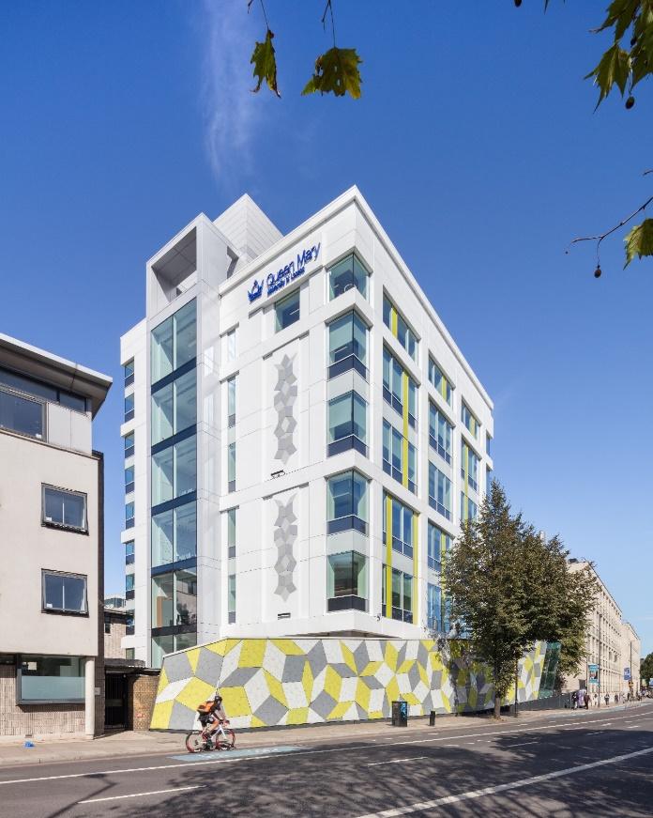
The School
68 academic staff
15 research staff
81 PhD students
13 professional services staff
7 research groups
12 seminar series including a monthly School Colloquium
Departmental-level Bronze Award for the Athena SWAN Charter obtained in April 2013 and renewed in 2016
Newly refurbished building to create an inspiring, collaborative space for the School community.
2

Slide 3
Grant income in the School
The School of Mathematical Sciences has a grant portfolio of about £10.8M (Sept 2021).
Funding sources include:
Engineering and Physical Sciences Research Council (EPSRC)
Science and Technology Facilities Council (STFC)
European Commission
Royal Society
The Leverhulme Trust
London Mathematical Society
The Alan Turing Institute
Heilbronn Institute for Mathematical Research
3

Slide 4
Postgraduate research students
The School of Mathematical Sciences has postgraduate research community of about 80 students.
Studentship funding sources include:
Engineering and Physical Sciences Research Council (EPSRC)
European Commission
Royal Society
The Leverhulme Trust
Heilbronn Institute for Mathematical Research
QMUL mini Centre for Doctoral Training
Government funding from Mexico (Conacyt), Saudi Arabia (KAU), Indonesia (LPDP), China (CSC), HEC (Pakistan), Algerian Ministry of Higher Education, Malaysian Govt & International Islamic University Malaysia
4

Slide 5
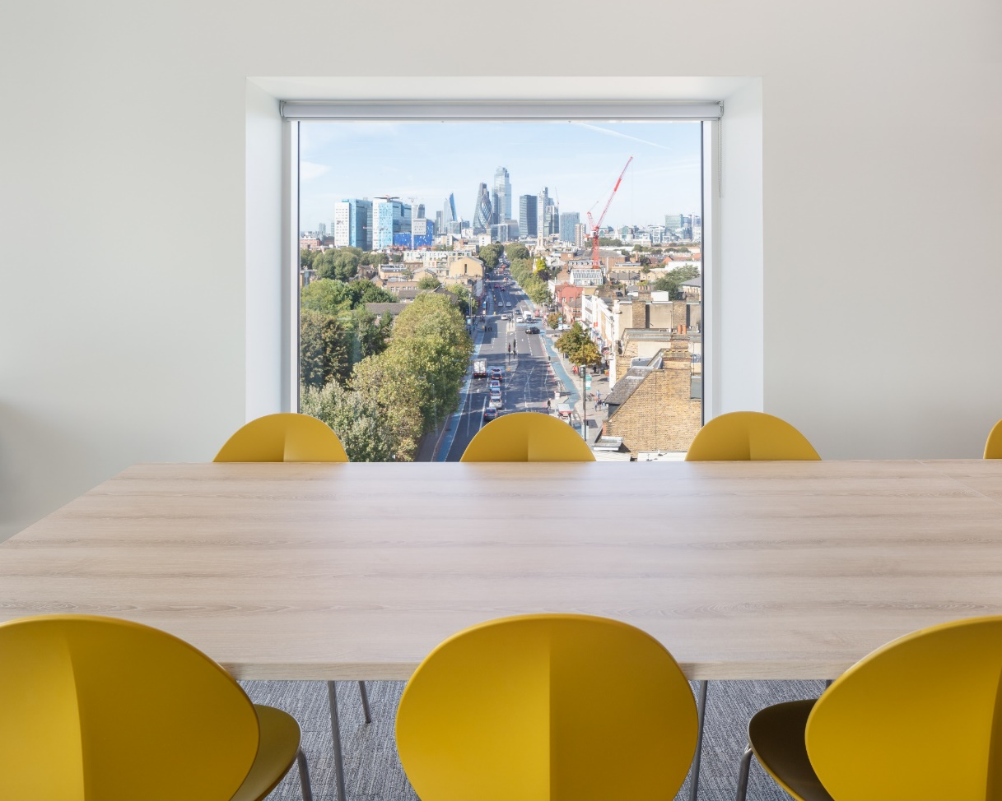
Algebra and Number Theory
Combinatorics
Complex Systems and Networks
Dynamical Systems and Statistical Physics
Geometry and Analysis
Probability and Applications
Statistics and Data Science
Research Areas
5

Slide 6
Algebra has for decades been a strength of the school. Historically, the focus was on group theory, but lately its scope had widened greatly and now extends into number theory. The work of the group is at the pure end of the spectrum, and is driven by a quest for insight and beauty. But in mathematics even the most the most theoretical pursuits have a habit of finding applications over the course of time.
Algebra and Number Theory
6

Slide 7
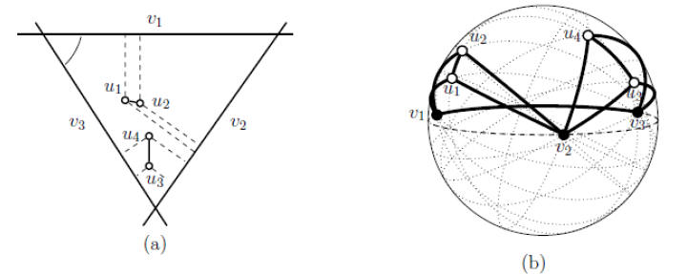
`Nudging’ is a topical concept in politics and the social sciences. How can we design an environment in which self-interested individuals act towards a common good? This question can be formalised mathematically, and rigorous answers obtained. This is the study of mechanism design which is one of several topics, often computationally informed, that are covered by the group.
Combinatorics
7

Slide 8
Complex networks abound in the modern world, in the study of social interactions, the internet, and the biology of the living cell. Despite the wide variety of application areas, it is possible to abstract common structures and principles. The group develops models for complex networks and examines their dynamics, in order to achieve deeper understanding and make informed predictions.
Complex Systems and Networks
8

Slide 9
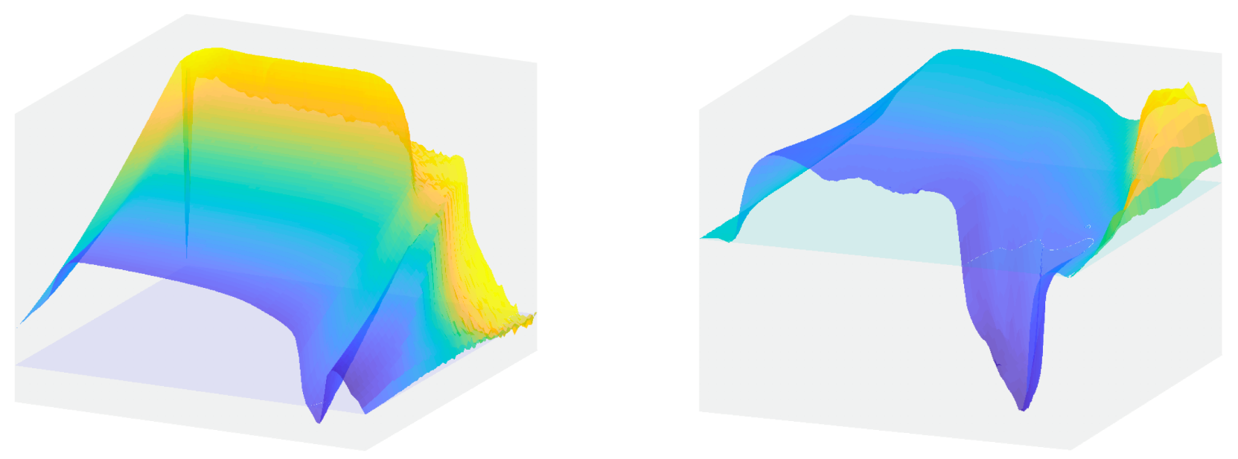
A central theme in physics is the idea that simple interactions between large numbers of particles or actors may result in complex macroscopic effects. Physics provides tools to understand these macroscopic effects without modelling every detail (which would be infeasible). At Queen Mary, these physical insights are applied in a wide range of situations which often go beyond traditional physics: packing of irregular objects such as tablets in a bottle, the foraging behaviour of insects.
Dynamical Systems and Statistical Physics
9

Slide 10
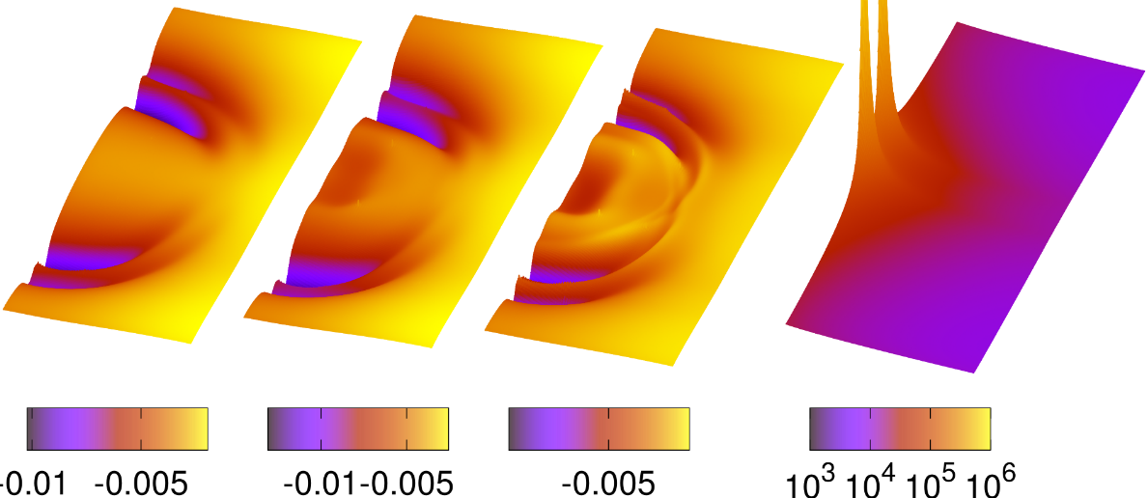
The research of this group is wide ranging. Work in differential geometry is on the direct line of development from Perelman’s celebrated resolution of the Poincaré conjecture. Meanwhile, in relativity, the group is at the cutting edge of research to understand gravity waves and the cosmological events that give rise to them. In this direction, the group contributes both to the foundations in general relativity and the computational methods that are crucial in interpreting data-intensive astronomical observations.
Geometry and Analysis
10

Slide 11
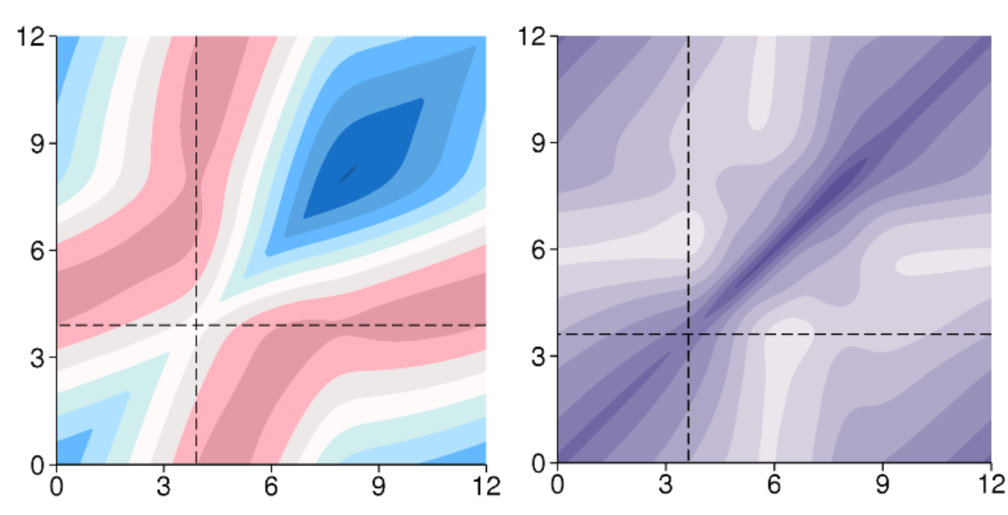
If nothing is certain, then probability is everywhere. In addition to developing the theoretical underpinning of the subject, the group develops applications to several areas of crucial concern in the modern world, including the analysis of financial markets, optimal control of energy systems and the urban environment, and modelling of biological mechanisms.
Probability and Applications
11

Slide 12
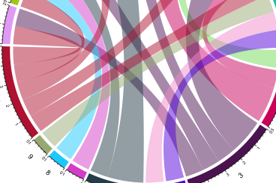
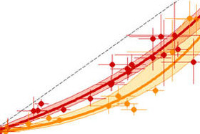
The key role of statistics in the study and control of infectious diseases has been underscored by the current Covid pandemic. At Queen Mary, statistical models have been developed to understand the spread of malaria. The insights obtained have informed the Global Fund’s decisions as to which interventions will be most cost effective. The group is also building strength in data science, a computationally intensive endeavour that makes inferences for massive data sets.
Statistics and Data Science
12

