Slide 1
DERI (short) update
22 June 2021

Slide 2
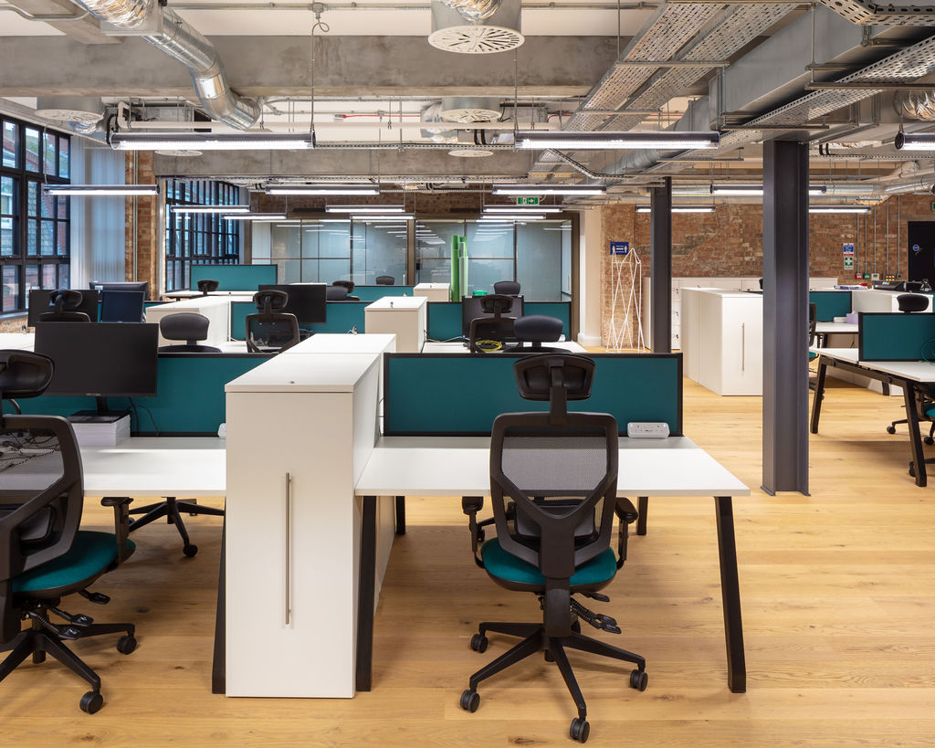
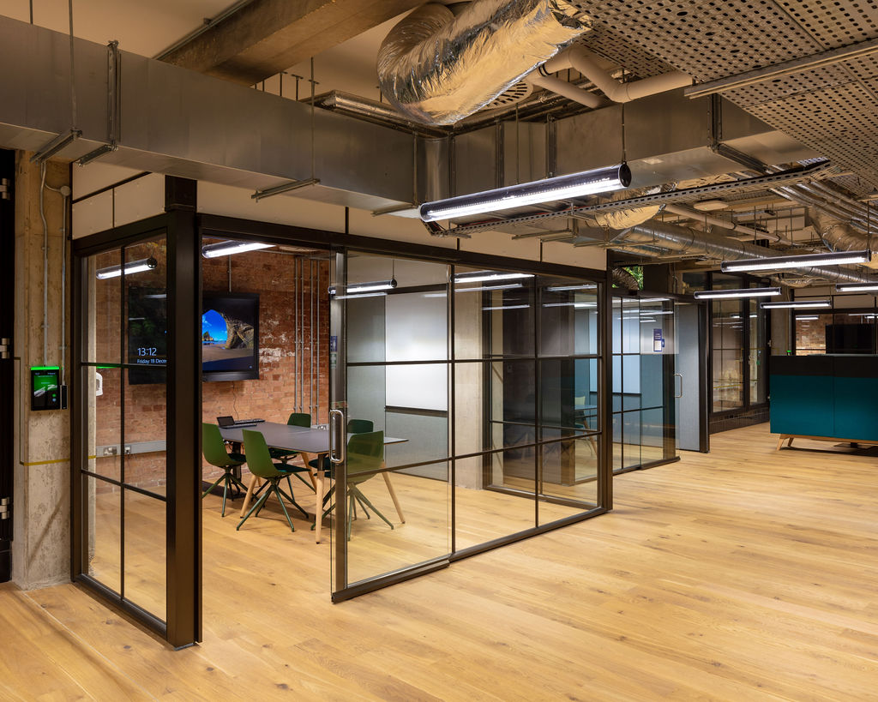
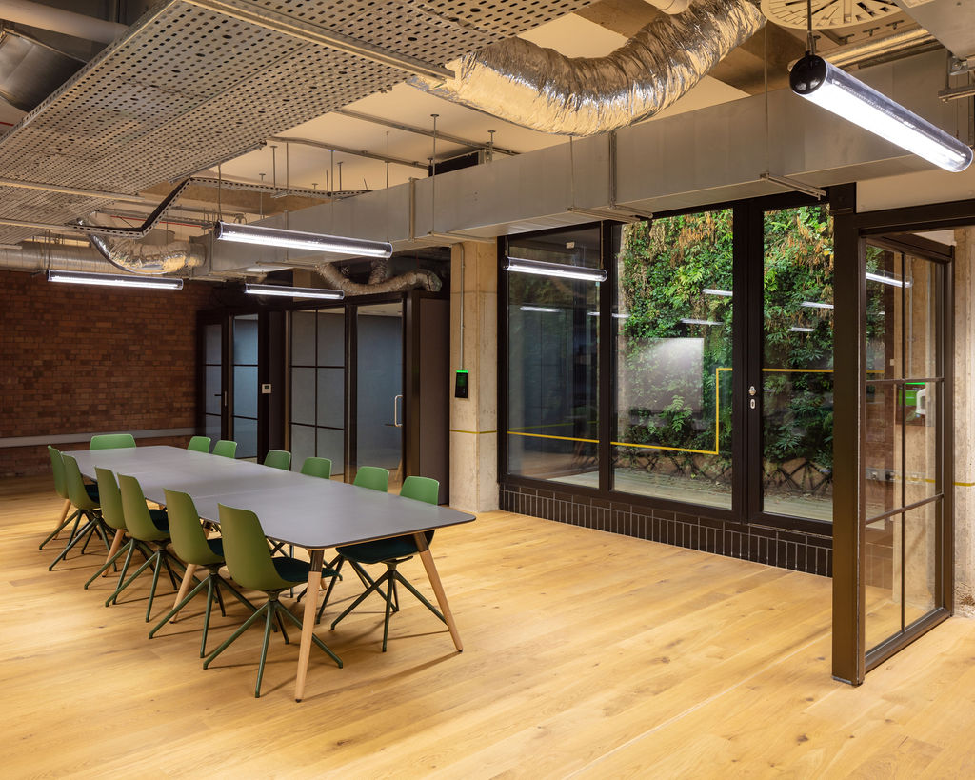
Digital Environment Research Institute (DERI)
University Research Institute (URI) dedicated to advancing digital and data science research at Queen Mary. Goals:
Drive progress amplifying existing work and forming new cross-cutting interdisciplinary collaborations
Further grow the ecosystem around QM’s expertise in digital and data science technologies and applications
Form strong links externally
Coordinate events, talks, workshops, sandpits
Leverage physical space
A fundamentally new approach: try new things that possibly wouldn’t happen with the status quo

Slide 3
In the building
September 2020
Games AI group
Chris Duffy’s lab - photosynthesis
Conrad Bessant’s lab - proteomics
William Marsh’s lab – decision support
Greg Slabaugh’s lab – computer vision
JRMO (Sharon Ellis’ team) – will relocate to Project W in Sept 2021
April 2021
Mark Freestone’s team – mental health
Moving into DERI
DERI is not about relocation.
Teams that move into the space must help deliver DERI
Strong strategic fit: Multi-disciplinary research in digital or data science including academics
Ambition: Eagerness to scale up activity going for bigger initiatives
Track record: Existing grant activity (funding, applications) and enable accessing new opportunities
Connections (industry, government) are plus
EECS and SBCS
SMD

Slide 4
Steering committee
Members
Andrew Livingston, VP Research & Innovation
Sharon Ellis, Director of Research Services
Simon Lucas, Professor of Artificial Intelligence, School of Electronic Engineering and Computer Science (S&E)
Michael Barnes, Professor of Bioinformatics, William Harvey Research Institute (SMD)
Kavita Datta, Professor of Development Geography, School of Geography (HSS)
Cecilia Poli, DERI Institute Manager (hired; starting in Sept)
Greg Slabaugh, Director of DERI (Chair)
Status
Meeting quarterly
DERI Admin (Greg Slabaugh, Janet Mowbray, Cecilia Poli)
DERI is in a pre-launch

Slide 5
DERI Themes (a work in progress)
Lead themes
AI’omics
Medical imaging
Games AI
Trustworthy / Regulated AI
Environment and sustainability
Emerging themes
FinTech
Digital humanities?
Targets
Form networks on theme topics. Meet regularly. Unite faculty where meaningful.
Link with industry
Apply for larger grants
Each theme should have a lead (and deputy lead)

Slide 6
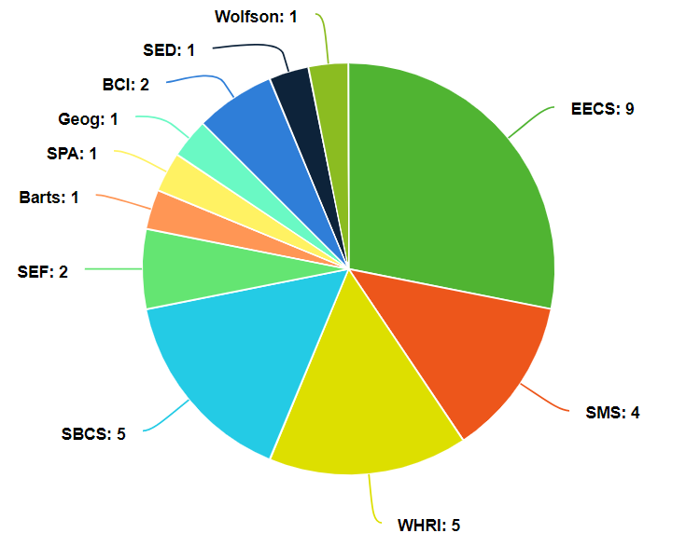
DERI Academic Fellow Model
Rolling out the DERI Academic Fellow Model (open call)
Applies post-hoc to people in the building
Allows academics to join DERI
Affiliation is additive
Currently 32 DERI Fellows
Working with faculty research managers to advertise
Benefits | Requirements
New networks for research | Work in the DERI building at least 37.5 hours per year
Access to new HPC | Presentation of research in DERI
Enhanced visibility and exposure | Bring in one external company per year to discuss collaboration
Building and hot desk access | Participation in two interdisciplinary events (e.g. sandpit, etc) each year
Access to small top-up funds | In the next year, lead (or co-lead) a multi-disciplinary grant application £300k+
Join DERI mailing list; activities | Be open to new collaborative research applications in new domains
Opportunity to help shape DERI

Slide 7
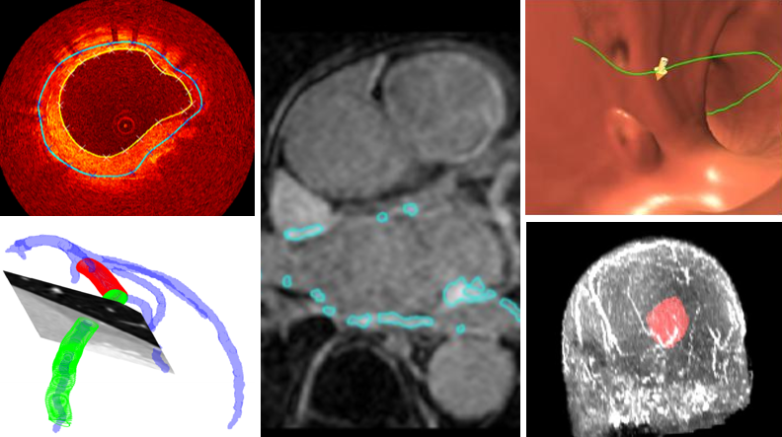
NEMIC
NEtwork for Medical Image Computing
The purpose of NEMIC is to unite researchers across the university performing (or interested) in research in medical image computing and related healthcare applications. The make-up of the network is a mix of academics, post-docs, and PhD students.
Started in March 2021
Currently 60+ members from S&E, SMD, Barts
Meeting monthly

Slide 8
Grant activity
Non-comprehensive list:
Unsuccessful
Strength in Places Fund | £22.4 million
Leverhulme Research Centre | £15.4 million
Total | £37.8 million
Awaiting outcome
BBSRC Collaborative Training Partnership (AI for drug discovery) | £2.1 million
Wellcome Leap - Delta Tissue | £4.1 million
GLA Community Renewal - iFellowship | £2.7 million
NIHR Biomedical Research Centre | ~£26 million
Total | £34.9 million

Slide 9
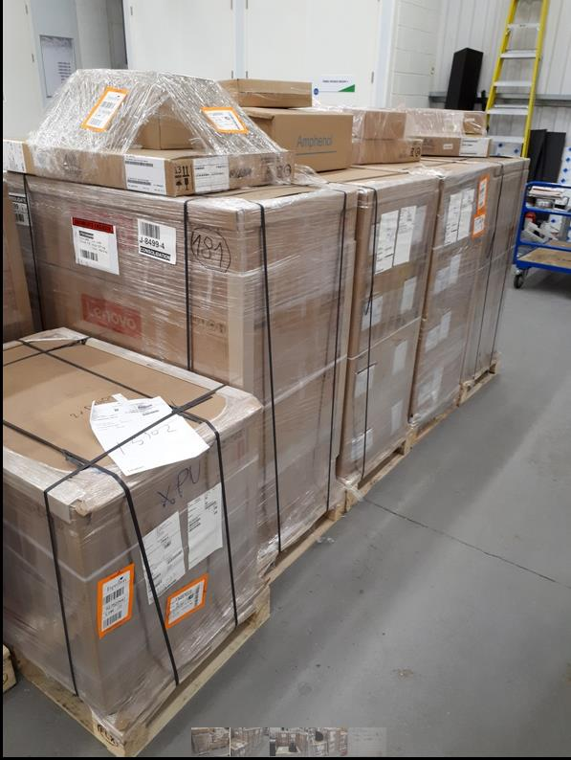
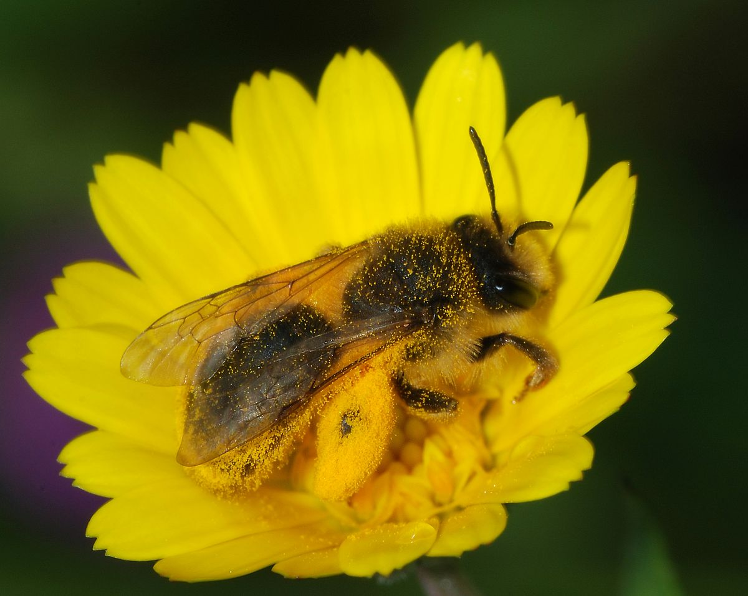
Andrena
£1 million Research Capital Infrastructure Fund (RCIF) grant awarded to DERI & WHRI
64 NVIDIA A100 GPUs. Waiting to install cabling; move equipment to former emedlab racks
Currently 12 of 64 GPUs are on for early trials
A100 access will be coordinated by DERI

Slide 10
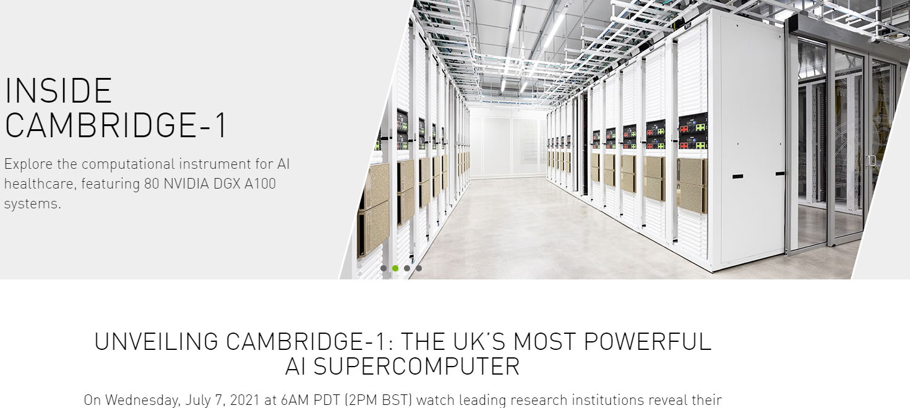
NVIDIA supercomputer for healthcare researchers
400 petaflops of AI performance and 8 petaflops of Linpack performance
Should be operational soon – unveiling on 7 July
NVIDIA is asking us if we have any use cases?

Slide 11
Sandpits and other activities
Law + AI sandpit (Feb)
EECS, Law – UKRI Trustworthy Autonomous Systems (TAS) call
FinTech workshop (last week)
13 companies, academics in EECS, SMS, SEF, SBM, Law
Next: Planning AI in healthcare sandpit in the fall

Slide 12
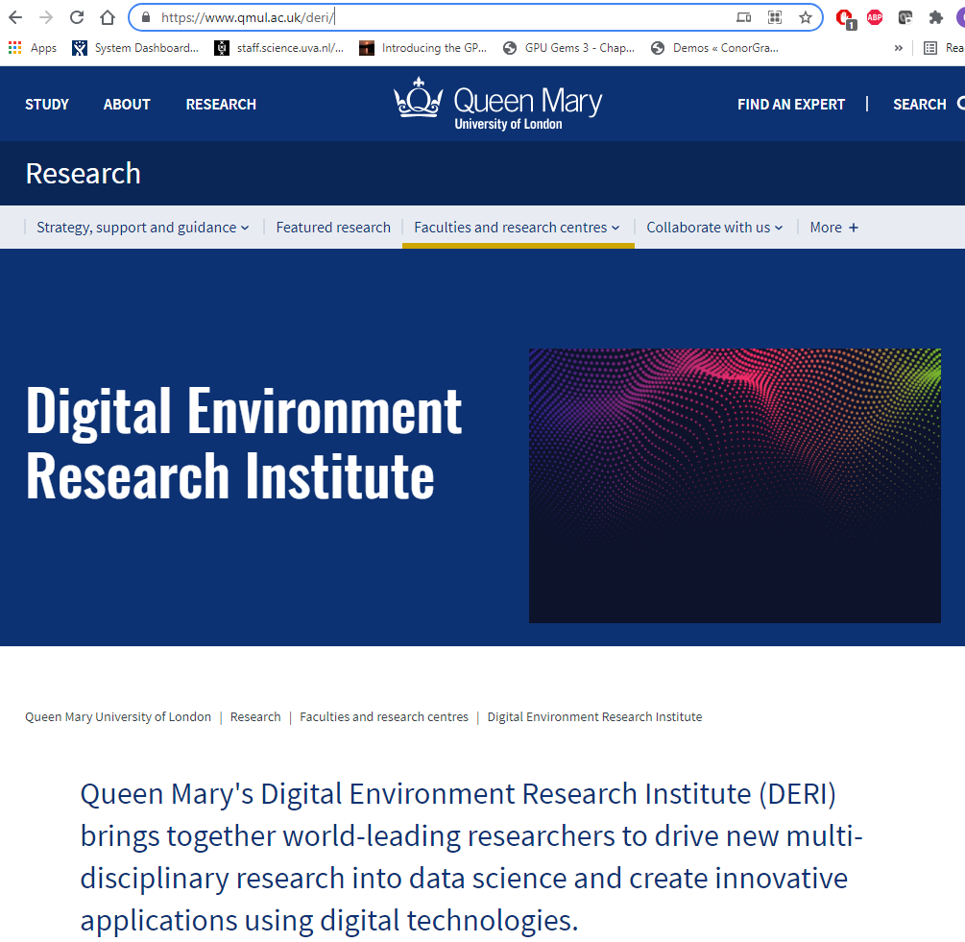
Website
https://www.qmul.ac.uk/deri/

Slide 13
Turing
New Turing Fellowship call, closes 23 June (tomorrow!)
Existing Fellows must reapply to be considered
Opportunity for new Fellows to join
Selection panel in July chaired by Andrew Livingston
IADS / DERI have merged seminar series
Michael Farber talk (Thursday)
Luca Rossi (15 July)
Greg to pick up Turing University Lead role from Michael Farber (term ending 30 June)

Slide 14
Thank you

