Slide 1
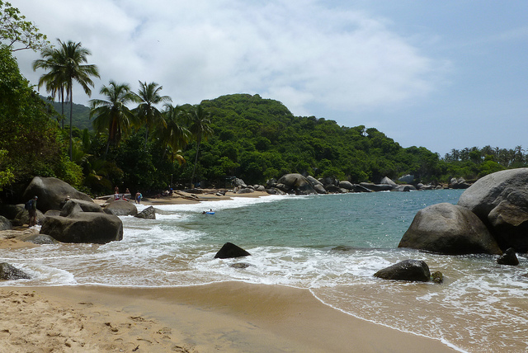
Boat
Flowers
Cake
Beach
Christmas
Buffet
Trees
Party
Water
Norway
Celebration
Tropics

Slide 2
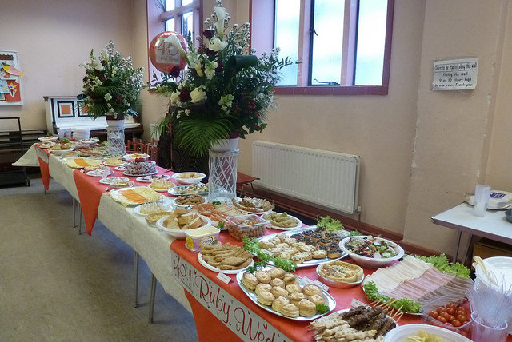
Boat
Flowers
Cake
Beach
Christmas
Buffet
Trees
Party
Water
Norway
Celebration
Tropics

Slide 3
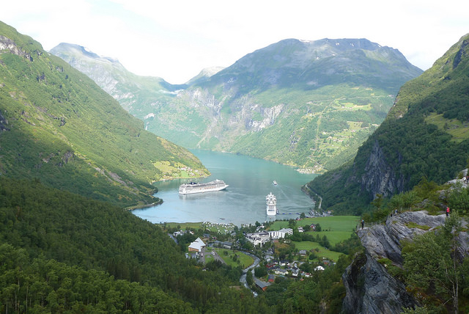
Boat
Flowers
Cake
Beach
Christmas
Buffet
Trees
Party
Water
Norway
Celebration
Tropics

Slide 4
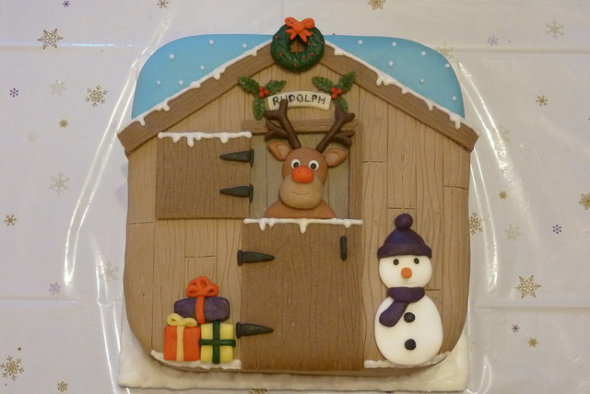
Boat
Flowers
Cake
Beach
Christmas
Buffet
Trees
Party
Water
Norway
Celebration
Tropics

