Slide 1
Athena SWAN Action Plan-Going for Gold
Aylin Baysan

Slide 2

Why is Athena SWAN Charter important?
Action plan themes
Some examples of action plan
Take home message

Slide 3

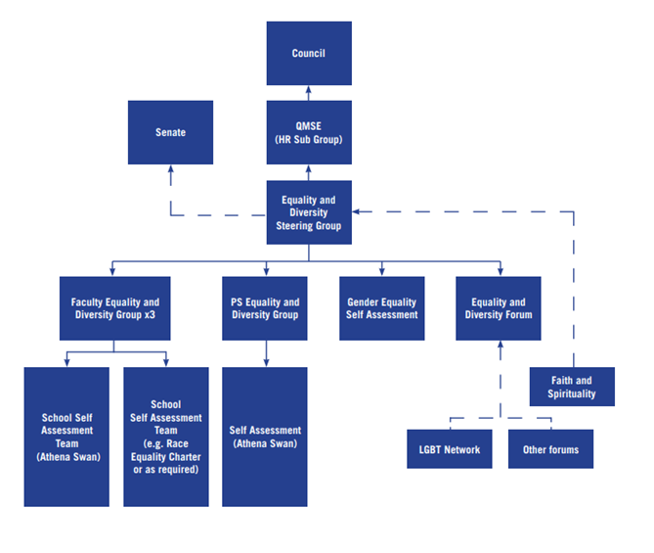
Queen Mary 2030 Strategy
VISION: To open the doors of opportunity

Slide 4
Athena SWAN charter
Athena SWAN Charter recognises and acknowledges an institution's commitment to gender equality.
Initially focused on the equality and progression for female academics and researchers in science, technology, engineering, mathematics and medicine (STEMM).
Since 2015, Athena SWAN has been extended to address gender equality more widely.

Slide 5
Athena SWAN charter
Support for trans staff and students.
Intersectionality of gender and different factors.
Consideration of areas demonstrating underachievement and underrepresentation of men.

Slide 6
Helps institutions achieve their gender equality
Supports the promotion of inclusive working practices
Recognise and share good practice
Demonstrating an institution’s commitment to an equitable environment
Assists institutions to meet equality legislation requirements of some funders and research councils
Uses a targeted self-assessment framework

Slide 7


Athena SWAN charter
Medicine
Dentistry

Slide 8
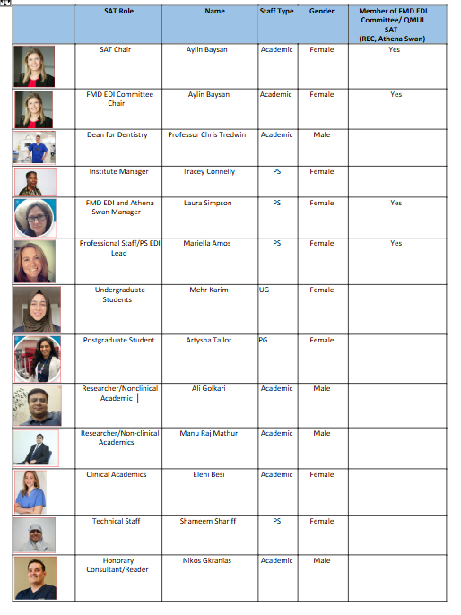



Slide 9


Our self-assessment process
Reflection
Focused to improve gender equality at IoD
Review annually

Slide 10



Slide 11
Priority areas
Address bullying and harassment
Expanding our intersectional approach to achieving equity
Unlock systemic barriers to support and guide academic staff with regards to recruitment, progression and rewards
Improve career trajectory and security for PTO staff
Creating an inclusive learning and teaching environment
Improving wellbeing, supporting staff, and enhancing a sense of community
Helping others to improve and applying for a Gold Athena Swan Award

Slide 12


Improving Staff Engagement
Increase Staff Diversity and Inclusion
Remove Student Attainment Gap
Improved Student Progression
Improved Career Outcomes for Graduates
Improved Reputation

Slide 13
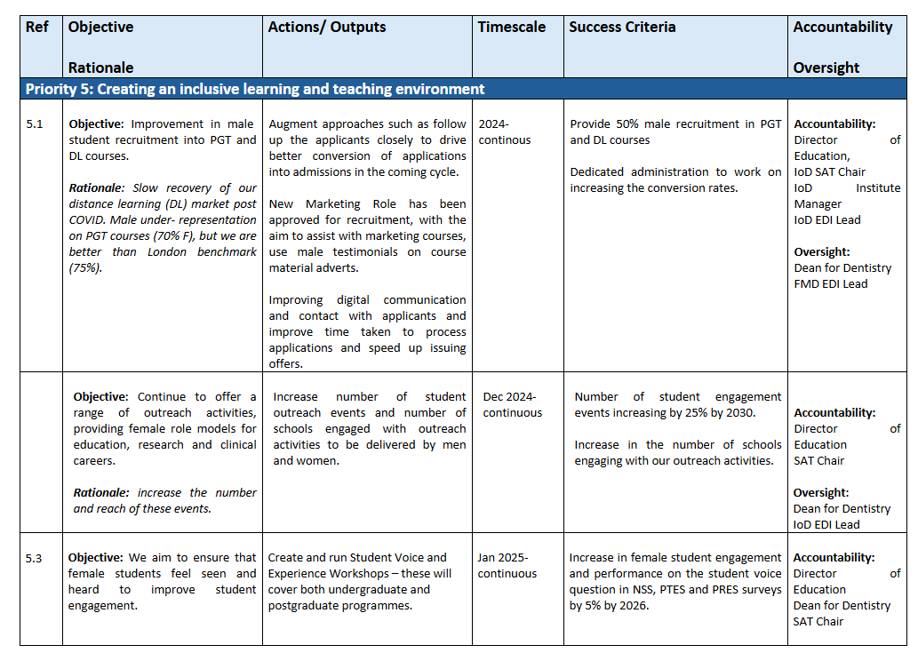

Slide 14
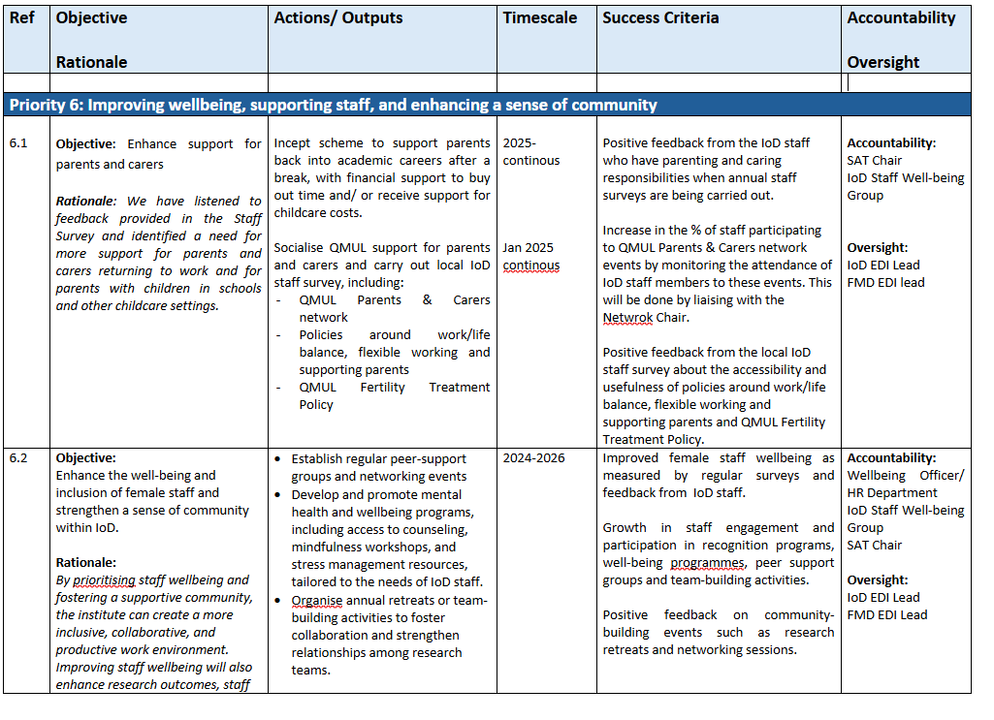

Slide 15
Our ultimate action plan is to provide a sense of community to support positive ethos, appreciate and promote diversity and individuality of each other by acknowledging positive attributes and abilities.

Slide 16

Thank you

