Slide 1

Institute of Dentistry
Student Support

Slide 2
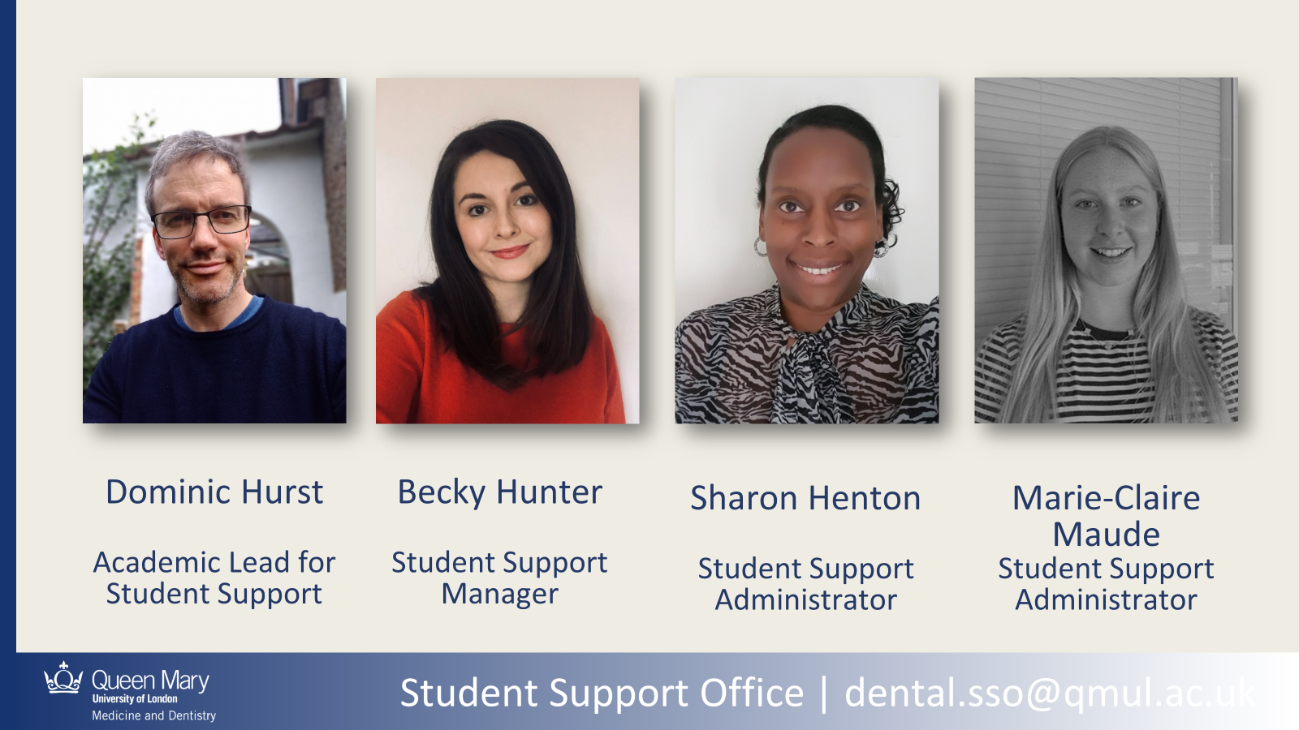

Slide 3
WQQ
Queen Mary University
WQQ
WFQQ
WQQ
FMD
FHSS
FSE
Faculties
WQQ
WQQ
WQQ
WQQ
WQQ
IHSE
Barts Cancer
Blizzard
Wolfston
William Harvey
IoD
Institutes

Slide 4
Dental.sso@qmul.ac.uk
Offices 5 and 20
4th floor, Dental Hospital
Whitechapel campus

Slide 5
Pastoral
Confidential, non-judgemental
Resources for well-being
SpLDs, health, disabilities
Inclusivity
Supporting students facing barriers
Engagement
Checking-in and working with students not engaging

Slide 6
Reasons to come to the Dental Student Support Office
SpLDs and Student Support Cards
Extenuating Circumstances/support with exams
Change of Circumstances/ interruptions
Mental and physical health
Bullying, harassment
Settling in, isolation
Support with academic
Anything impacting on your ability to study

Slide 7

Lots of other support at QMUL
Disability and Dyslexia Service
http://www.dds.qmul.ac.uk/
Advice and Counselling
https://www.welfare.qmul.ac.uk/
Academic Skills
https://www.qmul.ac.uk/library/academic-skills/

Slide 8
Common to all: Attention; Organisation; Working memory; Time management; processing speed
Dyslexia: reading; writing; spelling
ADHD: attention; activity; impulsiveness
Dyspraxia: motor coordination
ASD: social interactions; communication
Specific Learning Differences (SpLDs)

Slide 9
Harassment and Sexual Misconduct Induction Video file.mp4

Slide 10
Tackling Harassment and Sexual Misconduct
For information about further support visit: www.reportandsupport.qmul.ac.uk
If you have any questions, please email the Student life team: reportandsupport@qmul.ac.uk

Slide 11
Institute of Dentistry
Student Support

