Slide 1
Introduction to the
Disability and Dyslexia Service (DDS)
Kay Hall
kay.hall@qmul.ac.uk
Disability Advisor (FMD)

Slide 2
Today’s session
DDS – who we are
Supporting students – reasonable adjustments
Referring to DDS

Slide 3
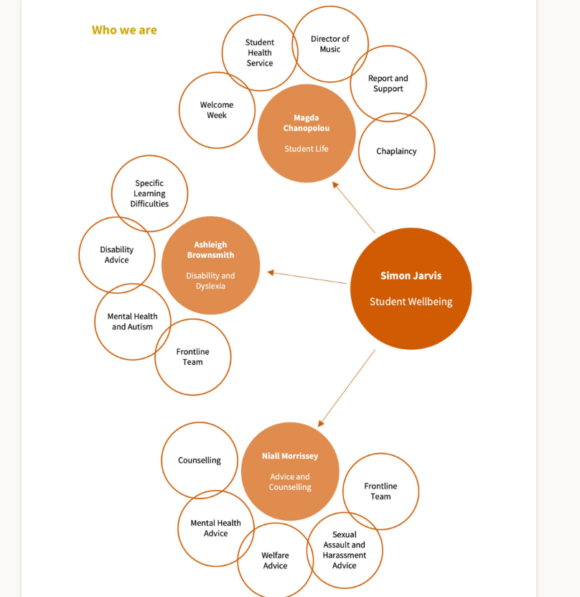
Who are we?
Student Experience Directorate / Student Wellbeing
  Team of disability advisors with different specialisms; Specialist Study Skills tutors; frontline team and operations

Slide 4
DDS: supporting students and staff
Reasonable Adjustments
Inclusive Learning environment
DDS facilitates reasonable adjustments for students who have a formal diagnosis of a disability such as:
  a Specific Learning Difference/s such as dyslexia, dyspraxia and/or ADHD
  autism
  a mental health condition
  a physical health condition such as a long-term medical condition or sensory impairment
DDS also provides information and guidance to help teaching and support staff develop more inclusive learning environments
Ethos is underpinned by the social model of disability
Anticipating students’ diverse learning needs and designing appropriate curriculum materials (minimising reasonable adjustments)

Slide 5
Support During Studies – Reasonable Adjustments
Examination Access Arrangements (e.g. additional time)
Bespoke support recommendations “Student Support Summary”
  Diagnostic information
  Support from DDS
  Support from elsewhere in QMUL (e.g. bespoke library support for disabled students)
  Support recommended from School
  Circulated to SSO who passes on to relevant academics.
  Information about disabled students is also available via Mysis
Liaison with School / NHS services / other external agencies as required
Drop-in sessions / Social Circle
Arrange Specialist 1:1 Study Skills Support / Specialist Mentoring / BSL / Non-specialist support (e.g. note takers / lab assistants)

Slide 6
Disability and Dyslexia Service
Support process for students
Student contacts DDS for support (or is referred for support by academic school/other department)
DDS requests medical evidence of a diagnosed condition if not already provided
Student provides evidence and is booked an appointment with a Disability Adviser
Student has no evidence but suspects they have a SpLD – directed to the Do-It Profiler
Student meets with a Disability Adviser to discuss support needs and reasonable adjustments
A Student Support Summary is generated documenting any agreed adjustments
The student’s Support Summary is now available to teaching staff via Mysis and a copy is also sent by DDS to the nominated student support contact in the student’s academic school/s

Slide 7
Support With Diagnoses
Specific Learning Differences (e.g. dyslexia)
  Screening
  Fully-funded referral to diagnostician
Autism
  Screening
  Referral to relevant NHS Services
Mental Health
  DDS implement support for students with diagnosed conditions only
  Referral to ACS who can help with diagnoses
Other conditions
  Refer to relevant NHS services / Student Health Service

Slide 8
Concerned about a student?
How to refer
Referral to DDS
  Contact our Frontline Team on dds@qmul.ac.uk and share your concerns and we will be able to advise
  Also contact us directly
    020 7882 2756
    dds@qmul.ac.uk
    kay.hall@qmul.ac.uk
    via our online form (available in the Disability and Dyslexia Service section of Mysis) or at https://www.qmul.ac.uk/disability-and-dyslexia-service/about-us/contact-us/
    Pop into our office (FB3.06) between 10am and 4pm Monday to Friday
Referral to Advice and Counselling Service
  welfare@qmul.ac.uk.

Slide 9

This Photo by Unknown Author is licensed under CC BY-NC-ND

