Slide 1


Equality, Diversity & Inclusion at the Institute of Dentistry
Dr Shabana Younas
Clinical Senior Lecturer
Paediatric Dentistry
IoD EDI Academic Lead
BDS2 Paediatric Lead

Slide 2

What Is EDI?
Equality: Treating individuals fairly and providing equal opportunities
Equity: Creating a fairer society where everyone has the opportunity to fulfil their potential
Diversity: Valuing varied identities—race, gender, religion, ability, sexual orientation
Inclusion: Ensuring all feel respected, supported, and able to contribute

Slide 3


Slide 4
Why EDI Matters in Dentistry
Ethical and legal responsibilities (e.g., GDC Standards, Equality Act 2010)
Improves patient trust, communication, and care outcomes
Creates a supportive, respectful environment for students and staff
Helps address health inequalities in underserved communities

Slide 5
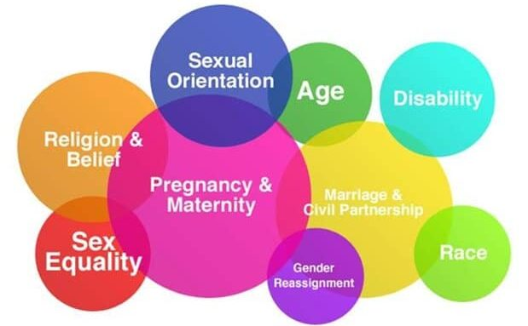
Legal & Ethical Framework
Equality Act 2010: Protects people from discrimination based on 9 protected characteristics
Age, Disability, Gender Reassignment, Marriage/Civil Partnership, Pregnancy/Maternity, Race, Religion/Belief, Sex/gender, Sexual Orientation
GDC Standards: Dental professionals must treat patients and colleagues fairly and without discrimination

Slide 6

EDI in Practice & Education
Embedding cultural competence, inclusive teaching, and bias training
Curriculum reflects oral health inequalities and diverse case scenarios

Slide 7
Inclusion: Creating Belonging
Inclusion = psychological safety, voice, and participation for all
Reasonable adjustments, accessible learning, and inclusive communication

Slide 8
Addressing Unconscious Bias & Intersectionality
Unconscious bias: hidden assumptions affecting decisions
Equity: Targeted support to level outcomes, not just uniform treatment
Intersectionality: Recognising overlapping identities and compounded disadvantage

Slide 9
INSTITUTIONAL SUPPORT
University and dental school EDI policies on QMUL site/QMPlus
Support services for students (counselling, accessibility, networks) SSO and QMPlus
Reporting discrimination or harassment of any description to staff or on Report and Support

Slide 10

Your Role as a Student and Future Dental Professional:
Self-awareness: understand your own biases and privilege and be open-minded
Speak up politely when witnessing discrimination or exclusion
Advocate for inclusive spaces in clinics, labs and study groups
Participate in mentoring and outreach programs to widen access

Slide 11
SCENARIO:
A 7-year-old patient, Amina, attends a dental clinic with her mother. Amina is visibly
anxious and speaks limited English.
Her mother explains that they recently moved from Syria and Amina has never visited a
dentist before.
The dental student must conduct an initial assessment and explain oral hygiene practices
in a way that is culturally sensitive and accessible.

Slide 12
Key EDI Considerations:
Cultural Awareness: The student must recognize that the guardian’s expectations and understanding of dental care may differ due to cultural norms. For example, the guardian may prioritize immediate pain relief over preventive care.
Language Barriers: An interpreter is present, and the student must ensure that communication is respectful, clear, and inclusive—avoiding jargon and checking for understanding.
Trauma-Informed Approach: The child has a history of displacement and may be anxious or fearful. The student should use non-threatening language, validate the child’s feelings, and avoid assumptions about their background.
Consent and Autonomy: The student must navigate consent appropriately, ensuring the guardian understands the proposed treatment and that the child’s voice is heard in the process.

Slide 13
SCENARIO:
James, a 35-year-old patient with autism spectrum disorder (ASD), attends a dental clinic for restorative treatment of multiple carious lesions. He is accompanied by a support worker and expresses discomfort with bright lights and loud noises. James is also on a low income and has limited access to private dental care. The student must plan and deliver care that is clinically appropriate, financially accessible, and sensitive to James’s sensory needs.

Slide 14
EDI CONSIDERATIONS:
Understand how neurodiversity can affect patient communication, consent, and treatment planning.
Apply inclusive strategies to create a calm and supportive clinical environment.
Consider financial barriers and explore NHS treatment options or phased care plans.
Reflect on the importance of patient autonomy and dignity in restorative care.

Slide 15
Key Takeaways
Equality = fair access;
Equity = need-based support;
Diversity = valuing differences;
Inclusion = ensuring belonging
EDI strengthens patient care, learning environments, and professional culture
Each student has a role in embedding EDI in everyday practice

Slide 16

THANK YOU!!
Any questions?
s.younas@qmul.ac.uk

