Slide 1
Welcome !
BDS & BSc Dental Therapy – Year 1
Professor Christopher Tredwin
BDS(Hons),BSc(Hons),MSc,PhD,MFDSRCS(Eng),
FDS(RestDent)RCS,FFDGP(UK),FFD(RCSI),FCGDent,FHEA
Dean of Institute of Dentistry

Slide 2

Congratulations
Welcome to QMUL a World Leading University with a difference.
25+ Applicants what to be sitting where each of you are
A top Dental school with:
  - World-class facilities
  - Access to London’s diverse population
  - Outstanding Training Opportunities

Slide 3
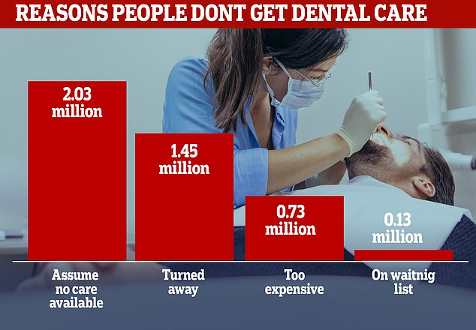
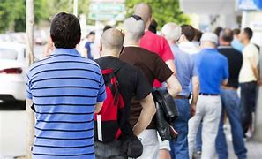
Fantastic Career at the Best Time
You and Team Working Hold the Key to Solve this

Slide 4
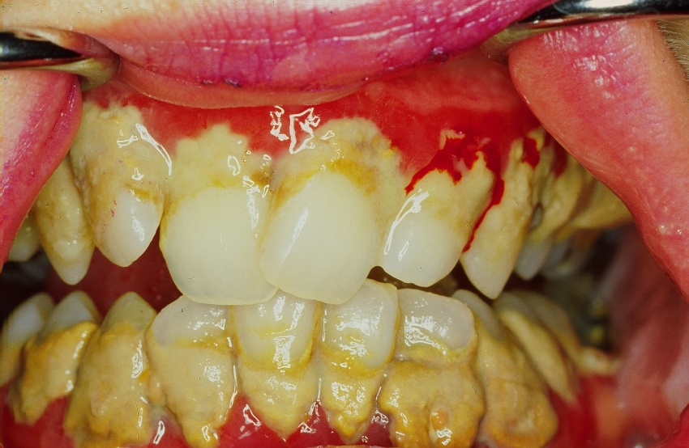

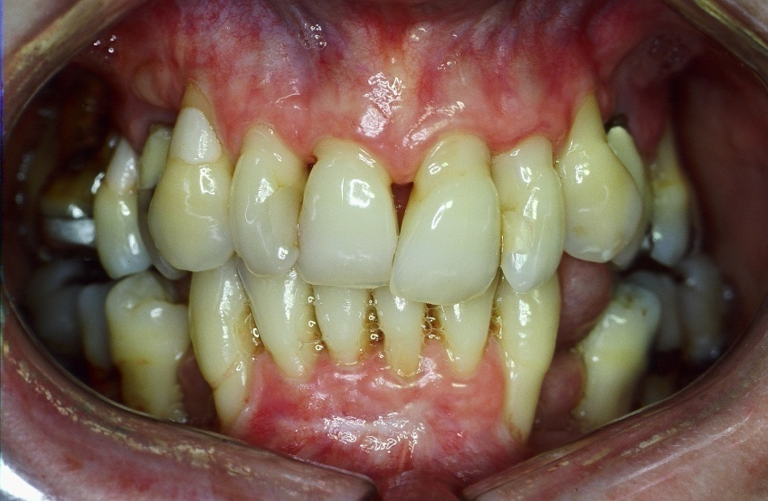

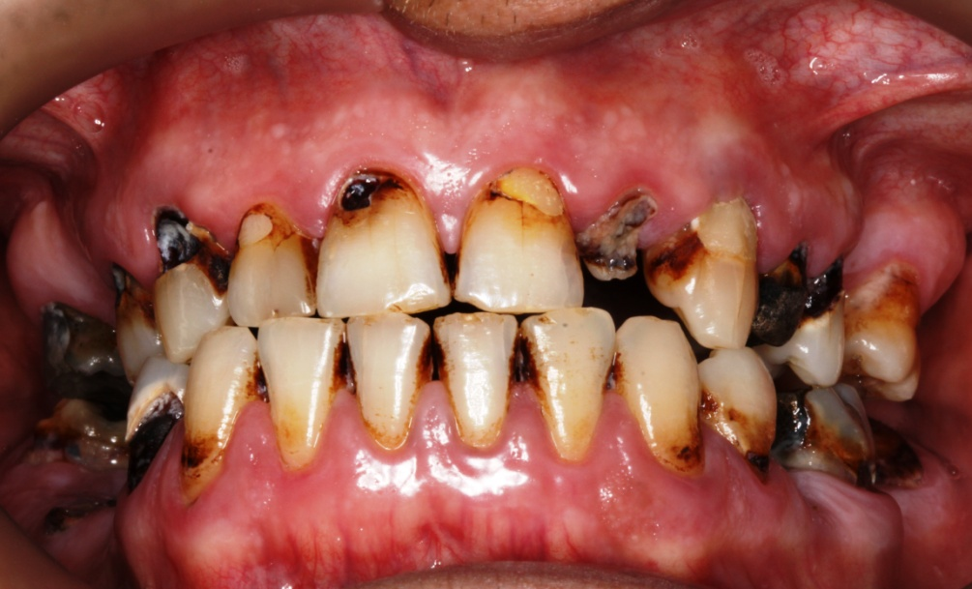
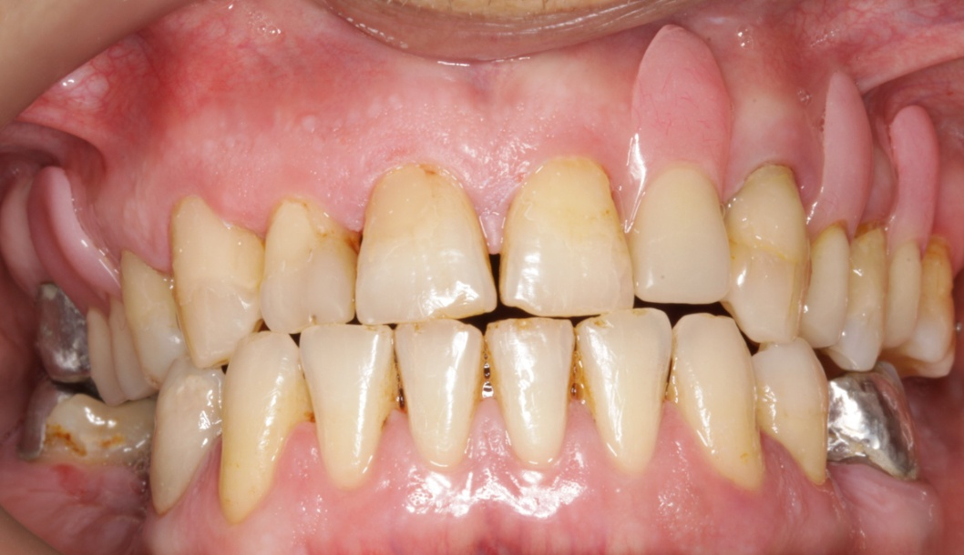
Fantastic Career at the Best Time
Oral Health
General Health
Shared Care

Slide 5
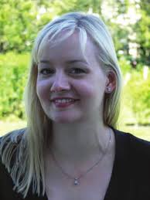
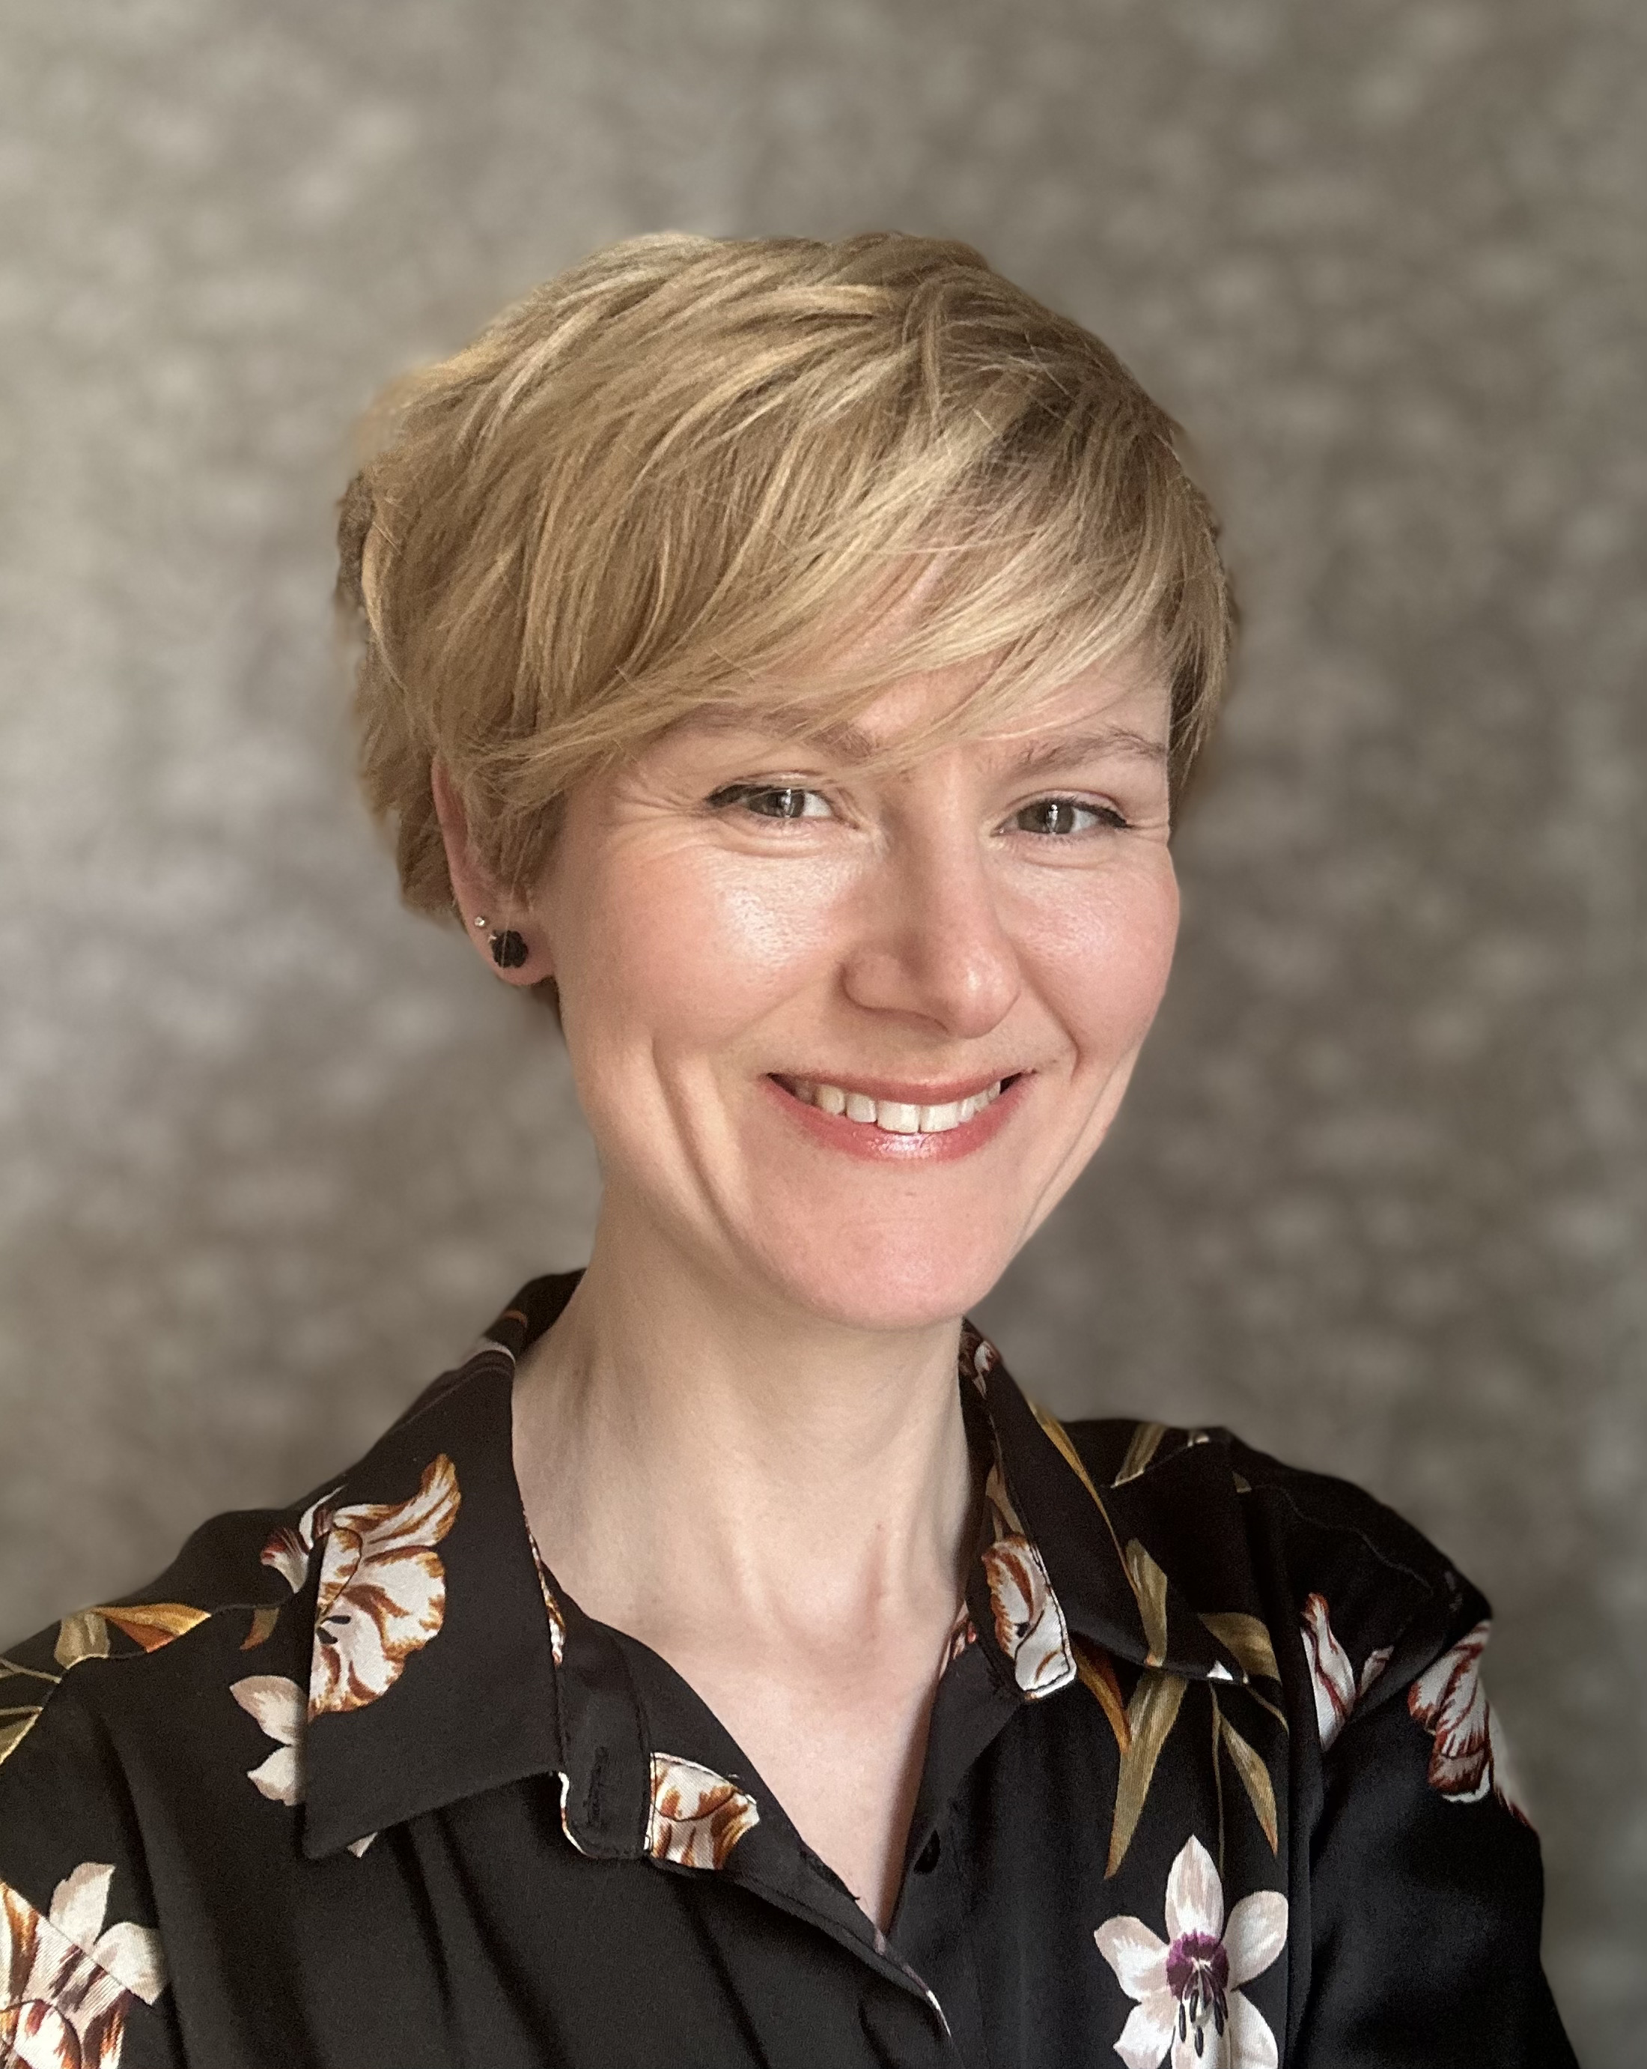
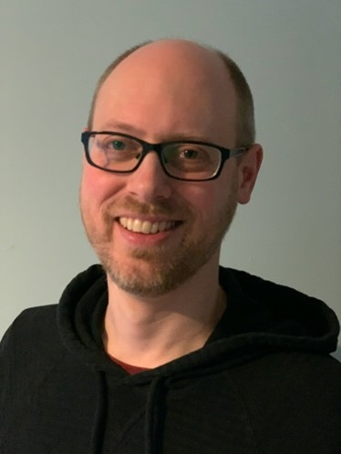
Brilliant Year 1 Leads
Kira Stearns
Dr Cassandra Lewis
Dr Simon McArthur

Slide 6
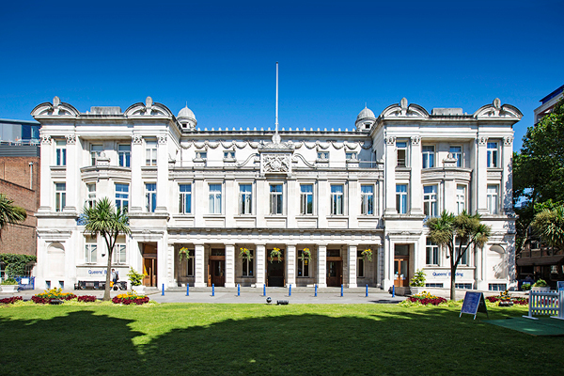
Our University
QMUL recognised as the most inclusive Russell Group university
The Times and Sunday Times Good University Guide.
>33,000 students on degree programmes
~5,400 members of staff.
students from >170 nationalities
~41 per cent are from overseas.
Queen’s Building, Mile End

Slide 7

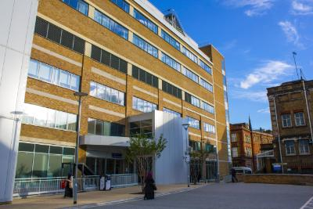
Our Dental Institute
1st in London

Slide 8

Our Students Feedback
The teaching on my course
Staff are good at explaining things = 89.09%
Learning opportunities
My course has provided me with opportunities to apply what I have learnt = 90.01%
Academic support
I have been able to contact staff when I needed to = 90.91%
Again…we are 1st in London
(in the last 5 yrs +)

Slide 9
QS World University Rankings 2025:
Dentistry
The only international ranking approved by the International Ranking Expert Group
Universities that are highly well-regarded by companies and other academics
We are ranked 15th in the world, 7th in Europe
We are one of the top 2 from the UK

Slide 10
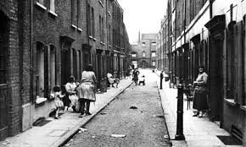
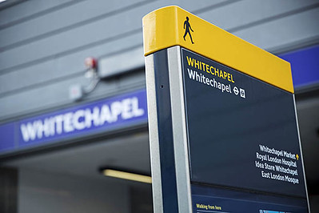


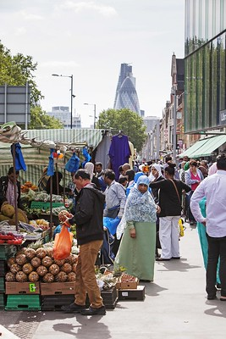

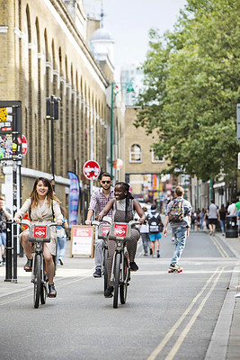
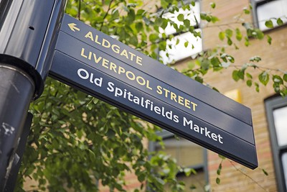

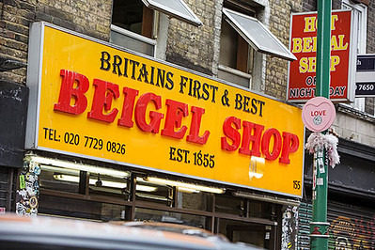
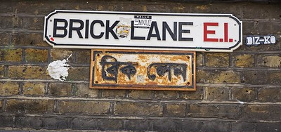
Our Dental Institute – The East End

Slide 11
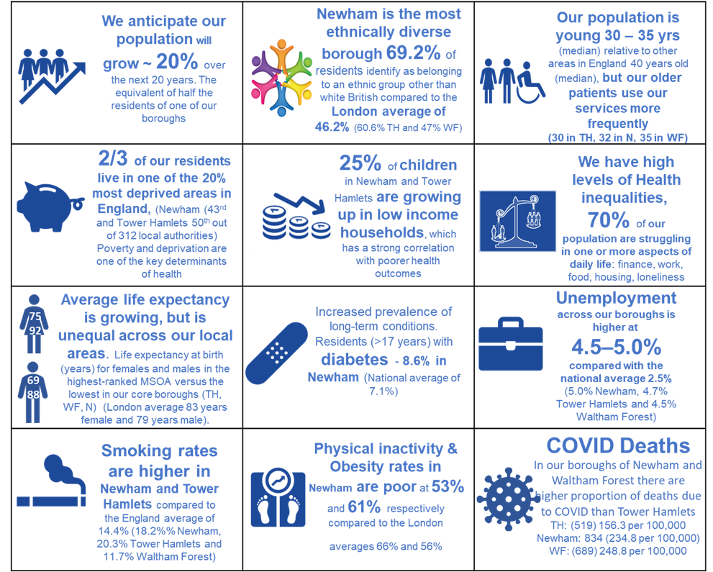

The Population we Serve
Across the 7 boroughs of North East London Barts Health NHS Trust support the healthcare needs of over 2m people

Slide 12
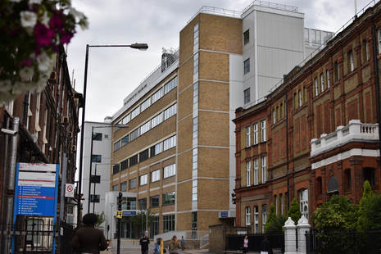
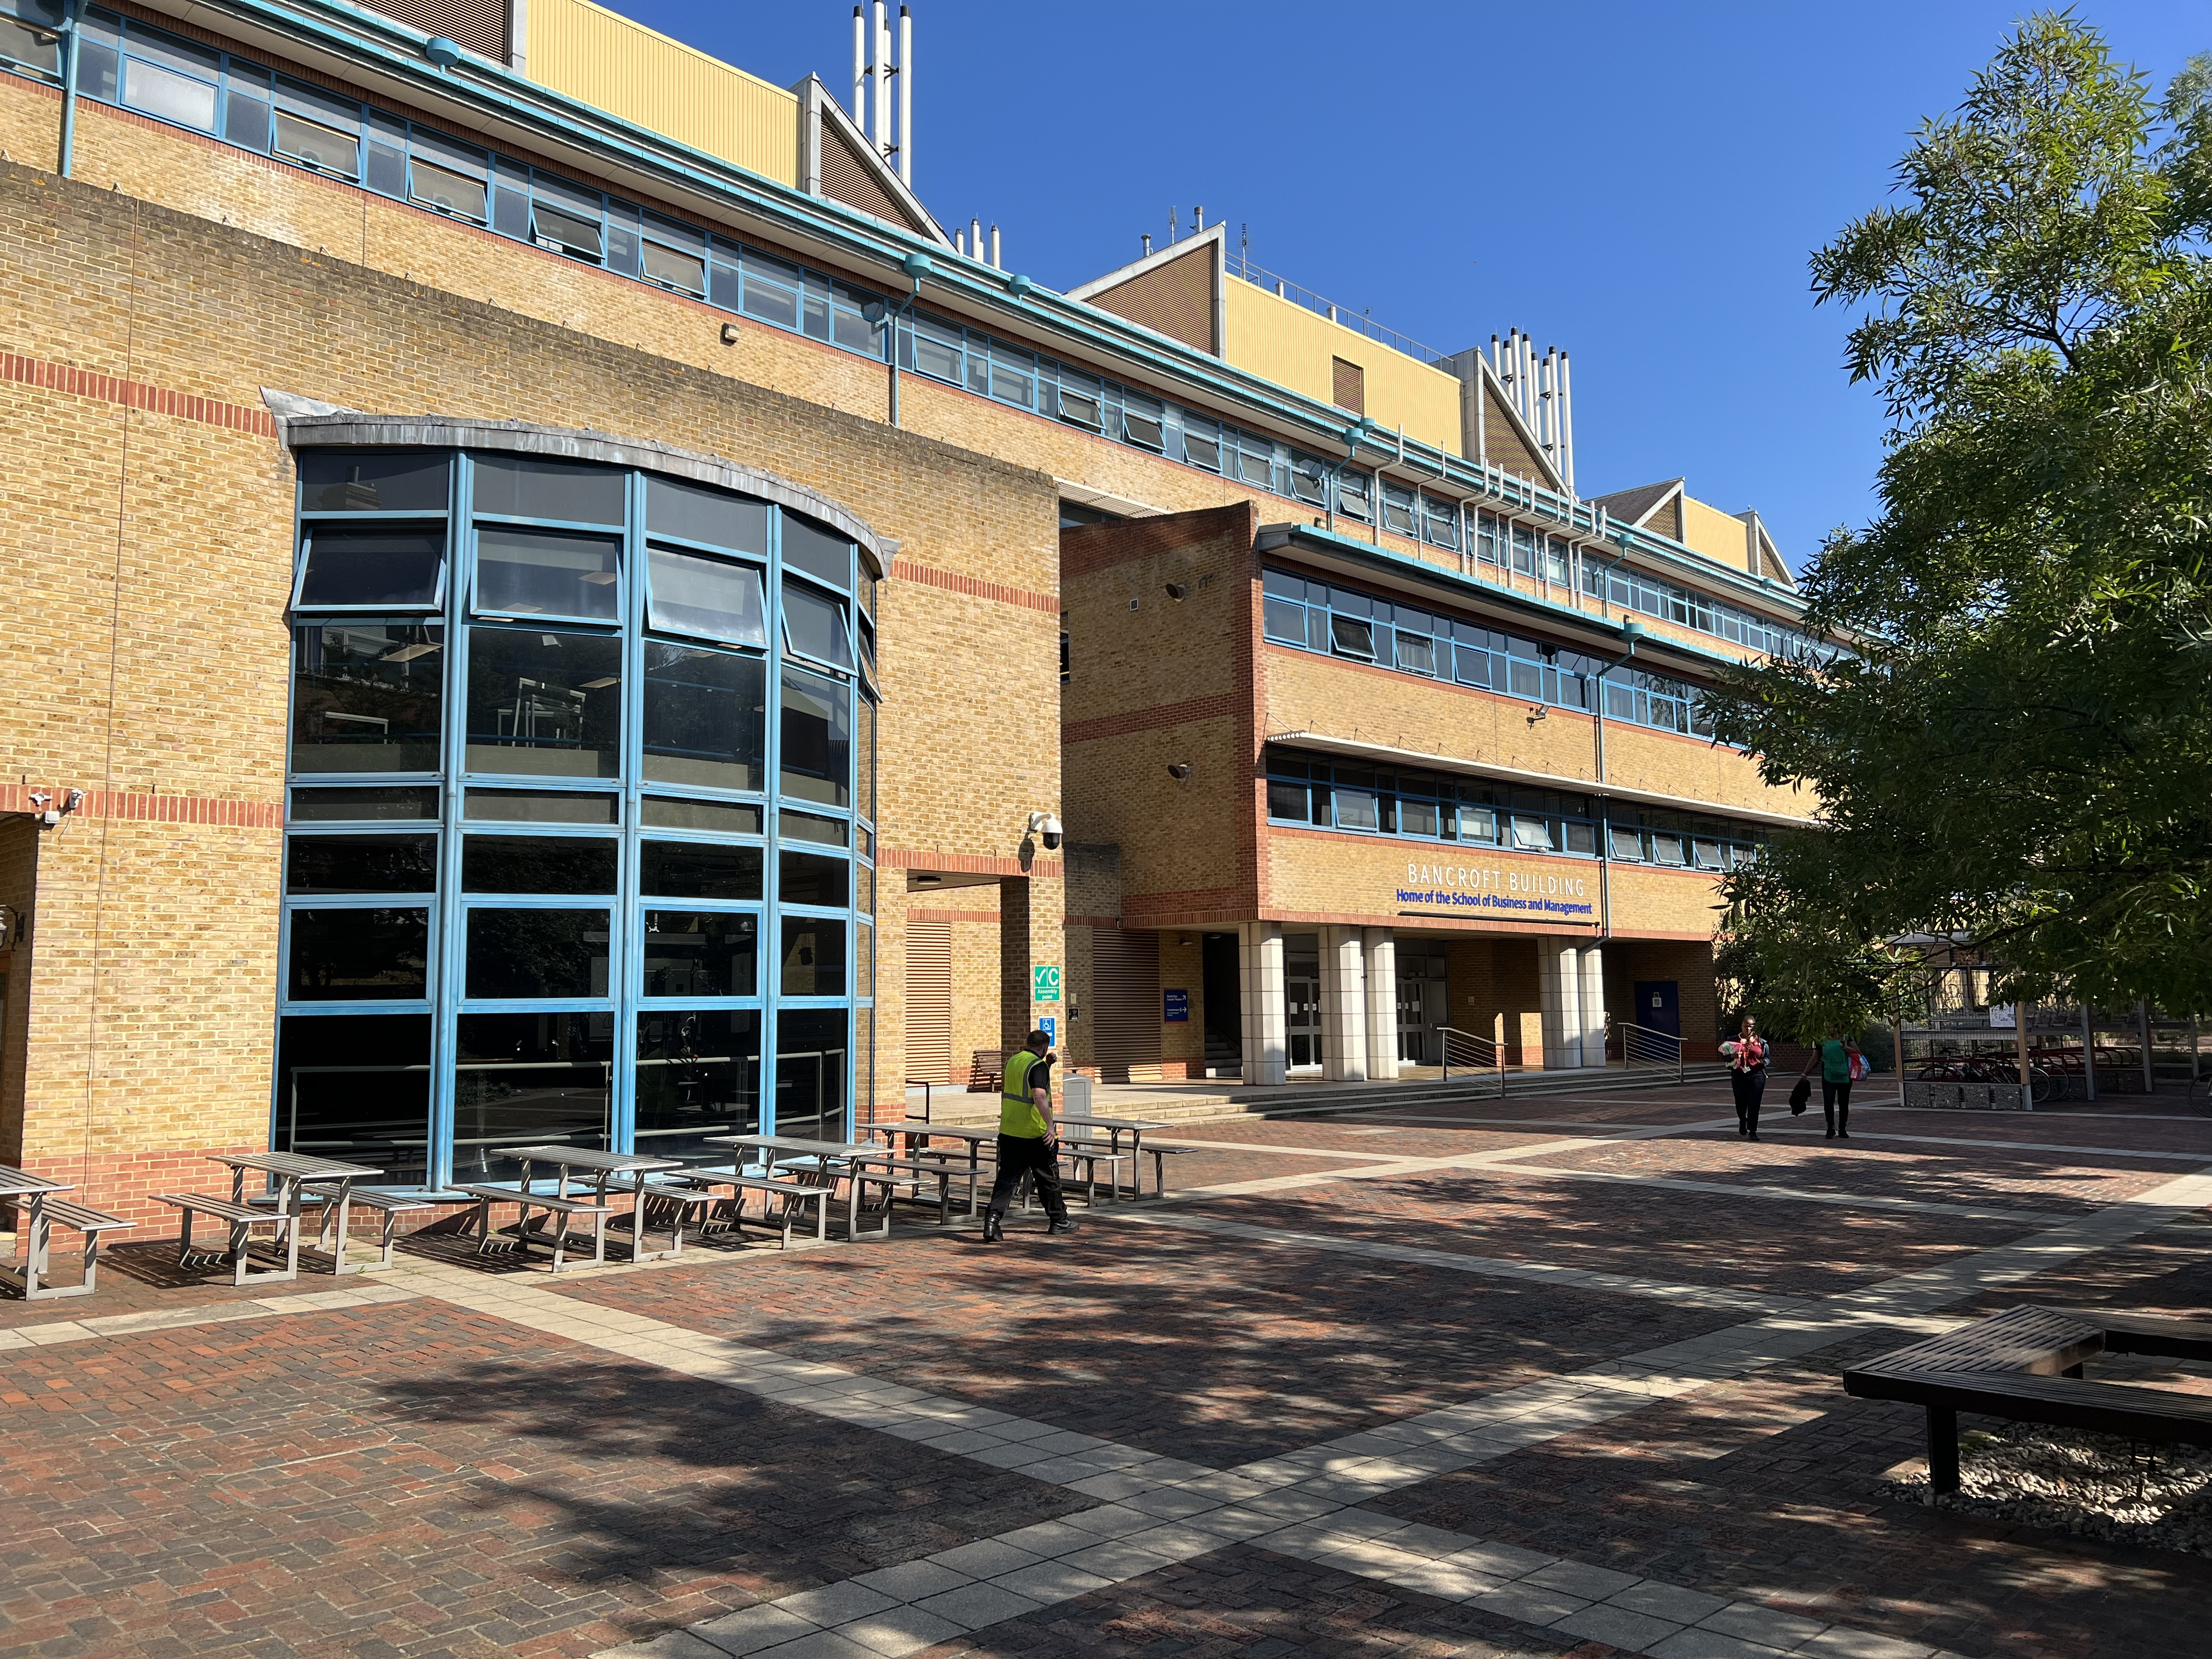
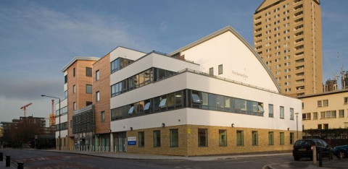
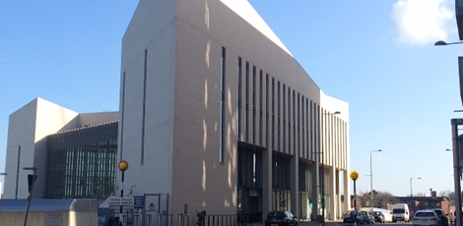
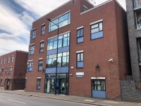
Where will you be learning ?

Slide 13
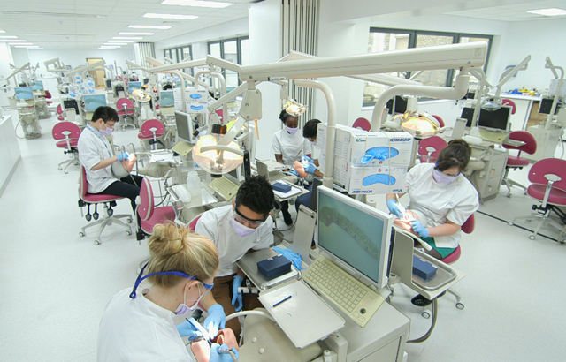
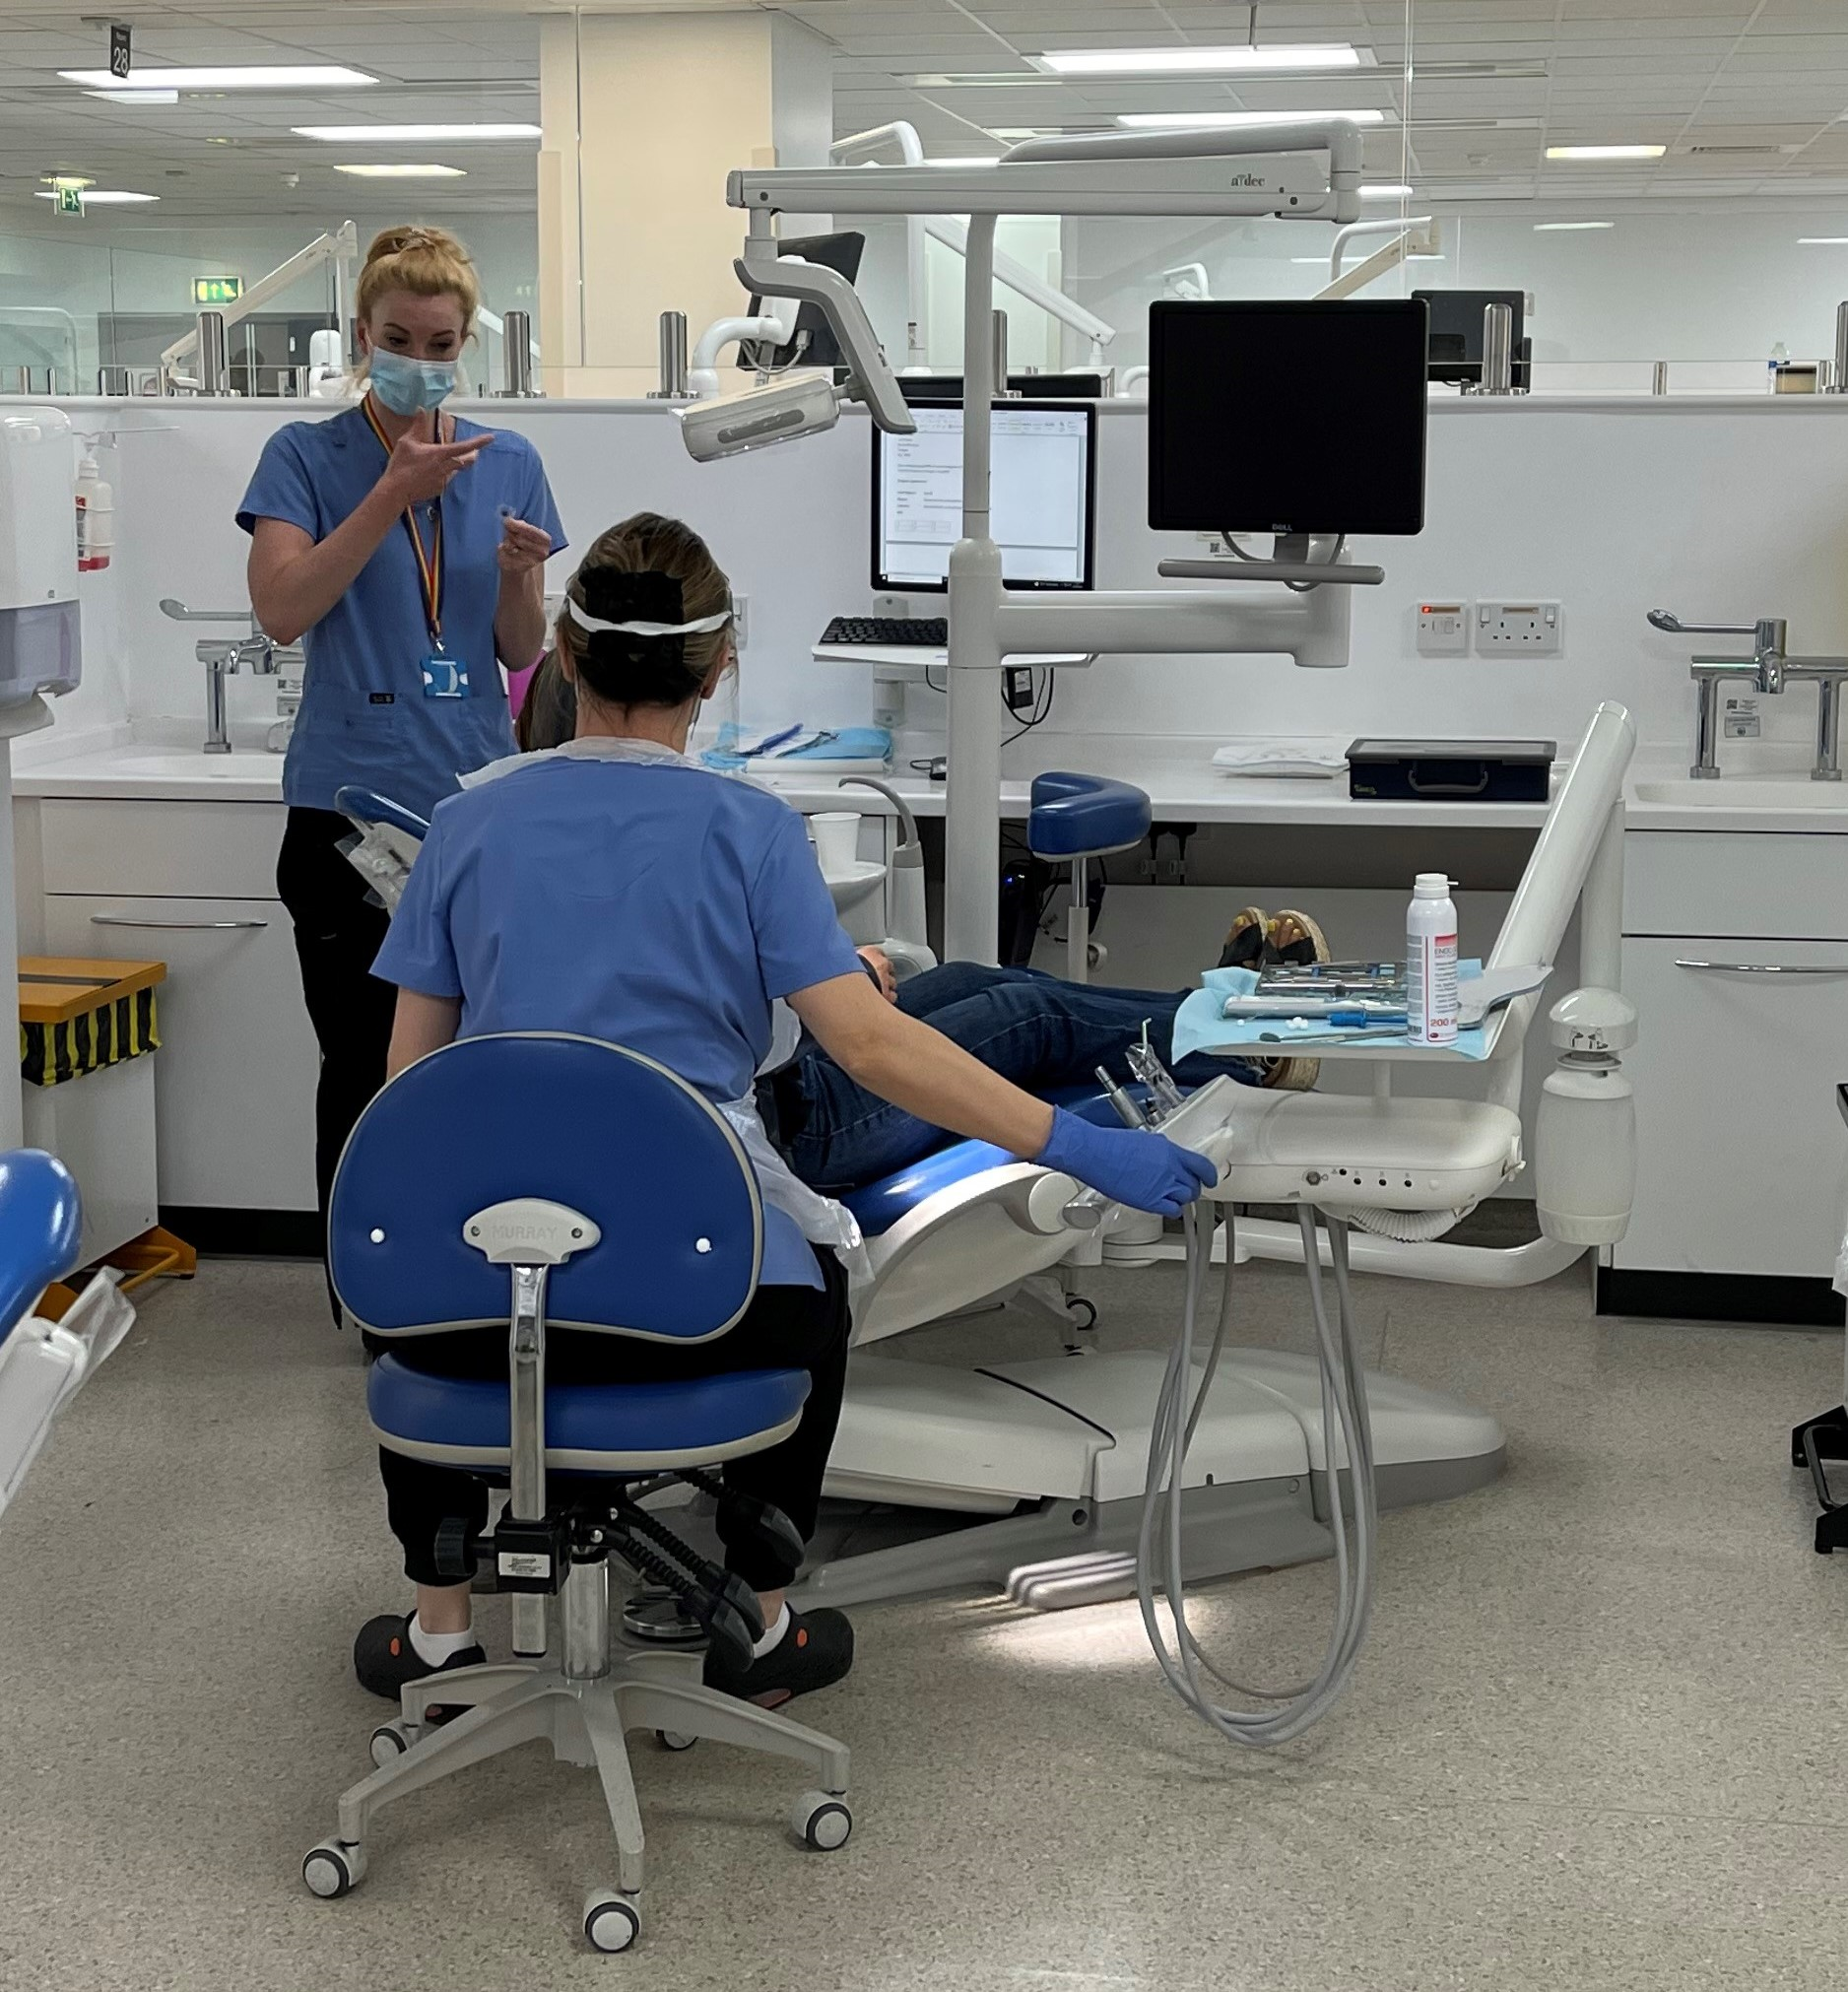
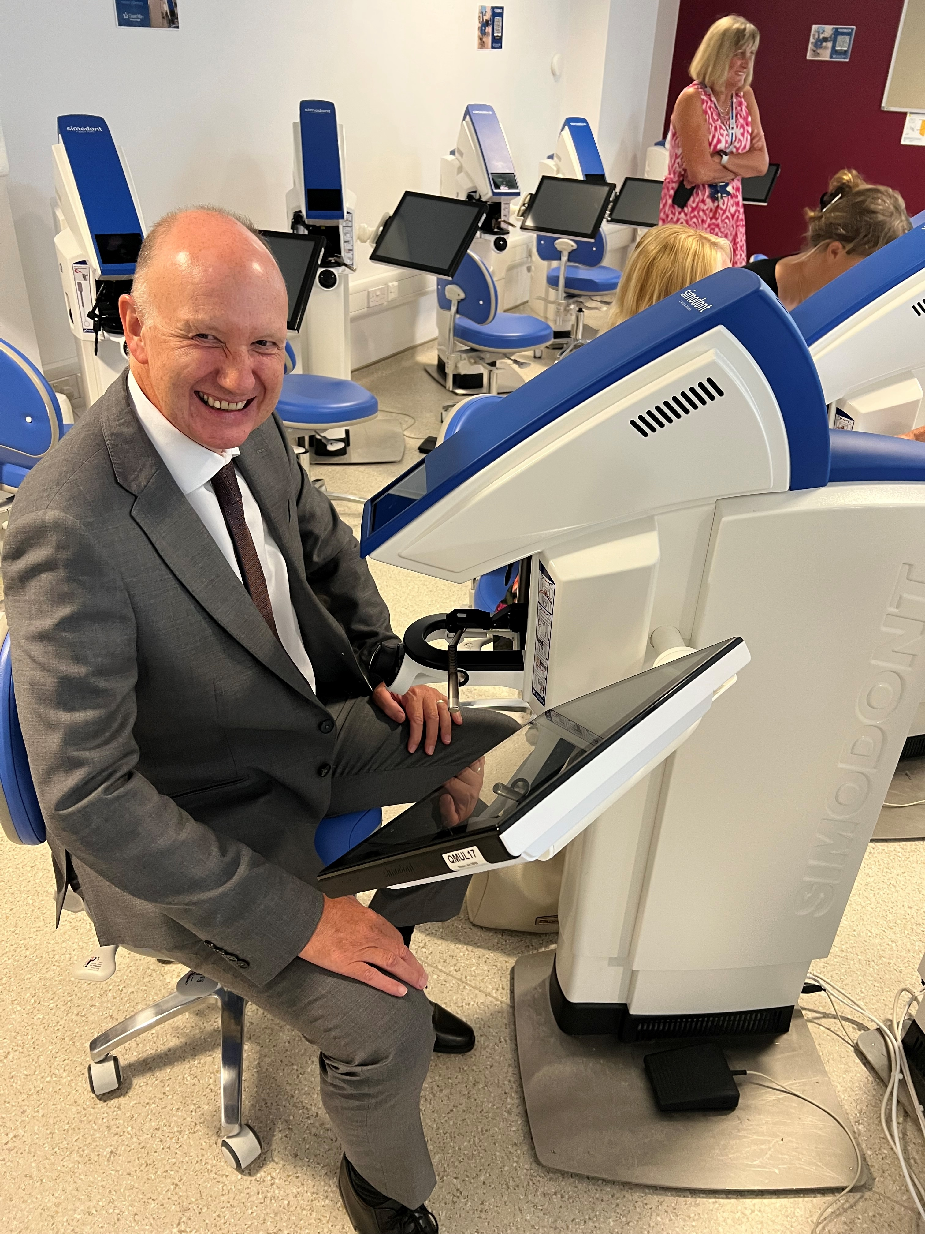
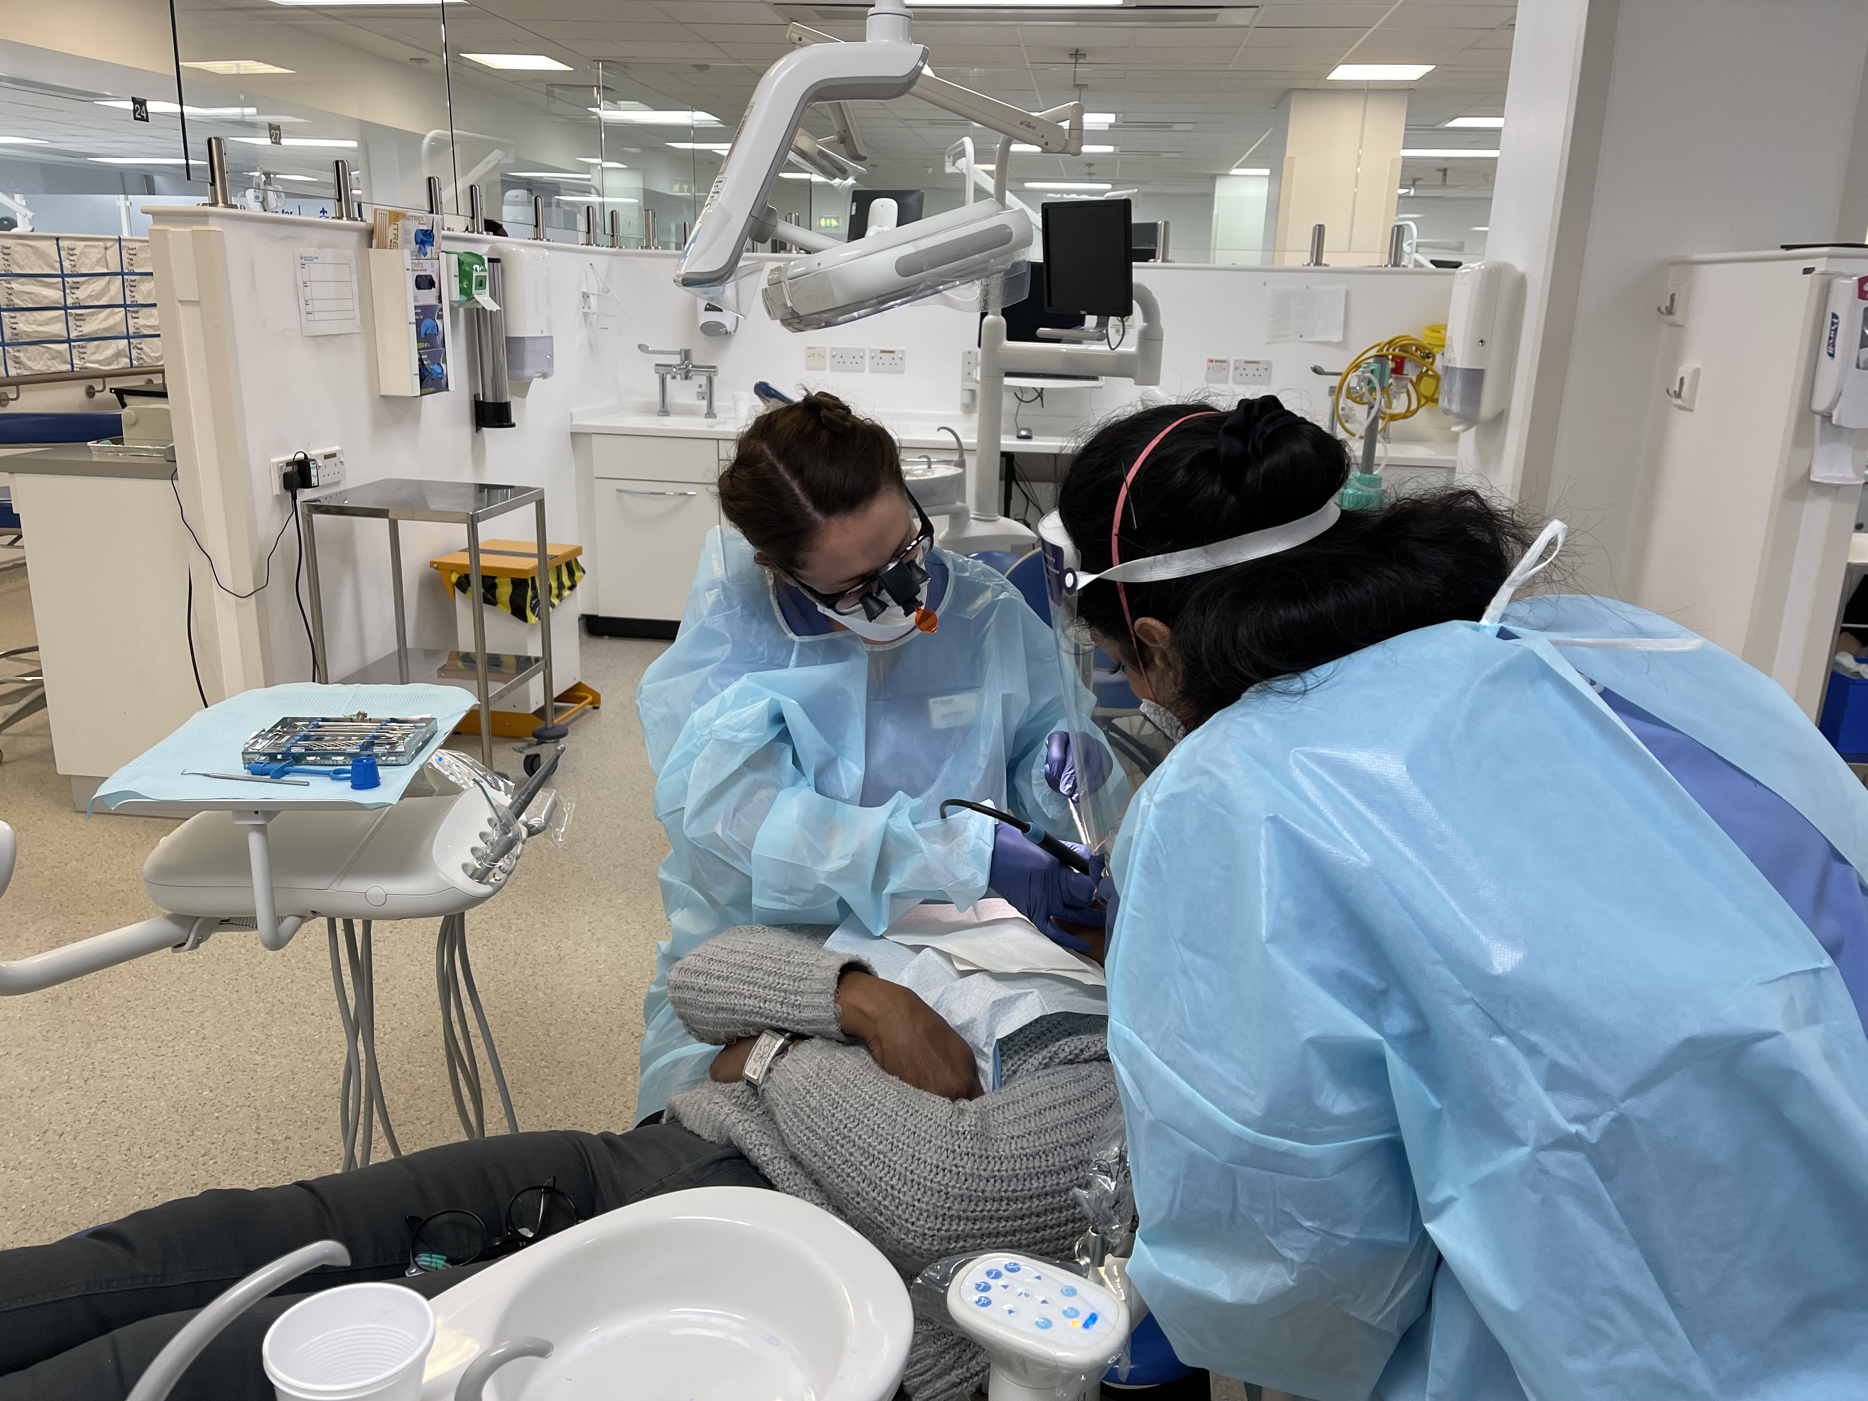
State of the Art Facilities

Slide 14
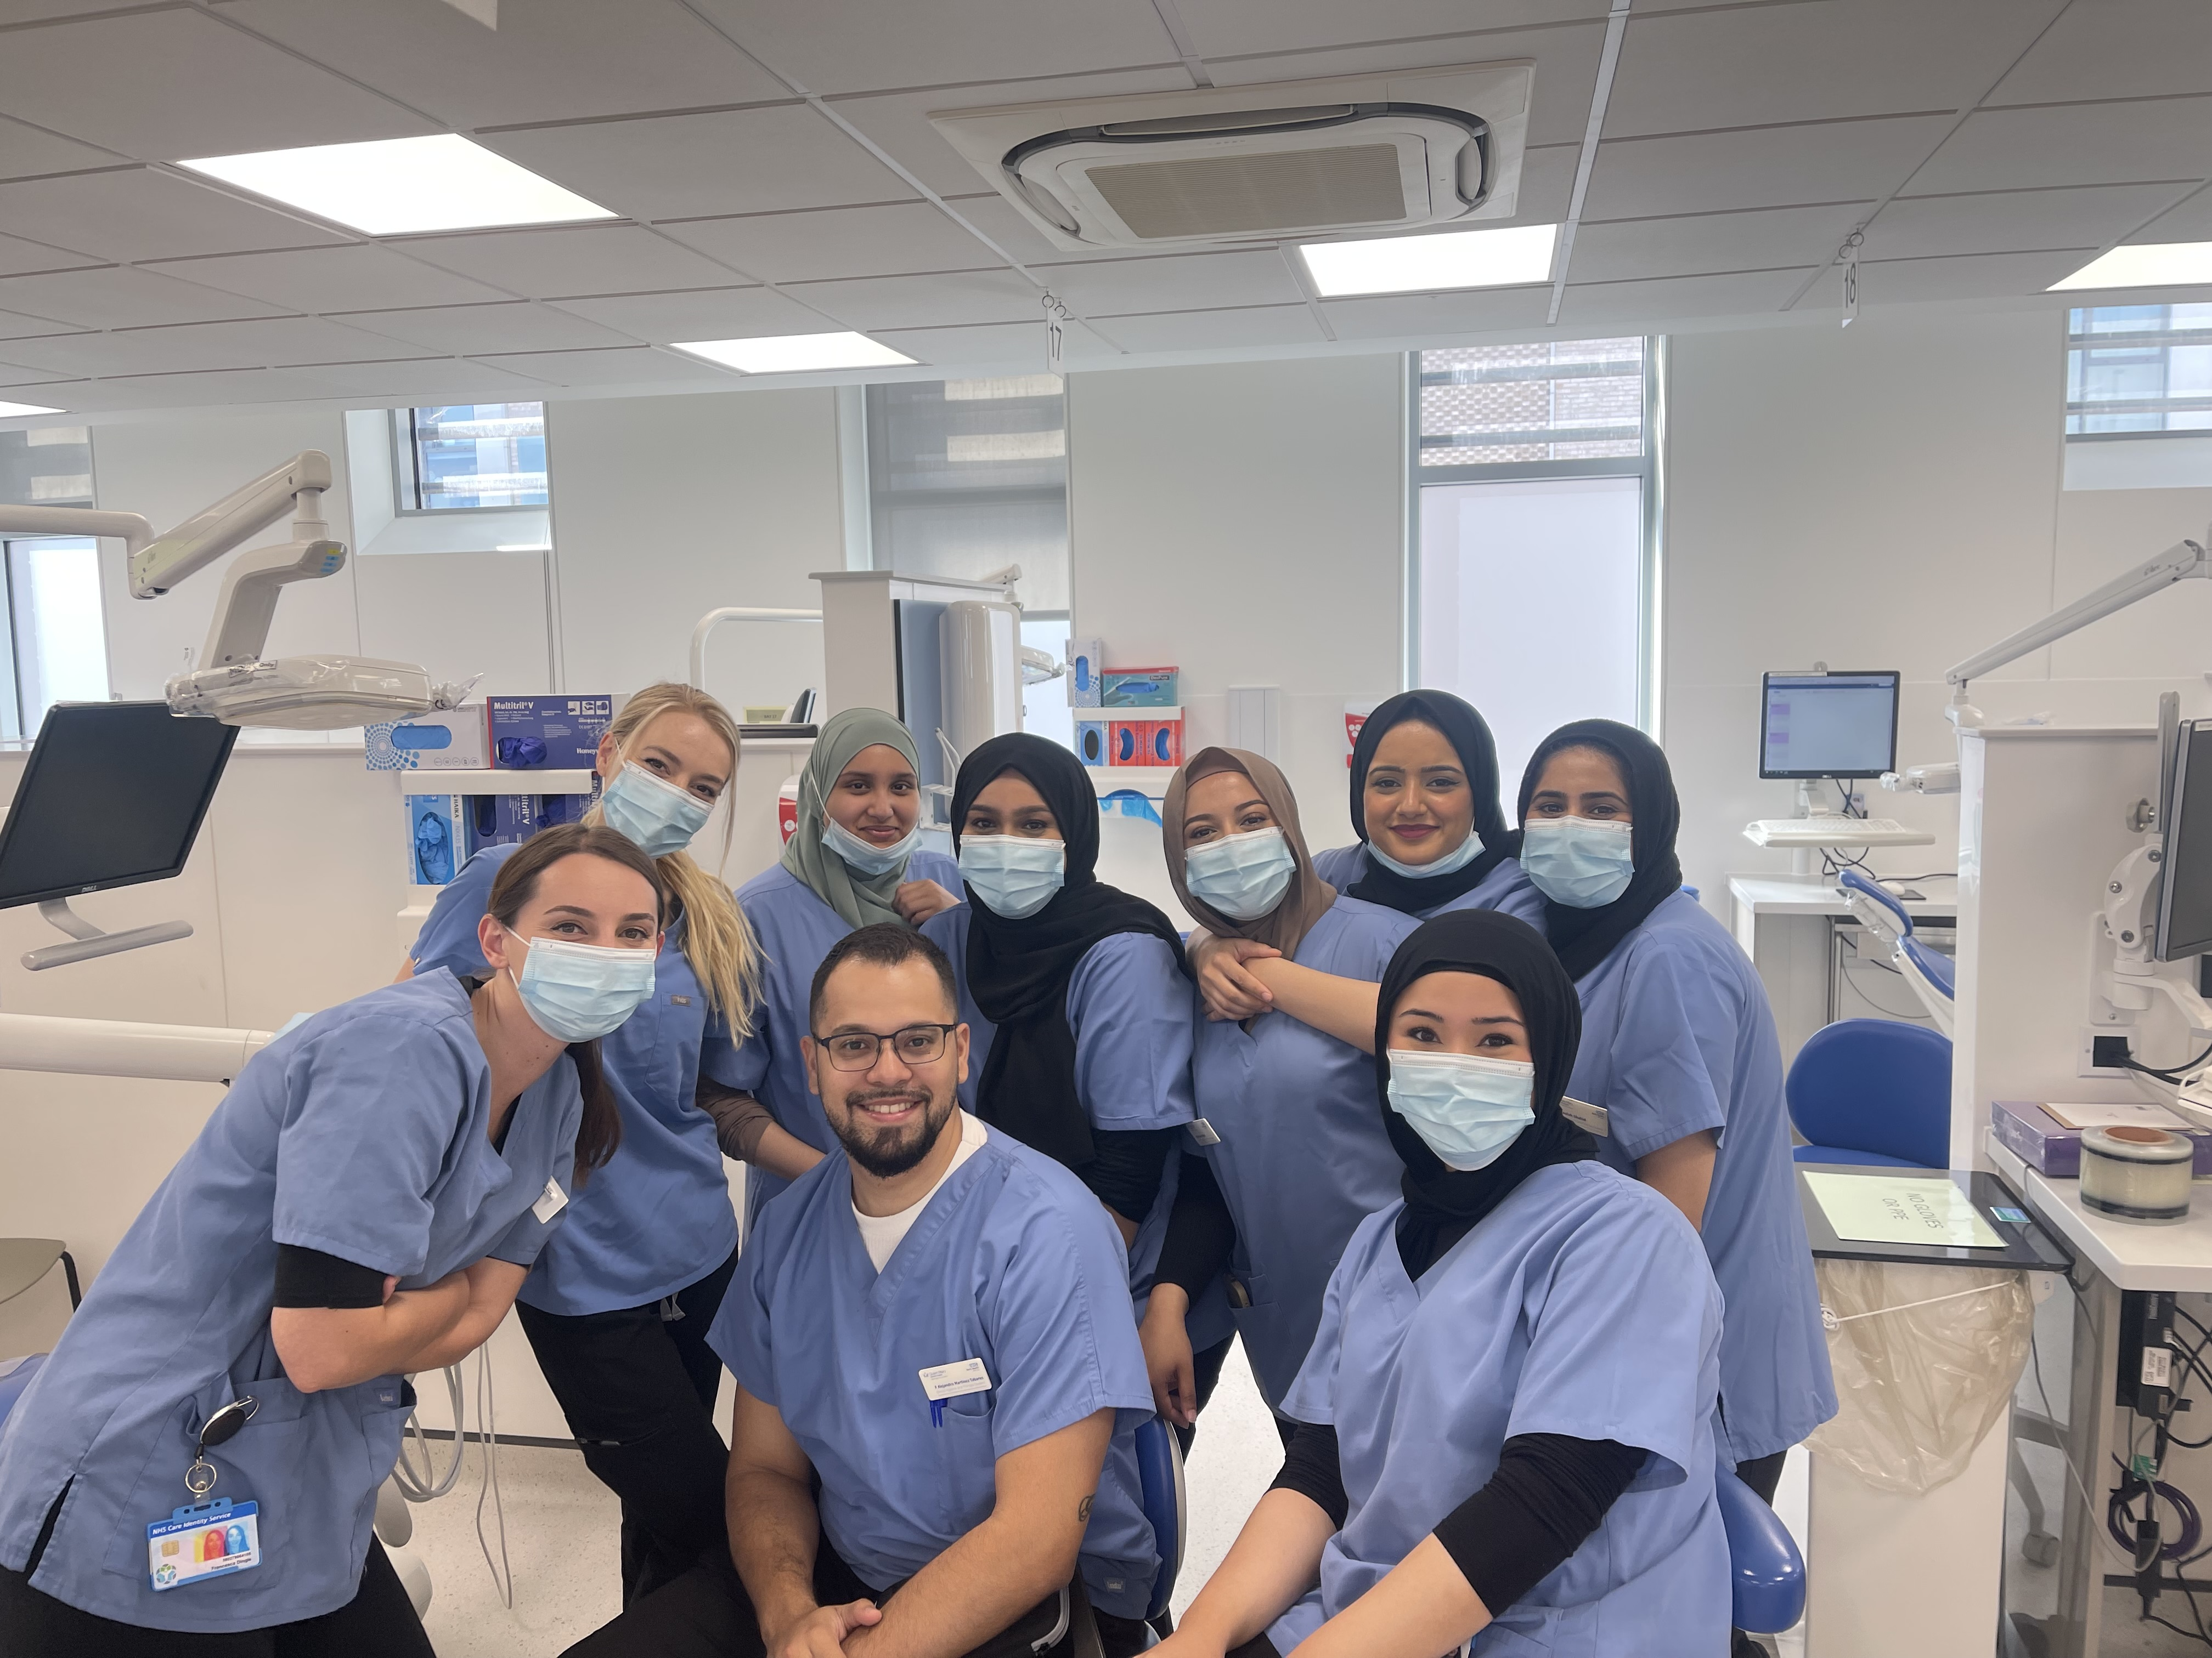
We Care about You
Open door policy
Dedicated Student Support Office
We take pride in how much we support you

Slide 15
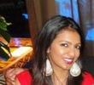
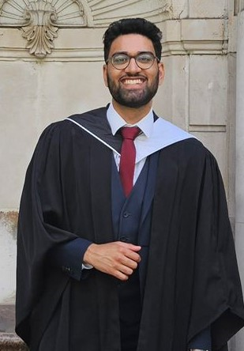
Past Student - testimonials
Facilitates development Clinically, Academically & Professionally
Skillset to provide excellent patient care
Opens eyes to breadth Dentistry and Therapy has to offer
Surrounded by staff with incredible knowledge and clinical experience
Staff support well-being being throughout the degree
Shandy Mohanan
Suraj Shah
Gold Medal Winner
Outstanding academic support
Staff are friendly and approachable
Enhance your professional and academic development.
Education received here has given me the firm foundation to flourish in my dental career and I am proud to be an alumni. ”

Slide 16
Becoming the Best with Queen Mary
Queen Mary
The East London advantage
Great diversity
Campus-based & community feel – small cohort of students
Supportive environment
Innovative curriculum
Team working with the BSc Students
Clinical experience across multiple sites
Excellent Student Support team dedicated for you
Student facilities
Highly ranked…..
1st in London!!!
Excellent opportunities
Fantastic social life

Slide 17
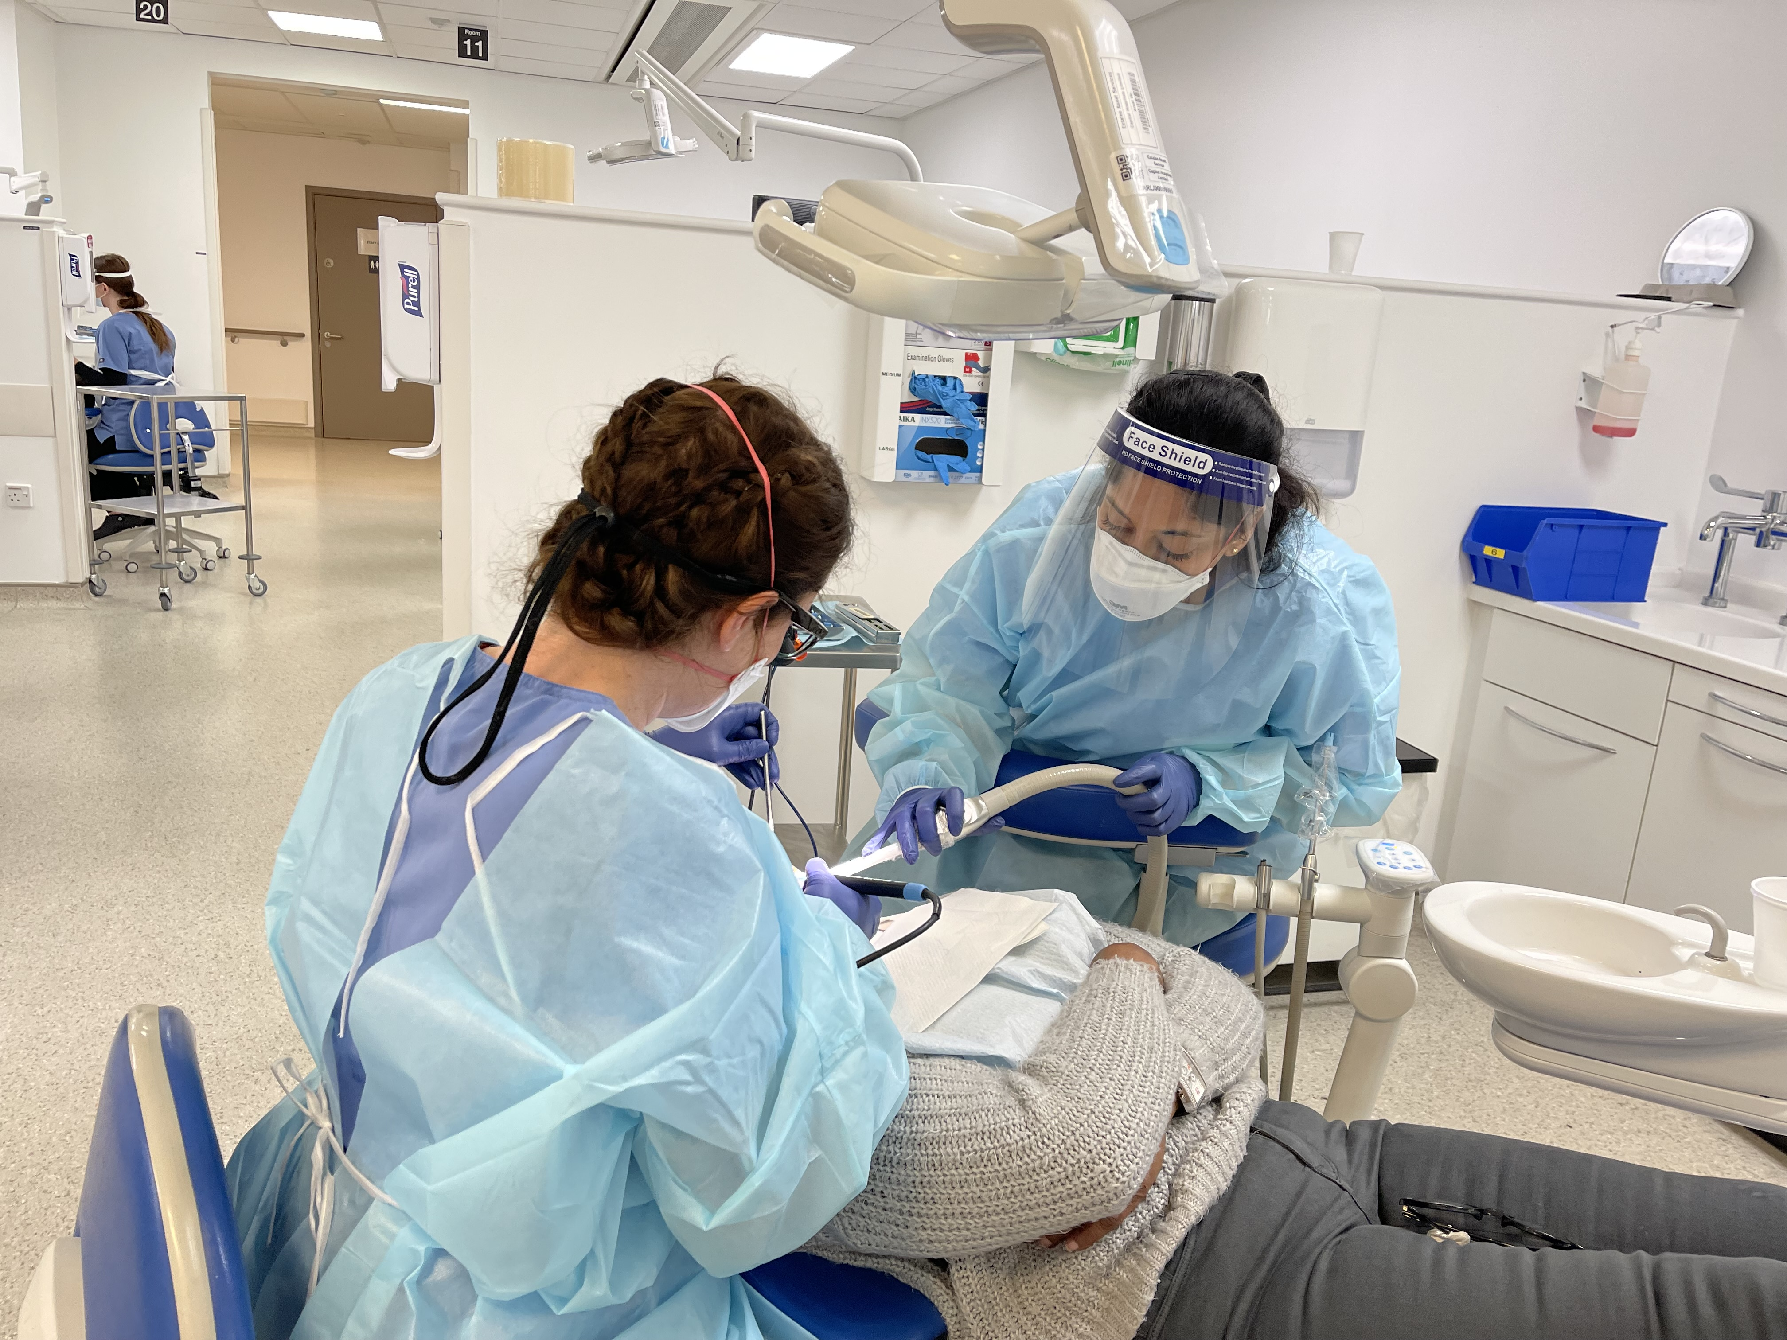
Welcome and Enjoy

