Slide 1
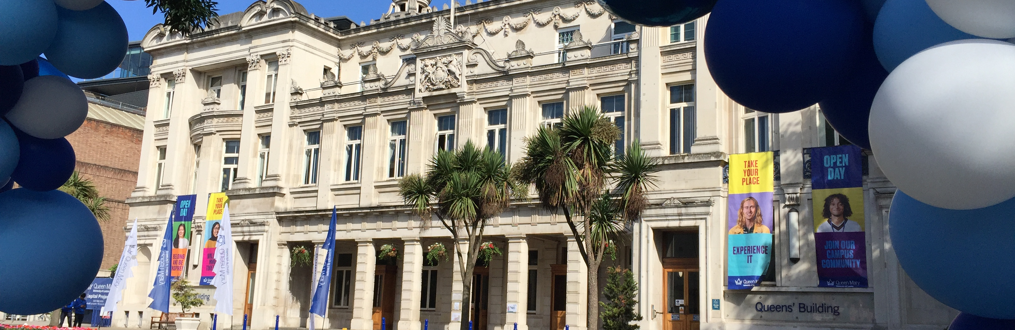
Welcome to Queen Mary University of London!
Institute of Dentistry

Slide 2
Faculty of Medicine and Dentistry
How to make the most of your first year in Barts Dental School?
Stefan Couch
Careers Consultant
David Tomas-Merrills
Graduate Success Coordinator
Notes:
DTM & SC provide brief introductions

Slide 3
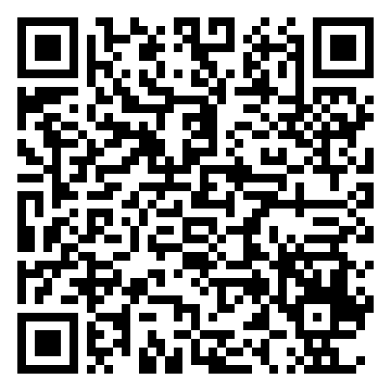
Registering your attendance
Institute of Dentistry
Notes:
DTM

Slide 4
What to expect from this session?
Careers & Enterprise support at QM
Making the most of your first year at Barts Dental School / QMUL
Institute of Dentistry
Notes:
DTM

Slide 5

Institute of Dentistry
Notes:
DTM

Slide 6
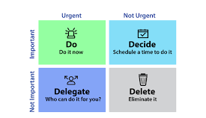
Prioritisation of tasks: The Eisenhower Matrix
Helps you make the distinction between tasks that are important, not important, urgent, and not urgent.
It splits tasks into four boxes that prioritize which tasks you should focus on first and which you should delegate or delete.
See also The Action Priority Matrix and the Covey Matrix
Institute of Dentistry

Slide 7
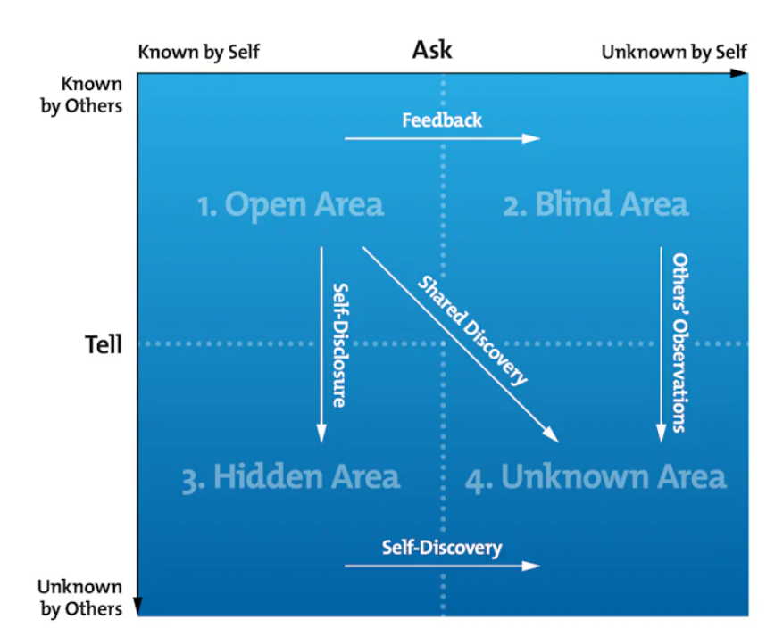
The Johari Window
The Johari Window is split into four quadrants:
The Open Area (things you know about yourself),
The Blind Area (things you don't know about yourself, but others do),
The Hidden Area (things you know about yourself, but keep hidden),
The Unknown Area (things that are unknown to you and to others).
Note the names and the directions of the arrows !
Institute of Dentistry

Slide 8

… on maximising your 1st year for your dental career
Institute of Dentistry
Notes:
SC

Slide 9

Top tips for maximising your 1st year
Building your community
Career Exploration / Planning
Extracurricular Activities
Join Student Organisations – Barts & The London Societies
Institute of Dentistry
Notes:
SC
Image source: https://www.fdiworlddental.org/fdis-vision-2030-report-aims-improve-oral-health-and-reduce-oral-health-inequalities-over-next
I would offer the following advice and guidance to first-year Oral Health students like yourselves on how to best prepare for their career during the first year of your degree program:
Career Exploration:
Start thinking about the type of dentistry you are interested in. While it's early, having a sense of your potential career path can help you set goals and make informed decisions.
Clinical Observation:
If opportunities arise, observe clinical procedures and shadow experienced dentists. This exposure can provide valuable insights into the practical aspects of dentistry.
Extracurricular Activities:
Engage in extracurricular activities that interest you, whether they are related to dentistry or not. Well-rounded individuals often make excellent dentists.
Participate in student dental associations or clubs related to dentistry. These organizations offer opportunities for networking, leadership development, and exposure to the profession.
Stay Informed:
Stay updated on current trends and developments in dentistry by reading dental journals, attending seminars, and following reputable dental news sources.
Remember that the first year of your BDS degree is foundational. While it's important to focus on your studies, it's also an excellent time to explore your interests, build connections, and develop the skills and habits that will serve you well throughout your career.
All of these “top tips” have one thing in common…. “building relationships”…. “building your community”.

Slide 10
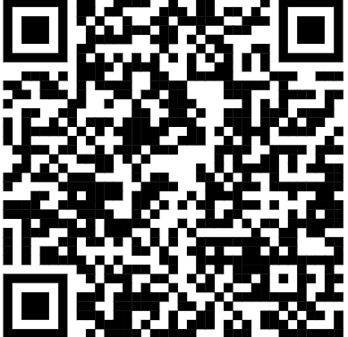
Barts London Societies
Institute of Dentistry
Notes:
SC/DTM

Slide 11
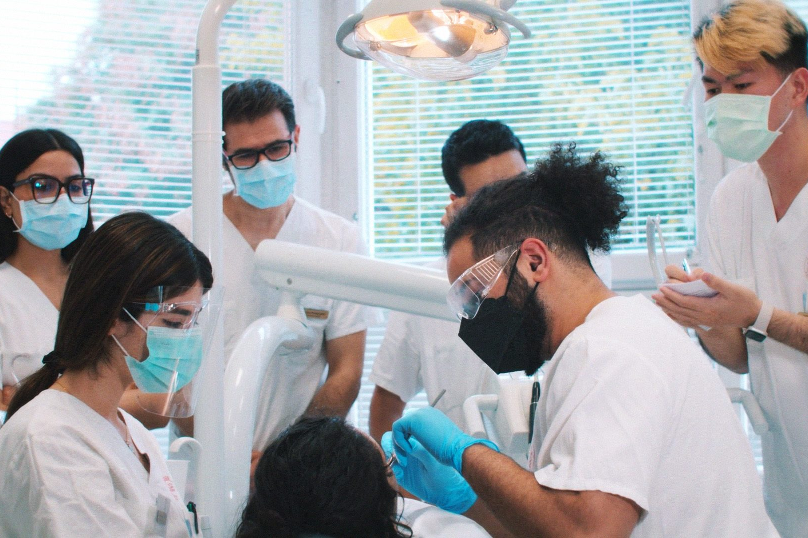
Building Relationships
Who can you build relationships with?
Fellow students
Faculty members
Dental Professionals
In-person
Online
Mentor(s)
Institute of Dentistry
Notes:
SC
Image source: https://lp.studyinternational.com/szeged-medical-school/dental-medicine/
Ask the question to them – “Who can you build relationships with?” and follow-up question can be “why?”
Build a Support Network:
Connect with fellow students, faculty members, and university resources. A strong support network can help you navigate challenges and opportunities.
A mentor can provide guidance and support as you navigate your career.

Slide 12
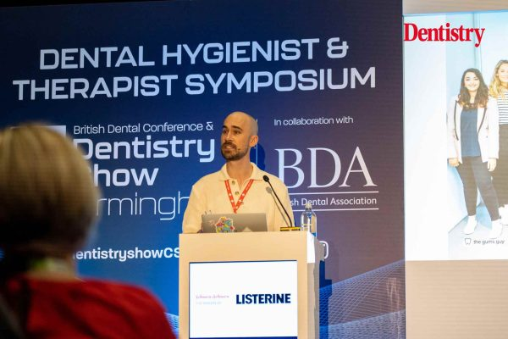
Places you may not have considered to build relationships in Dentistry?
British Dental Association (BDA)
FDI (Federation Dentaire Internationale) World Dental Federation
General Dental Council (GDC)
Online Forums
Royal Colleges etc. etc.
Dentistry Show London – 3-4 October 2025
Institute of Dentistry
Notes:
SC
Image source: https://dentistry.co.uk/2023/06/14/last-chance-to-see-the-dental-hygienist-roadshow/
British Society of Dental Hygiene & Therapy (BSDHT): Joining BSDHT provides access to a range of benefits, including networking opportunities at regional and national events, the Annual Oral Health Conference and Exhibition, and various CPD events¹.
Professional Associations: Joining professional associations like the British Dental Association (BDA) can offer networking events, seminars, and workshops specifically designed for students and young professionals.
As well as international spaces such as: -
FDI World Dental Federation: This international organization represents over 1 million dentists worldwide and serves as a platform for various national dental associations and specialist groups to collaborate and share knowledge³.
Other online forums include: -
Dentistry Forums: An online community where both patients and dentists can discuss dental issues. Verified dentists participate in discussions on a wide range of topics, from cosmetic treatments to emergency procedures¹.
Reddit: Dentistry: A subreddit dedicated to dentistry where professionals can stay updated on the latest developments, share insights, and connect with peers¹.
Reddit: Ask Dentists: Another subreddit where dental professionals and patients can ask questions and share experiences related to oral health¹.
Boards.ie Dental Issues Forum: Ireland’s largest online community, where members discuss various dental issues and share advice¹.
Just Answer: Dental: A platform where dental professionals can provide answers to questions posed by patients and other professionals¹.
Dental Buzz: A forum focused on dental news, trends, and discussions among dental professionals¹.
The Dental Geek: A community for dental professionals to share experiences, tips, and advice¹.
Dental Lab Network: A forum specifically for dental lab technicians to discuss techniques, materials, and industry news¹.
These forums provide excellent opportunities for networking, professional development, and staying updated on global oral health initiatives.

Slide 13

Managing your dental career journey
Institute of Dentistry
Notes:
SC

Slide 14
The SCAN Career Planning Model
What kind of dental professional do I want to be?
Values & work preferences
Skills & interests
Personality & Stressors
When and what do I have to do
to achieve my career goal?
Setting goals
Supporting goals
Specific goals
Self- awareness
Next steps
Career exploration
What options are open to me?
Options available
Information research
Networks & opportunities
Which is the best choice for me?
Making career decision
Making YOUR decision
Checking how robust your decision is
Arriving at YOUR decision
NHS England (2023) ‘The SCAN Career Planning Model’
Institute of Dentistry
Notes:
SC
Do the SCAN, so that you don’t end up with a SCAB (blocks to your success) or a SCAR (regrets).
How does this relate to how you make career decisions your careers decisions.
Where would you start?
What might be the parallel for anyone embarking on a career decision-making exercise
Etc
Etc
Is there any circumstance where you might do the clinical decision-making differently?
Why might this be inappropriate for career decision-making?

Slide 15

Self-Awareness
Aspects of work
you do well / that come
naturally
Skills &
Talents
Interests
What should be assessed?
In work context
what interests
you most
Aspects of work
that matter to you most
Aspects of work
you find particularly
stressful
Personal
Stressors
Values
Institute of Dentistry
Notes:
SC
What makes you motivated/fulfilled/satisfied? Innovation/Teaching/Leadership?
How easily can you express this coherently?
What are the opportunities/compromises in roles of interest e.g., Research opportunities, location

Slide 16
Reflect: What are your top 3 values?
Excitement | Sense of Purpose | Wellbeing
Adventure | Ambition | Freedom
Challenge | Sense of control | Responsibility
Recognition | Stability | Reliability
Knowledge | Being valued | Co-operation
Diligence | Creativity | Growth
Empathy | Competition | Making a difference
NHS England (2023) ‘Self Awareness’
Institute of Dentistry
Notes:
SC
So what would be useful for personal reflection? Let's start with your values as these will give you a sense of what gives you the most fulfilment and satisfaction – what motivates you to be a doctor. Read the online list of values and pick the 3 that resonate most strongly and write down. Don’t think about this too much – it should be intuitive

Slide 17
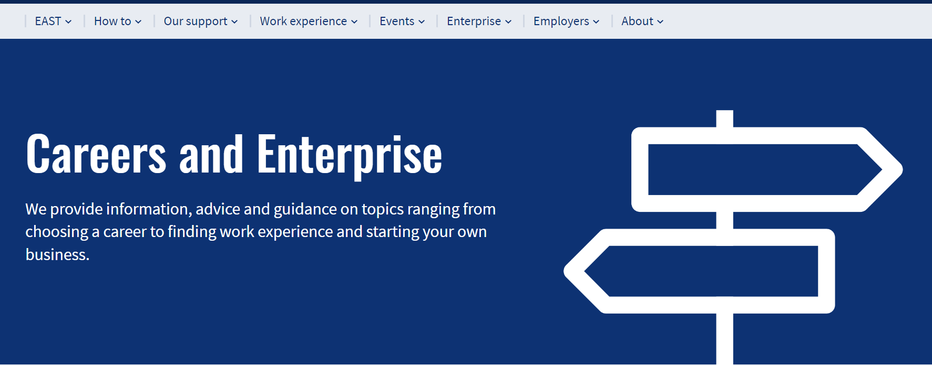
What does QM Careers & Enterprise offer you?
Institute of Dentistry

Slide 18
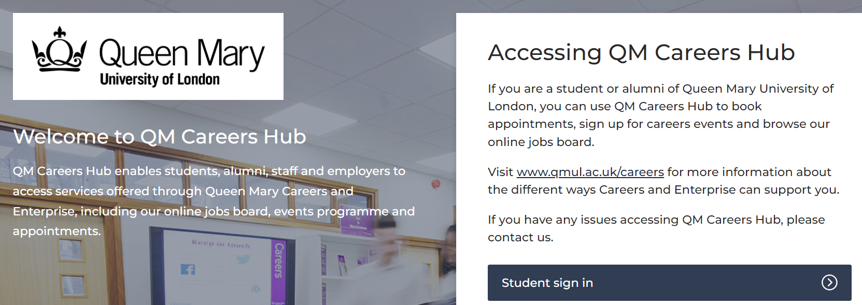
Your Careers Hub
QM Careers Hub – Student sign in
Institute of Dentistry
Notes:
Access to everything available from Careers & Enterprise!

Slide 19
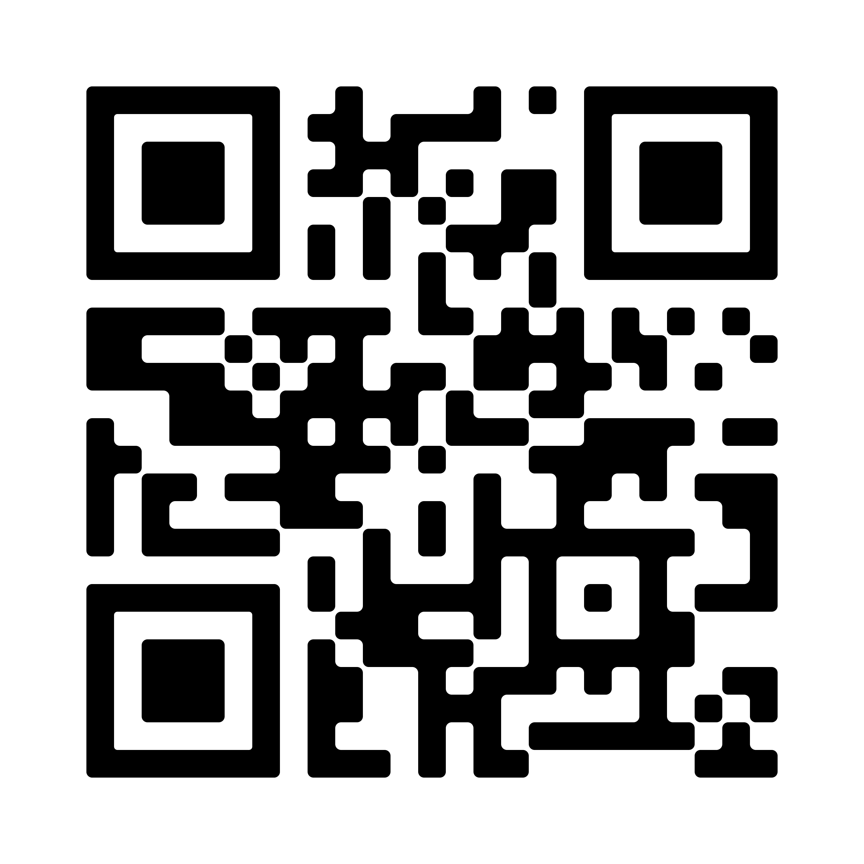
Take the first step…..
Create a profile on your QM Careers Hub
To receive information on opportunities and events relevant to you
QR code to access QM Careers Hub
Institute of Dentistry
Notes:
DTM Presenter Notes
Can demonstrate what QM Careers Hub looks like from a student’s perspective.
Show what their profile section looks like and that there are very minimal questions for them to fill in.
Also show what the ‘Career Discovery’ page is and how it is beneficial for the students.

Slide 20
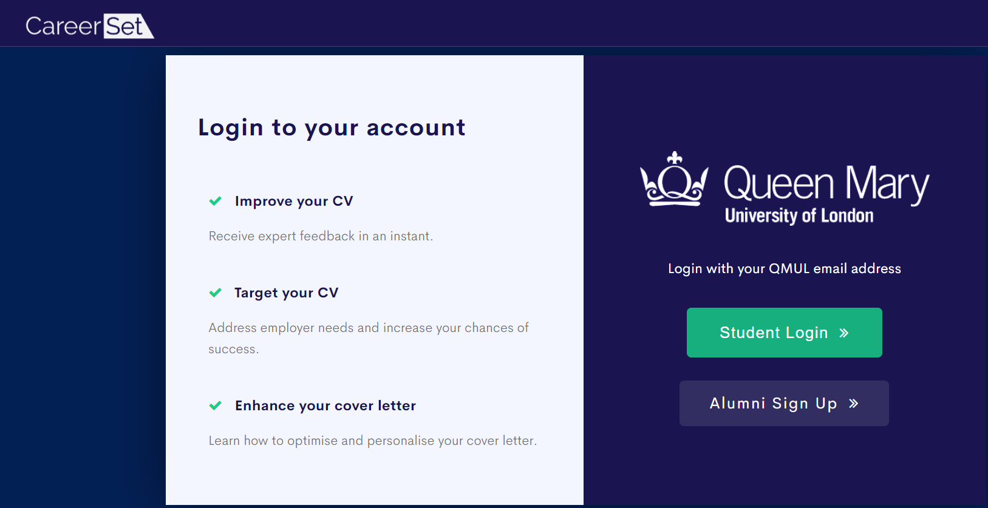
AI CV and Cover Letter Checker
CareerSet - QMUL
Institute of Dentistry
Notes:
DTM

Slide 21
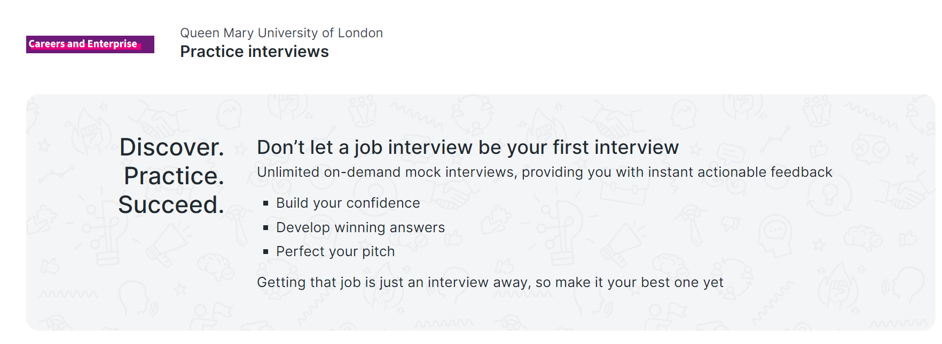
Shortlist.Me – video interviewing
Shortlist.Me - QMUL
Institute of Dentistry

Slide 22
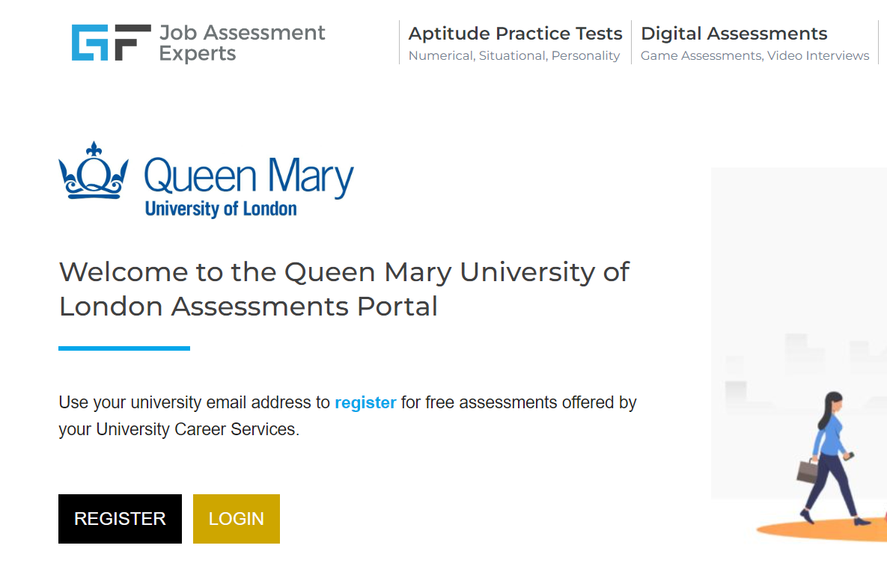
Graduates First – Psychometric Tests
Graduates First – QMUL
Institute of Dentistry

Slide 23
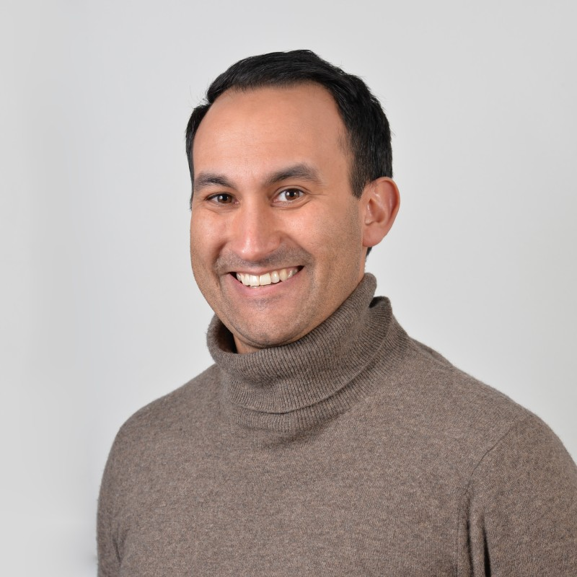
A dedicated Careers Consultant for the Institute of Dentistry
Stefan Couch’s contact details
stefan.couch@qmul.ac.uk
Stefan Couch’s LinkedIn Page
MS Teams chat
Institute of Dentistry

Slide 24

Specific career support
1:1 appointments (with Stefan - in person or online)
30-minute Careers Guidance or Application Support
40-minute Practice Interview
‘Clinical Careers’ series (online on a Wednesday afternoon - TBC)
Once or twice a semester.
A series of specific sessions for Medicine and Dental students will be available to join live.
Opportunity to gain a mentor
Institute of Dentistry – QMUL Staff
Hopefully, you leave with lots of reassuring smiles!
Institute of Dentistry
Notes:
Image source: https://www.istockphoto.com/search/2/image-film?phrase=dental+health+concept
1:1 appointments – has a hyperlink directly to Stefan’s Calendar where you can book a date and time with him. Default is online but if you wish for it to be in-person then please contact Stefan on stefan.couch@qmul.ac.uk
Clinical Careers Series
Previous topics have included Clinical CV session, Four reasons why all clinicians should be on LinkedIn, Hear how your peers effectively utilise LinkedIn and many more.
QMentoring
To learn from other more experienced clinical and/or non-clinical individuals about their career journey and how it can impact yours.
Individuals who registered their initial interest include: -
Dr Sinclair Butcher (Endodontics)
Dr Dominic Hurst (Adult Oral Health)
Dr Fleur Mumford (Oral Surgery)
Dr. Saroash Shahid (Dental Biomaterials and Dental Anatomy)
Dr. Roy Woodhoo (Head of Year 5 BDS – Interest in Dental Public Health and Primary Care)
Dr. Eleni Besi (Senior Clinical Lecturer/ Consultant in Oral Surgery)
Dr. John Buchanan (Hon Consultant in Oral Medicine)
Hyperlink provides more details on how to sign up to QMentoring and when you will need to do it by etc.
As well as a hyperlink to the IoD staff so you can see their specialisms and hopefully match with the ideal mentor who is most related to your interests in dentistry.

Slide 25

What careers are directly related to you?
Institute of Dentistry
Notes:
SC
Image source: https://explorehealthcareers.org/post-pandemic-healthcare-careers-what-to-expect/

Slide 26
Alternative dental career paths (portfolio careers)
Oral and Maxillofacial Surgery
Orthodontics
Oral Medicine
Academic and Research Careers
Dental Product Development
Healthcare Management
Dental Hygiene or Therapy
Consulting and Advisory Roles
Forensic Dentistry
Medical Writing and Communication
Dental Sales and Marketing
Healthcare Policy and Advocacy
Global Health Initiatives
Entrepreneurship
Healthcare Informatics
Institute of Dentistry
Notes:
SC
Dental students who have completed the BDS program at Queen Mary University of London have a solid foundation in healthcare, clinical skills, and problem-solving abilities that can be applied to a variety of alternative careers. Here are some alternative career paths they could consider:
Oral and Maxillofacial Surgery: Some BDS graduates choose to specialize in oral and maxillofacial surgery, which involves surgical procedures related to the mouth, jaw, and face.
Orthodontics: Those interested in orthodontics can pursue postgraduate training and become orthodontists, specializing in the alignment of teeth and jaws.
Oral Medicine: This specialty involves the diagnosis and non-surgical management of oral diseases. BDS graduates can specialize in oral medicine with further education.
Dental Public Health: Dental public health specialists work to improve the oral health of communities through policy development, health promotion, and education.
Academic and Research Careers: Some graduates choose to pursue teaching and research positions at dental schools or universities, contributing to the advancement of dental science and education.
Dental Product Development: Graduates with a strong background in dentistry can work for dental product companies in research and development, marketing, or sales roles.
Healthcare Management: With their understanding of healthcare systems and patient care, BDS graduates can explore careers in healthcare management, administration, or hospital leadership.
Dental Hygiene or Therapy: Some may opt for further training to become dental hygienists or dental therapists, focusing on preventive care and minor treatments.
Consulting and Advisory Roles: Graduates can work as consultants or advisors for healthcare organizations, dental insurance companies, or government health agencies.
Forensic Dentistry: This field involves identifying human remains through dental records, and BDS graduates can specialize in forensic dentistry with additional training.
Medical Writing and Communication: Dental professionals with strong communication skills can pursue careers in medical writing, healthcare journalism, or public relations.
Dental Sales and Marketing: Graduates can work for dental equipment or pharmaceutical companies in sales, marketing, or product management roles.
Healthcare Policy and Advocacy: Those interested in influencing healthcare policies and advocating for oral health can work for government agencies or advocacy groups.
Global Health Initiatives: BDS graduates can contribute to global health initiatives by working with international organizations to improve access to dental care in underserved areas.
Entrepreneurship: Some may choose to start their dental practices or dental-related businesses, such as dental clinics, dental labs, or dental technology startups.
Healthcare Informatics: Those interested in data and technology can explore careers in healthcare informatics, focusing on improving healthcare systems and data management.
It's important to note that transitioning to some of these alternative careers may require additional education, training, or certifications. Additionally, networking and seeking guidance from career advisors or mentors in the chosen field can be invaluable for making a successful transition. Each alternative career path offers unique opportunities to apply dental knowledge and skills in different ways while contributing to the broader field of healthcare and well-being.
Regenerate

Slide 27
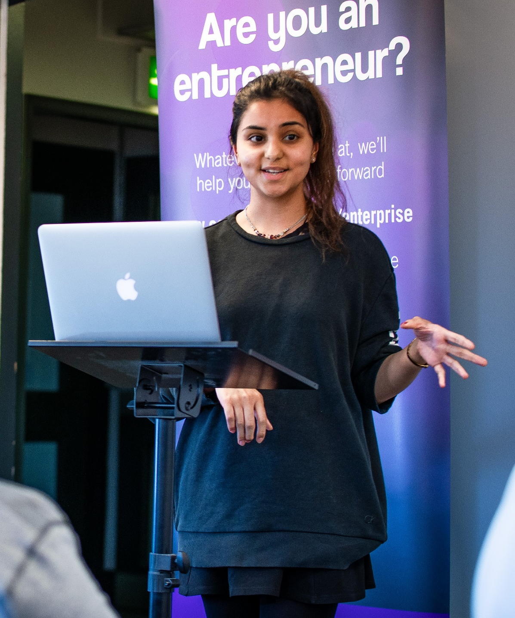

Enterprise
Contact: David Tomas-Merrills
d.tomas-merrills@qmul.ac.uk
enterprise@qmul.ac.uk
QHack: Develop your entrepreneurial skillset in our weekend boot camp (includes business mentors and competition judges)
QIncubator: Test your business idea in our 8-week programme
Funding awards:
Try It – £500 to test an idea
Build It – up to £10,000 to build a product
Launch It – up to £3,000 to launch a business
Grow It – up to £5,000 to grow a business
Institute of Dentistry

Slide 28
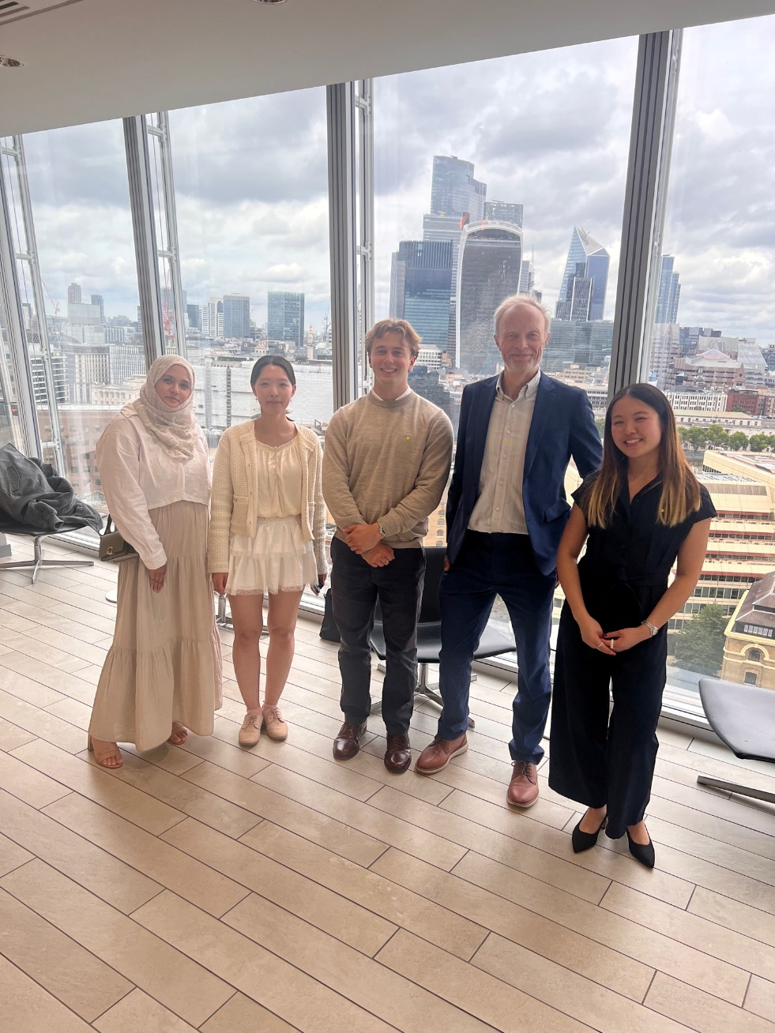
The Shard
Enterprise Showcase
At the University of Warwick Business School
Pitching for QMUL
Florence Mai
BDS graduate (S24)
QIncubator Spring 25 - placed
Build It Award Summer 25 – shortlisted
NATTURA
Institute of Dentistry

Slide 29
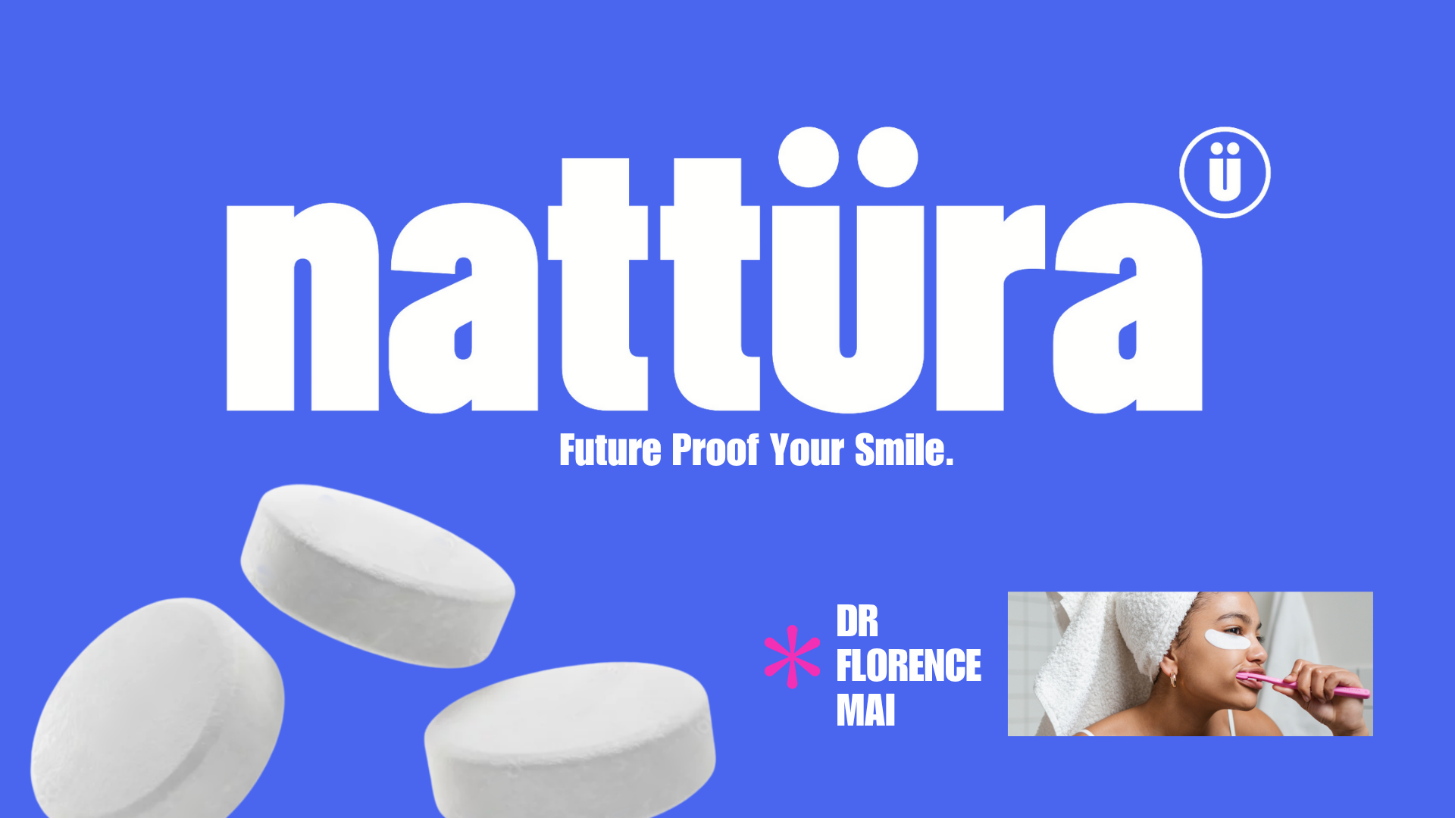

Slide 30
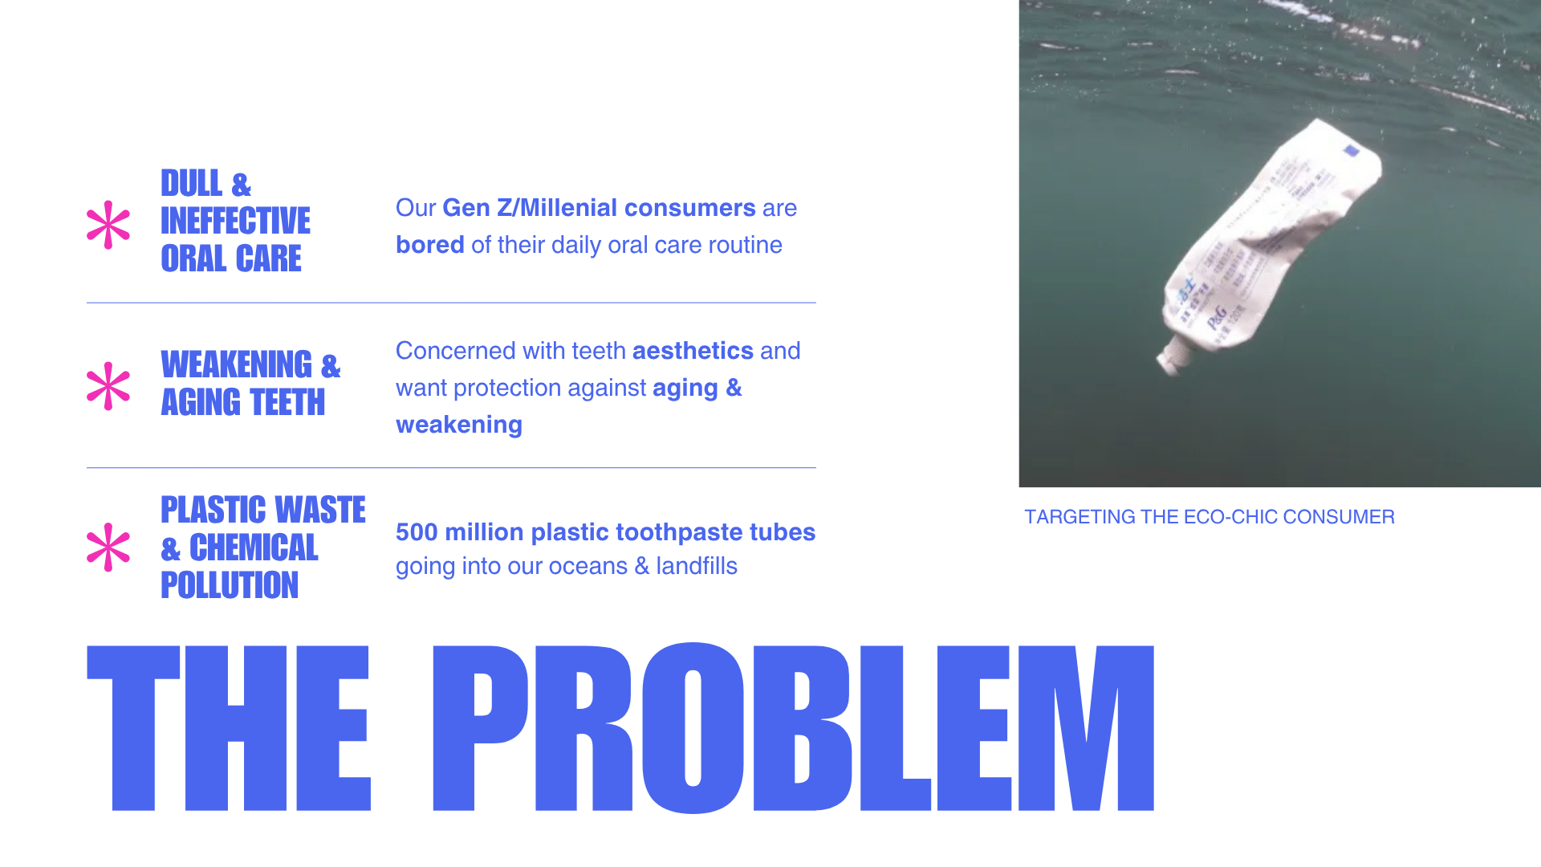

Slide 31


Slide 32
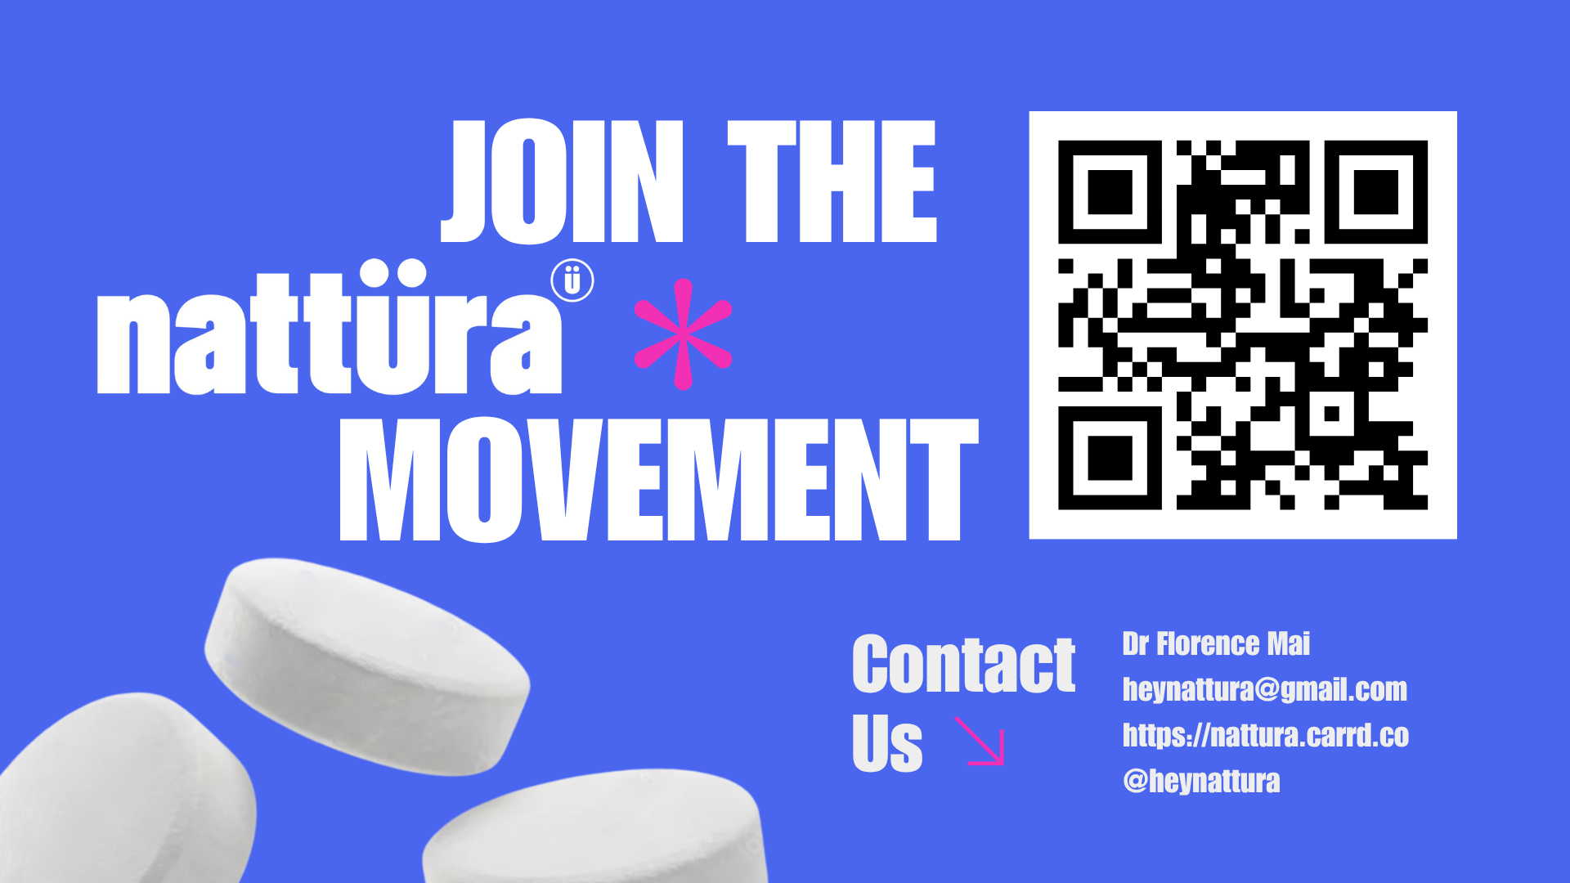

Slide 33
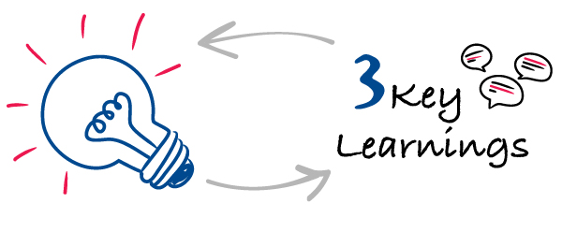
Support is available to help you with your future career.
You can gain a role model/mentor!
You can create your own business/side-hustle!
Institute of Dentistry
Notes:
Image source: https://3tscapital.com/2020/02/19/3-key-learnings/
To support with career choices, whether that is to ensure a career outside of dentistry or to ask yourself questions such as whether having a portfolio career is right for you or not, choosing a clinical or non-clinical specialism, knowing whether locuming or starting your own dental practice in the future is for you or not, etc. etc. – Conversations you can have with Stefan or myself (if about starting your own business).
Remember to apply for QMentoring and mention who and why you would like “x person” to be your mentor!
If your peer, Florence Mai can create her own product and business, why can’t you too with the help of me and the Enterprise team.

Slide 34

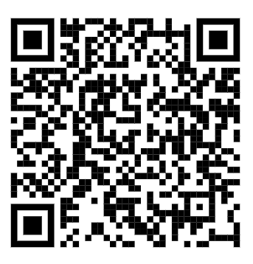
We would value your feedback!
Spend 2-3 minutes completing our survey in the QR Code below to tell us your thoughts on today’s session:
Institute of Dentistry

Slide 35






Contacting us
Careers and Enterprise
IQ East Court, Room 0.08
Mile End Road, E1 4GG
How to book an appointment
020 7882 8533
careers@qmul.ac.uk
@qmcareers
@qmcareers
facebook.com/qmcareers
Institute of Dentistry

Slide 36
Reminder - Registering your attendance
Institute of Dentistry
Notes:
DTM

