Slide 1
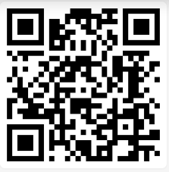
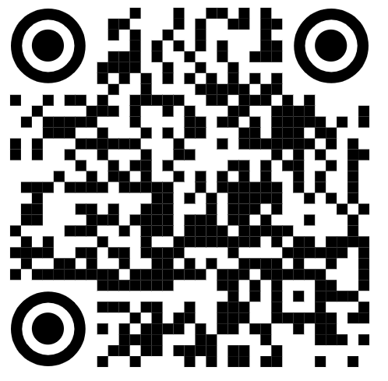
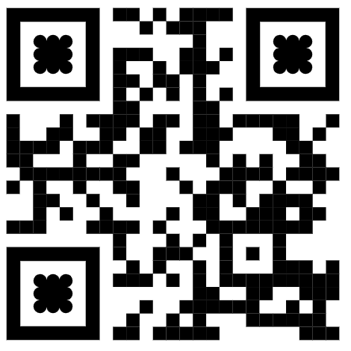
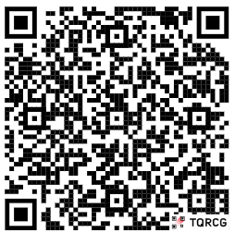
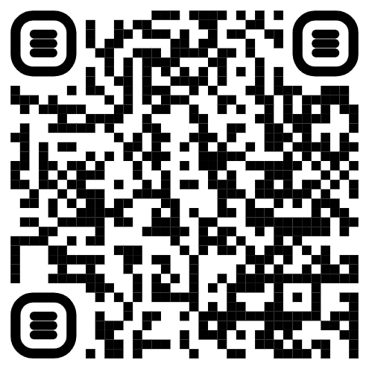
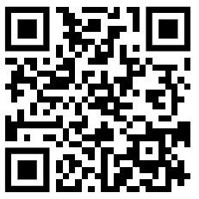
QMUL Guest Wi-Fi
QMPlus Social Circle Module
Disability and Dyslexia Service (DDS)
Autism Induction Event Survey
Student Support Officer (SSO) contacts
Disabled Students’ Allowance (DSA)

