Slide 1

Welcome to
QMUL

Slide 2

Ashleigh Brownsmith
Head of Disability and Dyslexia Service and Inclusive Practice

Slide 3
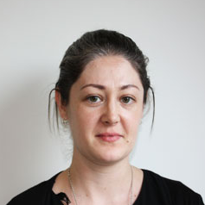
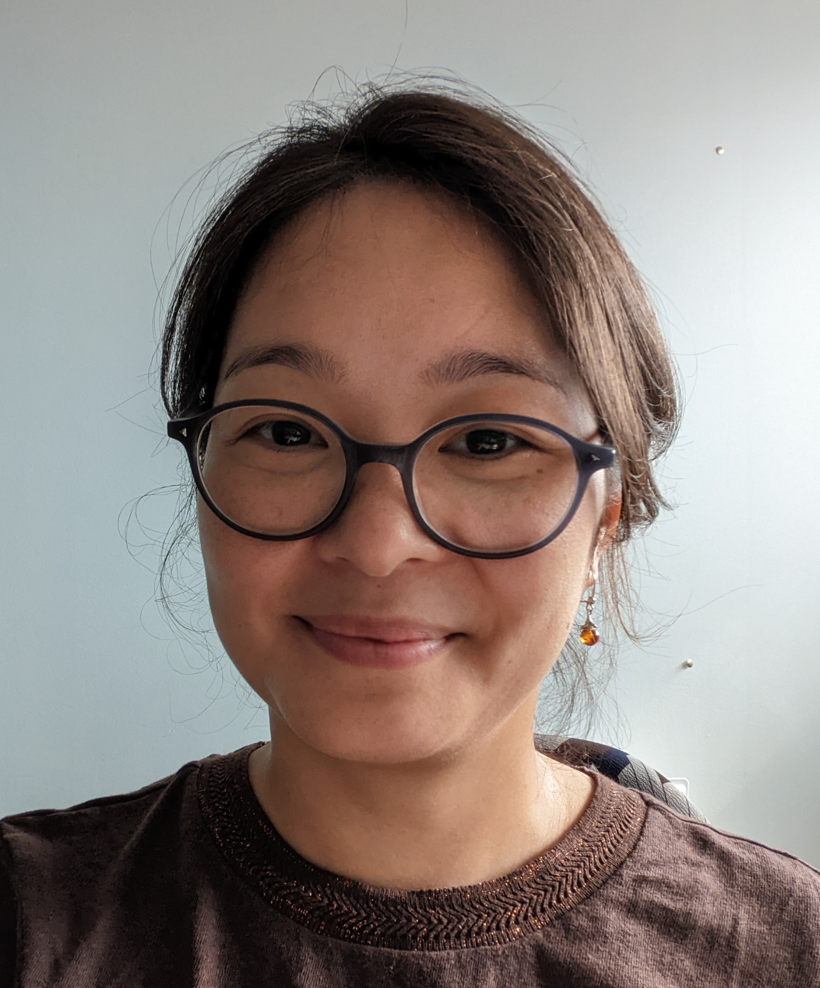
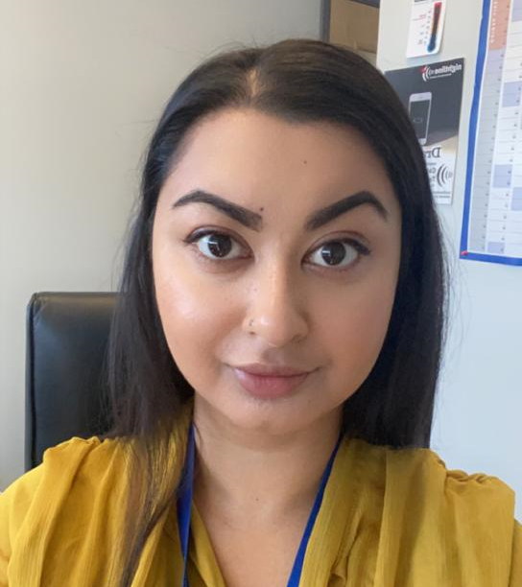
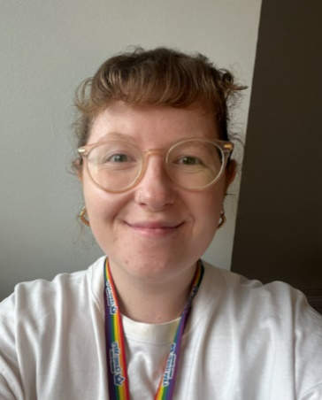
Senior Disability Adviser (SpLD)
Specialist Study Skills Tutor
Disability Advisers
(Mental Health
/Autism)
Assistant Disability Advisers
Kate
Huong
Samia
Olivia
Bancroft Building, 3rd Floor, Room 3.06
AskQM@qmul.ac.uk

Slide 4
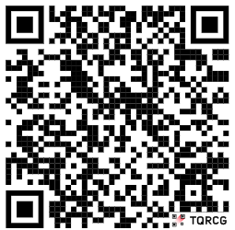
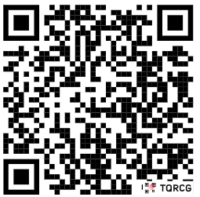
Disability & Dyslexia Service (DDS)
Our main reception office is room 3.06
Open Monday to Friday: 10am – 4pm
Making appointments:
dropping into the reception office
Web enquiry: askqm.qmul.ac.uk
DDS
AskQM

Slide 5
What do DDS advisers do?
Support to access academic arrangements.
We are a confidential service.
Appointments with DDS are confidential.
The only exception to this is if a staff member thought that you, or someone else, was in danger. In this case it might be necessary to break confidentiality in order to access help.

Slide 6
Disability Advisers: Areas of support
Specific Learning Differences (SpLD)
Mental Health and Autism
(MH&A)
Physical Disabilities

Slide 7
Disability Advisers can support with:
Applying for Disabled Students’ Allowance (DSA)
Examination Access Arrangements (EAA)
Co-ordinating 1:1 practical support (if required)
Contacting your academic school on your behalf (but only with your permission)
Advice on Extenuating Circumstances (EC), Fit to Sit policy
General worries about university, your course, other things you are unsure of

Slide 8
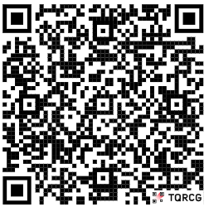
Exam Access Arrangements (EAA)
You can apply to DDS to have extra time in your exams.
We can also arrange additional arrangements if your medical documentation supports this.
We must have medical documentation on file if you wish to have special exam arrangements.

Slide 9
Human Support
If you think you will need support such as a Study Assistant or a Lab Assistant, please let us know.
We recommend you arrangement an appointment to speak to a Disability Adviser.

Slide 10
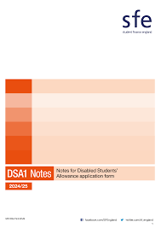
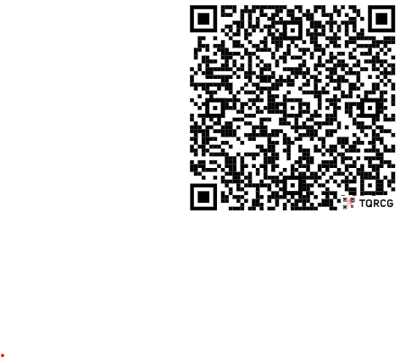
Disabled Students’ Allowance (DSA)
Funds your disability related support at university.
Needs tested - you do not have to pay it back.
It does not pay for things like medication, support for daily living or additional academic tutoring.
Notes:
Includes Laptop and assistive technology

Slide 11
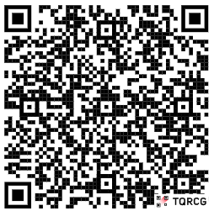
DSA: Specialist Mentoring
If your DSA2 letter entitles you to mentoring.
Please check your emails regularly and reply to your mentoring agency with the information they ask for.
DSA: Study Skills Support
If your DSA2 letter entitles you to Study Skills Support.
The tutors will not be familiar with your subject, but are there to help you will things like planning, essay structure and revision techniques

Slide 12
?
?
?
?
Any Questions?
?
?
?
?

