Slide 1
Electrolyte replacement
Reviewed by Barts Health ETD Team August 2024

Slide 2
Learning Objectives:
Review Electrolyte balance and regulation
Overview of Electrolyte Management
Scenario Questions

Slide 3
Electrolytes
The most common electrolytes in the human body
Sodium
Potassium
Calcium
Phosphate
Magnesium

Slide 4
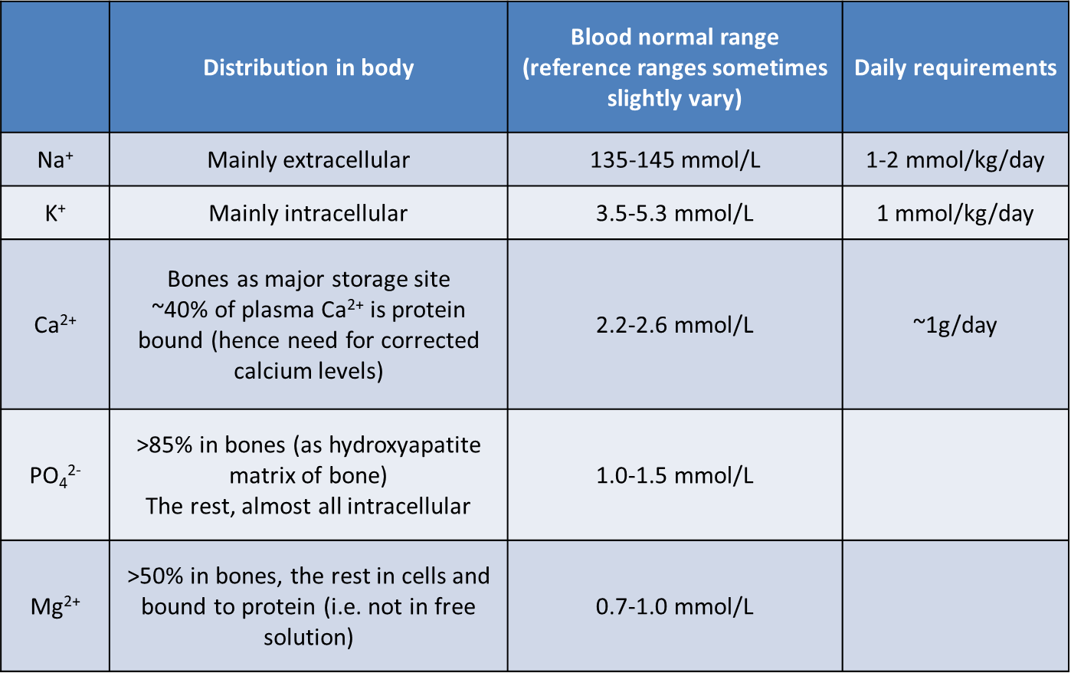
Electrolyte Distribution in body

Slide 5
Prescribing principles
What is the current deficit / excess?
What is the cause of the imbalance?
Is there ongoing loss / retention?
(In cases of deficit)
Route of administration
Is oral absorption sufficient?
OR is IV required?
Any other immediate action required?

Slide 6
Potassium

Slide 7
K⁺ (3.5-5.3 mmol/L)
Roles of potassium
Important for action potential
Nerve stimulation
Muscle contraction

Slide 8
Hyperkalaemia
Signs and Symptoms (typically only when > 6.0 mmol/L)
Common causes ↑K⁺
Nausea and fatigue
Muscle weakness
Arrhythmias
Possible cardiac arrest
ECG changes
Tall peaked T waves
Small P waves
Wide QRS complex
“Sinusoidal”
Renal failure
Addison's disease
Medications
ACE inhibitors
Spironolactone
Potassium supplements
Potassium sparing diuretics
(Less commonly) heparin/LMWH

Slide 9
Hyperkalaemia
Mild hyperkalaemia: 5.5 – 5.9 mmol/L
Moderate hyperkalaemia: 6.0 - 6.4mmol/L
Severe hyperkalaemia : ≥ 6.5 mmol/L

Slide 10
Hyperkalaemia
Common electrolyte disorder
Arguably the most serious of all electrolyte abnormalities
Hyperkalaemia commonly results from either:
Shift of potassium from intracellular to extracellular due to reduced activity of the sodium/potassium (Na+ /K+ ) ATPase pump
Decreased excretion of potassium from the body because of renal impairment (CKD or AKI)
Notes:
CKD = Chronic Kidney Disease
AKI = Acute Kidney Injury

Slide 11
Prescribing scenario 1
Case presentation
65 year old female, NKDA
Brought to the Emergency Department with significant weakness and lethargy. PMH. Heart failure. DH. Losartan 100mg once daily, bisoprolol 10mg once daily, spironolactone 25mg once daily
Investigations
Na⁺ 139 mmol/L (137–144), K⁺ 6.7 mmol/L (3.5–5.3), Creatinine 104 μmol/L (60–110)
ECG shows tall peaked T waves with shortened QT interval
Questions:
What are the treatment strategies?
What reference sources would you use?
What are the monitoring requirements?
What treatments would you prescribe for her hyperkalaemia?
Notes:
76 years old
Spironolactone = Potassium Sparing Diuretic – Reduction of potassium renal excretion due to hypoaldosteronism.
Bisoprolol = BNF states no effect.
Losartan = Increases potassium – Reduction of potassium renal excretion due to hypoaldosteronism.
Hyperkalaemia is more likely to occur when persons with kidney disease are prescribed renin-angiotensin-aldosterone system inhibitors (RAASi), such as angiotensin converting enzyme inhibitors (ACEi) or angiotensin II receptor blockers (ARBs), and the mineralocorticoid receptor antagonists (Eplerenone and Spironolactone

Slide 12
Hyperkalaemia treatment strategies
Notes:
This process begins with an assessment of the risk of arrhythmias, followed by action to reduce the serum K+ concentration by shifting K+ back into cells and removing it from the body. Treatment efficacy is assessed by monitoring the serum K+. Hypoglycaemia is a serious adverse effect of insulin-glucose, therefore frequent blood glucose monitoring is essential. Treatment is not complete until the cause is identified and steps taken to prevent recurrence.

Slide 13
References to Use
Hospital Guidelines
NICE guidelines
BNF

Slide 14
Notes:
What reference sources would you use
Hospital Guidelines
Nice guidelines
BNF
1.Protect the heart
30mL calcium gluconate is the dose recommended in the national guidance. An alternative is 10mL 10% calcium chloride over 5-10 minutes,
Repeat dose after 5 minutes if ECG changes persist; this can be repeated after five minutes. Effects are transient (30-60 minutes).
2. Shift potassium into cells
A. Soluble insulin Actrapid® + dextrose Administer 8 units of soluble insulin Actrapid® in 100mL of 20% dextrose and give over 15 minutes. If 20% dextrose is not available administer 10 units of soluble insulin Actrapid® in 50mL of 50% dextrose can be used as an alternative.
B. Nebulised Salbutamol Administer 10mg-20mg nebulised salbutamol (10mg in patients with IHD, severe tachycardia). In combination with insulin/dextrose, salbutamol can lower serum potassium by an additional 0.5-1mmol/L. Effect lasts up to 2 hours.Should only be used as first-line treatment while awaiting IV access for dextrose and soluble insulin.
C. Intravenous Sodium bicarbonate: Can shift potassium from the extracellular to intracellular by increasing blood pH. The evidence for routine use in hyperkalaemia is controversial, its effects are of variable onset and not sustained. Its use should be limited to cases of severe metabolic acidosis when recommended by an Intensivist or Nephrologist
NICE guidelines

Slide 15
Monitoring
ECG:
Repeat 12 lead ECG after administration of calcium gluconate to confirm resolution of ECG changes.
3-lead ECG monitoring should be continued whilst ECG changes persist
Potassium:
Measure potassium at 1, 2, 4, 6 hours after initial treatment
Aim to achieve serum potassium ≤6.0 mmol/L within 2 hours.
Measure potassium at 24 hours to ensure that this has been maintained.
Glucose:
Delayed hypoglycaemia is common.
Monitor at 0, 15, 30 minutes after starting treatment and then hourly up to 6 hours.

Slide 16
Treatment of Hyperkalaemia
Stop further potassium accumulation (withhold Losartan and Spironolactone)
Protect the heart: give 30ml of calcium gluconate 10% intravenously over 5 minutes or 10ml calcium Chloride 10%
Shift potassium into cells: give 8 units of Actrapid in 100ml Glucose 20% or 10 units of Actrapid Insulin in 50 ml glucose 50% by slow IV injection over 5 minutes
Shift potassium into cells: administer 10mg of nebulised salbutamol
Remove potassium from the body: oral potassium-binding agents (that increase gastrointestinal loss of potassium) e.g. sodium zirconium cyclosilicate (Lokelma)
Notes:
Calcium Gluconate – Protects the heart – Increases the threshold potential, thus restoring the normal gradient between threshold potential and resting membrane potential which would normally be elevated due to hyperK.
Calcium resonium: a slow MOA about , Cation-exchange resin, exchanges K+ for Ca2+.
Newer potassium binders Patiromer (Veltasa) and sodium zirconium cyclosilicate (Lokelma)
Lokelma: potassium binder that preferentially exchanges H+ and Na+ for K+ and ammonium ions throughout the entire gastrointestinal tract.1 The K+-binding capacity of SZC is up to 9 times greater than that of oral agents

Slide 17
ECG Changes

Slide 18
ECG Changes
Notes:
Slightly peaked P wave but in hyperkalaemia is wide and flat.
Prolonged PR interval in both.
ST depression is the same as hyperkalaemia
Shallow T wave but in hyperkalaemia it’s shallow.
Prominent U wave in hypo.

Slide 19
Hypokalaemia
Common causes ↓K⁺
Signs and Symptoms (typically only when < 3.0 mmol/L)
Excessive fluid loss e.g. burns, D+V
Drain output
High output stoma
↓ Mg2+
Re-feeding syndrome
Medications
Diuretics (loop and thiazide-like)
Laxative abuse
Corticosteroids
Salbutamol (esp repeated nebulisers)
Insulin infusions
Amphotericin
And others…
Weakened muscle strength
Muscle aches
Cramps
Palpitations
Abnormal heart rhythms

Slide 20
Prescribing scenario 2 (part 1)
Case presentation
65 year old male, NKDA
Currently a Cardiology inpatient, admitted with pulmonary oedema and has been receiving IV furosemide 80mg twice daily.
Investigations
Na⁺ 139 mmol/L (137–144), K⁺ 3.2 mmol/L (3.5–5.3), creatinine 104 μmol/L (60–110)
ECG normal
Questions:
What is likely to be causing his hypokalaemia?
What treatments would you prescribe for his hypokalaemia?

Slide 21
Prescribing scenario 2 (part 1)
Likely cause:
Furosemide – loop diuretic. Causes electrolyte imbalances incl. hypokalaemia
Liaise with cardiology for furosemide to be held.
Treatment:
Sando K (oral effervescent tablets) 2 tabs TDS
Monitor K+ daily.
Notes:
Really important to review duration, and potassium on a daily basis
One tablet = 12mmol
For serum levels between 2-3 mmol/l, a maximum daily dose of 100-200 mmol K⁺ (8-16 tablets) and for serum levels between 3-4 mmol/l, a maximum daily dose of 50-100 mmol K⁺ (4-8 tablets) should be considered.

Slide 22
Prescribing scenario 2 (part 2)
Case presentation
65 year old female, NKDA
Brought to the Emergency Department with significant weakness and lethargy. PMH. Hypertension. DH. Amlodipine 10mg once daily, Indapamide 2.5mg once daily
Investigations
Na+ 139 mmol/L (137–144), K+ 2.6 mmol/L (3.5–5.3), creatinine 104 μmol/L (60–110)
Questions:
What reference sources would you use?
What would the monitoring requirements be?
What treatments would you prescribe for her hypokalaemia?

Slide 23
Prescribing scenario 2 (part 2)
As K+=2.6, an IV preparation is now necessary
Check Medusa/IV Monograph
0.9% Sodium Chloride with 40mmol Potassium Chloride (sometimes written as 0.3% Potassium) 1L over 4 hours
Hold thiazide-like diuretic
Notes:
If you’re unsure how to prescribe, check Medusa.
Alternatively, you can also write as 0.9% NacL with 40mmol KCl.

Slide 24
Potassium (IV) Rules
On general wards
Max rate for adults is 10mmols/hour
Max concentration in bag is 40mmol/L via peripheral line
Use ready-made solutions - NOT Concentrated Potassium vials
Higher concentrations used on ITU only via central line
Things to consider when replacing Potassium
Use Sodium Chloride + Potassium Chloride
Review need for other drugs that decrease potassium e.g. salbutamol, aminophylline, diuretics, mineralocorticoids and glucocorticoids
Notes:
If you’re unsure how to prescribe, check Medusa.
Alternatively, you can also write as 0.9% NacL with 40mmol KCl.

Slide 25
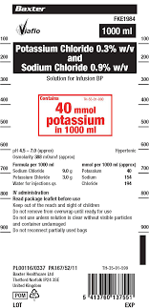
Units
Understand difference between units
%w/v (weight per volume) equates to g/mL
Where 100%w/v = 1g/mL
mM (millimolar)
= mmol/L
= mmol in 1000mL
These terms are based on moles, rather than weight and not directly interchangeable

Slide 26
Units (%w/v, mM, mmol in 1000 mL and mmol/L)
Solute | %w/v | mmol/L
Potassium chloride | 0.15% | 20 mmol/L
 | 0.3% | 40 mmol/L
Sodium chloride | 0.9% (“normal saline”) | 154 mmol/L
 | 0.45% (“half-saline” only for specialist use) | 77 mmol/L

Slide 27
Hypokalaemia Treatment
Severity | Treatment
All | Replace losses and provide maintenance
If eating and drinking, mild/asymptomatic, consider oral replacement | Prevention (25-55mmol/day) Treatment - higher doses - regular potassium monitoring NOTE: Sando K (12mmol/tab)
Severe / symptomatic | 1L IV Nacl 0.9% infusion with 40mmol K+ over 4 hours This reaches the maximum rate of K+ infusion on general medical ward (10mmol/hour) Higher doses under specialist advice, and may require central access

Slide 28
Sodium

Slide 29
Na⁺ (135-145mmol/L)
Role
Fluid retention
Acid-base balance
Nerve stimulation and action potential
Regulation
Renal excretion and hormonal control
Natriuretic peptide hormone
Renin angiotensin aldosterone system
Antidiuretic hormone (ADH) Vasopressin

Slide 30
Hypernatremia
Signs and Symptoms (typically only when > 150 mmol/L):
Muscle weakness
Confusion and headache
Dehydration and feeling thirsty
Polydipsia (excessive thirst)
Polyuria (excessive urination) can be drug induced
Common Causes of hypernatremia:
Dehydration (including drug-related)
Diabetes insipidus (nephrogenic or drug induced)
Endocrine – Cushing’s or Conn’s syndrome
Hyperosmolar hyperglycaemic state (HSS)

Slide 31
Hypernatremia treatment
Severity | Treatment
All | Identify factors and underlying causes Renal failure/disease Cardiac failure Hyperglycaemia / HHS / DKA Hypercalcemia Diabetes insipidus
Mild and dehydrated | Rehydrate Oral water or IV 5% glucose
Severe (e.g. Na > 170 mmol/L) Requires specialist input Do not decrease sodium by more than 10mmol/L per day → risk of pontine myelinolysis | Glucose 5% IV infusion OR Low BP/ Hypovolemic ? 0.9 % Nacl IV infusion Regular U+Es
HHS / DKA | Specific fluid and insulin regime (See trust protocols)

Slide 32
Hyponatremia
Common Causes of hyponatremia:
Hypervolaemic
Heart failure
Renal failure
Liver cirrhosis
Euvolaemic
Hypothyroidism
Adrenal insufficiency
SIADH
Hypovolaemic
Diuretics (sometimes thiazides can be euvolaemic hyponatraemia)
Renal loss
GI loss
Reduced oral intake
Signs and Symptoms (typically only when < 125 mmol/L)
With decreasing Na⁺ levels
Nausea, headache, drowsy
Confusion, stupor
Seizures, coma

Slide 33
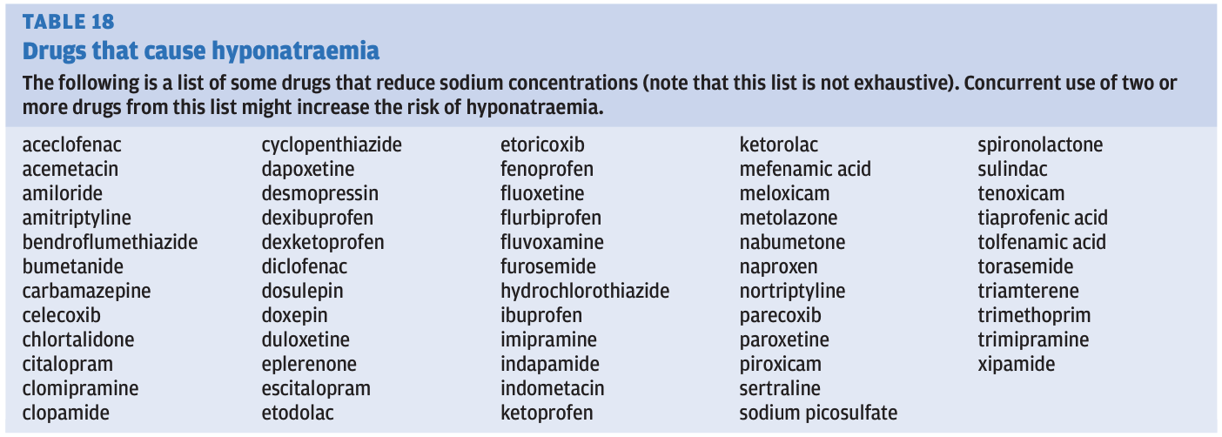
Hyponatraemia treatment
Severity | Treatment
All | Identify factors and underlying causes Also depends on severity and chronicity Medications review: Diuretics SSRI / TCA Carbamazepine Sodium valproate PPI ACE inhibitors Lithium Many more…
Hypervolaemic | Fluid restriction (Under specialist supervision, consider hypertonic saline 1.8% sodium chloride)
SIADH | Look for causes Medications review Fluid restriction (If unresponsive to fluid restriction or severe, specialist review → demeclocycline or tolvaptam)
Notes:
syndrome of inappropriate secretion of antidiuretic hormone (SIADH)

Slide 34
Calcium

Slide 35
Calcium (Corrected Ca²⁺ 2.1-2.6mmol/L)
Roles:
Intra/extra cellular metabolism
Nerve conduction
Muscle contractions
Bone formation
Coagulation pathway
Enzyme regulation

Slide 36
Hypercalcaemia
Signs and Symptoms (typically only when corrected Ca²⁺ > 3.0 mmol/L)
Renal/biliary stones
Bone pain
Nausea and vomiting
Pancreatitis
Arrhythmias
Common causes ↑Ca²⁺
↑PTH (tumour ?)
Hyperthyroidism
Cancer (multiple myeloma, breast and lung)
↑ Vitamin D,
Thiazide diuretics
Notes:
PTH – parathyroid hormone

Slide 37
Prescribing Scenario 3
Case presentation
70 year old female, NKDA
Brought to the Emergency Department with increasing confusion. PMH: Breast cancer.
Investigations
Na⁺ 139 mmol/L (137–144), K⁺ 3.6 mmol/L (3.5–5.3), creatinine 114 μmol/L (60–110), corrected Ca²⁺ 3.41 mmol/L (2.20–2.60), PO₄²⁻ 1.68 mmol/L (0.8–1.4)
What would you prescribe for the initial treatment for her hypercalcaemia?

Slide 38
Prescribing Scenario 3
What would you prescribe for the initial treatment for her hypercalcaemia?
Sodium Chloride 0.9% IV 1L over 4 hours

Slide 39
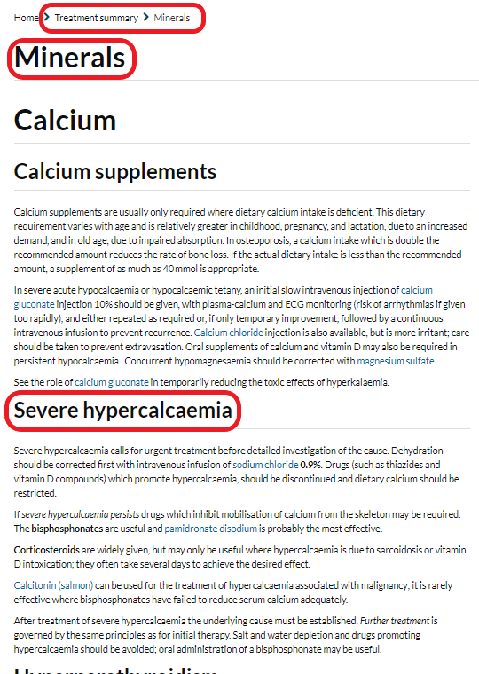
Severe hypercalcaemia treatment
Guidance available in BNF
Treatment summaries → Minerals
First line is IV 0.9% sodium chloride
Typically 1L over 4 hours, but might be faster in severe dehydration
Next options
IF persistent, IV bisphosphonates such as pamidronate
Steroids may be considered in sarcoidosis
Calcitonin may be considered in malignancy
Stop thiazides, vitamin D compounds and restrict dietary calcium

Slide 40
Hypocalcaemia
Signs and Symptoms (typically only when corrected Ca²⁺ < 1.9 mmol/L)
Neuromuscular irritability
Twitching and spasms muscles (tetany)
Seizures
Stiffness
Low blood pressure
Arrythmias
Congestive heart failure
Common causes ↓Ca²⁺
Limited dietary intake
↓ Mg2+
Chronic renal failure
Bisphosphonate therapy
↓ Vitamin D
↓ PTH
Notes:
PTH – parathyroid hormone

Slide 41
Hypocalcaemia treatment
Severity | Treatment
All | Identify factors and underlying causes Also depends on severity and chronicity
Mild | Oral replacement Consider 40-50 mmol daily in divided doses. E.g: Sandocal-1000 (25mmol/tab) 1 tablet twice daily AdCal (15mmol/tab) 1 tablet three times a day
Severe / hypocalcaemic tetany | Initially IV calcium gluconate 10% 10-20 ml (2.2 mmol calcium) over at least 10 mins with cardiac monitoring May require continuous infusion under specialist care, and may require central line

Slide 42
Prescribing Scenario 4
Case presentation
80 year old female, NKDA
Attends the Emergency Department with painful muscle spasms and numbness in her hands and feet.
Investigations
Na⁺ 139 mmol/L (137–144), K⁺ 3.6 mmol/L (3.5–5.3), creatinine 78 μmol/L (60–110), corrected Ca²⁺ 1.82 mmol/L (2.20–2.60), PO₄²⁻ 1.68 mmol/L (0.8–1.4)
ECG QTc 470 msec
How would you manage her hypocalcaemia?
Notes:
QTC interval normal – 350-460 milliseconds

Slide 43
Prescribing Scenario 4
How would you manage her hypocalcaemia?
10% Calcium Gluconate 10ml IV (STAT)
Notes:
QTC interval normal – 350-460 milliseconds

Slide 44
Phosphate

Slide 45
PO₄²⁻ (0.8-1.4 mmol/L)
Roles:
Energy production ATP
Growth and repair of cells (protein synthesis)
pH maintenance
Enzyme function and hormone production
Bone mineralisation
Notes:
QTC interval normal – 350-460 milliseconds

Slide 46
Hyperphosphatemia
Signs and Symptoms
Unspecific
Symptoms related to other current disease states
Common causes ↑PO₄²⁺
Reduced excretions (renal)
↓ PTH,
↓ Mg2+
Bisphosphonate therapy
Notes:
PTH – parathyroid hormone

Slide 47
Hyperphosphatemia treatment
Severity | Treatment
All | Identify factors and underlying causes
Under specialist care | Consider phosphate binders

Slide 48
Hypophosphatemia
Signs and Symptoms (typically only when PO₄²⁺ < 0.4 mmol/L)
Muscle weakness, lethargy, tremor
Mental state changes
Irritability, confusion, seizures and coma
Instability of cell membranes
Arrhythmias
(should also result in ↑PTH, unless primary hypoPTH)
Common causes ↓PO₄²⁺
Malnutrition
Malabsorption
Re-feeding syndrome
↓ Vitamin D
Alcohol abuse
Sucralfate
Antacids (containing aluminium, Ca²⁺, Mg²⁺)
Notes:
PTH – parathyroid hormone

Slide 49
Hypophosphatemia treatment
Severity | Treatment
Mild (0.5- 0.79 mmol/L) | Phosphate Sandoz® 1 - 2 tablets TDS PO (16 mmol phos/tab) Common side effect diarrhoea Reduce dose or give in at least 120 ml of water
Mild but unable to Absorb / NBM | IV phosphate 9mmol over 8-12 hours Check phosphate, potassium, calcium and magnesium 12-24 hourly Repeat the dose within 24 hours if still < 0.5 mmol/L
Severe (< 0.5 mmol/L) OR not responding | Seek help from pharmacist E.g. 500ml Phophate Polyfusor (50 mmol) E.g. 20ml Addiphos IV (40 mmol) in 500 ml 5%glucose over 12 hours E.g. 20ml Glycophos IV (20 mmol) in 500 ml 5% glucose over 12 hours E.g. 50ml Glycophos IV (50 mmol) in 500 ml 5% glucose over 12 hours

Slide 50
Refeeding Syndrome
In fasted state:
Energy sources switch from carbohydrates to fatty acids and amino acids
Some mineral stores (e.g. intracellular) can become depleted although serum levels may remain normal
Insulin secretion ↓ and glucagon ↑
On refeeding:
Insulin secretion ↑
↑ glycogenesis, lipogenesis and protein synthesis
This requires phosphate, magnesium and potassium (which stores may already have been depleted)
Therefore risk of severe ↓ PO₄²⁻, Mg²⁺, K⁺

Slide 51
Magnesium

Slide 52
Mg²⁺ (0.7-1.0 mmol/L)
Roles:
Important cofactor for over 300 enzymes
Enzymes important for muscle and nerve function
Blood glucose control and protein synthesis
Notes:
QTC interval normal – 350-460 milliseconds

Slide 53
Hypomagnesaemia
Signs and Symptoms
Nausea and vomiting
Fatigue, weakness including ‘pins and needles’
Agitation, confusion and seizures
Cramps and muscle spasms
Arrhythmias
(Often accompanied by ↓K⁺, ↓Ca²⁺, ↓Na⁺)
Common causes ↓Mg²⁺
Reduced dietary intake
Medications
Loop and thiazide diuretics
PPIs
Diarrhoea
Drain outputs
Chronic alcoholism

Slide 54
Prescribing Scenario 5
Case presentation
85 year old female, NKDA
Attends the Emergency Department with palpitations and was found to have atrial fibrillation with a rapid ventricular rate (154 bpm).
Investigations
Na⁺ 139 mmol/L (137–144), K⁺ 4.6 mmol/L (3.5–5.3), creatinine 92 μmol/L (60–110), corrected Ca²⁺ 2.48 mmol/L (2.20–2.60), PO₄²⁻ 0.98 mmol/L (0.8–1.4)
Mg²⁺ 0.48 mmol/L (0.7-1.0)
Thyroid function tests normal
She has been started on a beta-blocker and a low molecular weight heparin. Please prescribe appropriate magnesium replacement.

Slide 55
Prescribing Scenario 5
She has been started on a beta-blocker and a low molecular weight heparin. Please prescribe appropriate magnesium replacement.
Magnesium Sulphate 8mmol in 5% Glucose 100ml IV over 2 hours

Slide 56
Hypomagnesemia treatment
Severity | Treatment
0.3-0.7 mmol/L, and asymptomatic, and able to tolerate and absorb oral | Oral magnesium glycerophosphate e.g. 3-6 tablets/day in divided doses Reduce dose if renal impairment or causes diarrhoea side effect
Unable to tolerate/absorb oral, or <0.3 mmol/L, or Symptomatic | Intravenous magnesium sulphate E.g. 8mmol magnesium sulphate with ECG monitoring Typically up to 20 mmol/day if required Reduce dose if renal impairment Monitor serum Mg²⁺ levels at least daily

Slide 57
Magnesium Sulphate
Confusion can arise due to the different methods of stating doses of magnesium sulfate, as doses may be expressed in grams (g), milligrams (mg) or millimoles (mmol) of magnesium
1g of magnesium sulphate =4 mmol magnesium

Slide 58
Magnesium Sulphate
Magnesium sulphate heptahydrate concentration (percentage w/v) | Magnesium ions equivalence (approximate) (millimoles magnesium (Mg²⁺) per ml) | Magnesium sulphate heptahydrate concentration(mg/ml) equivalence | Examples of magnesium sulphate injection preparations
10% w/v | 0.4 mmol/ml | 100mg/ml | 200mg in 2ml 1g in 10ml
20% w/v | 0.8 mmol/ml | 200mg/ml | 4g in 20ml
50% w/v | 2mmol/ml | 500mg/ml | 1g in 2ml 2.5g in 5ml 5g in 10ml 10g in 20ml 25g in 50ml

Slide 59
Any Questions?

