Slide 1
Practical Prescribing:
Controlled Drugs
Updated by Barts ETD Team
August 2024

Slide 2
Learning Objectives:
To learn about what Controlled Drugs (CDs) are
Prescription Requirements for CDs
Overview of Opioid Prescribing
Breakthrough Pain
Scenario Questions

Slide 3
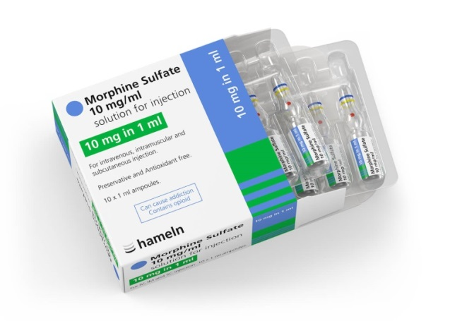
Prescribing Controlled Drugs (CDs) in Hospital
What is a controlled drug?
A controlled substance is generally a drug or chemical whose manufacture, possession or use are regulated by a government.
Controlled Drugs (CDs) are a group of medicines that have the potential to be misused. For this reason, they are 'controlled' by The Misuse of Drugs Act 1971.
  This may include illegal drugs and prescription medications

Slide 4
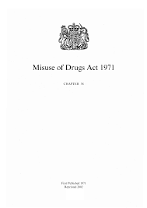
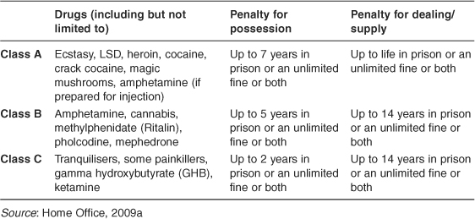
The Law behind CDs
The Misuse of Drugs Act, 1971
  Drugs are grouped according to their harmfulness when misused
  Class A, B and C
  Penalties vary accordingly
Notes:
Class A includes: alfentanil, cocaine, diamorphine hydrochloride (heroin), dipipanone hydrochloride, fentanyl, lysergide (LSD), methadone hydrochloride, 3, 4-methylenedioxymethamfetamine (MDMA, ‘ecstasy’), morphine, opium, oxycodone hydrochloride, pethidine hydrochloride, phencyclidine, remifentanil, and class B substances when prepared for injection.
Class B includes: oral amphetamines, barbiturates, cannabis, Sativex®, codeine phosphate, dihydrocodeine tartrate, ethylmorphine, glutethimide, ketamine, nabilone, pentazocine, phenmetrazine, and pholcodine.
Class C includes: certain drugs related to the amfetamines such as benzfetamine and chlorphentermine, buprenorphine, mazindol, meprobamate, pemoline, pipradrol, most benzodiazepines, tramadol hydrochloride, zaleplon, zolpidem tartrate, zopiclone, androgenic and anabolic steroids, clenbuterol, chorionic gonadotrophin (HCG), non-human chorionic gonadotrophin, somatotropin, somatrem, somatropin, gabapentin, and pregabalin.

Slide 5
Human Medicines Use Regulations 2012
The Misuse of Drugs Regulations 2001
  It allows for the lawful possession and supply of CONTROLLED DRUGS (CDs) for legitimate purposes.
  They cover prescribing, administering, safe custody, dispensing, record keeping, destruction and disposal of CDs to prevent diversion for misuse.
  Divides CDs into five schedules corresponding to their therapeutic usefulness and misuse potential.
Notes:
The Human Medicines Regulations 2012 (the “Regulations”) is the main legislation in the UK covering the manufacture, importation, distribution, advertising, labelling, sale and supply of medical products for human use and pharmacovigilance (the monitoring of the effect and safety of medical drugs after they have been licensed for use).

Slide 6
Controlled Drug Schedules
Schedule 1 (CD Lic POM)
Schedule 2 (CD POM)
Schedule 3 (CD No Register POM)
Schedule 4 (CD Benz POM and CD Anab POM)
Schedule 5 (CD INV P and CD INV POM)
Notes:
CD = Controlled Drug
Lic= Licence
POM = Prescription only Medication
Benz= Benzodiazapine
Anab = Anabolic
INV = invoice
P = Pharmacy only

Slide 7
Controlled Drug Schedules
Schedules (MDR 2001) | Examples of drugs
Schedule 1 | Hallucinogenics (e.g. LSD) Ecstasy-type substances Raw opium Cannabis (excluding cannabis based medicines)
Schedule 2 | Amphetamines Diamorphine Cocaine Ketamine Secobarbital Morphine Pethidine Methadone Remifentanil Nabilone Fentanyl Oxycodone Tapentadol Alfentanil Methylphenidate
Notes:
Schedule 1 (Controlled Drug license)
Have no recognized medicinal use and include cannabis, coca leaf, lysergic acid.
Schedule 2 (Controlled Drugs)
Includes diamorphine (heroin), morphine, pethidine, remifentanil, secobarbital, amfetamine, and cocaine.
Sch2 requires safe custody, rx requirements, register, 28 days legally valid

Slide 8
Controlled Drug Schedules
Schedules (MDR 2001) | Examples of drugs
Schedule 3 | Phenobarbital* Gabapentin Midazolam Buprenorphine* Pregabalin Temazepam* Tramadol
Schedule 4 Pt I | Benzodiazepines (except temazepam/midazolam – Sch 3) Z- drugs Sativex*
Schedule 4 Pt II | Androgenic and anabolic steroids Chorionic gonadotrophin Somatropin
In Barts Health:
Prescription Only Medicines with CD Schedule 2 Requirements:
Mifepristone
Misoprostol
Strong potassium chloride solutions
*Medicines with Schedule 2 requirements at Barts Health NHS Trust
Notes:
Schedule 3 (Controlled Drugs – no register)
Minor stimulant drugs less likely to be misused (Barbiturates – except secobarbital, buprenorphine, midazolam, and temazepam. Gabapentin and pregabalin.
no register, safe custody for only temaz and bupren, rx requirements for all, 28 days validity
Schedule 4
No specific CD prescription writing requirements (Benzodiazepines – except temazepam and midazolam), and also zolpidem, zopiclone and zaleplone. Most of the anabolic and androgenic steroids such as testosterone.
no legal req except 28 days validity
GOOD PRACTICE (Strong recommendation): max 30 days supply for Sch 2-4

Slide 9
Controlled Drug Schedules
Schedules (MDR 2001) | Examples of drugs
Schedule 5 | Oromorph* (Morphine Sulphate Oral Solution) Epidyolex
*Medicines with Schedule 2 requirements at Barts Health NHS Trust
Notes:
Schedule 5
No specific CD prescription writing requirements (codeine, dihydrocodeine, Oramorph 10mg/5ml)
Oramorph is treated as a Schedule 2 CD in Barts Health

Slide 10
Prescription Writing Requirements
The prescription must include:
  Patients’ full name, home address and/or hospital number and, where appropriate the date of birth (if <12yrs)
  Drug name & formulation eg Morphine Sulphate MR tablet
  Strength e.g. 10mg/5ml – if more than one available
  Dose to be taken/frequency – ‘as directed’ is not acceptable
  Total quantity and dosage units in words and figures: 10 (ten) tablets or 100ml (one hundred) millilitres
  Full signature and PRINTED name of the prescriber
  Date
  NOTE: ONLY THE SIGNATURE NEEDS TO BE HANDWRITTEN*
  It is good practice to include the contact number for the prescriber (clinic number/bleep number/mobile).
  NB – this is for discharge prescriptions and NOT for in-patient prescriptions
*Advanced electronic signatures can be accepted for Schedule 2 and 3 Controlled Drugs where the Electronic Prescribing Service (EPS) is used.

Slide 11
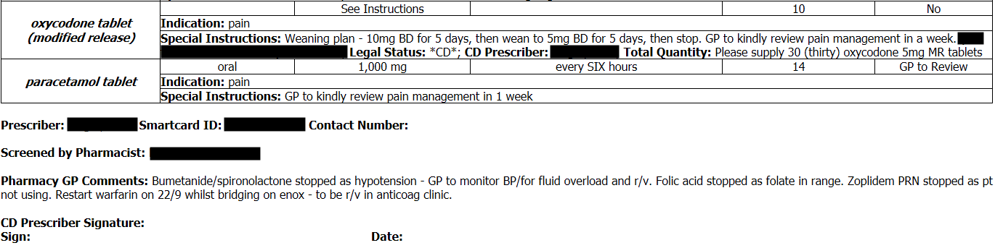
How to prescribe a CD on discharge
Name and Form of Drug i.e. patch or modified release tablets
Dose / Instructions
Strength + Formulation of Drug
Total Quantity in Words and Figures
Full name / Signature in own handwriting and date. MUST BE LEGIBLE
Notes:
Trainer to note that the prescription needs to be printed and the Drs signature added and given to pharmacy. No signature= no release of CDs
Full name of prescriber needed – initials not allowed

Slide 12
Practical Points
The maximum quantity of Schedule 2, 3 or 4 controlled drugs is recommended not to exceed 30 days.
A prescription for a Controlled Drug in Schedules 2, 3, or 4 is valid for 28 days from the date stated thereon.
Schedule 5 prescriptions are valid for 6 months from the appropriate date.

Slide 13

Summary
A pharmacist is not allowed to dispense a CD unless all the information required by law is given on the prescription.
Consequences: SERIOUS delays and SAFETY issues.
Refer to the BNF (Controlled drugs and drug dependence | Medicines guidance | BNF | NICE)
If in doubt- Ask the PHARMACIST

Slide 14
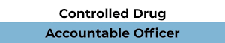
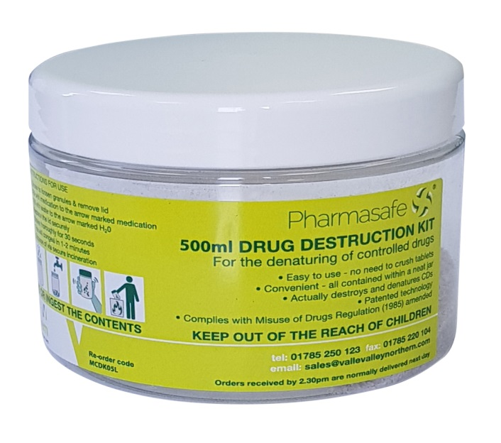
Accountable officers are responsible for supervising and managing the use of CDs in their organisation or setting. Their roles and responsibilities include:
  Oversight of the monitoring and auditing of the management, prescribing and use of CDs
  Ensuring that systems are in place for recording concerns and incidents involving CDs and the operation of these systems
  Attendance of Local Intelligence Network meetings
  Submission of occurrence reports which describe the details of any concerns the organisation has had regarding the management of CDs in a required time frame
  The appointment of authorised witnesses for the destruction of CDs

Slide 15

When to prescribe opioids
Acute pain management
WHO Analgesic ladder
General principles
Step down
Notes:
WHO pain ladder:
Step 1: Non-opioids (paracetamol/ NSAIDs); +/- Adjuvant (eg. neuropathic agents)
Mild pain
Step 2: Weak opioids (codeine, dihydrocodeine, tramadol)
Regular Paracetamol, +/- NSAID, +/- Adjuvant
Moderate pain
Step 3: Strong opioids (morphine, diamorphine, fentanyl, oxycodone)
Regular Paracetamol, +/- NSAID, +/- Adjuvant
Severe pain

Slide 16
When to prescribe opioids
Adjuvant drugs such as tricyclic antidepressants and antiepileptic drugs for neuropathic pain can typically be prescribed before starting opioids.
If opioids are considered the most appropriate therapy, arrangements must be made to monitor and follow up treatment appropriately.
Notes:
Neuropathic pain agents – eg. TCA (eg. amitriptyline); antiepileptics (eg. pregabalin/ gabapentin)

Slide 17
Types of pain that might benefit from opioids
Pain of both nociceptive and neuropathic origin might respond to opioid therapy
In most situations, for most patients and most pains, opioids should not be considered as the first-choice treatment.
The prescription of opioids can result in side effects (80% pts), and problem drug use.
Notes:
Side effects such as: n&v, constipation, drowsiness, respiratory depression

Slide 18
Drug Doses
Pain treatment with opioids should start with a low dose that is titrated upwards according to analgesic effect and side effects.
Start with an immediate release preparation 4-6hourly, then convert to equal daily dose of modified release formulation in divided doses (if appropriate)
Refer to a specialist in pain medicine if doses are higher than 120mg morphine in 24 hours.

Slide 19
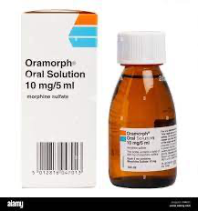
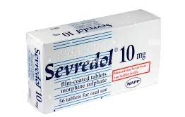
Morphine sulphate immediate release solution/tablets
The concept of “breakthrough pain”
Oramorph solution or sevredol tablets
Usually PRN – calculated to the nearest 1/6th to 1/10th of total morphine dose per day, given 2-4hourly
Notes:
Breakthrough pain is a flare of pain that might happen even though you are taking pain medication (modified release preparations). The pain “breaks through” the pain relief you get from the regular pain medicine. It usually cannot be predicted.

Slide 20
Breakthrough Pain Questions
Patient JC has been prescribed morphine sulphate oral solution 10mg 4 hourly and 5 as required. In the last 24 hours the patient has required 6 5mg PRN doses.
What would an appropriate MR release preparation prescription be?
Morphine Sulphate MR 45mg BD
Morphine Sulphate MR 30mg TDS
Morphine Sulphate MR 90mg BD
2) What would an appropriate dose of breakthrough immediate release morphine be?
a) 30mg 4-6 hourly PRN
b)15mg 4-6 hourly PRN
c) 15mg BD

Slide 21
Breakthrough Pain Answers
Patient JC has been prescribed morphine sulphate oral solution 10mg 4 hourly and 5mg as required. In the last 24 hours the patient has required 6 5mg PRN doses.
What would an appropriate MR release preparation prescription be?
Morphine Sulphate MR 45mg BD
Morphine Sulphate MR 30mg TDS
Morphine Sulphate MR 90mg BD
2) What would an appropriate dose of breakthrough immediate release morphine be?
a) 30mg 4-6 hourly PRN
b)15mg 4-6 hourly PRN
c) 15mg BD
Notes:
Total dose = (10mg x 6 = 60mg) +( 6x5mg= 30mg) = 90mg daily. Divided into a BD MR preparation = 45mg BD
1/6 of 90mg = 15mg 4-6 hourly PRN

Slide 22
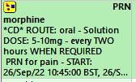
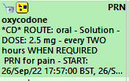
Example of PRN prescriptions on EPMA
Used for ‘breakthrough pain’

Slide 23

Increasing doses of opioids - NPSA alert
Particular care should be taken when checking the safety of increased doses of opioids.
E.g. for oral morphine / oxycodone in adult patients, doses should not normally be more than 50% higher than the previous dose.

Slide 24
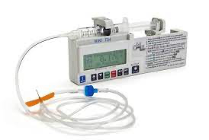
Syringe Drivers
A syringe driver pushes the plunger of a syringe forward at an accurately controlled rate
Rate is set according to volume of solution injected per hour (ml/hr)
For some: rate is according to the distance travelled by the plunger (mm/hr)
  Volume administered depends on the diameter of the syringe barrel + rate setting
  Essential brand is specified + stroke length measured with a ruler
Syringe driver is often used to administer drugs over 24 hours
Notes:
A syringe driver pushes the plunger of a syringe forward at an accurately controlled rate
For most syringe pumps the rate is set according to the volume of solution injected per hour (ie in ml per hour)
For some drivers the rate is set according to the distance travelled by the plunger in mm per hour (or mm per 24 hour)
If the rate is to be set in mm, the volume administered depends on the diameter of the syringe barrel as well as the rate setting. Different makes of syringe may have different barrel sizes. It is essential that the brand is specified and the stroke length is measured with a ruler (often syringe drivers travel 48mm in 24hours)
Syringe driver is often used to administer drugs over 24 hours

Slide 25
Morphine prescribing
Morphine PRN
  Prescribe separately (NEVER po/im/sc/iv) as doses are not equivalent.
oral | SC or IM injection | IV bolus injection (only in recovery)
20mg | 10mg | 2.5 to 5mg

Slide 26
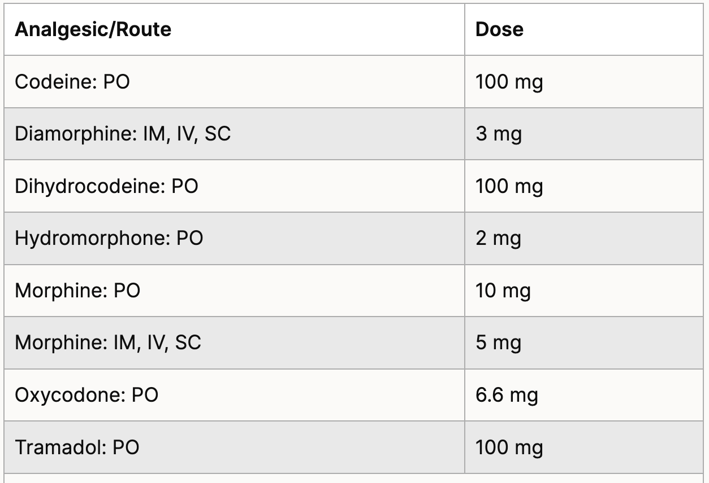
Opioid Conversion Chart
Found under ‘Prescribing in palliative care’ section of BNF

Slide 27

PLEASE ALSO REFER TO THE TRUSTS' CONVERSION TABLE
Guideline available from the Trust Intranet
Notes:
Separate PDF – table can be found within Bart’s Health ACUTE PAIN MANAGEMENT IN ADULT PATIENTS clinical guideline

Slide 28
Monitoring patients on opioids
Respiratory rate
Bowel function
Nausea and vomiting
Ensure fluid intake
Encourage mobility if possible
Prophylactic laxatives – senna /macrogol /docusate regularly
N&V – cyclizine 50mg 8 hourly

Slide 29
NPSA Alert: Naloxone
**The dose of naloxone varies depending on the clinical setting**
Key signs of opioid toxicity → respiratory depression, drowsiness and pinpoint pupils.
Immediate management of opioid toxicity:
→ stop opioid and reassess
→ relieve airway obstruction and administer oxygen
→ administer **naloxone at appropriate dose** and monitor
→ refer to acute pain team or palliative care team.
Rapid reversal of analgesia can lead to intense pain & distress, sympathetic nerve overstimulation and cytokine release.
Hypertension, pulmonary oedema, cardiac dysrhythmia and cardiac arrest may follow.
Notes:
What is naloxone, when would you need to use it ??
Alert was issued to offer support to minimise the risk of distress and death from inappropriate doses of naloxone (Oct 2015)
Highlighted the use of resources that had been developed to be used to inform best practice and minimise risk
Dosing:
Higher initial dose regimens are used in emergency situations IV or IM 400mcg initially
Lower initial dose regimens are used in the context of long-term opioid therapy including palliative care: slow IV injection IV naloxone 100-200mcg STAT

Slide 30
NPSA Alert: Naloxone
Lower doses of naloxone are used to avoid rapid reversal of opioid effects in the following patients:
→ palliative care
→ patients with chronic pain
→ substance misuse patients
However, ALL patients will likely need aggressive reversal of opioid induced respiratory depression regardless of previous opioid exposure in this emergency life-threatening situation.
Contact pain team or palliative care team for further advice & review of patient.
A Datix should be completed for patients who require naloxone as a result of opioid toxicity.
Refer to BNF/ Trust pain policy for dosing advice
Notes:
Higher initial dose regimens are used in emergency situations IV or IM 400mcg initially
Lower initial dose regimens are used in the context of long-term opioid therapy including palliative care: slow IV injection IV naloxone 100-200mcg STAT
Restrict use to severe resp depression RR < 8/ min

Slide 31
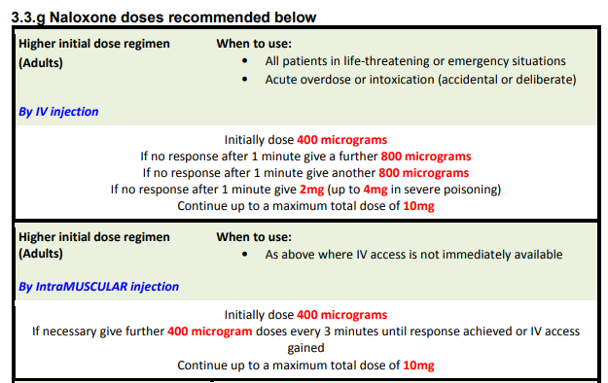
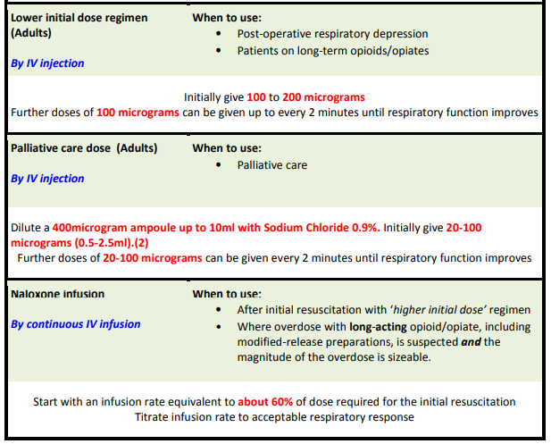
Notes:
Bart’s Health ACUTE PAIN MANAGEMENT IN ADULT PATIENTS clinical guideline - figure 3.3g

Slide 32
CASE STUDY
Notes:
Refer to case study answers – separate word document – for answers

Slide 33
Palliative Pain
Question 1
Mrs R. Brown of Flat 57C, Chisleworth Road, Whitechapel, DOB 23/05/1935 has pain from metastatic ovarian cancer, and has been receiving:
Oramorph® (Morphine Sulphate) solution 20 mg 4 hourly for analgesia and 20 mg as required
In the last 24 hours Mrs Brown has required four 20 mg prn doses
She is now being prepared for discharge. You have been asked to write her TTA (to take away) prescription and discharge note for the GP (14 days supply).
Convert her dose of Oramorph® solution to a 12 hourly modified release (MR) preparation of morphine, and prescribe breakthrough analgesia at an appropriate dose.
What information would you include in the prescription on a TTA for Morphine MR and Oramorph® solution?
What other prophylactic medications – and at what doses – should you co-prescribe for this patient?

Slide 34
Question 2
Unfortunately, Mrs Brown’s pain worsens on the day before discharge. She has also experienced some hallucinations and some symptoms of neuropathic pain (e.g. numbness, burning or shooting, ‘pins and needles’).
What change(s), if any, would you make to the current treatment?

Slide 35
SOURCES OF INFORMATION
Handbook of Controlled Drug accountable officers in England (1st edition) and is available on the UK Web Archive: www.webarchive.org.uk/wayback/archive/20140627111322/
http://www.npc.nhs.uk/controlled_drugs
The Controlled Drugs (Supervision of Management and Use Regulations 2013 NHS England Single Operating Model: www.england.nhs.uk/publications
A register of accountable officers in England is published on the Care Quality Commission website: www.cqc.org.uk
BNF (Prescribing in palliative care): Prescribing in palliative care | Medicines guidance | BNF | NICE
NPSA alerts: About the NPSA - NPSA

Slide 36
Any Questions?

