Slide 1
COM507 European Tragedy
Week 2: Tragedy in ancient Greece; Sophocles, Antigone
(The Burial at Thebes, tr. Seamus Heaney)

Slide 2
Plan for the session
Tragedy in context: Athens, 5th century BCE
Tragedy in performance
Plot and language in Greek tragedy
Key themes in Antigone
Key techniques in Antigone
The afterlife of Antigone

Slide 3
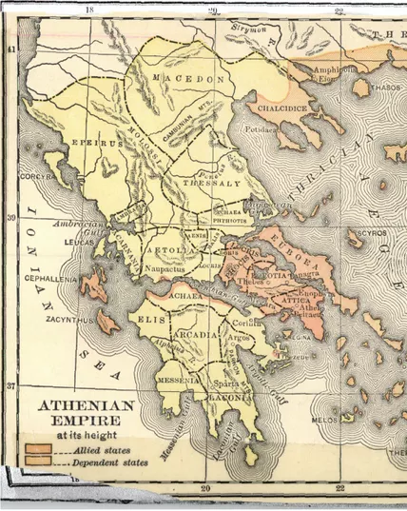
Athens, 5th century BCE
Antigone has been tentatively dated to 442 BCE
Sophocles was a public figure (politician / general) as well as a dramatist
Athens: a city-state (polis) within the region of Attica
  Attica’s population: c. 200-250,000, generally involved in agricultural labour
  Citizens of Athens: c. 30,000 adult males of appropriate ethnicity
  Athens frequently at war: c. 75% of the time in 5th-4th centuries BCE
  Most citizens were oarsmen in the Athenian navy
1899 map of a league of city-states led by Athens, c.450 BCE
Internet Archive Book Images/Wikimedia Commons

Slide 4
Athenian society
Athens was a democracy – an innovative kind of society
  Decisions made at an Assembly by citizens
  Very high proportion of citizens involved in running the polis
  Disenfranchized sectors of population: women (though they could have an important role in religion), slaves, resident aliens…
      ‘The Athenian democracy was a xenophobic, patriarchal, and imperialist community, economically dependent on slavery and imperial tribute’ (Hall, 1997, p. 93)
  Performance was central to Athenian culture: Assembly meetings, religious festivals, etc.

Slide 5
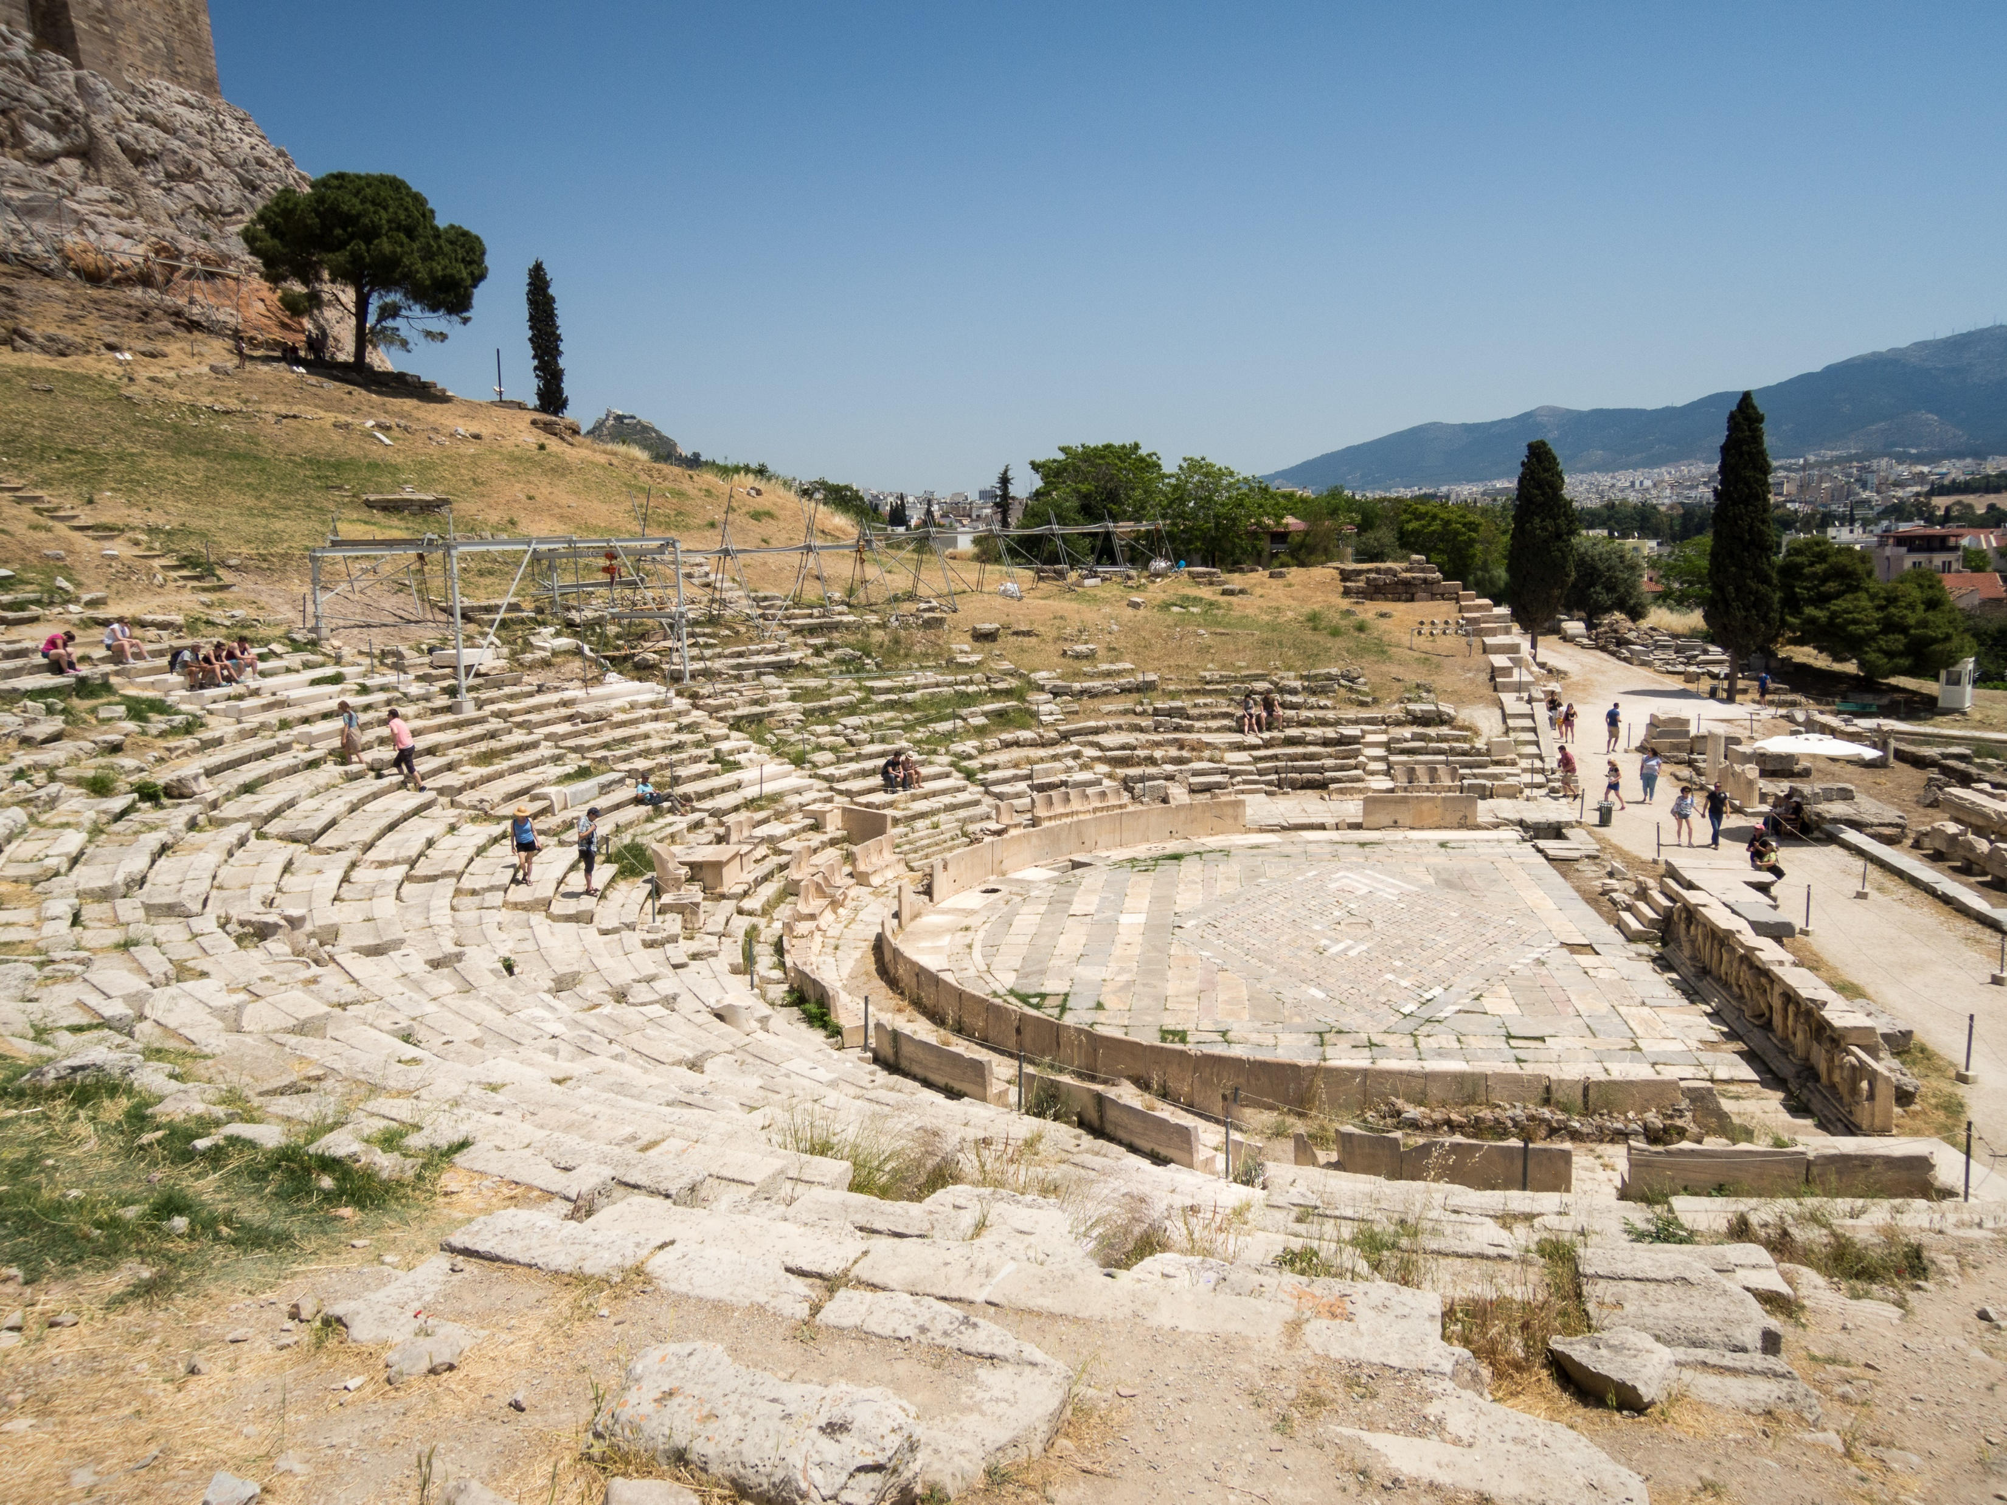
Performance in society: festivals
Religious festivals included two annual play festivals in honour of the god Dionysus
  These included ritual animal sacrifice (tragoidia originally meant ‘goat song’)
  Associated with wine, wild nature, ecstasy, dance, masks/disguise, mystic initiation
  In conjunction, these aspects seem to link Dionysus to mimetic performance
  Theatre capacity up to 25,000 in 4C BCE
Festivals had religious, and hence political, significance: both questioning and confirming social values
Tragedies were performed at these festivals: competitive element
View of the Theatre and Sanctuary of Dionysus from the west [on the southern slope of the Acropolis]
By dronepicr - Athen Akropolis, CC BY 2.0; Wikimedia Commons

Slide 6
Theatre audiences
Audiences overwhelmingly comprised citizens
  Foreigners and resident aliens attended; numbers unknown
  No reliable evidence for how many women and slaves attended
  Priestesses attended
Theatre was ‘a mass social phenomenon’ (Cartledge, 1997, p. 3):
  Some public funding of performances, from very rich citizens
  Financial support for attendance
  More people attended major festivals than Assembly: most estimates of theatre audiences range from c.14,000 to c.17,000
    c. half the citizens; ≈ Wimbledon Centre Court; up to 3 x Royal Albert Hall
  Tragedies seem to have been directed towards Dionysus; a form of worship

Slide 7
Tragedy in performance
5C festival performances:
  Open semicircular theatre; very little detail available
  Normally three tragedies, followed by a satyr play (tetralogy)
  Same chorus and actors involved in all four plays
  Actors also typically played multiple roles in a play
    Poetics credits Sophocles with introducing a third actor
    ‘Three actors’ didn’t include chorus or non-speaking roles
    Masks, covering performers’ whole heads, enabled switching of roles
  Chorus: 12 members for tragedy, then 15 from mid-5C
Modern performances very different…

Slide 8
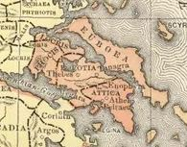
Tragedy and democracy
Tragedy helped teach a largely uneducated citizen body:
  How public meetings and debates work: characters try to persuade each other (agon: see glossary on QMplus)
  Analogies and allusions to contemporary political life
  Could challenge received wisdom as well as reinforcing it
  Made the community more self-aware
Tragedy gave a voice to characters who couldn’t speak in Athenian public life: women, slaves, non-Athenians
Most tragedies represent a range of ethnic groups: Antigone is a rare exception (everyone is from Thebes)
Thebes often used in tragedy as a negative counterpart to Athens:
  ‘Thebes in tragedy is often closed in on itself, and its royalty susceptible to internecine conflict, incest, and tyrannical conduct’ (Hall, 1997, p. 101)

Slide 9
Plot and language in Greek tragedy
Small number of classic plot and character types
Structural distinction: scenes v choral odes (stasima)
Stasima (sing. stasimon) sung by a group:
  Accompanying music and dance
  Varied verse forms, more so than in scenes
  Different regional dialect (Doric) from that used in scenes (Attic)
Flexible interplay between chorus and actors
Chorus witnesses events
  Often guides audience’s interpretation
  Can also be directly involved in action, though this is rare: e.g. Antigone
Key words in tragedy are often polysemous:
  Belong to different discourses (e.g. religious, legal, etc.)
  Scope for destructive misunderstandings

Slide 10
Key themes in Antigone
Element of social comment / critique:
    ‘two in principle compatible and indeed mutually supportive public norms – the unwritten laws of the gods and the man-made laws of the polis – are so construed by the principal antagonists that they inevitably clash head-on, with no serious possibility of harmonious and practical resolution as long as the terms of the argument are understood conventionally.’
    Paul Cartledge, ‘“Deep plays”: theatre as process in Greek civic life’, in The Cambridge Companion to Greek Tragedy, ed. by P. E. Easterling (Cambridge: Cambridge University Press, 1997), pp. 3-35 (p. 22)
Creon’s standpoint:
  Loyalty to polis takes precedence over personal/family loyalties
  Parallels and precedents in political rhetoric of the time
  Seems to slide into tyranny: ethos revealed by behaviour towards Guard etc
  Refusal to bury Polynices’ body: hamartia

Slide 11
Key themes in Antigone (ctd)
Antigone’s standpoint:
  Defends rights of family against those of city, and invokes divine ‘laws’
  Common tragic motif: disruptive effect of a woman without a husband or guardian (kurios)
  NB Antigone’s voice is the first one we hear; commonly regarded as ensuring the audience’s favour
  Not a sympathetic heroine, nor a straightforward victim
Social life v. inner needs? Or different sorts of social imperatives (polis v. family and gods)? Can we see both protagonists as ‘right’?

Slide 12
Key techniques in Antigone
Action was mainly invented: no extant precedents
Interplay of two classic plot types: sacrifice (Antigone) and retribution (Creon)
Common plot pattern of learning too late (Creon)
Conflict intensified by complicating factors:
  Antigone and Creon are related
  Haemon is Antigone’s betrothed and Creon’s son
  Ismene is Antigone’s sister and Creon’s niece
  Typical of tragedy: conflict is overdetermined

Slide 13
Key techniques in Antigone (ctd)
The identity and role of the chorus:
    ‘Sophocles’ choice of Theban elders for the chorus of Antigone, rather than companions or servants of the heroine, initially furthers her isolation but then permits a dramatically crucial shift in their understanding and sympathy.’
    Peter Burian, ‘Myth into muthos: the shaping of tragic plot’, in The Cambridge Companion to Greek Tragedy, ed. by P. E. Easterling (Cambridge: Cambridge University Press, 1997), pp. 178-208 (p. 198)
Play on audience expectations and ‘schemata’ (Scodel 2010)
  Pre-existing moral frameworks reveal their inadequacy

Slide 14
The afterlife of Antigone
Euripides’ version (fragmentary; datable to 420-406 BCE): Antigone survives to marry Haemon
Moral lessons and psychology in early modern France:
  Garnier (1580): dramatic confrontations predominate over plot coherence; conflict between religious and civil authority echoes Wars of Religion (Catholic-Protestant conflicts 1562-1598)
  Rotrou (1638): Creon of secondary importance; choice for Antigone between the claims of Polynices and Haemon
19th-century productions of Sophocles, in translation:
  1841 Potsdam (choral settings by Mendelssohn):
  Engaged with Hegel’s views on tragedy – cf. next week
  Also performed Paris (1844), London (1845)

Slide 15
The afterlife of Antigone (ctd)
20th-century versions/productions, and their political resonances:
  Jean Anouilh (1944), effectively rehabilitating Creon
  Bertolt Brecht (1948), aligning Creon with Hitler
  Andrzej Wajda (1984), aligning Antigone with the independent trade union Solidarity (Solidarność)
21st-century versions include:
  Seamus Heaney, The Burial at Thebes (2004): partly a response to the ‘war on terror’
  Anne Carson, Antigonick (2012): comic book version
  Hollie McNish (2021): retains Greek setting, and gestures towards original festival context, but changes aspects of plot and language (chorus aged 11-18; environmental allusions)
  Inua Ellams (2022): Antigone’s brothers are radicalized members of a multicultural London community

