Slide 1
Building your LinkedIn profile and Networking
Sera Singh, Careers Consultant

Slide 2
Purpose of this session
a) Give you some tips on building a professional brand and online presence on LinkedIn
b) Outline the career benefits of informational interviews and how to organise them
c) Provide a brief overview of some of the benefits of using social media for professional networking

Slide 3
What is professional branding?
“Professional branding is the process of creating a "mark" around your name or your career. This is achieved by having specific strengths and messages that people remember about you. It is how you express and communicate your skills, personality, and values—in person and online.”
Taken from ‘Building Your Professional Brand’ article

Slide 4
What is professional branding?
“It is about creating a consistent and credible image of yourself that showcases your skills, values, and personality. A strong professional brand can help you stand out from the crowd, attract new opportunities, and build trust with your clients, colleagues, and network”
Taken from ‘How do you build a professional brand?’ article

Slide 5
Building a Professional Brand and Network on LinkedIn

Slide 6
Benefits of LinkedIn
Make career
decisions
Network
Gain academic/
commercial
insights
Create
online brand
Research
career paths

Slide 7
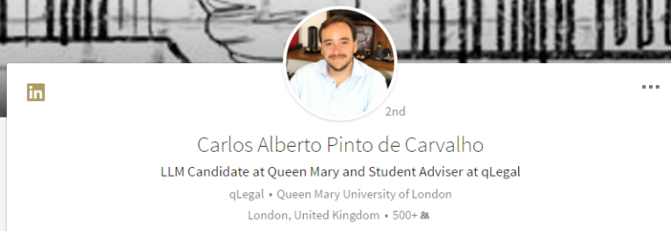
Add professional photo
First impressions – photo and headline
“Spanish qualified lawyer | LLM Candidate at Queen Mary University of London |
Seeking in-house roles in regulation and compliance”
What you currently do
Show your value
Use keywords
Include in headline
1
2
Notes:
Profile Summary
Similar to a CV but with some important differences.
Top 3rd is a profile summary designed to give any reader a quick idea of who you are, what you have accomplished and importantly what you are looking for – like personal statement. It is one of the most important sections in the profile
There are two parts
Headline
Summary
The pencil icons are the edit button. Whenever you see one it means you can edit. So
First element to a good profile is your photo and headline.
Photo – professional, head and shoulder – not glamour or with friends or a beach in the background. Plain background, get a friend to take a head and shoulder photo if you don’t have one.
Background picture – again pencil icon to edit. You can browse other people to get an idea. LinkedIn has a default background if you aren’t sure.
Then the first name and last name
Finally your headline. This is really important to spend time thinking about, as it is what defines whether you would come up in a search someone does (as it trawls headlines for keywords) and it’s what people see when they search, so it tells them who you are

Slide 9
3
First impressions - summary
Example of good LinkedIn summary
information about their studies
includes keywords
includes areas of specialism related to career interest
relevant work experience/project experience
future aims stated
Notes:
Here is an example of a summary that LinkedIn say is a good one.
- states where he is in studies
- states areas of specialism relevant to future career interest
- states relevant work experience
- states future aim
- includes a download of a CV
Have a go at writing your summary.
If you want to do a job totally unrelated to your degree, flag up other ways you have engaged with that career e.g. talks / magazines you subscribe to / blogs you read etc that inform you about that area. Also, if you don’t know what you want to do, then focus on the transferable skills that you have and how you have gained them.

Slide 10
https://www.linkedin.com/in/roykiruri/
4
Add work experience and education
(most recent first) and link to relevant skills

Slide 11
5
Include volunteer experiences & interests

Slide 12
6
Add skills and get endorsed for them
Include mix of technical and transferable

Slide 13
7
Get recommendations
Notes:
Highly desirable
Unsolicited, Requested, Reciprocated
LinkedIn has special functions for soliciting recommendations (under Recommendations on profile page)
The recommender needs to be a connection
It becomes clear when you write them for yourself so try to get your contact to write them and reciprocate.
Who can recommend you??

Slide 14
8
Join groups
indicates your interests on your profile
helps you gain more contacts
provides useful information

Slide 15
Grow your network – make connections
9
Always add a personalised note to let them know why you want to connect (and where you met if applicable) if you can
TIP: Do not contact the same person too often (x3 max)
Start at the profile to ensure you have the option to create a personal message.
Notes:
Ask to LinkedIn with every relevant
contact you meet
Send them a personal note!!
For graduates looking for jobs LinkedIn is important as a showcase but it also can be a place to network:
LinkedIn can automatically send connection requests to your contact list
You can search for people you know
Class mates and Alumni are a good source
Join Groups
Look for colleagues from previous employment
LinkedIn can be viewed as an address book too!
Can be game of six degrees of separation

Slide 16
LinkedIn messages
Hi Mr Turner, I'm looking for a job in your company. Any chance you could help me?
With over 3 years of experience in providing legal services, I've built countless valuable client relationships… I would be a valuable addition to your team
Hi Lisa, I came across your recent article on AI in Law. Your insights on effective use of AI for legal drafting were particularly interesting. I would love to connect and learn more about your work at Ashurst.
Your background caught my eye, so I figured I'd reach out to expand my network
Dear Ms Mitchell, It was great speaking to you at the Alumni Panel in CCLS last week. I’d love to connect and keep in touch
Hi Mr Khan, I noticed that you are a recruiter in London. I wanted to reach out to discuss potentially working together. I’m a law graduate with 5 years of experience in the legal sector and currently seeking new opportunities. I’d love to find out if I may be a fit for any of your current openings.

Slide 17
LinkedIn Dos and Don’ts
Mention commonalities and mutual connections
Don’t request endorsements too soon
Add an action point to follow up
Don’t be too vague
Be careful of using AI
Be considerate of people’s time

Slide 18
Follow companies/organisations
10
Chat with connections who work there
Look at different sections
Explore similar organisations people viewed
See how many of your connections affiliated with them in some way
Clifford Chance Trainee Tuesdays

Slide 19
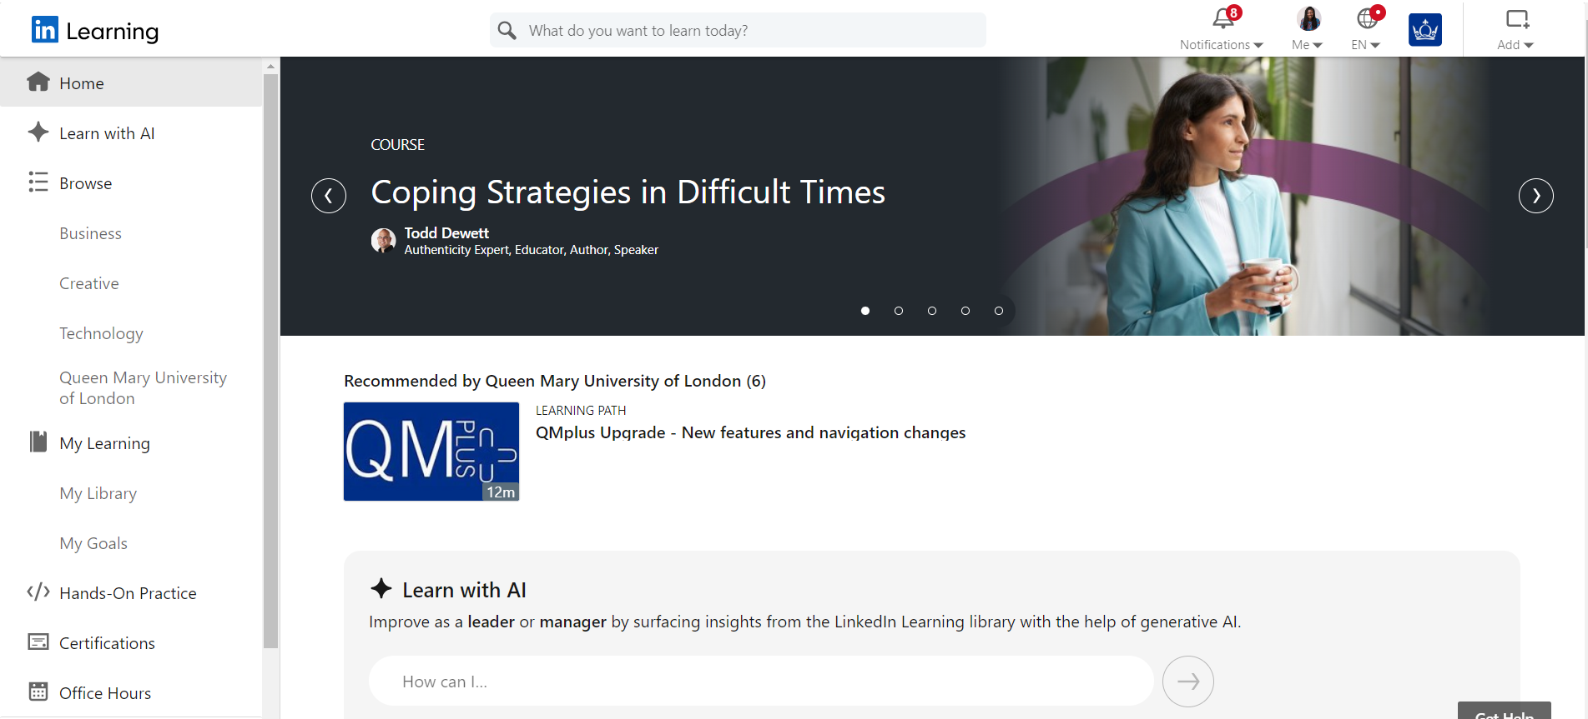
LinkedIn Learning - free whilst at QM

Slide 20
Connect with Queen Mary Alumni
Clifford Chance Trainee Tuesdays

Slide 21
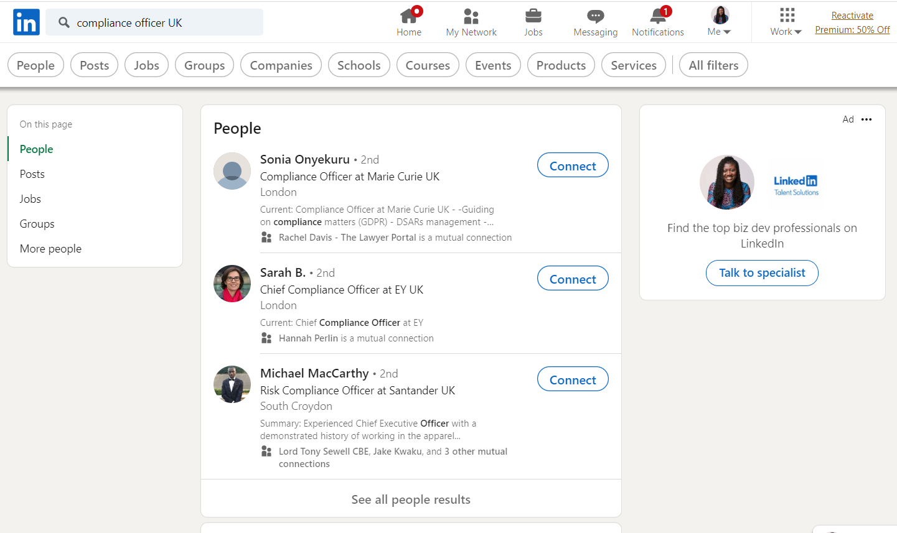
Explore other people’s career paths
Review profiles of people doing roles you are interested in (and companies they work for) to get ideas about career paths and keywords/language to use on your profile and in your searches
Clifford Chance Trainee Tuesdays

Slide 22
Show recruiters you are open to opportunities
Clifford Chance Trainee Tuesdays

Slide 23
The Queen Mary Alumni Network
Global community of almost 180,000 former students, in over 160 countries around the world
Lifelong link to the university
You can join as a current student
Provides access to alumni willing to provide a wide range of support, including e-mentoring and careers advice
A good way to practise your professional networking skills
https://www.qmul.network

