Slide 1
Funding Stages for Start-ups
Mohammed Al Rasheed

Slide 2
OVERVIEW OF SESSION
What is my business?
Stages of investment
Types of funding available
Pros and cons of equity and debt finance
Next steps

Slide 3
What is my business?
Product?
Sector?
Scalability and business model?
Profit margins?
Risks?
Goal?

Slide 4
Why do businesses need investment?
It can take a while before a business actually generates profit. Before this, they will need money to get off the ground and sustain growth.
Businesses may need to raise funds at various stages in their journey.

Slide 5
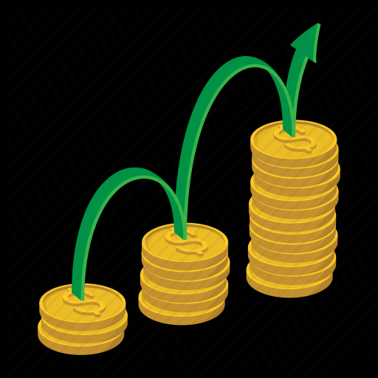
Investment Questions
Will the investment grow the current business or is it a safety net?
Ideal investment amount needed?
Ideal future investor involvement?
What level of control are you willing to give up?

Slide 6
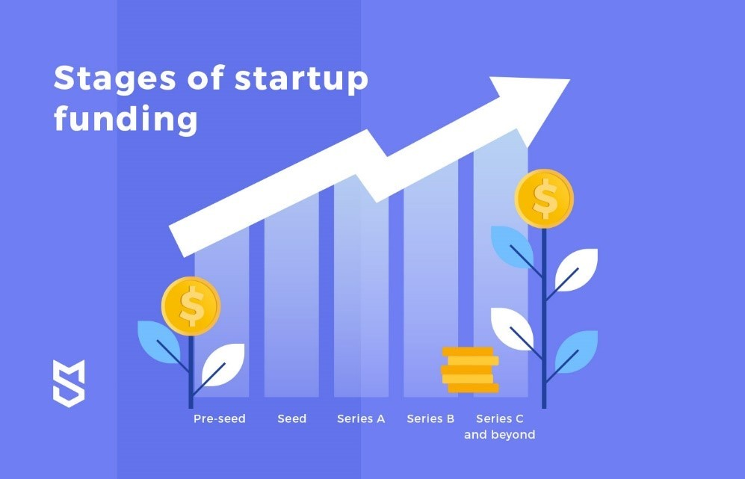
What are the stages of a Start-up?
Pre-Seed
Seed Funding
Series A
Series B
Series C
IPO (potentially)

Slide 7
Pre-Seed Stage
What is it?
Getting off the ground
Explore feasibility of the product
Testing the market
Developing marketing
Preparing sales pitches
‘Proof of concept round’
Funding:
Your own investment
Friends and family
Early supporters
Potential grants
Investment is not usually in exchange for an equity stake in business

Slide 8
Seed Funding
What is it?
First official stage of funding
Making the product market ready
Market research
Increase revenue stream
Expand and develop product and service
Launch the product
Funding
Angel investors
Friends and Family
Grants
Crowdfunding
Debt funding
Micro VC (potentially)

Slide 9
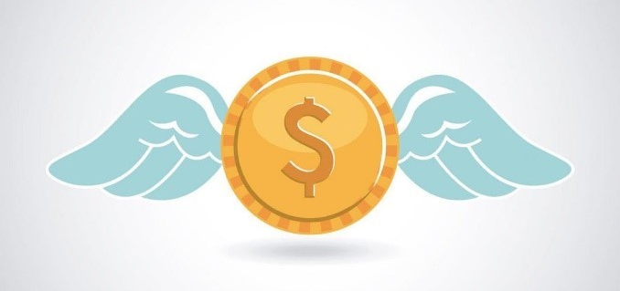
Angel investor
What are they?
Typically, a wealthy individual who provides funding for a startup, often in exchange for an ownership stake in the company.
Characteristics
Will normally invest their own funds
Investments bear a very high risk
The investment will not need to be repaid but the AI will have a say in how the business is run/receive portion of profits if business is sold

Slide 10
Series A
What is it?
Fully developed product
Working business model
Established user base
Further development/investment to increase returns
Scalable business
Funding
Accelerators
Incubators
Super angel investors
Venture capitalists

Slide 11
Incubators & Accelerators
Incubators
Earlier stage in development
Provide coaching and mentoring
Access to office space
Networking opportunities.
Examples include:
Seedcamp
Springboard
Wave
Accelerators
Companies at a later stage
Mentorship from experts
Usually highly selective
Some accelerators also invest in their cohort startups for equity
Examples include:
Y Combinator
Wayra
Techstars

Slide 12
Venture Capitalists
What are they?
A venture capitalist is a person/company that invests in a business venture, providing capital for a startup or expansion.
Examples include:
Accel
Ammadeus
Index
Eden
Differences to Angel Investors
Larger % holding
Larger investment
Usually a fund or firm, not an individual

Slide 13
Series B
What is it?
Potentially to scale up the business
Expansion in the market
Build up high quality teams
Funding
Late-stage venture capitalists
High net-worth individuals

Slide 14
Series C and Beyond
What is it?
Funding will develop new products
Enter new markets
Potentially acquire smaller businesses
Expansion in the market
Funding
Hedge Funds
PE Firms
Banks (mezzanine financing)
Late-stage venture capitalists

Slide 15
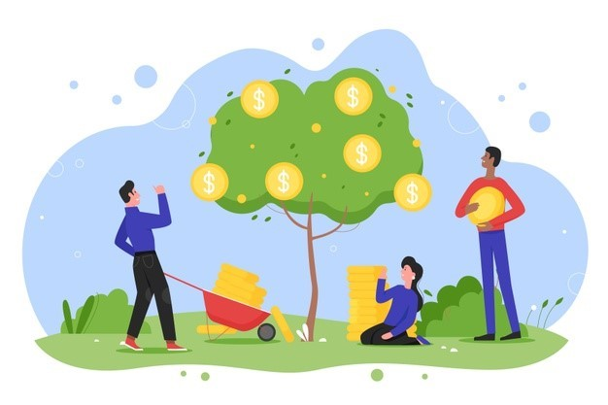
IPO (potentially)
What is it?
Expensive process and often driven by investors from Series C
Stable financials
Fully developed and sound products
Good corporate governance
Positive market sentiment
Funding
General public
IPO price underwritten by bank

Slide 16
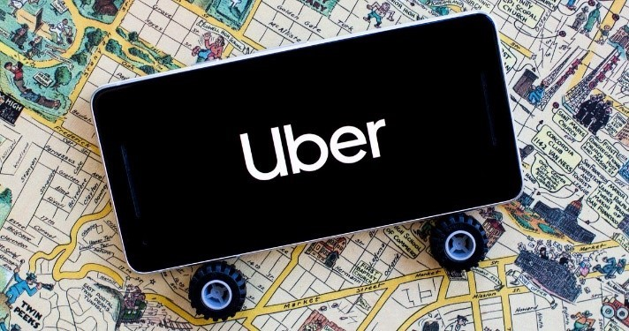
Example: Uber Investment Stages
Pre seed (2009) - $200,000 (by the founders)
Angel (2010) - $1.6 million
Series A (2011) - $11 million
Series B (2011) - $32 million
Series C (2013) - $258 million
IPO (2019) – $8.1 billion

Slide 17
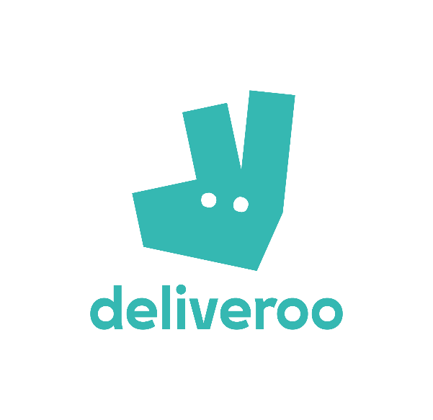
Example 2: Deliveroo’s IPO
Prior to the IPO in 2021, Deliveroo had raised $1.7 billion of funding in 13 rounds.
The latest funding was raised in August 2021 from a Post-IPO Equity round.
Deliveroo’s IPO offer price: £3.90 per share (around £7.6 billion valuation).
1 month post IPO: price had fallen to £2.28 (£4.4 billion valuation).

Slide 18
Example 3: Spotify’s Direct Listing
2018: Spotify opened at $165.90 a share ($29.5 billion valuation based on the 178,112,840 ordinary shares outstanding).
End of session: $149.01 a share ($26.5 billion valuation).
Why direct listing?
Provides liquidity to the company’s shareholders.
Offers equal access to all buyers and sellers and a transparent process.
A trading price determined by market-driven supply and demand forces.

Slide 19
Crowd Funding
Normally rewards based (i.e. public will receive a free product in exchange for £)
Movement into equity crowdfunding
Different online platforms
Kickstarter
IndyGoGo
CrowdCube
Seedrs

Slide 20
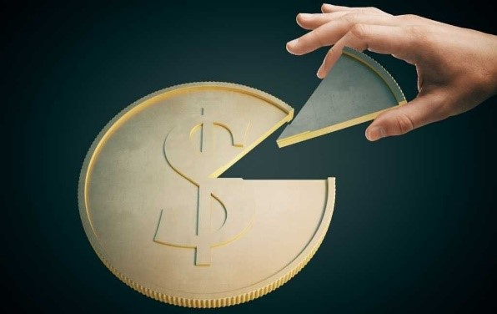
Equity or Debt?
Equity
As discussed, equity finance involves selling a stake in your business in return for an investment.
Debt
This is borrowed money that you pay back with interest within an agreed time frame.

Slide 21
Equity, Debt, Convertible Debt
 | Pros | Cons
Equity: Shares | No interest to pay Flexibility for different investors (ordinary, preferred shares etc.) | New owners of the company Personal income cut Lose control Dividends
Debt: Loans | Pay-off Still own the company Leverage Interest potential tax deductible | Interest Guarantees Covenants Withholding tax
Convertible Debt | Keep control for a period Poor credit rating more enticing Less restrictive covenants potentially | Interest in the beginning Eventually could lose control Cons discussed above

Slide 22
Next steps?
Think about your business
What stage are you in?
What type of investment would you need?
Investigate what grants, tax reliefs and funding options might be available to you

Slide 23
Any questions?

