Slide 1
CV and Cover Letters
October 2024
Dara Vexter- Career Consultant
Sera Singh- Career Consultant

Slide 2
Basic principles: nature and purpose of a CV
Which of these statements do you agree with?
A CV is a formally documented list of all my professional and educational skills and experience
A CV is a marketing document
A CV must follow a strict format
A CV is either good or it’s not
The purpose of a CV is more to inform than to persuade

Slide 3
Basic principles: nature and purpose of a CV
A succinct and clear summary
of your unique combination of knowledge, skills, experience and qualities to persuade that employer that
you are a good fit
for that role
with that employer

Slide 4
CV quiz
1.
What is the maximum acceptable length of a CV in the UK, for most purposes?
2 pages (sectors like finance may prefer 1 page CVs)
Is it best to use bullet points when describing your skills and experience?
Makes it easier to read but succinct summaries can be just as effective
Should a CV be written in first or third person?
Third person
What kind of verbs should be used when describing skills and experience?
Active
Should you include a photo in your CV?
Not for the UK, but common in many other countries
Should you include your age and nationality?
Not for UK, but may be required in other countries
Should you include a profile?
Not a requirement – if used - should be factual/substantiated, short and show your unique selling points (USP)
2.
3.
4.
5.
6.
7.

Slide 5
The structure of a CV
What you MUST include (the essentials):
Name and contact details
Educational qualifications
Professional qualifications
Details of professional experience and achievements

Slide 6
The structure of a CV
What you MAY CHOOSE to include:
Personal profile
Positions of responsibility
Volunteering
Additional skills and activities
References (available on request)

Slide 7
The structure of a CV
What NOT to include:
Photograph
Title ‘CV’ or ‘Curriculum Vitae’
Age/Date of Birth/Ethnicity
Marital status
Last salary
Reason for leaving your last job
Grids or tables

Slide 8
The form of a CV
What to avoid-
Jargon, abbreviations, colloquial language (unless you know the employer will understand it)
Narrative style - ‘I started my work experience in the IP department…’
Coloured paper/writing or crazy fonts
‘Fun’ email addresses
Things that aren’t true/exaggeration!

Slide 9
The form of a CV
Key information on page 1
Most relevant = more prominent
Logical structure with clear headings
Reverse chronology (most recent first)
Avoid repetition
White space helps things stand out (but not too much)
Consistent formatting
Easy to read and visually uncluttered
Triple check spelling and grammar!

Slide 10
The form of a CV – writing a profile
Like a film trailer
At the start of your CV
No more than 3 sentences
The main things you want that employer to remember about you
Further details can be incorporated in the body of the CV
Italian qualified lawyer currently undertaking an LLM in Commercial Law at Queen Mary University of London, with pro bono experience of advising tech start-up companies and entrepreneurs through Queen Mary Legal Advice Centre (qLegal).
Proven ability in customer relationship development and team-working in a high pressure environment within the retail and hospitality sectors. Fluent in French, Italian and Spanish.

Slide 11
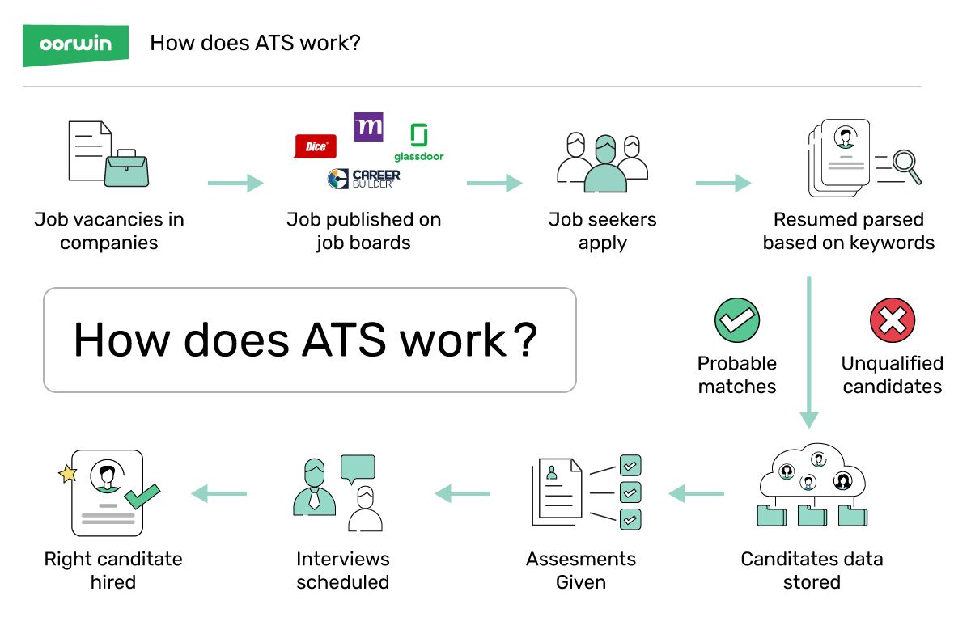
Applicant Tracking Systems (ATS)
Source: "Understanding ATS: What is ATS and How ATS Works" | Oorwin (2021)
Notes:
Resume parsing – This is the process of extracting data from resumes, such as contact information, work history, educational background, and skills.
Advanced search – This enables you to filter applications by specific keywords, job titles, skills, experience, education, and more.
Candidate sourcing – This allows you to actively search for, identify, and reach out to potential candidates for open positions.
Multi-channel candidate sourcing – This lets you search for potential candidates using multiple channels, including job boards, social media, and employee referrals.
In-built CRM software – Some ATS also feature CRM software to cover all your needs in one platform.
Email templates – Most ATS offer email templates to ensure that all your correspondence with candidates is consistent and professional.
Advanced analytics and reporting – This allows you to generate detailed reports on job seekers, hiring trends, and other data.
Various integrations – This means the ATS can connect with different types of software, such as email marketing software, accounting software, and CRM systems.
Ability to schedule interviews – By automating interviews, you won’t have to waste time rescheduling, sending out reminders, or coordinating multiple calendars.
Real-time collaboration -This allows people from different parts of the organization to get involved in the sourcing, screening, and decision-making regarding new hires.
Automation based on certain events and conditions – This means your ATS will only be triggered to do something if a specific scenario occurs.

Slide 12
Applicant Tracking Systems (ATS)
88%
98%
Employers agree that qualified candidates are vetted out of the process because they do not match the exact criteria established by the job description.
Fortune 500 Companies use an ATS. (66% of large companies and 35% of small organizations rely on recruitment software).
Source: "Hidden Workers: Untapped Talent" | Harvard Business Review (2021) & "What Is An ATS? 8 Things You Need to Know About Applicant Tracking Systems" | Jobscan (2018)
Notes:
Most use proxies (such as a college degree or possession of precisely described skills) for attributes such as skills, work ethic, and self-efficacy.
Most also use a failure to meet certain criteria (such as a gap in full-time employment) as a basis for excluding a candidate from consideration irrespective of their other qualifications.

Slide 13
Optimize Your CV for ATS
Use Word .doc or .docx
Use simple text formatting
avoid tables, charts, graphics, images, logos, columns, symbols
Spell out months – use JAN instead of 01
Spell out abbreviations – Microsoft instead of MS*
Use keywords – naturally

Slide 14
Drawing from experience
Think about your skills
Studies
Sports teams/societies
Legal work experience
Work shadowing
Seminar/conferences attended Volunteering
Local community work

Slide 15
Focus on what the employer wants from you
Scrutinise the job description and person specification
Underline the knowledge, skills, experience and qualities
that the employer is looking for
Identify those things which are essential and those that are merely desirable

Slide 16
Good and Bad CV Examples
​
School of Biological & Behavioural Sciences

Slide 17
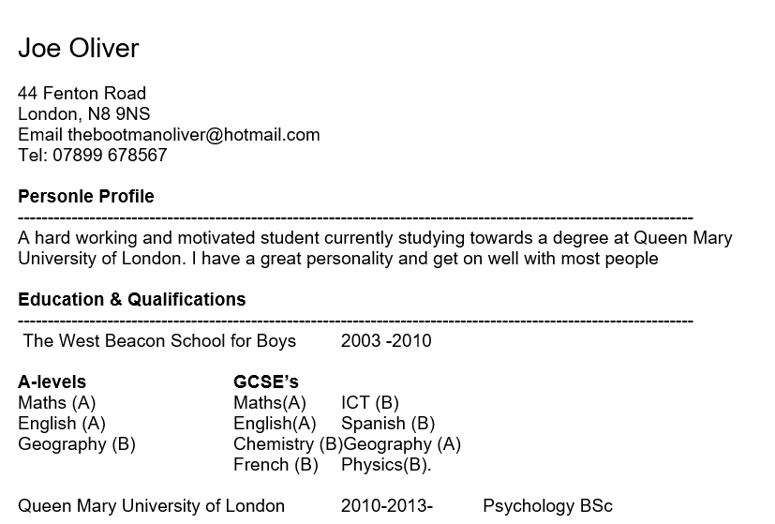
Professional (non-academic) CVs
Unprofessional email address
Spelling
Inconsistent formatting
​
School of Biological & Behavioural Sciences

Slide 18
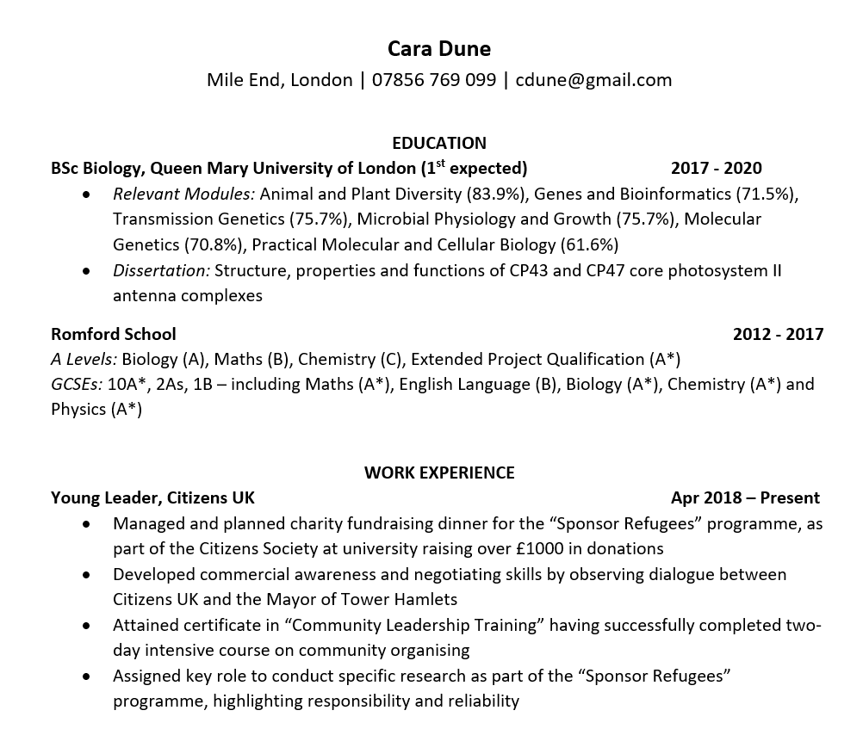
Professional (non-academic) CVs
Relevant Detail
Consistent Formatting
Well-organised information
​
Great readability
School of Biological & Behavioural Sciences

Slide 20
Let’s talk about cover letters…
Length, format and formalities
Structure
How much information to include
What information to include

Slide 21
Cover Letter | What is it?
Your name
Your full
Address
Email
Contact number
A companion to the CV.
Demonstrates passion and interest.
Shows informed decision to apply for the role and to the company.
It should be tailored to each role and company you apply to.
Employer’s
Address
Date
Dear Sir/Madam,
Re: Application for [title of role]
[TEXT]
Yours faithfully,
[Your Name]

Slide 22
Cover Letter | Why do we need one?
CV is a ‘what’ document:
What education
What experience
What skills
Cover letter is a ’why’ document:
Why the role?
Why the company?
Why you?

Slide 23
Cover Letter | What to include?
Intro
Why the role?
Why the company?
Why are you the right candidate (skills/experience)?
Why will this help your career?
Outro
TAILOR!

Slide 24
Making your cover letter work
Clear & succinct/quickly reach YOUR reason for writing the letter! Refer to yourself as “I”
Start by thinking of the employer’s perspective – what 3 criteria will they most value. Then provide your evidence.
Avoid too much outright/overt effusion (emotional sentiment/gush) towards target institution
Don’t be so modest that your qualities are in disguise!
Don’t be so immodest that on paper potential employers are left with sense of too good to be true!
Don’t assume you WILL be given the position! Don’t be impatient or overly assertive.
Keep it brief- 1 page

Slide 25
Cover letter tone – which is more appropriate?
I am writing to you, in the capacity of being an LLM student at Queen Mary, University of London. I have opted for modules that underpin my proposed research area of financial regulation and particularly the new “twin peak” regulatory levers that the government has introduced in light of the generally accepted failure of the FSA during the recession that started in 2008 .It is evident that your firm…
I am currently an LLM student at Queen Mary, University of London, specialising in the new regulation and supervisory bodies of the financial sector.

Slide 26
Pick One
I have, for many years, hugely admired Legal Services Co, and consider it the pinnacle of all of my lifetime’s ambitions to be considered as part of your globally-esteemed staff. It would be an honour to work for you.
I am attracted to Legal Services Co, not only as it is a renowned leader in corporate law, but also for its reputation for innovation. The firm’s investment in AI, flexible approach to pricing, and development of alternative career paths for staff, all suggest a forward-thinking mind-set. I am excited by the prospect of change in the way legal services are delivered, and so am keen to be a part of an organisation that demonstrates its commitment to improvement.

Slide 27
You can access help by:
Calling 0207 882 8533 or emailing careers@qmul.ac.uk to book a 1-1 appointment.
Login to your CareersHub on Target Connect
Booking your place on professional skills workshops and employer events via http://www.careers.qmul.ac.uk/events/
Notes:
Dara

