Slide 1
Centre for Commercial Law Studies
Entering the UK Job Market and Legal Training Pathways
September 2024
By Sera Singh and Dara Vexter
Notes:
AK

Slide 2

What we will cover
Nature of the roles available
Reality of what it really takes
Routes to qualification for legal practice in England & Wales
becoming a barrister
becoming a solicitor

Slide 3

Start with Research
Research the sector thoroughly
  law firms/chambers/in-house opportunities
  Chambersstudent.co.uk
  Lawcareers.net
  PG Law Careers Guide
  Legal Work Experience for Postgraduate Law
Look for other graduate opportunities
Prospects.ac.uk
Targetjobs.co.uk
Notes:
AK

Slide 4
Keep your eyes peeled
September-October
Research: think about career opportunities and know how to access the careers support and resources you need
Attend Law fairs and open days
Pupillage Fairs
Check out law fairs and open days on Prospects.ac.uk /Legal Cheek/allaboutlaw.com and on LPC/SQE providers websites
October-December
Perfect your CV and cover letter right, apply for vacation schemes and training contracts (solicitor) or mini-pupillages (barrister)
Notes:
DV

Slide 5
How to position yourself
Even if you are a qualified lawyer at home, if you have 4 years’ post-qualification experience, you may still have to start as a trainee
Understand the application process (how long it takes to write a good application) and relevant deadlines – for vacation schemes, training contracts, pupillages
Meet as many lawyers as you can – build your visibility, pick up insights, develop your network
Make yourself attractive to the law firm/chambers/organisations. If they like you, they will pay for the qualifications and you will get the training you need
Notes:
DV

Slide 6
Common mistakes previous students have made:
Underestimating how competitive the market is
Assuming their CV/cover letter and written application is good enough because it worked in their home jurisdiction
Leaving things too late and being unaware of/missing deadlines
Not having an alternative strategy in case applications fail
Doing insufficient research and preparation
Giving too much weight to academic ability alone
Notes:
AK

Slide 7

The skills you need
Drive, commitment and resilience
Ability to juggle job applications with academic work
Taking responsibility for your career – using available support but also your own initiative
Networking
Learning a new writing style for CVs , cover letters and online applications
Being creative, thinking laterally and keeping an open mind
A bit of luck!
Notes:
AK

Slide 8
Think outside the box
Paralegal roles
Risk/compliance roles
In-house roles
Other graduate schemes e.g. consultancy
Legal consulting/advisory roles
Work experience (paid and unpaid available) and voluntary work
Make the most of your Masters and your international experience
Ask yourself ‘what have I got that will help me stand out from the competition?
Notes:
DV

Slide 9

Qualifying as a lawyer in England and Wales
Notes:
DV

Slide 10
I want to be a lawyer
What type of lawyer
where
Type of organisation
Type of client
Practcie area
Notes:
DV

Slide 11
Practice as an English qualified lawyer
Solicitor -
2021 : 153,283 practising solicitors in England & Wales 9793 inhouse
Total 5,495 traineeships offered
256 inhouse
Barrister-
2021 : 153,283 practising solicitors in England & Wales 9793 inhouse
Total 5,495 traineeships offered
256 inhouse

Slide 12
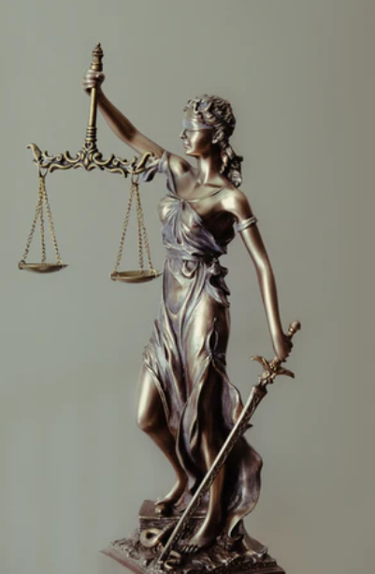
Barristers
Provide one-off advocacy or specialist technical advice
Primarily work in courts or tribunals
Are self- employed but grouped within a ‘set of Chambers’
A minority (c.20%) work at the ‘employed bar’
Notes:
AK

Slide 13
Qualifying as a barrister in England and Wales
Academic Stage
LLB Law degree or
PGDL
Vocational stage
Bar Training Course BTC
1 year
Professional stage
Pupillage
1 year
Practicing Barrister
Get tenancy
You start applying to chambers in the academic stage
Notes:
AK

Slide 14
How do I find out about the Bar Transfer Test?
Bar Standards Board website
https://www.barstandardsboard.org.uk/training-qualification/becoming-a-barrister/transferring-lawyers.html
Bar Transfer Test through BPP
https://www.bpp.com/courses/law/legal-training/btt-bar-transfer-test#downloads
Notes:
AK

Slide 15
2022 26,290 accepted onto undergraduate law courses (c. 9,300 overseas students)
2021 26,185 accepted onto undergraduate law courses (c. 5,800 overseas students)
2021/22 2,178 applicants to Bar training course
    541 pupillages
Many students take the costly bar training course without going on to qualify
https://www.barstandardsboard.org.uk/media-centre/research-and-statistics/statistics
https://www.barstandardsboard.org.uk/news-publications/research-and-statistics/statistics-about-the-bar.html/
Qualifying as a barrister – some figures (21/22 cohort)
Notes:
AK

Slide 16
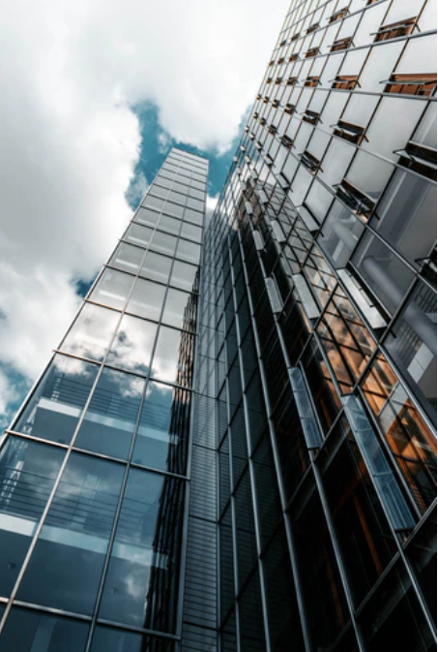
Solicitors
Provide legal services directly to the client
Majority work in private practice (i.e. in law firms)
Some work ‘in-house’ in legal departments
Notes:
AK

Slide 17

SQE – new route from 1 September 2021
Any degree
+ SQE - Solicitors Qualifying Examination
SQE 1 legal knowledge
SQE 2 legal skills
+ 2 years’ QWE qualifying work experience (up to four different organisations)
+ fitness to practise
Time of transition – some uncertainty and flexibility:
  City consortium (e.g. Linklaters, Herbert Smith Freehills) have designed bespoke SQE programme with BPP
  Kennedys: created an SQE programme called ‘Graduate Solicitor Apprenticeship’
Notes:
DV

Slide 18
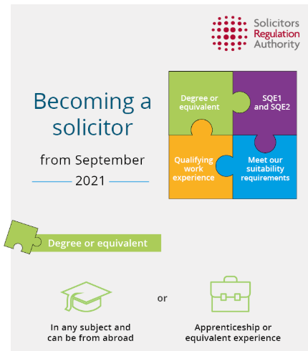
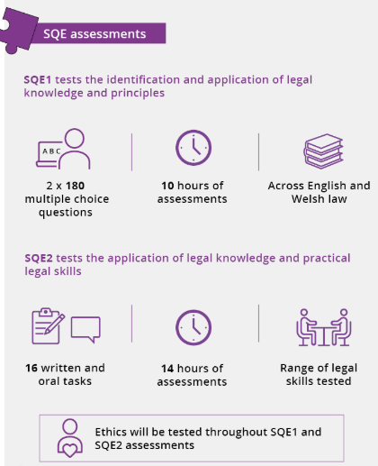
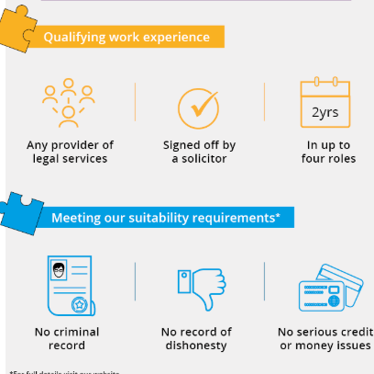
Notes:
DV

Slide 19
Qualifying as a solicitor – some figures (21/22 cohort)
2021 26,290 accepted onto undergraduate law courses (c. 9,300 overseas students)
2021 5,495 traineeships
Large firms recruit c.50% non-law degree trainees
https://www.lawsociety.org.uk/career-advice/becoming-a-solicitor/entry-trends
Annual statistics report 2021 | The Law Society
Notes:
DV

Slide 20

Overseas students and trainees
Overseas degree will usually count- for details see SRA website.
A non-UK qualification can be considered equivalent if it is:-
-Shown to be equivalent to either a UK degree or equivalent UK qualification through a UK NARIC (National Recognition Information Centre for the United Kingdom) Statement of Compatibility or
-An accredited qualification at level 6 (or above) of the European Qualifications Framework.
You can get Qualifying Work Experience overseas- needs to be signed off by a COLP (Compliance officer for legal practice) or other solicitor of England and Wales
SQE1 available to sit internationally, availability will evolve with demand
SQE2 written assessments available internationally
SQE oral assessments only available in England and Wales
Information on Solicitors Regulation Authority (SRA) website
https://www.sra.org.uk/students/sqe/
Notes:
DV

Slide 21
Should I qualify or go for a lateral hire role?
Training route
Definite recruitment cycle
Longer term career prospects
Takes 3-4 years+ to qualify
Lateral hire route
Luck – dependent on recruitment need
May not need to requalify
Firm may sponsor training
Notes:
AK

Slide 22
Other alternatives
In-house lawyers
Some companies may pay for you to qualify, e.g. BNP Paribas, Credit Suisse, Vodafone
To find in-house training contract opportunities, visit lawcareers.net and select ‘in-house’ in the ‘type of practice’ drop-down menu
For paralegal opportunities in-house, register with Flex Accutrainee
Financial Services, e.g., banks, insurance companies (regulation and compliance)
Other professional services, e.g. accountancy/consultancy (graduate training schemes)
Policy – IGOs and NGOs
Charities
Academia and education
Legal Tech
Project Management
Data and knowledge management
Notes:
DV

Slide 23
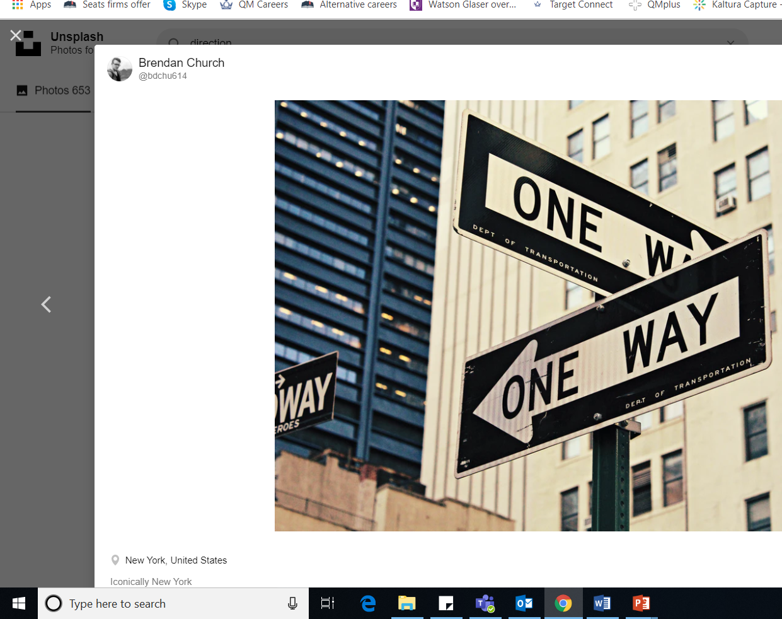
How to start narrowing down options
Read the PG Law Careers and Legal Work Experience for Postgraduate Law guides
Meet employers and connect with alumni
(events, law fairs, QM Network)
Apply for mentoring and internships
Think about what you ARE interested in and why (motivation)
Notes:
DV

Slide 24

Where can I research my career options?
Start with online resources
(register so opportunities come to you)
Legal websites
LawCareers
Chambers Student
Non-legal websites
Prospects
Targetjobs
Notes:
AK

Slide 25
1-1 appointment and practice interviews with Law Careers Consultants (or another Consultant or Student Employability Adviser)
book by logging onto the Careers Hub
Or by calling 020 7882 8533 or emailing careers@qmul.ac.uk
book onto PG Law Skills-Workshops and Employer events https://www.qmul.ac.uk/careers/events/
We’re Here To Help
Notes:
DV

Slide 26
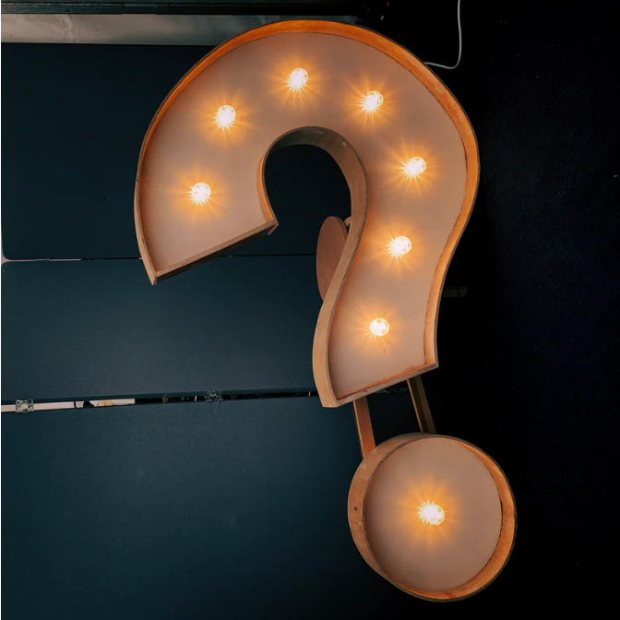
Q&A

