Slide 1
Your Options for Hiring Staff
2024 © qLegal
Notes:
“Welcome to this qLegal workshop. After this workshop, you will understand … qLegal is a free business law service that works with City law firms to provide legal advice letters, legal education workshops and videos and legal design consultancy work to innovative and creative start-ups, social enterprises and charities.”
NOTE: You need to put a title that fits your workshop and tells your audience what the workshop is about and pulls them in. We include the copyright notice on the opening slide to protect your work, to model how to insert a copyright notice and to make clear the workshop is accurate as of a certain date (as the law will change over time).

Slide 2
Disclaimer:
Please note that we are providing public legal education, not legal advice.
For free legal advice tailored to your business, please apply to qLegal’s Legal Advice Clinic.
Notes:
“Please note that this workshop provides legal education and is not legal advice. You should not rely on this video for legal advice. If you need free legal advice tailored to your business, please apply to qLegal’s free Legal Advice clinic.”

Slide 3
This workshop will cover:
1.
2.
3.
Notes:
“This workshop will cover xyz… “

Slide 4
Why is it so important to determine an individual’s employment status when hiring them within your organisation?
Notes:
This slide will tell the audience why the topic is important for their organisation. You will tailor the wording here to your workshop.

Slide 5
Coffee Clothes
To help teach you, we are going to use a fictional business called Coffee Clothes. The two co-founders of Coffee Clothes own the business 50-50 and operate the business as a partnership. The business uses an app to source used coffee grounds from local coffee shops and residents. The grounds are converted into yarn using a chemical process that has been kept secret by the co-founders. Coffee Clothes sells the yarn to fashion companies for use in clothes that are advertised as sustainable.
Notes:
This is an example of how you can create a fictional business to illustrate your legal points to the audience. You would want to use a fictional business that suits your audience and include enough facts to cover the points you want to cover. You’ll need to be careful not to put too many words on the slide.

Slide 6
Difference Between Employees and Freelancers
Notes:
After pulling your audience in with storytelling, you want to have a series of slides that teach the key take aways that you listed in your agenda. Note that this slide has minimal text and some visuals. This is good

Slide 7
Employees’ duties
Subject to company policies and rules
At a specific location and at mandated times
Obliged to accept any reasonable task requested by their employer and follow their employer’s directions
If told to do so by their employer, they must work exclusively for the company
Notes:
Here is an example of an appealing visual to accompany your words.

Slide 8
A few take aways
1. An employee works under the control of their employer
3. An employee must carry out the work personally
2. A “mutuality of obligation” between the employer to provide work and the employee to accept the work
4. An employee is integrated into the employer
What are the general criteria for an employment relationship ?
Notes:
It’s good to have some take away slides throughout the workshop to reinforce what you want the audience to learn. But this text is too small.

Slide 9
Key Take Aways
Choose or refuse the work offered to them
Decide when and where to work
Work for more than one client
Appoint a substitute
With high level autonomy, freelancers may:
Notes:
Again, nice use of visuals and not too much text. Here you would want to list 3 or 4 key take aways.

Slide 10
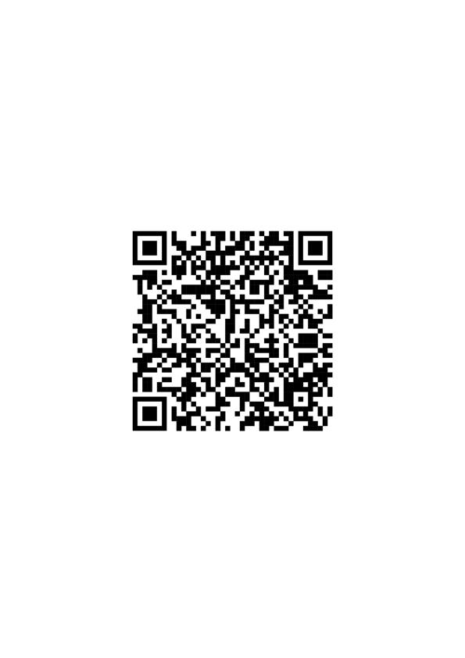
Contact qLegal.
qLegal free legal advice
qLegal Resource Hub
Notes:
“Thanking you for attending this qLegal workshop. For free legal advice tailored to your business, please apply to the qLegal Legal Advice clinic. For additional public legal education resources on this topic and other topics, please go to the qLegal Resource Hub.”

