Slide 1
Queen Mary Buddy Scheme 2024
Notes:
-Before we begin: Introduce self, set expectations time-wise - 5min break in middle
-I’ll give everyone 5 mins or so to join
-Feel free to turn mics/cameras on to ask questions or use the chat at any time throughout the session
-If at any point you cant see the slides or I loose connection please shout and let me know
-REGISTER – important to capture everyone who's attending, as attending the training is one of our compulsory requirements
-We are going to put up a video of a session on QM plus and the slides, as you are doing training now but not meeting your mentees until Sep, you might need a bit of a refresher before then.

Slide 2
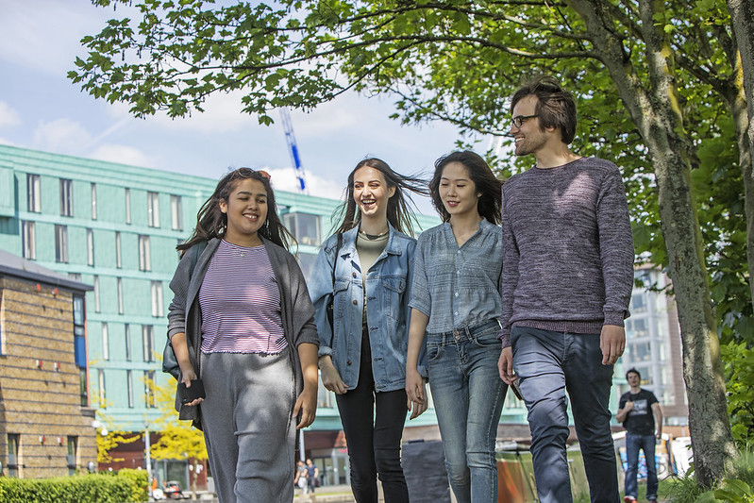
What is a Buddy Scheme Mentor?
Students in your School in their 2nd or 3rd Year at Queen Mary who want to support new students with:
Notes:
Finding their way around on Campus
Making the most of their Uni experience
Feeling settled
Making friends

Slide 3
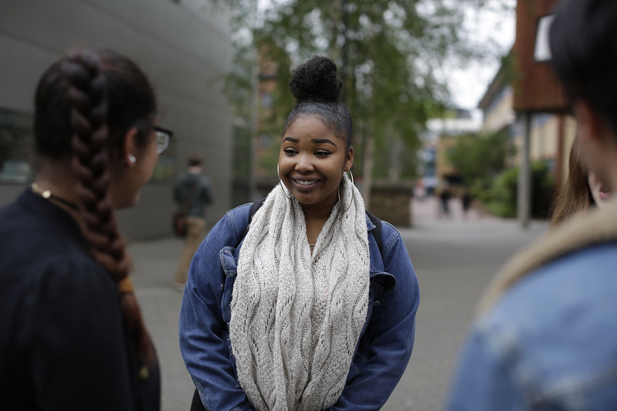
What can a Mentor help you with?
Having a friendly face on Campus
Meeting colleagues in small groups
Finding out about extracurricular activities
Finding out about Mile End and the local area
Making the most of your time

Slide 4
What is beyond the role of Buddy Scheme Mentor?
General academic advice only
Study Skills support is available through PASS sessions
Peer
Assisted
Study
Support

Slide 5
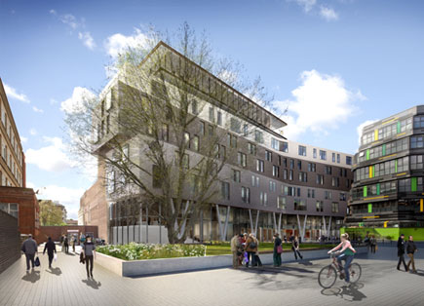
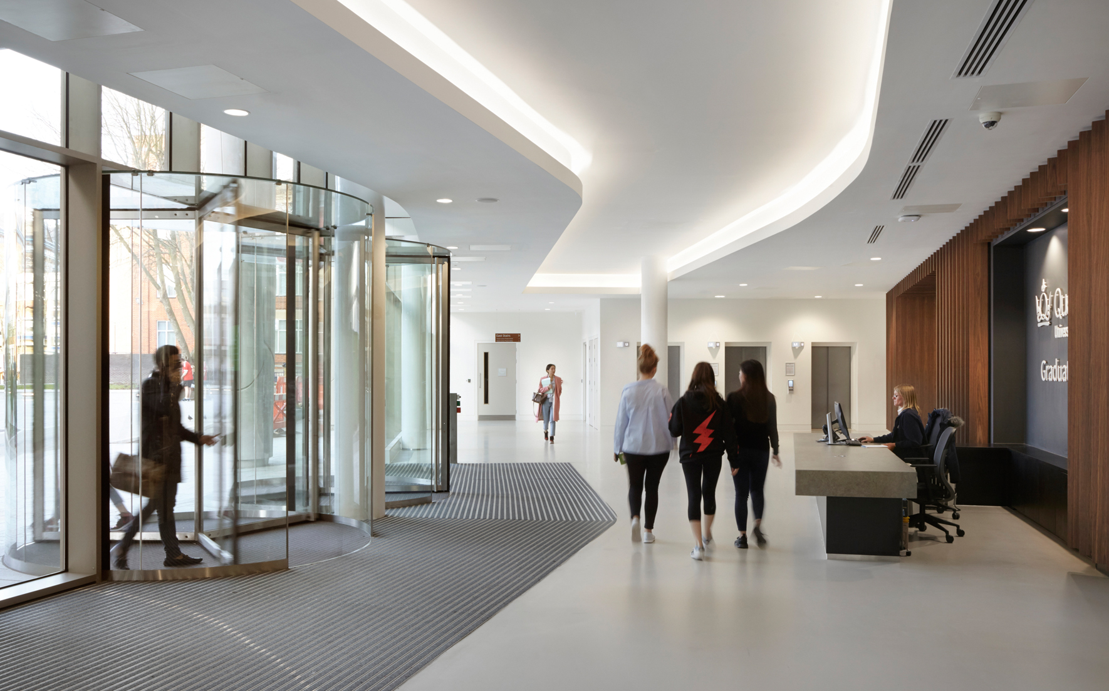
When will I meet my mentor?
Buddy Scheme Student transition: from 18th September – 13th October.
The Big Buddy Scheme Meet Up
2nd October and 10th October from 3pm to 5pm
Notes:
Around welcome week mentors will meet with new students and welcome them to Queen Mary. You will receive e-mail addresses for the new students you should maintain contact with.
Lasts for the academic year. Starts in week zero. We ask that you meet with them 4 times over the course of the year.
The scheme is events led, so this is about you arranging events to connect with your mentees and catch up with them. But I will cover this more later on, giving you some ideas about the types of events you can arrange both virtually and in person
Scheme is school specific, so you will be matched with mentees within the same school
You will be matched with new students joining us this Sep
Its about building a sense of community and belonging making sure our students have some support
There will be online resources available to you which are primarily on the Qmplus page
The Buddy scheme Team are always here to help you

Slide 6
When will I meet my mentor?
Look out for an email sent to your new university email address from Vygo: you will be matched with your mentors after signing up for vygo.
Then your mentor will arrange a time, date and place to meet up and meet each other.
Notes:
Around welcome week mentors will meet with new students and welcome them to Queen Mary. You will receive e-mail addresses for the new students you should maintain contact with.
Lasts for the academic year. Starts in week zero. We ask that you meet with them 4 times over the course of the year.
The scheme is events led, so this is about you arranging events to connect with your mentees and catch up with them. But I will cover this more later on, giving you some ideas about the types of events you can arrange both virtually and in person
Scheme is school specific, so you will be matched with mentees within the same school
You will be matched with new students joining us this Sep
Its about building a sense of community and belonging making sure our students have some support
There will be online resources available to you which are primarily on the Qmplus page
The Buddy scheme Team are always here to help you

Slide 7
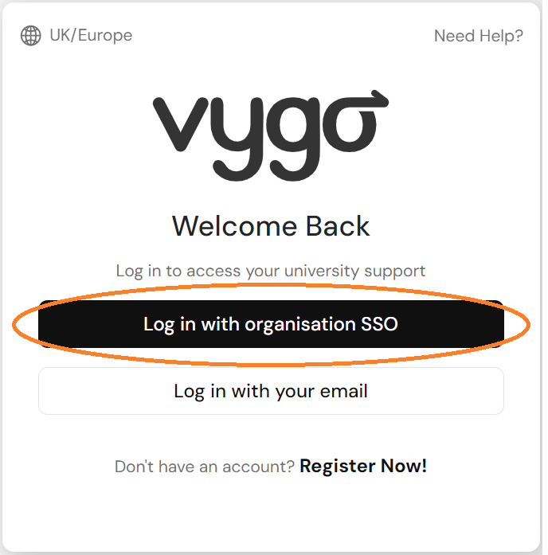
Creating your Vygo profile is simple!
Step
1
Sign in using your SSO login (university email address) via web address: https://web.vygo.app/login

Slide 8
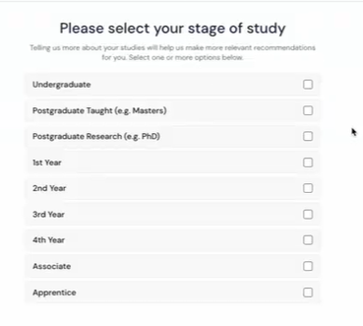
2. Complete onboarding questions
Step
2
Answering the onboarding questions will help match you to the most appropriate mentor.

Slide 9
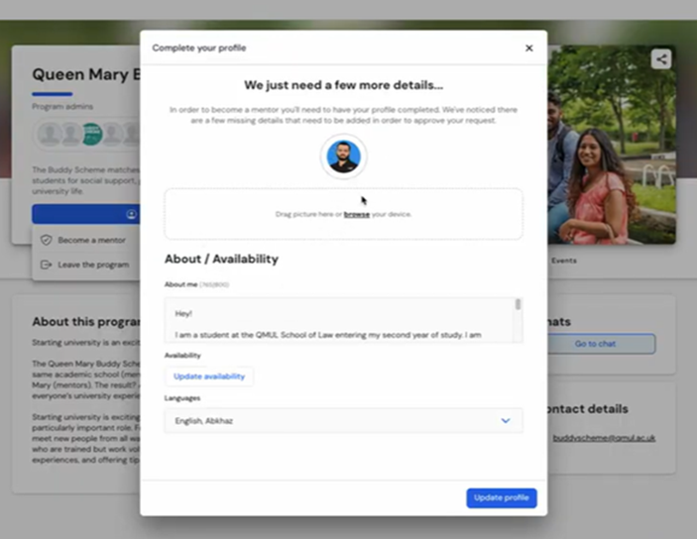
3. Complete your profile
Step 3
Et voila!!
Upload picture of yourself
Tell mentees a bit about yourself
What languages do you speak?

Slide 10
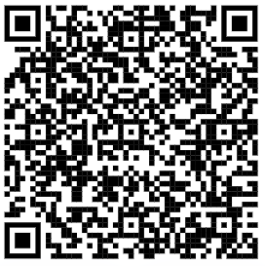
How do I sign up?
You can sign up on the Queen Mary MyQMUL webpages: http://my.qmul.ac.uk/buddyscheme/i-want-a-buddy/
OR
You can send me an email requesting to be matched with a buddy at: buddyscheme@qmul.ac.uk
Notes:
Your role as a good mentor is to have these skills:
These are the things that make a good mentor.
These are the things you all put on your applications which is why we have chosen you to be mentors

Slide 11
Any questions
Thank you!
Any Questions?

