Slide 1
“Autism” Induction Day.
Library Talk and Tour
11th. September 2024
Nick Holloway, Frontline Services, QM Library Services

Slide 2
Welcome!
Introduction: Today’s session
eg. finding the books you need
Please follow at https://www.qmul.ac.uk/library/

Slide 3
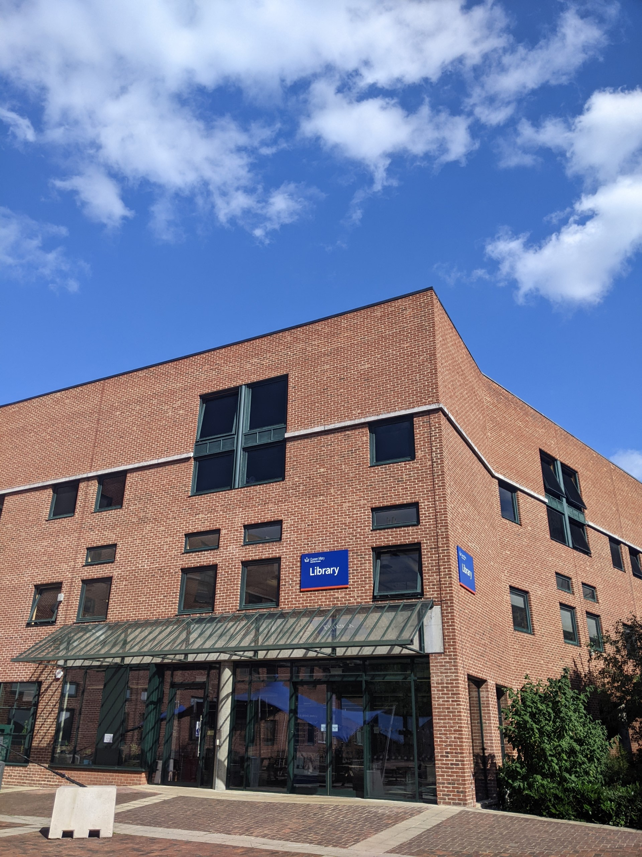

Slide 4
What are we?

Slide 5
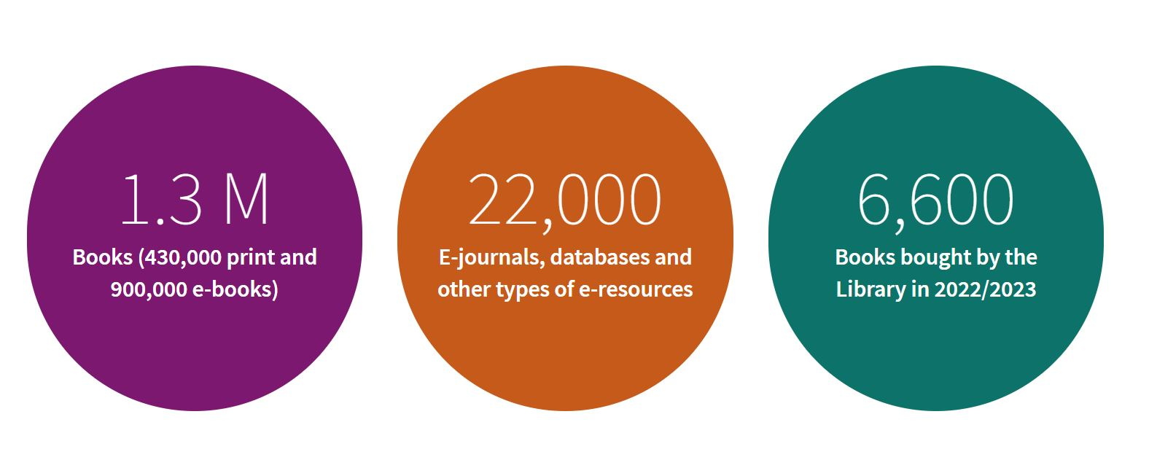
Our Collections
Three circles with collection size statistics
Notes:
We have invested over 16 million in recent years to develop the library and our services
We have 1.3million books, 22,000 e-journals and databases.
Our collection is split of 3 different libraries which everyone is entitled to use (Whitechapel, West Smithfield and here at Mile End) along with 3 additional study spaces (canalside, the hive and graduate centre)
Most of what we will go through does apply to every library but the presentation (images etc) are tailored to Mile End.

Slide 6
Opening Hours
Mile End
24/7 during term time (8am.-10pm. currently)
Whitechapel
8.00 am –midnight, Monday-Sunday
West Smithfield Library open Monday to Friday, 10am – 8pm, Closed Saturday and Sunday
Basement open 24/7 – access with QMUL ID card outside library opening hours

Slide 7
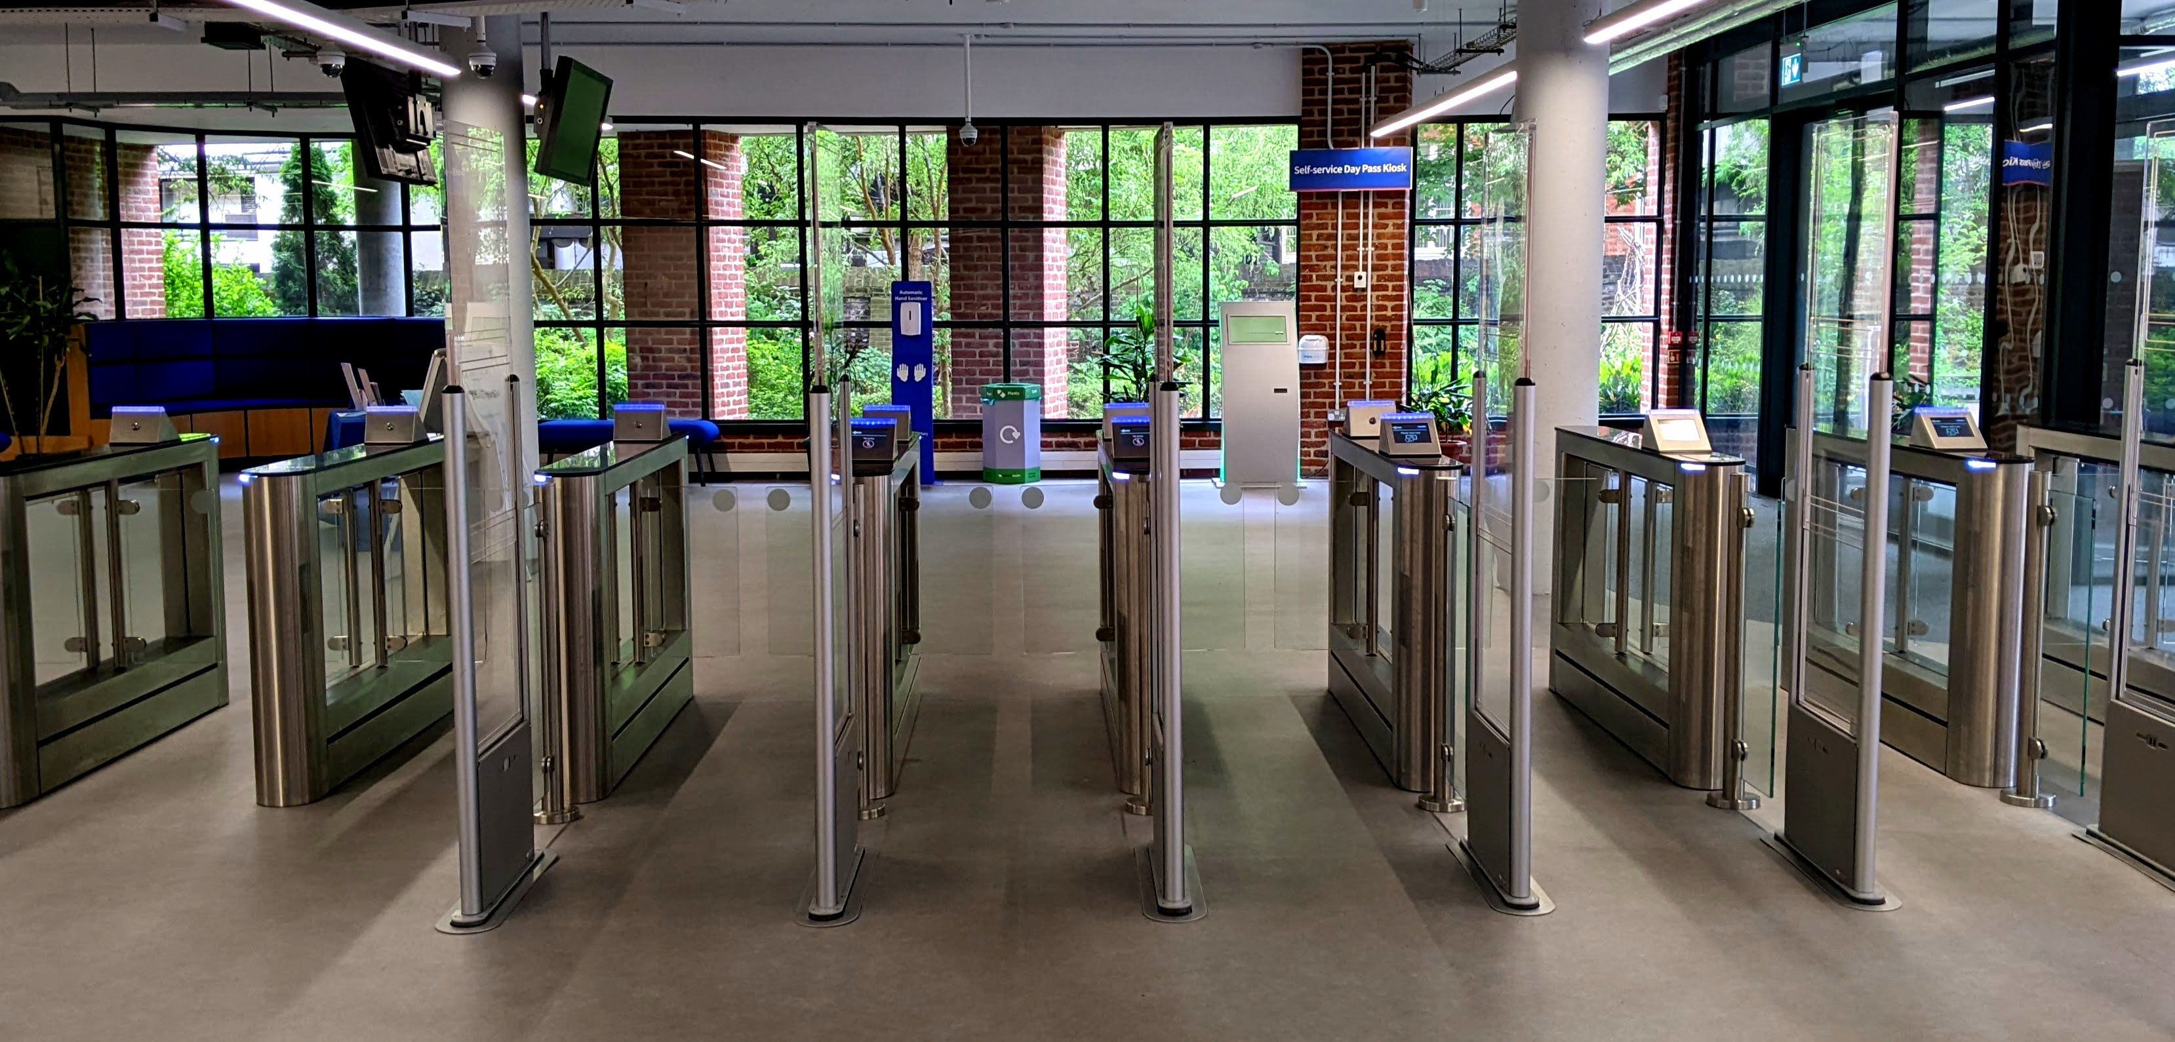
Don’t forget your ID card!
You will need your card to -
Enter & exit the library
Borrowing
  Books
  Laptops & Chargers
  Whiteboards
A gated entryway with a screen and a window

Slide 8
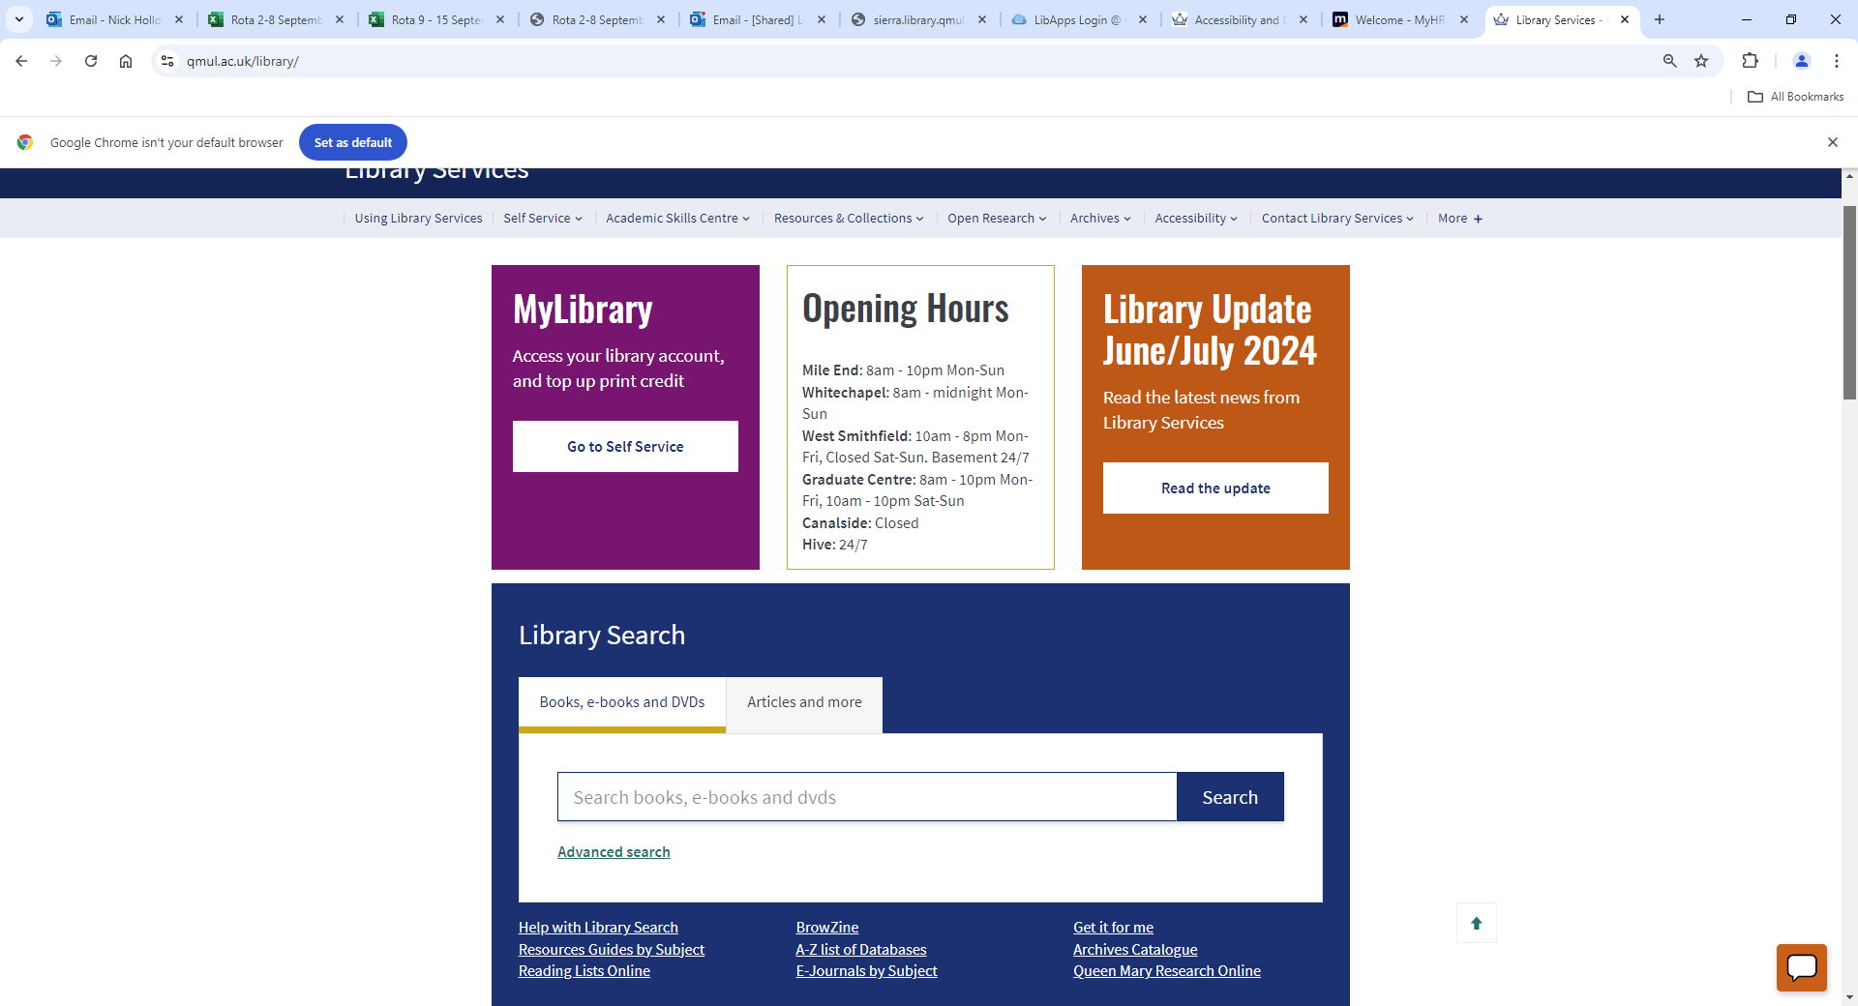
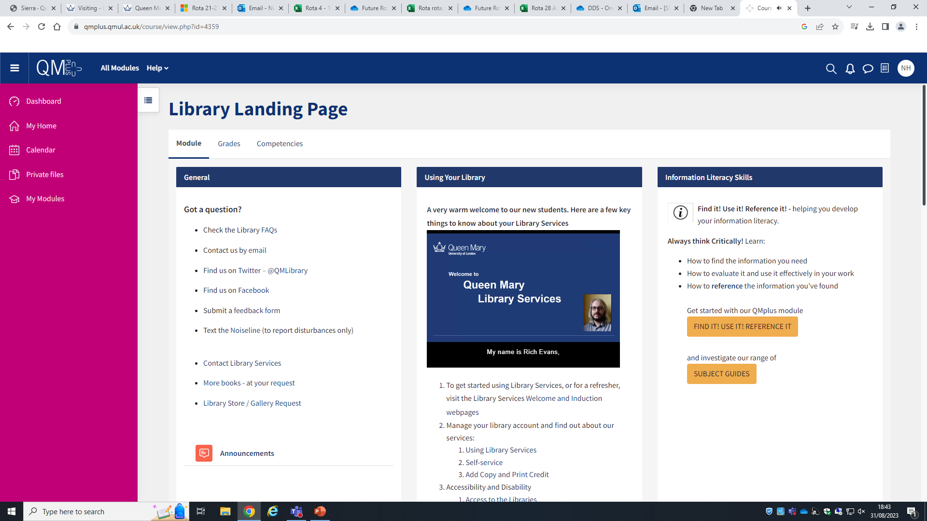
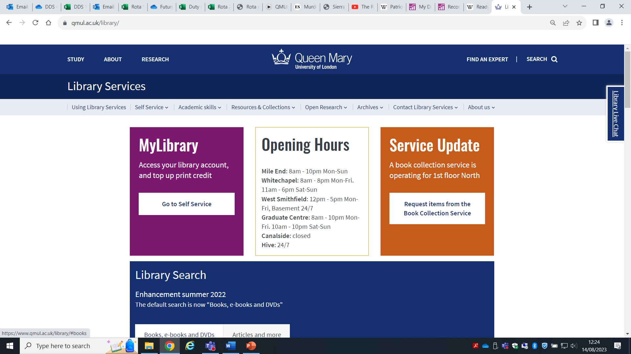
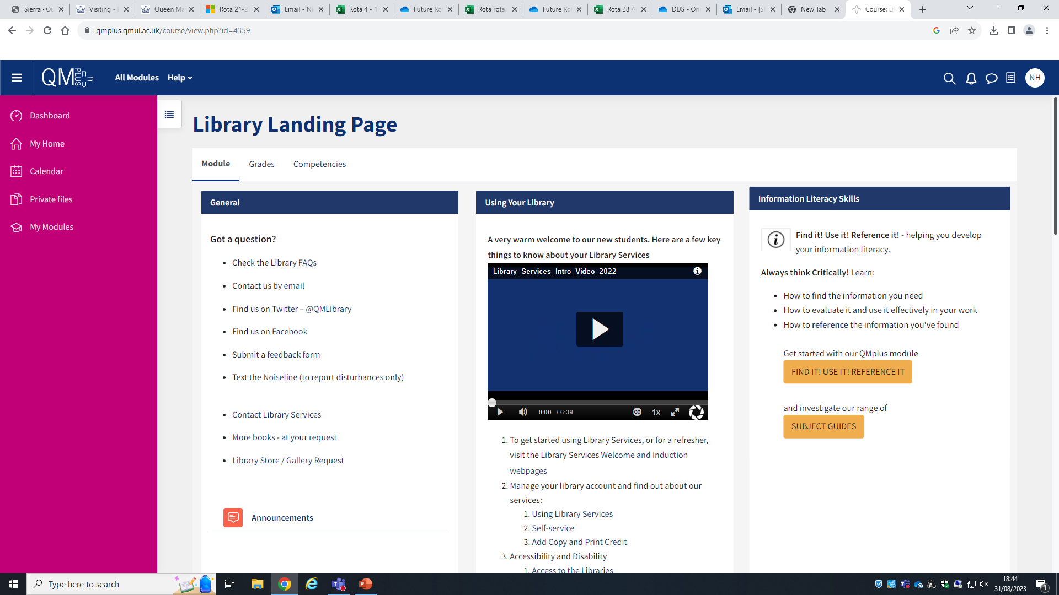
Get to know the Library online
The Library Landing Page on QMplus
The Library Website
www.library.qmul.ac.uk

Slide 9
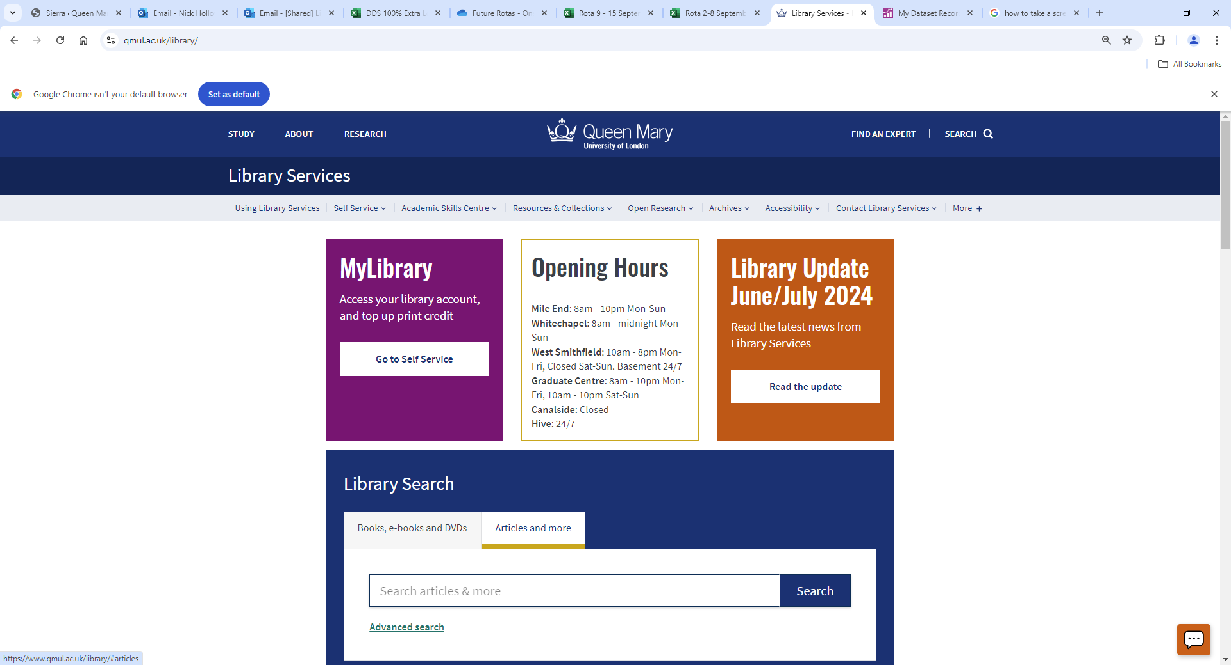

How to find the Library website
https://www.qmul.ac.uk/library/

Slide 10
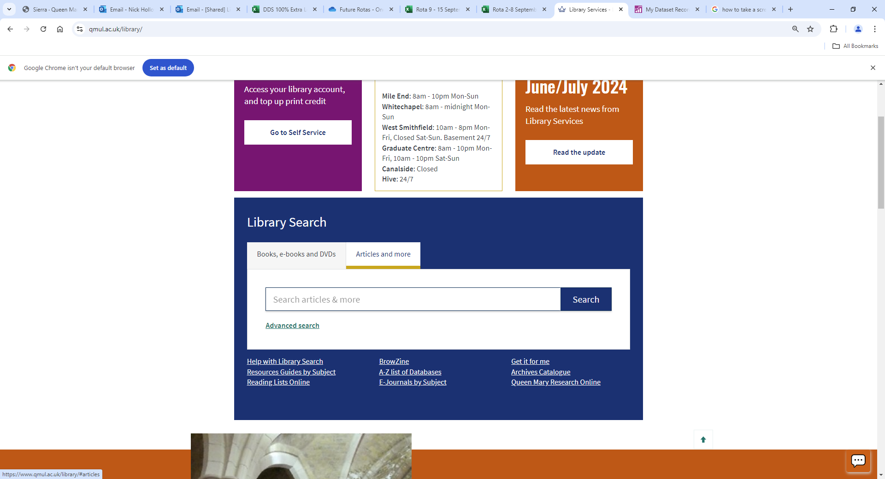
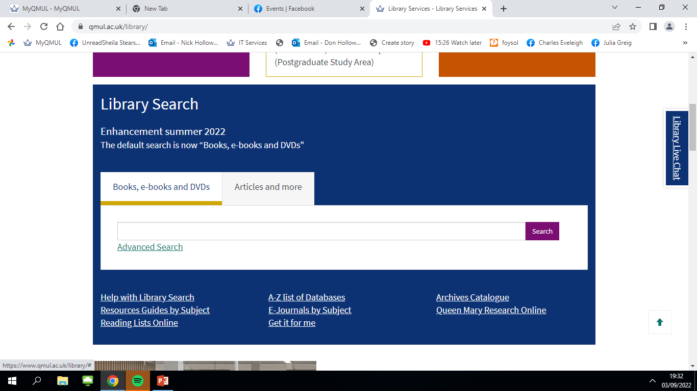
The Library website: where is the catalogue?

Slide 11
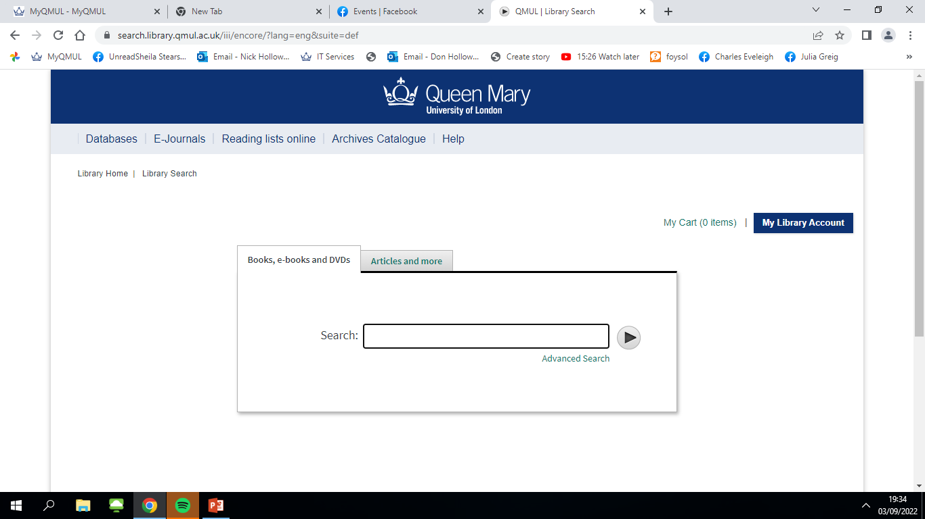
How to find electronic resources, (books and journals)

Slide 12
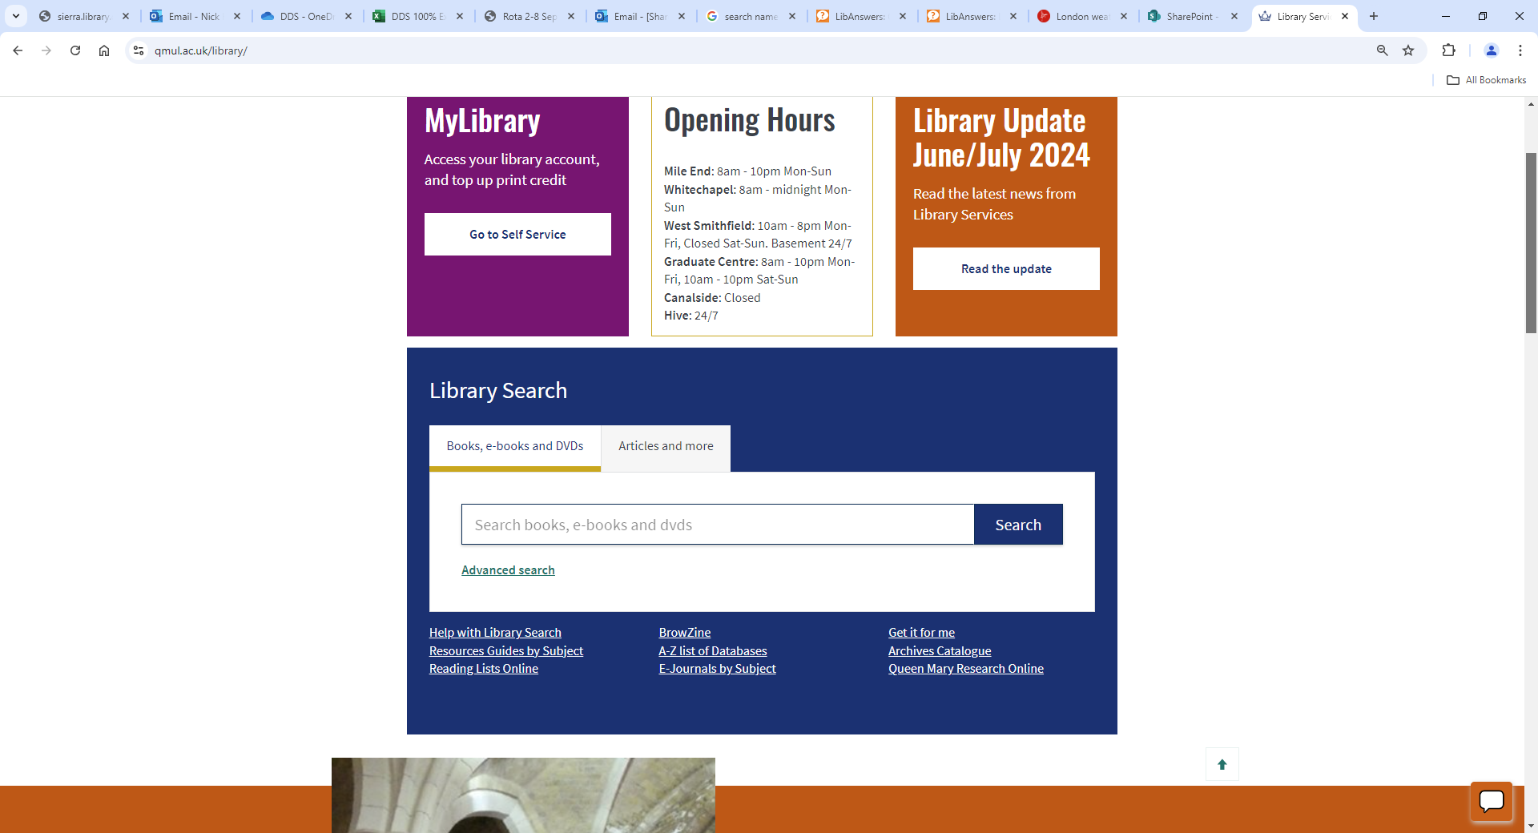
Add screenshot of home page
How to find the books you need

Slide 13
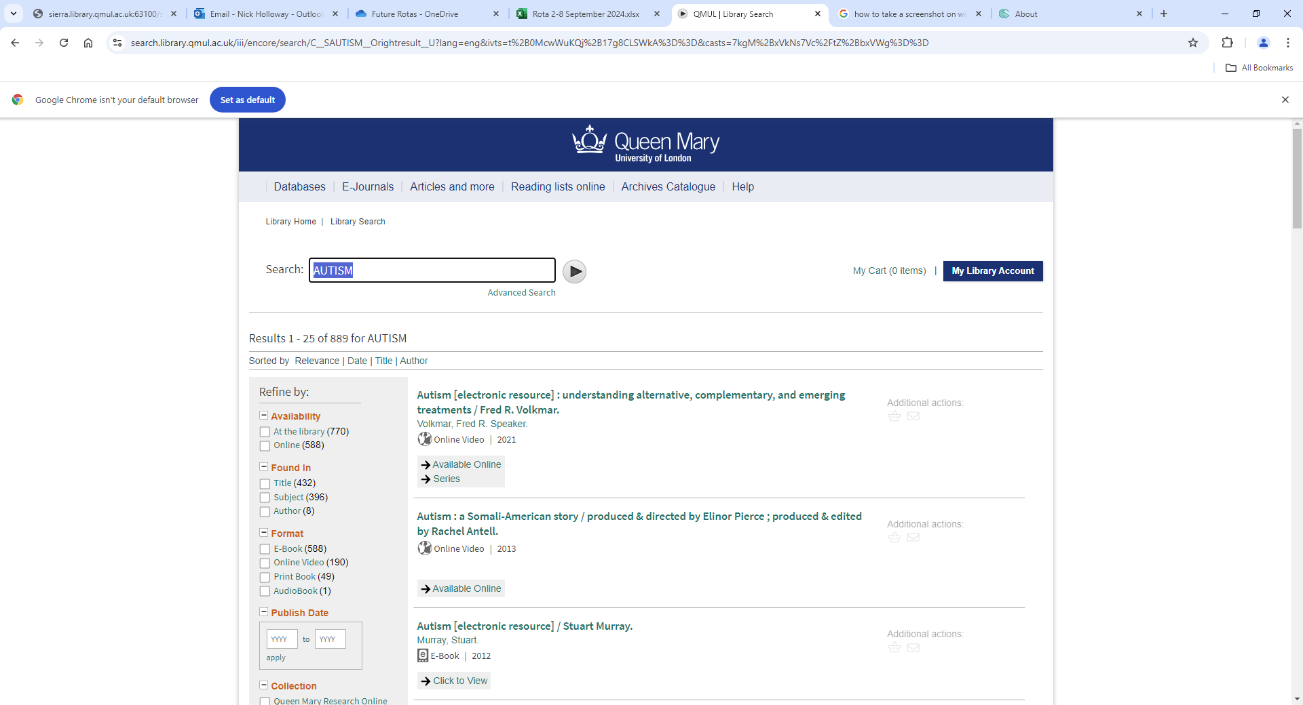
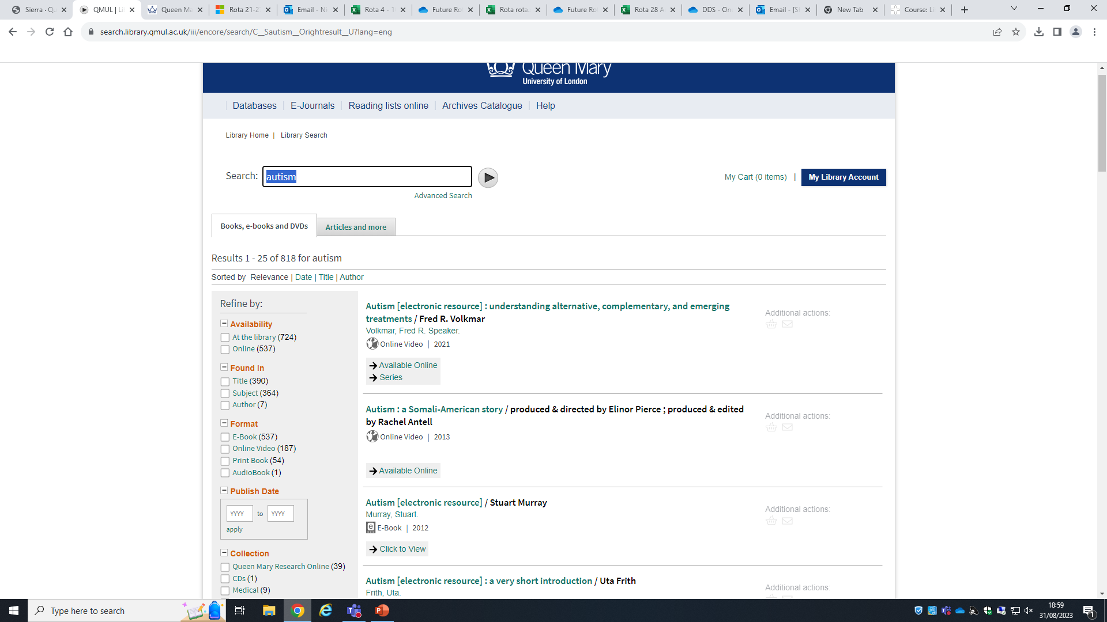

Slide 14
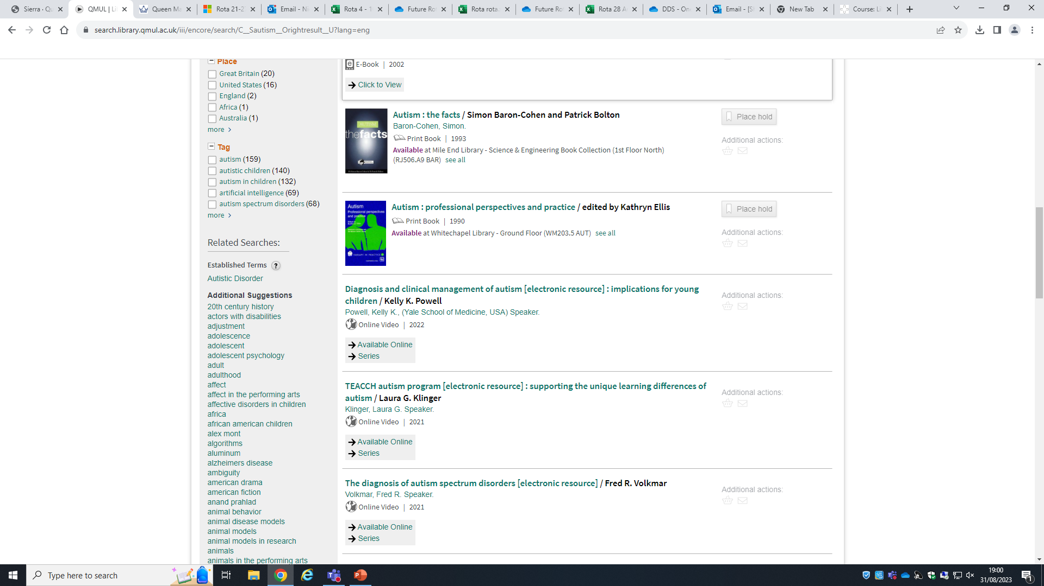
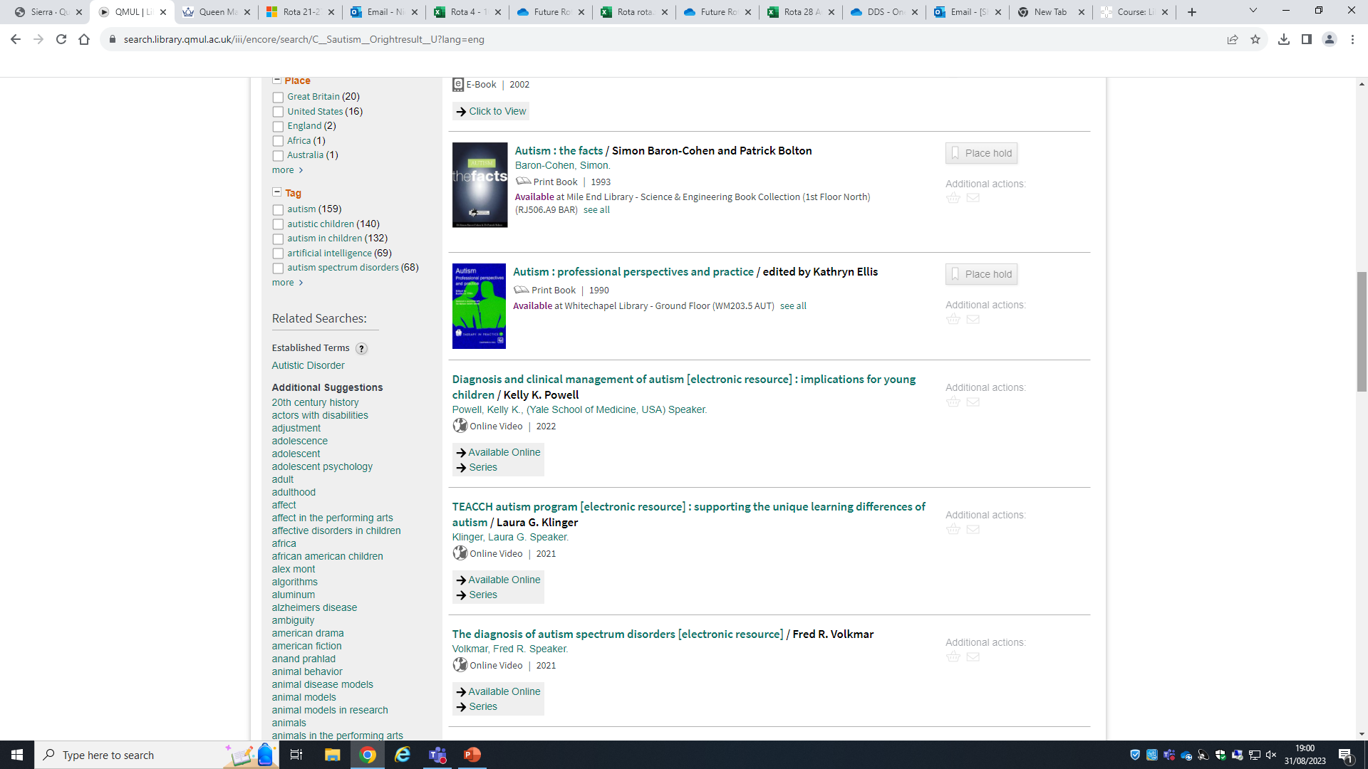

Slide 15
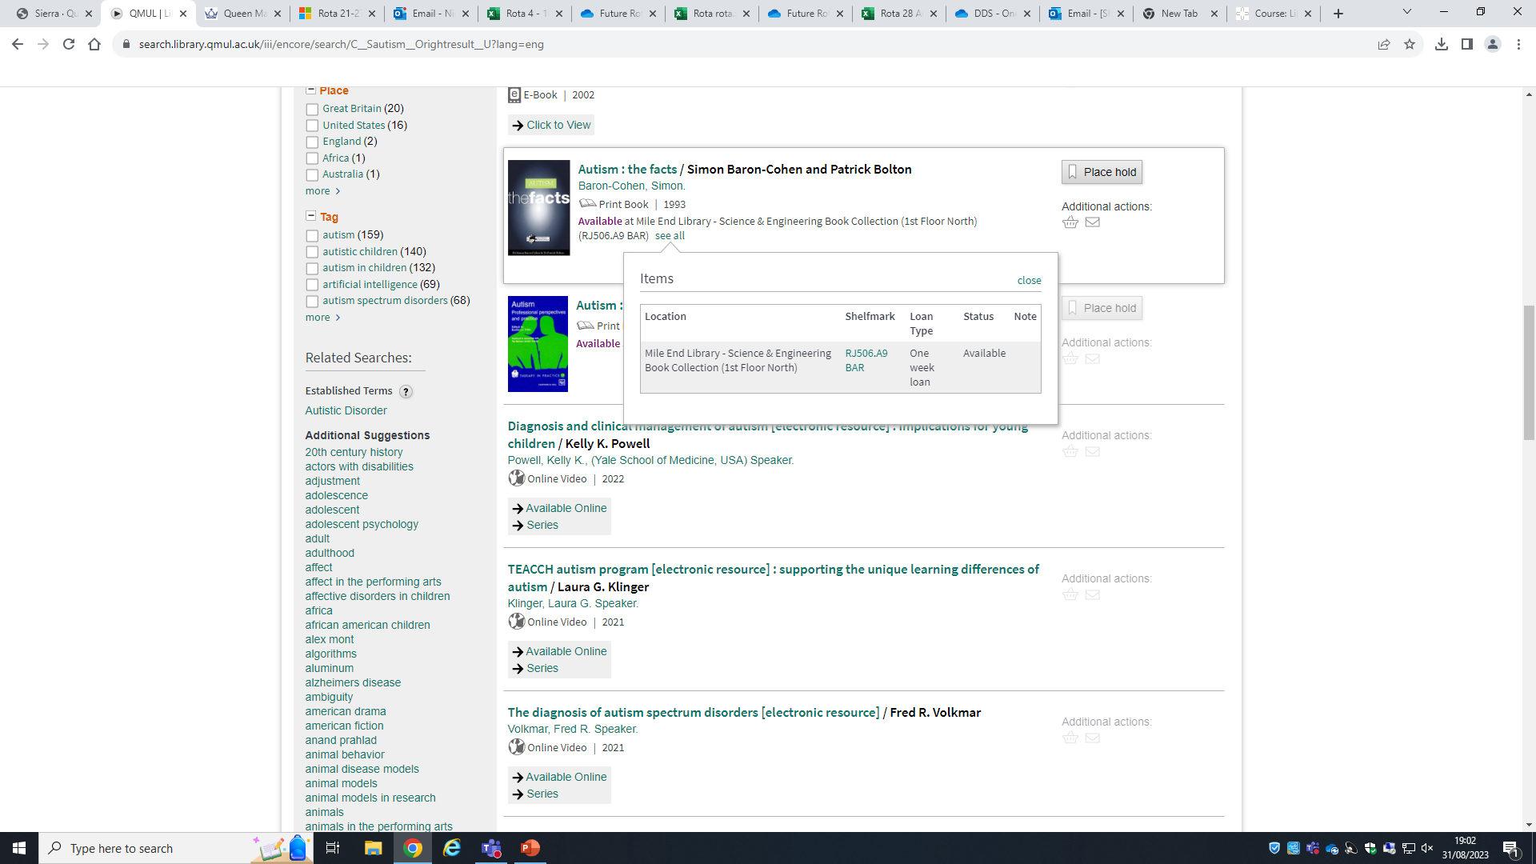


Slide 16
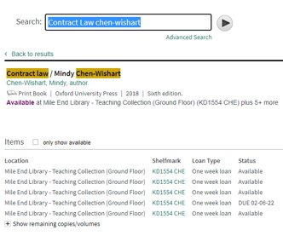
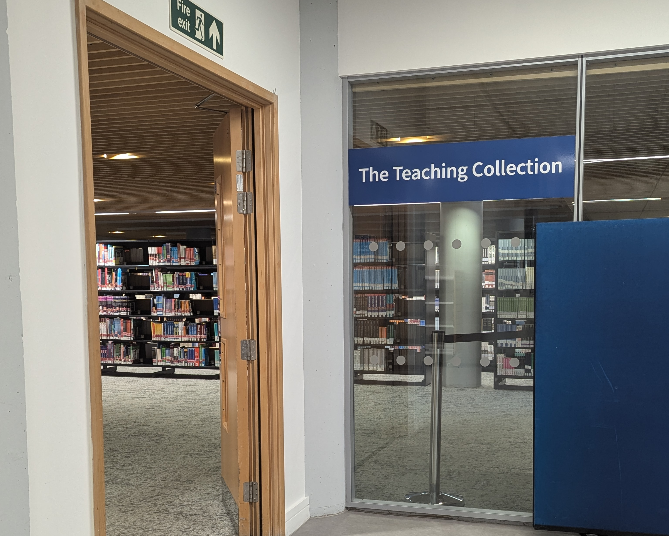
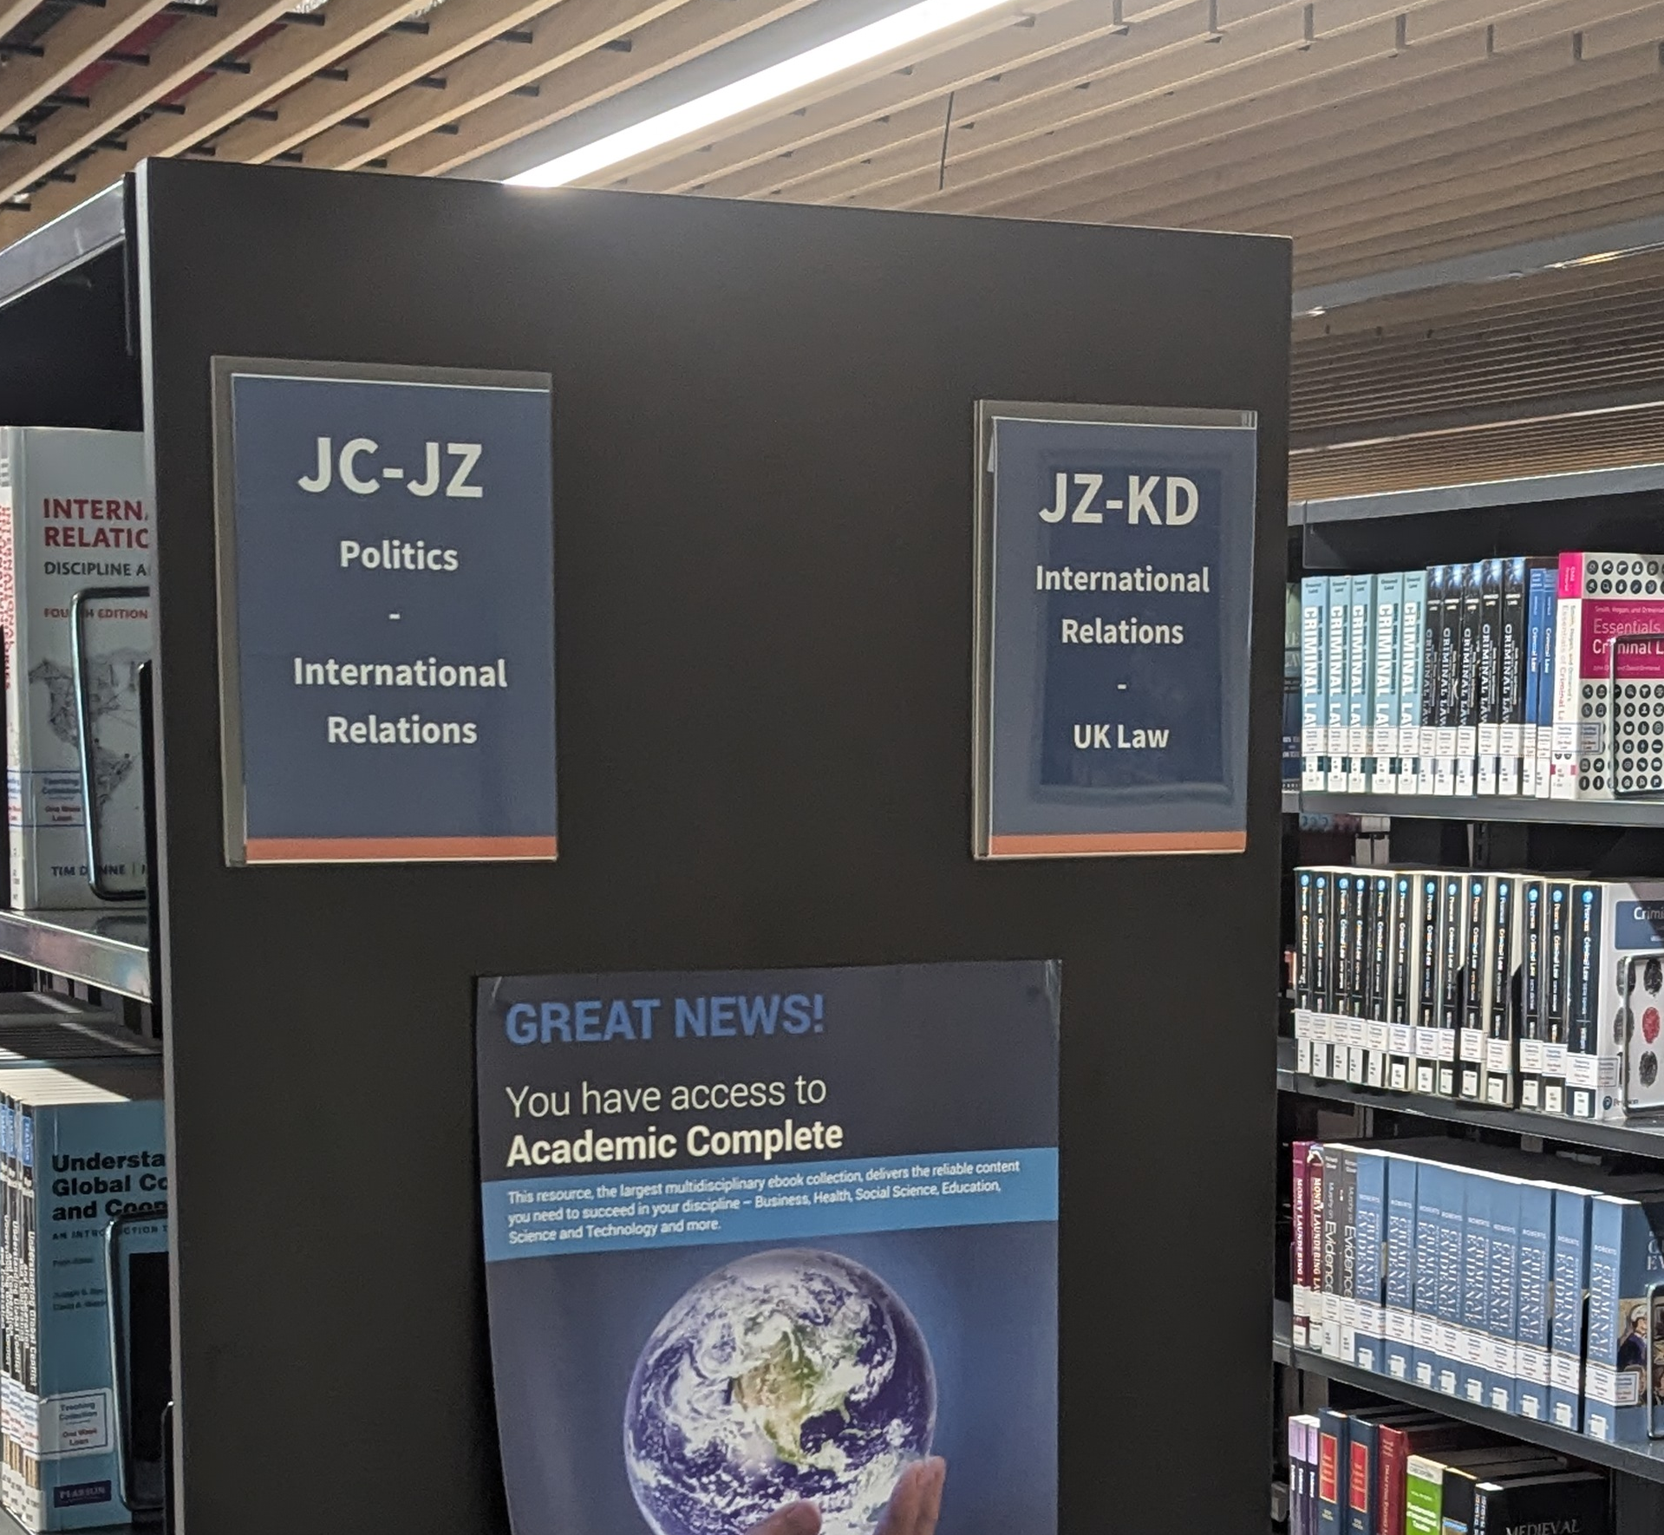
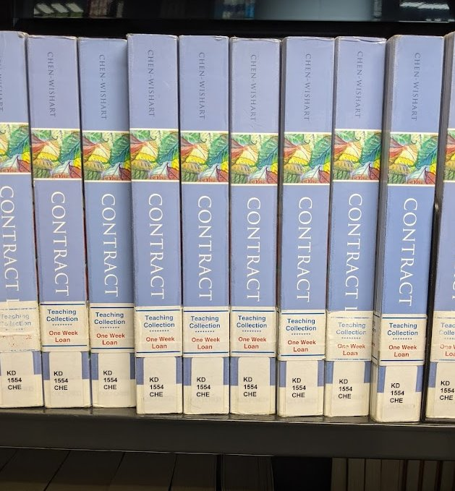
Finding a book on the shelf
Find on Library Search
Go to the location
Find the bay
Find the shelf mark

Slide 17
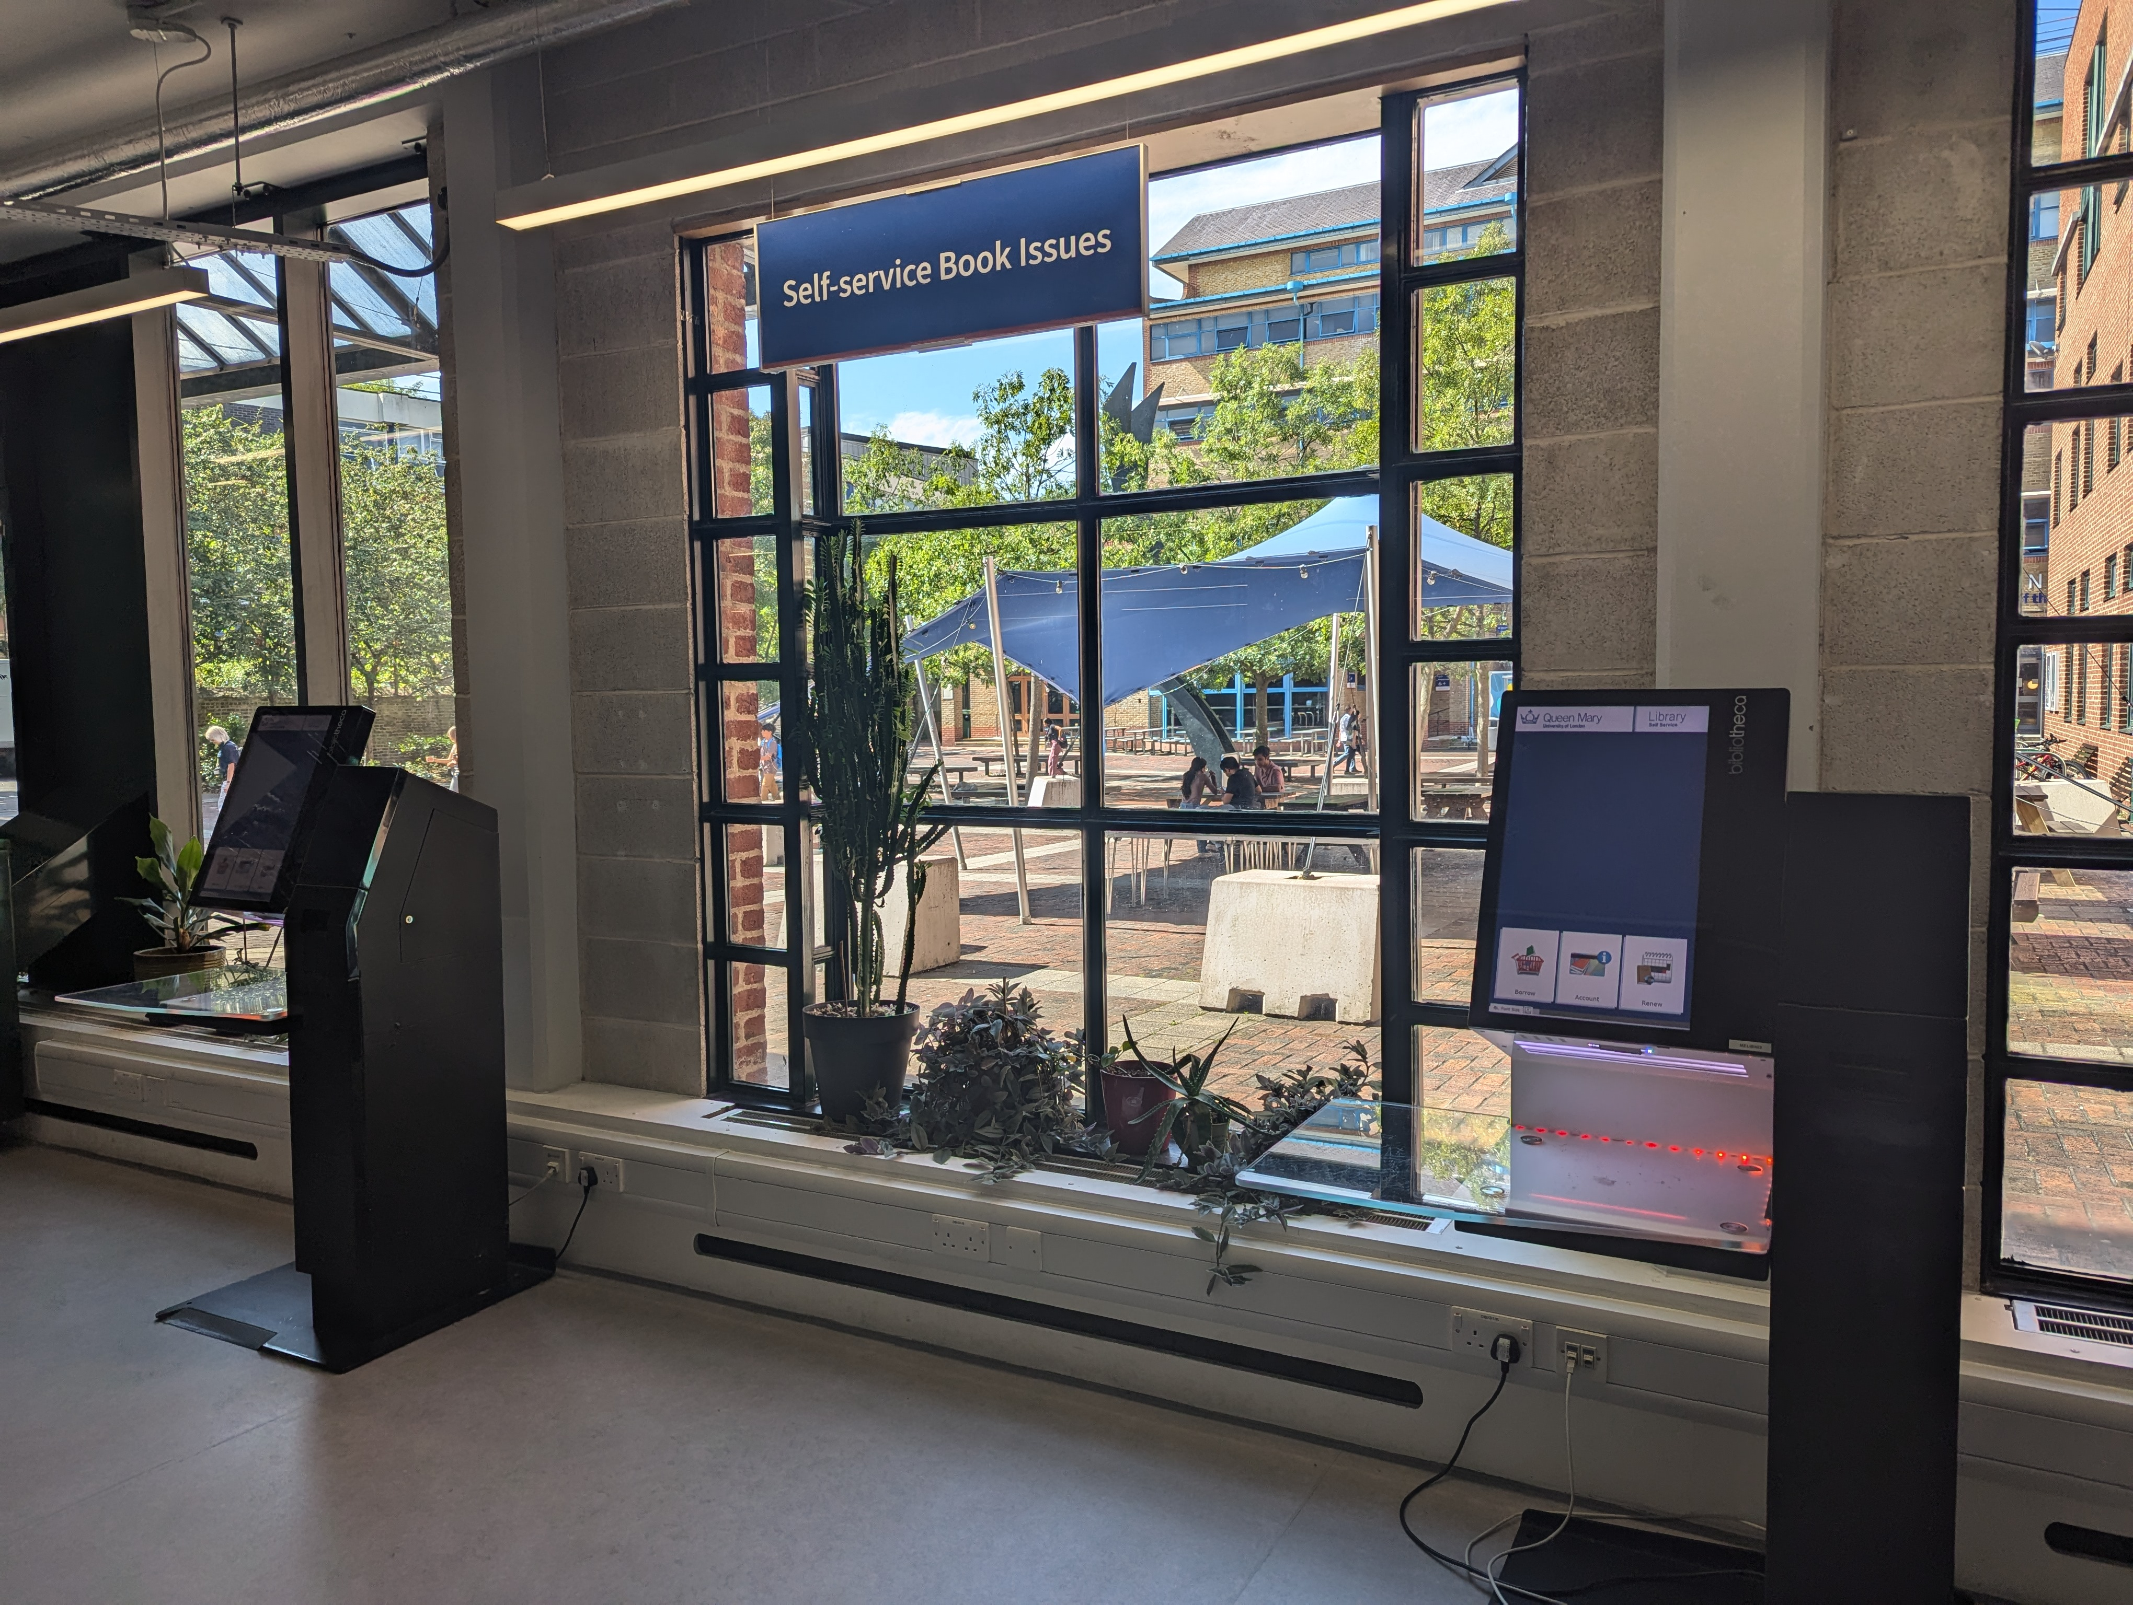
Borrowing
Two book issuing machines

Slide 18
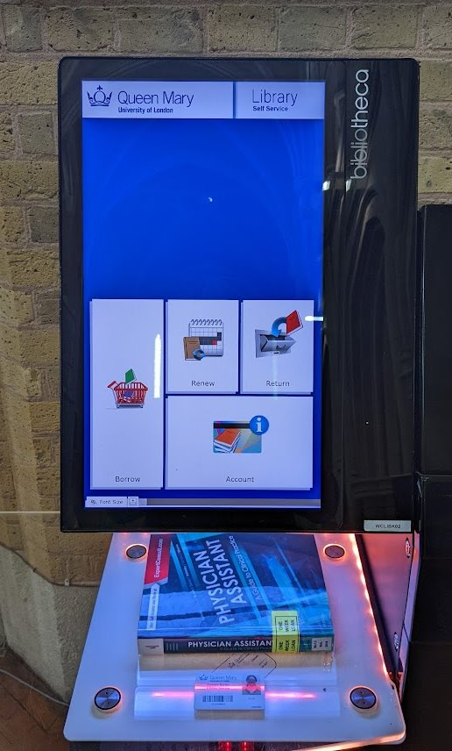
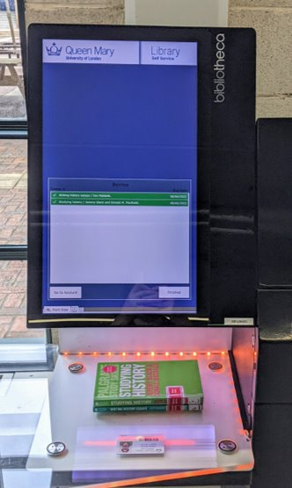
Borrowing
Scan library barcode and press Finished
Scan library barcode and press Finished
Place books and press borrow

Slide 19
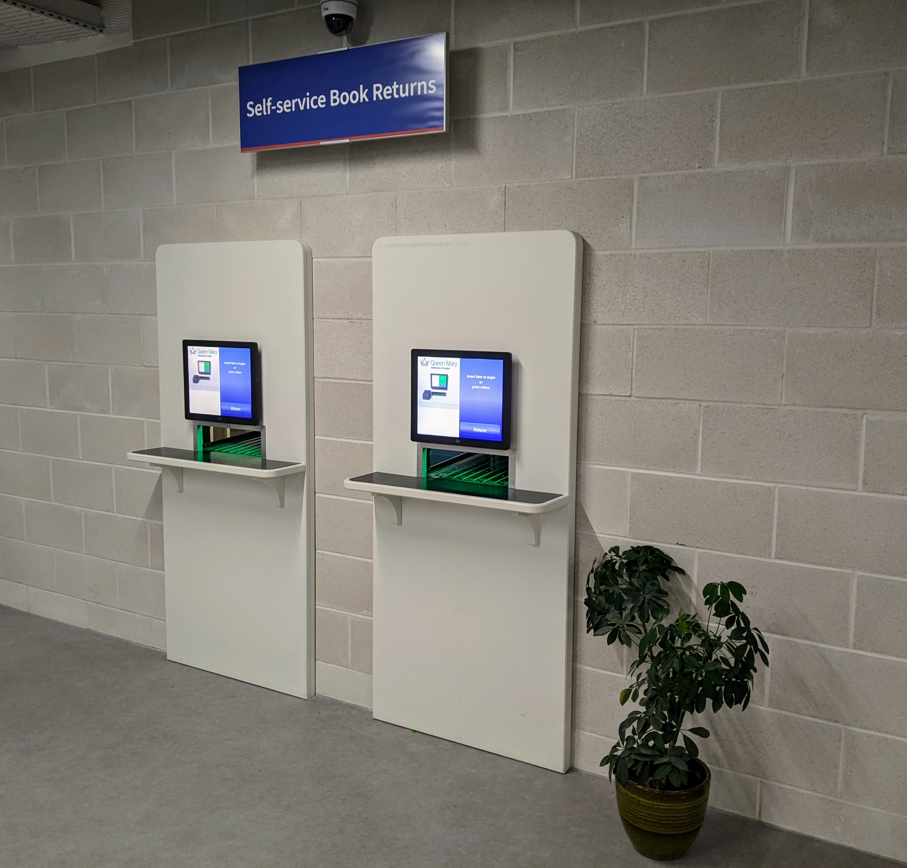
Returning
A two self service book return machines on a wall

Slide 20
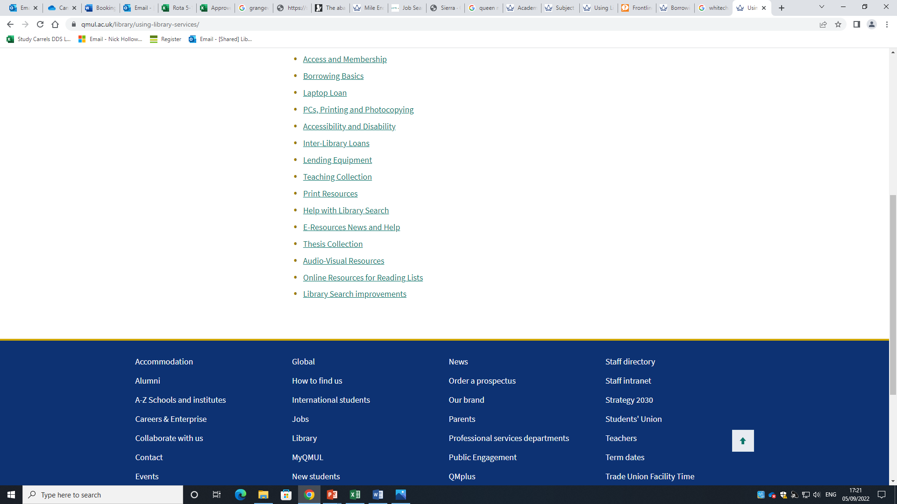
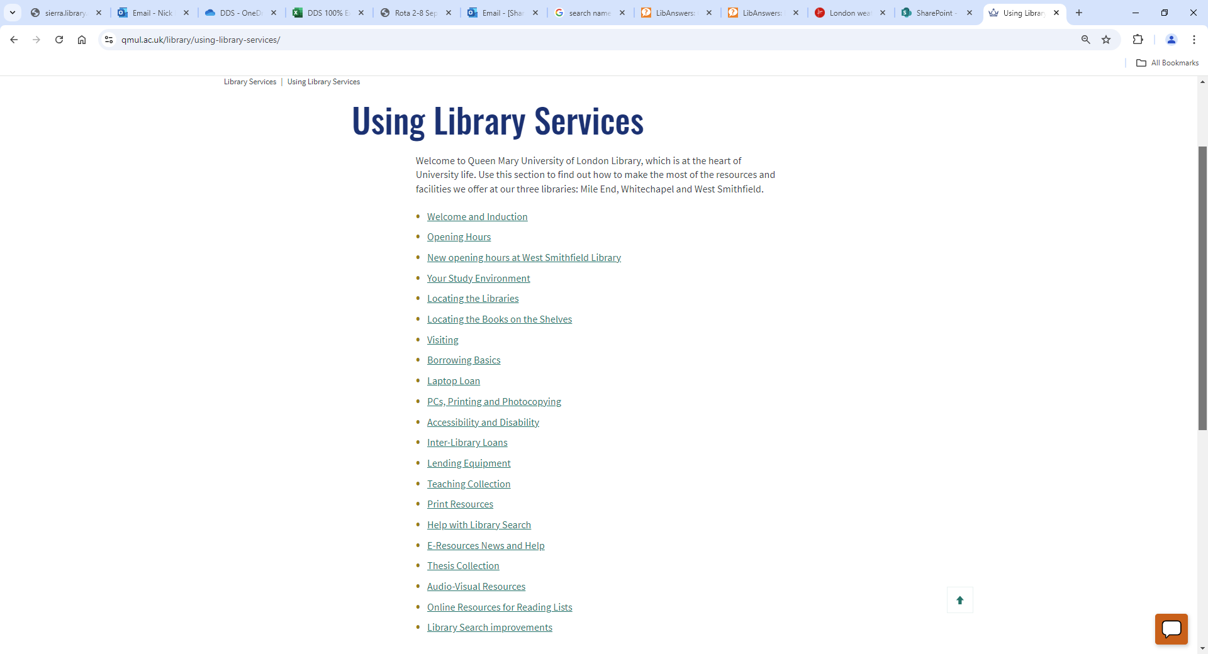
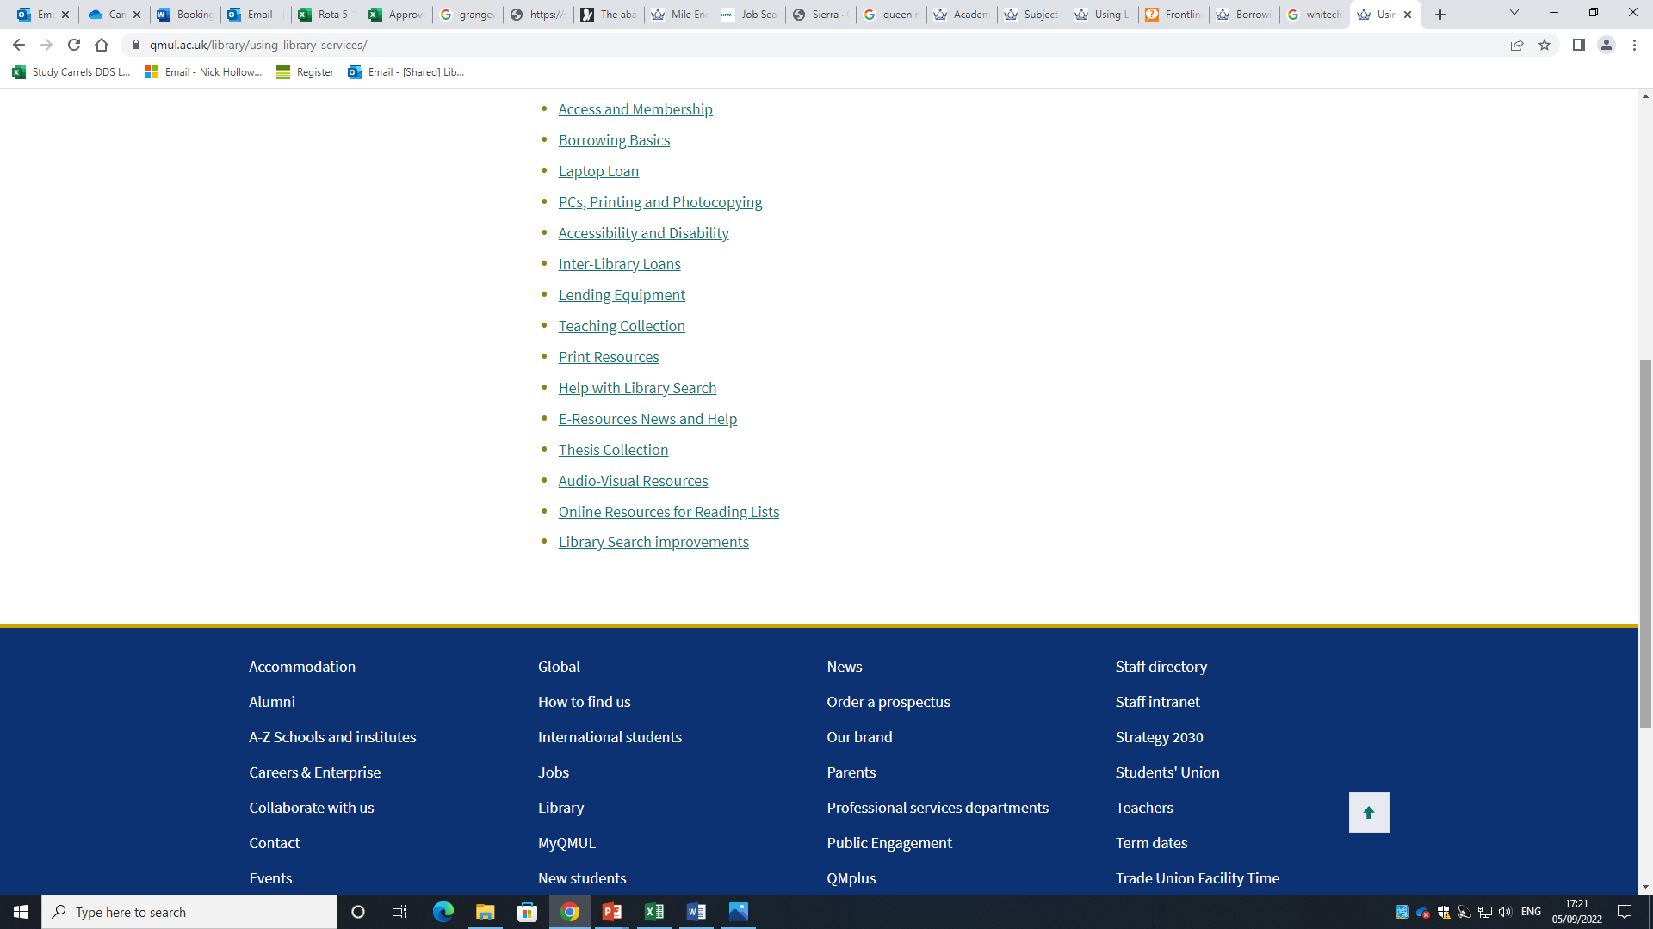

Slide 21
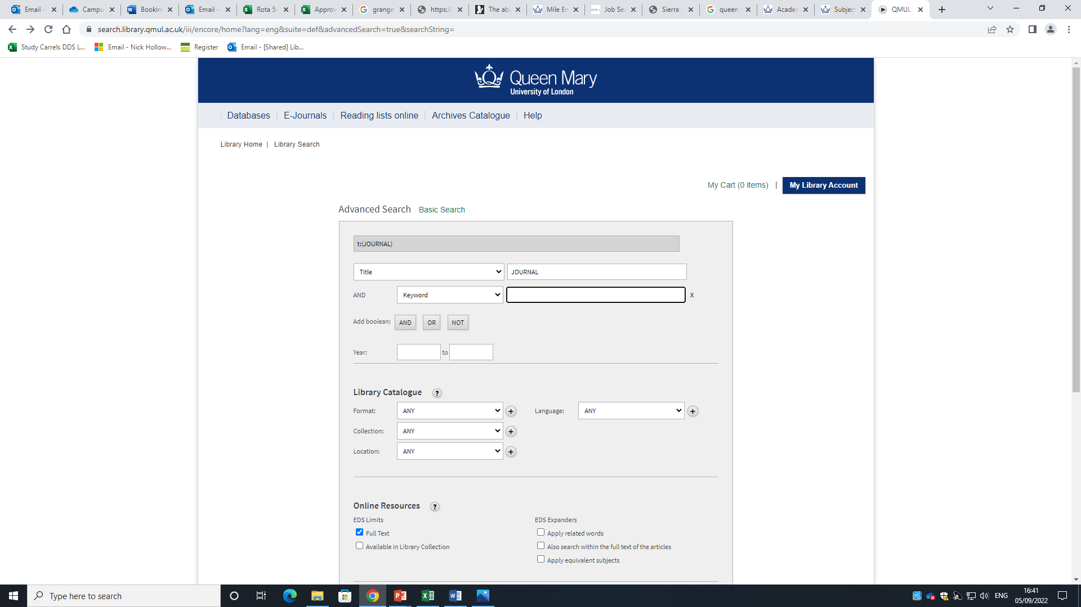
Use Advanced Search to find a Journal

Slide 22
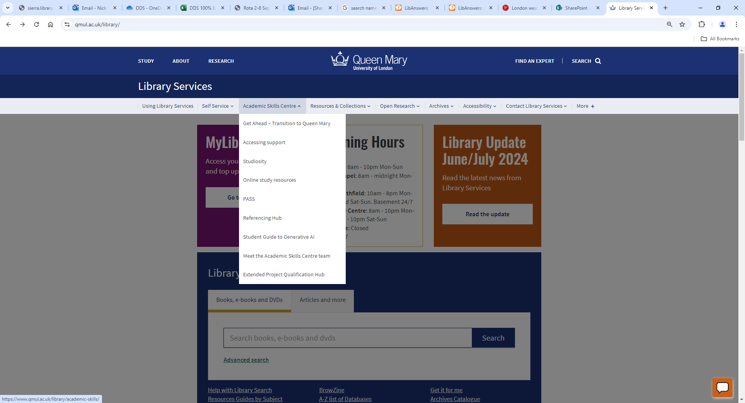

Slide 23
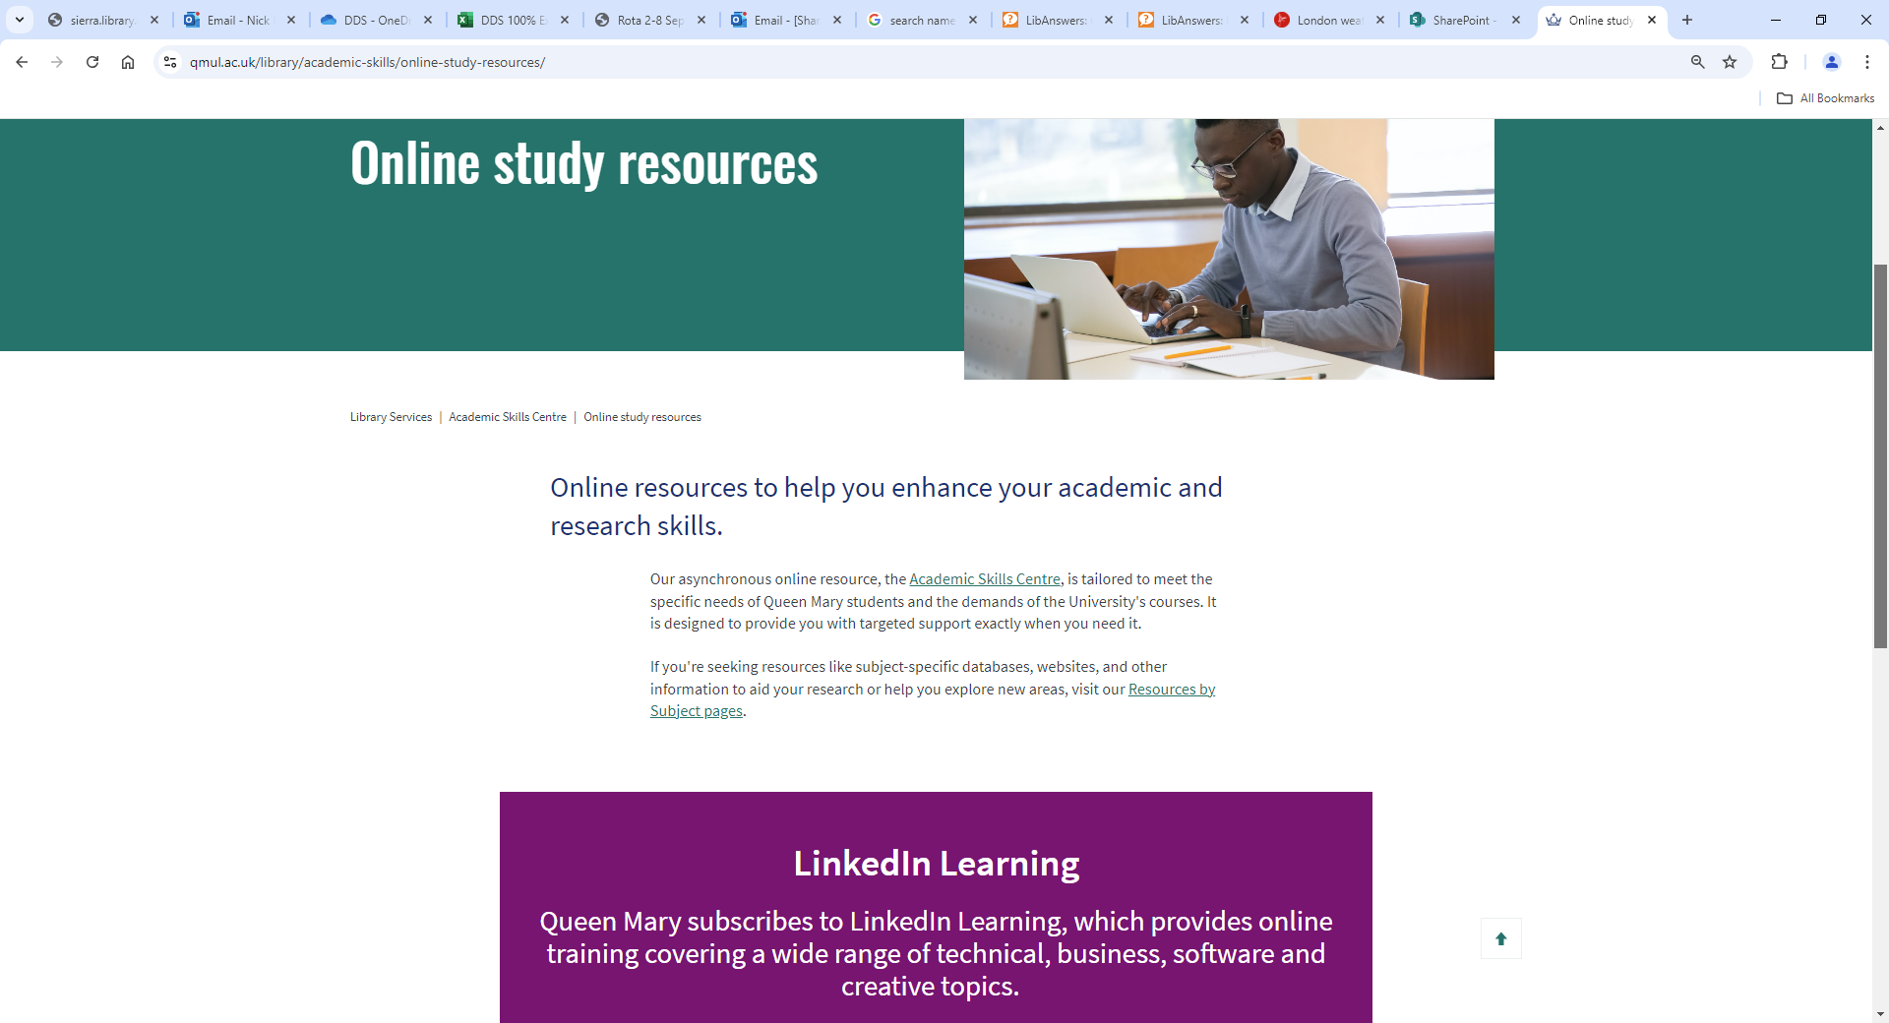

Slide 24
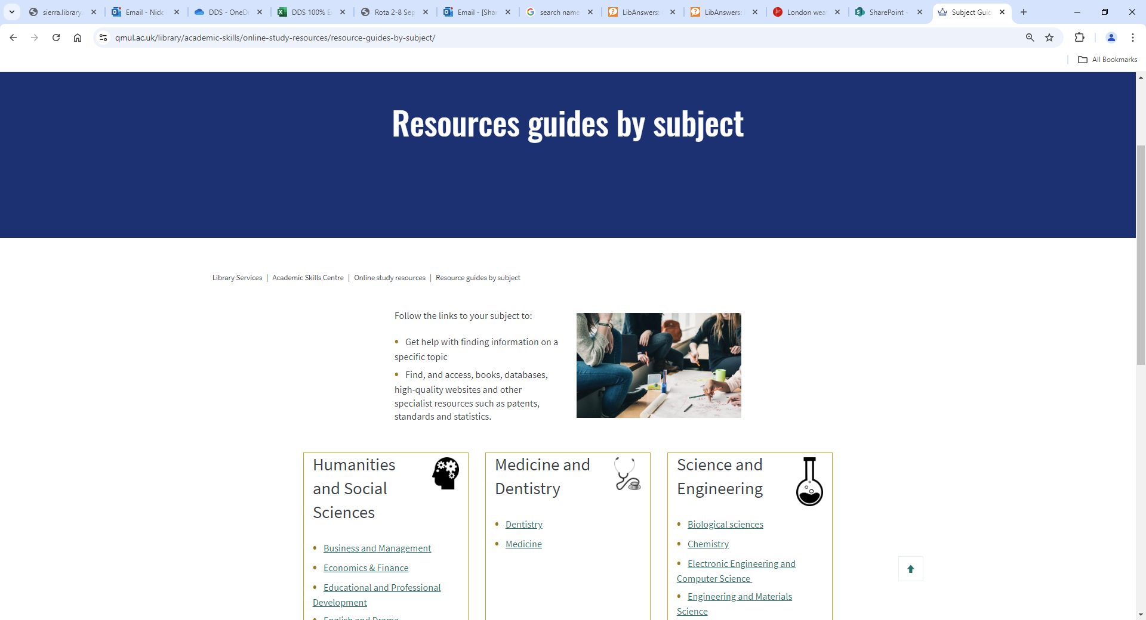


Slide 25
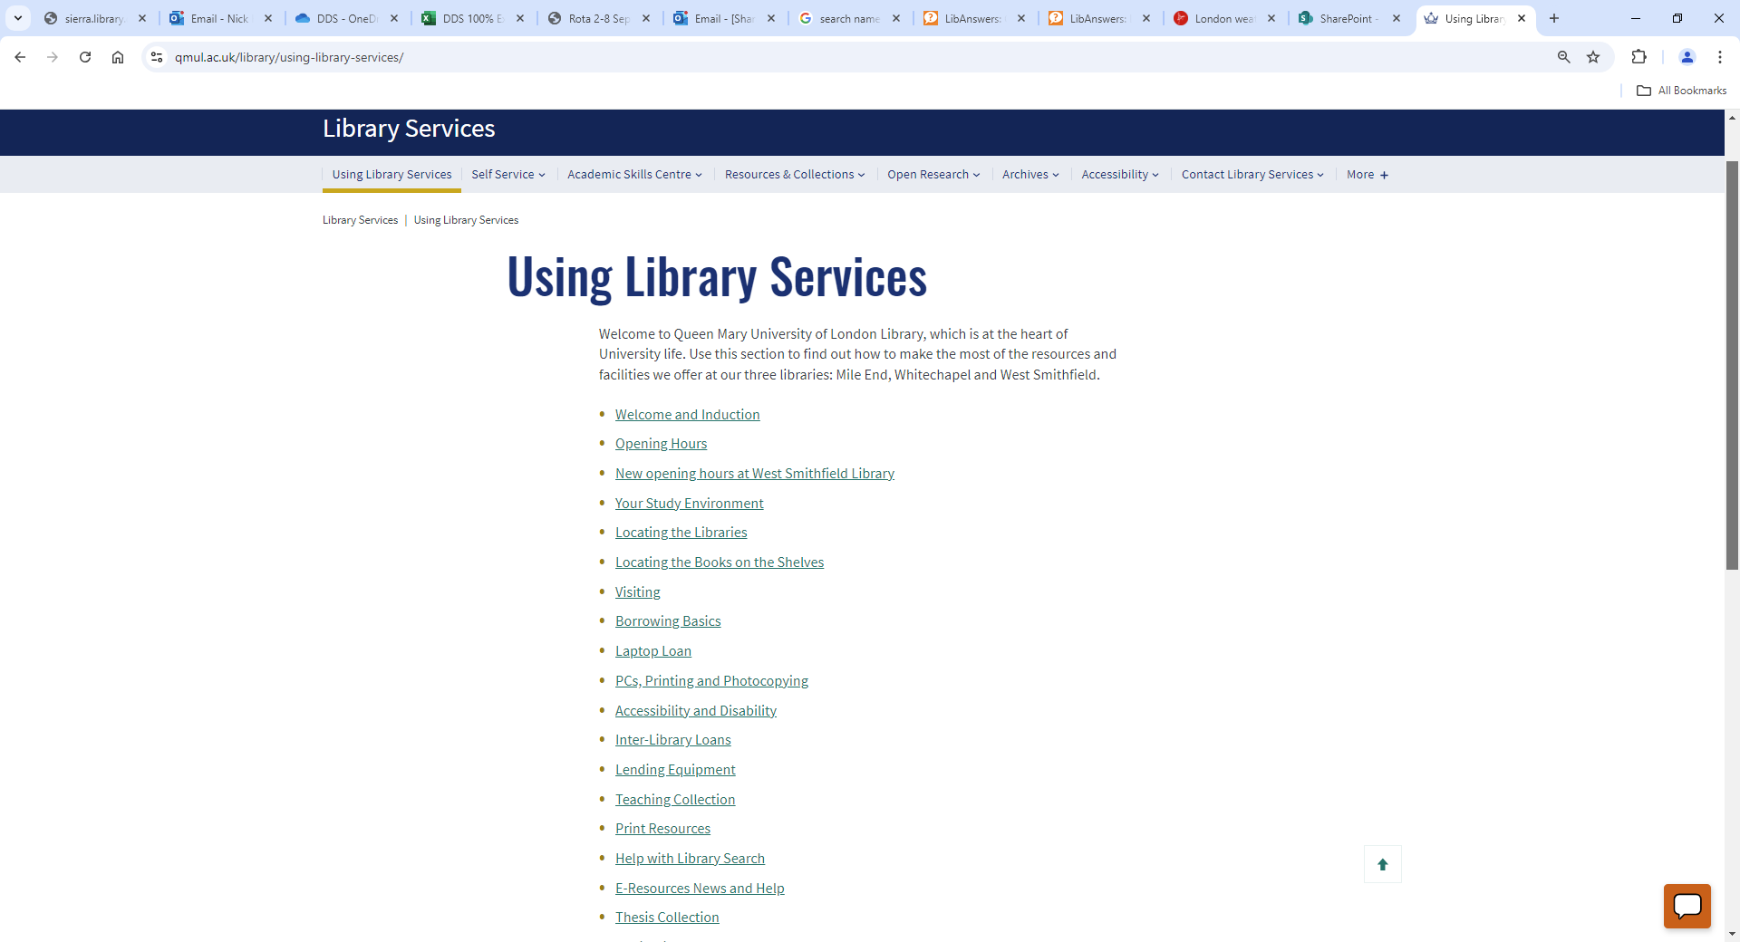
How to find and borrow a laptop, and book a Library study space

Slide 26
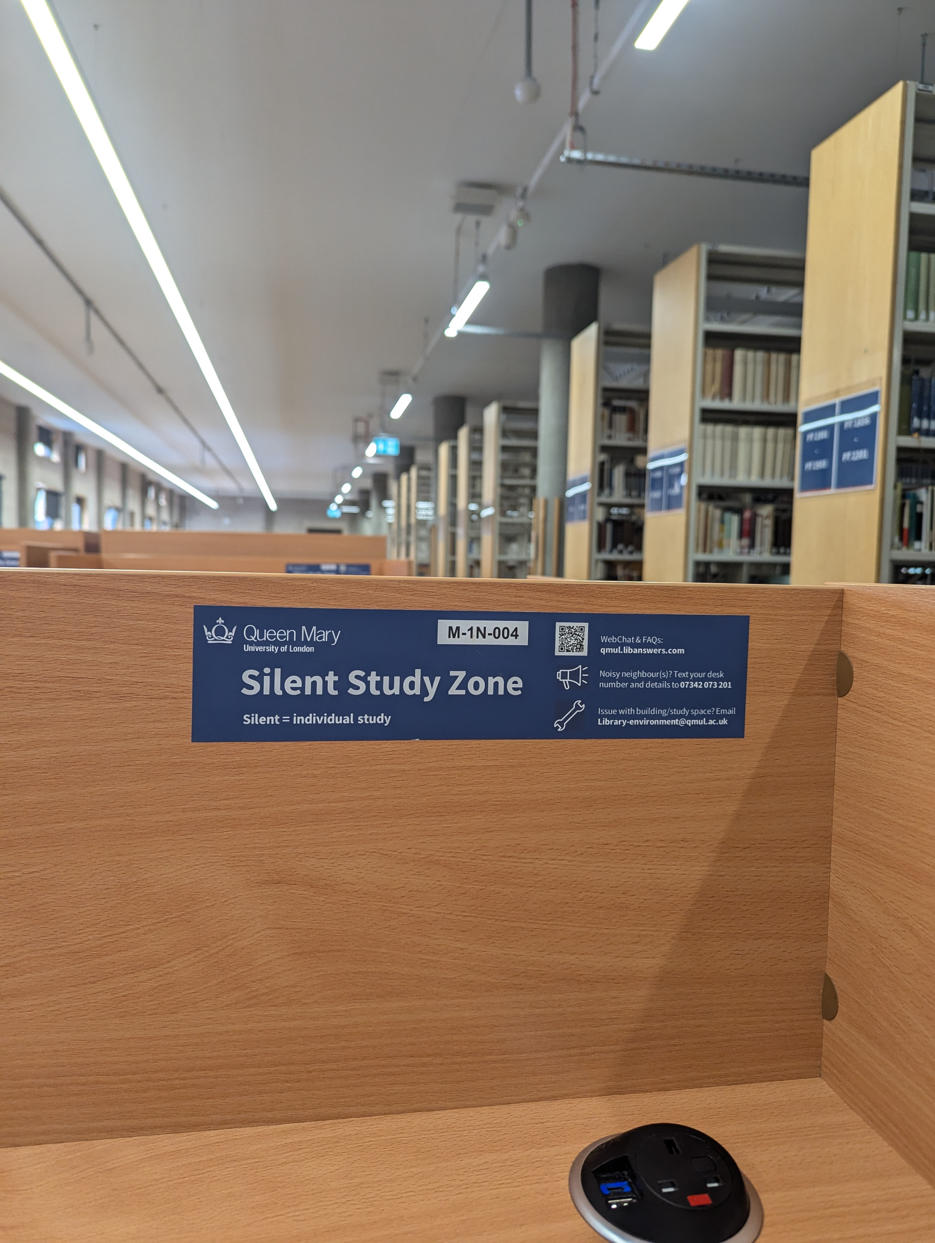
Where can I sit?
You will find a range of study spaces for individual and group study at Mile End Library. Check the signage in each area to find out if it is a silent, quiet or discussion zones.
Booking a group study room
There are 12 group study rooms in the library and 4 in the Hive
https://qmul.libcal.com/ OR via the library website
A wooden desk in a library
Notes:
Tip! Quiet areas are perfect for individual study with low-level conversation
Tip! Discussion Zone will suit you if you're looking for a space where you can chat with your friends while studying, or do group work
Group study rooms can be booked up to 7 days in advance for a maximum of 3 hour slots per

Slide 27
Stay Safe!
Fire alarms, look for the green Emergency Exit signs around the building, (and see https://www.qmul.ac.uk/library/using-library-services/your-study-environment/)
Like other departments some Library staff are qualified First Aiders, and some are also Mental Health First Aiders
The Library holds a collection of “WellBeing” books, which are located on the Ground floor as you approach the Teaching Collection, and these are available for loan.

Slide 28
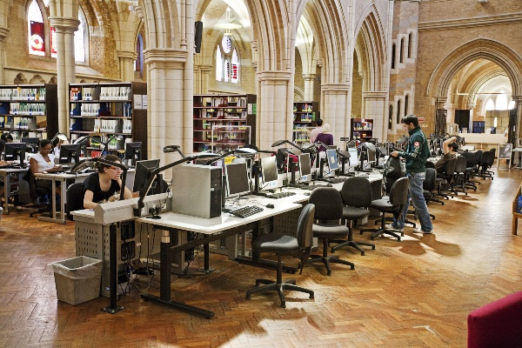
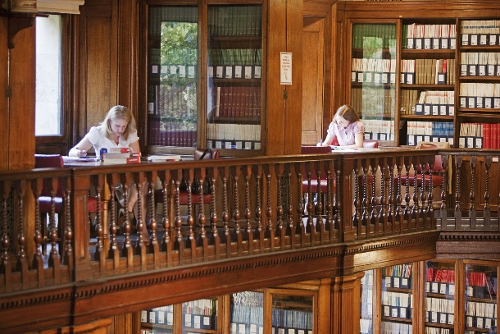
Visit the libraries
Range of study spaces
Enquiry points
Self-service
Books
Computers, and laptops to borrow
Wi-fi
Printers / photocopiers

Slide 29
How to get Help!

Slide 30
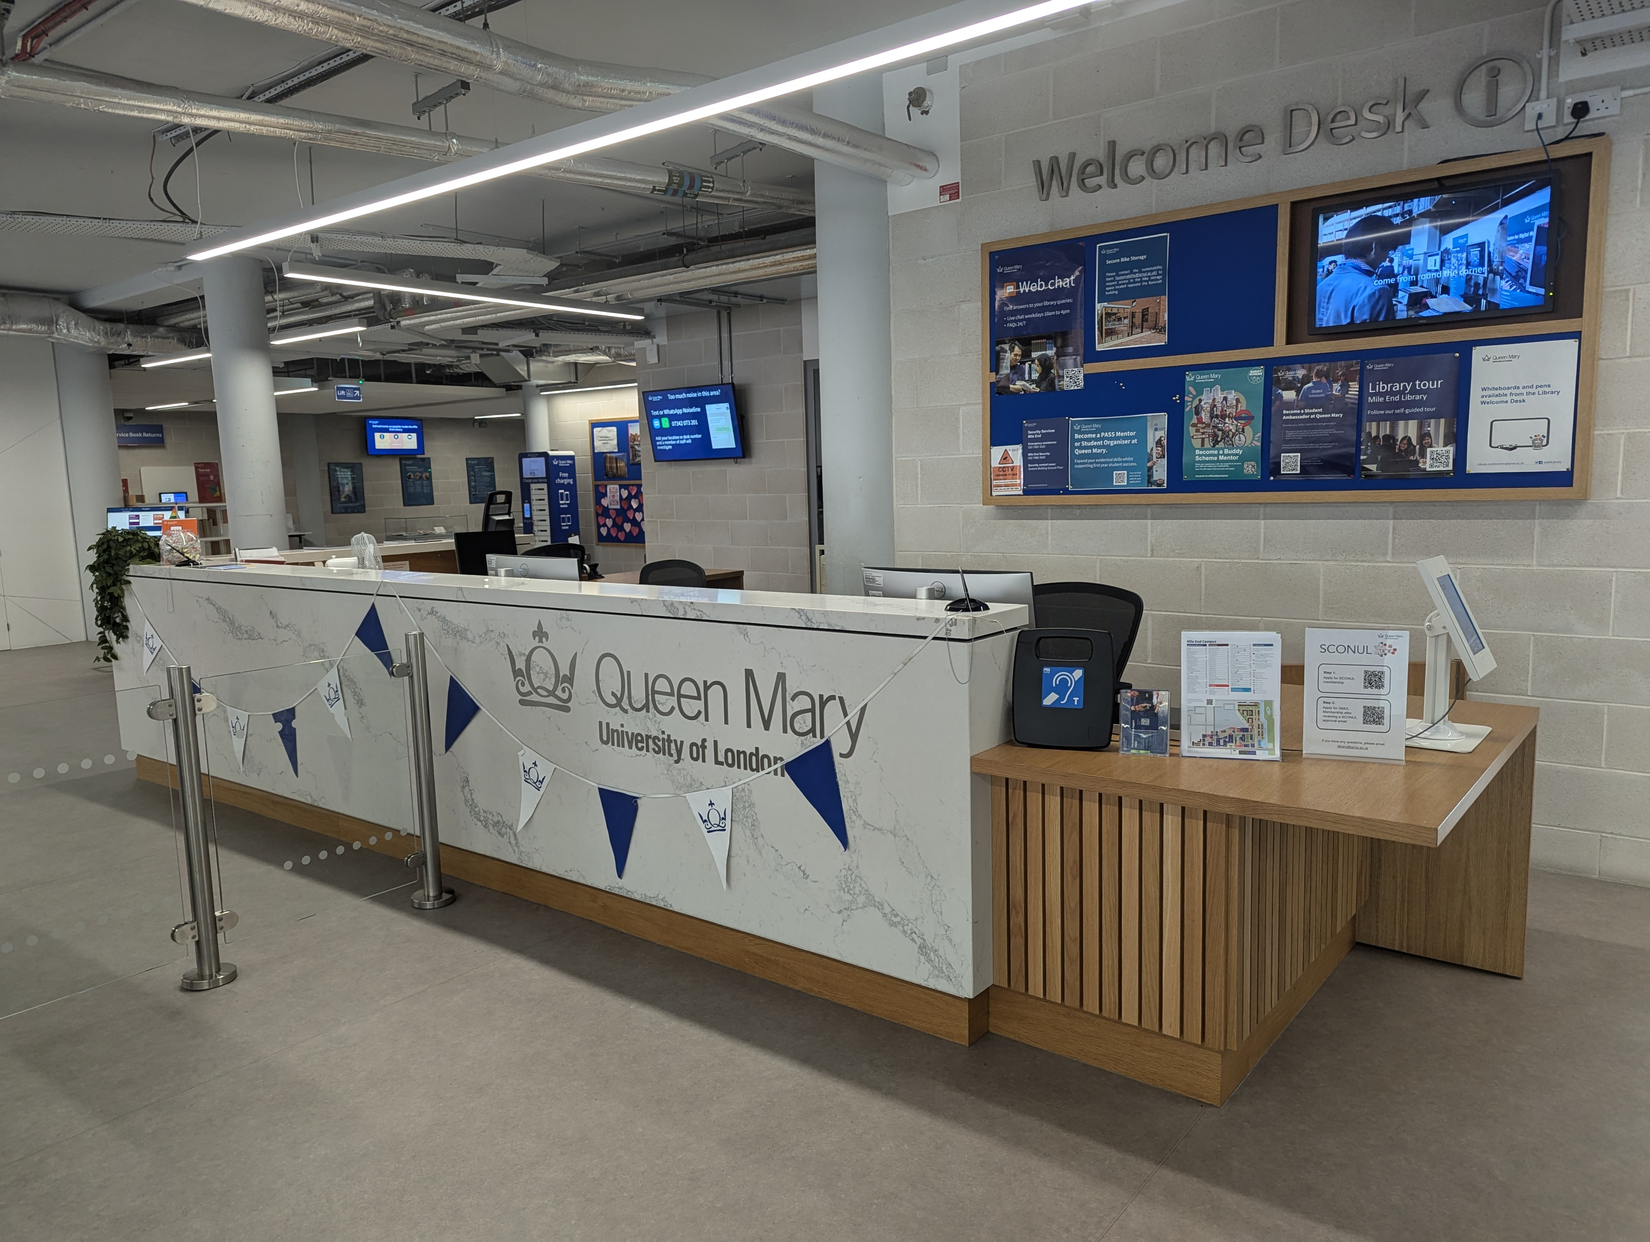
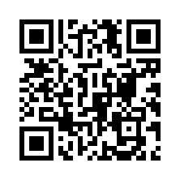
How to contact us
Library Welcome desk
Library live chat
QR Code for Library live chat
Email library@qmul.ac.uk
Notes:
IF IN DOUBT SEEK US OUT!

Slide 31

For general library enquiries please email
library@qmul.ac.uk
For help finding information for your subject please email
library@qmul.ac.uk

Slide 32
Questions?

