Slide 1
DDS Autism Induction Event: Specialist Study Skills Support

Slide 2
Specialist Study Skills Support Sessions: Introduction
https://www.qmul.ac.uk/disability-and-dyslexia-service/dyslexia/specialistsupport/
Private, 1:1, personalised support sessions for students with Specific Learning Differences (SpLDs) including dyslexia, dyspraxia and ADHD, and those with Autism Spectrum Conditions
Making you a more independent learner by helping you to develop skills to work more efficiently and effectively
By identifying your strengths, learning styles and personal preferences to build and review / evaluate a ‘toolkit’ of appropriate strategies
This could be in-house (QMUL staff) or external, depending on funding etc, but the offer is guaranteed for anyone in this room

Slide 3
Specialist Study Skills Support Sessions: Topics
Areas that could be covered (negotiated with the student):
Reading strategies for comprehension, retention and fluency
Note-taking methods
Structuring assignments and/or presentations
Improving research techniques
Time management and organisational strategies
Attention and concentration techniques
Examination and revision strategies
Memory techniques

Slide 4
Specialist Study Skills Support Sessions: Assistive Technology
Demonstrations / guided practice of Assistive Technology (software packages) to support your learning, many of which are free or accessible via QMUL computers (e.g. in the library), such as:
Text-to-speech (also text-to-mp3)
Speech-to-Text / dictation
Mind mapping
Screen tinters and reading rulers (to minimise visual stress)
Creating alternative formats using https://www.sensusaccess.com/
Further info on various programs: https://qmulcase714579245.wordpress.com/

Slide 5
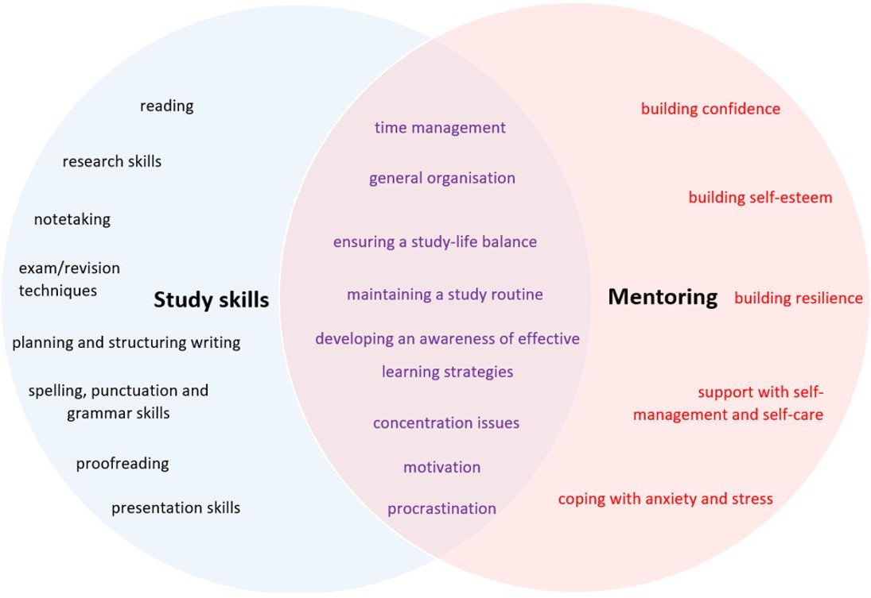
Study skills vs. Mentoring

Slide 6
Any questions?

Slide 7
Thank you

