Slide 1
Welcome to Queen Mary University of London Halls of Residence
With the Residential Welfare Team

Slide 2
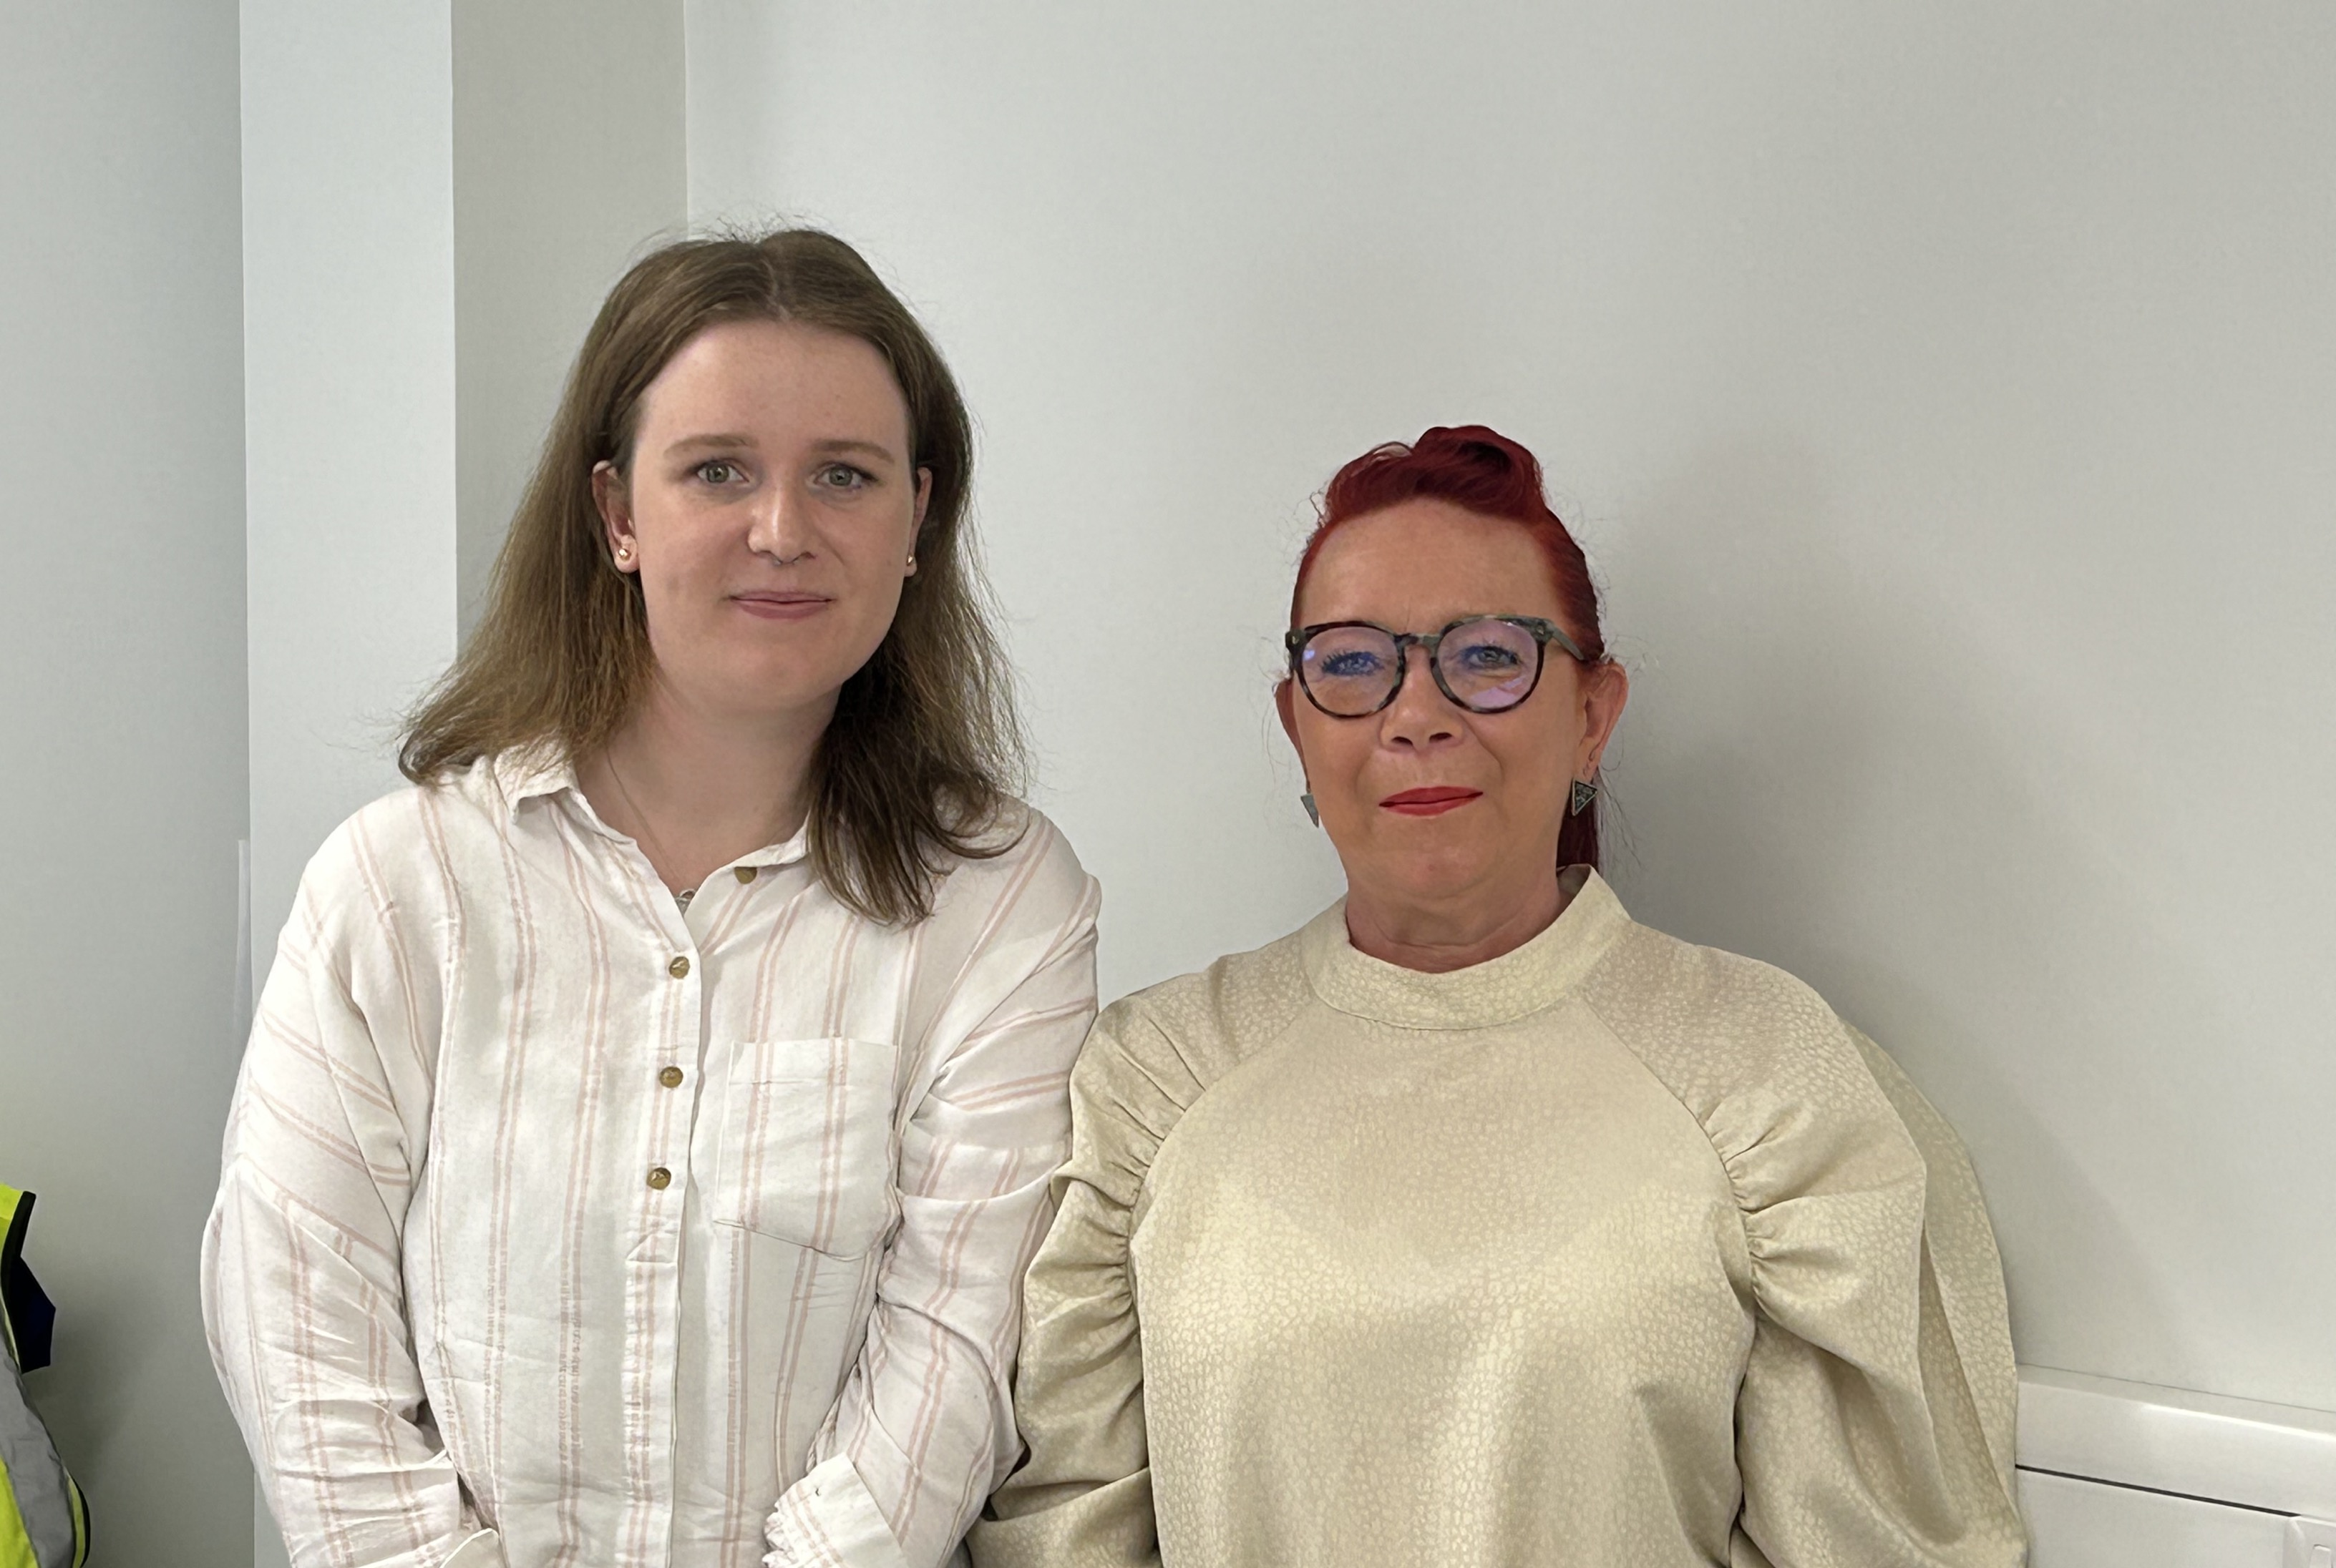
The Residential Welfare Team In everything we do, our ultimate purpose is to promote student wellbeing
Emma Godfrey
Residential Welfare Officer
Tracey Paradise
Residential Welfare Manager
Contact us by email at residentialwelfare@qmul.ac.uk

Slide 3
We CARE
Community Spirit
Advice & Support
Reaching Out
Excelling Academically

Slide 4
How we can support you
One-one support meetings
Wellbeing advice and support
Tailored approach to support
Referrals to other support services
First response support for issues faced by students in accommodation
Wellbeing initiatives & events
Contact us by email at residentialwelfare@qmul.ac.uk

Slide 5
Who we work with…
Queen Mary Security
Housing Services & Residences Finance
Disability & Dyslexia Services
Advice & Counselling Service
Residential Cleaning Services
Residential Maintenance Team

Slide 6
Communal living – what to expect
Your room – you are responsible for cleaning your own room & bathroom (if en suite)
Shared kitchen – you will have you own cupboard & drawer, a shared fridge & freezer
Residents may have one guest at a time each in your own room/flat
Overnight guests - one guest can stay 2 nights in a row, no more than 6 nights in one month
Quiet hours between
11pm – 7am

Slide 7
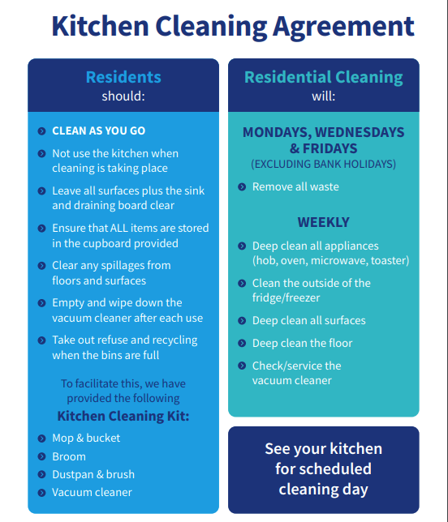
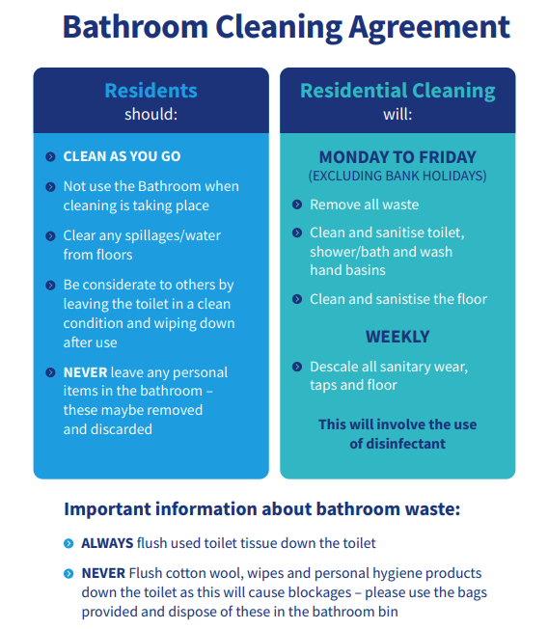

Slide 8
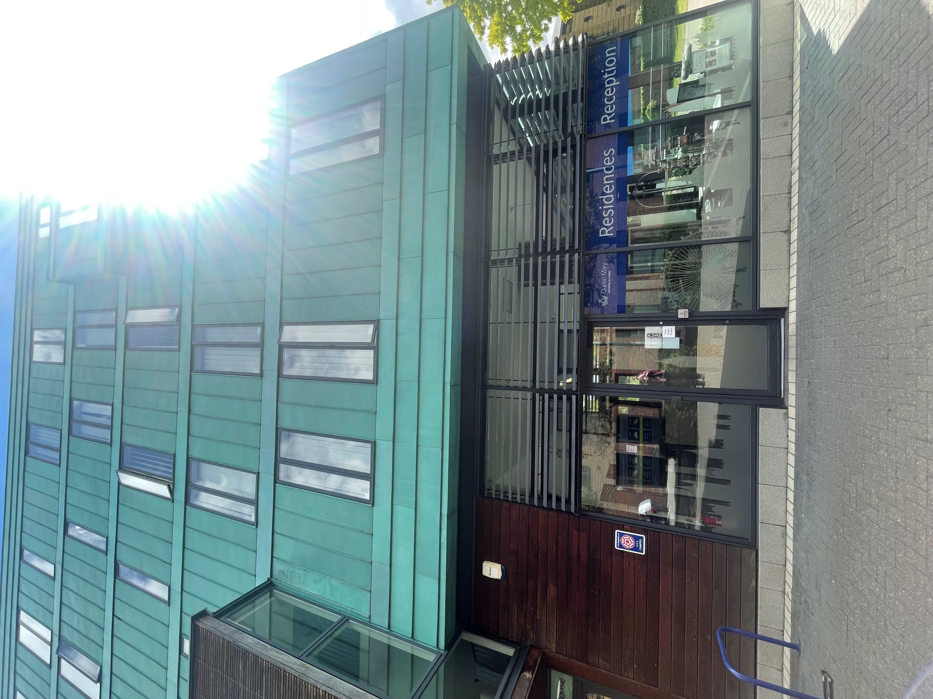
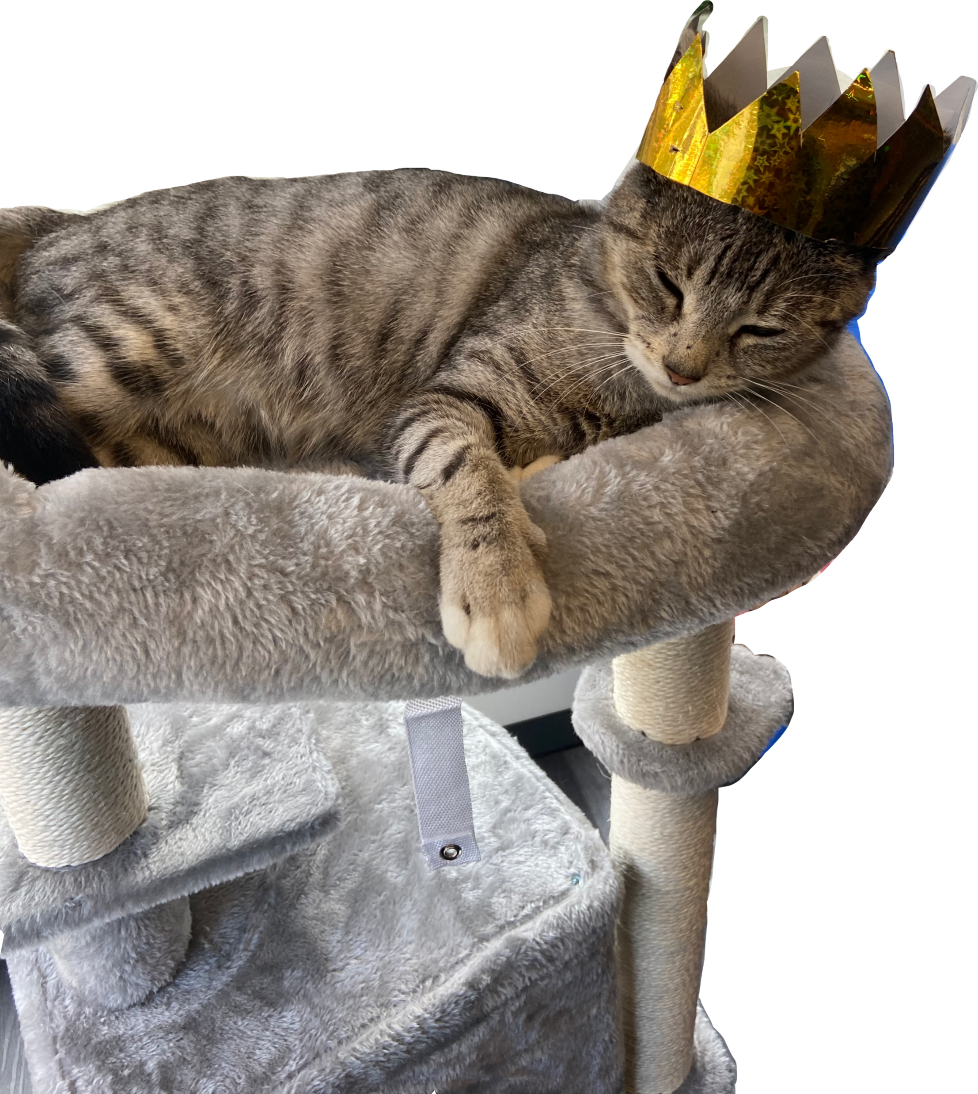
Campus life – what to expect
24/7 France House Residences Reception
Contact Reception 24/7 on 020 7882 6470 or at residences-reception@qmul.ac.uk for general enquiries
We expect residents to report any maintenance or cleaning issues themselves on Ivanti (info in your arrival pack with your keys) but if you are experiencing problems Reception Staff will be happy to help
You do not need to be home for maintenance staff to access your room and carry out a repair request
Parcel lockers next to France House laundry, you will be emailed a collection code if your parcel is delivered to the lockers
Queenie the Campus Cat

Slide 9
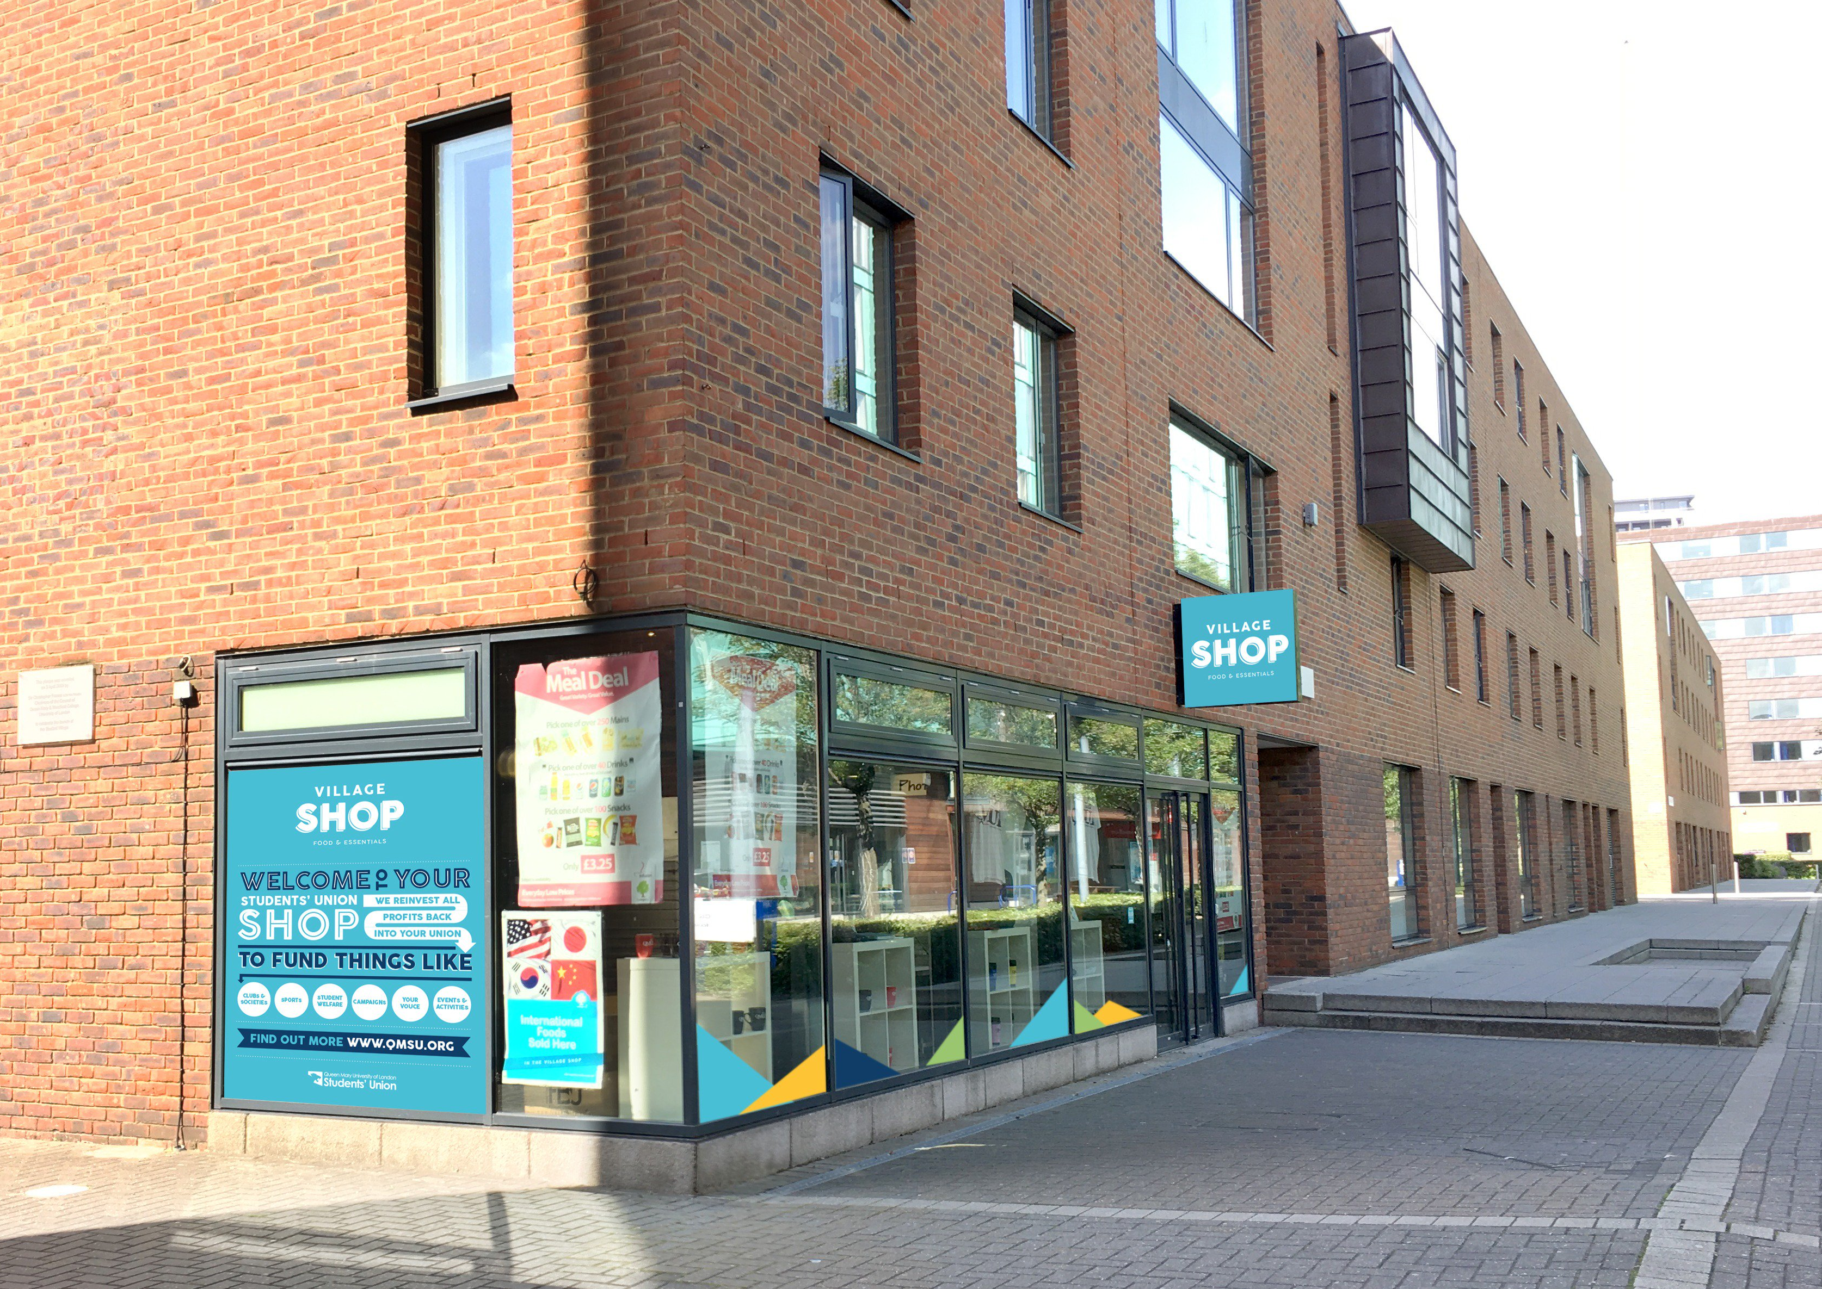
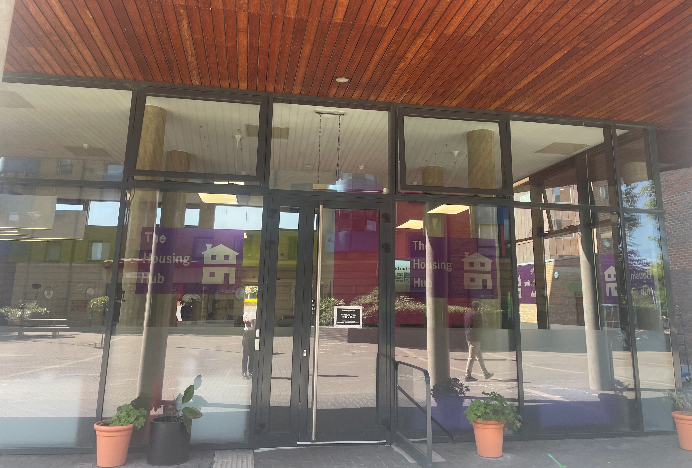
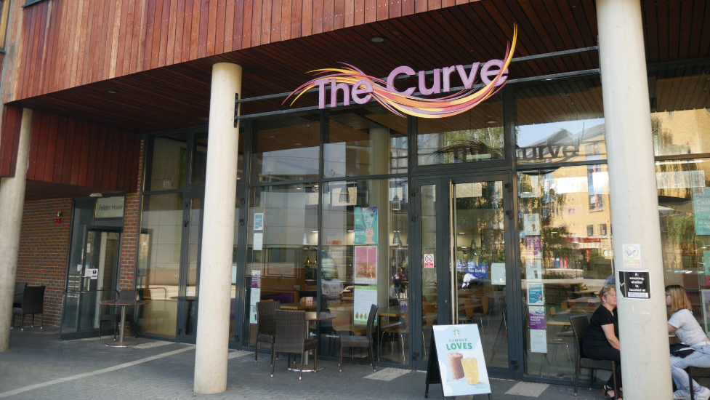
Campus life – what to expect
An exciting social and inclusive event programme and initiatives organised by the Residential Life Team
@qmreslife Website - residentiallife.qmul.ac.uk
Residential Assistants (student staff) at events – meet the team on the website!
Residential Welfare hold events for our residents at least termly
The Village Shop & The Curve
The Housing Hub

Slide 10
Health & Safety in Halls
All residents are required to complete an online induction
This induction covers Health and Safety and fire alarm activations
A resident who causes a fire alarm activation will be required to meet with the Residential Welfare Team
Further information on this is outlined in the Residents’ Handbook

Slide 11
Fire Alarms
If the alarm sounds – you must leave the building immediately
Do not return to the building until staff tell you it is safe to do so
Know your assembly point – info on this is on the back of your flat doors
Fire alarm tests are weekly on the named maintenance day for your Hall
During weekly tests, the alarm will sound for a short period of time, and it is not necessary to evacuate

Slide 12
Do not cover or tamper with any smoke detectors
It is a criminal offence in the UK to cover fire detection devices
There is a zero-tolerance policy at Queen Mary regarding the misuse of, or tampering with any fire alarm systems or equipment, including covering detectors
Anyone found to have carried out any of the above will be issued a Notice to Quit and a minimum charge of £100

Slide 13
Smoking – strictly prohibited in halls
Smoking is prohibited except in the designated smoking shelters
Smoking in Halls could lead to a Notice to Quit
Same applies to vaping – classed as smoking

Slide 14
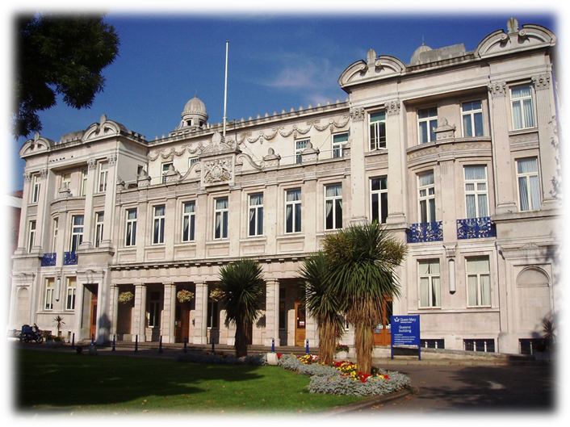
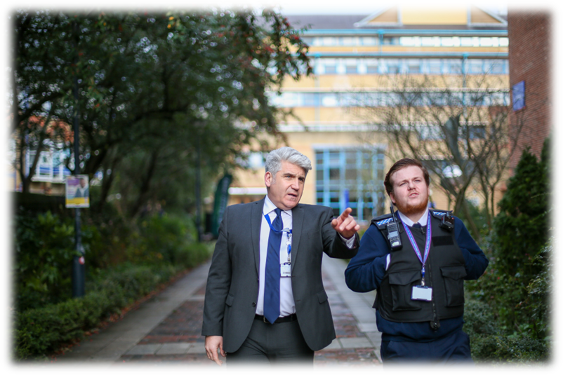
Queen Mary Security
24/7 service
Located on ground floor of Queens Building
020 7882 5000

Slide 15
5 Tips for Settling In
Take care of your wellbeing – fresh air, exercise, cook meals you enjoy
Challenge yourself to make new friends - look into which societies, clubs and events you may be interested in
Familiarise yourself with your surroundings - the campus, routes to classes, local area & transport – use the Campus Map!
Make your room a safe space – photographs, home comforts
Make use of the support available to you

Slide 16
Thank you for listening!
If you have any questions, please contact us at
residentialwelfare@qmul.ac.uk

