Slide 1
Welcome to Queen Mary University of London

Slide 2
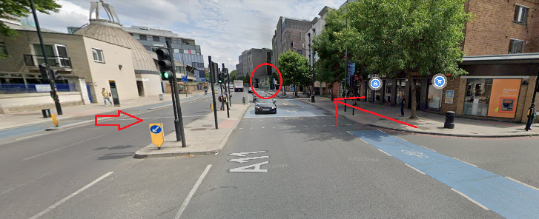
We are Careers & Enterprise
Visit us in person or phone us
iQ East Court 0.08, Mile End Road
020 7882 8533
careers@qmul.ac.uk
@qmcareers
@qmcareers
www.qmul.ac.uk/careers

Slide 3
Careers & Enterprise
Careers Appointments
Programmes & Events
Enterprise
Online resources

Slide 4
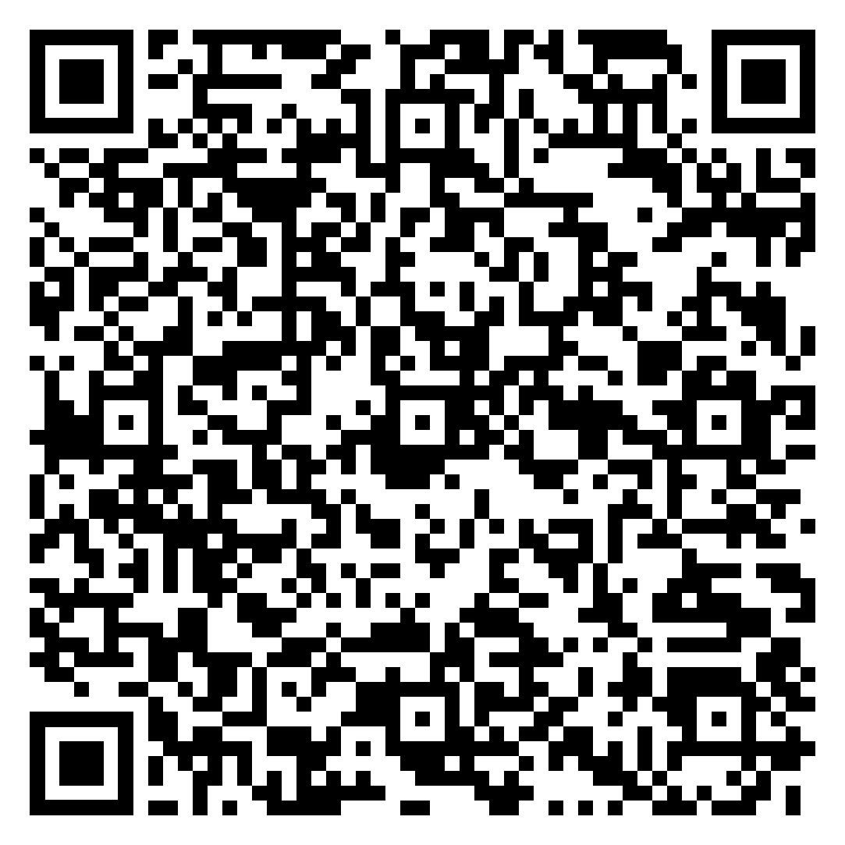
Aspire
Queen Mary’s career development programme, consisting of work experience opportunities designed for the different stages of your career journey
QMentoring
QTaster
Student Consultancy Project
Micro Internships
QHack
QIncubator

Slide 5
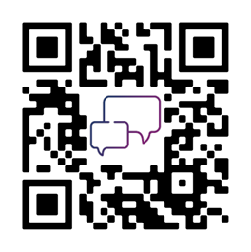
QMentoring
Explore career ideas with a mentor from the Queen Mary alumni community or a UK-based professional. For UGs in receipt of the bursary
Runs for six months, from November-May
Applications Open 17th Sept
and close 17th October
Scan here to find out more

Slide 6
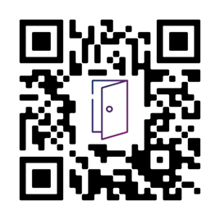
QTaster
Visit different employers to gain insight into different sectors and roles to discover what might suit you.
Runs Autumn, Spring & Summer
Book your space on Careers Hub for autumn events now ( on Wednesday afternoons)
Scan here to find out more

Slide 7
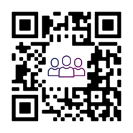
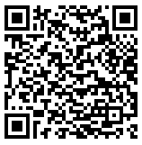
Student Consultancy Project
Build your employability skills working with fellow students on a real-life consultancy project for a business/charity.
Runs Autumn, Spring & Summer
Deadline: 25th September
Scan here to find out more

Slide 8
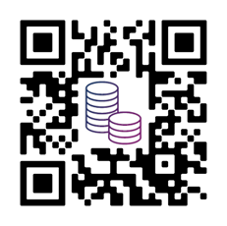
QTemps
Learn about the world of work and your own strengths and preferences as you gain paid temporary work around your studies.
Almost all roles on campus or local to QMUL
Create a profile on https://q-temps.co.uk/
Scan here to find out more

Slide 9
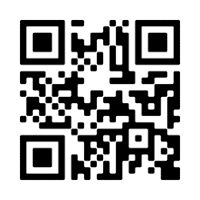
Micro Internships
Experiment with a career idea through a 40-hour project that fits around your studies.
Receive training before and after.
Programme runs spring & summer. Starting March 2025.
2025 dates to be updated on web page*
Scan here to find out more

Slide 10
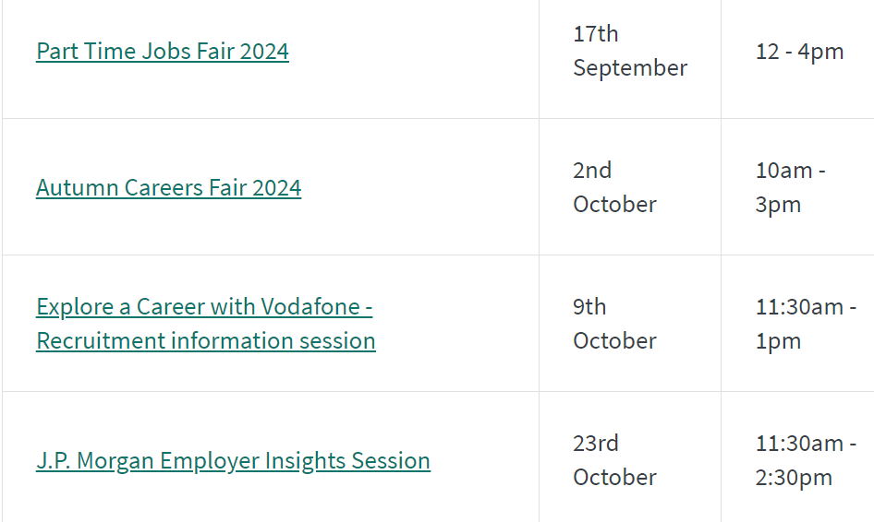
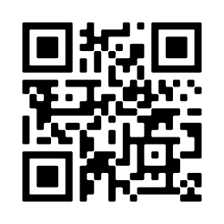
Careers Events
Scan here to find out more

Slide 11
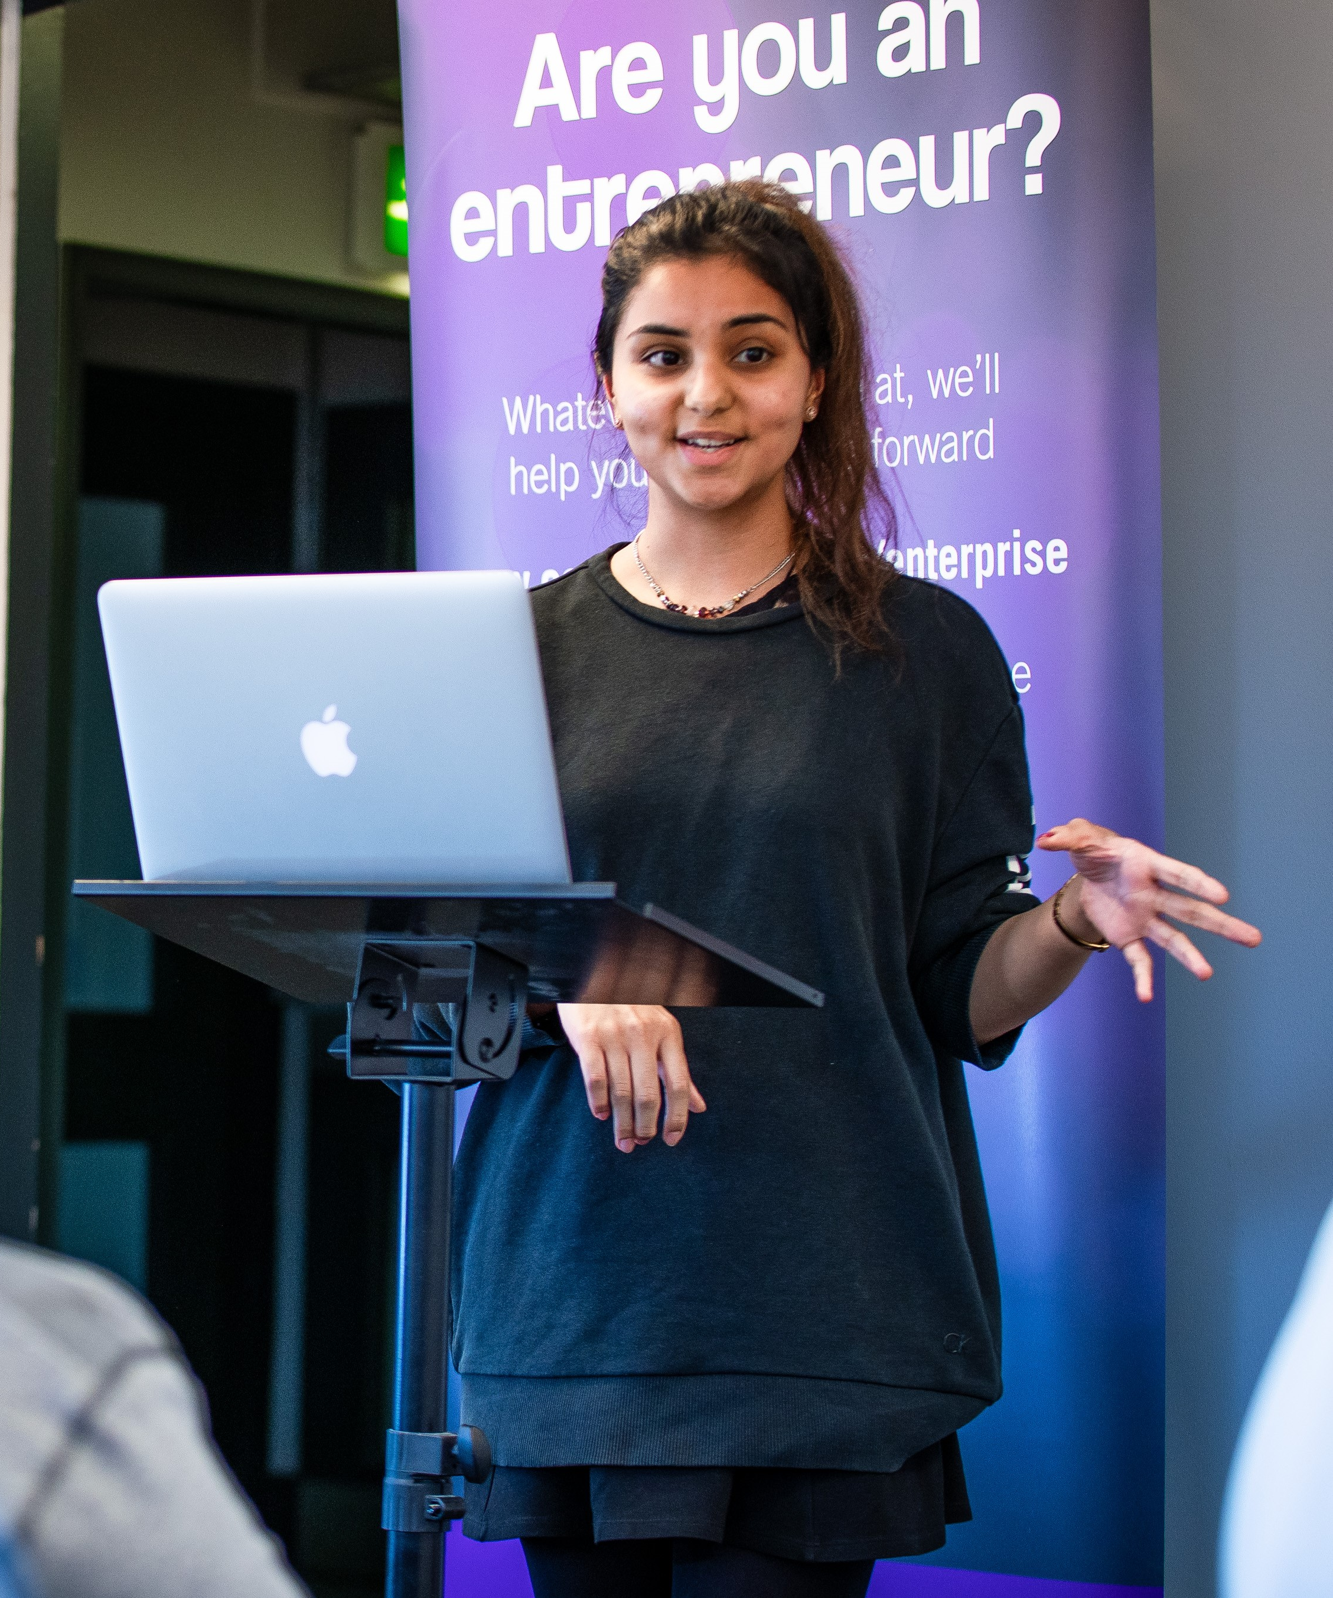
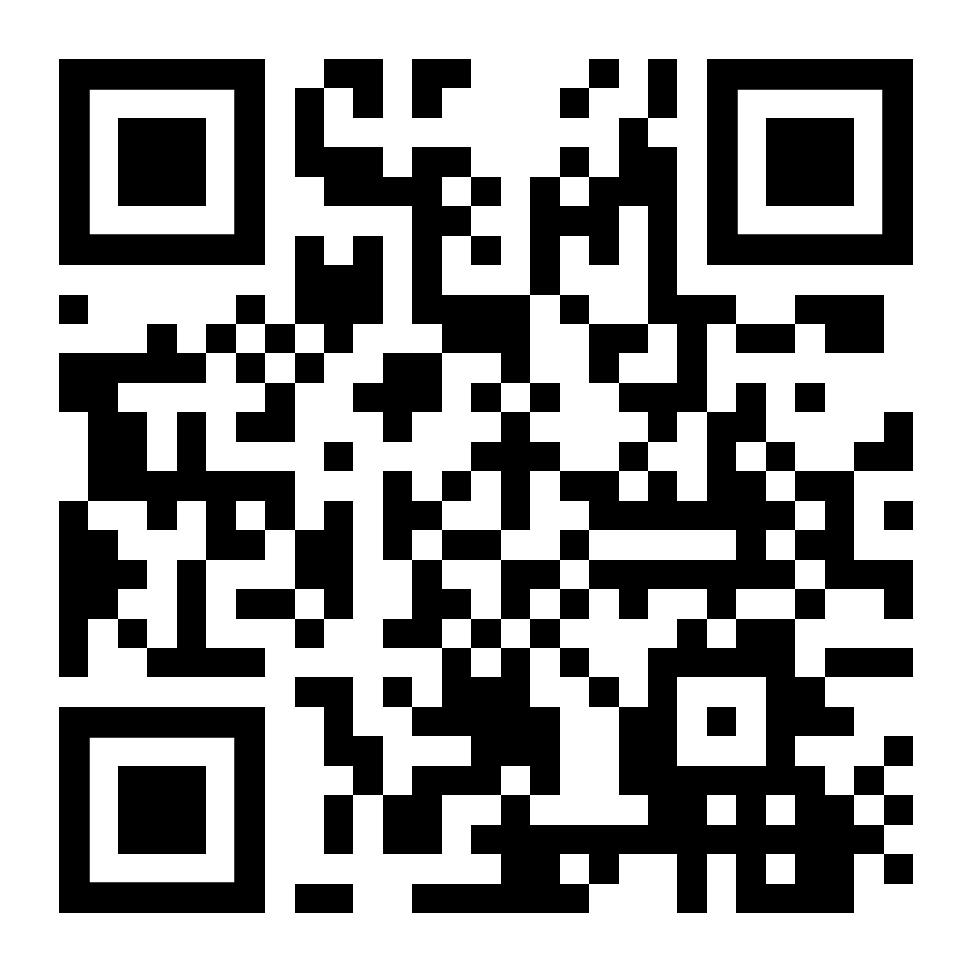
Enterprise
QIncubator (Intrapreneurs): Develop your innovative and teamwork skills through a live project within an organisation.
QIncubator (Entrepreneurs): Test your business idea in our 8-week programme.
Applications are open Deadline to apply: 29th September
QHack: Develop your entrepreneurial skillset in our weekend bootcamp. 1st -3rd November
Applications open early October
Funding: Win up to £10,000 for your start-up or social enterprise

Slide 12
Careers and Enterprise Appointments
We offer one-to-one support:
Careers guidance appointments
CV and Application support
Practice Interviews
Enterprise appointments
Book an appointment via QM Careers Hub, or contact us on careers@qmul.ac.uk or 020 7882 8533

Slide 13
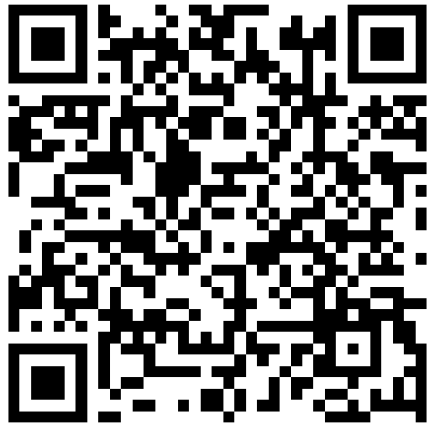
Support for Students with a Disability
Extended 40-minute career guidance and application appointments (email careers@qmul.ac.uk to request)
Resources for talking to employers about your disability
Specialist disability themed workshops.
Scan here to find out more

Slide 14
Organisations We Work With
Mentoring for neurodivergent students and graduates
Supporting ‘Autistic talent’ into work
Look out for events on QM Careers Hub!

Slide 15
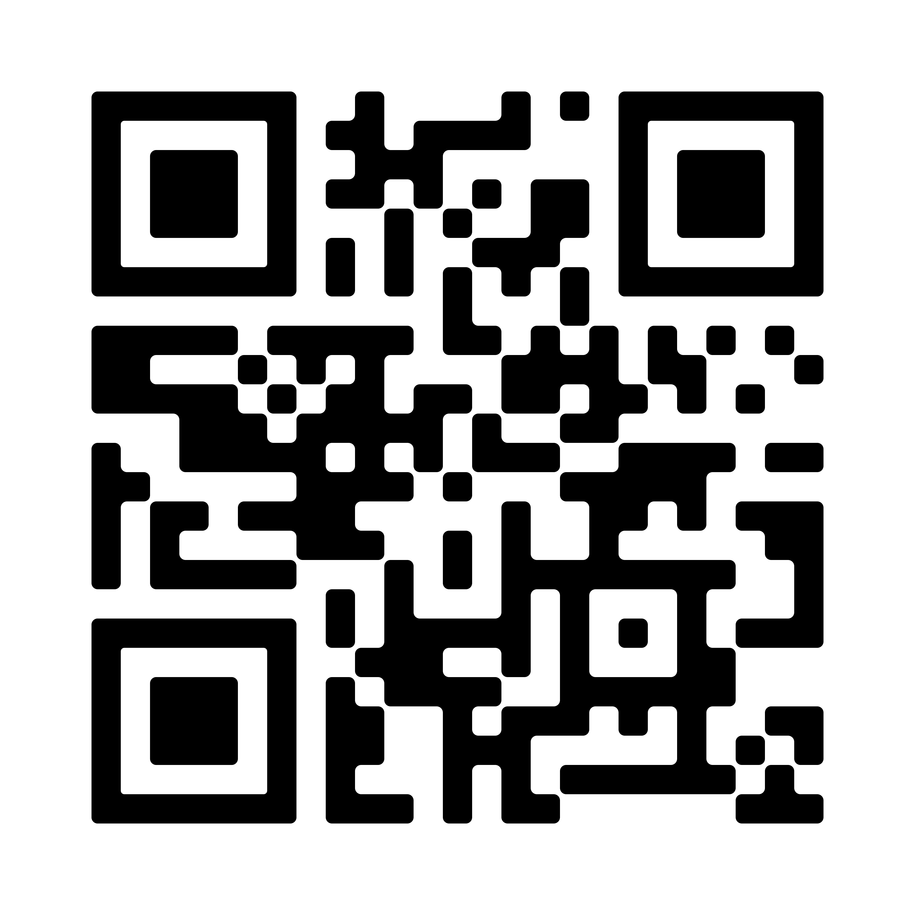
QM Careers Hub
To receive vacancies and events, complete your ‘Profile’ and…
Unlock your QM Careers Hub!
QR code to access QM Careers Hub
Notes:
Presenter Notes
Can demonstrate what QM Careers Hub looks like from a student’s perspective.
Show what their profile section looks like and that there are very minimal questions for them to fill in.
Also show what the ‘Career Discovery’ page is and how it is beneficial for the students.

Slide 16
QM Careers Hub video

Slide 17
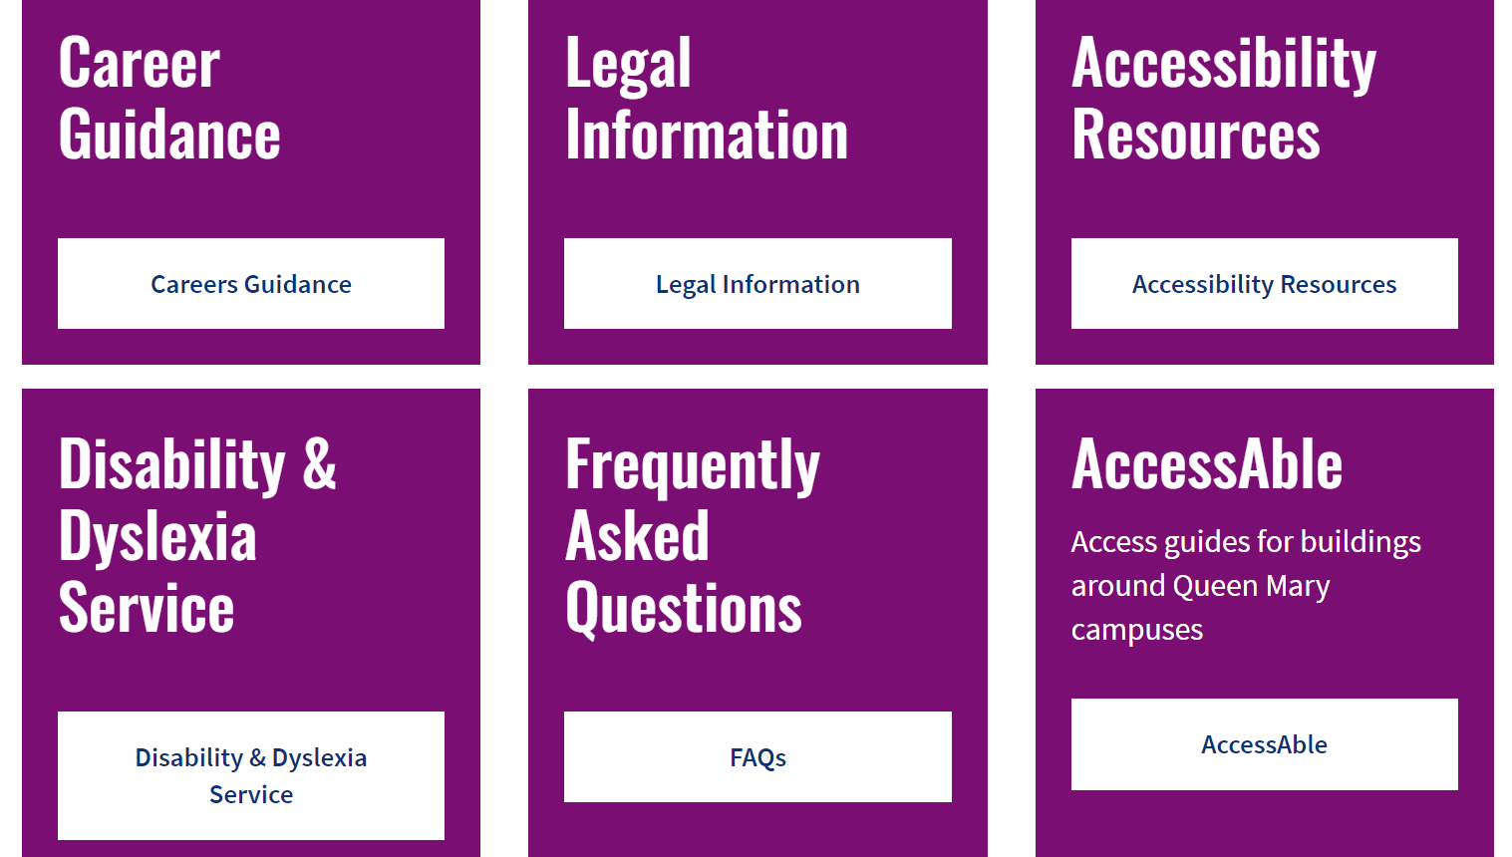
Additional Support
Notes:
Extended appointments (email careers)
Resources online
Main advice – contact us!

Slide 18
Any Questions?

