Slide 1
Advice and counselling service
Student wellbeing advisers

Slide 2
agenda
INTRODUCTION
ICEBREAKER
TRANSITION TO UNIVERSITY
ACTIVITIES
SUMMARY

Slide 3
Introduction
We are student wellbeing advisers within the Advice and Counselling Service. We will be going through a brief overview of the department.
Advice and counselling is located on the ground floor of the Geography building

Slide 4
Advice & Counselling department
Support
Counsellors
Mental Health Advisers
Student Wellbeing Advisers
Welfare
Sexual assault and Harassment adviser

Slide 5
Icebreaker
Favourite Things
How to play:
1. Write on a piece of paper your name, what you’re studying and a favourite thing. This could be a hobby, object or even a famous person!
2. Underneath, write down three reasons why it's your favourite thing.
3. Discuss this with your table/the person next to you
4. Feel free to ask that person more about their favourite things, or say if you share a similar interest :)

Slide 6
Game time - Taboo
We will split you up into two teams.
1 person within your team will be given a card with a ‘guess word’.
The rest of the team will need to guess what this word is- you will be given hints.

Slide 7
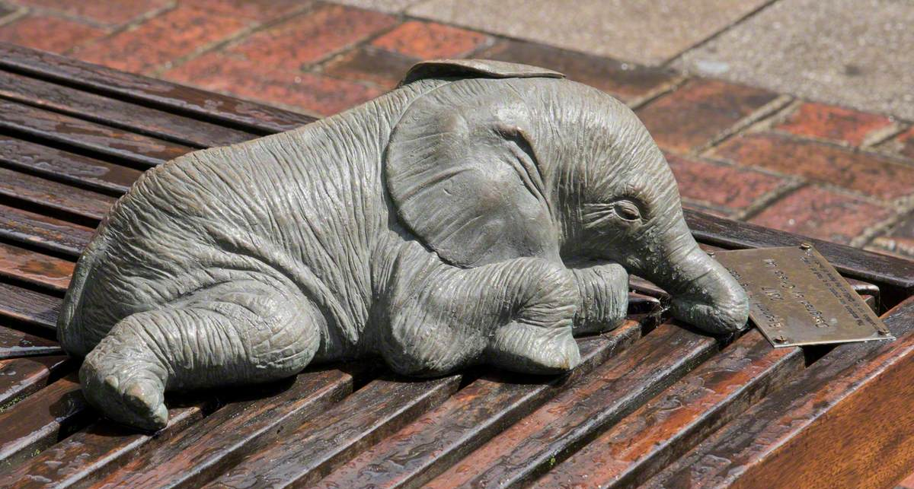
Activities
1. How many students were there at Queen Mary in 2022? Nearest guess wins
2. Can you name:
a. Any place to find hot food or drink on campus
b. Where to buy a QMUL hoody or branded stationary
c. The place to workout and play sports
d. the Students' Union's newest space for informal learning and socialising, with group study tables, pods, comfy furniture and a relaxed environment
e. Your student support officer!
3. Where would you find this elephant statue?
Notes:
Answers
1. (32000)
2. a) (Curve, Ground café, Draper's) (Whitchapel: The Griff Inn)
B) (Union Shop)
C) (Q-motion)
D) (The nest)
E) (explain SSO & help to find)
3. Library square
4. Who would you contact...

Slide 8
Activities
4. Who could you contact in each of these scenarios?
A) Struggling with some coursework and you are not sure if you will make the deadlines.
B) If you're feeling unwell and can't make it to a class.
C) You have an argument with a flatmate.
5. Over the next few days, think of a 'safe space' on campus where you can go to for a few quiet moments or to get a break from freshers.
Notes:
Answers
1. (32000)
2. a) (Curve, Ground café, Draper's) (Whitchapel: The Griff Inn)
B) (Union Shop)
C) (Q-motion)
D) (The nest)
E) (explain SSO & help to find)
3. Library square
4. Who would you contact...

Slide 9
What would you do?
Read the scenario below. You have a few minutes to discuss what you would do with your table.
Sally is a 1st year student at Queen Mary. Sally has missed the submission deadline for one of her assignments, she is concerned that she will not be able to catch up as she has more deadlines approaching. Sally is not sure what to do or how this could impact her grades.
What should Sally do?

Slide 10
What would you do?
l
Read the scenario below. You have a few minutes to discuss what you would do with your table.
Abdul is a 2nd year student at Queen Mary and since joining University he has been finding it difficult to make friends and has been feeling sad and lonely. Abdul has been attending less lectures as he feels anxious about trying to meet new people.
What should Abdul do?

Slide 11
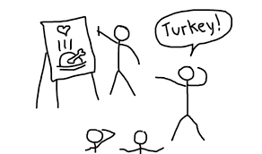
Activities
Pictionary
Take a card and describe what you see. We will draw this based off your instructions.
Remember, don’t tell us what it is!

Slide 12
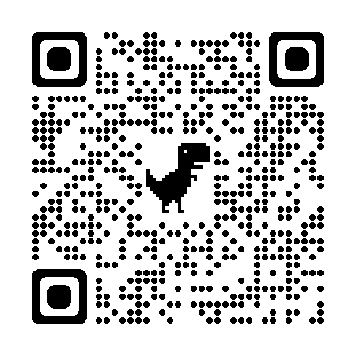
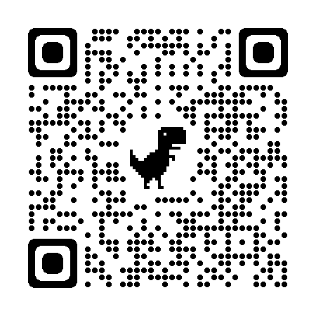
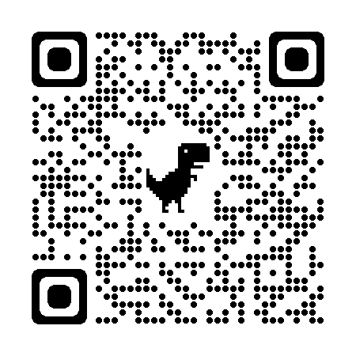
Signposting – Internal QM Services
Language Centre
01
QMSU's Get Active
02
QMSU What's On Page
03

Slide 13
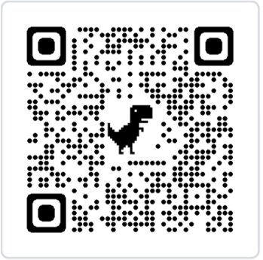
Thank you
Advice and Counselling:​
​
www.welfare.qmul.ac.uk/

