Slide 1
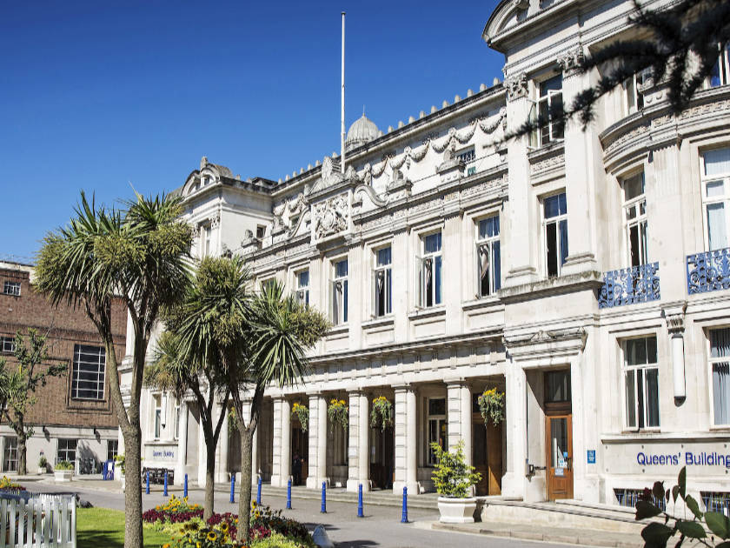
QMUL
CAMPUS
TOUR

