Slide 1
Dissertation workshop 3

Slide 2
Objectives for today…
Articulate the steps you need to take to complete and submit your ARM1 research proposal assignment.
Understand how to submit your dissertation topic so you can be allocated a supervisor.
Identify any further questions you have about the development of your dissertation proposal.

Slide 3
MSc marking guide
Criteria | Total available
Title and abstract (not included in word count) | 5
Introduction and background/rationale | 20
Research aims, question and objectives | 15
Methods | 20
Approach to analysis | 10
Expected contribution of your proposed research | 10
Timelines for your dissertation (not included in word count) | 15
Reference list and referencing (not included in word count) | 5
TOTAL | 100

Slide 4
iBSc marking guide
Criteria | Total available
Title and abstract (not included in word count) | 5
Introduction and background/rationale | 20
Research aims, question and objectives | 15
Methods | 20
Approach to analysis | 20
Timelines for your dissertation (not included in word count) | 15
Reference list and referencing (not included in word count) | 5
TOTAL | 100

Slide 5
Title and abstract
Try to include subject and study design in the title
Make it concise and punchy
The abstract is a summary of everything in the proposal – a sentence or two on each element
Write the abstract at the end!

Slide 6
Introduction and background rationale
What is the problem you are addressing? Why does it matter?
Drawing on key literature on your topic (use annotated bibliography if MSc) identify what’s already been done, what gaps are, what methods, theories, and frameworks have been used
Situate your own approach in relation to the above

Slide 7
Research aims, question and objectives
Aim: What do you hope to achieve?
Research question: What question is your research answering, in order to achieve your aim?
Objectives: What steps will you take to address your question?

Slide 8

Methods
What is your chosen method (e.g., narrative review, policy analysis, in-depth interviews) and how will this help you answer your question?
Why is this the most appropriate method?
Draw on methodological literature (use further reading lists)
Are there any ethical issues and do you need ethical approval?

Slide 9
Approach to analysis
What theoretical perspective are you approaching your topic from?
What frameworks will you use?
Why is this the most appropriate approach to answering your question?

Slide 10
Expected contribution of your proposed research (MSc only)
Who cares?
Who will this benefit?
How will it benefit them
Be realistic here

Slide 11
Timelines
Use a Gantt chart to plan your research timeline
This will help us (and you) to assess feasibility
Use it as a guide to see if you are staying on track
Gantt chart templates available under ‘Assessment information’ tab on QMPlus

Slide 12
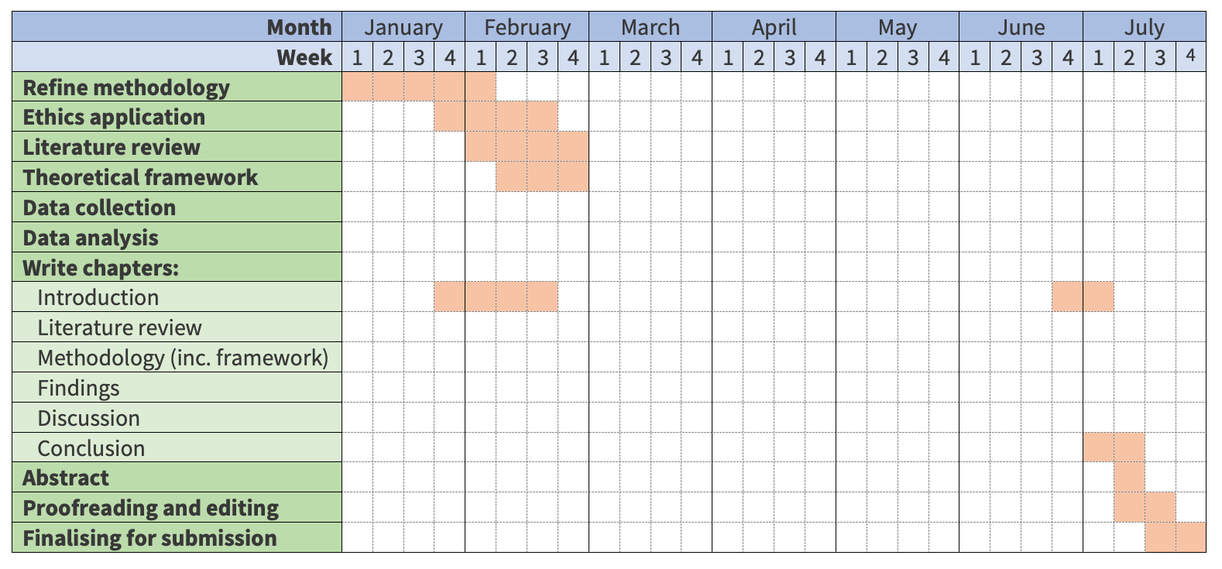
The Gantt Chart: An (incomplete) example

Slide 13
Reference list and referencing
Use either Harvard in-text referencing (author, date) [or (author, date: page number) if quoting directly]…
…or Vancouver (numbered endnotes)
Your reference list should be consistently formatted
Using referencing software (EndNote, Zotero, Mendeley) will make your life easier down the line, but requires a bit of upfront practice
Guidance on how to use these on the library website
If using software, do still double-check your references!

Slide 14
Key things to bear in mind
Feasibility feasibility feasibility!
Link rationale, aims, RQ, objectives, methods and approach to analysis
Read literature on methods and frameworks/analysis
Think carefully about timeline
Word count differences between MSc and iBSc (check you are looking at right guidance)!
Your project will change – you are not locking yourself into anything at this point

Slide 15

Any questions

Slide 16

Getting started with planning and writing
You should now have some understanding of your topic and relevant literature
Today we will work on the following sections of your research proposal:
  Intro and background rationale
  Methods
The process we use here can be used for other sections

Slide 17
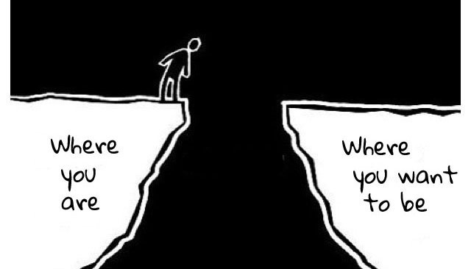

Slide 19

Get writing!
Thinking and writing are connected
Writing forces you to put down on paper what you know already
Helps you identify gaps and what you need to do to address them
Writing does not have to be perfect first time around
But you do need to start somewhere

Slide 20
The Task
Get into pairs
Referencing the requirement for each section you have 5 mins to write down:
  Information you know already
  Gaps in your knowledge things your are stuck on
  What you need to do to come un-stuck
You then have 5 mins each:
  explain what you have written down to your partner and how you plan to come un-stuck
  Your partner to give feedback on your proposed next steps – do they make sense, any alternative approaches, suggested forms of support? Etc.

Slide 21
Introduction and background rationale
What is the problem you are addressing? Why does it matter?
Drawing on key literature on your topic (use annotated bibliography if MSc) identify what’s already been done, what gaps are, what methods, theories, and frameworks have been used
Situate your own approach in relation to the above

Slide 22
Methods
What is your chosen method (e.g., narrative review, policy analysis, in-depth interviews) and how will this help you answer your question?
Why is this the most appropriate method?
Draw on methodological literature (use further reading lists)
Are there any ethical issues and do you need ethical approval?

Slide 23
Any questions/reflections?
You can repeat this exercise to help you get started with:
Research, aims, question and objectives
Approach to analysis
Expected contributions

Slide 24

Allocation of supervisor
Day of your ARM 1 assessment complete the dissertation topic survey.
You can do this even if you have an EC in place – we need basic info on methods, topic to allocate a supervisor.
Supervisor allocations will be circulated w/c 15th January.

Slide 25
Allocation of supervisor
Student number NOT username
Your name
Your programme of study (iBSc, iMSc, MSc or MRes
Draft dissertation title
150 words summerising drafts of your topic, aim, research question, proposed method
Any members of staff you have spoken to about your dissertation who you would like to supervise you

Slide 26

First supervisor meeting
Discuss your ARM 1 assessment feedback
Next steps you need to take, e.g. refining research question, more reading, reflecting on feasibility
Complete your dissertation supervisor agreement
You need to have a date scheduled for you first supervisor meeting by the 31st of Jan at the latest

