Slide 1
Dissertation Workshop 2
Turning a topic idea into a research aim and question

Slide 2
Learning objectives
Describe a what a research aim, and a research question is.
Demonstrate how to develop a research aim and question from a period of scoping research.
Plan how you will develop your dissertation aim and question and write this process up in your ARM1 assignment.

Slide 3

What do you know already about research questions?

Slide 4
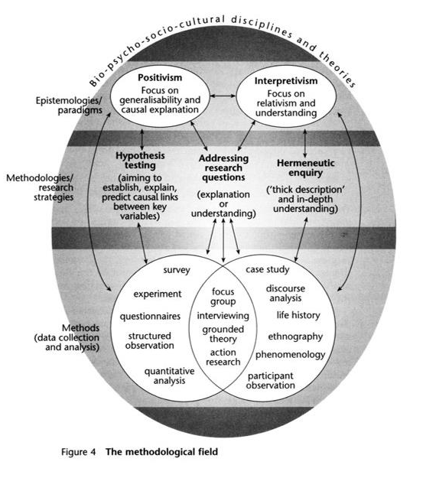
You already know…
There are different research paradigms/ theories of research
Different paradigms explore different kinds of research questions
Different kinds of questions should be explored though the application of different methods.

Slide 5
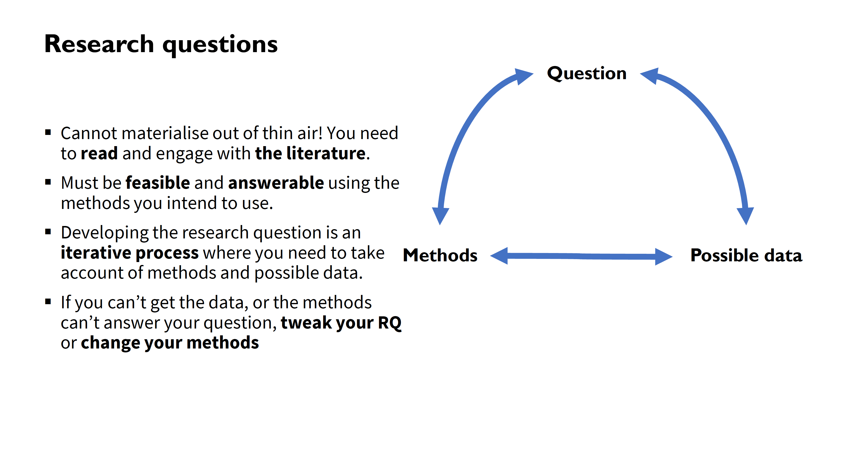
You already know…

Slide 6

What is a research aim?
Statement about the overarching goal or purpose of the research
An aim will help with decisions about:
Your research question
Methods of data collection
Approaches to data analysis

Slide 7

“Good questions do not necessarily produce good research, but poorly conceived or constructed questions will likely create problems that affect all subsequent stages of a study”
Agee, J. (2009) Developing qualitative research questions: a reflective process, International Journal of Qualitative Studies in Education, 22:4, 431-447

Slide 8

Why are research questions so important?
Help you maintain a clear vision of what you want to know/ summarise the key issue you want to investigate
Enable you to make a specific and meaningful contribution to a pre-existing or new field of research
Help you to identify the methods and approach you will use in your dissertation
Help you analyse and interrogate the data and evidence you gather through your research

Slide 9

What is a good research question?
A good research question (Blaxter et al., 2002; Laws, 2003 ):
Derives from a (practical or intellectual) problem
Provides direction (in terms of topic, theoretical approach and methodology)
Sets boundaries (e.g. sub-population).
Is expressed in specific , rather than vague and woolly terms
Can be addressed with evidence which you will (and can!) collect.
Thus, research questions help to:
Focus your field of study (topic) (Blaxter et al., 2002; Laws, 2003)
Link your research topic to a research strategy (Laws, 2003)

Slide 10
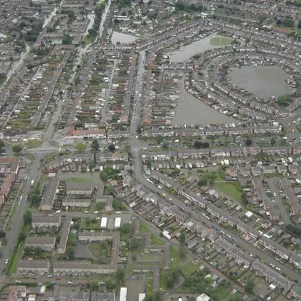
Example aim:
In collaboration with the residents of two deprived wards at risk of flooding in Hull, explore the fairness and feasibility community led climate and flood adaptation interventions and policies in the United Kingdom

Slide 11
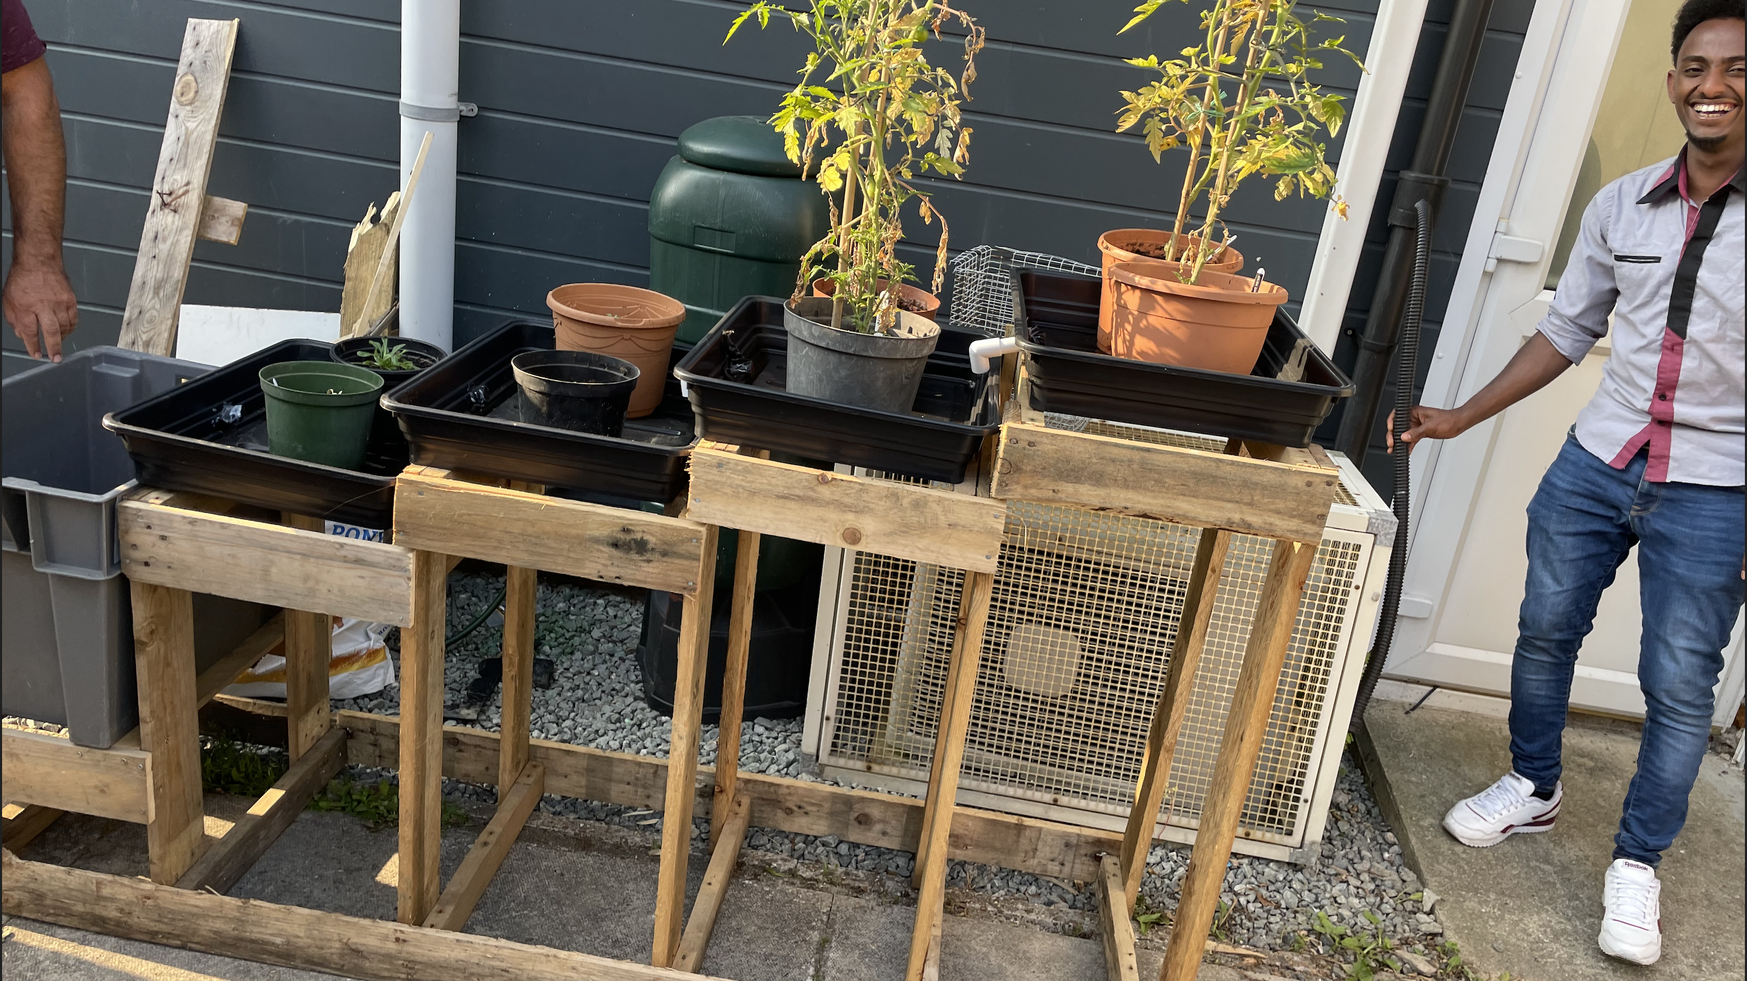
Example question: How do inequalities shape people’s engagement with community led flood and climate adaptation policies and interventions in Hull?

Slide 12
AIM: In collaboration with the residents of two deprived wards at risk of flooding in Hull, explore the fairness and feasibility community led climate and flood adaptation interventions and policies in the United Kingdom
Derives from a practical or intellectual problem: flooding, need to adapt to climate change and flooding, neighborhood inequalities, climate justice, localist policy agendas
Provides direction in terms of topic, theoretical approach and methodology: climate/environmental justice, co-production, qualitative
Sets boundaries: Hull, neighborhoods in Hull that have a high flood risk and high rates of deprivation
RESEACH QUESTION: How do inequalities shape people’s engagement with community led flood and climate adaptation policies and interventions in Hull?

Slide 13
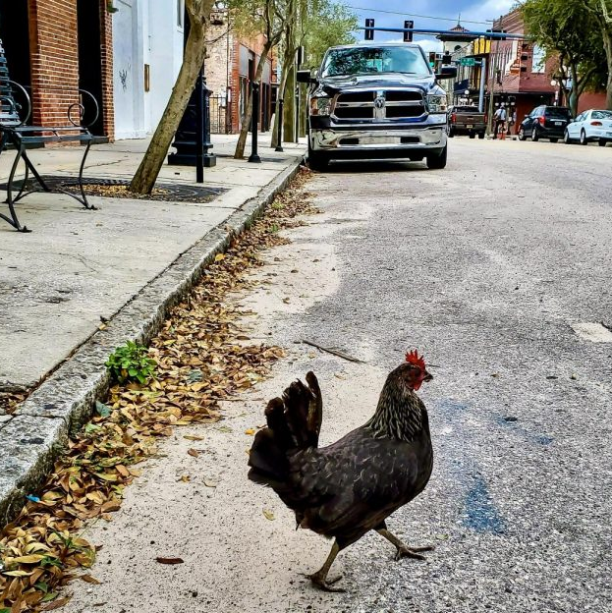
Which is the best and how would you research it?
Why did the chicken cross the road?
What were the conditions that led the chicken to cross the road on the 18th January 2019?
How has the highways act of 2019 shaped the road crossing experiences of chickens?

Slide 14

Exercise: paradigms, aims, questions and methods
Topic: Differences in access to the HPV vaccine globally
Positivist study: aim, question, methods
Interpretivist study: aim, question, methods
15 mins + 5 mins for feedback

Slide 15

Where does a research question come from?

Slide 17


Slide 18

Step 1: Developing your research question
Get into pairs
Set a timer for 3 mins
Talk your partner through the worksheet you completed in preparation for today
Your partner provides 5 mins of feedback/repeats back* on the following:
Clarity of broad topic area/problem
Main points from your description of current literature
Clarity of research gaps you might address
Clarity of your proposed research aim and question
*Please make notes on their feedback
Swap roles and repeat

Slide 19

Was that difficult? If so, why?

Slide 20
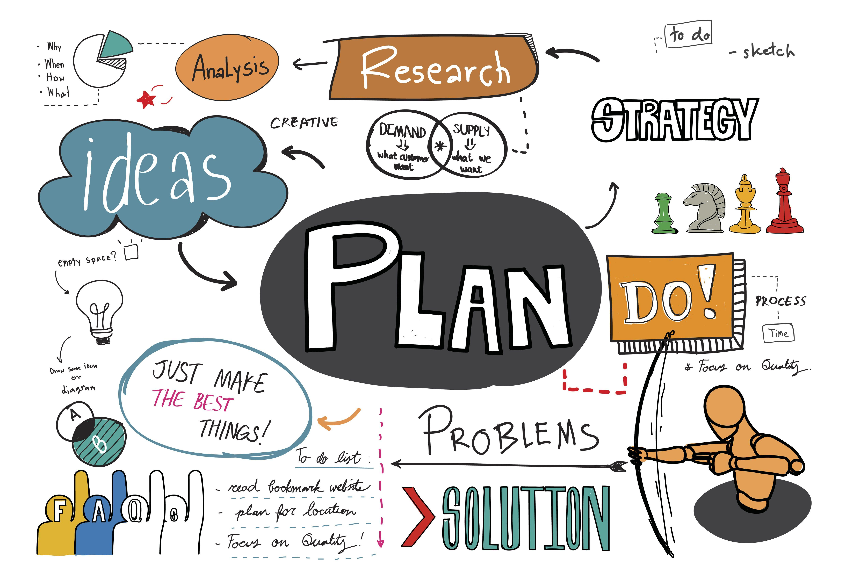
Step 2: Developing your research question
Look at the notes you made in your partner's feedback
What tasks do you need to do to improve on your:
Short topic description
Summary of the literature
Description of research gaps
Research aim and question
Tip: make sure you make the most of the study skills resources provided by the library (e.g. literature searching, using endnote)
10 mins and then feedback

Slide 21

Step 3: Developing your research question
Annotated bibliography deadline (MSc): 17/11/23
Research proposal deadline (iBSc and MSc): 15/12/23
When are you going to conduct the tasks, you need to undertake to:
Short topic description
Summary of the literature
Description of research gaps
Research aim and question
Tip: make sure you leave time to develop your methods, approach to analysis and contribution sections of the proposal

Slide 22


