Slide 1
Global Health Dissertation Workshop 1
(iBSc/iMSc/MSc)

Slide 2
Introduction and learning objectives
By the end of the workshop, you will be able to:
Describe the dissertation process and the learning activities it involves.
Recall how to find information and support about the dissertation.
Explain how you will start to develop a dissertation topic.
Create a plan for your term 1 dissertation activities

Slide 3

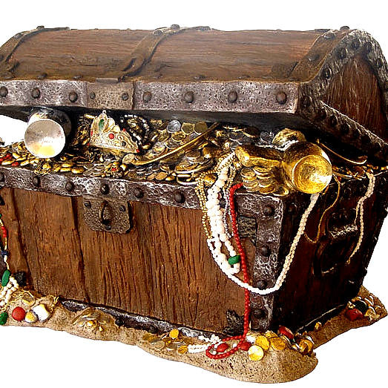
The pleasure and pain of a dissertation!

Slide 4


Slide 5

Shout out!

Slide 6
Who has/has not done a dissertation before?
If you have…
What was it about?
Did you enjoy/dislike the experience?
Why did you enjoy dislike the experience?
Is there anything you would do differently this time around?

Slide 7
What is a dissertation?
How does it differ to the assessments for you other modules?
What kinds of skills/knowledge do you need to produce a successful dissertation?

Slide 8
What is a dissertation?
An extended piece of academic or scholarly work that demonstrates:
A detailed understanding of a subject.
Exploration of a research question that arises from a detailed understanding of existing scholarly literature (or lack thereof).
Educated choice of and the application of research methods.
Demonstration of critical thinking.
A contribution to a field of research.
Ability to conduct an independent research project.

Slide 9


What is a dissertation?

Slide 10
What is a dissertation?
Dissertation structure and marking criteria
Go on to QM Plus and find the ‘dissertation assessment guide and criteria’
Take 5 mins to read through the dissertation assessment guide and criteria on your own.
Then get into pairs (with a fellow PG or UG colleague) and take 15 mins to work through the following questions
Abstract: at what stage in the dissertation are you able to write your abstract?
Background to Issue, Rationale and Objectives: where does a research aim come from?
Methodology and methods: what is the difference between your methodology and method?
Findings and results: what things should help to structure your presentation of findings?
Analysis, Discussion, Conclusion and Recommendations: how does your analysis, discussion, conclusion and recommendations chapter differ from your findings and results?

Slide 11


Slide 12
Abstract
The abstract is a concise summary of your dissertation, usually about 300-500 words long. You should write it at the very end, when you have completed the rest of the dissertation. In the abstract, make sure to:
State the main topic, aims and objectives of your research
Describe the methods you used
Summarise the main results
State your conclusions

Slide 13
Background to Issue, Rationale and Objectives
Establish you research topic and present the issue to be researched
What is the background and context of the research?
Why is this topic or issue important and for whom?
Discuss the state of existing research on the topic and the relevance of your work to a broader problem and/or debates:
  How does your research fit into the bigger picture?
  What are the key debates?
  What theories and concepts are used to explain and un-pack the topic?
Based on the above craft a research aim, research question and research objectives.
Briefly indicate how you will answer your question(methodology, methods and theoretical frameworks)

Slide 14
Methodology or methods
1. WHY?
Describe the methodology/theory of research that underpins the research
REALLY IMPORTANT! Why is this approach the best to answer your research question?
2. HOW
Method(s) of data collection
Details of where, when or with whom the research took place
Method of analysis

Slide 15
Findings and results
Once you have collected your data you need to present it and show:
  The characteristics of your findings
  Key themes
Must be organised in a logical manner
  headings and sub-heading
Descriptive, rather than analytical
Provides ’stuff’ that you can then work on further in the next chapter…

Slide 16
Analysis, Discussion…
Remind the reader of the aims, research question and objectives
Answer your research question
Discuss/explain if the research findings fit with can be explained by the theoretical frameworks built in the background
Discuss/explain if there are further theories and frameworks that help to explain the results
If any of the results were unexpected, offer explanations for why this might be.
Are there alternative interpretations of your data?
Discuss any limitations that might have influenced the results.

Slide 17
…Conclusion and Recommendations or SO WHAT?
What are the implications of your findings for relevant audiences (policy makers, other scholars, the public etc.)
How has your findings contributed to knowledge in the field of global health?
Identify any limitations of the research?

Slide 18
Any questions?

Slide 19


Slide 20
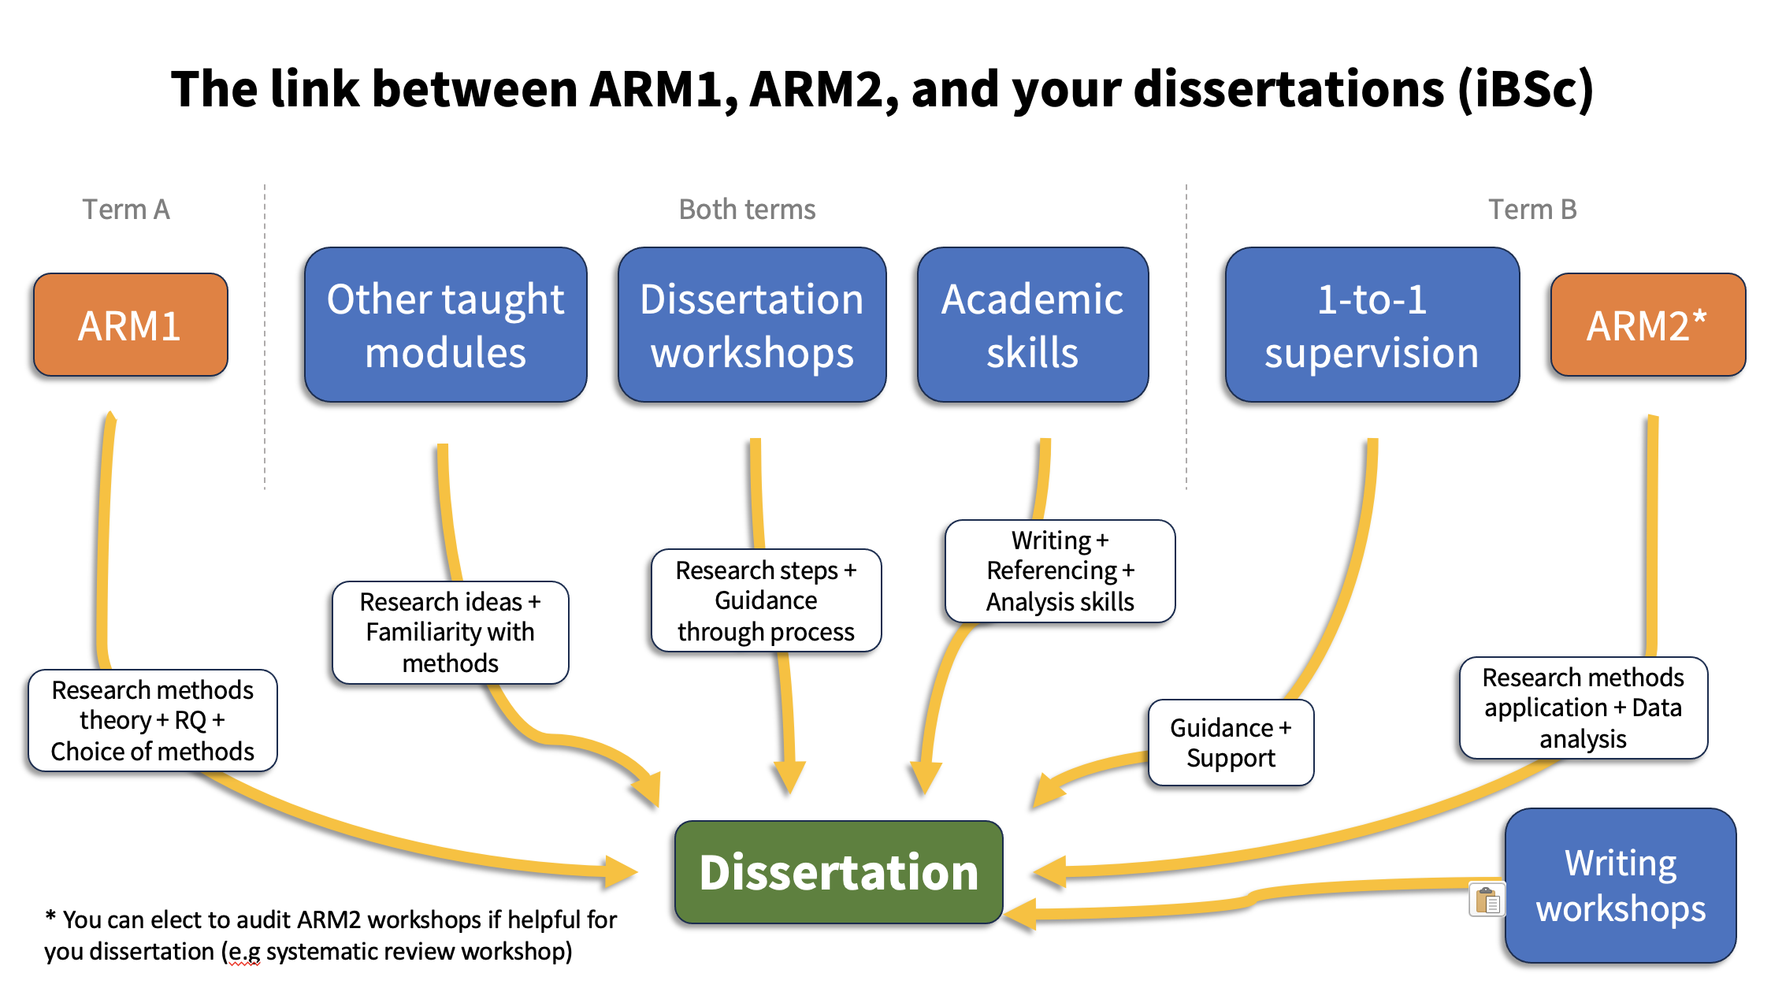
The dissertation process: iBSc students

Slide 21
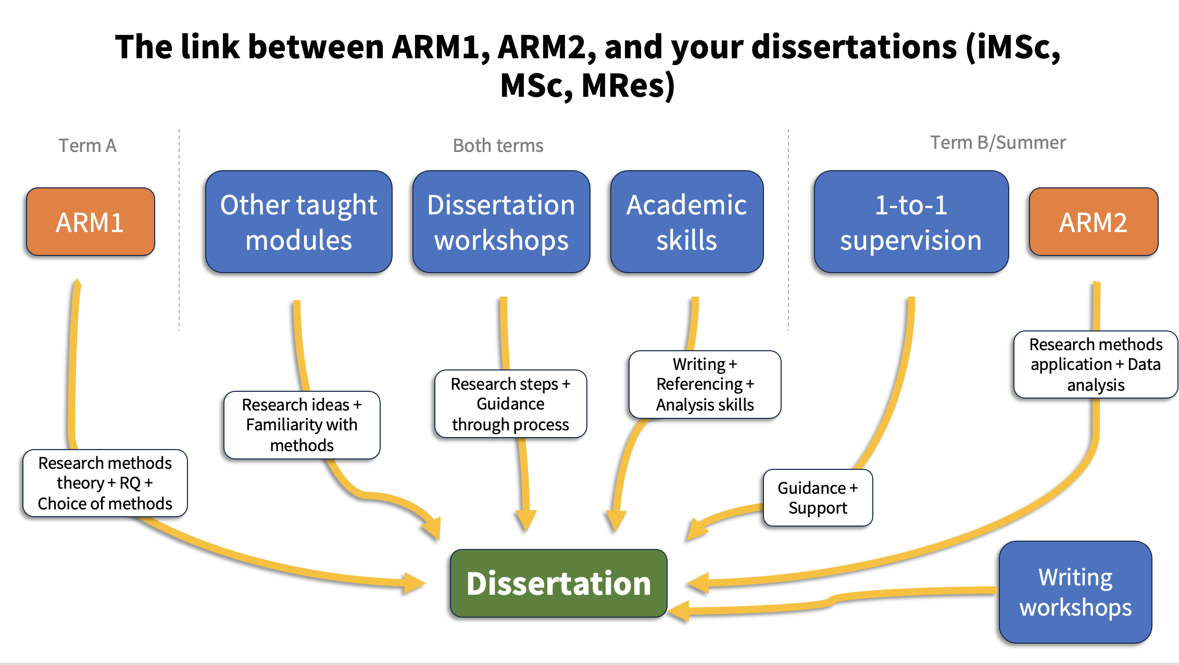
The dissertation process iMSc, MSc and MRes students

Slide 22

Get into a group of 4(ish)

Slide 23
What should you be doing and when
iBSc | iMSc/MSc/MRes
Term 1: Develop an understanding of your topic, design research aims/questions, and a provisional research plan | Term 1: developing a topis, research aims/questions and a provisional research plan (ARM 2 assessment)
Term 2: Finalise your research plan with you supervisor, gather relevant research skills, conduct the research and writing up | Term 2:Finalise your research plan with you supervisor, gather relevant research skills, begin to conduct the research
Term 3: Writing up, getting feedback on a whole draft and submitting | Term 3: Continue to conduct the research and writing up
 | Summer: Writing up, getting feedback on a whole draft and submitting

Slide 24
Support for your dissertation in term 1
3 x Term 1 workshops
The dissertation pages on QM Plus
The library and study skills support
Academic staff – ARM 1, your adviser or staff who have knowledge of your research topic
Your supervisor (will be allocated at the start of term 1)
Your peers

Slide 25
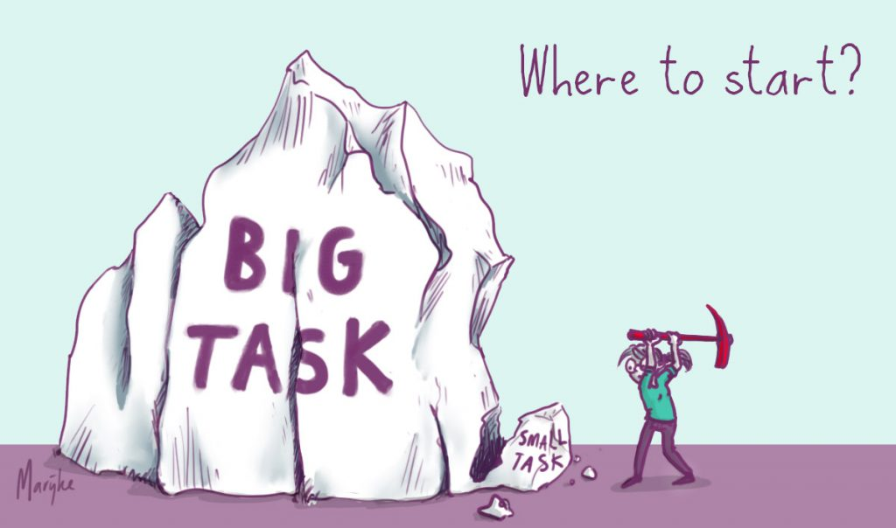
Forming a dissertation topic

Slide 26
Preparation for the next workshop
Workshop 2: develop a research question
In preparation for this you need to get to know your topic: key debates, key publications and researchers, theoretical frameworks, commonly used methods etc.
What does the preparation entail?

Slide 27
Plan your preparation
Take 10 mins to develop a plan of work between now (week 4) and the next workshop (week 7)
How are you going to get to know your topic OR choose a topic?
What tools/activities are available to help you do this?
When will you do this?
Materials that will help you develop your plan:
ARM 1 assessment (for iBSc students too)
Your timetable
The study skills area on the QM library website
The Background to Issue, Rationale and Objectives section of the dissertation criteria document (see QM Plus)
These slides.

Slide 28
Share your plan….

Slide 29

Up and coming dissertation activities
Keep on engaging with ARM 1!
Week 5: Dissertation supervisor list and topic areas released – talk to them
Week 7: Workshop 2

Slide 30
Any questions?

