Slide 1
Summer School
Environmental Impacts on Health and Disease
Stavroula Kanoni, PhD, PGCAP, FHEA
Reader in Nutrigenetics and Cardiovascular Health
Academic Lead (Dep) Environment & Health Multi-Disciplinary Theme
Fellow Digital Environment Research Institute (DERI)
s.kanoni@qmul.ac.uk

Slide 2
Journal Club: The ethical aspects of exposome research

Slide 3
What is a systematic review?
https://www.cochrane.org/

Slide 4
Introduction
Genetic factors: 10-30% of disease risk
Environmental risk factors
Exposome research
Map and investigate ethical issues relevant to exposome research
Limited literature on ethical implications of exposome research
Aim: Perform a comprehensive overview of the ethical aspects of exposome research by categorizing the various ethical aspects that are mentioned in the exposome research literature

Slide 5
Methodological choices
Identify arguments that either support or oppose particular ideas
Not an attempt to assess the quality of these arguments -> systematic collection and description of all the relevant articles in which particular arguments occur
Review ethical aspects instead of “reasons for and against” -> aim is to map the ethical aspects of exposome research and not to narrowly identify the reasons for and against doing exposome research

Slide 6
Search strategy
Search that included the term “exposome” or potential derivatives of the word “exposome” and ethics, morality, or words that are derivative from these -> 9 articles, none of which substantively addressed the ethics of exposome research
Search query that covers not only the term “exposome” and derivative words, but also related research fields and approaches that come together in the exposome research program (i.e. -omics fields, biomonitoring, and biomarkers research)
PubMed, Scopus, and Web of Science because these databases cover published material within biomedical and epidemiological research in a comprehensive way
Original searches on 12/02/2021 and an update search on 08/06/2022

Slide 7
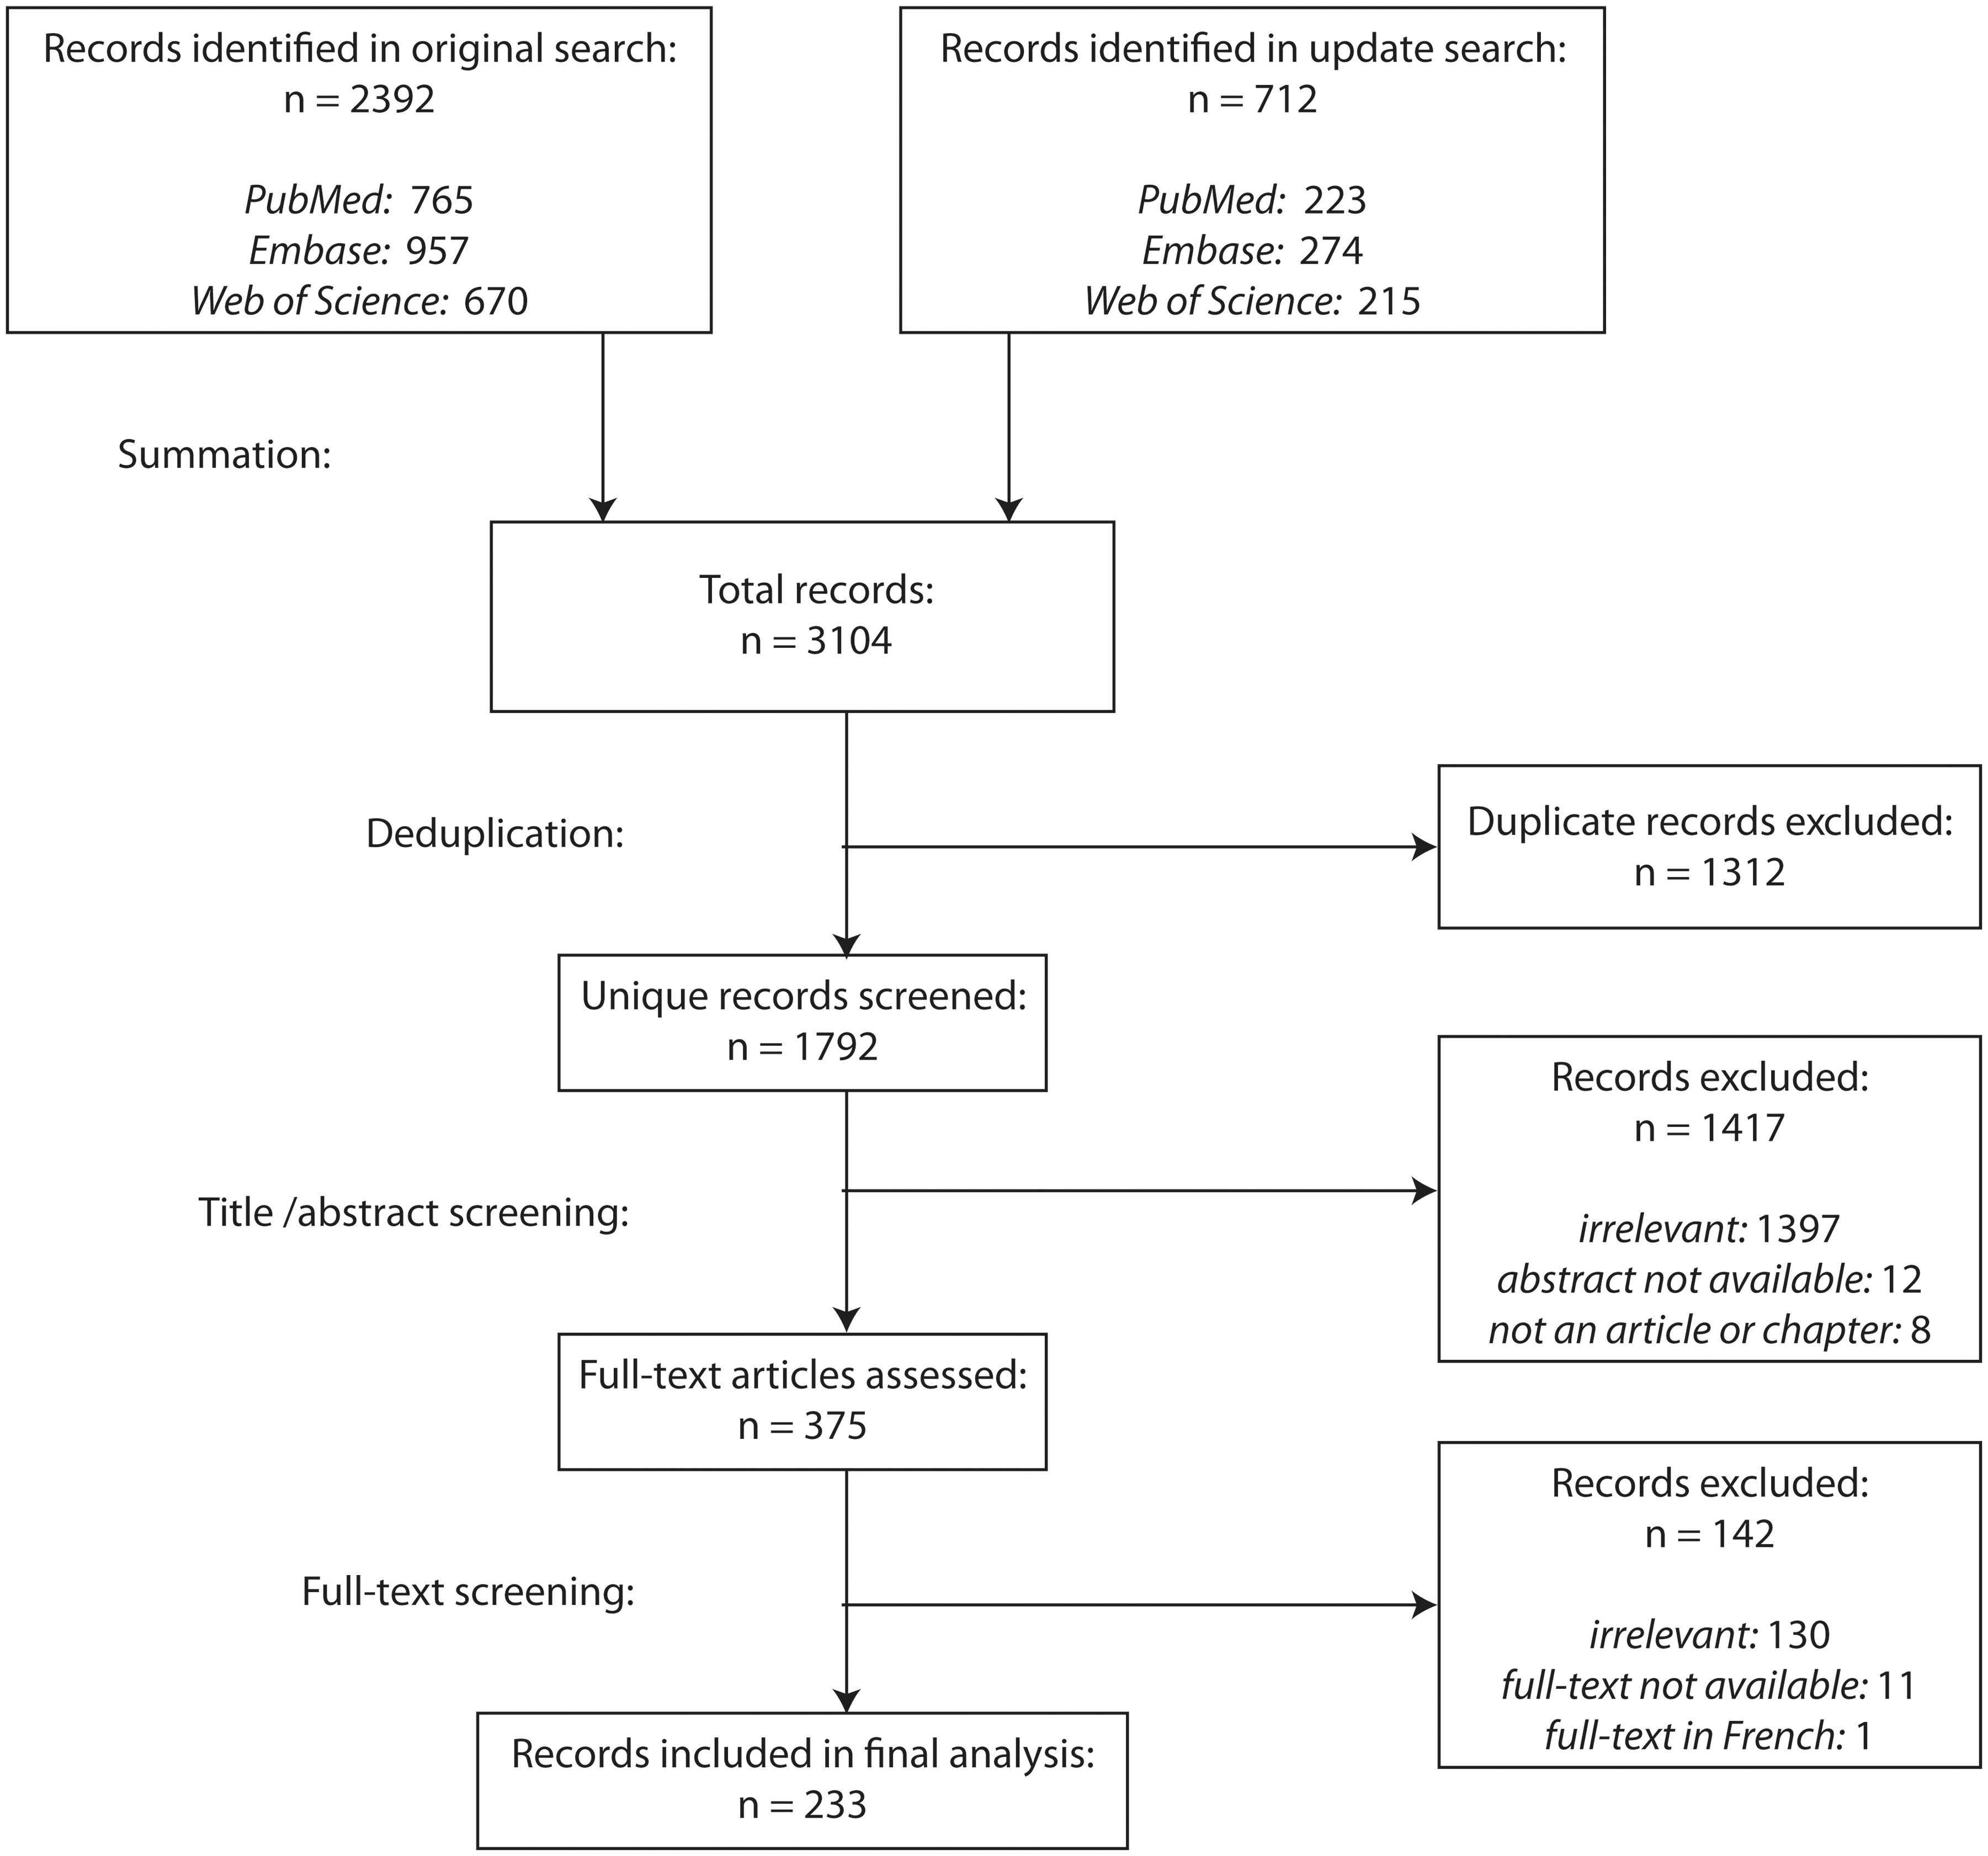
Article selection and inclusion criteria

Slide 8
Data extraction and analysis
Categories of ethical considerations -> thematic analysis to connect ethical aspects mainly to categories that are important from the perspective of the practice of exposome research
Synthesis/formulation of themes, sub-themes, and paragraphs -> combination of inductive and deductive reasoning
Within single paragraphs:
group multiple statements that view an idea from the same perspective
contrast statements that provide different perspectives on the same point

Slide 9
Theme 1: Research program goals
Identify environmental factors
Biological effect on human body
Improve human health
Ethical concerns:
How do the exposome research goals align with other goals that are deemed valuable (such as policy goals or values from the funder)?
Which general considerations should be incorporated when exposome projects are being set-up with concrete goals, such as the investigation of a particular health outcome, time slice, or community?

Slide 10
Theme 1: Research program goals
Exposome research aligning with other goals
Biomedical enterprise -> alleviate human suffering, mitigate environmental harms and generally improve the human condition
Omics -> human well-being (economic, health, and social development)
Develop a robust system that ensures the full societal benefits of research and the communal good
Assess disparate research fields with different goals that are united under a single program from an ethical point of view

Slide 11
Theme 1: Research program goals
Exposome research incorporating values
Research goals are affected by societal, market, health and environmental, and policy and regulatory demands
Ethical theory -> select the least harmful projects that most improve health on a global scale
Biomonitoring projects to be designed with specific policy goals
Omics technologies -> drive research vs being a tool for well-trained epidemiologists
Publicly funded scientific research -> assumptions, impact on communities and individuals, and include communities in the scientific process

Slide 12
Theme 2: Research standards
Exposome research
Multidisciplinary and innovative methods
Existing standards need update
Ethical concerns:
assay validity
peer review
ethics committees
training programs for researchers

Slide 13
Theme 2: Research standards
Measurement technologies:
Standardized controls for high-content/high-throughput technologies # false positives -> erroneous interpretations of studies
Dynamic development for innovation in the field of omics research -> flip side: excessive consumerism and risk the inappropriate use of laboratory testing
Ethical proteomics -> clinical utility of proteomics

Slide 14
Theme 2: Research standards – Peer Review
Lack of reviewers with multidisciplinary and/or bioinformatics expertise
Register for the data and detailed computational procedures (github) -> reproducibility of statistical analysis
Post-publication peer-review process
Not allowed: “Data will be made available upon request to the authors”
Research integrity

Slide 15
Theme 3: Research tools
The exposome research program advocates the usage of agnostic approaches for discovering and tracking exposures and their effects on the human body
Exposures that are part of the exposome and are clustered together -> expotype
Researchers should only gather data necessary to address a specific scientific question
BIG-data nonhypothesis driven approaches

Slide 16
Theme 3: Research tools – Data sharing
Personal and health data sharing
Scientific development
Harmonization of international database
Replication of results
Improvement of methods
Transparency & accountability
Statistically relevant results for rare health conditions
Federated platforms for data to be digitized, integrated, structured, centralized, secured, and standardized (DISCSS)
Data verification
Exposome research -> aims to analyze all of the exposures during lifespan and the biological responses -> data from a multitude of sources outside and inside the body -> data sharing & integrating
Privacy protection issues
IP protection issues
Public trust

Slide 17
Theme 3: Research tools – Study design & Evidence

Slide 18
Theme 3: Research tools – Sources of bias
Bias
Misclassification of exposure, biomarker or health status
Model overfitting or underfitting
Unreasoned algorithm selectivity
Socioeconomic participation bias
Selection or nonresponse bias (invasiveness, inconvenience, or physical discomfort )
Existing health disparities
Racial and ethnic minorities are less likely to participate in biobanks -> hindered discoveries based on omic data
Historical ethical violations (Tuskegee Study)
Diverse groups and underrepresented communities should be included -> improve health inequalities and address environmental justice
Socioeconomic participation bias in human biomonitoring studies is a form of environmental injustice -> those who are most exposed and vulnerable are the least monitored and represented in research

Slide 19
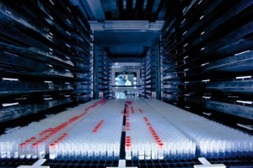
Theme 3: Research tools – Ethical aspects of biobanking
Need to standardize the methodology of sample collection and storage
Biobank policies -> standardized, harmonized, governance structures need to be accepted by all stakeholders to ensure appropriate sample access for research
Biobanks should be established on a national as well as an international basis
Forward thinking about what happens to samples, data, chains of informed consent for the continual use of samples, scientific consequences of losing rare sample types, and other problems when biobanks have to close down or otherwise need to eliminate stored samples and data

Slide 20
Theme 4: Study participants
↑ measurements -> ↑ burden to the participants -> ↓ participation rates and ↑ reporting bias
Potential consequences of data leaks:
People’s medical conditions become public -> societal discrimination
Insurance companies might have the right to request medical information from, or authorization to access medical records of, a person who wants to take out life insurance (Sweden)
Participants’ right to withdrawn consent:
Anonymised samples -> cannot be withdrawn
Double coded samples shared with collaborators -> cannot be withdrawn
Scientists must be honest with participants about the extent to which their samples and data can be destroyed upon their request

Slide 21
Theme 4: Study participants
How should we take into account new technological developments that can protect privacy?
Security systems and de-identification algorithms used by banks in the financial sector
DataSHIELD technology is especially suited for privacy protection because results returned to the analyst can be carefully created to be non-disclosive and match the policies of the data provider’s data governance rules

Slide 22
Theme 4: Study participants – Returning results
Should researchers return results to the participants?
Requirement to return results only when participants have consented to that
Modern advances in environmental biomarker technology precede knowledge of how to address unexpected findings -> design a thoughtful communication plan at the outset of a study and articulate it in the informed consent process
Researchers may not give participants false expectations or pressure them because that would be patently dishonest and unethical
Biomonitoring may blur the distinction between environmental and lifestyle risks in the minds of participants, causing them to feel responsible for exposures that are not part of their lifestyle
Dissemination of epigenetics include exaggerated and premature claims about health risks, we need to clearly communicate about what the risks actually are
Costs of communicating results to research participants

Slide 23
Theme 4: Study participants – Returning results
Results returned to participants
Results that benefit clinical care
Results outside clinical care
Results with emotional, cognitive, behavioural or societal value
Actionable results
Which results should we return to participants?
Secondary, unanticipated, or incidental findings
Extensive counselling to understand which unrelated conditions could turn up in incidental genetic findings
Ethical issues related to the disclosure of incidental findings, or the return of results -> cognitive capacity of research participants (i.e. children)

Slide 24
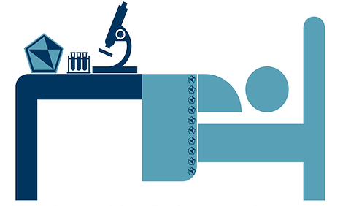
Theme 5: Consequences of research products
Combined and sustained effort of exposure scientists and clinicians
Clinicians
Exposure scientists
Clinical translation of exposome research
Exposome research can become clinically relevant -> bench-to-bedside and cohort-to-bedside
Integrative strategies -> bioinformatics, omics studies, and systems biology -> better understanding of complex diseases -> personalized medicine
Environmental and occupational exposure data -> no part of medical history taking in clinical settings -> urgent need for bridging and overcoming silos
Potential barriers: biomarkers are splintered into numerous costly patent-protected tests -> FDA approval -> health care cost

Slide 25
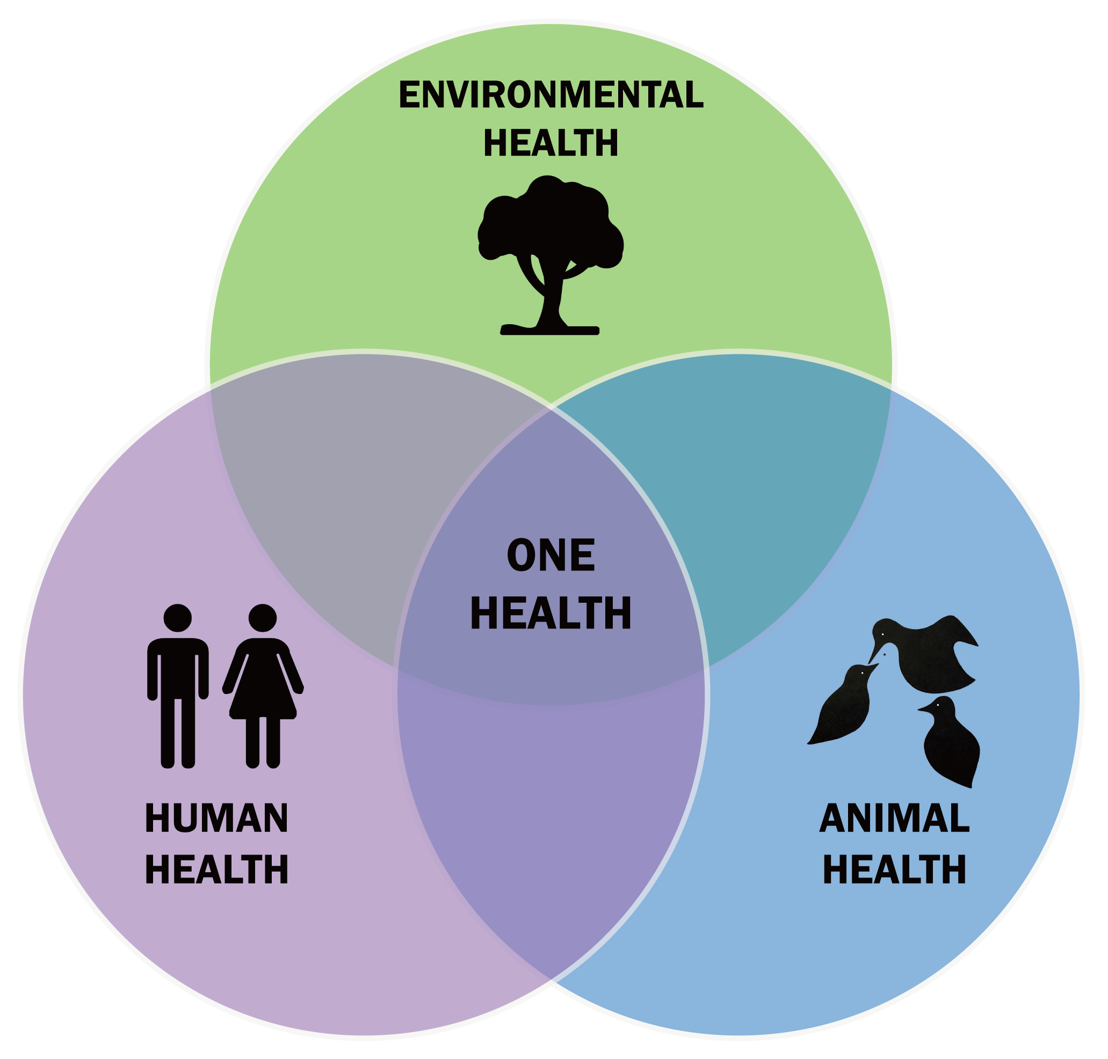
Theme 5: Consequences of research products
Clinical translation of exposome research
OneHealth approach
One Health is a collaborative, multisectoral, and transdisciplinary approach — working at the local, regional, national, and global levels — with the goal of achieving optimal health outcomes recognizing the interconnection between people, animals, plants, and their shared environment.

Slide 26
Executive Summary
Theme 1: Research program goals
The exposome research program aims to improve human health by creating the tools necessary to analyze all bodily exposures and their corresponding biological responses throughout an individual’s lifespan. This prompts the question how the goals of the exposome research program align with other goals, such as advancing human wellbeing or alleviating human suffering. It also raises the question which general considerations should be incorporated into the concrete goals of specific research projects, such as policy goals or ‘stakeholder’ voices.
Theme 2: Research standards
Exposome research and other multi-omics research create new tools, perform complex interdisciplinary analyses and result in scientific uncertainty. In light of these advances, there is a need for academic journals, educational programs, ethics committees and researchers using new measurement technologies to adequately update their research standards. Doing so would safeguard a multitude of values, such as research integrity, innovation and researcher competency.

Slide 27
Executive Summary
Theme 3: Research tools
Exposome research uses data-driven agnostic screening approaches to discover and track expotypes (clusters of exposures). Such data gathering might conflict with the principle of data minimization. Relatedly, data sharing and integration are of enormous value to exposome research for many reasons, such as generating more scientific progress, allowing for data verification & replication and creating a reproducible and accountable scientific practice. However, data sharing and integration practices need to be evaluated in light of values with which they might conflict, such as privacy, participant integrity and data security. Next, because population health research requires the statistical study of a subset of individuals from a population, there are also ethical aspects relating to statistical bias. This includes ideas such as the need for a diverse dataset to achieve external validity, the potential of artificial intelligence to reinforce existing misdiagnoses and attempts to distinguish between desirable and undesirable biases. In terms of research infrastructure, biobanks are an important source of data for exposome research. It is mentioned that biobanks need to be economically sustainable and require standardized and harmonized policies that do not hamper innovation. Intellectual property rights are also a recurring topic in the literature; discussions contain familiar questions with respect to the justification of biological patents, as well as worries about the chance that patents hamper research progress. Because researchers are in the process of creating a reference exposome, we grouped discussions about the value of population-level data for individual risk assessment with discussions on the reference epigenome.

Slide 28
Executive Summary
Theme 4: Study participants
Exposome research analyzes an increasing number of exposures and biomarkers within populations, which allows for an increased resolution of both disease etiology and individual behavior within populations. In this respect, exposome research touches on all aspects of the rights of study participants and the obligations of researchers towards study participants. For example, there are questions concerning the property rights that participants hold and can exercise over their bodily materials and data, and the extent to which participants should be burdened and rewarded for participating in research. Similarly, the increased complexity, scope and resolution of exposome research requires a reevaluation of the ways in which researchers can best safeguard (data) privacy, present potential participants with good informed consent forms, as well as determine which type of consent is best for their research. Researchers also need to think about the communication of results to study participants: which data they return, how to return them, and how or whether to provide exposure reduction strategies and exposome counseling. Important aspects include the participant’s ‘right to know’ and the question whether reporting results either causes unnecessary fears or empowers participants. Similar discussions occur on the topics of privacy and informed consent, which contain questions surrounding the best ways in which to protect privacy and organize informed consent; especially in light of increased scientific knowledge, advances in digital infrastructures and rights of participants.

Slide 29
Executive Summary
Theme 5: Consequences of products
As its research program comes to fruition, the products of exposome research will have consequences to various domains of human activity. To anticipate the ethical aspects of those consequences, several papers suggest employing methods such as SWOT-matrices, speculative scenario’s, comparisons to the ethics of genomics, and ethics parallel research. Because exposome research aids in the push towards more precise and personalized health knowledge, it also has several effects on public health practices and the use of reference values. Furthermore, there are discussions of how exposome research can affect ‘distributive justice’ in either creating or reducing unjustified health inequalities. Similarly, there are discussions on how exposome research could be used to discriminatory ends. The potential effects of exposome research on law and international treaties are also discussed in the literature. Advances in research might provide new types of knowledge or evidence that require updating environmental and reproductive tort law, human rights and ethics declarations, and non-discrimination and privacy law. Next, because exposome research could allow for better stratification and diagnosis, there are discussions about ethical aspects related to the clinical translation of exposome research, such as: the proper treatment of patients who are not eligible for personalized treatments, the explainability of artificial intelligence in diagnosis, and direct-to-consumer diagnostic testing. There are also discussions on how individuals can benefit from exposome information and whether exposome research will lead to more individual responsibility for health issues that individuals can’t directly affect. Other fields of exposome-application are occupational health and forensic science, where (classic) issues of privacy, discrimination and responsibility arise. Exposome research also aids in an increased molecular understanding of health and disease. This raises ethical aspects relating to data overload for medical professionals, the increasing distinction between molecular problems and felt symptoms, and the corresponding potential neglect of non-molecular factors relating to health.

Slide 30
@StavroulaKanoni

