Slide 1
Food, diet and other health behaviours
Environment and Health/International Politics of Global Public Health Summer School

Slide 2
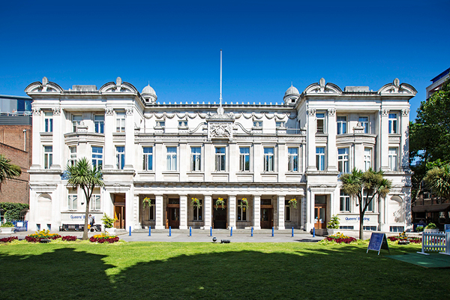
0. Agenda
Some key health behaviours and a focus on diet and nutrition
How does the environment effect what you eat
Should we and how can we change the environment to improve population health?

Slide 3
1. Key health behaviours

Slide 4

Women outlive men in every region of the world
Life expectancy at birth globally is 74.2 for women and 69.8 for men
In low-income countries the gap is smaller (64.5 vs 60.0)
In high-income countries the gap is bigger (83.4 vs 78.2)
Women on top
From: WHO report shows that women outlive men worldwide
BMJ 2019; 365 doi: https://doi.org/10.1136/bmj.l1631

Slide 5

Women outlive men in every region of the world
Life expectancy at birth globally is 74.2 for women and 69.8 for men
In low-income countries the gap is smaller (64.5 vs 60.0)
In high-income countries the gap is bigger (83.4 vs 78.2)
Why???
Very happy older women
From: WHO report shows that women outlive men worldwide
BMJ 2019; 365 doi: https://doi.org/10.1136/bmj.l1631

Slide 6
What do you think?

Slide 7
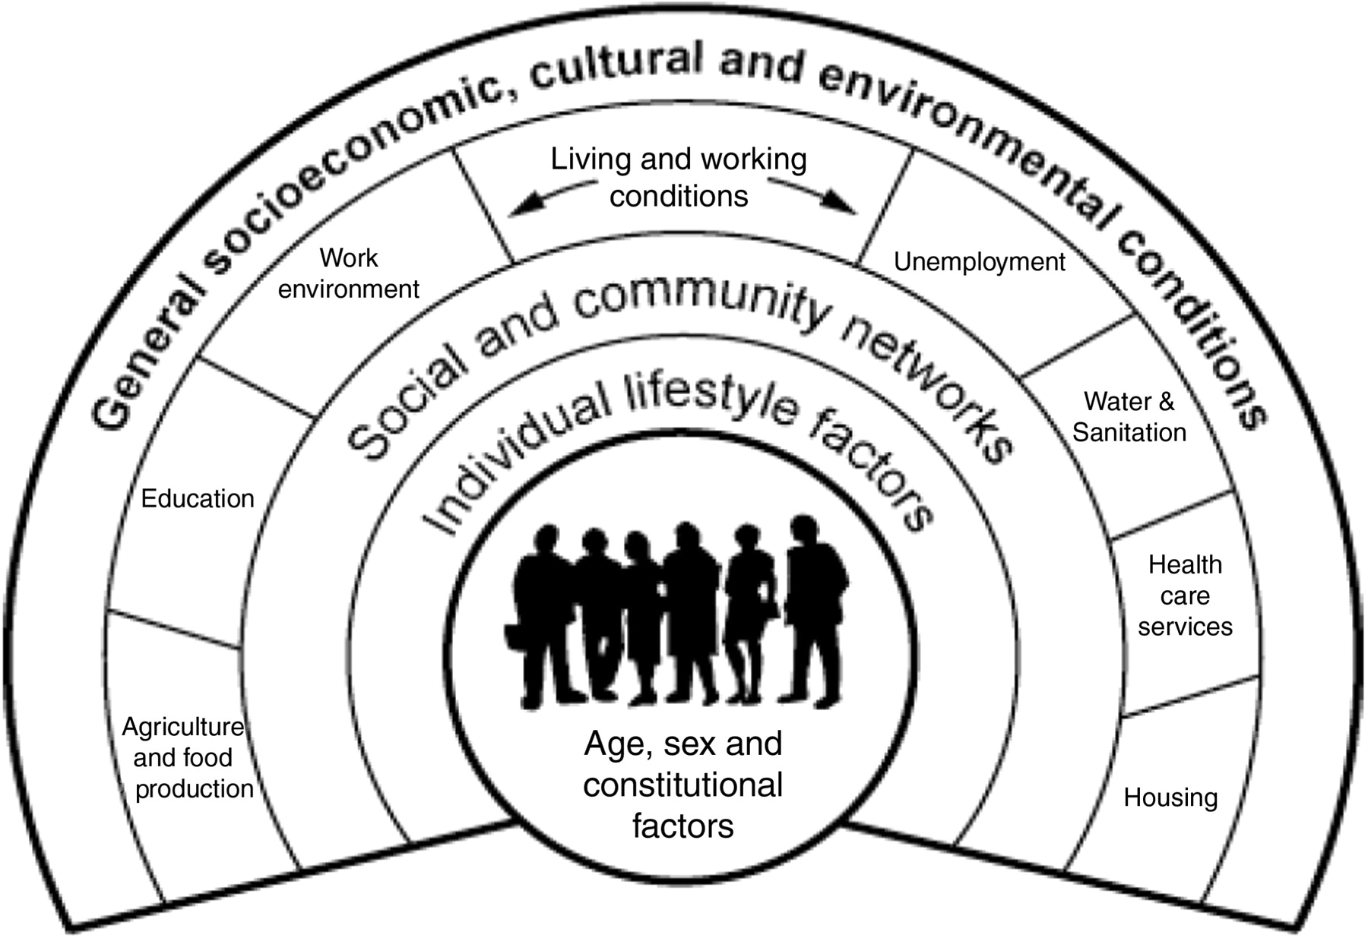
Notes:
10:20

Slide 8
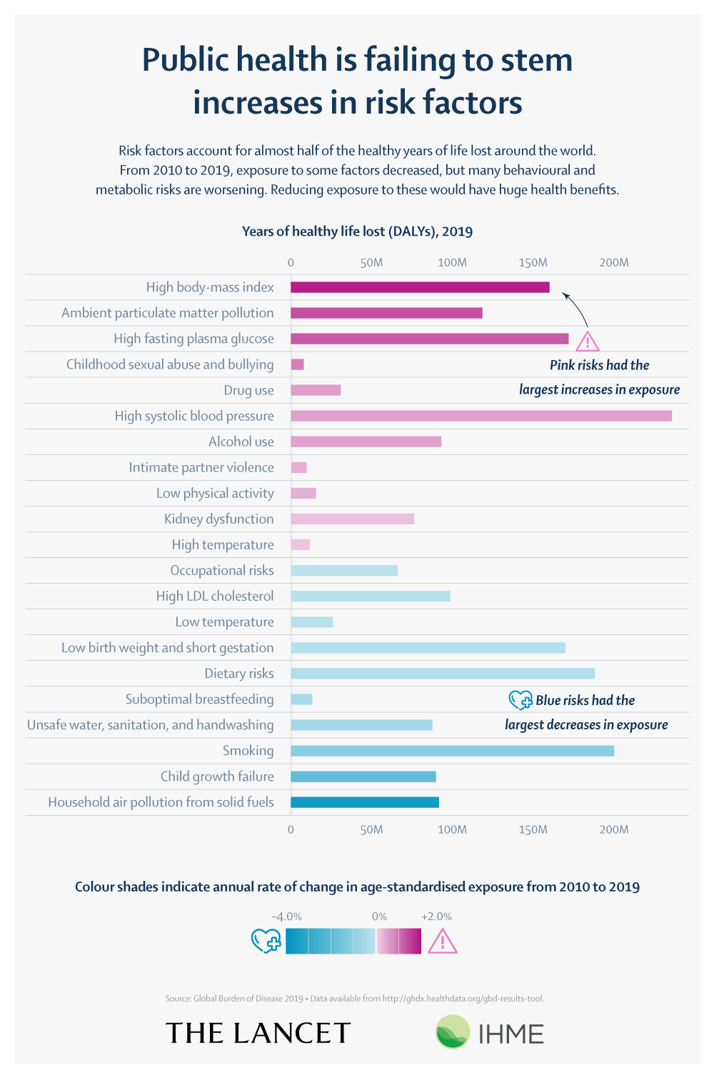
The most important risk-factors for death, 2019

Slide 9
Food and diet

Slide 10
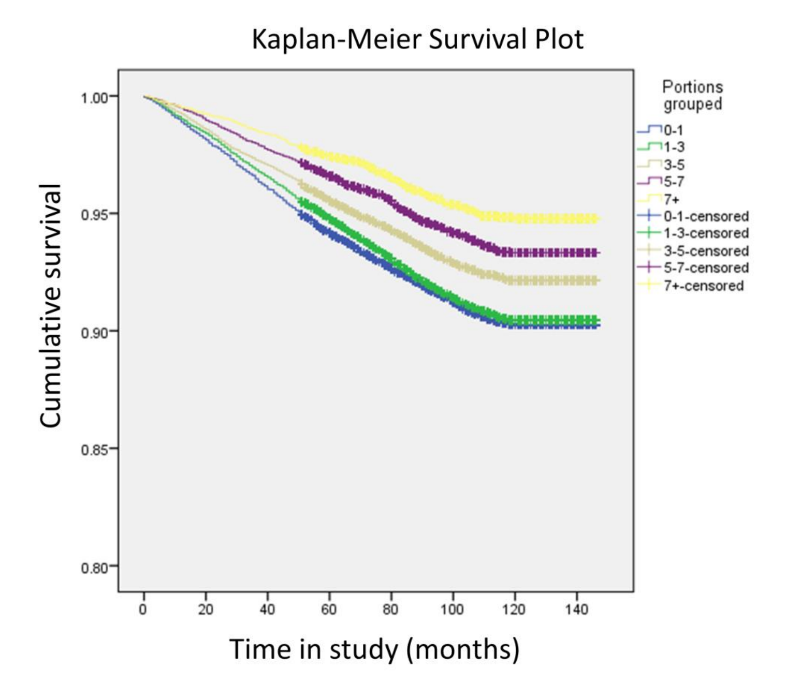
Risk of death during the study period, by fruit and vegetable consumption

Slide 11
Risk of death during the study period by fruit and vegetable consumption

Slide 12
Risk of death during the study period, by fruit and vegetable consumption
Oyebode O, Gordon-Dseagu V, Walker A, et al
Fruit and vegetable consumption and all-cause, cancer and CVD mortality: analysis of Health Survey for England data
J Epidemiol Community Health 2014;68:856-862.

Slide 13
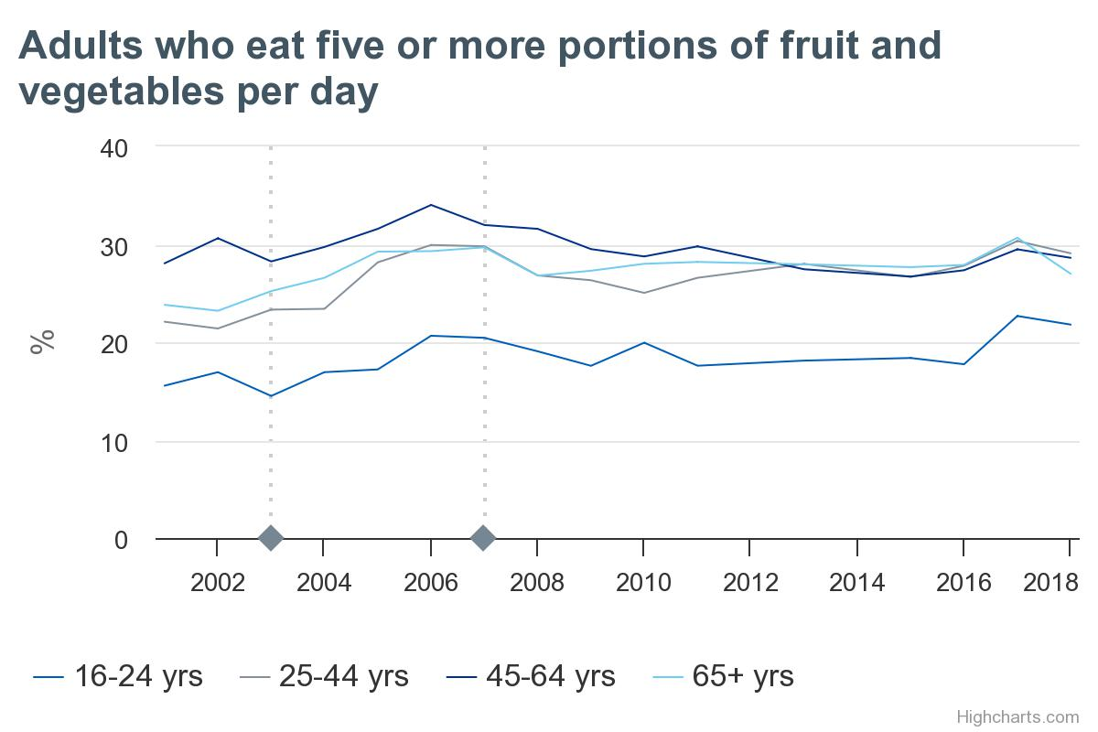
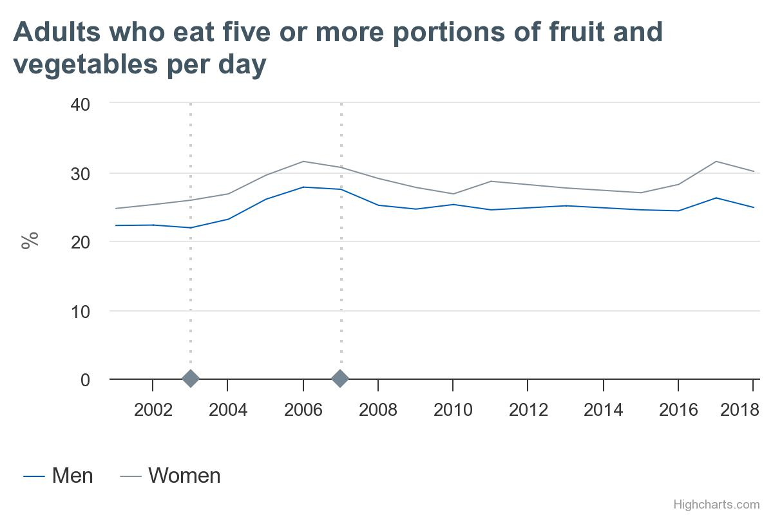
Inequalities in who eats at least 5-a-day in England

Slide 14
Inequalities in who eats at least 5-a-day in England
Income
Occupational group
Neighbourhood deprivation
Education

Slide 15
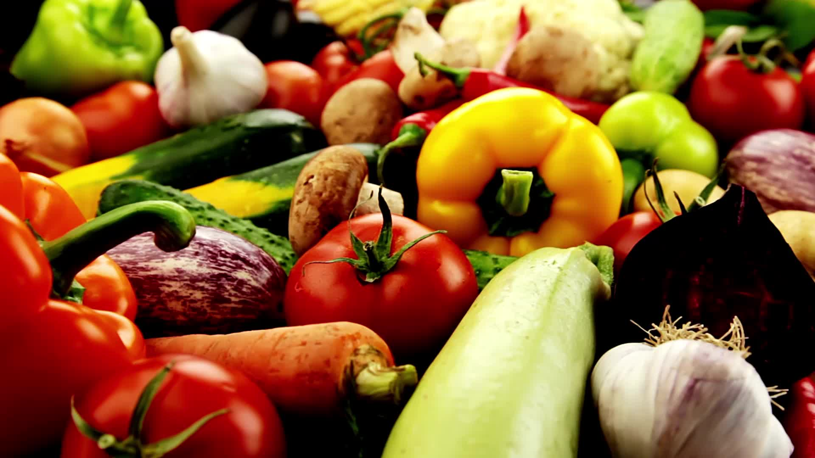
Fruit and vegetables are good for your health
But how can people be encouraged or supported to eat more?

Slide 16
2. How does the environment effect what we eat?
Insert sub-heading / date
Notes:
10:30

Slide 17
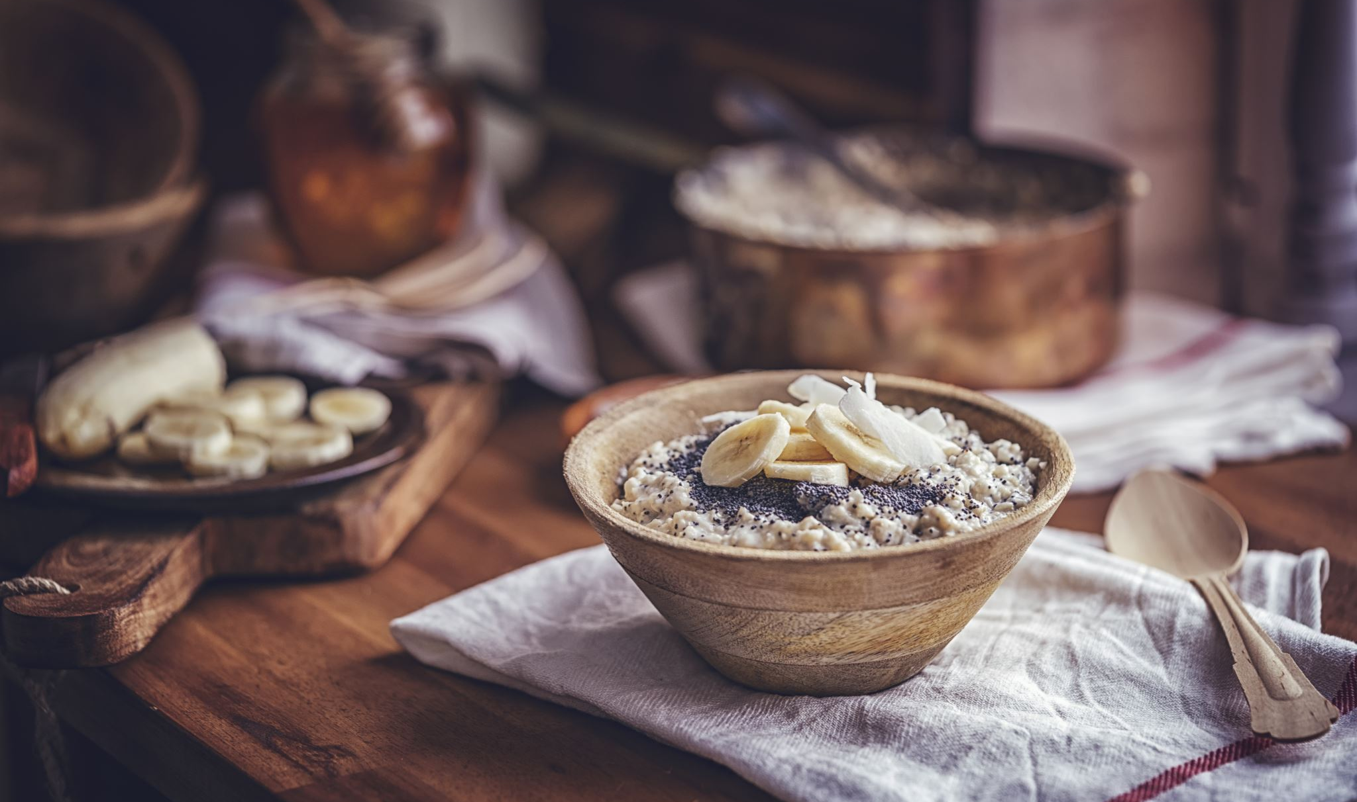
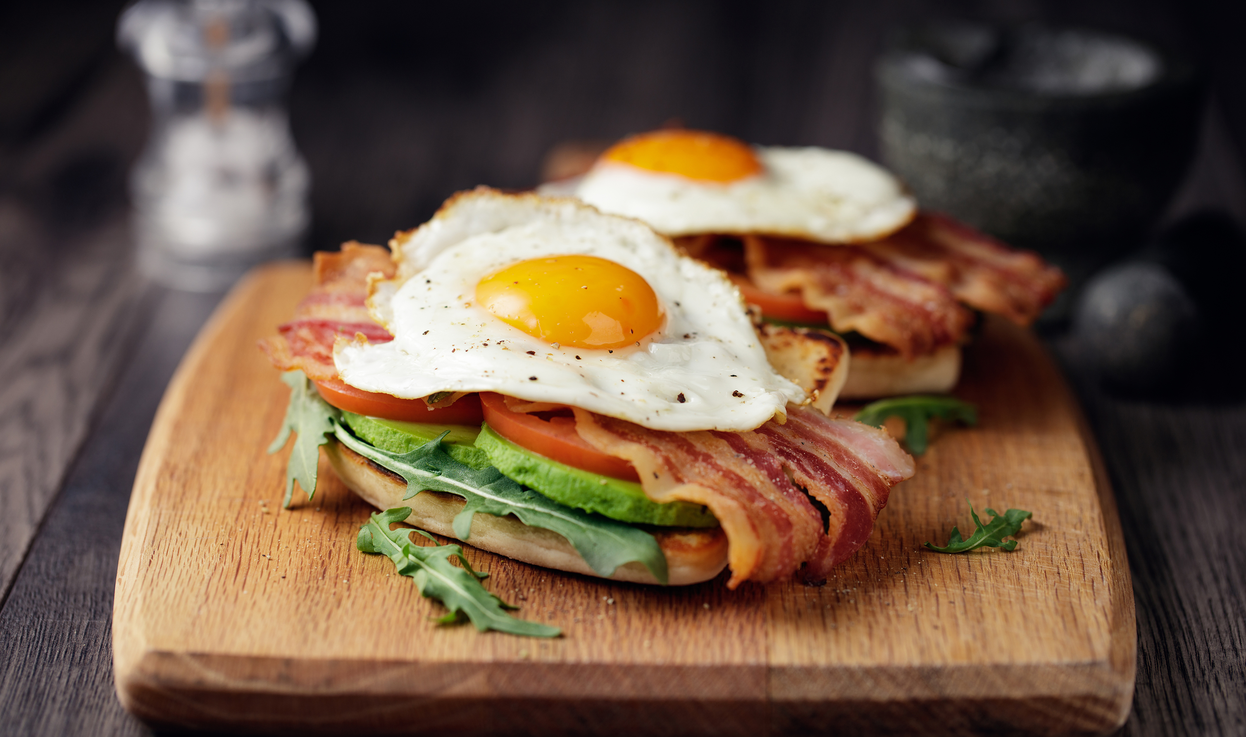
What did you have for breakfast?
Talk to the person next to you
Tell them what you had for breakfast and why you chose to have it
If you had something different from the pictures on the right, why didn’t you choose to have something like this?
Porridge with blueberries and banana
Egg, bacon and avocado on toast

Slide 18
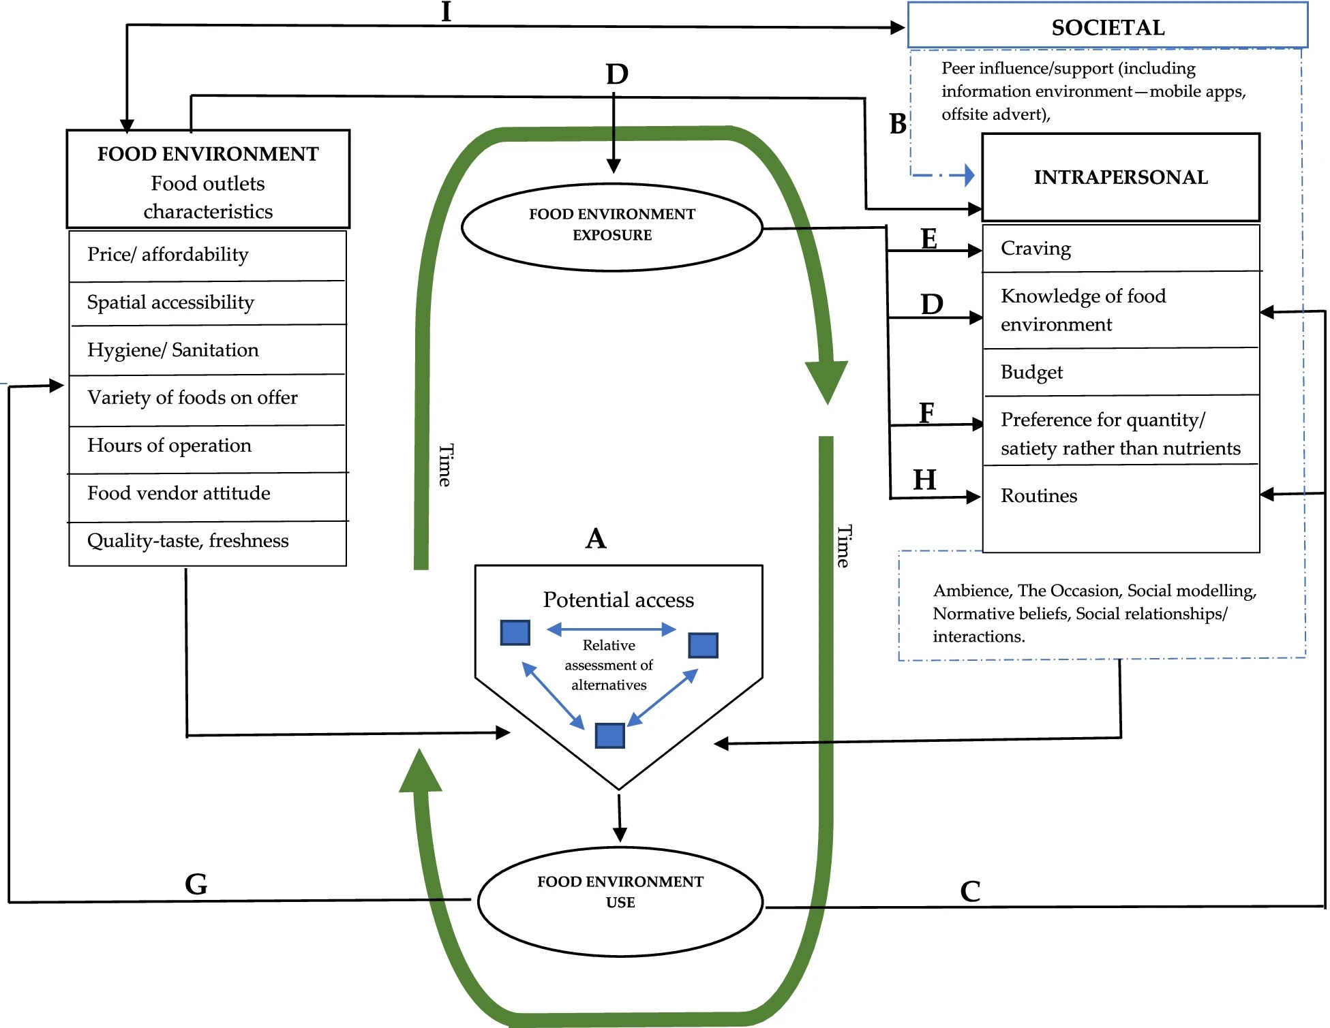
Factors influencing emerging adults’ food outlet choice in a university food environment, a qualitative enquiry
Mensah, D.O., Oyebode, O. “We think about the quantity more”: factors influencing emerging adults’ food outlet choice in a university food environment, a qualitative enquiry. Nutr J 21, 49 (2022). https://doi.org/10.1186/s12937-022-00801-0

Slide 19
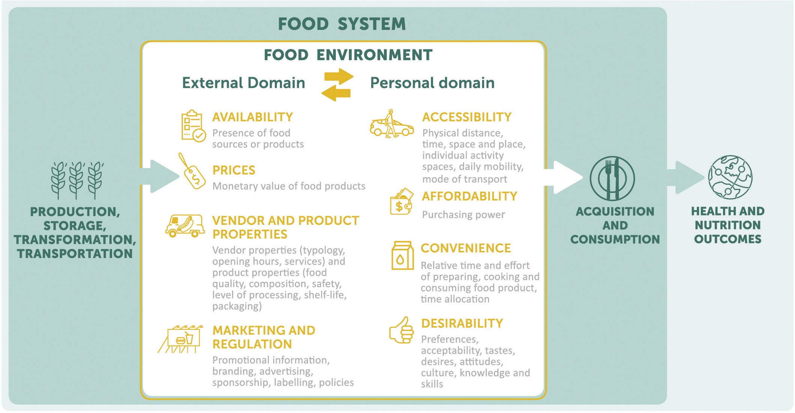
Turner et al, 2018 https://doi.org/10.1016/j.gfs.2018.08.003

Slide 20
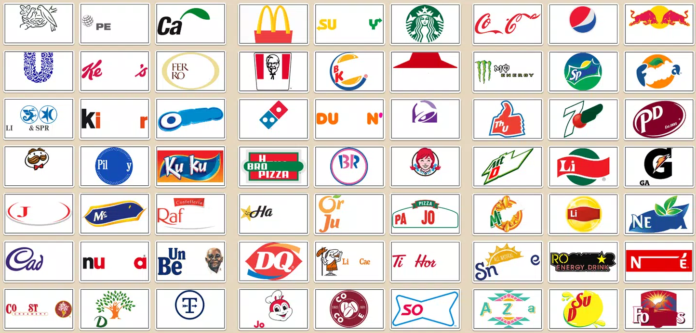
The case of food marketing
The WHO has urged governments to introduce restrictions on the marketing to children of food and beverages high in fat, sugar and salt (HFSS)
In 2007 UK was the first country to introduce a total ban on HFSS food advertising around children’s telcition programmes
By 2019 a further 15 countries had introduced similar regulation
But there are gaps…
In 2020 the new UK Obesity Strategy proposed further restrictions of marketing of HFSS online and on TV

Slide 21
Do you think food marketing causes obesity?
There is no scientific consensus that food advertising causes obesity
We are focused on our responsibility to our patrons…we recognise the role that our sector has in playing its part within a framework, aimed at reducing children’s exposure to the HFSS advertising. It is also important that brands rights to advertise is protected.
Obesity and diet are complex issues which will be relatively unaffected by these proposed rule changes.

Slide 22

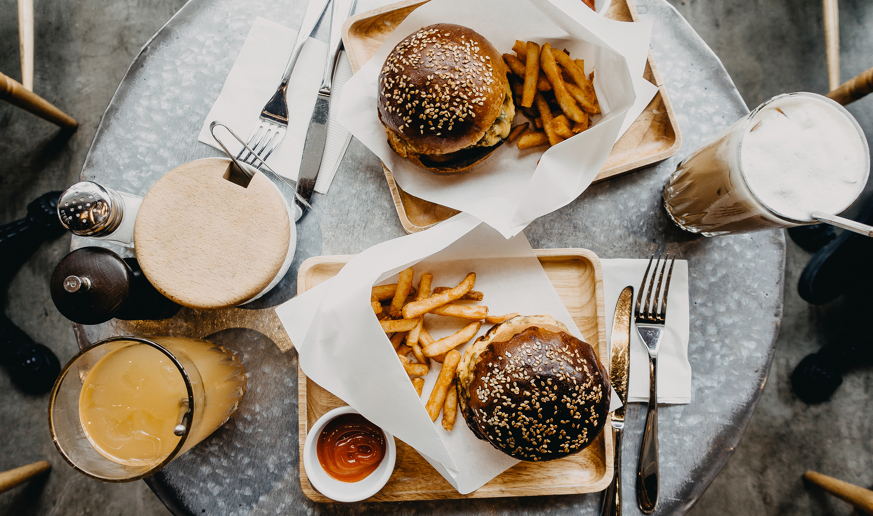
Do you think food marketing causes obesity?
Bradford-Hill criteria
  Consistency
  Dose-response relationship
  Biological plausibility
  Experiment
  Temporality
Watching TV
Coleman et al, 2022. A rapid review of the evidence for children’s TV and online advertisement restrictions to fight obesity. Preventive Medicine Reports.
Eating burgers

Slide 23
Turner et al, 2018 https://doi.org/10.1016/j.gfs.2018.08.003

Slide 24
3. Interventions to improve population health
Insert sub-heading / date

Slide 25
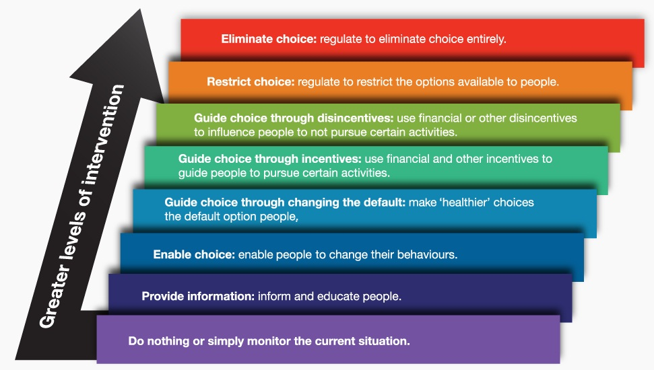
In 2007, The Nuffield Council on Bioethics published: Public health: ethical issues.
Says the state has a duty to enable people to lead a healthy life.
Proposes an intervention ladder to help determine if and when a public health measure is acceptable.

Slide 26
Why does providing information alone often increase health inequalities?

Slide 27
Sugar sweetened beverages banned in schools.
Healthy Start vouchers
Sugar tax
“5-a-day” messaging
Ban on trans fats in food
Every Happy Meal comes with a portion of fruit
Any food outlet must offer tap water to paying customers
Notes:
To check understanding

Slide 28
Sugar sweetened beverages banned in schools.
Healthy Start vouchers
Sugar tax
“5-a-day” messaging
Ban on trans fats in food
Every Happy Meal comes with a portion of fruit
Any food outlet must offer tap water to paying customers
Notes:
To check understanding

Slide 29
How far do you think we should go to improve diet?
Notes:
Well I am at the point of working with colleagues to understand the pros and cons of intervening- for example trying to quantify the benefits to health if fruit and vegetables were subsidised; how does behaviour change if labelling changes etc.

Slide 30
4. Conclusions
Insert sub-heading / date

Slide 31
Salient consortium
10 trials funded by the UK government
  Online grocery shopping
  Co-op
  COOK
  Food bank
  COMPASS

Slide 32

What you have hopefully learned
Some key health behaviours and the importance of diet
How the environment can affect what you eat
The types of interventions that might support the population to improve their diet
ANY QUESTIONS?

Slide 33
Thank you

Slide 34
End slide

