Slide 1
The impact of psychosocial effects on health
FMD MTD Environment & Health Summer School
Dr Livia Carvalho
l.carvalho@qmul.ac.uk

Slide 2
Overview
What is stress?
Stress biology
The relationship between stress and health
Mechanisms linking stress and health

Slide 3
Lecture outline
Understanding stress
The physiology of stress response
Stress and health outcomes

Slide 4
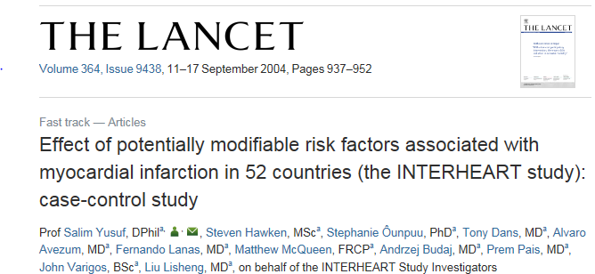
Stress as a risk factor
15,152 MI patients & 14,820 controls in 52 countries
Risk factors:
  smoking
  history of hypertension or diabetes
  waist/hip ratio
  diet
  physical activity
  alcohol
  lipids
  psychosocial factors
Notes:
The INTERHEART study is probably the largest study to date in which the relationship between long-term stress and CHD has been examined
In this study, 15,152 patients with acute myocardial infarction (MI) and 14,820 control individuals free from CHD were enrolled from 52 countries worldwide, representing every inhabited continent.
Long-term stress was included in a psychosocial composite score, which comprised stress at work and home, financial strain, lack of control, and depression

Slide 5
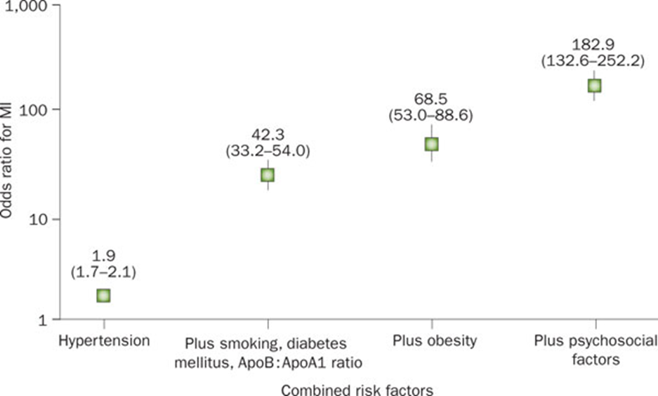
Results
OR of MI more than double among those exposed to psychosocial adversity plus conventional risk factors compared to those free of stress
Figure 3 Risk of acute MI associated with exposure to multiple risk factors among 29,972 individuals across 52 countries in the INTERHEART study
Steptoe, A. & Kivimäki, M., 2012
Notes:
Here you can see the risk factor combinations on the x-axis and the odds ratio representing the odds of having a MI on the y-axis
The researchers found that exposure to long-term stress added to the risk of acute MI even after taking into account combined exposure to conventional risk factors such as smoking, diabetes mellitus, hypertension, lipid ratio, and obesity
The odds ratio for MI was more than double (increasing from 69 to 183) among individuals who were exposed to psychosocial adversity in addition to conventional risk factors compared with those free of stress
These findings were robust, as a similar pattern of associations was found in men and women, old and young individuals, and in all continents of the world

Slide 6
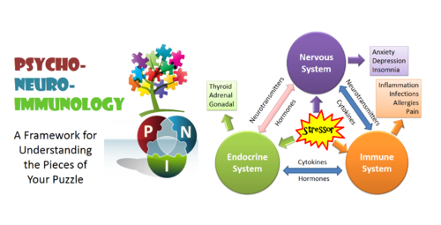
Psychoneuroimmunology
Notes:
Convergence of disciplines
More complete understanding of how the interaction of systems affects health and disease
Integrated model helps to explain the development of modern day, complex diseases that dominate the medical landscape
Departure from thinking in terms of distinct organ systems
Specialisation should not come at the cost of a cohesive, holistic perspective with an emphasis on treating the whole person, not just a single organ system

Slide 7
Types of stressor
Jot down 3-4 things (e.g. events/ situations/ experiences) that you find stressful.
For each ‘stressor’ identify whether it is:
  Acute or chronic?
  Controllable or uncontrollable?
  Predictable or unpredictable?
Feed back to the rest of the class.

Slide 8
What is stress?
Dhabhar & McEwen, 1997.
“A constellation of events consisting of a stimulus (stressor) that precipitates a reaction in the brain (stress perception) which activiates physiological fight-or-flight systems in the body (stress response).”

Slide 9
Acute vs. chronic stress
Acute stressors – short acting, brief or temporary (e.g. an exam, break-up with a partner, flying)
Chronic stressors – long-lasting, present for some time, no obvious end (e.g. caregiving, poor marriage, bad job).
“Exposure to chronic stress thought most toxic because they are most likely to result in long-term changes in the emotional, physiological, and behavioural responses that influence susceptibility to and course of disease.” Cohen et al (2007).

Slide 10
Stress pathways to health
Stressor:
Psychological
(threat/aggression)
Physical
(wounding/infection)
Physiological
(scarcity of food/water)
Stress
Perception
Appraisal
Cognitive/
Emotional
response
‘Adaptive’
Physiological response
Repeated on a chronic basis
‘Maladaptive/dysregulated’
response
Resilience
Psychological (coping,
control, social support,
optimism)
Physiological (genetics,
neuroendocrine activity, nutrition)
Onset and progression
of disease

Slide 11
How stress gets under the skin
Reactivity hypothesis
Physiological response
Stressor 1
Stressor 2
TIME
Days/weeks
Based on lab studies not real-life stress responses
Weak and inconsistent support
Only considers occasional increases not prolonged physiological activity
Notes:
However, it is still not entirely clear how stress ‘gets under the skin’ to cause or influence physiological processes and ultimately health and disease
For decades, this health risk has been explained by theorising that stressful events are accompanied by increased physiological responses, which, if frequent and intense, may cause bodily harm.
This idea has been termed ‘the reactivity hypothesis’
However, the often reported lack of relationship between reactivity in the laboratory and real-life stress responses as well as the tenuous association between laboratory reactivity and disease markers or end-points has led many to question the reactivity hypothesis as an explanation for the stress–disease relationship
This model has received only weak and inconsistent support and has been argued to be insufficient because it does not account for prolonged increased physiological activity

Slide 12
The prolonged activation model
Brosschot et al., 2005
Worry, rumination, preservative thinking
Anticipation
Slow recovery
Physiological response
Stressor 1
Stressor 2
TIME
Days/weeks
Notes:
Prolonged physiological activity, instead of occasional increases, is believed to lead to the bodily wear and tear that can finally cause or codetermine disease
Physiological activity during stressful events will only become a critical health threat when it is sustained long after these events, or when physiological activity is already present in anticipation of these events, sometimes even far before them
Importantly, a large amount of our stress responses may occur in anticipation of events that in fact never happen!
Stressful events include severe life events such as the death of a loved one as well as common daily stressors and stressful work situations after which it is often difficult to ‘unwind’. What counts
is the stress response’s total load on the organism, not only what happens during their occurrence
Evidence from ambulatory studies now shows that stressors have prolonged cardiovascular effects
The big question now is, what causes this prolonged physiological activity?

Slide 13
Perseverative cognition
Recovery after physical and psychological stressors
  Physiological response to average daily stressor is comparable to mild physical exercise
  Recovery from physical stressor is much faster (minutes)
  Psychological stressors can make people ‘linger on’ mentally
Human brain looks backward and forward
  Planning and remembering can lead to rumination and worry
  Repeating mental representations prolongs physiological effects
  Applies to brief quarrels or chronic stress e.g. care giving
Notes:
To explain prolonged activity, researchers use the perseverative cognition hypothesis, which is based on two core arguments.
Slow recovery after stressors or long anticipatory responses before stressors cannot be due to biological mechanisms alone
The physiological response to an average daily stressor is comparable to that of mild physical exercise, for example a brisk bike ride of 10 minutes
Recovery of the autonomic nervous system after physical stressor is much faster (a matter of minutes) than from most psychological stressors
In addition, there is often an anticipatory response, psychological stressors can make people ‘linger on’ mentally.
A special feature of the human brain is that it can look back and learn from the past and look ahead planning for the future
Unfortunately, this often leads to ruminating about the past and worrying about the future
Especially with more important stressors - problems in relationships, income and health
By extending and repeating the mental representation of stressors, PC prolongs their physiological effects too.
It is likely that by far the most stress-related physiological activity in daily life is not due to stressful events themselves, but to frequent and often spontaneous thinking about them
This is true whether it concerns occasional brief quarrels as well as the chronic stress of low socioeconomic status, or caring for an Alzheimer’s patient at home

Slide 14
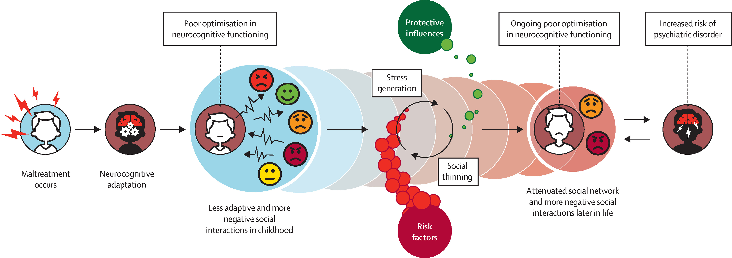
Stress generation after childhood maltreatment and psychiatric vulnerability
McCrory, Foulkes, Viding The Lancet 2022 9:828-837

Slide 15
Lecture outline
Understanding stress
The physiology of the stress response
Stress and health outcomes

Slide 16
Stress physiology
Allostasis: the process by which organisms respond to changes in the environment through adjustments in multiple biological systems to maintain homeostasis. Perceived threats to allostasis initiate an acute stress response (McEwen, 1998)
Main systems activated during the stress response
Hypothalamic–pituitary–adrenal (HPA) axis
Sympathetic–adrenal-medullary (SAM) axis
Parasympathetic nervous system
Notes:
biological stability is threatened = stress response
Number 2 and 3 are part of the autonomic nervous system
I have greyed the parasympathetic nervous system here because technically it is not involved with the stress response rather it is involved in recovery for stress to return the body to homeostasis. Something to be aware of will not be discussing today

Slide 17
Stress physiology
Nervous system
Central nervous system (CNS)
Brain & spinal cord
Peripheral nervous system (PNS)
Sensory & motor neurons
Somatic nervous system
Voluntary movement
Autonomic nervous system
Involuntary response
Stress
Parasympathetic nervous system
“Rest or digest”
Sympathetic nervous system
“Fight or flight”
Notes:
The nervous system is complicated!
2 main parts- the CNS and the PNS
The CNS contains the brain and spinal cord
The rest of the nerves that run through the body are part of the PNS
We are interested in the autonomic nervous system which controls involuntary responses

Slide 18
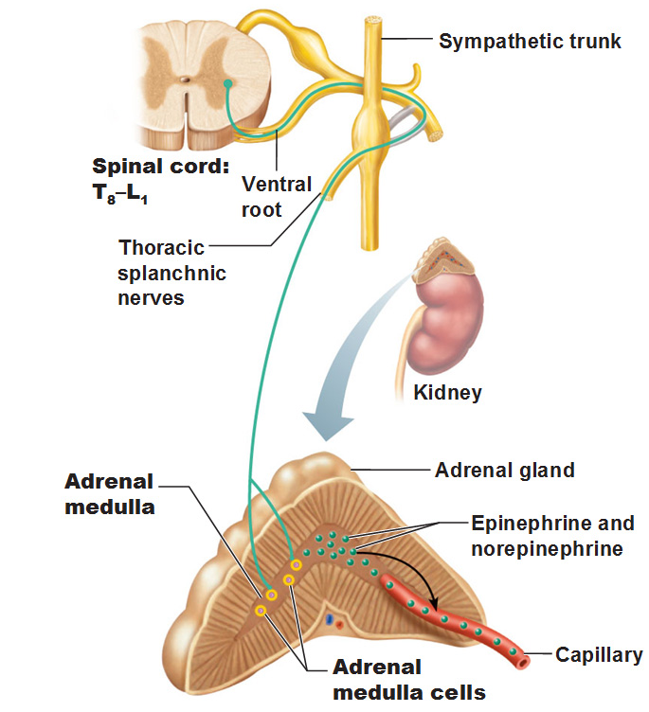
Sympathetic-adrenal-medulla system
The hypothalamus signals the SNS to stimulate the release of adrenaline and noradrenalin.

Slide 19
Sympathetic adrenal medullary (SAM) axis
Adrenalin and noradrenalin are products of the SAM axis
Immediate changes resulting from sympathetic activation:
  increased glucose production
  increased heart rate and blood pressure
  increased cardiac output
  increased production and secretion of LDL (bad cholesterol)
  dilation of the bronchioles in the lungs (changes to breathing)
  can cause people to ‘go red’ (vasodilation)
Notes:
Alters brain activity: enhances processing of sensory inputs, enhances attention, enhances the formation and retrieval of memory

Slide 20
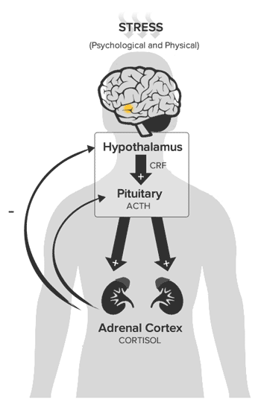
Hypothalamic-pituitary-adrenal axis
CRF: corticotrophin releasing factor
ACTH: adrenocorticotrophic hormone

Slide 21
The glucocorticoid receptor
Cell membrane
Glucocorticoid receptor
Chaperone
molecules
Protein synthesis
Nucleus
mRNA
Glucocorticoid
GRE
Cytoplasm
Notes:
Cortisol exerts its effects by binding to its receptors
In it’s inactivated state, the receptor resides inside the cytoplasm.
Once bound to cortisol, the receptor translocates into the cell nucleus where it directly binds to DNA in order to enhance or inhibit gene transcription, including downregulation of pro-inflammatory genes
One explanation of HPA axis dysregulation may be diminished sensitivity of the corticosteroid receptors.
With reduced receptor sensitivity, cortisol is no longer able to exert its regulatory effects successfully leading to a breakdown in the HPA axis negative feedback loop, and an increase in the intensity of the inflammatory response
An increase in the intensity or duration of the inflammatory response has consequences for the development and progression of chronic inflammatory diseases such as CVD as well as depression

Slide 22
Cortisol function
Cortisol and normal function
Cortisol and dysfunction
Mobilises stored energy
Redistributes blood flow
Enhances cardiovascular activity
Modulates the immune response
Hypertension
Hyperlipidaemia
Adiposity
Inflammation
Insulin resistance
Endothelial dysfunction
Depression
Notes:
Cortisol orchestrates a variety metabolic and immunologic functions

Slide 23
Cortisol Awakening Response
CAR
Slope
cortisol
levels
6am
9am
12pm
3pm
6pm
9pm
12am
3am
6am
Notes:
Under normal conditions cortisol secretion fluctuates according to a circadian rhythm
Under normal conditions, cortisol levels rise throughout the early hours, increasing sharply around 30 minutes after waking.
This is referred to as the cortisol awakening response
There is then a subsequent decline throughout the day with lowest levels occurring around midnight.
Studies show associations between dysregulation of HPA axis activity and cardiovascular disease.
CHD patients have been found to have flatter cortisol slopes across the day compared to healthy controls

Slide 24
Physiological reactions
Activation of the ANS leads to:
  ↑mental activity
  ↑respiration
  ↑heart rate
  ↑blood pressure
  ↑adrenaline, noradrenalin, cortisol
  ↓reproductive and sexual systems
  ↓digestive system
  ↓excretory system
  ↓pain perceptions
  ↓kidney function

Slide 25
Immune effects of stress
Acute stress:
  Increase in immune cell trafficking
  Increased NK cell activity
  Elevation in secretory IgA
Chronic stress:
  Reduced trafficking of lymphocytes
  Fewer circulating NK cells
  Lowered cytotoxicity
  Reduced IgA secretion

Slide 26
Two way neuroimmunoendocrine interaction
STRESS
/depression
CRF
Cytokines
IL-1, IL-6, TNF
+
ACTH
+
SNS
Immune System
Catecholamines
Adrenal Glands
Cortisol
Infection, Inflammation
Notes:
Stress and depression have some biological features in common. Both interact with the immune, endocrine and neuronal systems. Both stress and depression are associated with activation of the hpa axis, resulting in increased levels of glucocorticoids. Inflammation may be related to depression through two way neuroimmunoendocrine interactions. Brain functioning regulates secretion of glucocorticoid hormones, and glucocorticoids can inhibit inflammation processes. On the other hand, inflammation reduces glucocorticoid signalling and reduced glucocorticoid signalling may lead to abnormal brain functioning. Research over the last decade shows that depressed patients also have immunological activation which suggests that these cytokines may have a causal relationship with aetiology of depression.

Slide 27
Stress hormones and immunity
Glucocorticoids (cortisol) and catecholamines (noradrenaline, adrenaline) can
regulate immune function by binding to their receptors on immune cells
Cortisol
Noradrenaline &
Adrenaline
Immune cells
Y
Y
T
Y
T
T
Y
T
Glucocorticoid
Receptor (GR)
Alpha- and Beta-adrenergic
Receptors (α/βAR)
Macrophage
T lymphocyte
ALTERED IMMUNE FUNCTION

Slide 28
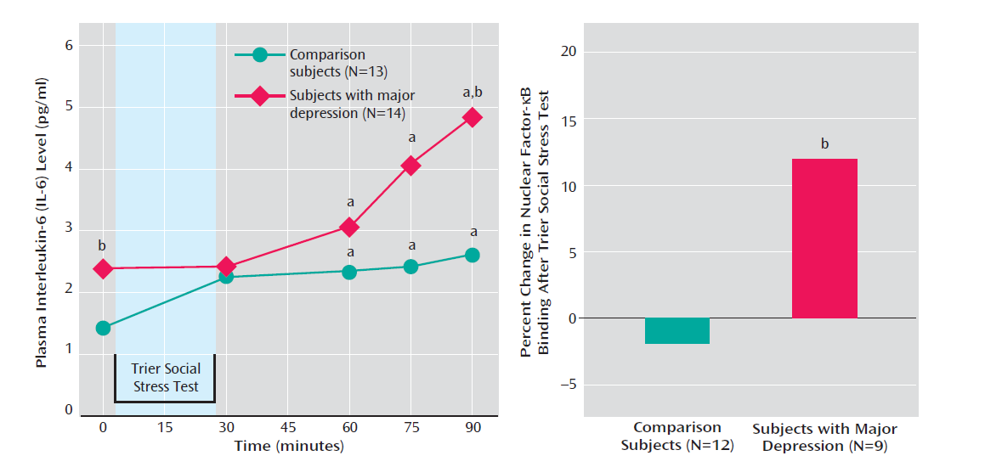
MDD have increased IL6-stress response, particularly in those with early-life stress
Pace et al., Am J Psych 2006 1630-33

Slide 29
Chronic stress and inflammatory cytokines
Chronic Stressor
Plasma/serum cytokines
Reference
Perceived daily
stress
IL-6
Goldman N et al. 2005
Caregiving
IL-6 (age related)
Kiecolt-Glaser JK et al. 2003
Hostile Marital
Interactions
IL-6, TNFα
Kiecolt-Glaser JK et al. 2005
Low socioeconomic
status
IL-6, IL-1Ra
Steptoe A et al. 2002
Depression
IL-6, CCL-2, IL-1β
Carvalho, LA et al. 2008, 2012, 2014
Burnout Syndrome
(job strain)
TNFα
Grossi G et al. 2003
Post-traumatic
stress disorder
IL-1β, TNFα,
IL-6
Von Kanel R et al. 2007
Maes M et al. 1999

Slide 30
Childhood maltreatment increases inflammation in adulthood
Danese et al., Arch Gen Psy 2008 65:409-15

Slide 31
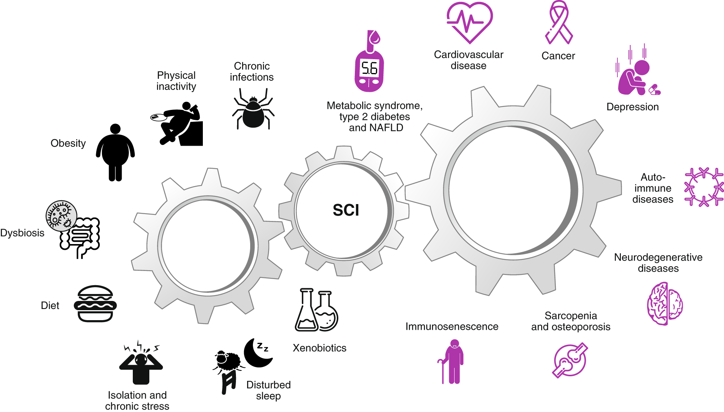
Social, environmental and lifestyle effects on health
Furman et al., Nature Medicine 2019 25: 1822-1832

Slide 32
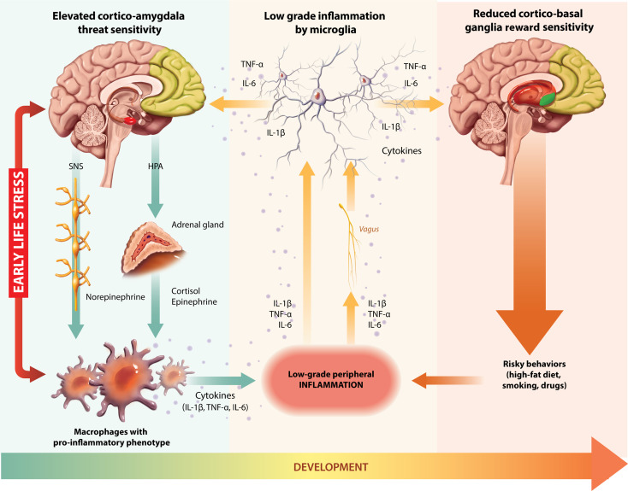
Neuroimmune network hypothesis
Nusslock and Miller, Biol Psych (2016) 80, 23-32
Notes:
we argue that early-life adversity amplifies crosstalk between peripheral inflammation and neural circuitries subserving threat-related, reward-related, and executive control-related processes.
here is now substantial experimental and clinical evidence to indicate that a combination of inflammation and oxidative stress plays a crucial role in the pathophysiology of major depression (Maes et al., 2011; Maes, 1995 ; Song et al., 1994). At the level of the neuron, these changes result in the activation of excitotoxic pathways that contribute to the increase in apoptosis and a reduction in areas of the brain (such as the hippocampus, amygdala and pre-frontal cortex) which are critically involved in the pathology of depression. Smith (1991) was one of the first to hypothesise that the pro-inflammatory cytokines, exemplified by interleukins (IL-) 1 and 6, interferon gamma (IFN) and tumour necrosis factor alpha (TNF) in the serum, were associated with the principal symptoms of depression (Pariante and Miller, 2001) while the anti-inflammatory cytokines (such as IL-4,10 and 13) were reduced. Such observations formed the basis of the macrophage theory of depression, a concept that has been substantiated with additional evidence showing that the activated prostenoid pathway (leading to an increase in prostaglandin E2, PGE2) and nitric oxide sythase (resulting in an increase in nitric oxide) also played key roles in the damaging effects of chronic, low grade inflammation in the brain (see Connor and Leonard, 1998; Kubera et al., 2001; Janelidze et al., 2011; Maes, 1999; Kim et al., 2002 ; Leonard, 2001).

Slide 33
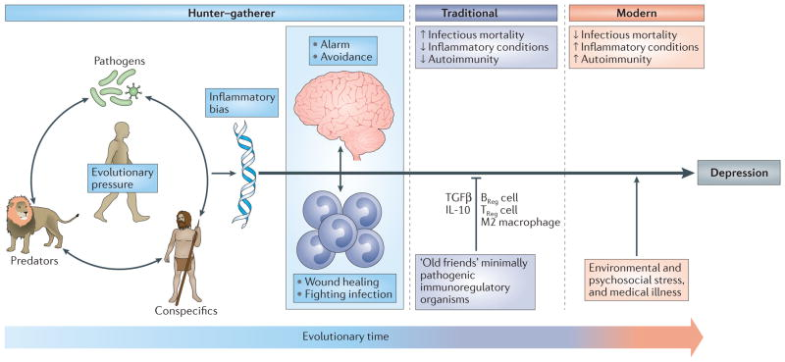
Inflammation in depression: evolutionary imperative
Miller and Raison, Nat Rev Immunol. 2016 Jan; 16(1): 22–34.

Slide 34
Acute vs chronic inflammation
 | Acute inflammation | Systemic chronic inflammation
Trigger | PAMPS (infection) DAMPS (cellular stress, trauma) | DAMPs (‘exposome’, metabolic dysfunction, tissue damage)
Duration | Short-term | Persistent, non-resolving
Magnitude | High grade | Low-grade
Outcome | Healing, trigger removal, tissue repair | Collateral damage
Age-related | no | Yes
Biomarkers | IL-6, TNF-alpha, CRP, IL1b | No canonical standard biomarker
PAMPs pathogen associated molecular patterns, DAMPs damage-associated molecular patterns
Furman et al., Nature Medicine 2019 25: 1822-1832

Slide 35
Measuring stress
Questionnaire measures e.g. life event scales, CISS-21
Ecological momentary assessment: repeated measures across the day
Biological measures e.g. saliva samples for cortisol
Physiological stress testing in the laboratory

Slide 36
CISS-21
Read through the CISS-21 (Coping Inventory for Stressful Situations) and have a go at answering each of the questions.
Working with one or two other people, identify which items of the questionnaire relate to the three coping styles: task-orientate coping, emotion-orientated coping and avoidance coping.
Jot down one or two advantages and one or disadvantages of this questionnaire. Think about how it might apply to someone living with a chronic illness (e.g. cancer, diabetes, rheumatoid arthritis).

Slide 37
Lecture outline
Understanding stress
The physiology of the stress response
Stress and health outcomes

Slide 38
Stress and health research
Research focuses on:
  Changes in immune or endocrine parameters
  Intermediate disease states e.g. atherosclerosis
  Clinical events e.g. heart attack , myocardial infarction, stroke
Measures include:
  Self-report questionnaires e.g. perceived stress scale, work-life balance scale, PHQ-9, GAD-7, BDI
  Biological measures e.g. saliva/blood samples, BP
  Physiological stress testing in the laboratory or patients with chronic stress such as MDD

Slide 39
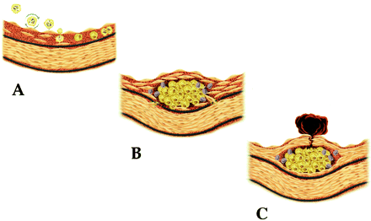

Atherosclerosis:
An Inflammatory Condition
A: Endothelial dysfunction &
Inflammatory processes
B: Macrophage infiltration &
Development of coronary
plaque
C: Plaque disruption &
thrombus formation
(Libby, Peter 2006)

Slide 40
Lifestyle, social and environmental effects on health
Adrenergic/HPA axis dysregulation
Inflammation
Depression
Cardiometabolic illnesses
Stress

Slide 41
Does stress lead to increased allostatic load?
Epidemiological Evidence
Experimental Evidence
Clinical Relevance

Slide 42
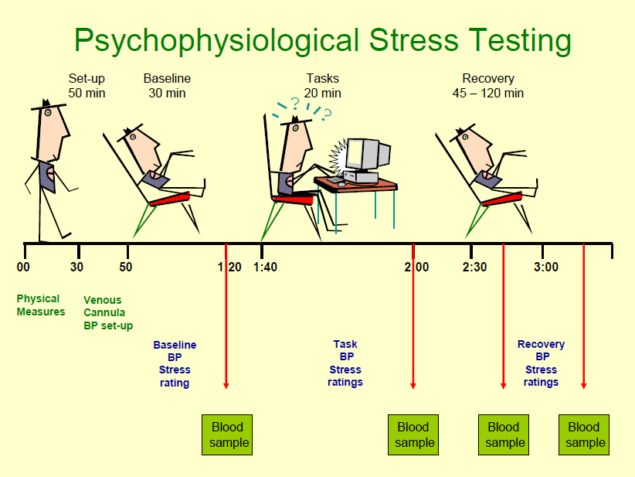

Slide 43
Stress and plasma IL-6 response
Notes:
In order to understand if stress leads to increased levels of cytokines, we have developed a laboratory mental stress protocol.
IL6 response to stress (red bar), showing delayed increase

Slide 44
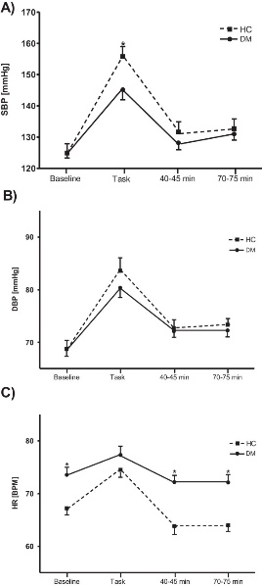
Cardiovascular stress responsivity
Steptoe , Carvalho et al., 2015

Slide 45
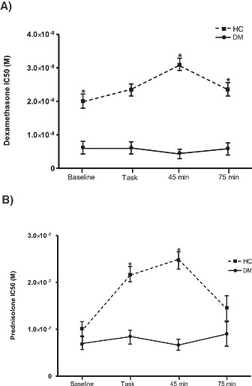
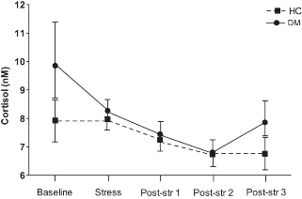
Cortisol stress responsivity
Carvalho et al., 2015

Slide 46
How can inflammation present
in people with chronic stress/depression?
Epidemiological Evidence
Experimental Evidence
Clinical Relevance

Slide 47
Two way neuroimmunoendocrine interaction
STRESS
/depression
CRF
Cytokines
IL-1, IL-6, TNF
+
ACTH
+
SNS
Immune System
Catecholamines
Adrenal Glands
Cortisol
Infection, Inflammation
Notes:
Stress and depression have some biological features in common. Both interact with the immune, endocrine and neuronal systems. Both stress and depression are associated with activation of the hpa axis, resulting in increased levels of glucocorticoids. Inflammation may be related to depression through two way neuroimmunoendocrine interactions. Brain functioning regulates secretion of glucocorticoid hormones, and glucocorticoids can inhibit inflammation processes. On the other hand, inflammation reduces glucocorticoid signalling and reduced glucocorticoid signalling may lead to abnormal brain functioning. Research over the last decade shows that depressed patients also have immunological activation which suggests that these cytokines may have a causal relationship with aetiology of depression.

Slide 48
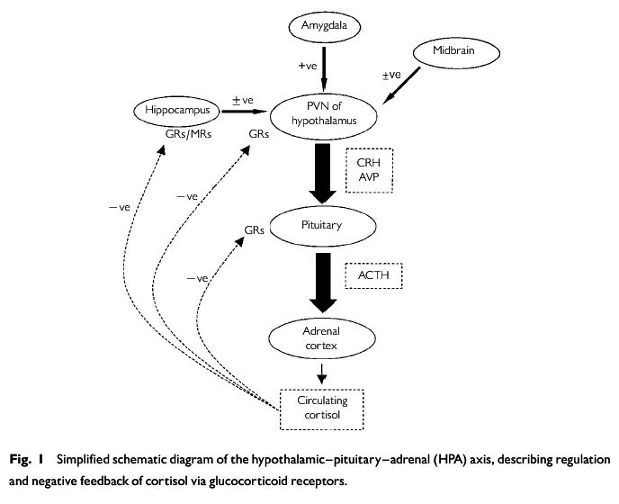
Hyperactivity of HPA axis
MDD or BD
Glucocorticoid
Resistance
X
X
X
inflammation
Notes:
One of the most consistent findings in psychiatry is the hyperactivity of the HPA axis in major depressed patients, leading to increased levels of the glucocorticoid cortisol. CRH produced by the hypothalamus, stimulates the production of ACTH from the pituitary, which in turn stimulates the release of cortisol from the adrenal gland. Cortisol will then exert its function by interacting with its receptors the glucocorticoid and mineralocorticoid receptor. Increased cortisol levels regulates its own production via a negative feedback. In depressed patients, however, there is a hyperactivity of the axis leading to increased levels of cortisol, in a phenomenon called glucocorticoid resistance. Why exactly patients with major depression have glucocorticoid resistance is not known, but receptor dysfunction is likely to play a role.

Slide 49
Cytokine profile in TRD
Carvalho et al, 2012
Notes:
Remember, this was not only in the context of dysturbance of HPA axis as show by increased levels of cortisol, but also inflammation.
The overall objective of their project is:
The introduction into clinical practice of two sets of biomarker tests
- To identify mood disorder patients and individuals at risk for mood disorders characterized by an activated inflammatory response system (IRS) and/or a disturbed metabolism of tryptophan and
- To treat these patients and individuals with drugs counteracting the consequences of the activated IRS/disturbed metabolism of tryptophan.
The further exploration of three animal models characterized by an activated IRS, an abnormal tryptophan metabolism and a depressive behaviour, to study in particular
- The pathogenesis of inflammation-related mood disorders on the level of an aberrant neuron-microglia-astrocyte interaction, and
- The efficacy and working mechanism of anti-inflammatory drugs and of drugs restoring tryptophan metabolism on depressive-like behaviour.

Slide 50
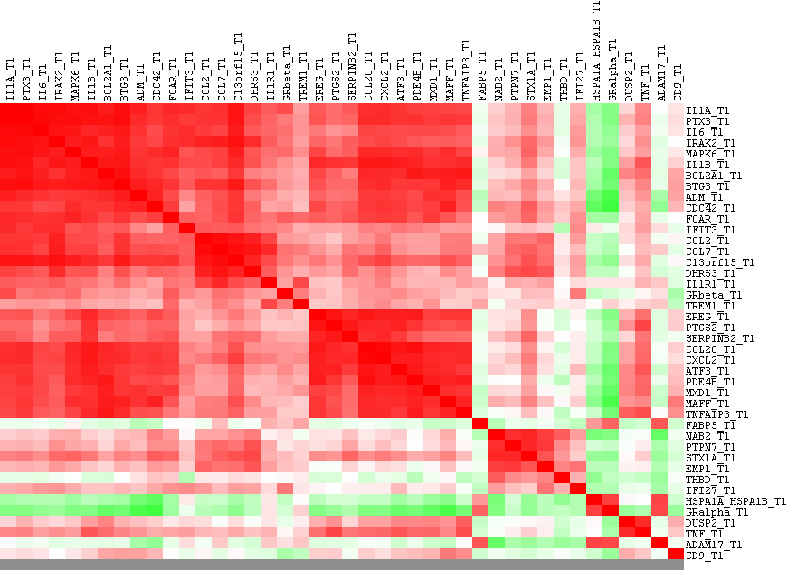
Test: RNA biosignature in MDD
Identified monocyte-related biomarkers using high throughput technique established an aberrant gene expression signature
inflammatory (PDE4B, IL-1β, Il-6, TNF-α, PTGS2, PTX3, FcαR, ADAM17),
chemokinesis/motility (CCL2, CCL7, CCL20, CXCL2, CCR2, cdc42)
cell survival/apoptosis (A20, BCL2A1, EMP1)
MAP kinases pathway (MAPK6, PAC1, NAB2, ATF3, HePTP).
Carvalho et al., Transl Psych 2014
Notes:
Monocyte cytokine production assays and serum cytokine level assays as described are apparently not precise and robust enough to constantly detect the pro-inflammatory state of monocytes/macrophages of patients with a major mood disorder.

Slide 51
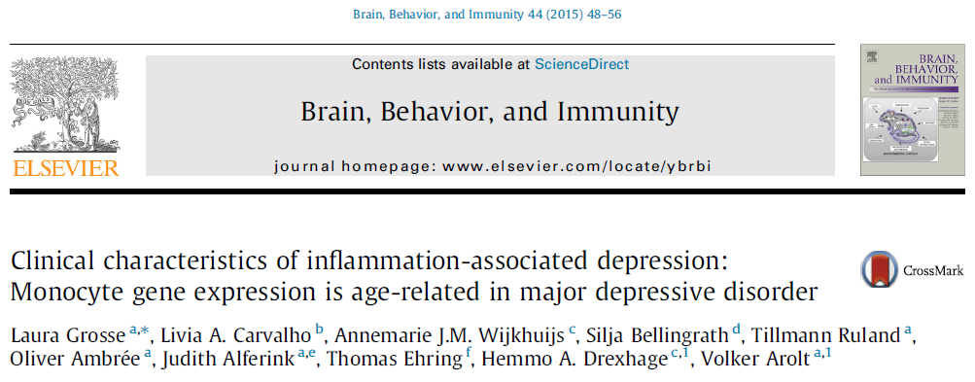
Independent replication
Identified monocyte-related biomarkers using high throughput technique established an aberrant gene expression signature
Notes:
Monocyte cytokine production assays and serum cytokine level assays as described are apparently not precise and robust enough to constantly detect the pro-inflammatory state of monocytes/macrophages of patients with a major mood disorder.

Slide 53
Inflammatory cytokines and antidepressant outcome

Slide 54
Sub-cellular types and antidepressant outcome

Slide 55
Prevalence of Depression
General population: 2–9%
  Men 2-3%
  women 5-9%
Medically-ill: 10-14%
Heart conditions: 17- 20%
Post-myocardial infarct patients: 45%
(Louch, P., 2009)

Slide 56
CHD patients
100 CHD patients with/without depression
Primary Care Trusts, UK
BECK depression scale

Slide 57
CHD patients with depression show higher Inflammatory biomarker CRP
CRP | Risk for Cardiovascular Disease
Less than 1.0 mg/L | Low
1.0-3.0 mg/L | Intermediate
Greater than 3.0 mg/L | High
American Heart Association (2003)

Slide 58

Depression, inflammation and mortality
Prospective study, 5,328 older men and women in England
Measures: depressive symptoms and C-reactive protein (CRP) from 8 item Centre for Epidemiological Studies Depression Scale
Mortality was ascertained from national registers
Follow up: mean 7.7 years
(Lawes … Carvalho et al., Psychological Medicine 2019 49:1521-1531)
Notes:
We investigated the combined association of depressive symptoms and inflammation with the prediction of CVD and all-cause mortality in a representative cohort of older men and women.

Slide 59
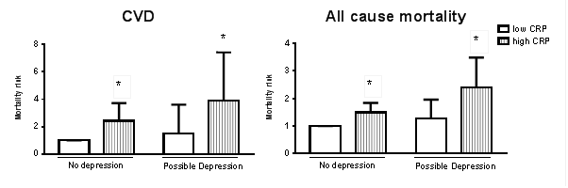
Depression, inflammation and mortality
Men were almost 4 times more likely to die from CVD and almost 2.5 times more likely to die from any cause
Adjusted hazard ratios for all-cause mortality according to levels of depression and inflammation in men.
* Statistically significant at P<0.001.
Notes:
The combination of depressive symptoms and increased inflammation confers a considerable increase in mortality risk for men.
No effect was observed in women
These findings show that men with both depressive symptoms and increased levels of inflammation constitute a high-mortality risk phenotype.
This risk is particularly high for cardiovascular related death.
These findings have clinical implications for the treatment of CVD in men.
Subgroups of depressed individuals with comorbid increased inflammation may benefit from additional anti-inflammatory pharmacotherapy.

Slide 60
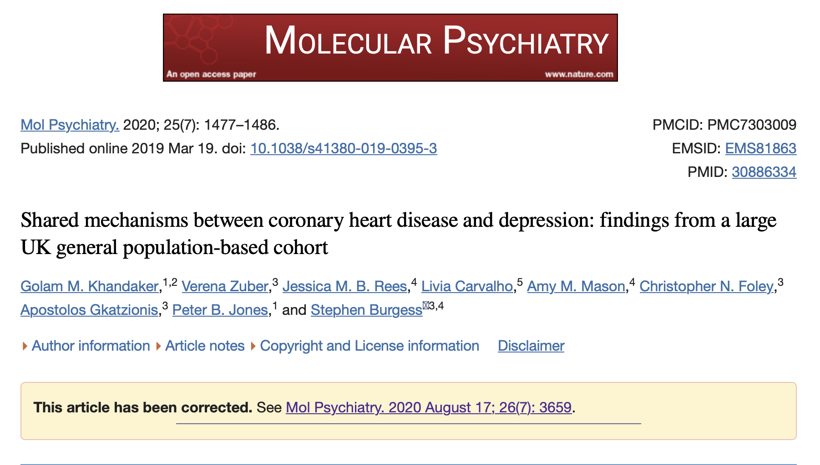
Mendelian Randomization points towards inflammation (CRP and IL6) as shared mechanisms of depression and CHD
There was evidence for causal effects of IL-6 and CRP, with an odds ratio of 1.35 (95% CI 1.12–1.62; p = 0.0012)
per unit increase in genetically-predicted values of log-transformed IL-6
OR 1.35 (95% confidence interval 1.12–1.62, p = 0.0012) for depression per unit increase in log-transformed
circulating levels of IL-6.

Slide 61
Conclusion
Explore psychological aspect of modern day stress:
  Life events
  Stress as an appraisal of demands and resources
  Prolonged activation
Physiological stress response:
  SAM and HPA axis
  Effects of cortisol
  Acute and chronic stress and chronic systemic inflammation
  inflammation in individuals with chronic stress/MDD is associated may increase the risk of cardiometabolic illness

Slide 62

And the award goes to…
Translational Pharmacology Lab
Sam Lawes
Thomas Mitchell
Josh Bell
UCL
Glyn Lewis
Andrew Steptoe
Mika Kivimaki
Livia Carvalho is funded by MRC and BHF

Slide 63

Any questions?

Slide 64
Recommended reading
Stress and Heart Disease Steptoe and Kivimaki 2012 9:360-70
Chronic inflammation in the etiology of disease across the life span. Furman et al., Nature Med 2019 25: 1822-1832
Inflammation and treatment resistance depression in major depression: the perfect storm. 2013 Psychiatric Times 30(9) https://www.psychiatrictimes.com/view/inflammation-and-treatment-resistance-major-depression-perfect-storm Last accessed 11/7/23
Daruna, J. H. (2012). Introduction to Psychoneuroimmunology. London: Elsevier
Carver, C. S., & Vargas, S. (2010). Coping and health. In Handbook of behavioral medicine (pp. 197-208). Springer New York.
Curtis, A. J., (2000) Health Psychology
Diamond, D. M., Campbell, A. M., Park, C. R., Halonen, J., & Zoladz, P. R. (2007). The temporal dynamics model of emotional memory processing: a synthesis on the neurobiological basis of stress-induced amnesia, flashbulb and traumatic memories, and the Yerkes-Dodson law. Neural plasticity, 2007.
Dallman, M. F. (2010). Stress-induced obesity and the emotional nervous system. Trends in Endocrinology & Metabolism, 21(3), 159-165.
Hobfoll, S. E. (1989). Conservation of resources: A new attempt at conceptualizing stress. American psychologist, 44(3), 513.
Hobfoll, S. E. (1998). The psychology and philosophy of stress, culture, and community. New York.
Gehi, A., Haas, D., Pipkin, S., & Whooley, M. A. (2005). Depression and medication adherence in outpatients with coronary heart disease: findings from the Heart and Soul Study. Archives of internal medicine, 165(21), 2508-2513.

Slide 65
Recommended reading
Kirschbaum, C., Pirke, K. M., & Hellhammer, D. H. (1993). The ‘Trier Social Stress Test’–a tool for investigating psychobiological stress responses in a laboratory setting. Neuropsychobiology, 28(1-2), 76-81.
Sapolsky, R. M. (1994). Why zebras don't get ulcers. New York: WH Freeman.
Selye, H. (1956). The stress of life.
Steptoe, A., Strike, P. C., Perkins-Porras, L., McEwan, J. R., & Whitehead, D. L. (2006). Acute depressed mood as a trigger of acute coronary syndromes. Biological psychiatry, 60(8), 837-842.
Steptoe, A., & Kivimäki, M. (2012). Stress and cardiovascular disease. Nature Reviews Cardiology, 9(6), 360-370.
Wilbert-Lampen, U., Leistner, D., Greven, S., Pohl, T., Sper, S., Völker, C., ... & Steinbeck, G. (2008). Cardiovascular events during World Cup soccer. New England Journal of Medicine, 358(5), 475-483.
Yusuf, S., Hawken, S., Ôunpuu, S., Dans, T., Avezum, A., Lanas, F., ... & Lisheng, L. (2004). Effect of potentially modifiable risk factors associated with myocardial infarction in 52 countries (the INTERHEART study): case-control study. The Lancet, 364(9438), 937-952.

