Slide 1
Oral health and the risk for disease.
Professor R.P. Allaker
Oral Microbiology
Queen Mary, University of London

Slide 2
Oral bacteria and disease.
Oral cavity can act as the site of origin for dissemination of pathogenic microorganisms to distant body sites esp. in the immunocompromised.
Increasing no. of epidemiological studies suggest oral infection esp. periodontitis is a risk factor for systemic diseases.
Teeth – only exposed non-shedding surfaces in the body with levels of bacteria often > 10¹¹ microorganisms / mg dental plaque.
Periodontal infections are associated with complex microflora – mostly anaerobic with gram-negative rods being most common isolates.
Anatomic proximity of periodontal infections can allow bacteraemia and systemic spread of bacterial products, components and immunocomplexes.

Slide 3
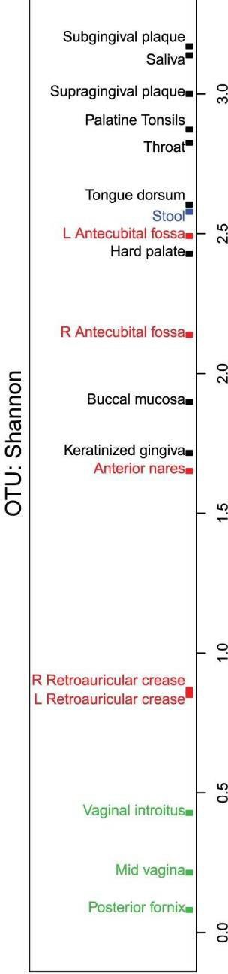
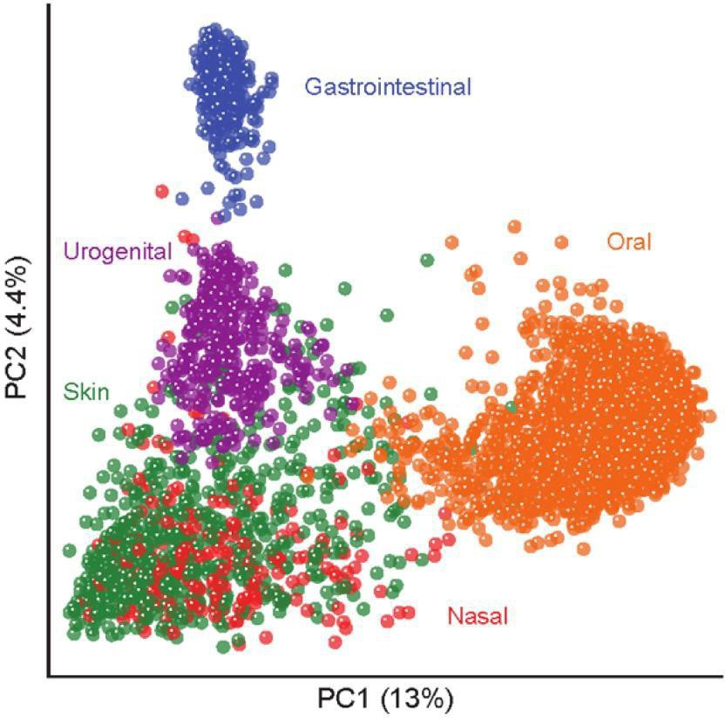
The Human Oral Microbiota is Diverse & Unique
C Huttenhower et al. Nature 486, 207-214 (2012) Li, Kelvin et al. PloS one 7, 6 (2012)

Slide 4
Possible pathways of oral infections and non-oral diseases.
Pathway for oral infection | Possible non-oral diseases
Metastatic infection from oral cavity via transient bacteraemia | Subacute infective endocarditis, acute bacterial myocarditis, brain abscess, cavernous sinus thrombosis, sinusitis, lung abscess/infection, Ludwig's angina, orbital cellulitis, skin ulcer, osteomyelitis, prosthetic joint infection
Metastatic injury from circulation of oral microbial toxins | Cerebral infarction, acute myocardial infarction, abnormal pregnancy outcome, persistent pyrexia, idiopathic trigeminal neuralgia, toxic shock syndrome, systemic granulocytic cell defects, chronic meningitis
Metastatic inflammation caused by immunological injury from oral organisms (immunocomplex formation). | Behçet's syndrome, chronic urticaria, uveitis, inflammatory bowel disease, Crohn's disease

Slide 5
Bacteraemia
Dissemination of oral microorganisms into bloodstream is common and rapid. One minute after an oral procedure organisms from infected site may have reached the heart, lungs and peripheral blood capillary system.
Can occur after dental procedure e.g. tooth extraction (100% of cases), endodontic treatment (20%) , periodontal surgery and root scaling (70%).
Anaerobes > facultative anaerobes isolated.
Several barriers to microbial penetration within the oral cavity – physical – immunological (innate and adaptive responses) – chemical.
Normal oral health & dental care – only small numbers of facultative bacteria gain access to bloodstream.
Poor oral hygiene leads to 2- to 10-fold increase in dental plaque bacteria and increased bacteraemia risk.

Slide 6

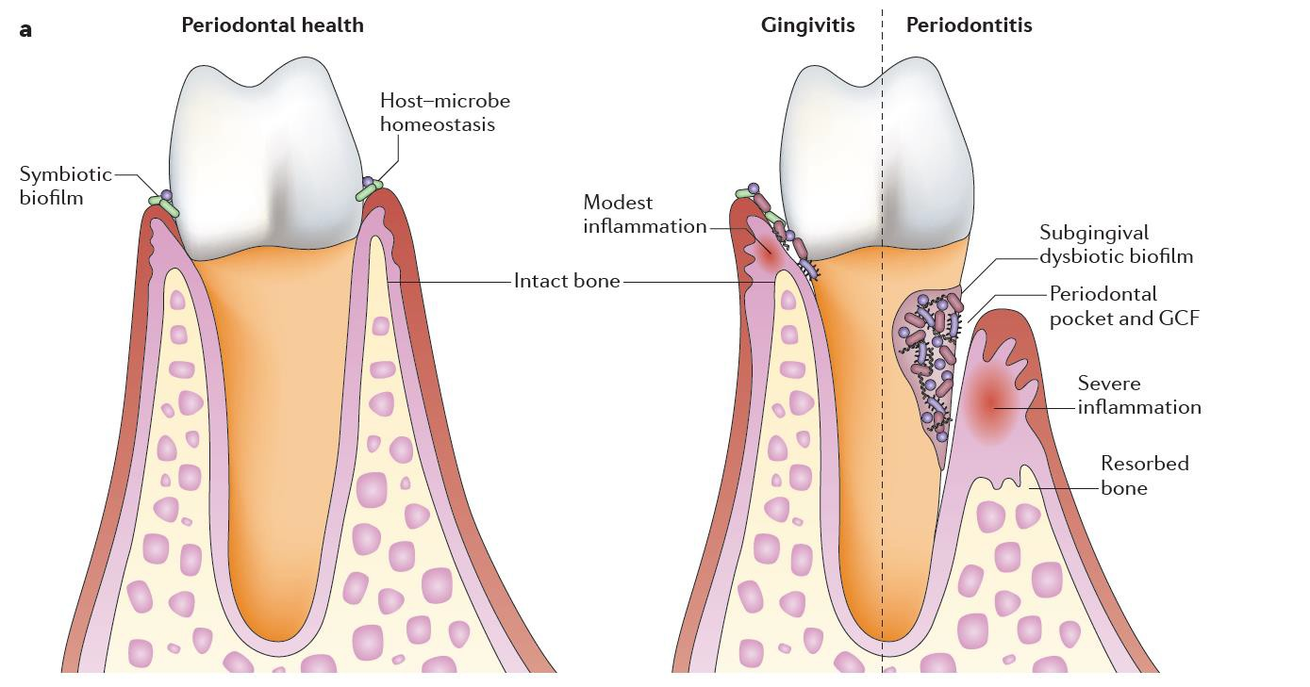
Health > Gingivitis/Periodontitis
Hajishengallis G. Periodontitis : from microbial immune subversion to systemic inflammation. Nat Rev Immunol. 2015;15(1):30–44.

Slide 7
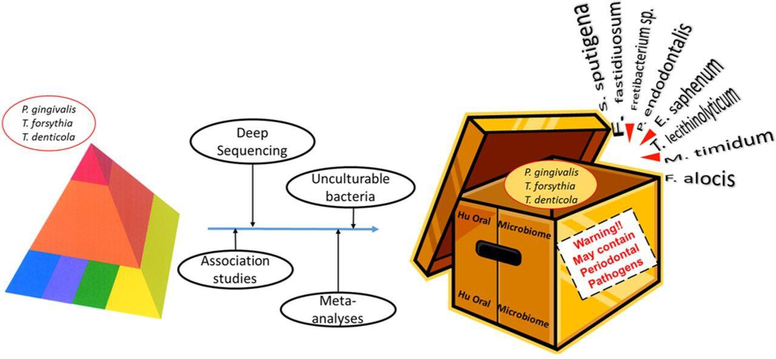
The application of new technologies to the analysis of the periodontal microbiome is leading to an expanded repertoire of putative periodontal pathogens.
Curtis M J DENT RES 2014;93:840-842

Slide 8
Periodontal disease affects susceptibility to systemic disease.
Shared Risk Factors e.g. tobacco smoking, stress, aging, race / ethnicity, male gender, (genetics).
Subgingival biofilms acting as reservoir of gram-negative bacteria – continuous challenge by gram-negative bacteria / LPS induces vascular responses and upregulation of inflammatory molecules.
Periodontium acting as reservoir of inflammatory mediators.

Slide 9
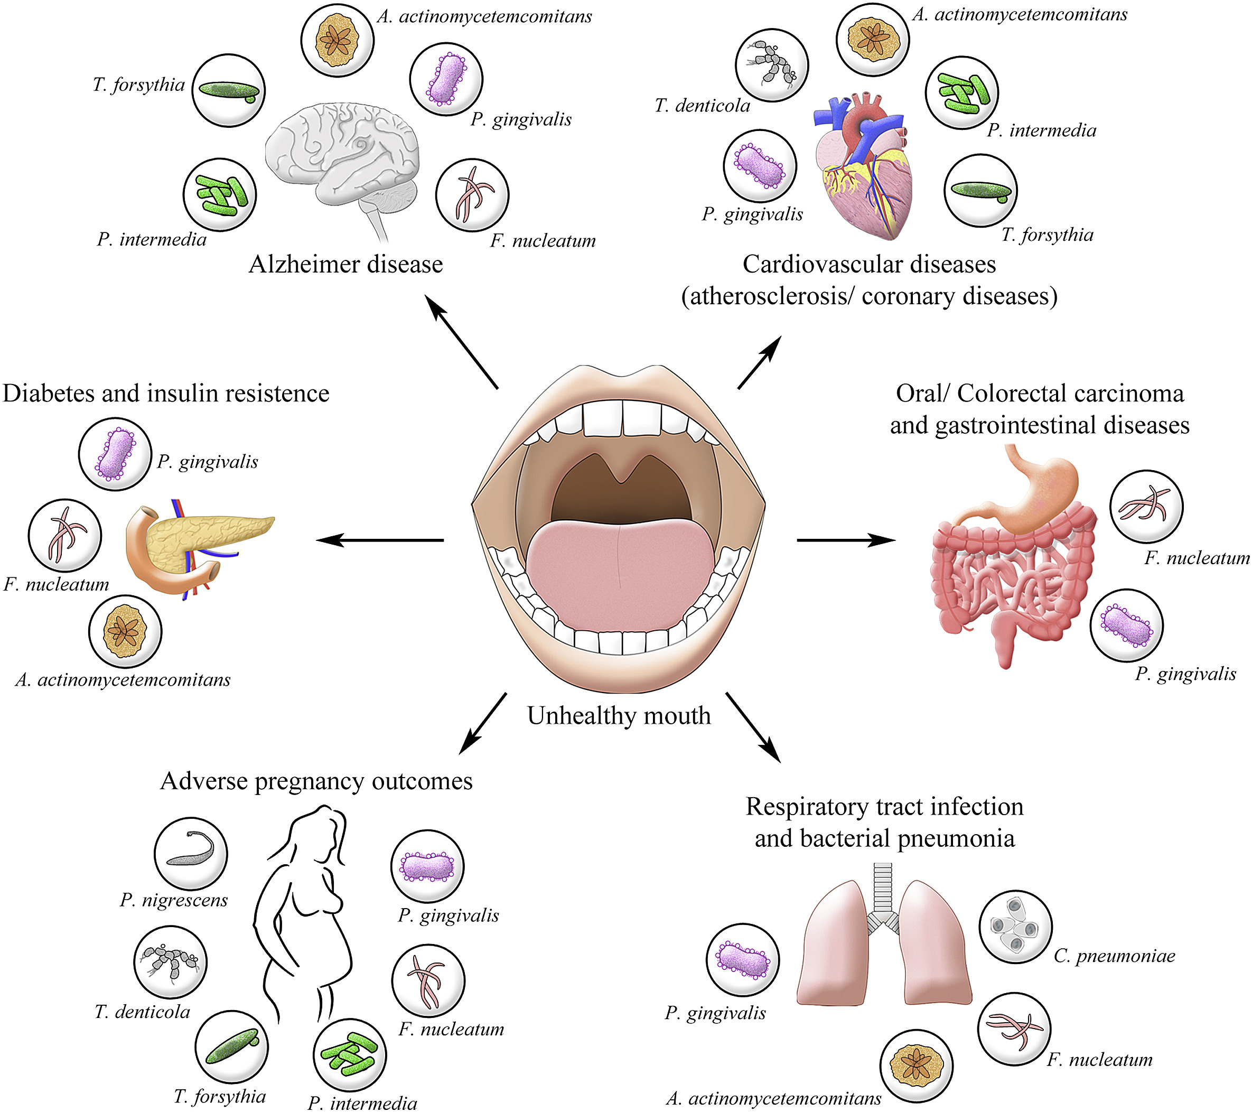
Schematic representation of different systemic diseases and their association with oral pathogens (Bui et al, 2019)

Slide 10
Systemic Diseases associated with oral infection.
Cardiovascular Disease.
Diseases such as atherosclerosis and myocardial infarction involve complex set of genetic and environmental factors – account for up to two-thirds of cases.
Other possible risk factors incl. chronic infection and inflammation.
Periodontal disease is associated with predisposition to CVD.
Several proposed mechanisms linking PD to CVD through direct and indirect activity of oral bacteria.
Evidence accumulating incl: Periodontal pathogens have been found in up to 42% of atheromas in patients with severe PD. Early-onset and refractory periodontitis associated with a hyper-inflammatory monocyte phenotype. Adult periodontitis associated with increased C-reactive protein. Tooth loss and dietary change etc..

Slide 11
Infective Endocarditis
Bacterial infection of the heart valves or endothelium – individuals with pre-existing heart defects at risk.
Associated with dental diseases and treatment.
Dental procedures esp. extractions and possibly scaling are associated.

Slide 12
Bacterial Pneumonia
Infection of pulmonary parenchyma (portion involved in gas transfer) caused by wide variety of infectious agents.
Community and hospital (nosocomial) acquired.
Microorganisms infect lower respiratory tracts by 4 routes: 1. aspiration of oropharyngeal contents 2. inhalation of aerosols 3. spread of infection from adjacent sites 4. haematogenous spread from other sites
Periodontal pathogens can be aspirated into lower airways and cause pneumonia. Link with poor oral hygiene and respiratory / periodontal disease.

Slide 13
Low Birth Weight
Hormonal changes in pregnancy may lead to pregnancy gingivitis.
Oral infection linked to increased risk of low birth weight (LBW - <2,500g).
LBW in preterm infants – significant cause of morbidity & mortality.
Wide range of risk factors including infection.
Amniotic fluid infection, chorioamnion infection / chorioamnionitis supports association between preterm birth / LBW and infection during pregnancy.
Anaerobic gram-negative species of bacteria in oral cavity increase during pregnancy. Increase in LPS leads to increase in circulating cytokines which can augment physiological levels of PGE₂ and TNF-α in amniotic fluid and induce premature labour.

Slide 14
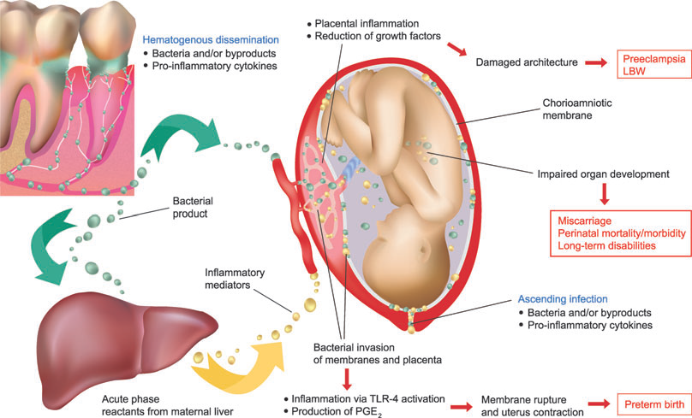
Madianos, P. N., Bobetsis, Y. A. & Offenbacher,
S. (2013) Adverse Pregnancy Outcomes
(APOs) and Periodontal Disease: Pathogenic
Mechanisms. Journal of Clinical Periodontology,
40 (Suppl 14), 170–180.
Possible biological mechanisms/pathways associating periodontal disease and pregnancy complications.

Slide 15
Low Birth Weight
Severe PD associated with LBW as a result of preterm labour or premature rupture of membranes.
Offenbacher et al concluded that 18% of preterm LBW babies may result from PD.
Association between PD and LBW may reflect patient’s altered immune-inflammatory trait – places patient at risk of both conditions.
Thus PD may be a marker of preterm delivery – as well as a risk factor.

Slide 16

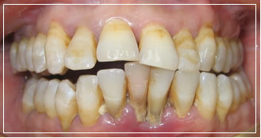
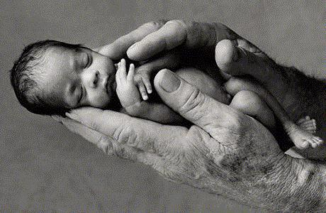
Possible link between Periodontal Disease and Preterm/Low Birth Weight
PERIODONTAL DISEASE
Odds Ratio= 7.5
PRETERM / LOW BIRTH WEIGHT
From Offenbacher et al. 1996
Notes:
In the mid 90s there was much interest in the dental research community as to the possibility of a link between perio and general health including CHD, diabetes and preg complications.
Mike Curtis and Liz Davenport here at Queen Mary embarked on a large clinical project funded by the NHS to look at a possible assoc between perio and PTLBW.
Around this time I also got involved …

Slide 17
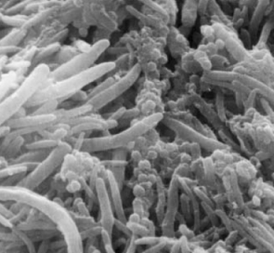
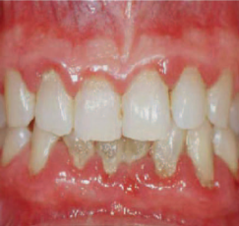
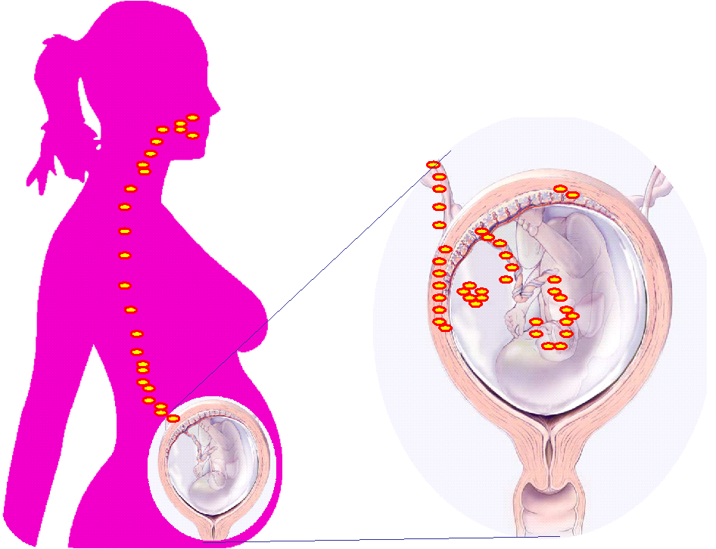
Supporting evidence of link (microbiological studies)
Oral anaerobic bacteria (including Fusobacterium nucleatum) found in the amniotic fluid and associated with adverse pregnancy outcomes (preterm, miscarriage, still birth etc..)
Brit J Obs Gynaecol 2002
Notes:
As I had a background working with oral anaerobic bacteria. And with funding from the BTLC we undertook a study to determine if bacteria associated with periodontitis from the mouth could reach the amniotic fluid surrounding the developing baby by passing through the bloodstream.
We found that there was a particular assoc between F nuc and adverse pregnancy outcome including preterm birth, miscarriage and still birth …

Slide 18
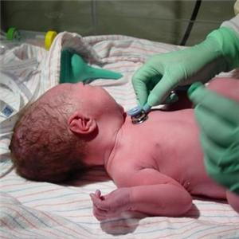
Gastric Aspirate Samples
GASTRIC ASPIRATE
Routinely taken under normal clinical care.
First hours of life.
From newborns at risk of infection (premature, LBW, congenital infection).
Infection Source: Amniotic Fluid + birth canal
Notes:
More recently Cecilia joined me and was funded by a L’Oreal fellowship to look at GA samples (essentially swallowed amniotic fluid) as part of her PhD.
Gastric aspirates are ….
Routinely taken under normal clinical care
Sampled in the 1st few hours of life
Taken from newborns at risk of infection
Potentially infected from the maternal amniotic fluid or birth canal

Slide 19

Study to determine origin of gastric aspirate infection.
SAMPLE COLLECTION
DATA COLLECTION
NEWBORN
MOTHER
GA
Oral cavity
Vagina
MULTIVARIABLE ANALISIS
LABORATORY
Genomic DNA Extraction
Characterize bacterial composition
Suspect oral origin
Notes:
The main focus of the work was to determine the origin of infection in GA samples. Proof was needed that there was this link.
GA samples were characterised at the molecular level and compared to samples that were characterised in the same way from the oral cavity and vagina of the respective mothers.
This generated lots of data – that required some very involved statistical analysis!

Slide 20
10 possible oral species detected in gastric aspirates
J Med Micro 2012
Notes:
10 possible oral species (in RED) were detected in gastric aspirates including F. nuc.
As F. nuc was the most common bacterial species isolated from amniotic fluid in cases of preterm labour with intact membranes we investigated this species further ….

Slide 21
Levels of Fusobacterium nucleatum show maternal oral cavity to be main site of carriage.
Mol Oral Microbiol 2011
Notes:
And showed the oral cavity to be the main site of carriage

Slide 22
16S-23S rRNA Intergenic Spacer Region (ISR) allows discrimination between samples
ISR
Fn1F
Fn2R
Results show F. nuleatum subsp. polymorphum of oral origin could be involved with pregnancy complications.
genus-specific F primer
456R
ITSR sequences
Oral cavity
Vagina
J Med Micro 2013
Notes:
Bacterial DNA extracted and amplified from neonatal gastric aspirate, oral and vagina samples was also analysed in a more sophisticated way.
Genetic sequences - between the 16S and 23S genes of bacteria being tested for a match - as these gene sequences are sufficiently variable to enable us to discriminate between samples
Results showed that a particular sub species of F. nuc from the mouth could well be involved in preg complications

Slide 23
Diabetes Mellitus
Clinical syndrome characterised by hyperglycaemia due to absolute / relative deficiency of insulin. Type 1 – insulin dependent and type 2 – non-insulin dependent.
Characterised by metabolic abnormalities & long-term complications involving eyes, kidneys, nervous system vasculature and periodontal tissues.
Severe PD often coexists with severe DM / DM is a risk factor for PD.
Conversely – PD predisposes / exacerbates DM.
Treatment aspects – control of chronic gram-negative periodontal infection (systemic antibiotics + mechanical therapy) results in improvement of diabetes control.
2-way relationship between DM and PD / Infection proposed.

Slide 24
Relationship between oral infection and systemic diseases.
Apart from endocarditis – more evidence is needed to claim a causal association between oral infection and other systemic diseases.
Epidemiological research (cross-sectional and longitudinal studies) can identify relationships but not causation.
PD may be an oral component of a systemic disorder or have aetiological features in common. Therefore no cause-effect relationship.

Slide 25
Criteria for causal links between PD and systemic diseases. (Slots et al, 1998)
Prevalence & incidence of systemic disease should be significantly higher in periodontitis patients than in periodontally healthy ones.
Onset of systemic disease should follow onset of PD.
Removal/reduction of PD should decrease the incidence of the systemic disease.
Microorganisms from systemic disease should be same species & strain as oral microorganisms.
Animal model with PD / inoculated microorganisms should develop more systemic disease than periodontally healthy.
Association between PD and systemic disease should be biologically feasible.

Slide 26
Concluding remarks
Apart from the well-established link between endocarditis
and dental associated bacteraemia, there is no firm evidence to indicate
that the other postulated diseases are either initiated
or perpetuated by the oral micro flora and their by-products.
Much of the available evidence is circumstantial, with a multitude
of confounding factors.
Further research is necessary to confirm or refute these observations.
Nonetheless, it is beyond doubt that good oral health is important not
only to prevent oral disease but also to maintain good systemic health.

Slide 27
Reading material
Kumar, P.S. (2013) Oral microbiota and systemic disease. Anaerobe 24: 90-93
Martínez-García, M., Hernández-Lemus, E. (2021) Periodontal Inflammation and Systemic Diseases: An Overview. Frontiers in Physiology Vol 12 https://doi.org/10.3389/fphys.2021.709438

