Slide 1
Methods to measure pollutants
Dr Abigail Whitehouse
Senior Clinical Lecturer in Children’s Environmental Health

Slide 2
Plan for the day!
Brainstorming session on how to measure pollution
Quick project time
Analyse data and discuss!

Slide 3
Measuring Pollution
What to measure?

Slide 4
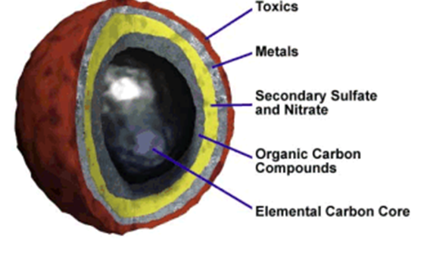
What is air pollution?
Particles
Particulate Matter
Gases
Nitrogen dioxide
Carbon monoxide
Ozone
Sulphur dioxide

Slide 5
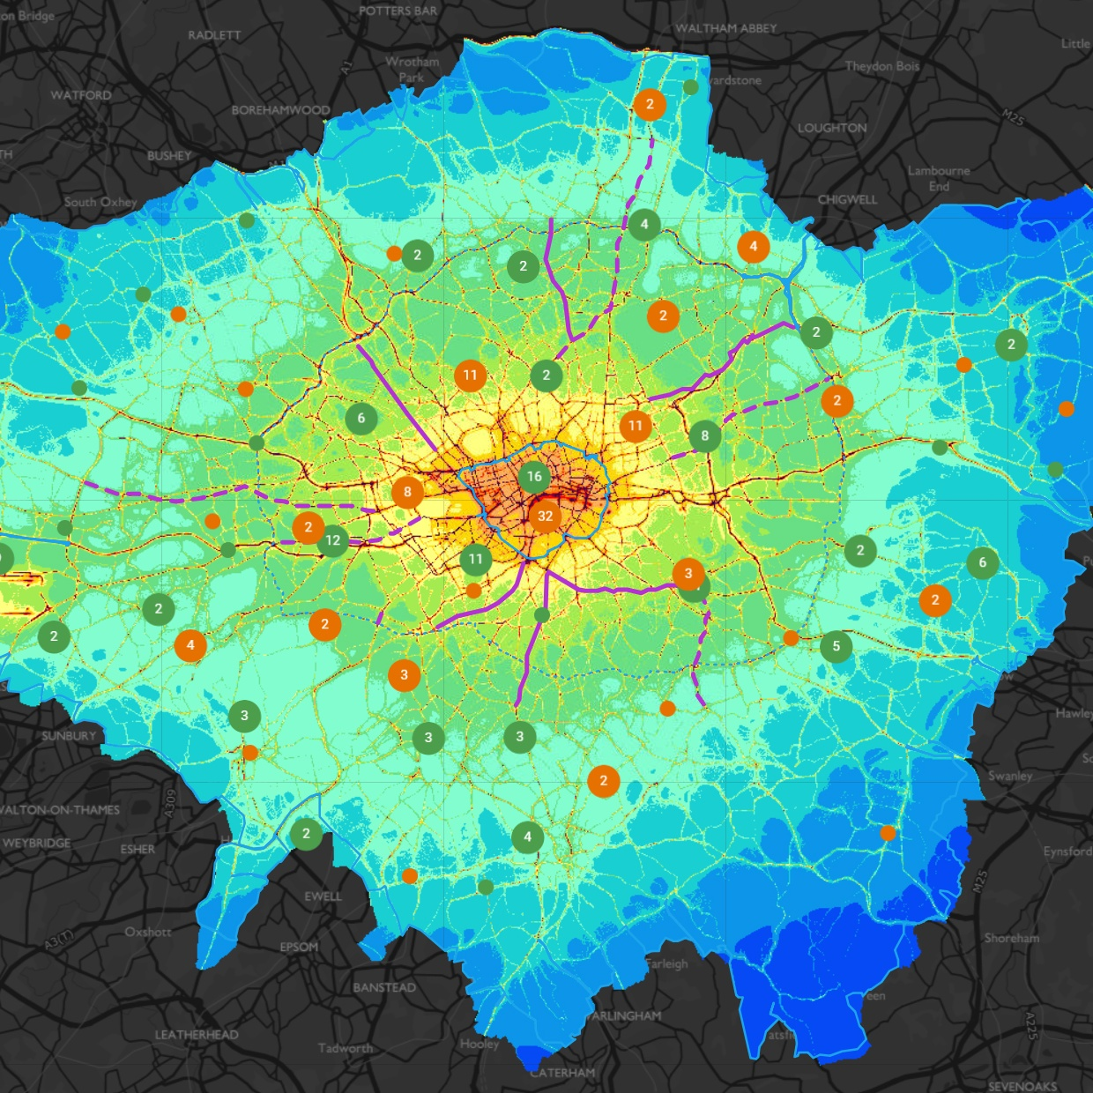
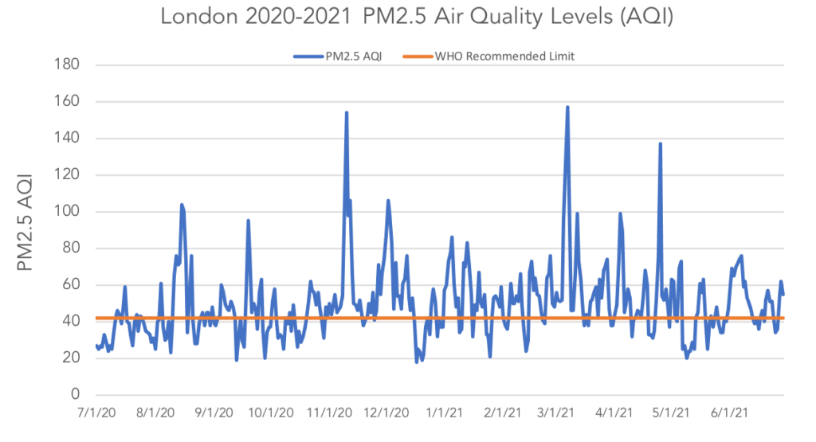
Air pollution levels in UK
https://smartairfilters.com/en/blog/london-air-quality-aqi-air-pollution/
https://www.london.gov.uk/what-we-do/environment/pollution-and-air-quality/london-air-quality-map

Slide 6
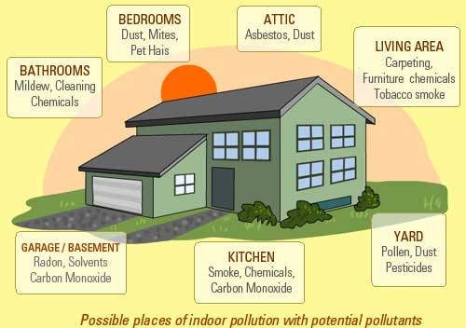

Slide 7
How can we measure?
What is reported in the literature?

Slide 8
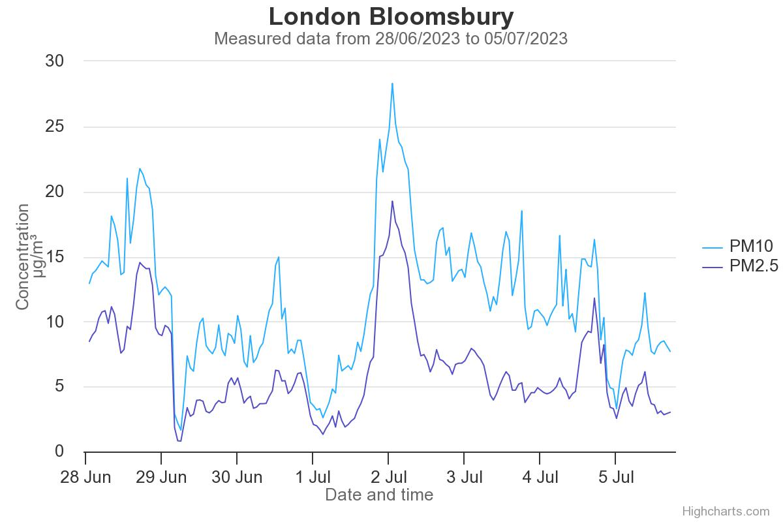
Roadside monitoring

Slide 9
Distance from main road
<50m
<100m

Slide 10
Modelled Exposure
Pollution in my area (londonair.org.uk)
Uses validated model – usually older dater
Combines monitor data with dispersion models

Slide 11
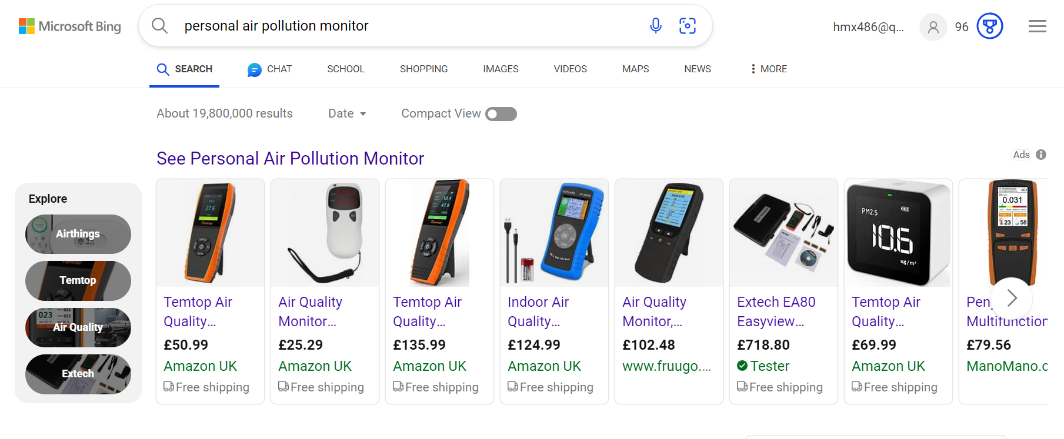
Personal Monitoring

Slide 12
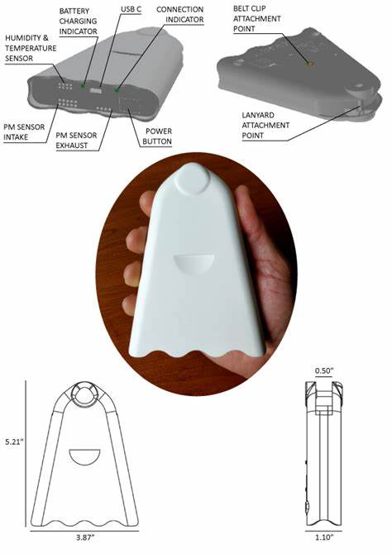
More expensive personal monitors
The AirBeam2 uses a light scattering method to measure PM. Air is drawn through a sensing chamber wherein light from a laser scatters off particles in the airstream. This light scatter is registered by a detector and converted into a measurement that estimates the number of particles in the air.
Via Bluetooth, these measurements are communicated approximately once a second to the AirCasting Android app, which maps and graphs the data in real time on a smartphone. Via Wi-Fi, these measurements are communicated approximately once a minute to the AirCasting website. At the end of each AirCasting session, the collected data is sent to the AirCasting website, where the data is crowdsourced with data from other AirCasters to generate heat maps indicating where PM_{2.5} concentrations are highest and lowest.

Slide 13
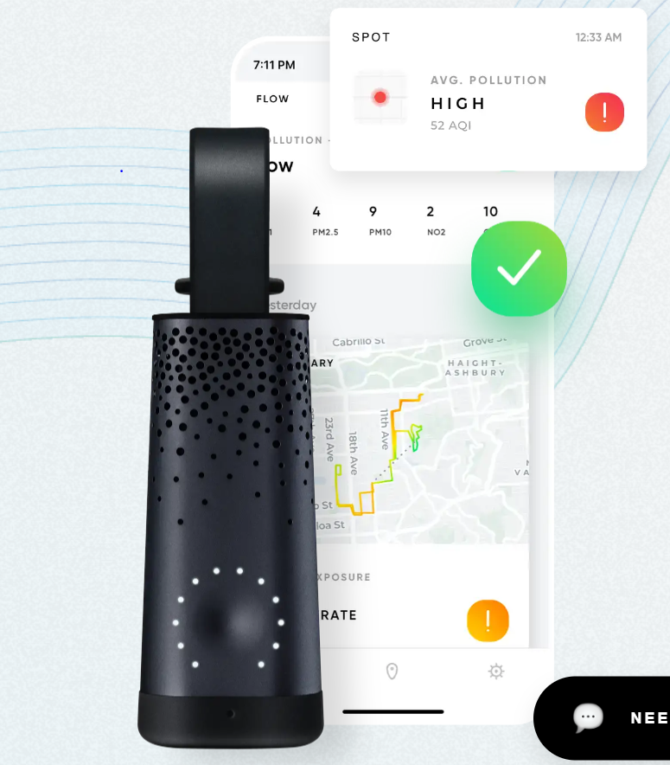
Other monitors

Slide 14

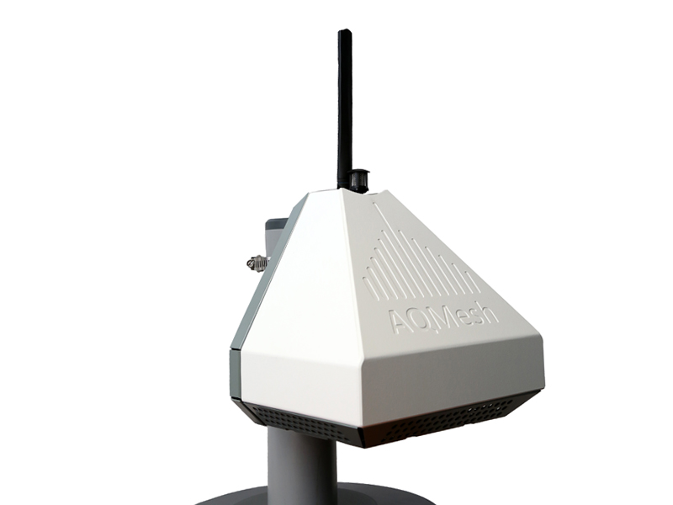
High-tech options

Slide 15
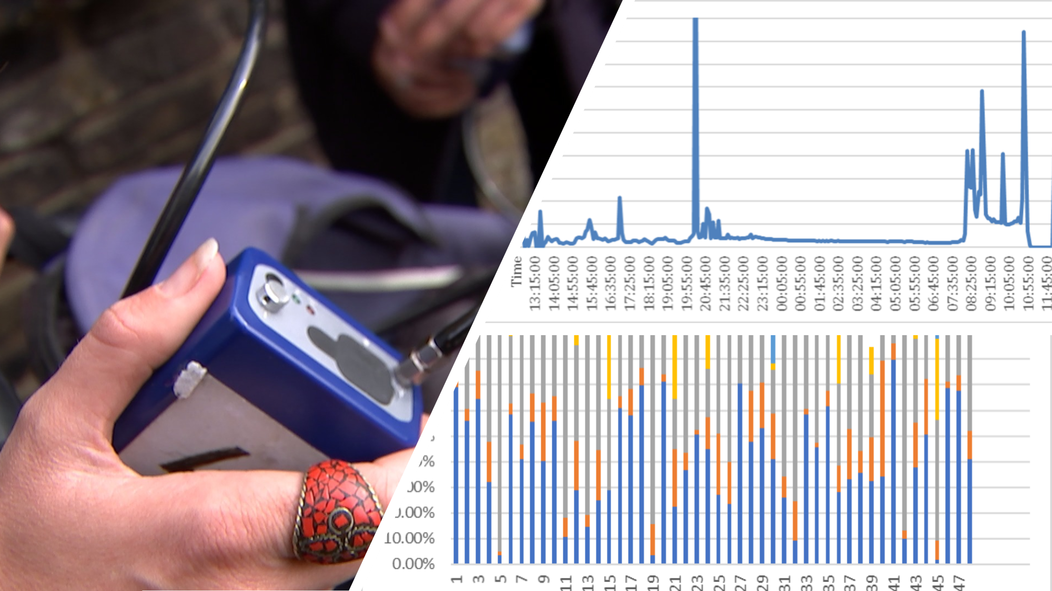
MicroAeth

Slide 16
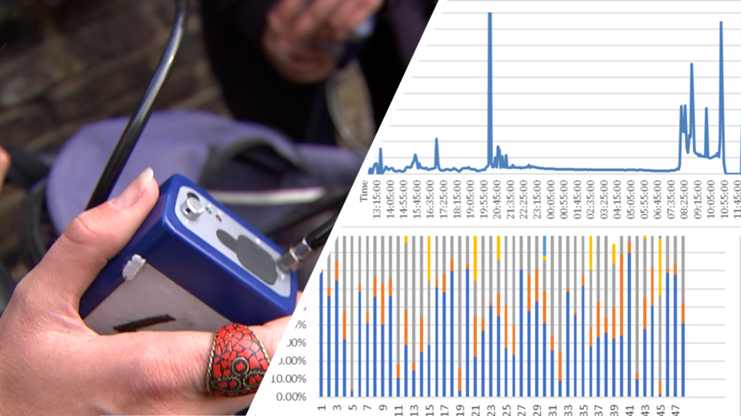
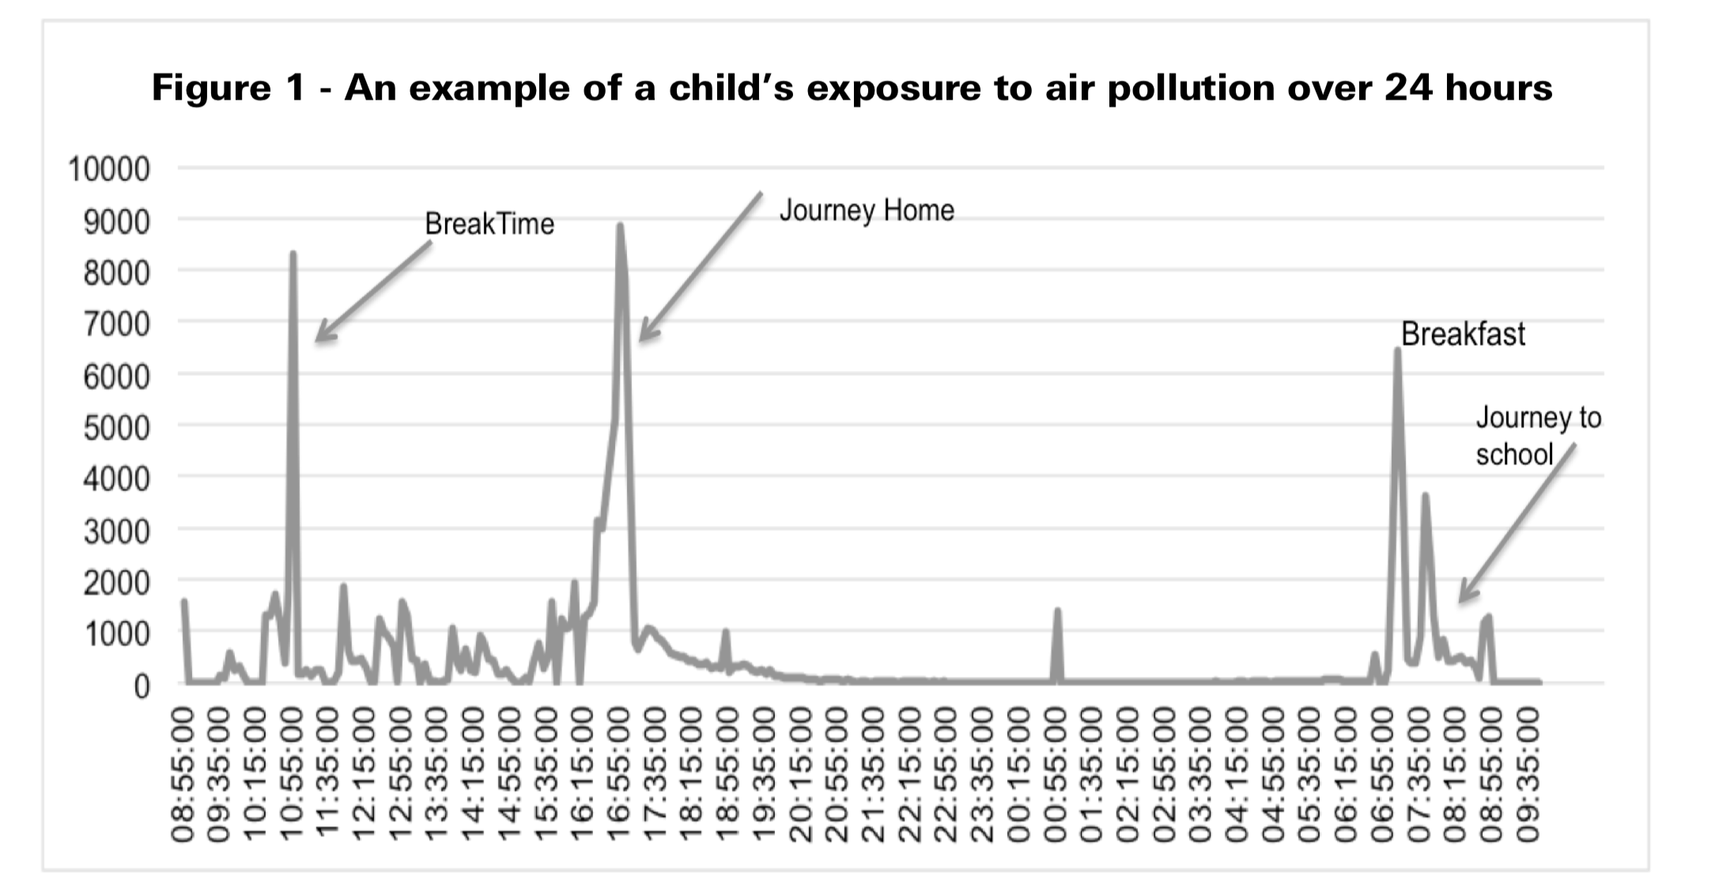
Monitoring in children
Toxic School Run 2018, Unicef

Slide 17
Monitoring in children
Toxic School Run 2018, Unicef

Slide 18
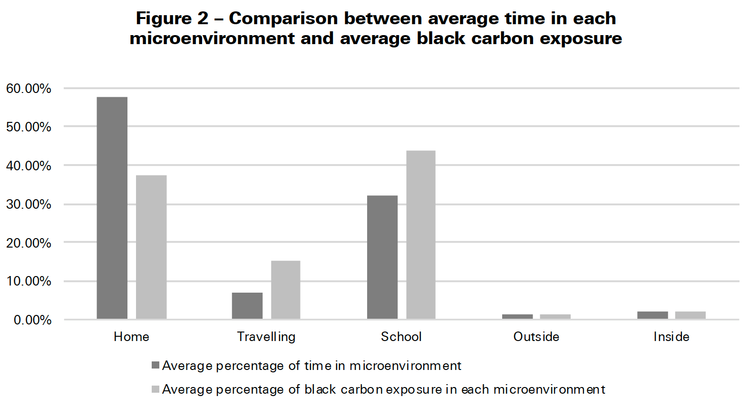

Slide 19
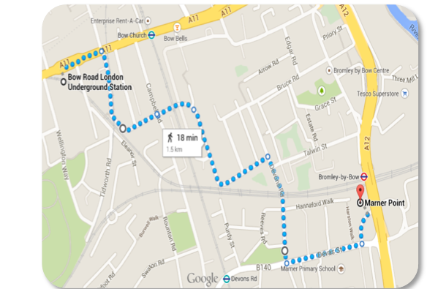
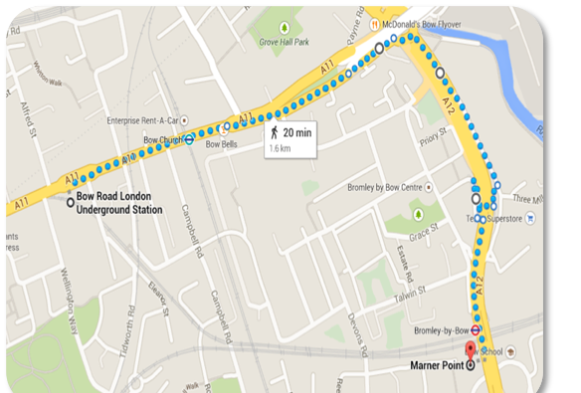
low pollution routes
(Abstract) American Thoracic Society 2015

Slide 20
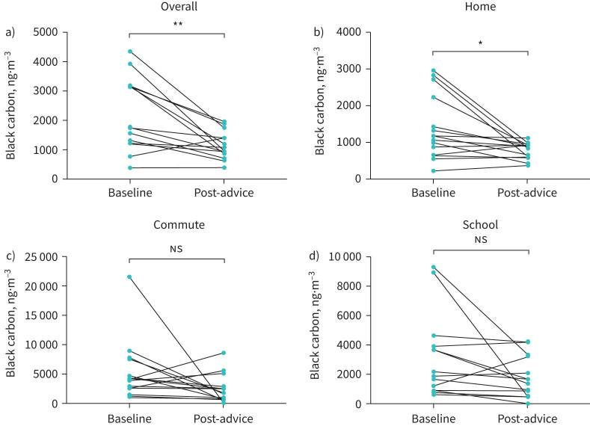
Altering Exposure
Koh et al 2021, ERJ Open

Slide 21
What shall we measure?
??

