Slide 1
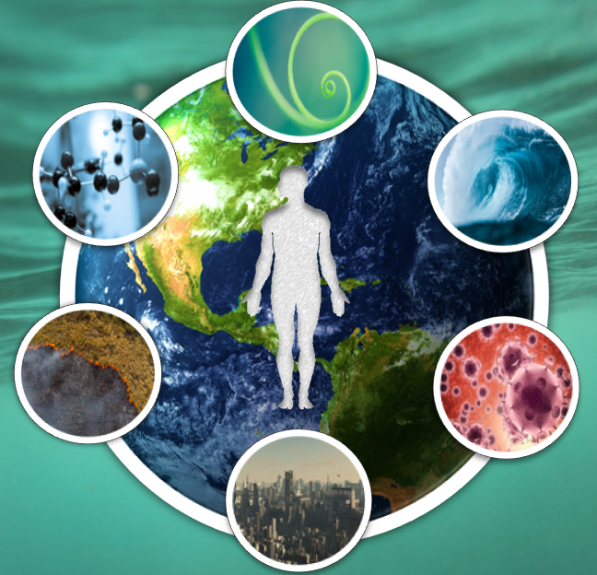
Summer School
Environmental Impacts on Health and Disease
Stavroula Kanoni, PhD, PGCAP, FHEA
Reader in Nutrigenetics and Cardiovascular Health
Academic Lead (Dep) Environment & Health Multi-Disciplinary Theme
Fellow Digital Environment Research Institute (DERI)
s.kanoni@qmul.ac.uk

Slide 2
Journal Club: Concomitant exposure to air pollution, green space, and noise and risk of disease - Lessons from Denmark

Slide 3
Paper 1: T2D

Slide 4
Paper 2: Stroke

Slide 5
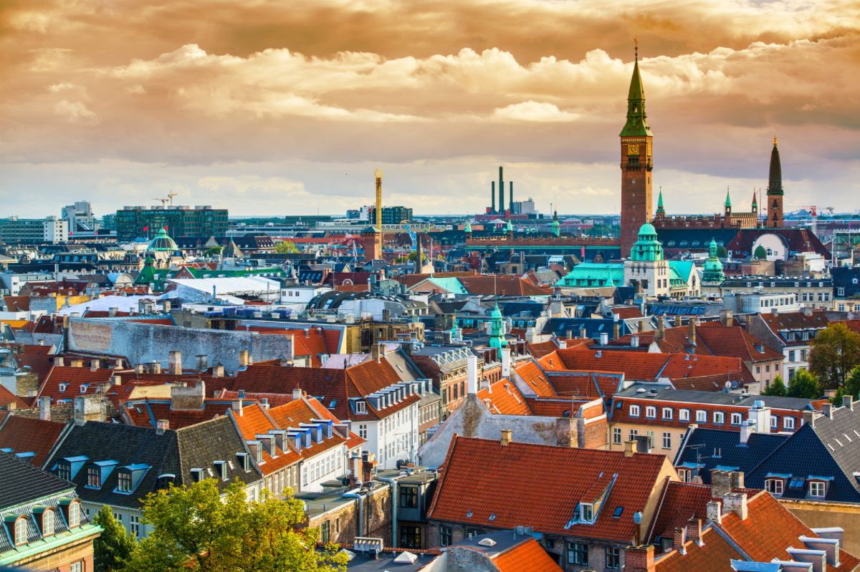
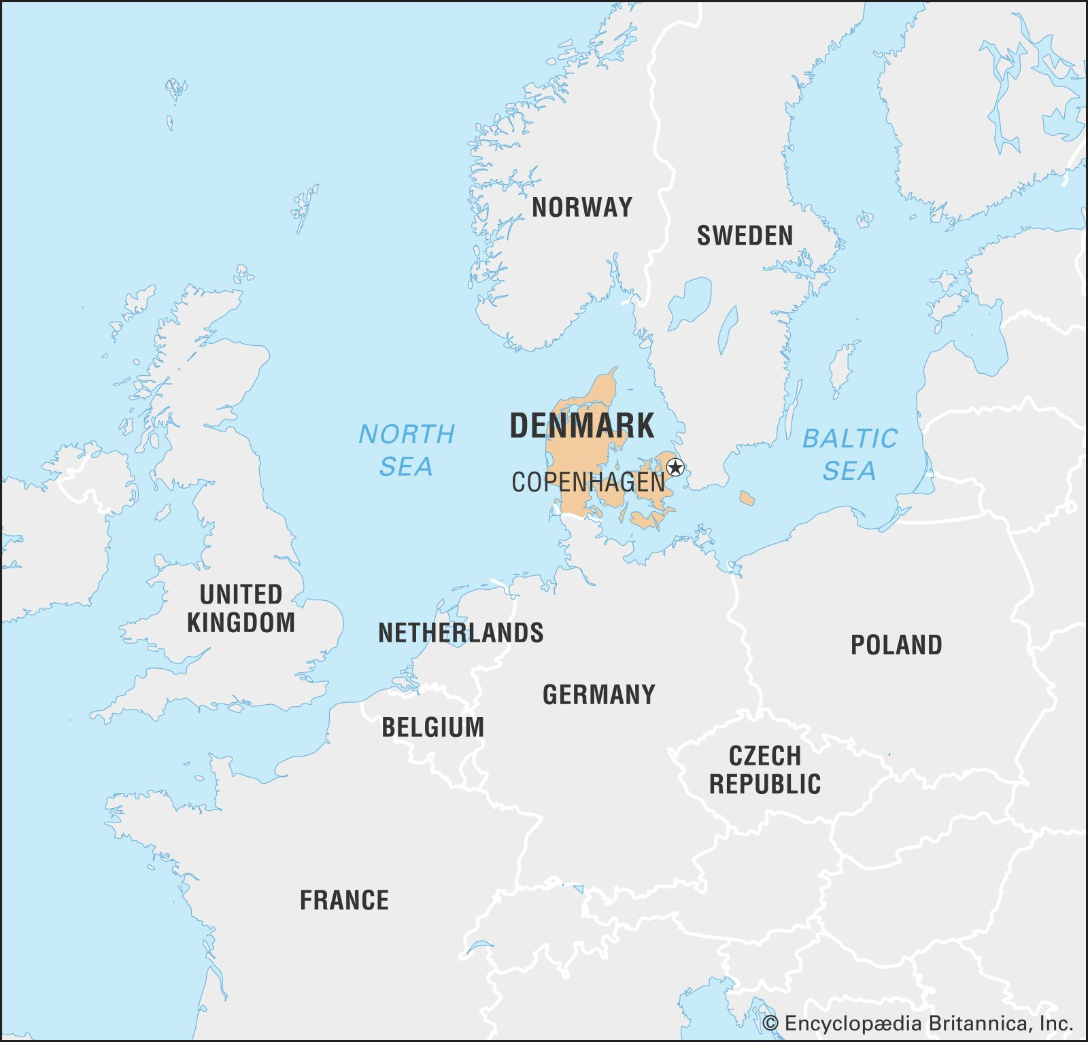
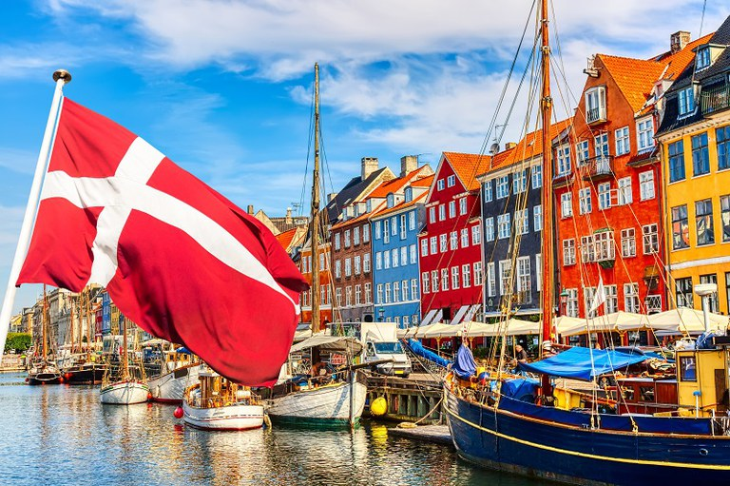
Where is Denmark?

Slide 6
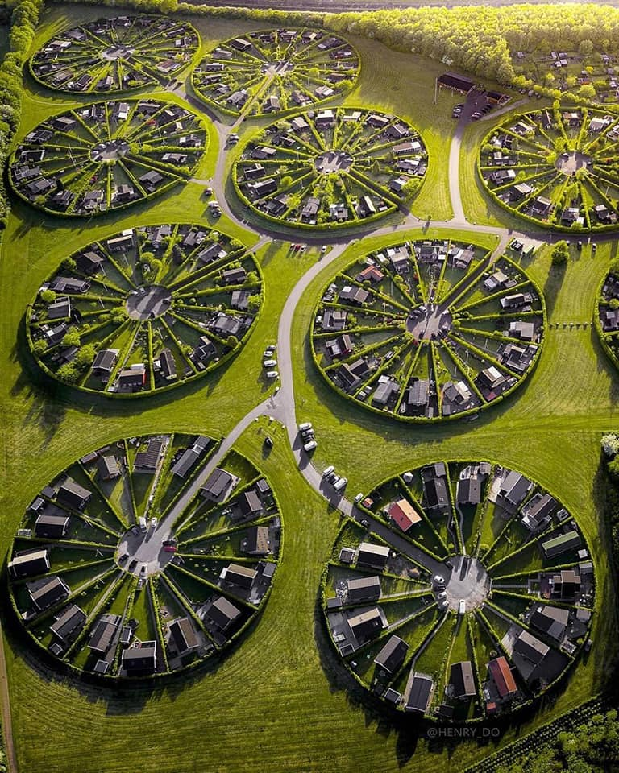
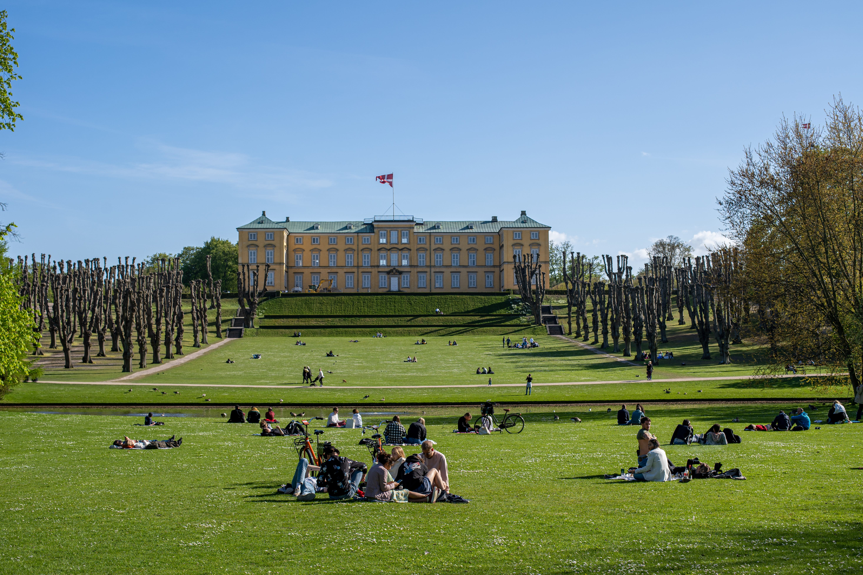
Air pollution, noise and green spaces in Denmark
European Environment Agency
https://www.eea.europa.eu/themes/air/country-fact-sheets/2022-country-fact-sheets/denmark-air-pollution-country
https://www.eea.europa.eu/themes/human/noise/noise-fact-sheets/noise-country-fact-sheets-2021/denmark
https://www.eea.europa.eu/highlights/how-green-are-european-cities
https://www.iqair.com/world-most-polluted-countries

Slide 7
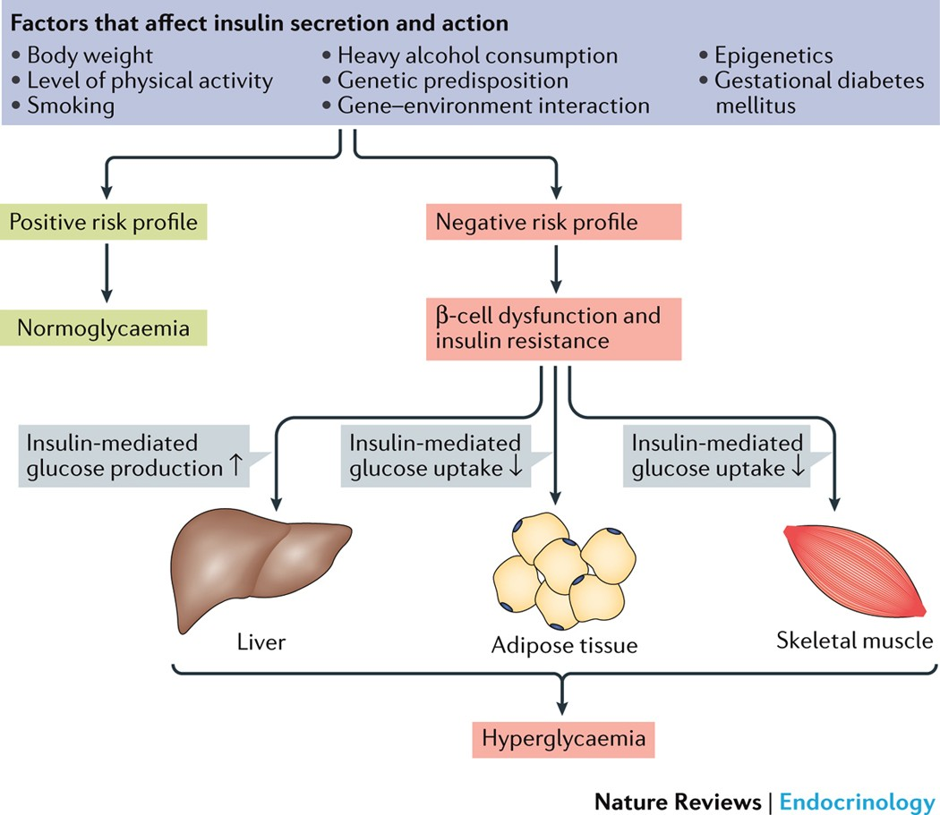
What is Type 2 Diabetes?
A chronic metabolic disorder characterized by persistent hyperglycemia due to:
Impaired insulin secretion
Resistance to peripheral actions of insulin
Microvascular (retinopathy, nephropathy, and neuropathy) and macrovascular complications leading to a 2-fold to 4-fold increased risk of cardiovascular diseases.
Risk factors:
Genetic susceptibility
Physical activity
Obesity
Lifestyle
Zheng, Y. et al. Nat Rev Endocrinol, 2018

Slide 8
What is Stroke
Stroke is a leading cause of death and disability worldwide -> ischaemic stroke & haemorrhagic stroke
Ischaemic stroke: infarction of the brain, spinal cord or retina -> ~71% of all strokes globally
Risk factors:
Genetic heritability
Age, sex
History of hypertension
Diabetes
Lifestyle (lack of physical activity, diet , smoking, stress)
Campbell, B.C.V et al. Nat Rev Dis Primers, 2019

Slide 9
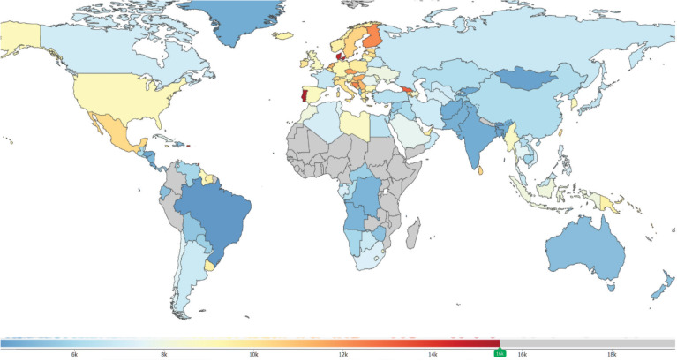
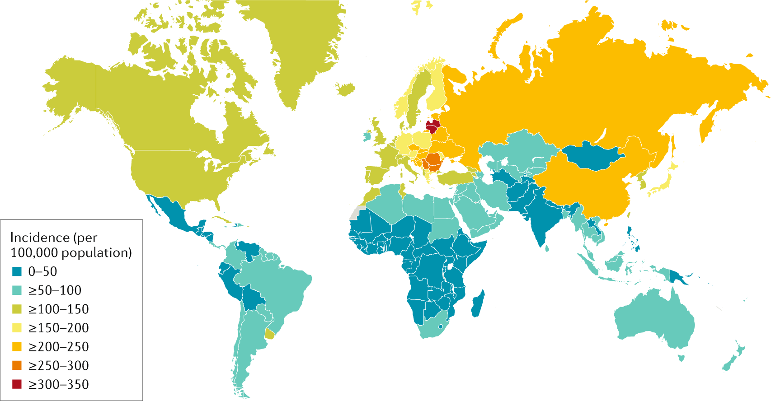
How prevalent is T2D and Stroke in Denmark?
T2D
Stroke

Slide 10
How prevalent is T2D and Stroke in Denmark?
https://vizhub.healthdata.org/gbd-compare/

Slide 11
Background to the studies
Literature evidence from meta-analysis -> association between air pollution particles and T2D and stroke
Studies associating road traffic noise with ↑ risk of T2D & ↑ risk of stroke
Neighbourhood green space -> ↓ risk of T2D & ↓ risk of stroke
Noise and air pollution are often correlated, due to shared sources
The presence of green space might be correlated with air pollution and noise

Slide 12
Aims
Study associations between long-term exposure to air pollution, road traffic noise and green space in relation to risk of type 2 diabetes in a multi-exposure perspective based on the Danish population
Capturing multiple aspects of each exposure:
Estimate total and traffic-specific contributions of PM2.5, EC, UFP and NO2
Aimed to unravel independent associations between air pollution with PM2.5, NO2, EC, and UFP, noise, and green space in relation to risk of stroke
Model road traffic noise at both the most and least exposed facade
Estimate the proportion of different types of green space

Slide 13
Methods – Who was included?
Danish Civil Registration System -> exact address-history for all people in Denmark, including date of moving and migration
Address-history for all persons born after 1st of 1921 and living in Denmark from 1979
Address histories ended after >14 consecutive days of incomplete address data or when people emigrated from Denmark
Participants living in Denmark on 1st of 2005 and who were ≥50 years of age any time between this date and 31st December 2017
N = 1,922,545 for the T2D study
N = 2,048,282 for the Stroke study

Slide 14
Methods – How was the outcome defined?

Slide 15
Methods – How was air pollution measured?
Danish Civil Registration System -> exact address-history for all people in Denmark, including date of moving and migration
DEHM/UBM/ AirGIS modelling system -> estimation of total concentrations of PM2.5, UFP, EC and NO2 and their source-specific contributions at the front door of all Danish residential addresses
This system calculates air pollution contributions from:
Regional background, modelled using the Danish Eulerian Hemispheric Model
Local background, modelled using the Urban Background Model covering Denmark with a 1 km² spatial grid resolution
Local street, modelled using the Operational Street Pollution Model, which takes into account traffic intensity and composition, meteorology, emission factors, and street and building configurations

Slide 16
Methods – How was road traffic noise measured?

Slide 17
Methods – How was green space evaluated?

Slide 18
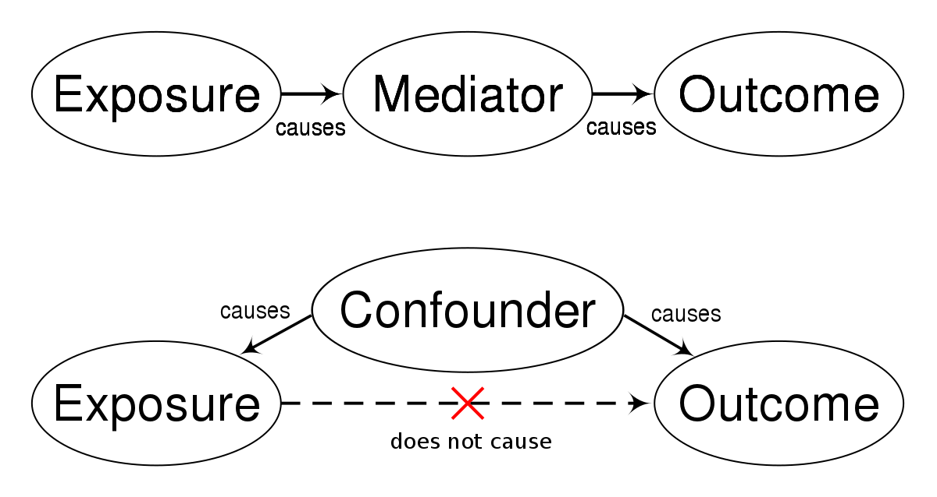
Methods – Other confounders
Education
Occupational status
Family and individual income
Cohabiting status
Country of origin

Slide 19
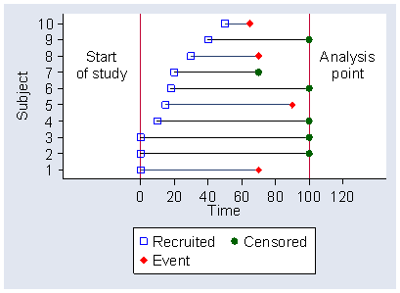
Methods – Statistical analysis
Cox proportional hazard models with age as underlying time-scale to estimate hazard ratios (HR) for the association between air pollution, noise, and surrounding green space in relation to risk of type 2 diabetes and stroke
Adjustments for covariates
Single and multi-exposure models
CRI<- cumulative risk index for stroke

Slide 20
Results
Exclusion of 104,130 people with prevalent diabetes (type 1 or 2) & 21,611 people with missing confounder information -> 1,922,545 people with a median follow-up of 11.2 years -> 128,358 incident T2D cases
Exclusion of 54,416 people with prevalent stroke & 22,620 people with missing confounder information -> 1,971,246 people with 18,344,976 years of follow-up -> 94,256 incident strokes (incidence rate of 514 cases per 100,000 person years)

Slide 21
Results
The Spearman correlations:
Strong between total pollutant concentrations and their non-traffic component
Total concentrations of the different air pollutants were in the range 0.71–0.93
Correlations ranged from 0.63 to 0.85 between the four non-traffic contributions
Correlations between air pollution and noise were weak to moderate ranging from 0.07 to 0.53
Green areas <150 m was weakly correlated with noise and air pollution

Slide 22
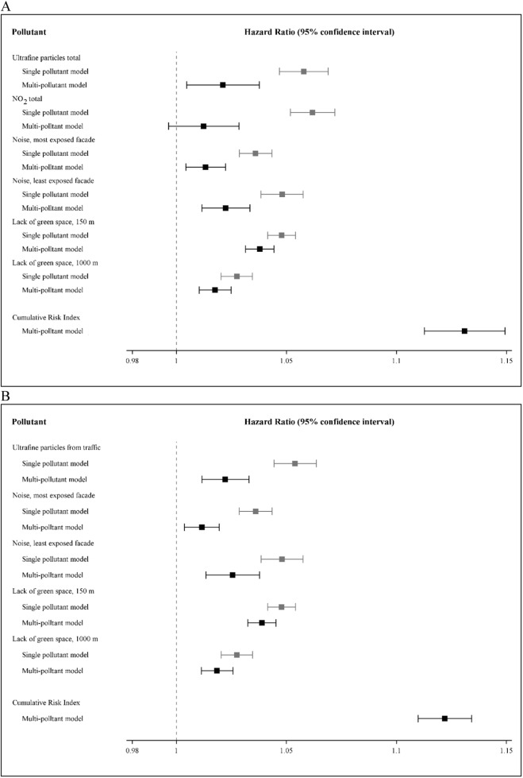
Results – T2D
In single-pollutant models, air pollution, noise and lack of green space were all associated with a higher risk of type 2 diabetes.
In models including two to four of the air pollutants (total concentrations), UFP and NO₂ remained associated with diabetes in all models
LdenMax and LdenMin were both associated with diabetes in a two-pollutant model
NonGreen150m and NonGreen1000m were both associated with diabetes in a two-pollutant model
In a multi-pollutant model including air pollution (total UFP and total NO₂), noise and green space, all exposures remained associated with higher risk of diabetes and the CRI was much higher than the risk estimate of any single pollutant.

Slide 23
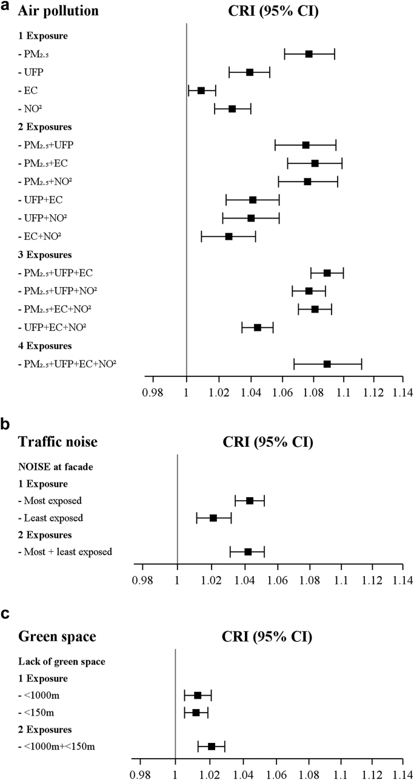
Results – Stroke
In single pollutant models, all air pollutants were associated with higher risk of stroke
In multi-pollutant models, PM_{2.5} was the most robust air pollutant, showing increased HRs in all two-, three-, and four pollutant models
For air pollution concentrations from non-traffic sources, HRs for both PM_{2.5} and NO₂ were consistently above 1.00, whereas UFP and EC showed HRs below 1.00 in several multi-pollution models
For both total air pollutants and for non-traffic contributions, CRI analyses indicated PM_{2.5} as the primary exposure
Noise, both at the least and most exposed façade, was associated with risk of stroke in single pollutant models, whereas only LdenMax had an increased HR in a model including both
Non-green space within 1000 m and within 150 m of residence, were both associated with a higher risk of stroke in single pollutant models and when included in the same model

Slide 24
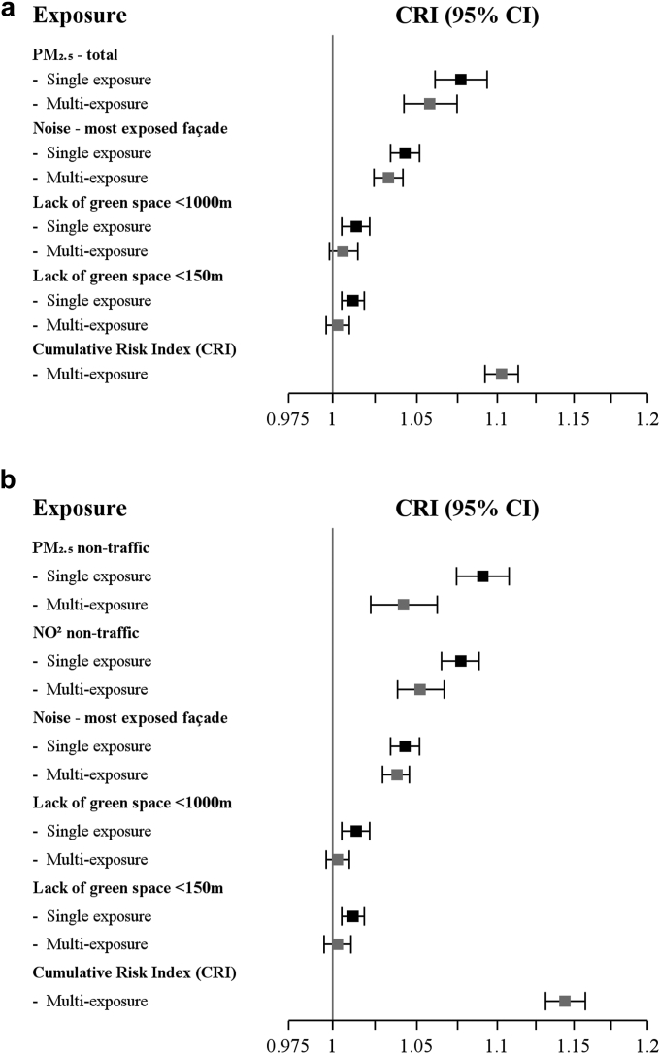
Results – Stroke
In the multi-pollutant model including total PM_{2.5}, LdenMax, and non-green space within 150 m and 1000 m, the HRs for the two latter were reduced to just slightly above 1.00, whereas the association for noise and PM_{2.5} persisted, with only minor reductions - > the CRI of the four-pollutant model was 1.108 (95% CI: 1.097–1.120)
In the multi-pollutant model with non-traffic contributions of PM_{2.5}, NO₂, LdenMax, and non-green space within 150 m and 1000 m, both green space metrics were associated with HRs only slightly above 1.00
The HR for LdenMax was virtually unchanged compared to the single pollutant model
Both PM_{2.5} and NO₂ from non-traffic sources were associated with an elevated risk of stroke, although the HRs were reduced compared with the single pollutant models -> the CRI of this model was 1.150 (95% CI: 1.144–1.157)

Slide 25
Conclusions

Slide 26
Study strengths
Nationwide prospective cohort design
Comprehensive Danish registers -> detailed information on residential history, diagnoses, and a comprehensive set of covariates at individual and area level
Validated state-of-the-art models -> air pollution total concentrations and contribution from traffic and non-traffic sources, and noise at both the least and most exposed façade
Analysed simultaneously multiple air pollutants and several measures of green space and noise

Slide 27
Study limitations
High correlations between exposures -> biased association results due to auto-collinearity
Lack of lifestyle information (confounder)
Large proportion of people with undiagnosed T2D (24%) -> misclassification
Caution must be taken when generalizing to other Western populations

Slide 28
Are the conclusions justified based on the results?
Did they miss anything?
Is there literature to corroborate their findings?
What other limitations?
Further investigations?
How about suggested biological mechanisms for the observed associations?
Give your evidence in the QMplus forum for Journal club 1

Slide 29
@StavroulaKanoni

