Slide 1
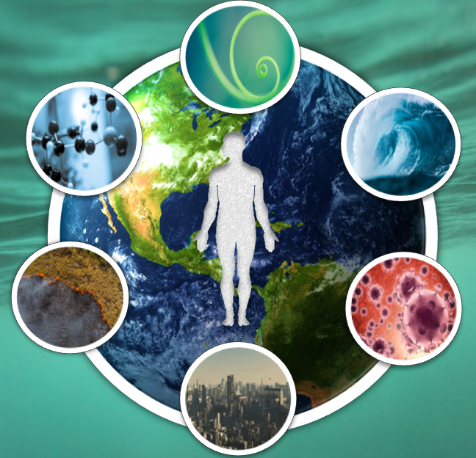
Summer School
Environmental Impacts on Health and Disease
Stavroula Kanoni, PhD, PGCAP, FHEA
Reader in Nutrigenetics and Cardiovascular Health
Academic Lead (Dep) Environment & Health Multi-Disciplinary Theme
Fellow Digital Environment Research Institute (DERI)
s.kanoni@qmul.ac.uk

Slide 2
Outline
Round of introductions
Presentation of the Multidisciplinary Theme (MDT) “Environment & Health”
Overview and learning outcomes of the Summer School
Content on QMplus and how to access it
Summer School Assessments and feedback
Your expectations from the Summer School

Slide 3
Round of introductions
What is your name?
Where are you from?
What is your background?
Why did you choose this Summer School?
Why are you interested in Environment & Health?

Slide 4
The Environment & Health MDT
Part of the research mission and strategy for the Faculty of Medicine and Dentistry at QMUL
An innovative and holistic approach is necessary to enable effective management of the chronic diseases that affect the world’s population. Such complex diseases involve multi-factorial aetio-pathogenesis which is compounded by the burdens of life-style, societal (e.g. poverty) as well as environmental (e.g. pollution) factors, including an interplay with non-communicable diseases impacted by multi-morbidity and long-term conditions. Lifestyle factors (including smoking, obesity, and unhealthy diet) often augment the entity of disease manifestation and hamper the effectiveness of clinical management. Health inequalities also impact on the care and treatment of rare diseases, where there is significant variation in the availability of therapies, biomarkers and research activities around specific rare diseases.

Slide 5
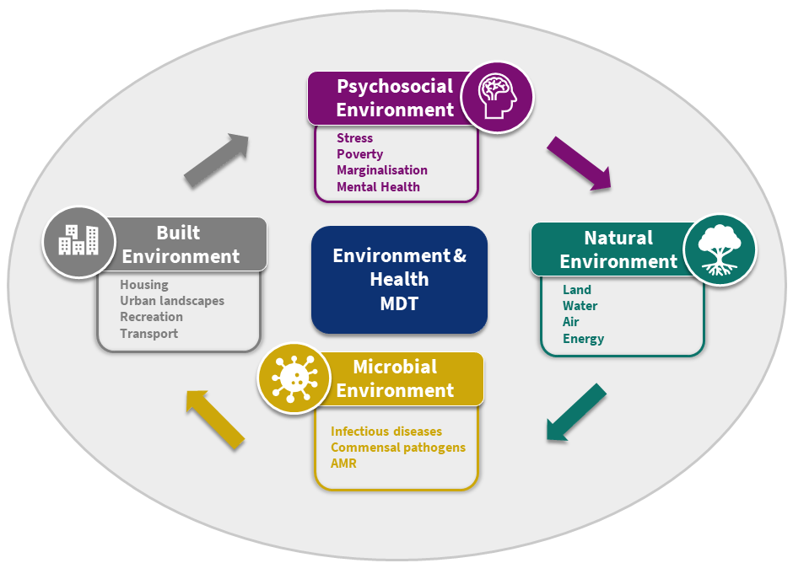
The Environment & Health MDT

Slide 6
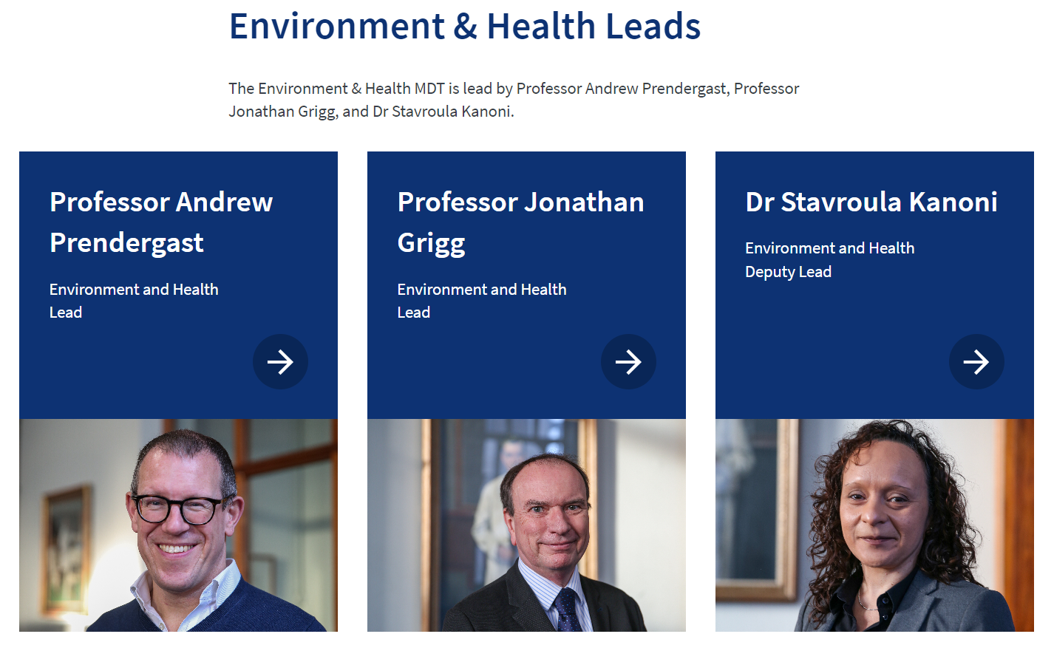
The Environment & Health MDT

Slide 8
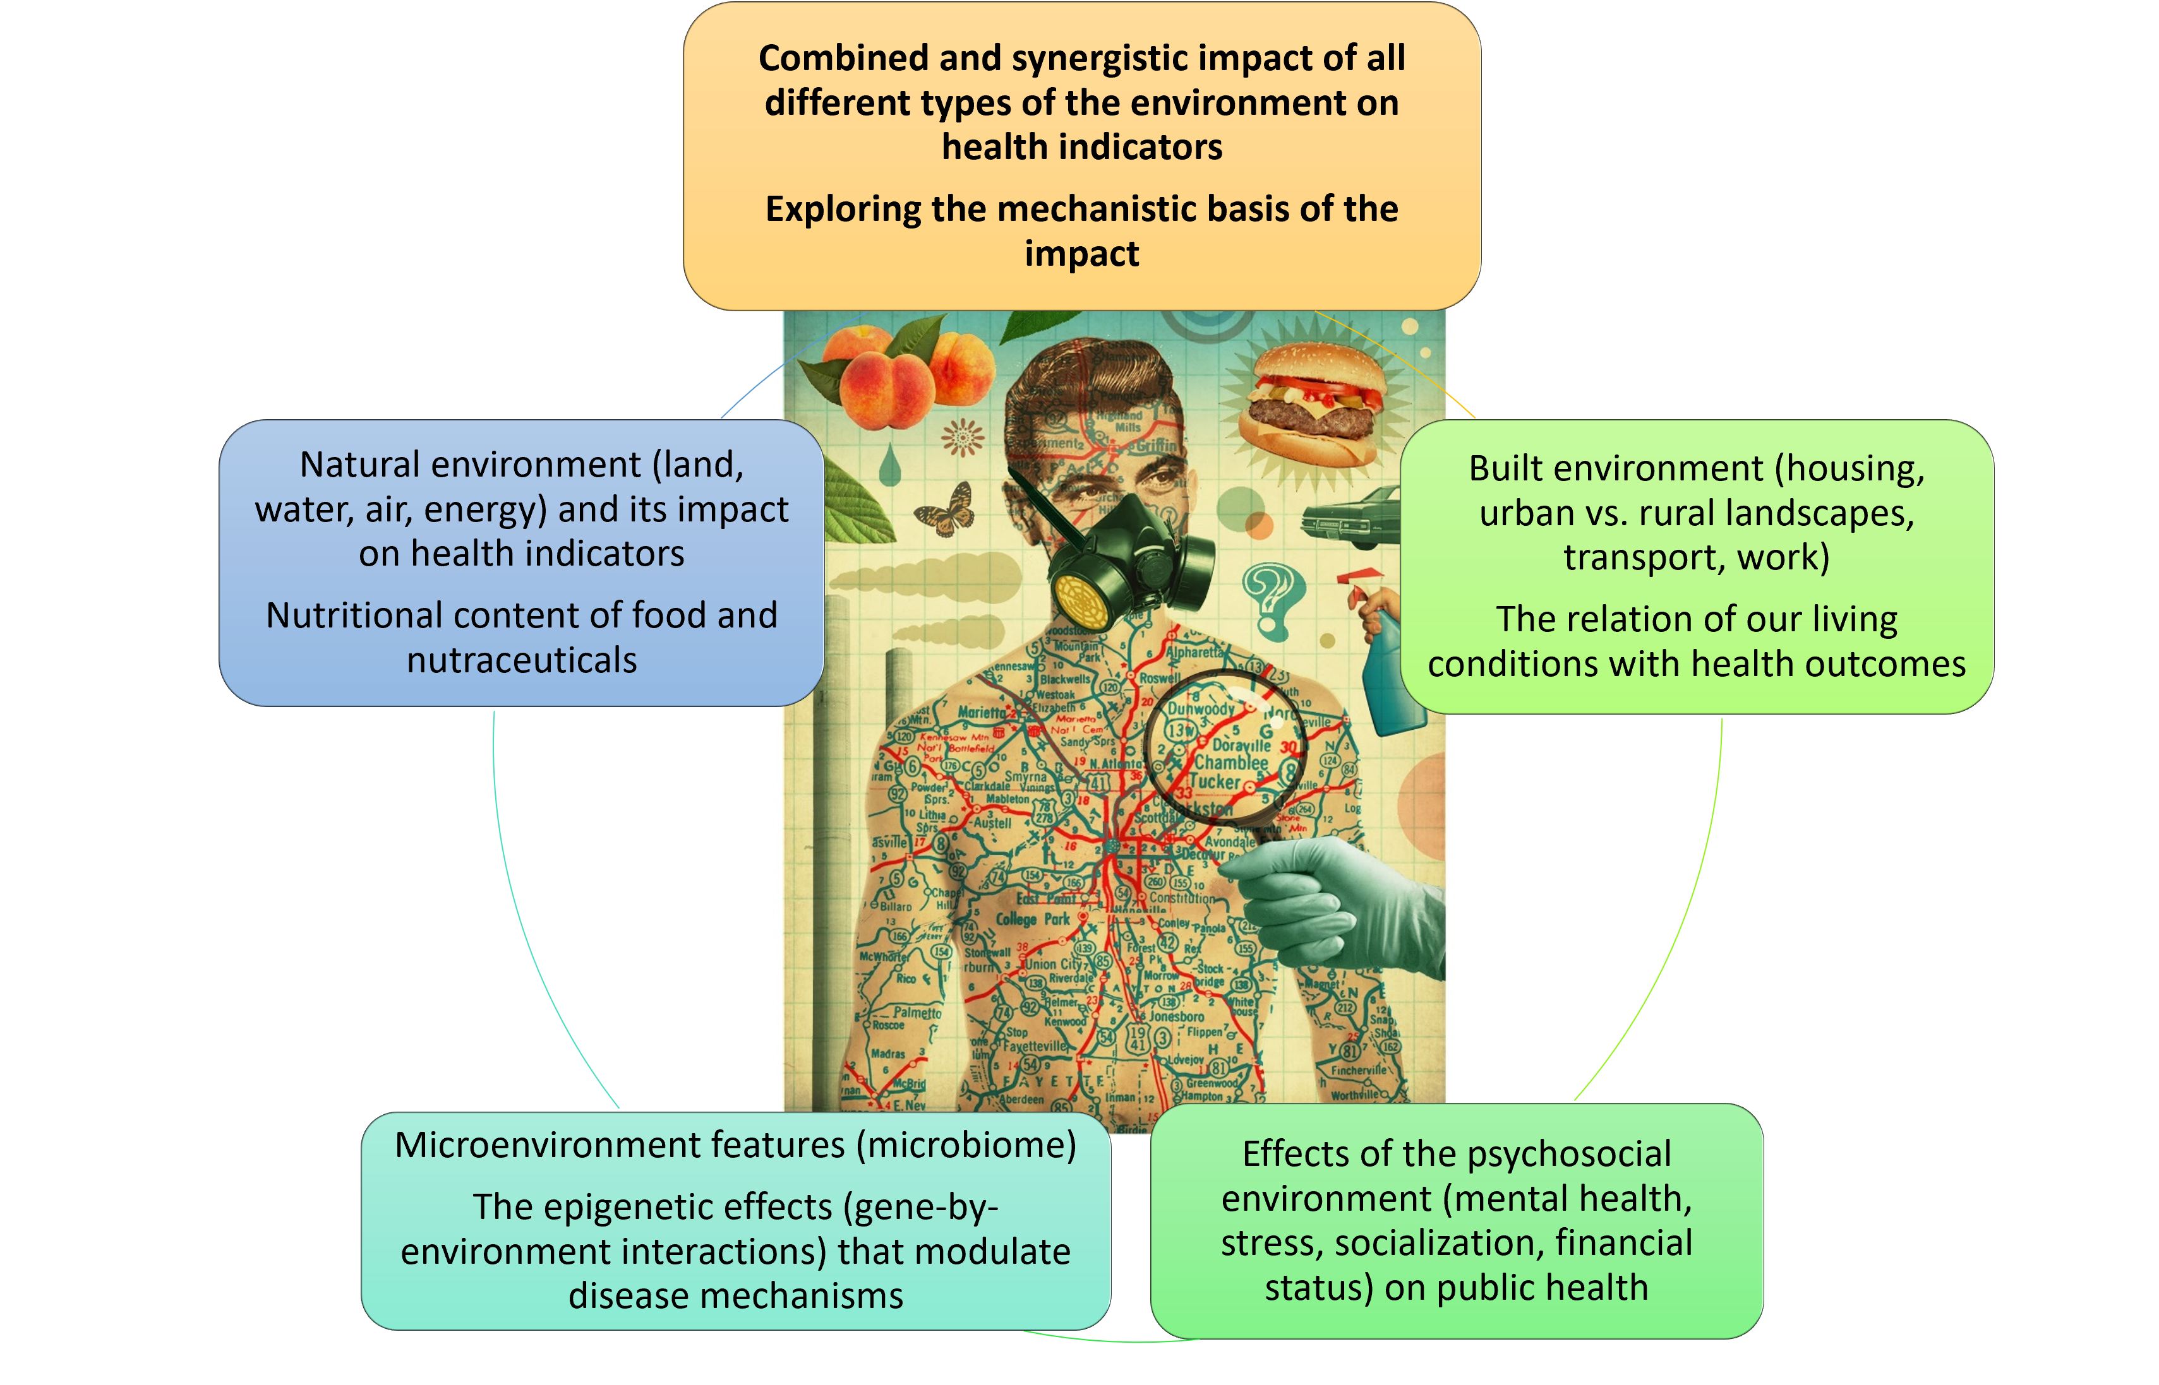
Summer School - Overview
This summer school will provide clear understanding of the different types of environmental exposures that are related with pathogenic mechanisms of human diseases

Slide 9
Summer School - QMplus
https://qmplus.qmul.ac.uk/course/view.php?id=21981
Lecture slides
Further reading material
Reading list
Journal club (2) material

Slide 10
Summer School – Sessions: Week 1
“The role of the natural environment and microenvironment”
Dr Charles Teta
Journal club: “Exposure to air pollution, green space, and noise and risk of disease”
Dr Stavroula Kanoni
“Impact of global climate change and climate policy”
Dr Andrew Russell
“Methods of monitoring pollutants”
Dr Abigail Whitehouse
“Climate and Health Effects from a Public Health Perspective” Webinar
Dr John Paul Cauchi
“Air pollution and health risks” Webinar
Professor Jonathan Grigg

Slide 11
Summer School – Sessions: Week 2
“Oral health and the risk for disease”
Professor Robert Allaker
“The effect of environment on skin disease”
Professor Edel O’Toole
“Pandemics and environmental health”
Webinar
Dr John Paul Cauchi
“The impact of psychosocial aspects on health”
Dr Livia Carvalho
“Microbiota: The new frontiers in environmental health”
Webinar
Dr Ruairi Robertson
“Social determinants of health and infection rates”
Dr Giorgos Galanis
Epigenomic insights to the interplay between the Environment and Health
Dr Christopher Bell
“Links between the built environment and mental health”
Dr Nikolina Jovanović
The genetic basis of human disease
Professor Patricia Munroe

Slide 12
Summer School – Sessions: Week 3
“Nutrition as the key to improved health: nutrigenetics, nutraceuticals, and functional foods”
Dr Stavroula Kanoni
“The link between infection, immunity and malnutrition”
Professor Andrew Prendergast
“Health equity and behavioural risk for disease”
Professor Oyinlola Oyebode
Journal club
Summer school summary/Q&As
Dr Stavroula Kanoni
“New methods and the importance of monitoring global biodiversity”
Dr Joanne Littlefair
“The exposome concept: the totality of exposures as an integrated environmental health factor”
Dr Stavroula Kanoni

Slide 13
Summer School – Learning outcomes
Understand fundamental principles of the environmental effects on human health
Evaluate the different types of environmental exposures
Appraise and interpret the role of the environment as a key factor in pathogenic mechanisms of human disease
Gain fundamental knowledge in the area of environment and health
Adapt the principles of environmental health and critical evidence-based discovery to your field

Slide 14
Summer School – Assessments
20th of July
Exams: MCQs covering all sessions (50% of total mark)
In-class presentations (50% of total mark)
Groups of 2 people or solo
Select a publication on the topic of Environment & Health (it can be a publication from the QMplus reading list)
Give a 20 minutes presentation (background, methodology, results and main conclusions) plus 10 minutes for questions
Decide on the groups and the publication you are presenting by Thursday 13th of July

Slide 15
Summer School – Feedback
Anonymised, online feedback form at the end of the summer school

Slide 16
Summer School – Your expectations

Slide 17
@StavroulaKanoni

