Slide 1
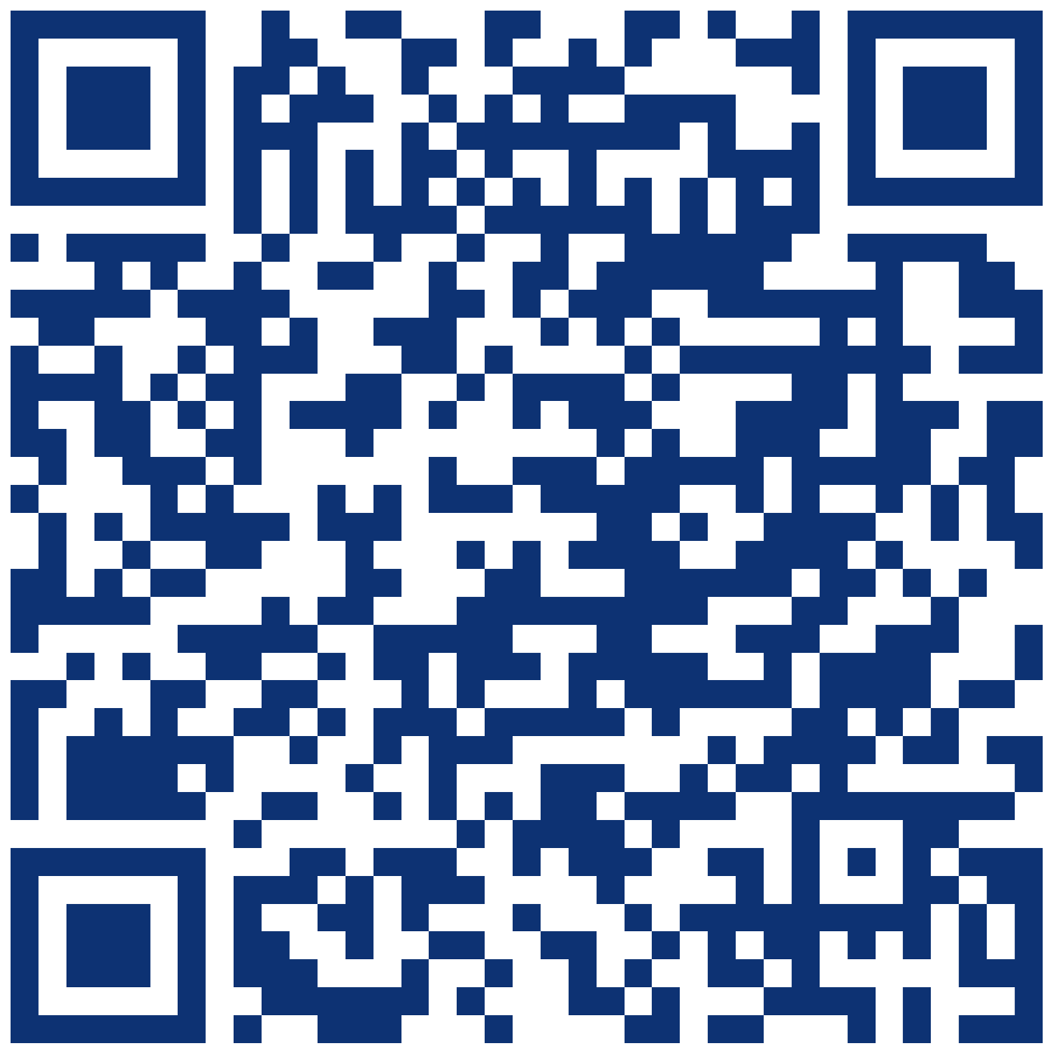
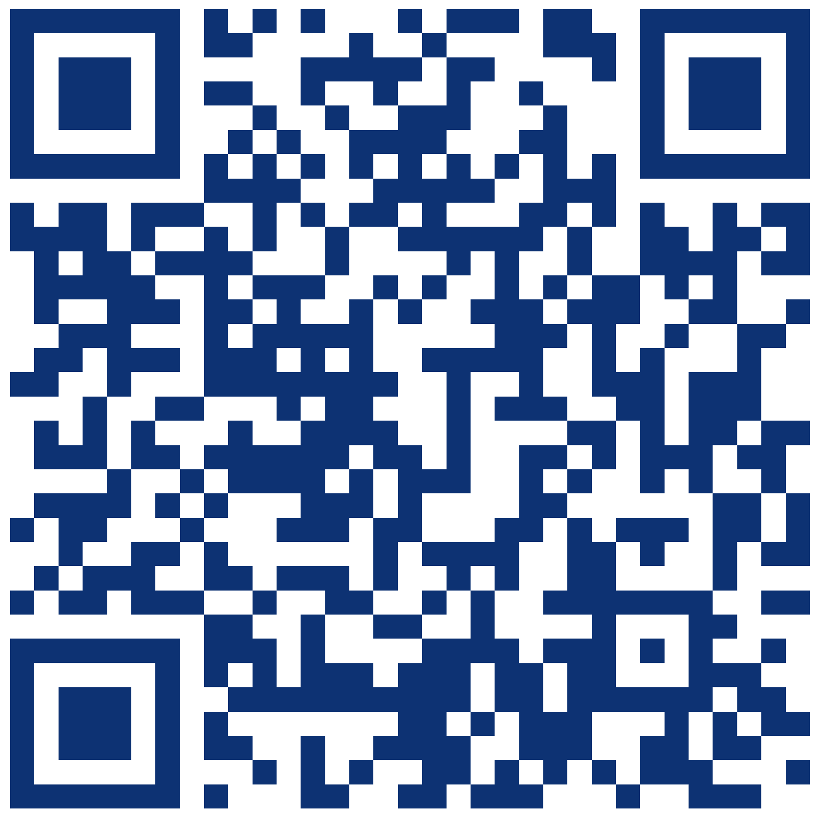
Discover more on our webpages
Go abroad during your degree with Global Opportunities
Choose from a range of destinations and find the right fit: flexible opportunities including summer
Bursaries and grants prioritised for students from low-income backgrounds and widening participation backgrounds
Gain benefits, make your CV stand out, develop a strong skillset
Learn more at a promotional talk (02 October, 25 October, 07 November)
Attend the Go Abroad Networking Event on 11 October to meet students who have been abroad (event details will be advertised on QMplus page)
Get support where and when you need it, every step of the way:
Connect with Global Opportunities Ambassadors
Meet with teams across Queen Mary such as the Advice and Counselling Service and the Disability and Dyslexia Service
Attend new workshops to help you prepare to apply for an exchange abroad (these will be held throughout October and November; details will be advertised on QMplus page)
“Going abroad is a great way of getting a sense of who you are because you are actively challenging your comfort zone.”
- Lucia Rodriguez, BA Politics and International Relations, exchange abroad at the University of Hong Kong, 2021/22
Enrol now on our QMplus page to receive all announcements about events and deadlines
Deadline to apply for an exchange abroad during 2024/25: 22 November 2023 (11am UK time)
Notes:
Here are some pictures and testimonials of our students in recent years enjoying a great time at our partners in destinations all around the globe!

