Slide 1
Introduction to Camera

Slide 2
System Settings
System Frequency at 50Hz
Bit rate at highest available
Frame rate to 25P (PF25)

Slide 3
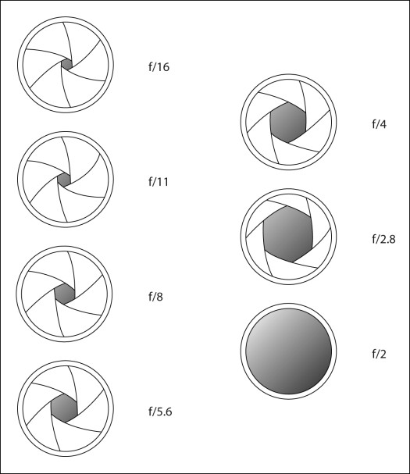
Aperture
Larger aperture = more light = brighter image
Measured in f-stops

Slide 4
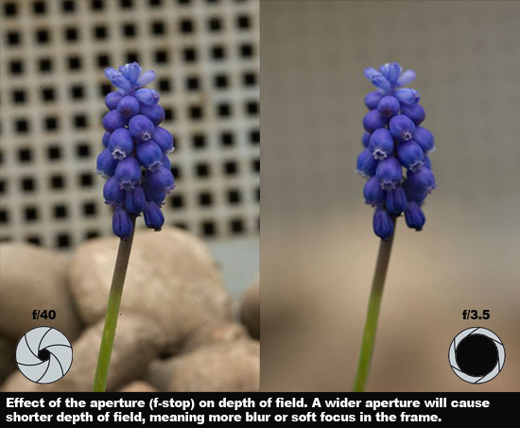
Aperture and Depth of field
Small aperture = more DoF = sharper background
Large aperture = less DoF = blurrier background

Slide 5
Depth of Field
Four factors affect depth of field:
  Aperture
  Sensor size
  Distance to subject
  Focal length

Slide 6
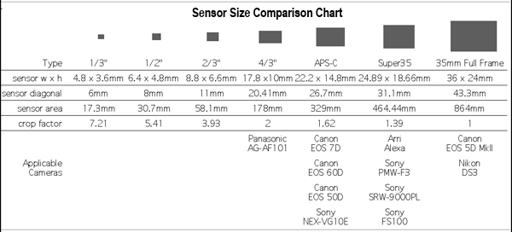
Sensor Size

Slide 7
Shutter Speed
Shutter speed is the amount of time each frame is exposed for. Affects exposure & motion blur
Shutter speed of 50 = 1/50 of a second exposure per frame. This is standard
Higher shutter speeds = darker image & less motion blur = crisper frames
Lower shutter speeds = brighter image & more motion blur = blurrier frames

Slide 8
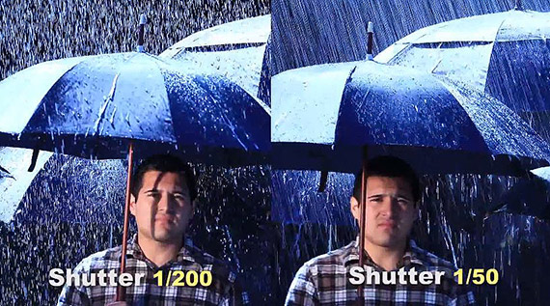
Shutter Speed

Slide 9
ISO
Doesn’t add light but makes camera more sensitive
Higher ISO = noisier image
But the C100 is good in low light

Slide 10
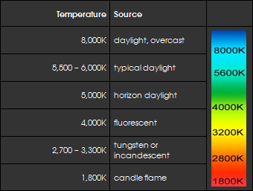
Colour Temperature
Light comes in different colours
We tell the camera what light colour the light is so the image doesn’t have the wrong colour

Slide 11
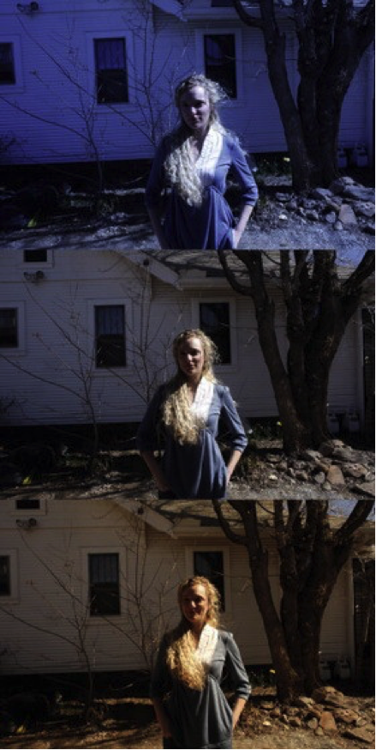
Colour Temperature
‘Lower’ colour temperature. By adjusting for
Tungsten, blue is added to compensate
‘Correct’ colour temperature
‘Higher’ colour temp. By adjusting for
Daylight, red is added to compensate

Slide 12
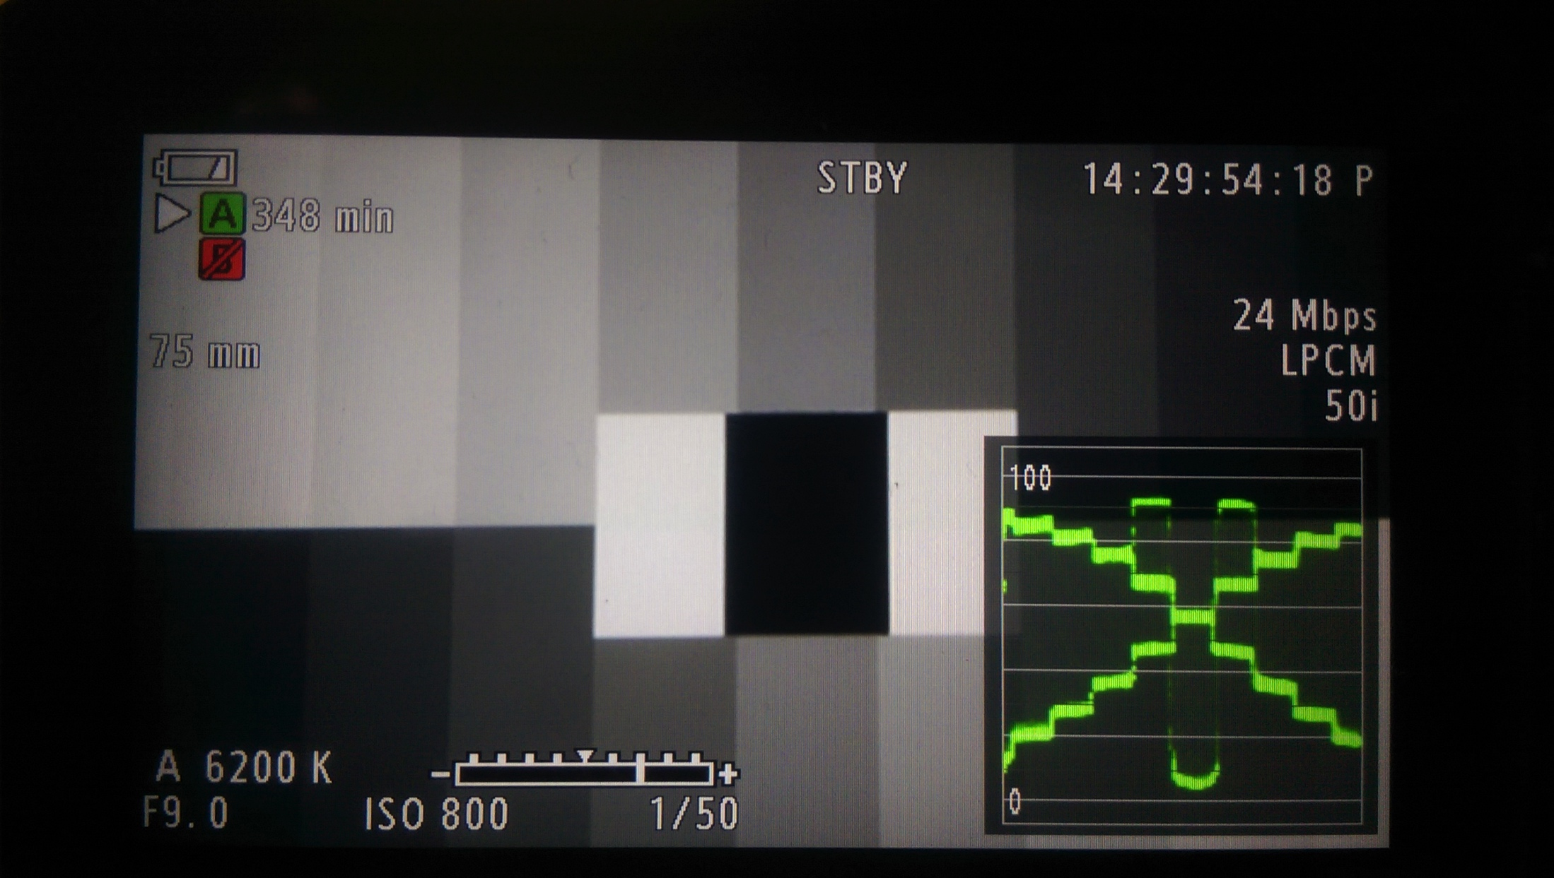
Waveform
Measures Luma - brightness of the image
Dark pixels are at the bottom, bright ones are at the top

Slide 13
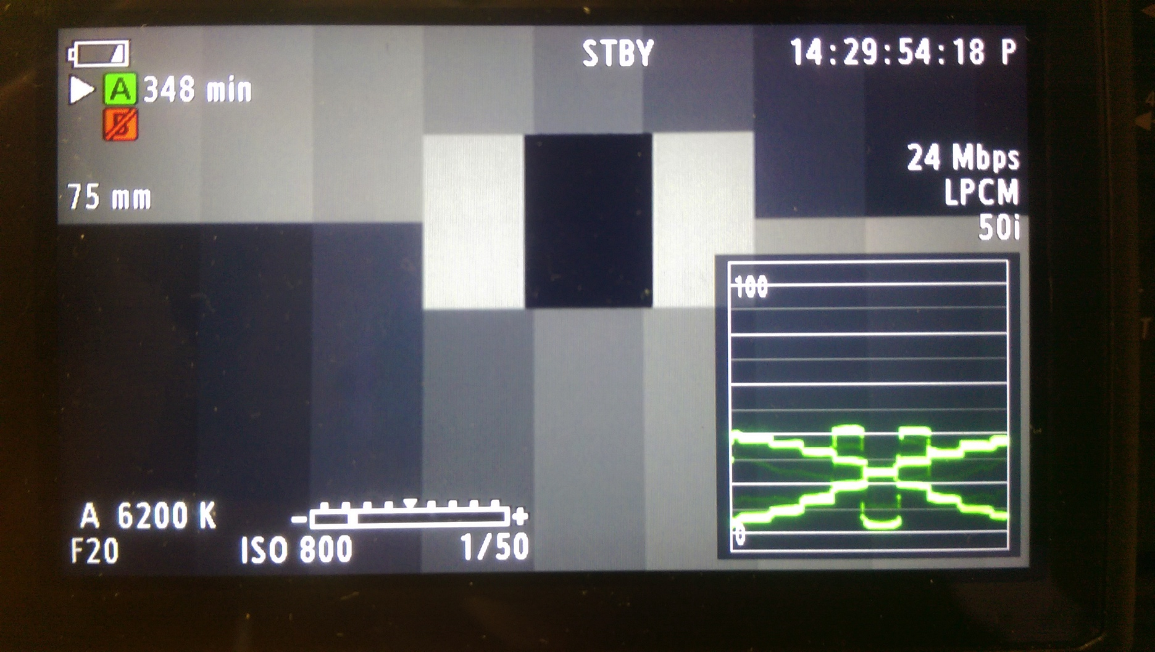

Slide 14
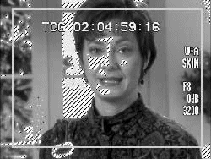
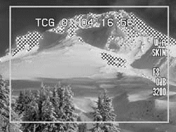
Zebra pattern
Zebra at 70-90 IRE for facial highlights
Zebra at 100 IRE for overexposure

Slide 15
Cinema Mode
Often what we shoot is too bright/dark to record well – so we compromise.
Increase the range of the camera using Cinema mode
But it looks grey/washed out so we must grade it

Slide 21
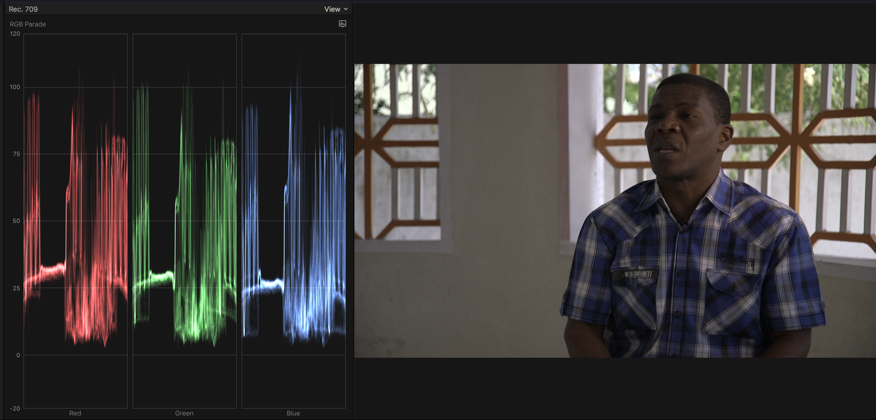
Standard Gamma

Slide 22
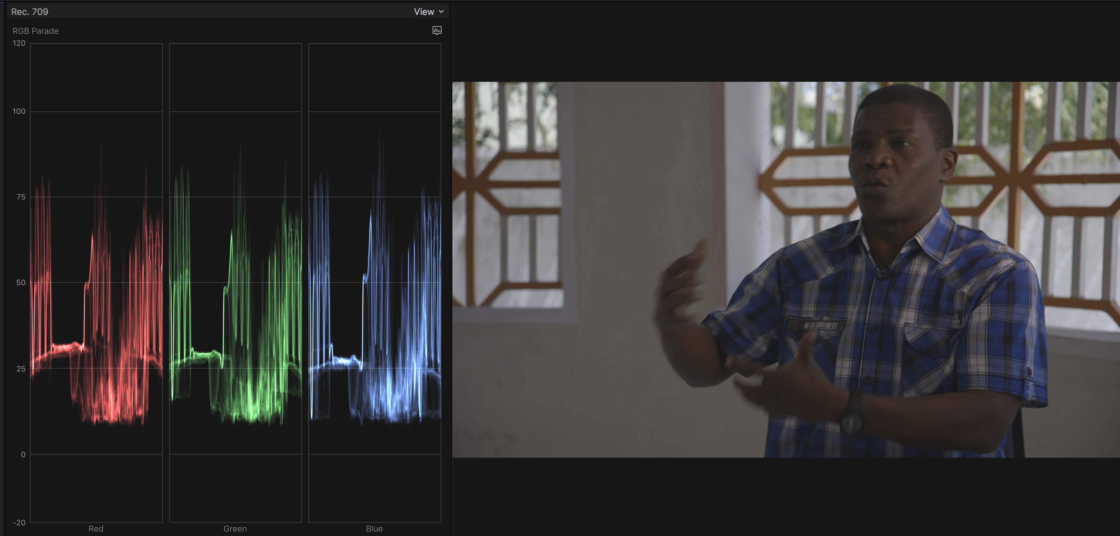
Canon Log Gamma

Slide 23
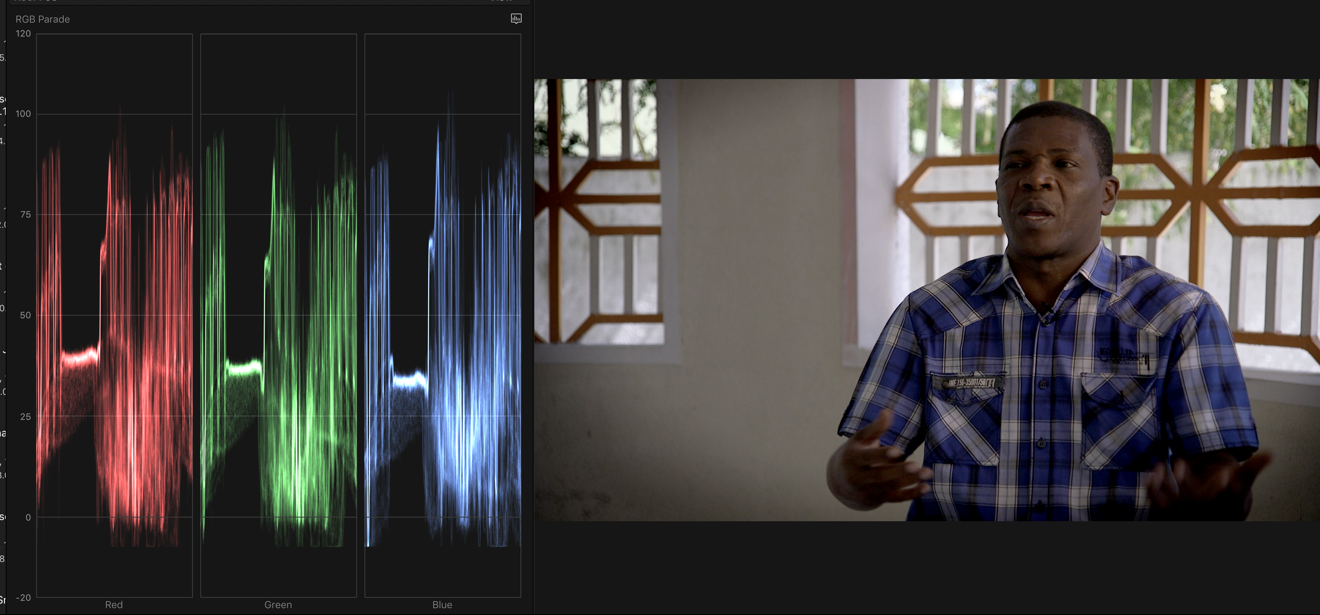
Log Gamma - Graded

Slide 24
Audio channels
CH1 – Records audio to each channel separately.
  Input 1 recorded to channel 1, Input 2 recorded to channel 2
CH1/CH2 – Audio input into CH1 is recorded to both channels. Audio input into CH2 will not be recorded.
When using one mic, use the CH1 setting but set the second channel at a slightly lower setting

