Slide 1

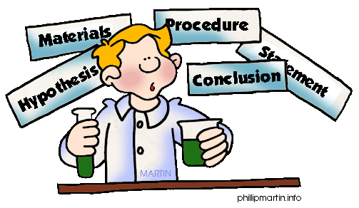
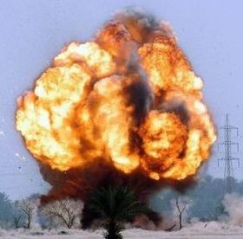

New Health & Safety Induction
Chemistry, Physics & Biochemistry
School of Physical and Chemical Sciences

Slide 2





Welcome to SPCS
Head of School of Physical and Chemical Sciences (SPCS)
Professor Peter Hobson
School of Physical and Chemical Sciences Manager
Ms Lorna Ireland
Executive Assistant
Ms Srividhya Kulandaivelu
Head of Physics and Astronomy
Professor Adrian Bevan
Head of Chemistry
Dr Isaac Abrahams
SPCS H&S Coordinator
Dr Atanas Tomov
SPCS Technical Facilities Manager
Dr Jan Soetaert

Slide 3

Technical Managers
Jan Soetaert: Technical Facilities Manager, GOJ/1.19
Atanas Tomov: Chemistry Laboratories Manager and SPCS H&S Coordinator, JP/1.33A
Phil Duncanson: Chemistry Research Laboratories Manager, JP/1.26 Write-Up Area
Mark Hudson: Teaching Laboratories Manager, JP/G22

Slide 4



Facilities Managers
Roberto Buccafusca: Analytical Services Facilities Manager
Michaela Egertova: Microscopy Facility Manager
Nasima Kanwal: NMR Facility Manager
Giulia Mastroianni: Transmission Electron Microscopy Facility Manager
Stefanie Oseni-Momodu: Finance Manager

Slide 5
Health & Safety – who to contact
Safety coordinator for SPCS
Chemistry & Physics and Astronomy: Atanas Tomov
Buildings Managers: Atanas Tomov (JP)
QMUL Policies and Arrangements
Health and Safety is managed by : Health and Safety Directorate (HSD) - http://www.hsd.qmul.ac.uk
HSD Safety contact for SPCS : Rob Haigh
HSD Health contact : Suzanne Mason
Fire Marshals; 1st Aiders
Information posted in laboratories
Also ask for help or discuss safety matters with technical team, senior colleagues and supervisors!

Slide 6



Health & Safety Training
How to work safely in the lab:
Know the risks: SOP, RISK ASESSMENT
Minimise risks: LABORATORY CODE OF PRACTICE
Know HOW TO DEAL WITH EMERGENCIES
3333

Slide 7

How to work safely in the lab
1. Identifying risks

Slide 8


For all lab work: RISK ASSESSMENT
We do quick risk assessments all the time…
We have to do a careful risk assessment before starting any work and then document it!

Slide 9
What is a risk assessment?
A risk assessment is a careful examination of the hazards associated with a particular work activity/environment, and the likelihood that the hazard(s) may cause harm. It will allow you to assess and reduce the risks in advance of your starting the activity.
Control of Substances Hazardous to Health (2002)
http://www.hse.gov.uk/pubns/indg163.pdf

Slide 10
For all lab work: RISK ASSESSMENT
Key to risk assessment
in Chemistry labs
Control of Substances Hazardous to Health
COSHH
Before beginning work answer the following
Safety Data Sheets (SDS)
Standard Operating Procedures (SOPs)
Waste management procedures
Emergency procedures
  What are the hazards?
  What are the worst things that could happen?
  What do I need to do to be prepared?
  What work practices, facilities or personal protective equipment are needed to minimize the risk?
You will also need

Slide 11
For all lab work: RISK ASSESSMENT
Standard Operating Procedure (SOP)
‘a set of step-by-step instructions to help users carry out routine operations efficiently and safely and avoid miscommunication’

Slide 12
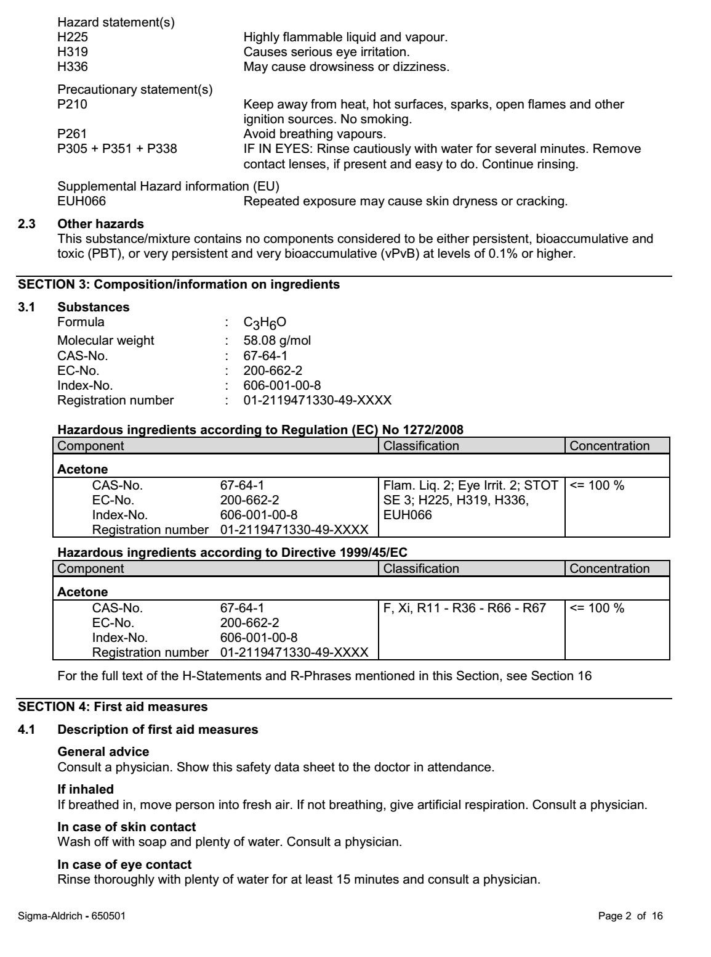
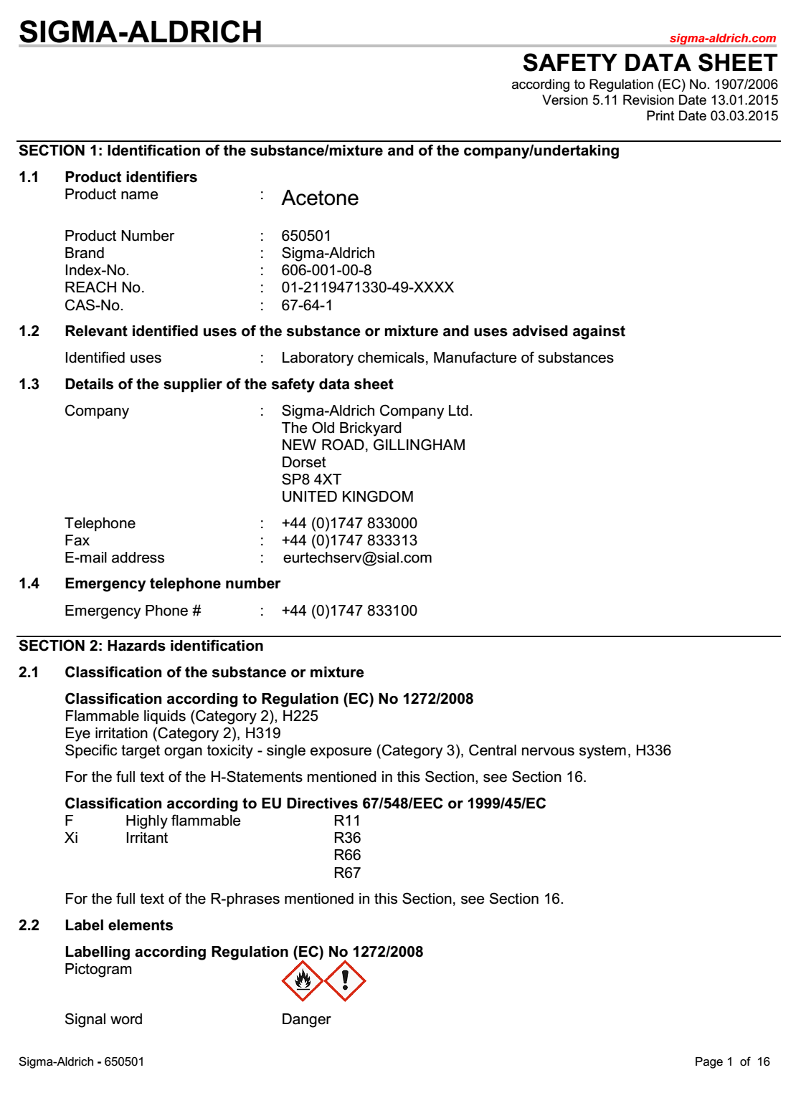
For all lab work: RISK ASSESSMENT
Safety Data Sheets - SDS
(Former Materials Safety Data Sheets – MSDS)
Provided by the supplier (visit www.sigmaaldrich.com)
Presented in a consistent user-friendly, 16-section format
Sections 2 to 8 will help you to fill out the COSHH forms
Section 2: identification of hazards
Section 4 to 8: safe handling practices, and emergency and control measures

Slide 13
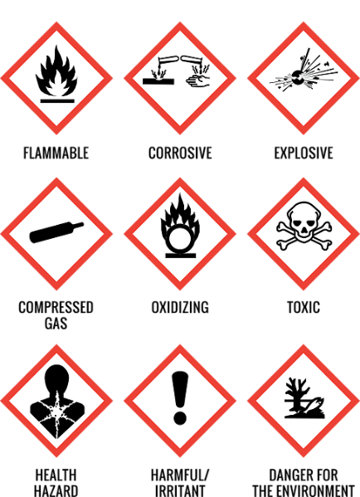
For all lab work: RISK ASSESSMENT
Learn to recognise GHS pictograms and of Hazards classification
GHS Pictograms
Globally Harmonized System (GHS) of Classification and Labelling of Chemicals
3 Hazard groups (health, physical and environmental)
Hazard classes (flammable, carcinogen, etc.)
Categories (severity of the hazard, 1 to 4)
GHS Communication of Hazards (labelling system)
Pictograms
Hazards statement (H codes)
Signal Words (Warning and Danger)
Precautionary statements (P codes)

Slide 14
Unknown hazard isn’t no hazard
Inadequate treatment of unknown hazards
JACS, 1961, 83, 1516
Probably no fume hood or appropriate PPE
Be aware of long-term exposure effects and unknown risks

Slide 15
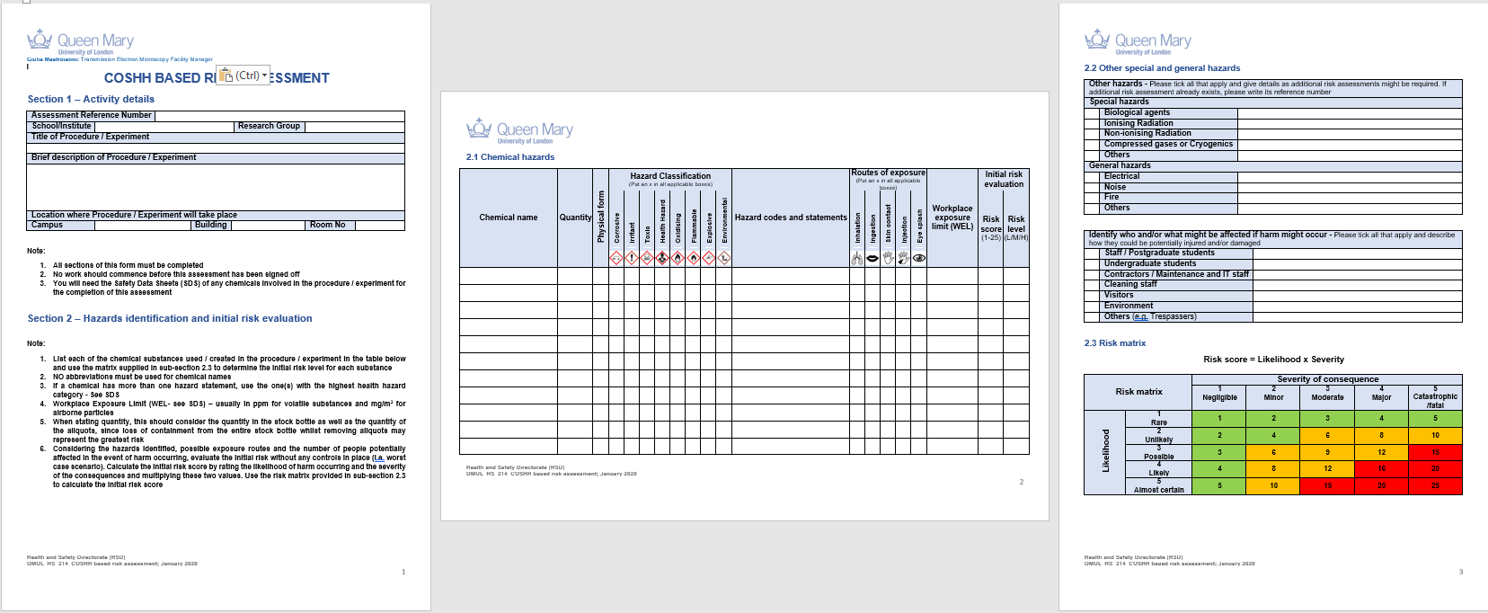
COSHH Based Risk Assessment

Slide 16
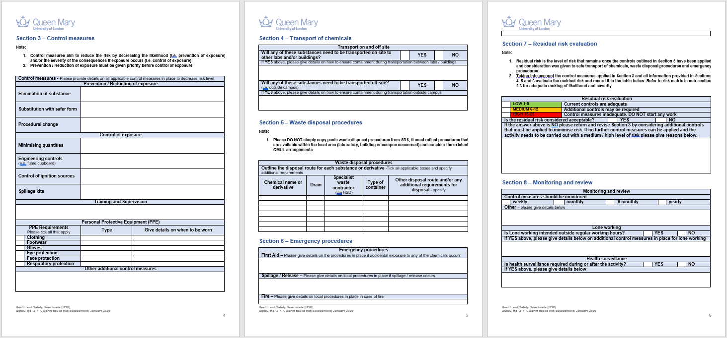
COSHH Based Risk Assessment

Slide 17
COSHH Training
Course Details
Course Hazardous Substance Risk Ass (COSHH)
Type Health and Safety Training
Attendance On Site
Understand the basis of the COSHH Regulations 2002 and associated Regulations Understand the need for the COSHH based risk assessment Be able to carry out a basic COSHH risk assessment of their own working acivities
Pre-requisites
Suitability: For all staff and students who use,purchase, control the use of, or handle and store hazardous chemical substances.
Programme
This 3-hour course will introduce the Control of Substances Hazardous to Health (COSHH) Regulations 2002 and associated regulations (e.g. Classification, Labelling and Packaging of Substances and Mixtures Regulations) in the context of risk assessment in research and teaching laboratories, based on Health & Safety Executive's 'five steps for risk assessment' and the COSHH 'Hierarchy of Control' of hazardous substances. It will include a practical 'table-top' COSHH risk assessment exercise using safety data sheets and will provide information on practical measures such as emergency procedures and waste disposal.

Slide 18
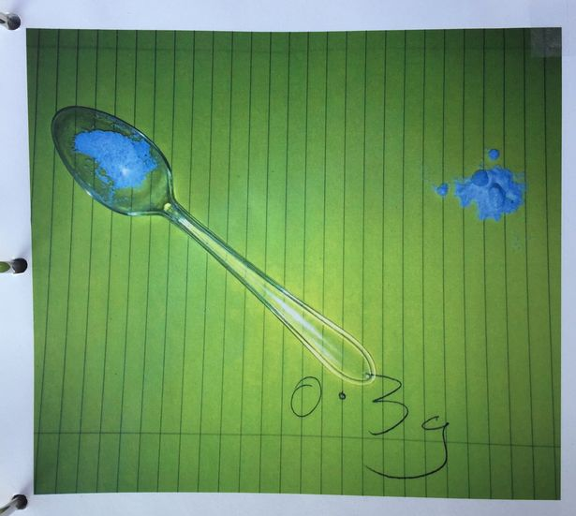
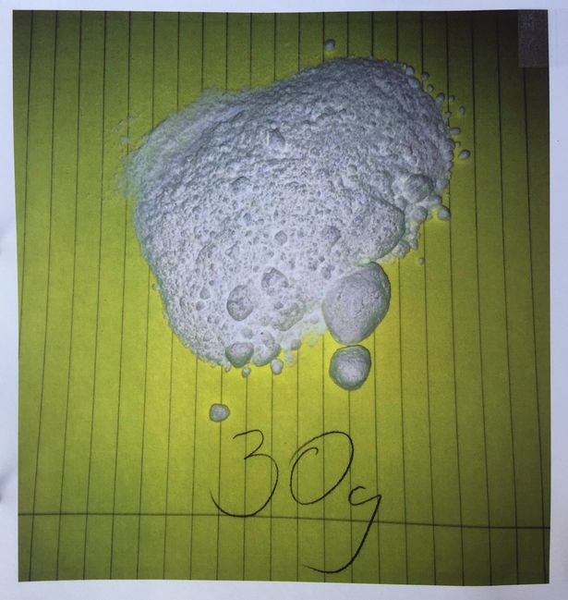
Northumbria University fined £400,000 after botched experiment leaves students fighting for life
Two students were left fighting for their lives after being given the equivalent of 300 cups of coffee by mistake in a botched sports science experiment.
Mr Rossetto and Mr Parkin both ended up in intensive care and required dialysis and had they not been admitted to intensive care they could have died from the caffeine overdoses.
There was no suitable and sufficient risk assessment, inadequate supervision, inadequate checks and failure to follow rudimentary health and safety legislation.”
“There are civil claims for compensation from the two students.”

Slide 19

Waste Management

Slide 20
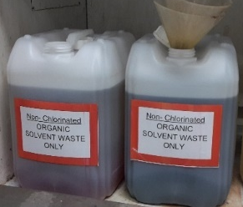
Waste Management
ZERO by Sink policy
Organic solvents to designated fume hoods in each lab
Do not mix chlorinated and non-chlorinated solvents!
Do not overfill or overtighten waste containers

Slide 21
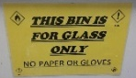
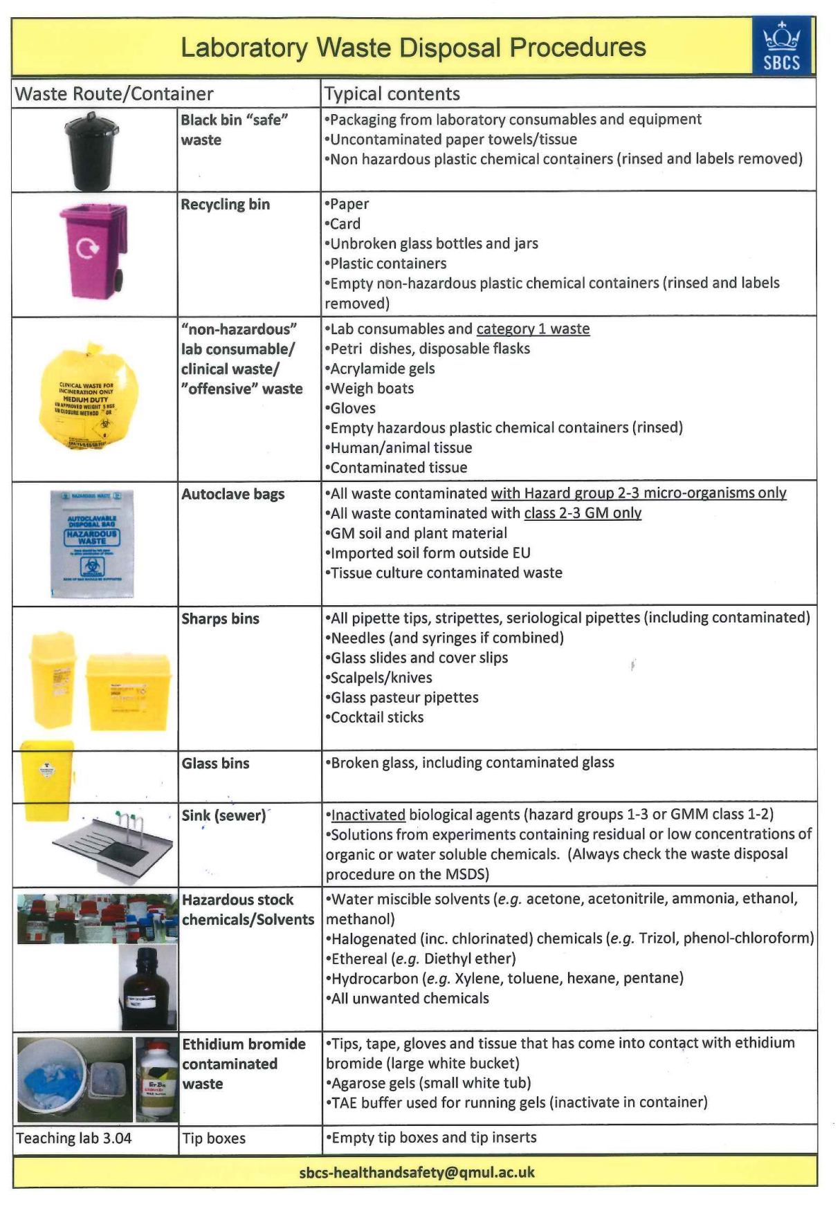
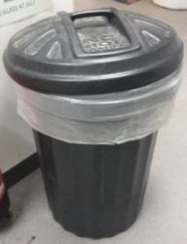
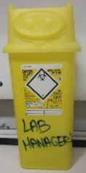
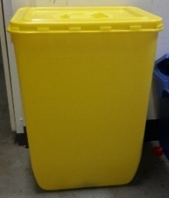
Waste Management
Contaminated waste to yellow bin bags (used gloves, weight boats, rinsed chemical containers, etc.)
Needles, pipette tips, etc. to sharps bin – never re-sheath needles
Broken and contaminated glassware to yellow glass bins
Non contaminated waste (packaging, paper towels) can go to black bins
Dispose of solid waste in a suitable container and clearly labelled
Dispose of acids and bases in a suitable container after diluting. Label clearly
Liquid biohazards must be disinfected before throwing down the sink
Solid biohazardous samples to clinical waste

Slide 22
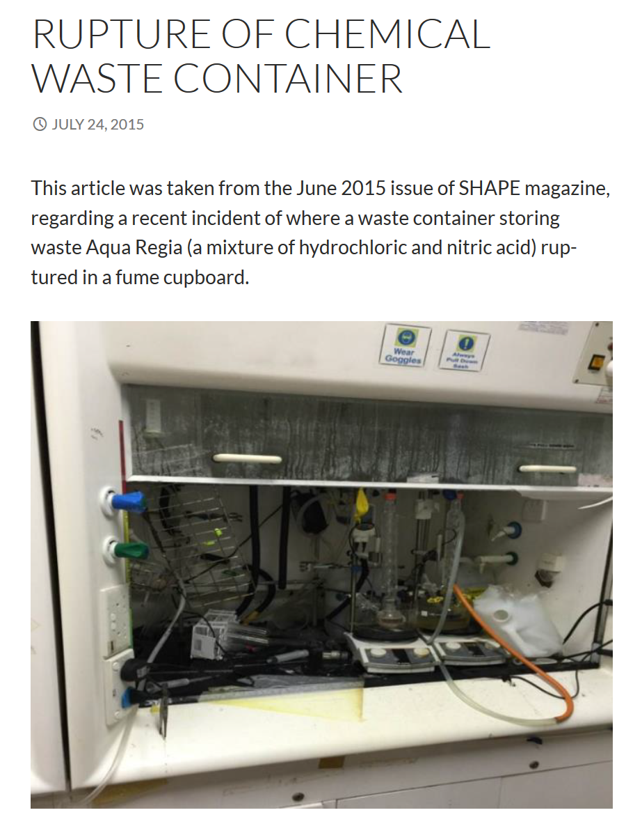
Waste Management
A student prepared Aqua Regia to clean glassware overnight
The day after the students disposed of the Aqua Regia in a container not designated for chemical waste, wrote acid on it and left it uncapped in the fume hood he was working in
10 min after, the container ruptured and the Aqua Regia solution splashed onto his face and left arm.
The sash was up (i.e. not at the safe operating level)
Incompatible waste must NOT be stored in the same container.
No COSHH was prepared = not aware of risks and correct disposal method
Further details: http://bioeng.nus.edu.sg/safety/?m=201507

Slide 23
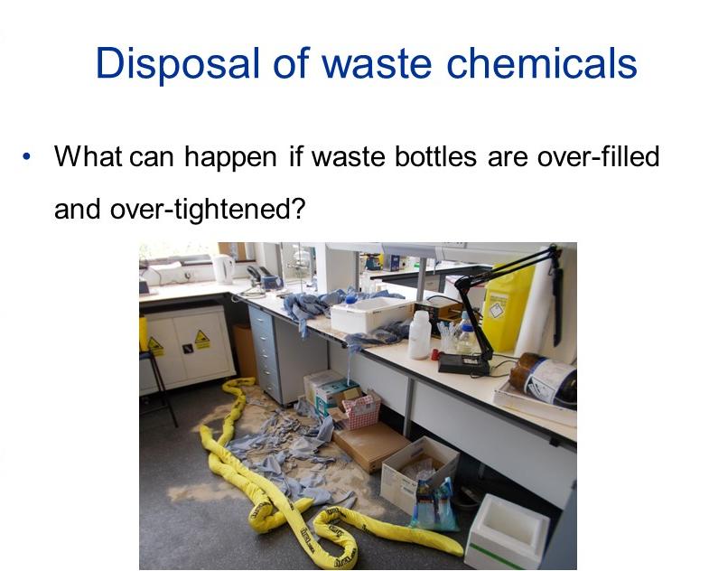

Slide 24
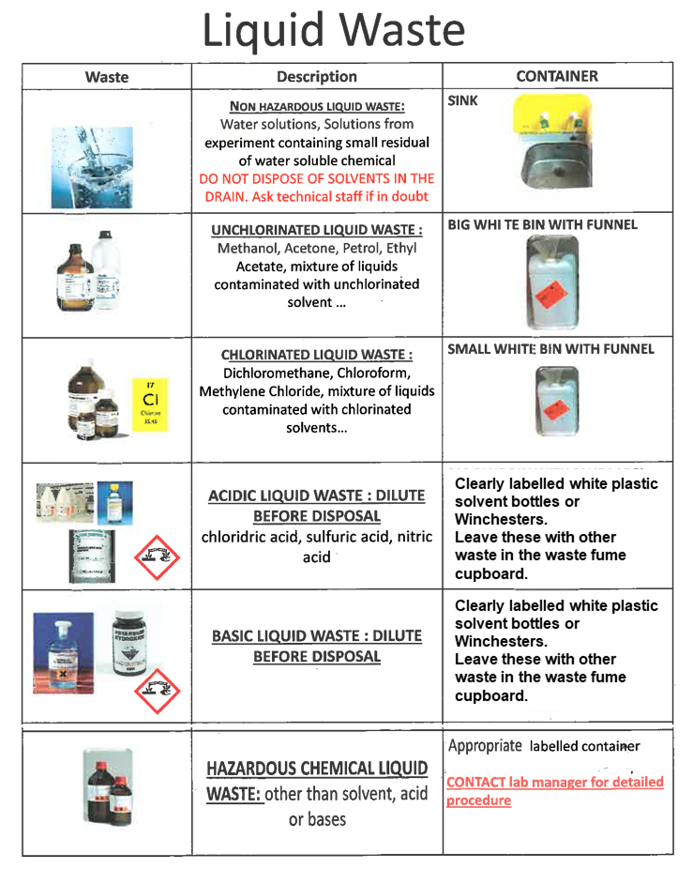
Waste Management

Slide 25
Waste Management
Some waste procedure are specific to each laboratory
Consult with lab managers, colleagues, supervisors, etc.
If you don’t know don’t throw!
ASK
    Chemistry : Phil Duncanson, Tony Hooper
    Biochemistry: Yumi
    Fogg: Floor managers

Slide 26
How to work safely in the lab
2. Laboratory Code of Practice

Slide 27




Personal Protective Equipment (PPE)
Lab coat
Safety glasses
Gloves
must be worn in all chemistry labs !
must be worn in all experimental labs !
depends on risk assessment
All available for free at goods stores!

Slide 28
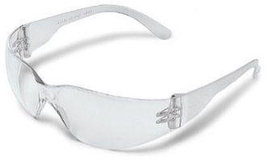

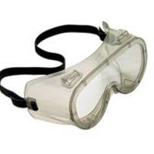
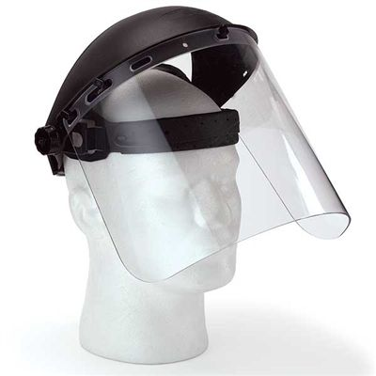
Personal Protective Equipment (PPE)
Safety glasses
must be worn at all times in all labs !
(biochemistry lab depends on Risk Assessment)
Protection from splashes and explosions
Standard prescription glasses must not be used in lieu of safety glasses.
Safety googles, visor, etc. depends on the risk assessment
Do not use contact lenses in the lab
Safety Eye ware Vouchers to obtain prescription safety glasses are available through email to Atanas Tomov (a.tomov@qmul.ac.uk).

Slide 29
Personal Protective Equipment (PPE)
Not wearing safety glasses will result in disciplinary measures. (Free prescription safety glasses are available upon request)
Researchers have been excluded from laboratories and sent disciplinary warnings.
DO NOT follow the example of recalcitrant colleagues.

Slide 30
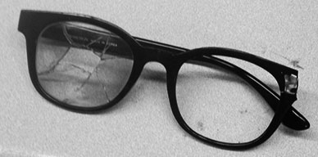
Personal Protective Equipment (PPE)
Student hit by caustic material. No eye damage!
A graduate student was transferring synthesized perchlorate when the material exploded. The fragments shattered the lenses of his eyeglasses and lacerated his left cornea.

Slide 31
UCL fined £300,000; student partially blinded in experiment
In June 2014, a researcher was placing a sample into the London Centre for Nanotechnology’s lithium evaporator when the viewing port shattered. Fragments of glass were sent flying into her left eye. The student required extensive surgery over six months to treat the eye and repair a hole in her retina. She now suffers from blurred and double vision, symptoms of PTSD and facial scarring.
The judge said the fine had been reduced to take account of the college’s charitable status.

Slide 32
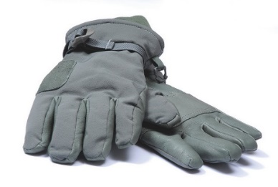

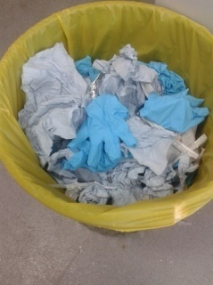
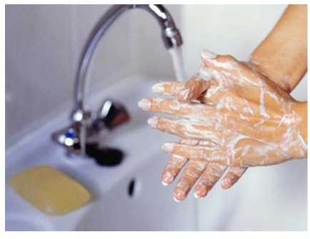
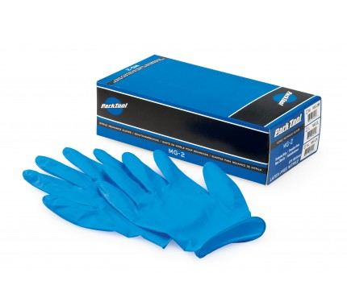
Personal Protective Equipment (PPE)
Protection from absorption via skin, sensitisation, burns, etc.
Make sure the gloves match the use (cold, heat, etc.)
Use gloves resistant to permeation by the substance in use
Gloves should be changed regularly (and do not re-use!)
Gloves must be disposed of in yellow clinical waste bags
Wash your hands after removing gloves.
Gloves

Slide 33
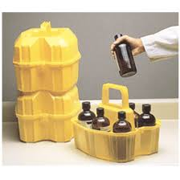
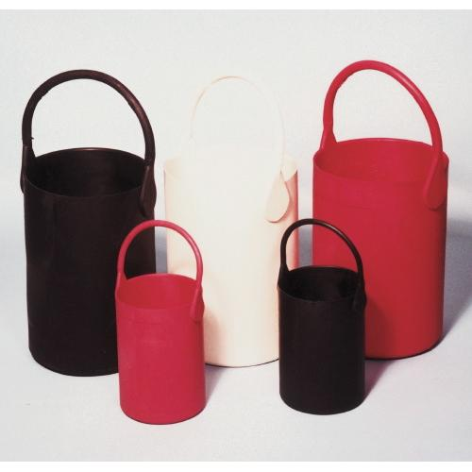
Personal Protective Equipment (PPE)
Never wear gloves outside of the work area or to open doors, handle telephones, computer keyboards, etc.
Gloves
We have specific carriers for containing bottles and they are in each research lab

Slide 34

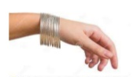
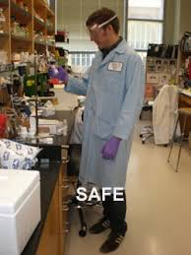
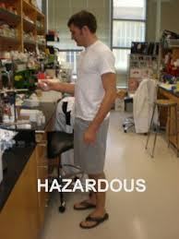


Personal Protective Equipment (PPE)
Suitable clothing
Long hair tied up
No dangling jewellery
No loose clothing
Suitable shoes
✗
✓

Slide 35
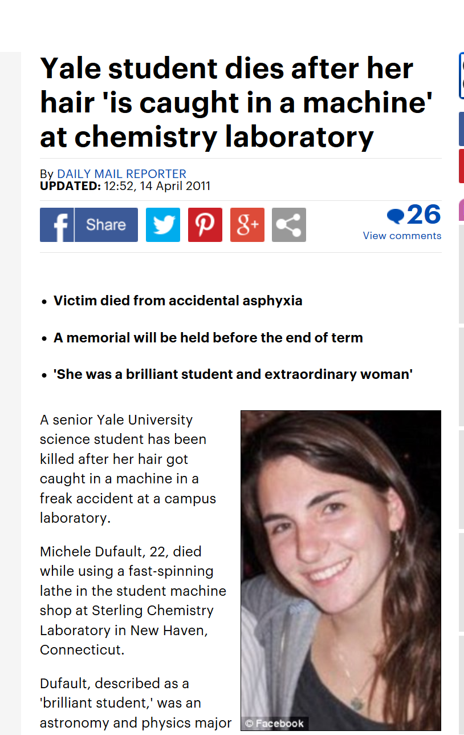

Yale, April 2011
“In the early hours of 13 April, undergraduate students working at Yale University's Sterling Chemistry Laboratory made a shocking discovery. There in the lab's machine shop was the dead body of 22-year-old undergraduate student Michele Dufault, her hair tangled in a lathe. She had apparently died of asphyxiation in an accident described by Richard Levin, president of Yale in New Haven, Connecticut, as a "true tragedy“.
The student was working alone late at night
Link: Yale accident

Slide 36
PPE and Suitable Clothing
Do
Do NOT
Always wear safety glasses in the lab
Get prescription safety glasses if necessary
Wear safety goggles over your prescription glasses
Always wear lab coat when working
Wear lab coat correctly
Use suitable gloves (heat, cold, etc.)
Change gloves regularly
Use only one glove if transporting chemicals outside the lab
Protect your legs and feet
Tie long hair up tightly
Use PPE outside lab (unless transporting hazardous materials)
Use dangling jewellery or loose clothes
Wear short trousers/skirt
Wear sandals
Apply cosmetics in the lab
Touch your face, mouth, eyes while in the lab
Re-use gloves
Use gloves with holes
Wear normal prescription glasses in lieu of safety glasses
Use gloves when using computer keyboard, phones, etc.

Slide 37
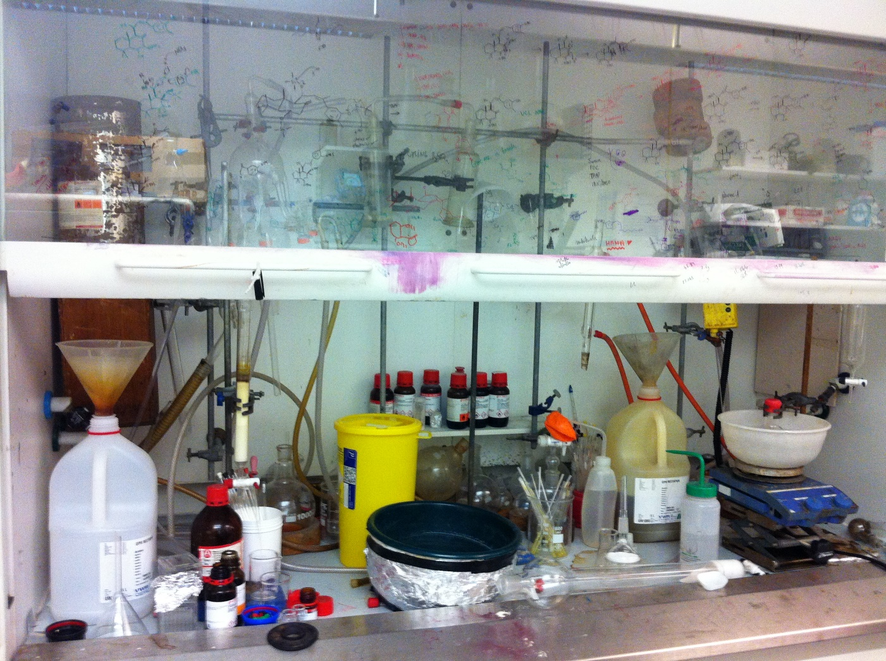
Good Housekeeping
Keep your work area clean and organized to avoid accidents

Slide 38


No Drink, No Food & No Phones

Slide 39
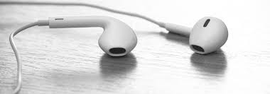


Use of Earphones in the Lab
Hazards of Using Earphones in the Lab
Not hearing warnings from colleagues (e.g. if you are about to collide with a colleague carrying hazardous chemicals)
Not hearing people moving nearby and bumping into them
No hearing alarms (fume cupboard, oxygen or fire alarms)
Slower response to hazardous events
Only one earphone may be used……but make sure the other one does not become another hazard

Slide 40
Good Housekeeping/Behaviour
Do
Do NOT
Keep your workplace tidy
Deal with waste, washing up immediately
Make sure everything is safe before you leave things unattended
Keep communal areas tidy and organized
Keep aisles free of clutter.
Keep all solvents and hazardous materials in their assigned cabinets when not in use.
Have all chemicals/samples clearly labelled
Be aware of what others around you are doing
Follow waste management procedures (ask lab managers if in doubt). Clearly label waste
Leave waste solvent bottles loosely capped when not in use, particularly overnight
Store empty Winchesters/containers on the benches or on the floor
Use broken glassware
Use unsuitable equipment, electricals
Use equipment without training
Turn off the fume hood alarm
Leave unlabelled containers in the waste fume hood
Eat drink/eat in the lab
Use phones in the lab without washing your hands first
Use earphones
Use your the fume hood or bench as storage for chemicals, samples or dirty glassware
Leave unlabelled samples on the bench

Slide 41
Laser Lab Accidents

Slide 42
Laser Lab Accidents

Slide 43

Working Out of Hours
Working out of hours: QMUL views 8 am to 6 pm on normal working weekdays as ‘normal working hours’. People working outside the ‘normal working hours’ will be considered to be working ‘out of hours’, the capacity of QMUL to provide health and safety assistance will be markedly reduced.
NOT allowed for MSci/MSc/UGs/visitors/summer/project/A-level students
Restricted card access to JP for PhD students and postdocs (6am-10pm)
Sign in the online out-of-hours form (also sign up your buddy)
Lone working NOT ALLOWED in chemistry labs, other high hazard areas (based on risk assessment) or the workshop.
BUDDY SYSTEM
Policy : http://www.hsd.qmul.ac.uk/Documents/161674.pdf

Slide 44

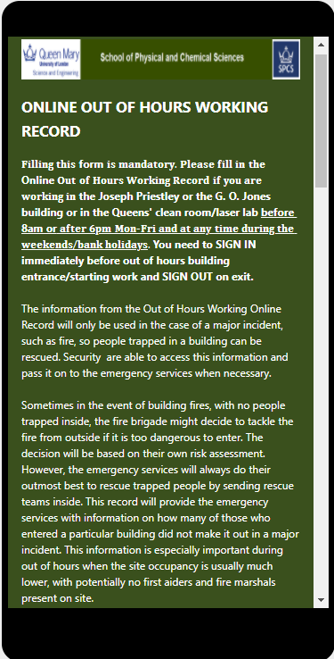
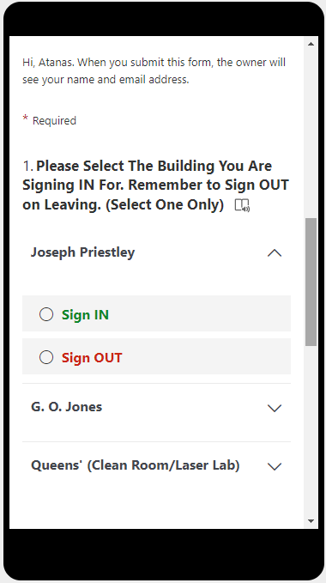
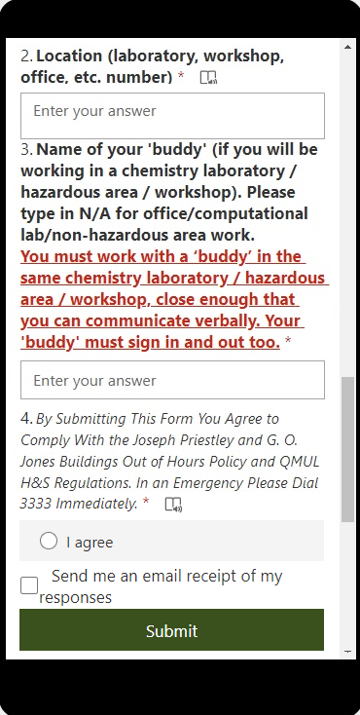
Online Out of Hours Record

Slide 45
How to work safely in the lab
2. Some Safe Procedures

Slide 46
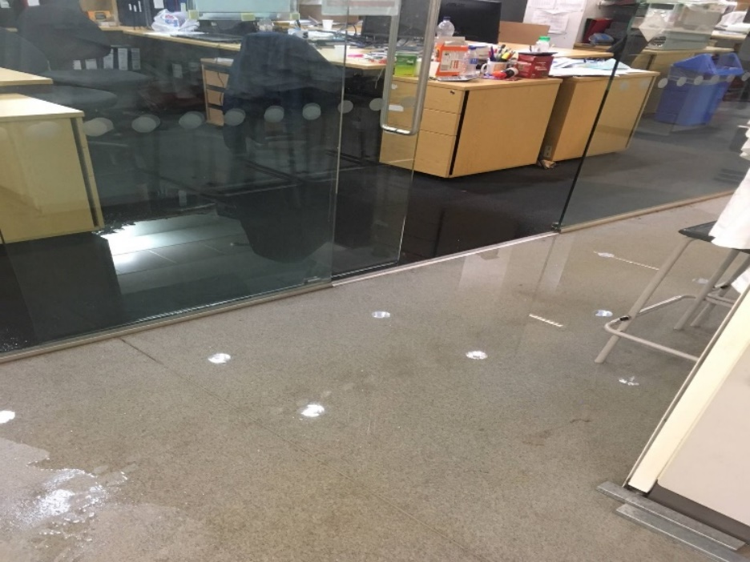
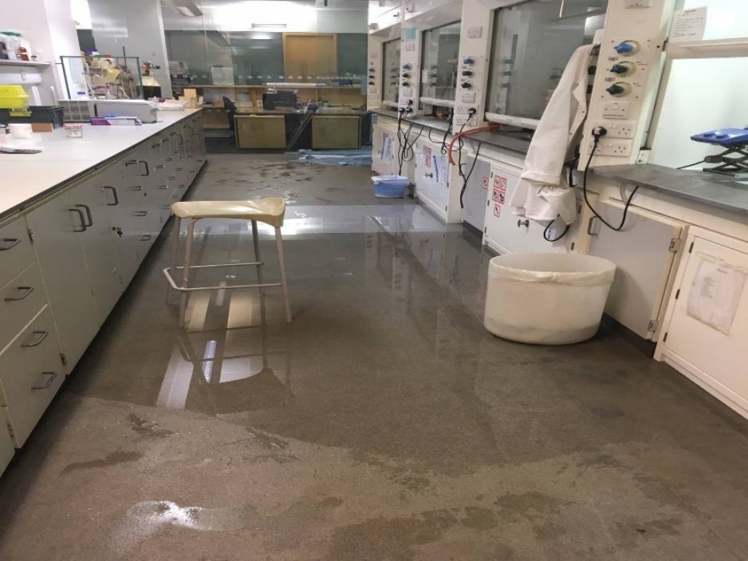
Careful Set up of Equipment
1st Floor JP – Flooding caused by a condenser not set up properly

Slide 47
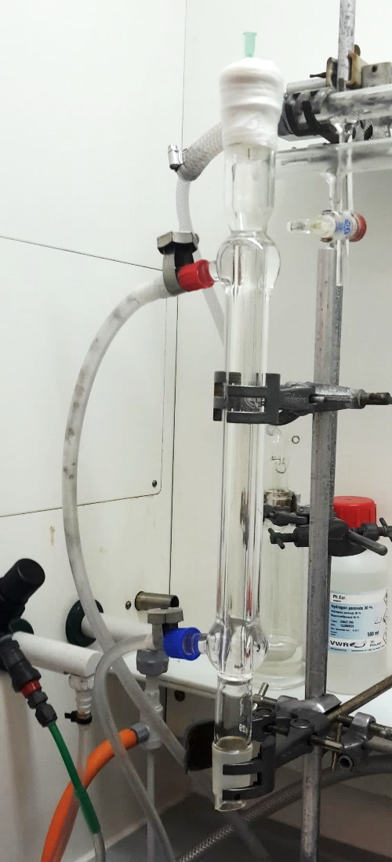
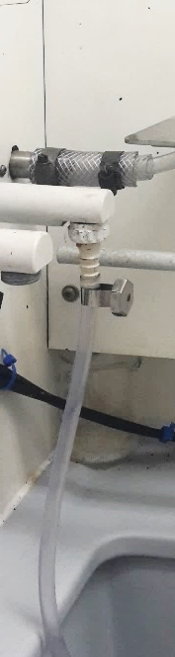
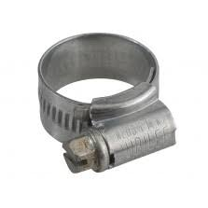
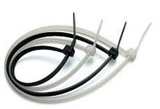
Careful Set up of Equipment
Condensers
Fluctuations of water pressure (specially overnight)
Use cable ties or tube clips in the connections (condenser inlet and outlet and tap)
Preferably use silicone tubing rather than PVC tubing

Slide 48
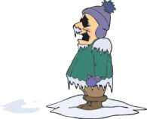
Handling Liquid Nitrogen
Hazards associated with liquid Nitrogen
Explosion of sealed containers
Asphyxiation (very quickly) – four deep breaths
of pure nitrogen will kill a person instantly!
  On vaporization expands by a factor of almost 700 displacing O₂
  Extremely cold (-196 ºC)
Frostbite, cryogenic burns or eye damage
Materials may become brittle and shatter
For frostbite and minor burns slowly raise the temperature back to normal. Treat affected area with copious quantities of tepid water (40°C) for a minimum of 15 minutes. DO NOT use hot water.

Slide 49

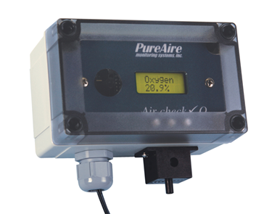
Oxygen Depletion System
Oxygen levels may be depleted due to dilution by other gases (e.g. CO₂, N₂ or He) and chemical absorption by corrosion processes and similar reactions
Equipment to detect oxygen depletion
Oxygen sensor
Oxygen monitor:
  Located inside labs storing large liquid N₂ Dewar, N₂ and/or CO₂ gas cylinders
  Located outside labs storing large liquid N₂ Dewar, N₂ and/or CO₂ gas cylinders
In G. O. Jones building: G4, G5, 1.25, 3.01, 3.02, 3.04, 3.06

Slide 50
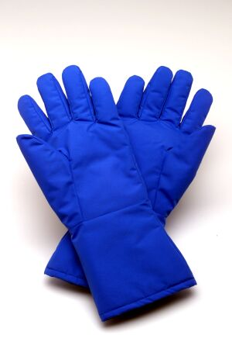
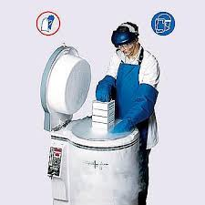
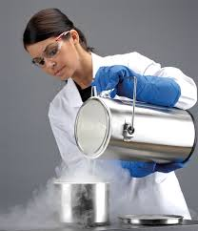
Handling Liquid Nitrogen
Hazards associated with liquid nitrogen
Working safely with liquid nitrogen
Handle liquid nitrogen in a large and well ventilated space!
Lab coat, cryogen gloves and a safety specs or visor must to be worn at all the times when handling cryogenically cooled samples or dispensing liquid nitrogen
Never immerse cryogen gloves in liquid nitrogen
You must wear closed toed shoes (mesh fabric trainers must not be used)
Only use suitable equipment and sample containers
Check Dewar and equipment for signs of damage before use
No lone working or out of hours work
NEVER GET IN A LIFT with liquid nitrogen

Slide 51
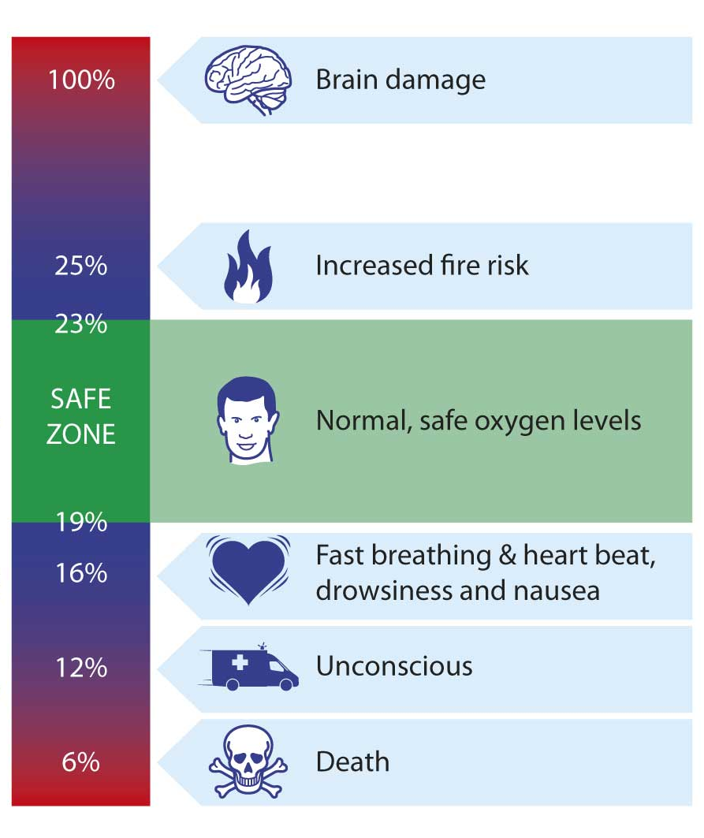
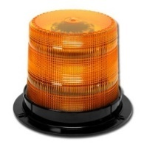

Oxygen Depletion System
% O2 in atmosphere
Two Step Alarm
Above 19%
19% - 1st alarm
flashes
flashes
and
sounds
very fast
17% - 2nd alarm

Slide 52

Oxygen Depletion System
If the oxygen depletion alarm is activated:
1. LEAVE THE ROOM IMMEDIATELY and DO NOT ENTER
2. Put the sign on the door handle
3. Contact/report to
  JP/ GOJ - Atanas Tomov*3202/a.tomov@qmul.ac.uk
  JP -Phil Duncanson *2024/1st floor write up area
  JP - Yumi Tashiro *6603/y.tashiro@qmul.ac.uk
GOJ - Jotham Selvarajah *6562/j.selvarajah@qmul.ac.uk
3333

Slide 53

Imperial College London fined £70,000 after scientist suffocated in lab filled with nitrogen
Imperial College London fined £70,000 after scientist suffocated while he was working in a hospital that filled with nitrogen. Chelsea and Westminster NHS Trust was fined £80,000 and both ordered to pay £23,000 in costs. The judge said the fines were lower than the sentencing guidelines as both public institutions are not profit-making.
Damian Bowen died because the ventilation system to his hospital lab was switched off. “If the ventilation had been switched on Damian Brown would not have died. He was working out of hours and alone.

Slide 54

Using Gas Cylinders
£ 0.3 m spent in removing cylinders from the laboratories in 2018
Never use without formal training, only BOC to handle them.
Cylinders are heavy and can cause serious damage if they fall
  ensure that they are chained when in use
  move only with a cylinder trolley
  https://www.youtube.com/watch?v=ejEJGNLTo84
Use regulators & control equipment suitable for the gas concerned
Consider the consequences if your cylinder leaks

Slide 55



Minor Chemical Spills
Spill Kits
Chemizorb® H+ Absorbent and neutralizer for spilled acids
Chemizorb® OH- Absorbent and neutralizer for spilled alkalis
Big white container with highly absorbent material
For spills of bacterial cultures: treat with Virons solution (10%) and after 30 min absorb with granule absorbent. Dispose of the absorbent in clinical waste bin bags.

Slide 56
PAT testing
Nothing can be brought in from home and used without PAT TESTING FIRST
  Phone charger
  Laptop charger
  Heater
  Fan
  Kettle
  Coffee maker

Slide 57




Electromagnetic Fields
Causes
Magnets
Heavy motors, transformers, generators
Thick electricity cables
High powered antennae
NOT mobile phones
Effects
Nausea
Nerve /muscle stimulation
Heating of body tissues or surface burns
Control Measures
Keep distance – typically up to 1m, field dependant
No long term effects

Slide 58
Legionella
Legionella sp.
37 species (Legionella pneumophila can be fatal)
Causative agent of Legionnaires disease, Pontiac fever, respiratory diseases
Contracted by inhalation of droplets containing bacteria
Symptoms ‘flu-like, pneumonia, cough blood, confusion, neurological disorder, death.
500 cases per year, fatality 5-30%.
Rare but found everywhere in the environment
Water systems provide growth conditions to generate numbers
Treatment
Early diagnosis and antibiotics
Control measures
Include flushing of taps for rarely used outlets weekly
Technicians flush all others except LEVs – Rota and SOP in Dept

Slide 59

Needles and Syringes
Needlestick injuries are major cause of serious accidents at QMUL.
Causes include;
Syringe is broken/split
Barrel and needle don’t fit
Residues highly reactive – dispose safely
NEVER re-sheath a needle
Do not carry around the lab
Always point away from you (needle and contents hazardous)
Dispose of correctly, never put one in your lab coat
Control Measures;
Request training
Techniques for air–sensitive reagents
Techniques to remove air bubbles – REQUIRED FOR ACCURATE VOLUMES
Techniques for pyrophoric liquids

Slide 60





Nanomaterials
The hazards of a nanoparticle cannot be assumed from Safety Data Sheets of similar material or even identical bulk material due to the way nanoparticles can enter the body.
Nanoparticles are far more hazardous than the identical bulk material
Request information from supervisors and safety coordinators

Slide 61

How to work safely in the lab
3. How to deal with emergencies

Slide 62

3333
or +44 (0)20 7882 3333

Slide 63
Contacts in case of emergency
For all serious emergencies and injuries | Dial 3333 (or 999) save : +44 (0)20 7882 3333 on your mobile 3333
First aiders in the building | Via 3333 – LAB NOTICES
Fire marshals in the buildings | Lab notices
Security emergency | Dial – ext. 5000
Facility emergency | Estates Helpdesk – ext. 2580

Slide 64

In Case of Fire Alarm
Shout Fire
Make your workplace safe and exit the building
Hit the fire point alarm on the way out (tackle the fire if it is safe to do so – there is no requirement)
Go to assembly point
Do not re-enter the building

Slide 65



Emergency Evacuation Plan
Meeting point Library square
Guidance on QMUL Emergency Fire Procedures:
http://www.hsd.qmul.ac.uk/A-Z/Fire%20Safety/index.html
Personal Emergency Evacuation Plan (PEEP) can be installed if needed

Slide 66




In Case of Fire
If you cause or see a fire:
Raise the fire alarm or shout Fire, Fire, Fire…
Follow the emergency evacuation procedure
3333
Flammable liquids
Flammable gasses
Electrical Hazard
Paper, Wood, Textiles
Flammable liquids
Vehicle protection
Beware if you are not trained !

Slide 67

In Case of Major Chemical Spill
Immediately alert area occupants and evacuate the area, if necessary
Notify H&S coordinator/lab managers and/or emergencies (3333)
Only if safe proceed to clean the spillage:
Use PPE as appropriate to the hazards
Protect floor drains or other means for environmental release.
Use spill control materials.
Do not pick up broken glass with hands
Put spilled materials in an appropriate container.
Complete a hazardous waste sticker
Decontaminate the surface where the spill occurred using a mild detergent and water.

Slide 68



Chemical on Skin or Clothing
Immediately flush with water for no less than 20 minutes, except in the cases of concentrated sulfuric acid or alkali metals, when water should not be used
While rinsing, quickly remove all contaminated clothing or jewelry
Caution when removing shirts or sweaters to prevent contamination of eyes
Dial 3333, call 1st aider
Check the SDS to determine if any delayed effects should be expected
Do not use solvents to wash skin or apply creams.
For flammable solids, first brush off as much as possible
3333

Slide 69


Chemical in Eyes
Immediately flush eye(s) with water for at least 20 minutes. The eyes must be forcibly held open to wash, and the eyeballs must be rotated so all surface area is rinsed.
You should not be wearing contact lenses in the lab. However, if you somehow ended wearing contact lenses in the lab, remove them while rinsing. Do not lose time removing contact lenses before rinsing.
Seek medical attention regardless of the severity or apparent lack of severity.
3333
Eyewash bottles (in workshop and biochemistry lab)

Slide 70


Accident/Incident/Near Miss
Report Accidents/Incidents/Near Misses
  Report accident to your supervisor
  Report accident to Health and Safety Coordinator
  Report accident to OHSD (online report http://www.hsd.qmul.ac.uk/accident-reporting/)
All accidents, however minor, have to be reported
Near-misses should also be reported
ONLINE (HSD) OR TO SAFETY COORDINATOR
WHO WILL REPORT IT ONLINE
3333

Slide 71
Accident/Incident/Near Miss
Why is it important to report near misses? No one has been harmed!
It is critical that near misses are reported so that they can be investigated and the causes determined and eliminated. The reporting of near misses gives us an opportunity to prevent future injuries or ill health.
Who should do the reporting? Everyone and anyone – no login or permission is required to report an incident using the online MySafety form.

Slide 72

Reporting
If it happened to you, it will happen to someone else
Report ‘near misses’ as someone else might not be as lucky
If you did something wrong, someone else can do it too
There is NO BLAME to report
If in doubt, call into the lab manager to tell him (Joseph Priestley 1.33a)

Slide 73
Reporting
Report Injuries
  In case of serious injury Dial 3333 (or 999) - +44 (0)20 7882 3333 on your phone
  Attend the injured person if it is safe
  Report accident to your supervisor
  Report accident to H&S Coordinator
  Report accident to OHSD (http://www.hsd.qmul.ac.uk/accident-reporting/)
Always report injuries, no matter how minor
First-aid boxes located at vantage points in labs and building, please note their location and first aider responsible for it

Slide 74


Sackville Street in Manchester city centre is cordoned off (Image: Charlotte Cox ‏@ccoxmenmedia)
Police were called to the Paper Science Building in Sackville Street, Manchester University, after reports that some Acetone Peroxide had ‘crystallised’ making it potentially explosive. Acetone peroxide, a white powder, is a highly explosive, extremely unstable and has become popular among terrorists.
The bomb disposal team are en route to the building, police have confirmed.

Slide 75
Take home message
Health and safety professionals are on the same side as the researchers helping keep everyone safe.
Health and safety should NOT stop you doing anything, but….. it may have an impact on HOW you do it.
You have a moral and legal responsibility to look out for yourselves and you colleagues.
Do not wait for intervention from authority. If you see your peers doing something unsafe, intervene.

Slide 76



H&S Disciplinary Policy in SPCS
Violations of safety rules
Sanctions
Category 1
Not using online out-of-hours record
Poor housekeeping
Inadequate waste management
Using equipment without training
Not completing COSHH forms
Not reporting incidents
Warning via e-mail
1st
3 days banning from lab + H&S improvement work
1st
2nd
1 week banning from lab + H&S improvement work
2nd
3rd
Category 2
No overnight reaction forms
Lone working
No PPE
No PPE when handling liquid N₂
Disregard of direct safety related instructions
QMUL disciplinary process will be applied
3rd

Slide 77
Useful websites
SPCS Website : https://www.qmul.ac.uk/spcs/
SPCS Chemistry : https://www.qmul.ac.uk/spcs/chemistry/
QMUL H&S: http://www.hsd.qmul.ac.uk/
SPCS H&S:SPCS Health and Safety Documents - Documents - OneDrive (sharepoint.com)
H&S forms : http://hsd.qmul.ac.uk/Forms/index.html
Where to find (M)SDS : https://www.sigmaaldrich.com/GB/en/search
Disability and Accessibility: https://www.qmul.ac.uk/site/accessibility/
CAPD and e-learning
Safety Manual/Quizzes https://qmplus.qmul.ac.uk/mod/subpage/view.php?id=672095

Slide 78
Induction Procedures
Induction | Done by | When ? | Who ?
General induction | Phil Duncanson / Atanas Tomov Online form signed Online Test Card Access | As soon as possible after arrival | Everybody
Chemistry lab systems | Phil Duncanson/ Atanas Tomov | Before working in the chemistry lab | All people concerned
Facilities induction | Corresponding facility manager | Before using facility | All people concerned
Display screen equipment http://queenmaryuni.hosted.safetylearning.co.uk/ | OHSD, online, follow guidelines | As soon as possible | Everybody > 6 weeks
Fire safety http://queenmaryuni.hosted.safetylearning.co.uk/ | OHSD, online, follow guidelines | As soon as possible | Everybody > 6 weeks

Slide 79
Online Test

Slide 80
Online Test

Slide 81
THANK YOU

