Slide 1

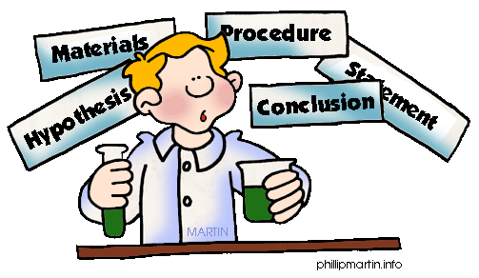
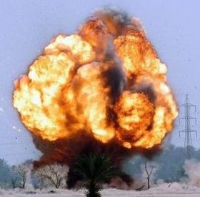

Introduction to Health & Safety
Chemistry, Physics & Biochemistry
School of Physical and Chemical Sciences
Website: http://www.sbcs.qmul.ac.uk/internal/healthsafety/index.html

Slide 2
Do you agree with these statements?
Health and safety isn’t important at all?
It’s just a load of bureaucracy?
It’s got nothing to do with what I do?
I’m really good, the best, no need to worry about me.
It’s just a waste of time.
It’s the whole world gone mad!

Slide 3



So why does H&S matter?
Moral
Legal
Financial

Slide 4
Moral duty
In our society we expect to be able to work for the benefit of our employer without endangering ourselves, or being endangered.
Qatar do not have this societal emphasis at present

Slide 5
Moral duty
Why should an organisation put someone at risk of harm for their own institutional or financial gain?
Should society permit employers to allow their employees to be harmed at work when the harm is predictable?
Between 1974 and 2021
  The number of fatal injuries to employees fell by 90 per cent
  The number of reported non-fatal injuries fell by 85 per cent.
  The rate of injuries per 100,000 employees fell 80 per cent
  The EU average was 1.8 fatalities per 100,000 workers; the figure in the UK is 0.44 (2021).
  WHY?........In 1974 the law changed

Slide 6
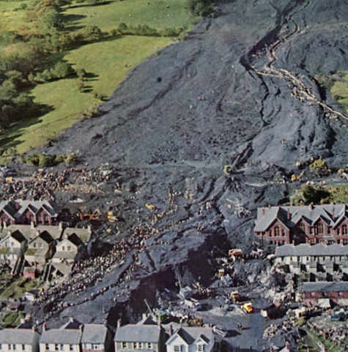
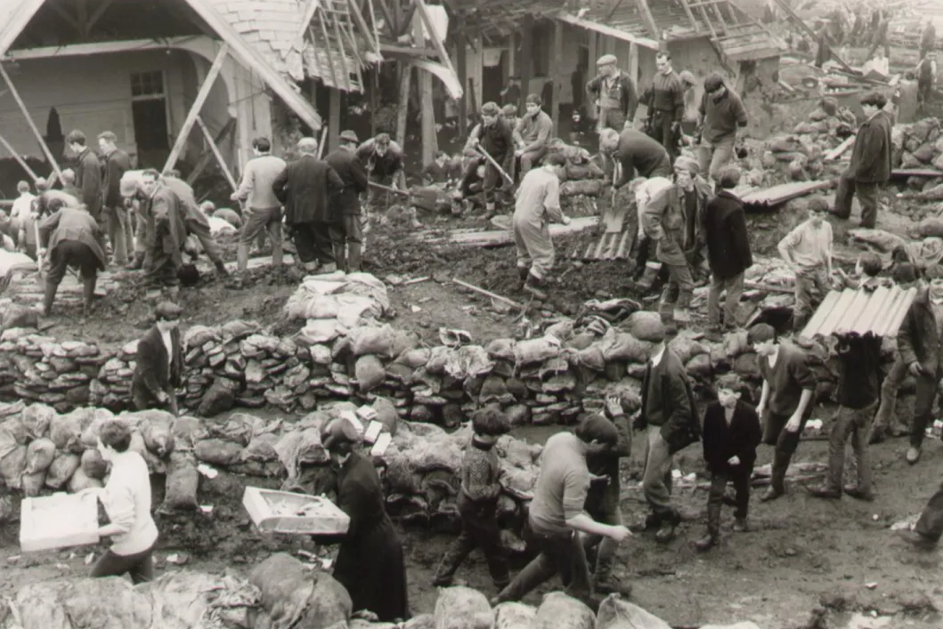

LEGAL DUTY
Aberfan, 21st October 1966 - the catastrophic collapse of a colliery spoil tip
110,000 m³ of spoil slid 650 m down, producing a 6-9 m high waves, travelling at 34 km/h.
116 primary school children and 28 adults died.
Young children and teachers died from impact or suffocation.
If the disaster had struck a few minutes earlier or a few hours later, no one would have been hurt.
The official inquiry blamed the National Coal Board (NCB) and its chairman, Lord Robens for extreme negligence.

Slide 7
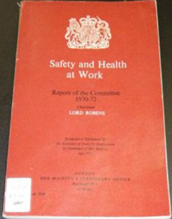
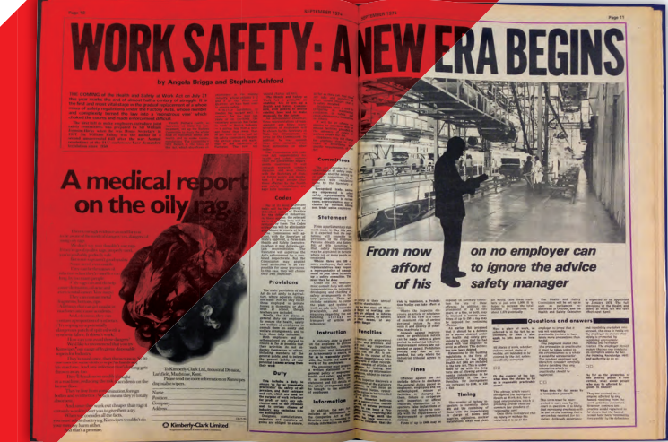
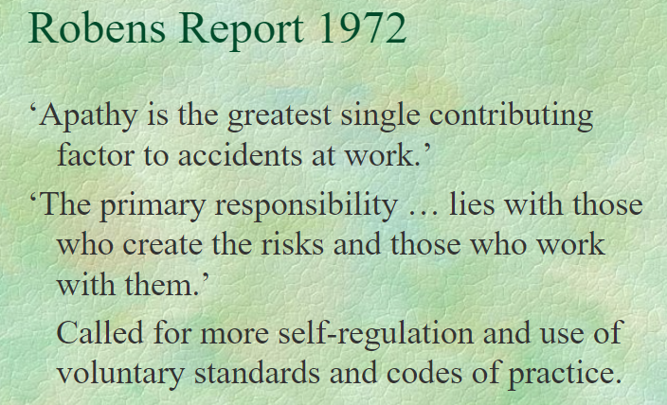
LEGAL DUTY
The Robens Report was published in 1972 and in 1974 the new Labour administration secured the passage of a Bill.
Health and Safety at Work etc. Act 1974
You have statutory duties!
You are breaking the law if you neglect them, and you can be prosecuted
Fines and sentences now are HUGE.

Slide 8
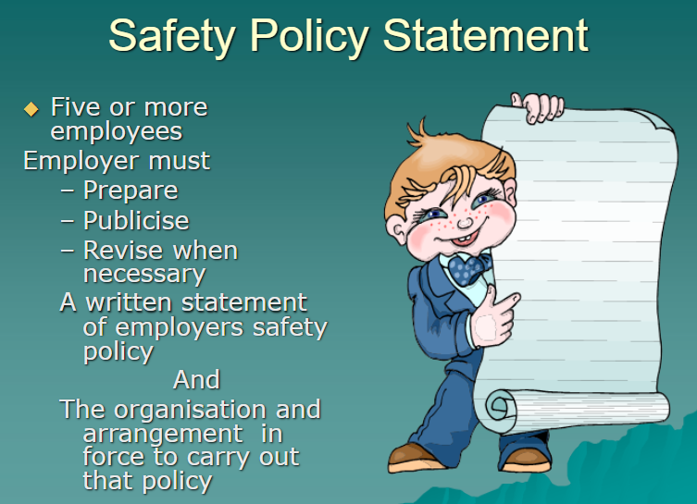
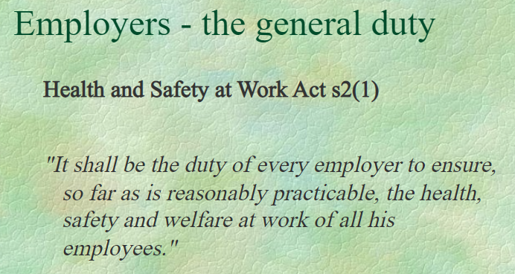
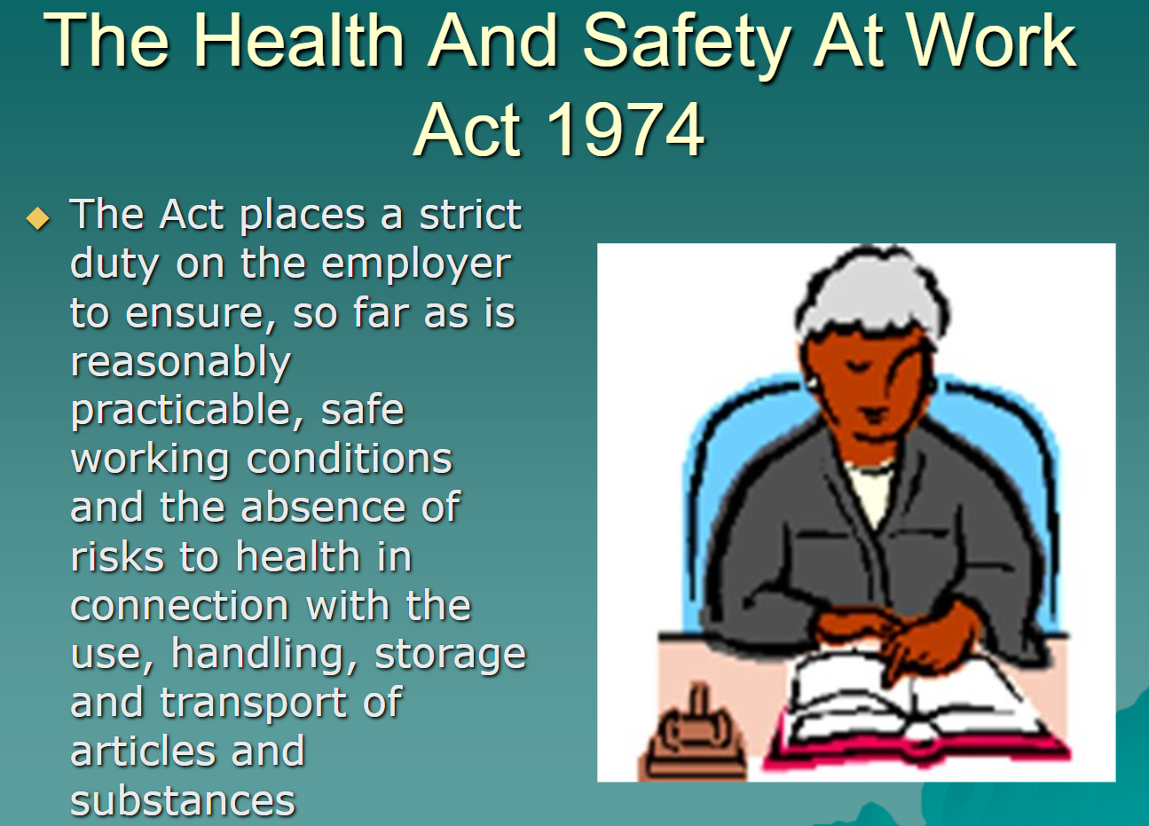
HEALTH AND SAFETY AT WORK ACT (HASAWA) 1974
Duties of employers:
It is the duty of every employer, so far as is reasonably practicable, to ensure the health, safety and welfare at work of all his employees (HASAWA Section 2(1)).
What does ‘so far as reasonably practicable’ mean?
This means balancing the level of risk against the measures needed to control the real risk in terms of money, time or trouble. However, you do not need to take action if it would be grossly disproportionate to the level of risk.

Slide 9

DUTIES OF EMPLOYEES
Health Safety at Work etc Act 1974
  You must not, through your acts or omissions, put yourself or others at risk
  You must not misuse or interfere with safety equipment
  You must co-operate with your employer (QMUL) to comply with the law
Responsibility Rests With Both Employer (QMUL) and the Employee or Student
Penalty – up to 2 years in prison &/or an unlimited fine

Slide 10
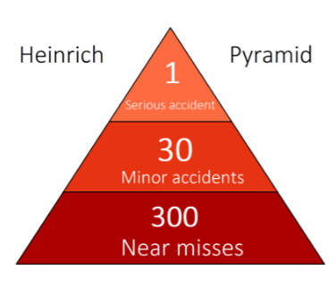
KEY POINTS OF THE HEALTH AND SAFETY AT WORK ACT ETC. 1974
1. Provide a safe place of work
2. Provide safe equipment
3. Ensure staff are properly trained
4. Carry out risk assessments
5. Provide proper facilities
6. Appoint a competent person to oversee health and safety

Slide 11
What does the law say?
Health Safety at Work etc Act 1974
Section 2 of the Act makes it the duty of every employer to ensure, so far as is reasonably practicable, the health, safety and welfare at work of all his employees.
Section 3 extends this duty so that employers must also ensure, so far as is reasonably practicable, the health and safety of non-employees affected by the work activities.
Section 7 makes it the duty of every employee while at work to take reasonable care for their own health and safety and of other persons who may be affected by their acts or omissions at work. Employees are also required to co-operate with their employer as regards any duty or requirement imposed by health and safety legislation.
Section 8 makes it the duty of everyone not to interfere with, or misuse, anything provided in the interests of health, safety or welfare.
Section 9 states that no employer can charge an employee for anything done or provided in accordance with health and safety legislation.
Penalty – up to 2 years in prison &/or an unlimited fine

Slide 12
Financial
Costs of accidents to QMUL and therefore to student fees
Costs of financial liability
Costs to the resulting lack of facilities, if property damaged
Costs to research capability, teaching facilities

Slide 13
Risk Perception
Risk perception depends on common knowledge but also experience and expert knowledge
Students by definition are inexperienced and are yet to become experts.
The School chemistry labs contain poisons, pyrophoric materials, flammable solvents, strong acids and oxidising agents to name a few but there are many hazards which are not obvious.

Slide 14

Safety is a part of your job
Your job is at risk
A good scientist works safely
H&S knowledge is fundamental for your career
working safely shows understanding of what you are doing
An example: for GSK one single infraction of safety rules is a sackable offence

Slide 15
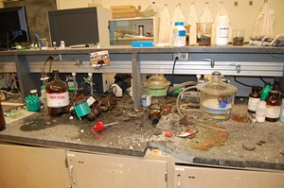
Why does H&S matter?
No risk assessment when scaling up a reaction
An Explosion at Texas Tech U. lab leaves a student with serious injuries (January 2010)
Two graduate students synthesising nickel hydrazine perchlorate
They scaled up from 100 mg to 10 g
A mortar that a student was using to break up clumps of product formed exploded in his hands.
Serious injuries: the student lost three fingers on his left hand, severely lacerated his right hand, perforated his left eye, scratched his right eye and had superficial cuts to the parts of his body that were exposed.

Slide 16
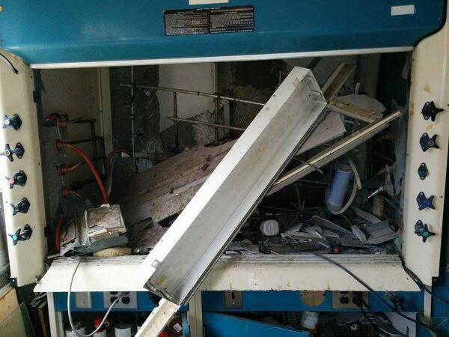
Why does H&S matter?
Lack of ‘hazard reassessment’ + overconfidence
A small explosion at the University of Minnesota lab destroyed equipment and injured student (June 2014)
Fifth-year graduate student handling large amount of azides
Scaled-up a literature procedure
Lack of proper hazard reassessment
No appropriate risk mitigation
Lack of appropriate SOP
No PPE
Excess of confidence when repeating an experiment

Slide 17
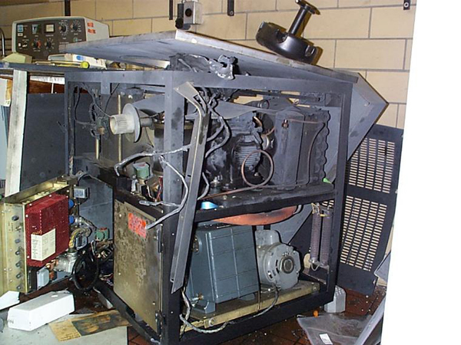
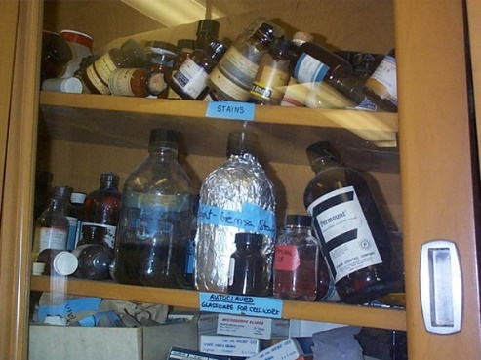
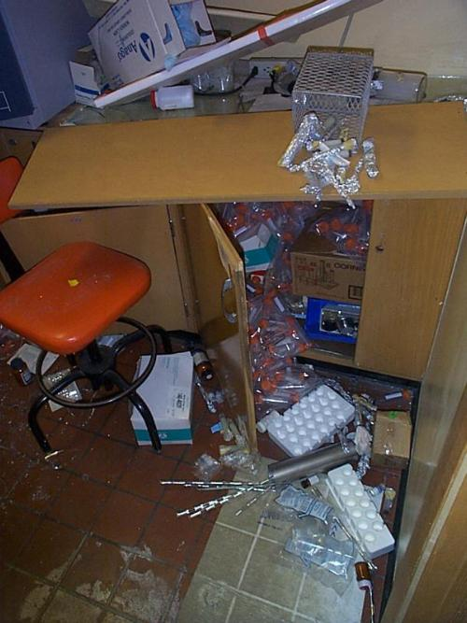
Why does H&S matter?
Inadequate equipment maintenance and careless set up
Centrifuge Explosion Incident (1999)
A laboratory was seriously damaged when the rotor of an ultracentrifuge failed while in use. Flying metal fragments damaged walls, the ceiling and other equipment. The shock wave blew out the laboratory's windows and shook down shelves.

Slide 18
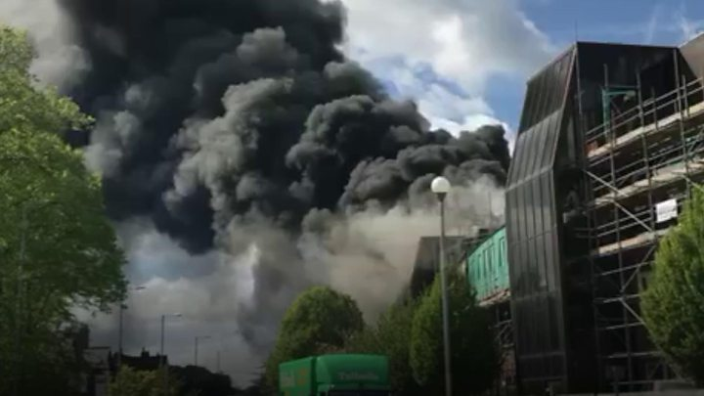
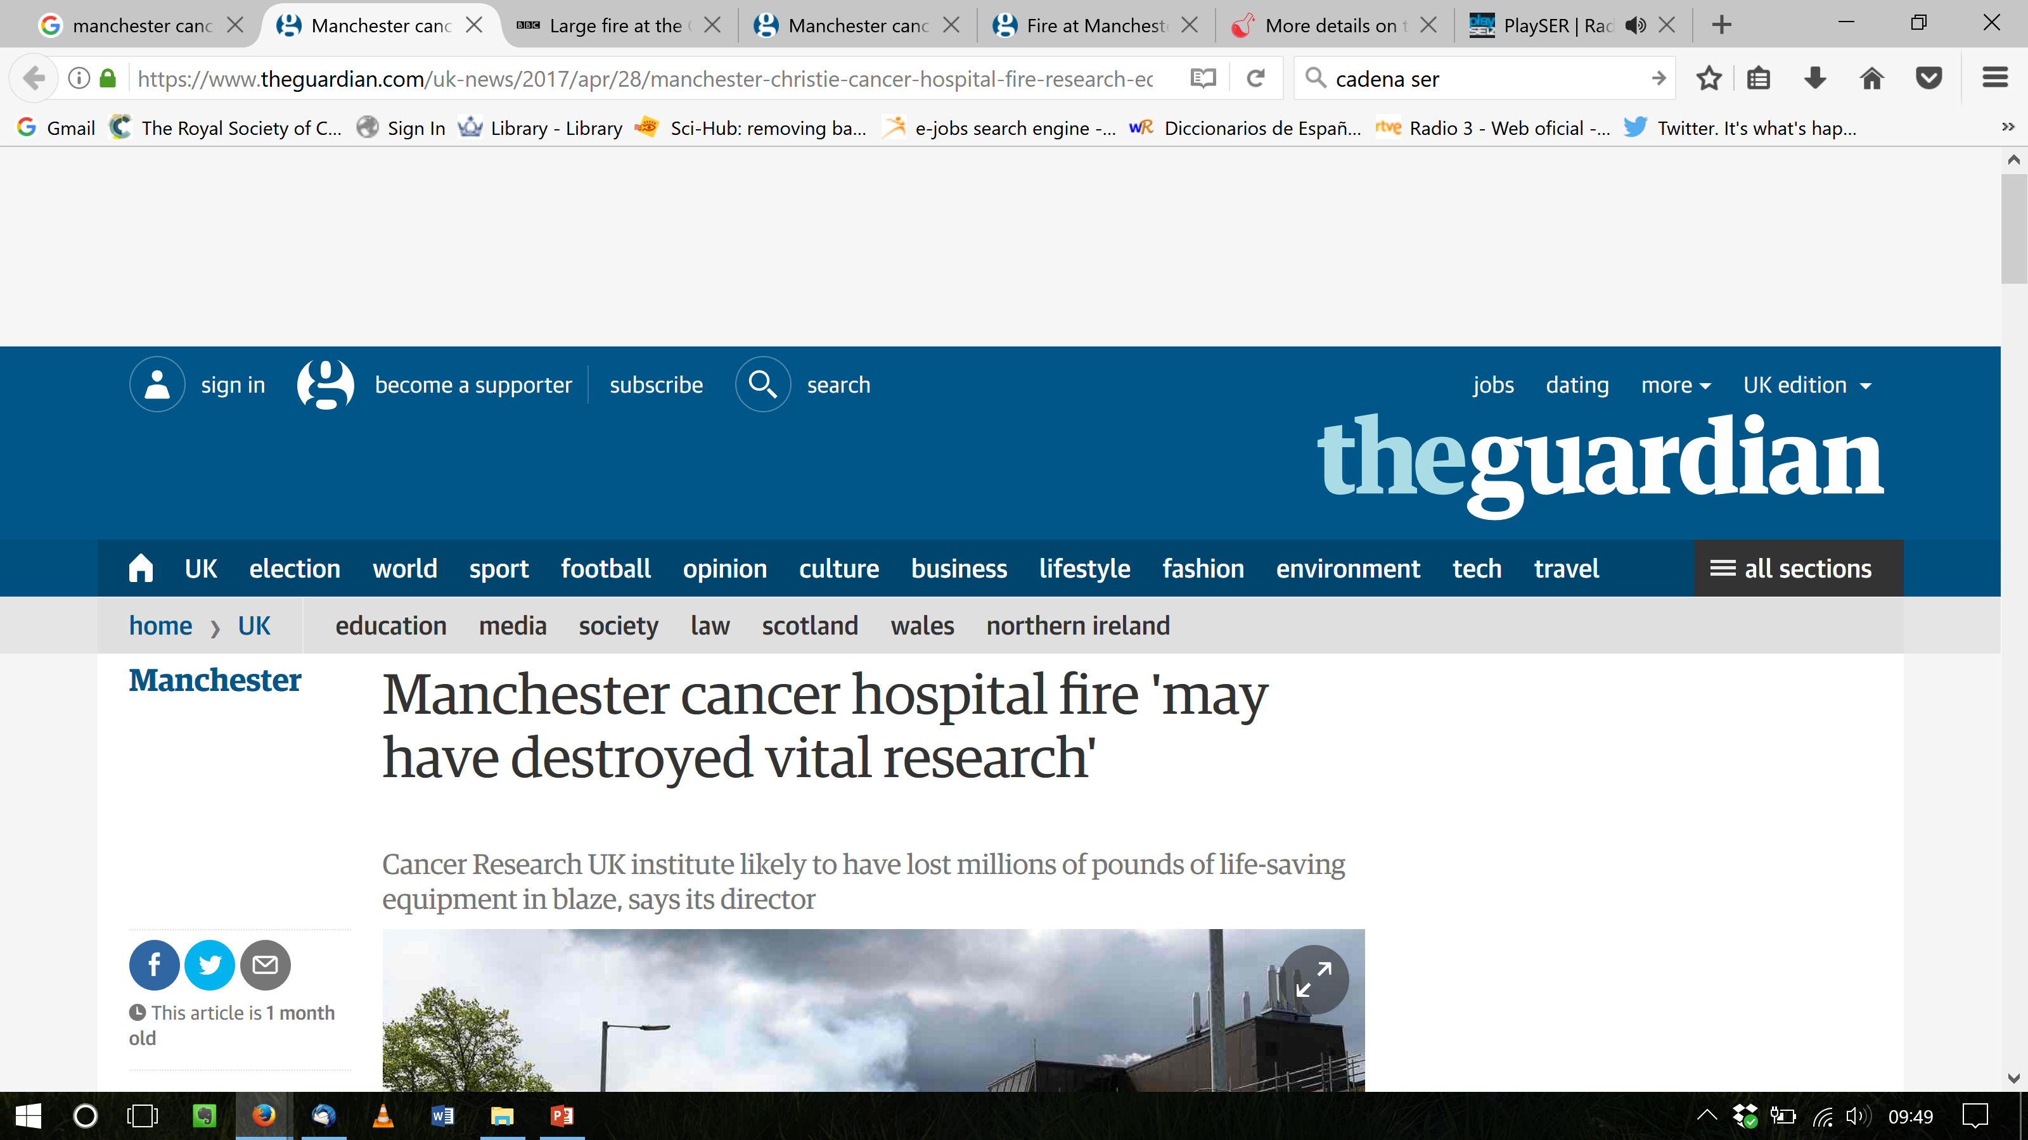
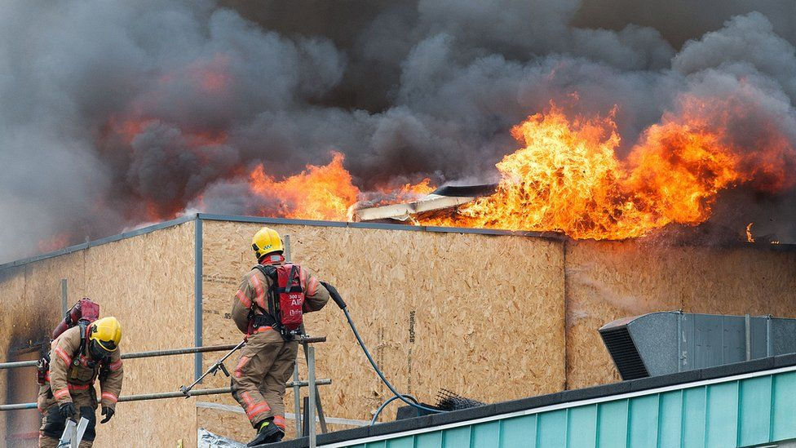
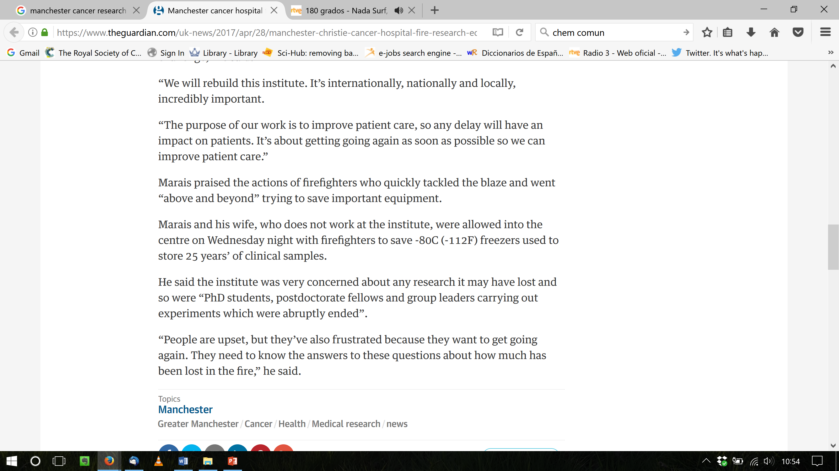
Why does H&S matter?
One mistake affects many
Fire at Manchester, April 2017

Slide 19
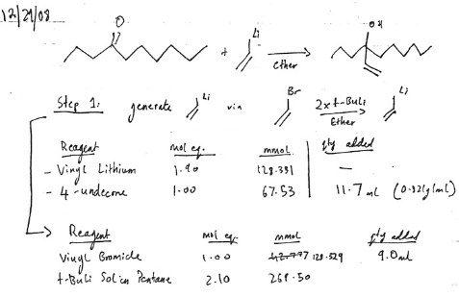
WHY DOES H&S Matter
Sangji had only carried out the reaction once in a much smaller scale but decided to scale up
She was wearing nitrile gloves, possibly safety glasses but no lab coat (her sweater made of synthetic materials caught fire very quickly)
She knocked off an open bottle of hexane in the fume hood and which was not necessary for the experiment
When her clothes caught fire she run away from where the emergency shower was
A post-doc in the lab that saw her did not put her under the shower either but tried to stop the fire with a lab coat
A post-doc from another lab who heard the screams finally called 911
For further info on the UCLA accident see
http://cen.acs.org/articles/87/i31/Learning-UCLA.html

Slide 20
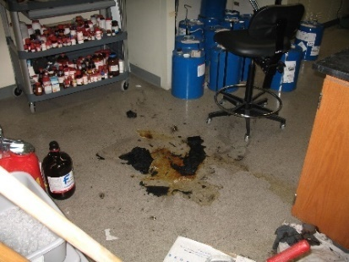

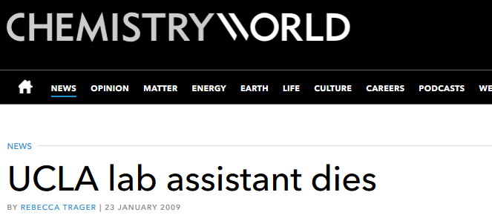
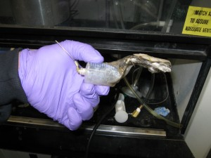
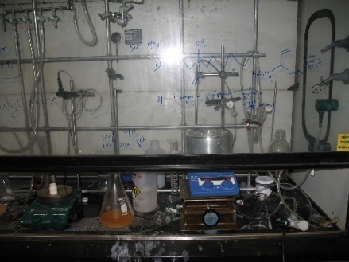
The investigation concluded that it could have been prevented
Insufficient training, no labcoat, poor housekeeping, unawareness of emergency procedures
UCLA Lab Fire: December 29, 2008
Sheri Sangji was using this plastic syringe to transfer tert-butyllithium when the plunger came out of the barrel and the material ignited.
Sheri died January 16, 2009 of second- and third-degree burns over 43% of her body

Slide 21
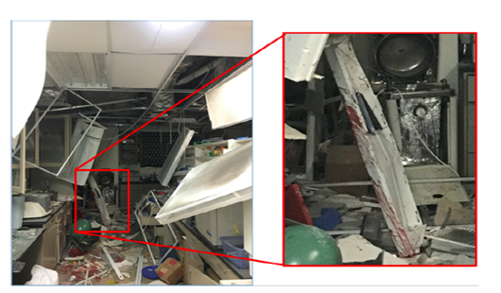
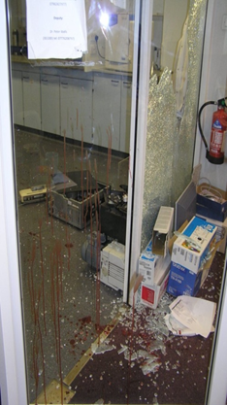
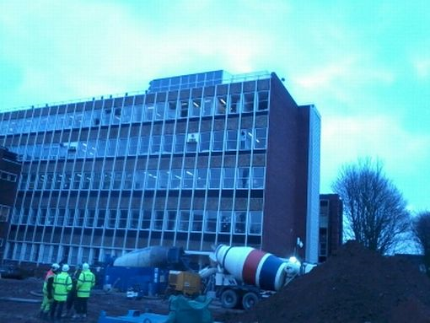
More Examples?
University of Hawaii - post doc lost her arm in this blast.
Windows blown out – Liverpool University 2015
Suspected peroxide explosion.

