Slide 1
School Meeting Education Update
S. Beheshti, Director of Education
16 Jan 2023

Slide 2
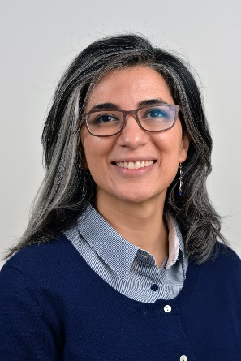
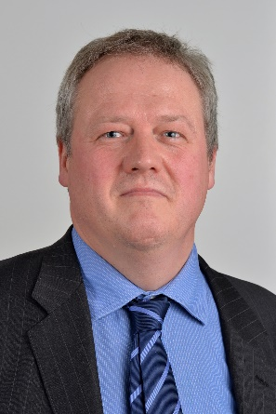
Who am I/Who are we?
Director of Education Dr Shabnam Beheshti
Deputy DoE Dr Sebastian del Bano Rollin
Programme Directors Dr Felix Fischer, Dr Huy The Nguyen
Dr Dudley Stark, Dr Kathrin Glau
Mr Chris Sutton, Prof Oliver Jenkinson
Director of Student Experience Dr Weini Huang

Slide 3
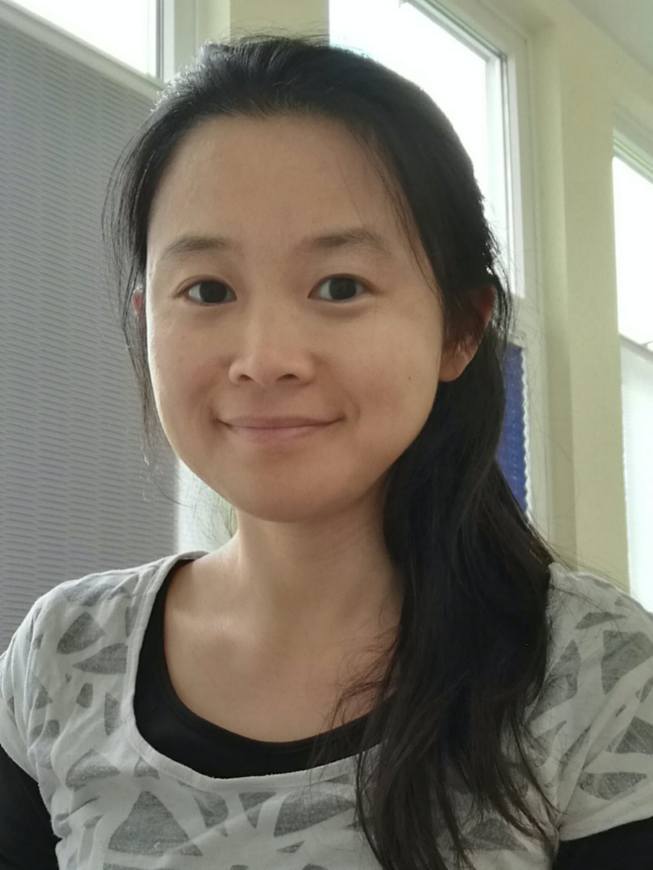
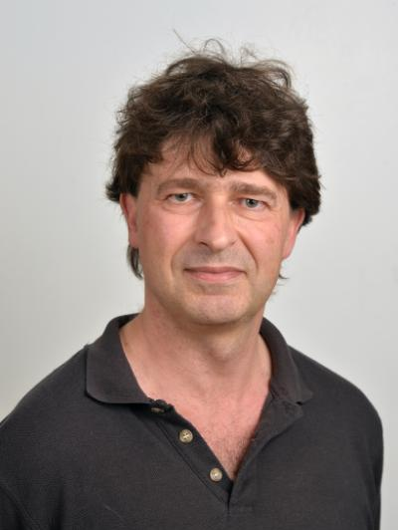
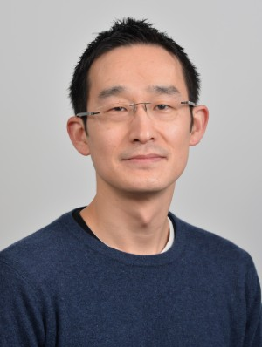
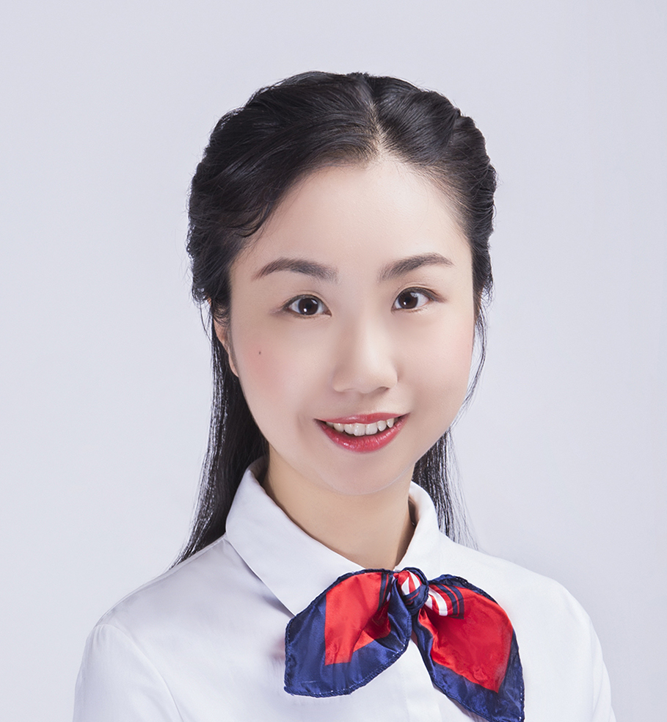
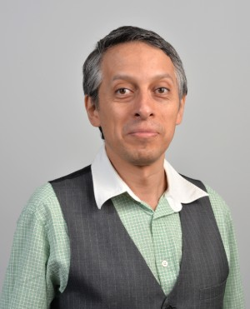
Student Experience, Year Tutors
Director of Student Experience Dr Weini Huang
Y0/Foundation Tutor Prof Oliver Jenkinson
Y1 Tutor Dr Shu Sasaki
Y2 Tutor Dr Lei Fang
Y3/Finalists Tutor Dr Hugo Maruri-Aguilar

Slide 4
Operations
Lectures
Y1 – 4 contact hours comprised of 3hr Lectures + 1hr (small group) Tutorials/IT Labs
Y2/Y3 – 4 contact hours comprised of two 2hr Lectures or 2+1 hrs Lecture + 1 Seminar/IT Lab
Y4/MSc – 3 contact hours comprised of 2 Lectures +1 Seminar/IT Lab hours
Notes on MME
Please use MME with Zoom, but do not fuss around with tech to make things “equal”; students are expected to be on campus.
Y1 Tutorials are not MME. Some Y2/Y3/PGT modules have exceptional structures, double taught seminars/IT Labs, etc.
Please visit your teaching rooms to try out the equipment and your links in advance of your first session, and raise an IT ticket/get in touch with maths-qmplus@qmul.ac.uk for support.
Notes:
Queen Mary is an established member of the top 200 institutions in the world and a member of the prestigious Russell Group of universities.
It has the third largest proportion of International students at any University in the UK and the 16th largest in the world.
A great place to study mathematical sciences
Encounter variety of teaching styles, learn to become Independent thinkers
Make personal and professional connections beyond your years here at QM!

Slide 5
Operations
Tutorials/Seminars
Y1 – Weekly tutorials typically commence in Week 2 = Timetable Week 26 = week of Jan 30th
Please check your Good Friday/Easter Monday rescheduling
Y2/Y3 – Weekly seminar hour/IT Lab, starting in Weeks 1 or 2
In 2+2hr modules, you choose where the seminar hour goes
In 2+1+1 modules, split seminar is labelled in timetable
If you need further TA support in your seminar/IT Lab, etc. please get in touch with me ASAP
Please try to be as interactive as possible! Student feedback indicates they appreciate when the lecturer breaks up the time in large-group sessions to do some kind of active learning, and when we are very clear in their tasks at weekly/bi-weekly level, (e.g., “Do reading X, Week N, watch A before Tues Lecture Week N, by the end of week N, you should know how to …” etc.)
Notes:
Queen Mary is an established member of the top 200 institutions in the world and a member of the prestigious Russell Group of universities.
It has the third largest proportion of International students at any University in the UK and the 16th largest in the world.
A great place to study mathematical sciences
Encounter variety of teaching styles, learn to become Independent thinkers
Make personal and professional connections beyond your years here at QM!

Slide 6
QMPlus
Basics Checklist
Days/times and locations of your module (physical space + Zoom links)
Weekly responsibilities of student (videos, independent reading, assignments, etc.)
Where questions should be directed (forum vs. email)
Office Hours (min 1 hr/week)
EXAM FORMAT (face-to-face vs. online)
Checklist as term progresses
Recordings
Lecture notes, Readings/Library resources
Exercises + due dates, Solutions (if relevant), Feedback
Exam resources
Extras (as appropriate)
Please make sure your have basics posted and that your page is unhidden before Week 1.
Notes:
Queen Mary is an established member of the top 200 institutions in the world and a member of the prestigious Russell Group of universities.
It has the third largest proportion of International students at any University in the UK and the 16th largest in the world.
A great place to study mathematical sciences
Encounter variety of teaching styles, learn to become Independent thinkers
Make personal and professional connections beyond your years here at QM!

Slide 7
Assessments
In-Term
Most modules levels 4-6 (Y1-Y3) have 20% coursework/midterm + 80% final exam
IFoA-accredited modules have special assessment pattern (usually 30%+70%)
Bonus if you can coordinate due dates for bigger modules in the year (especially Y3)
Final Examinations
UG/PGT have timed exams (2hr UG, 3 hr PGT), not timed in a 24-hour window.
Checked exams due Week 7, with detailed instructions from SEB Chairs. Please note that every module needs at least 50% assessments to go to external examiners.
All Level 5/Level 6 modules having face-to-face final assessments need mock exams, with details to follow from the Education Services Team (EST).
Remarks on how Sem A assessments went: student feedback Y3→Y2, petitions, “Inclusive by Design” 3-4 hour window, 3 sides A4, IT issues, ECs (extenuating circumstances), …
Notes:
Queen Mary is an established member of the top 200 institutions in the world and a member of the prestigious Russell Group of universities.
It has the third largest proportion of International students at any University in the UK and the 16th largest in the world.
A great place to study mathematical sciences
Encounter variety of teaching styles, learn to become Independent thinkers
Make personal and professional connections beyond your years here at QM!

Slide 8
Beyond Mechanics…
More on teaching of mathematics, statistics, data science online: http://talmo.uk/index.html
Curriculum Review continues
New PGT Programmes being explored: Applied Statistics, Actuarial, Finance/Risk Analytics
S&E Enhanced Programme Review postponed to AY23/24
…and Finally, planning for AY23/24
Education Away (1/2) Day in Week 7 with big decisions (MME, assessments, etc.)
Joint Teaching Preferences, Flexible Teaching, Admin Allocation form coming soon!
I am here to help and support both you and our students in having a really good second semester. Please feel free to get in touch with me!
Notes:
Queen Mary is an established member of the top 200 institutions in the world and a member of the prestigious Russell Group of universities.
It has the third largest proportion of International students at any University in the UK and the 16th largest in the world.
A great place to study mathematical sciences
Encounter variety of teaching styles, learn to become Independent thinkers
Make personal and professional connections beyond your years here at QM!

Slide 9
Questions?
Thank you for listening
Notes:
CONCLUSION: We will need to work together to give you the best education possible, especially when so many of us have had our lives and education disrupted so significantly; this involves continuous engagement on your part and good ideas from all of us. The best way to have good ideas is to have many ideas and the way to have many ideas is to engage everyone in thinking of the issues we all care about! So, please come and talk with us, our (real and virtual) doors are open!

