Slide 1

Queen Mary Buddy Scheme
2025
Notes:
-Before we begin: Introduce self, set expectations time-wise - 5min break in middle
-I’ll give everyone 5 mins or so to join
-Feel free to turn mics/cameras on to ask questions or use the chat at any time throughout the session
-If at any point you cant see the slides or I loose connection please shout and let me know
-REGISTER – important to capture everyone who's attending, as attending the training is one of our compulsory requirements
-We are going to put up a video of a session on QM plus and the slides, as you are doing training now but not meeting your mentees until Sep, you might need a bit of a refresher before then.

Slide 2

What can your mentor help with?
1st & 2nd year students in your School have been trained as mentors to help you:
Find your way around on campus
Help you feel settled
Meet new people and make friends
Signpost you to services on campus
Help you make the most out of your time at Queen Mary!
Notes:
Having a friendly face on Campus
Meeting colleagues in small groups
Finding out about extracurricular activities
Finding out about Mile End and the local area

Slide 3

When will I meet my mentor?
Buddy Scheme Student transition: from 15th September – 11th October.
Look out for an email sent to your new university email address from Vygo: Contact your mentor on Vygo to say hello.
Then your mentor will arrange: a time, date and place to meet up and meet each other.
Notes:
Any questions: please contact us! We are always happy to help: buddyscheme@qmul.ac.uk

Slide 4
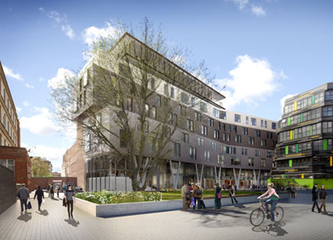
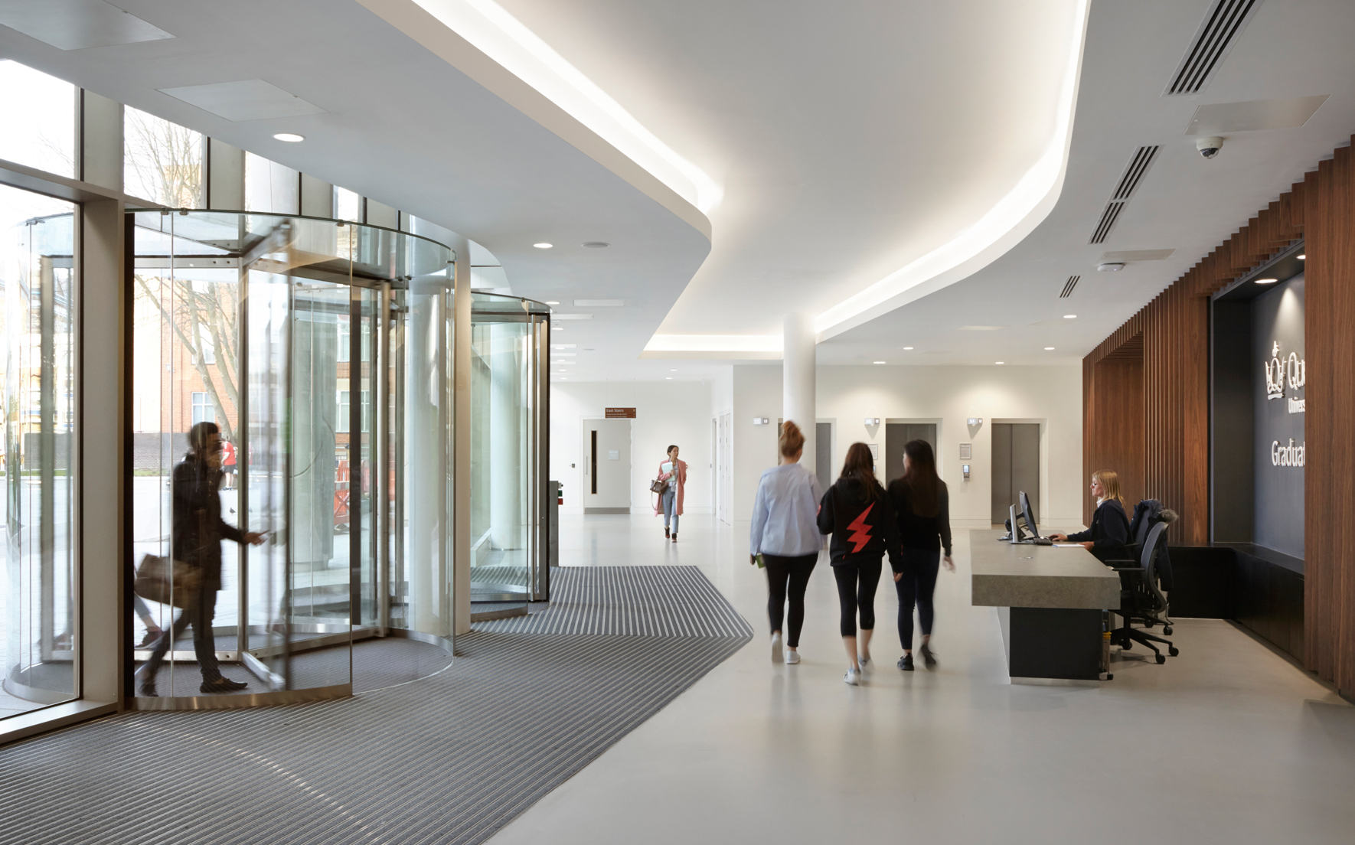
Upcoming events
The Big Buddy Scheme Meet Up:
  8th October & 15th October from 3pm to 5pm in the Foyer of the Graduate Centre:

Slide 5

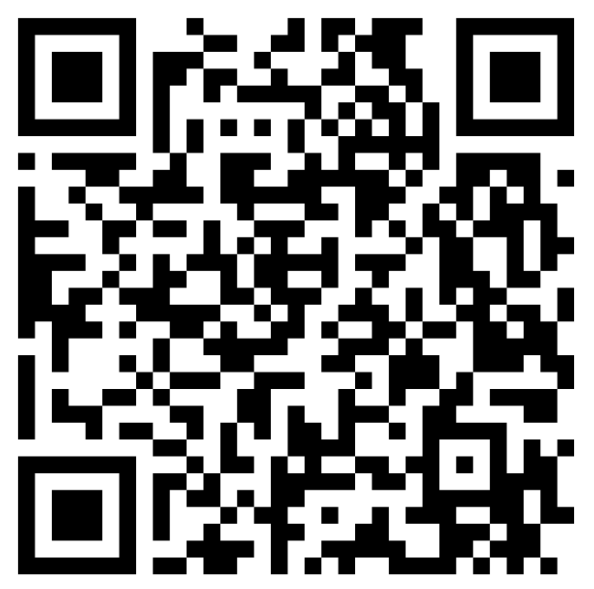
How do I sign up?
You can sign up on the Queen Mary MyQMUL webpages: http://my.qmul.ac.uk/buddyscheme/i-want-a-buddy/

Slide 6
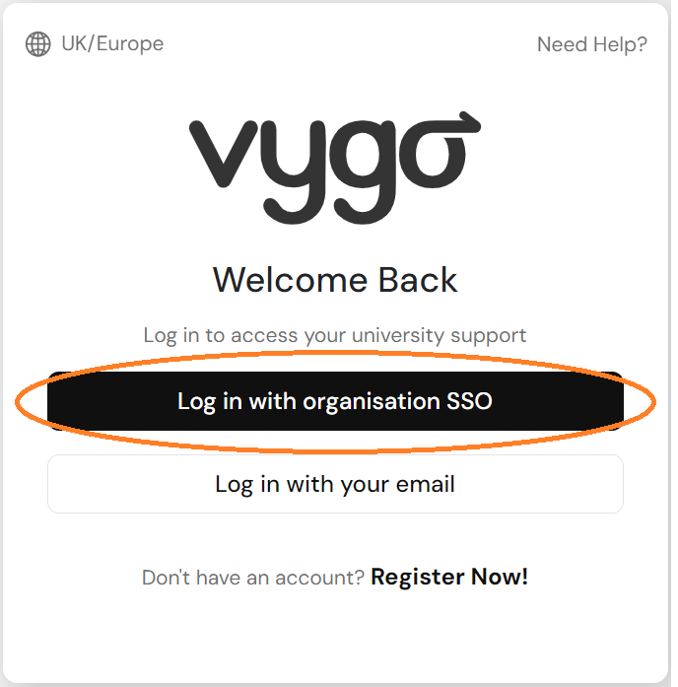
Creating your Vygo profile is simple!
Step
1
Sign in using your SSO login (university email address) via web address: https://web.vygo.app/login

Slide 7
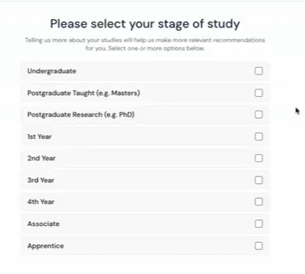
Complete onboarding questions
Step
2
Answering the onboarding questions will help match you to the most appropriate mentor.

Slide 8
Send us an email if you have any questions at:
buddyscheme@qmul.ac.uk

Slide 9

Any questions
Thank you!
Any Questions?

