Slide 1
Final year dissertation
PSY600 & PSY606

Slide 2
Dissertation project
PSY600: Final Year Research Project
30-credit module (over two semesters)
Module Organiser: Dr Gwen Brekelmans (g.brekelmans@qmul.ac.uk)
Fulfils a core British Psychological Society requirement
Alternative is to write an extended essay (PSY606) in a 15-credit module and take another 15-credit module
→ To graduate with a BPS-accredited degree, you must pass PSY600

Slide 3
PSY606: Extended essay
Systematic/narrative review paper of an area of psychology literature
Think of a longer version of a literature review in a lab report
Can be any area of psychology literature
Supervisor will be allocated based on broad areas of interest
Equivalent of one 15-credit module worth of work
Hence the extra elective!
NOT eligible for BPS membership

Slide 4
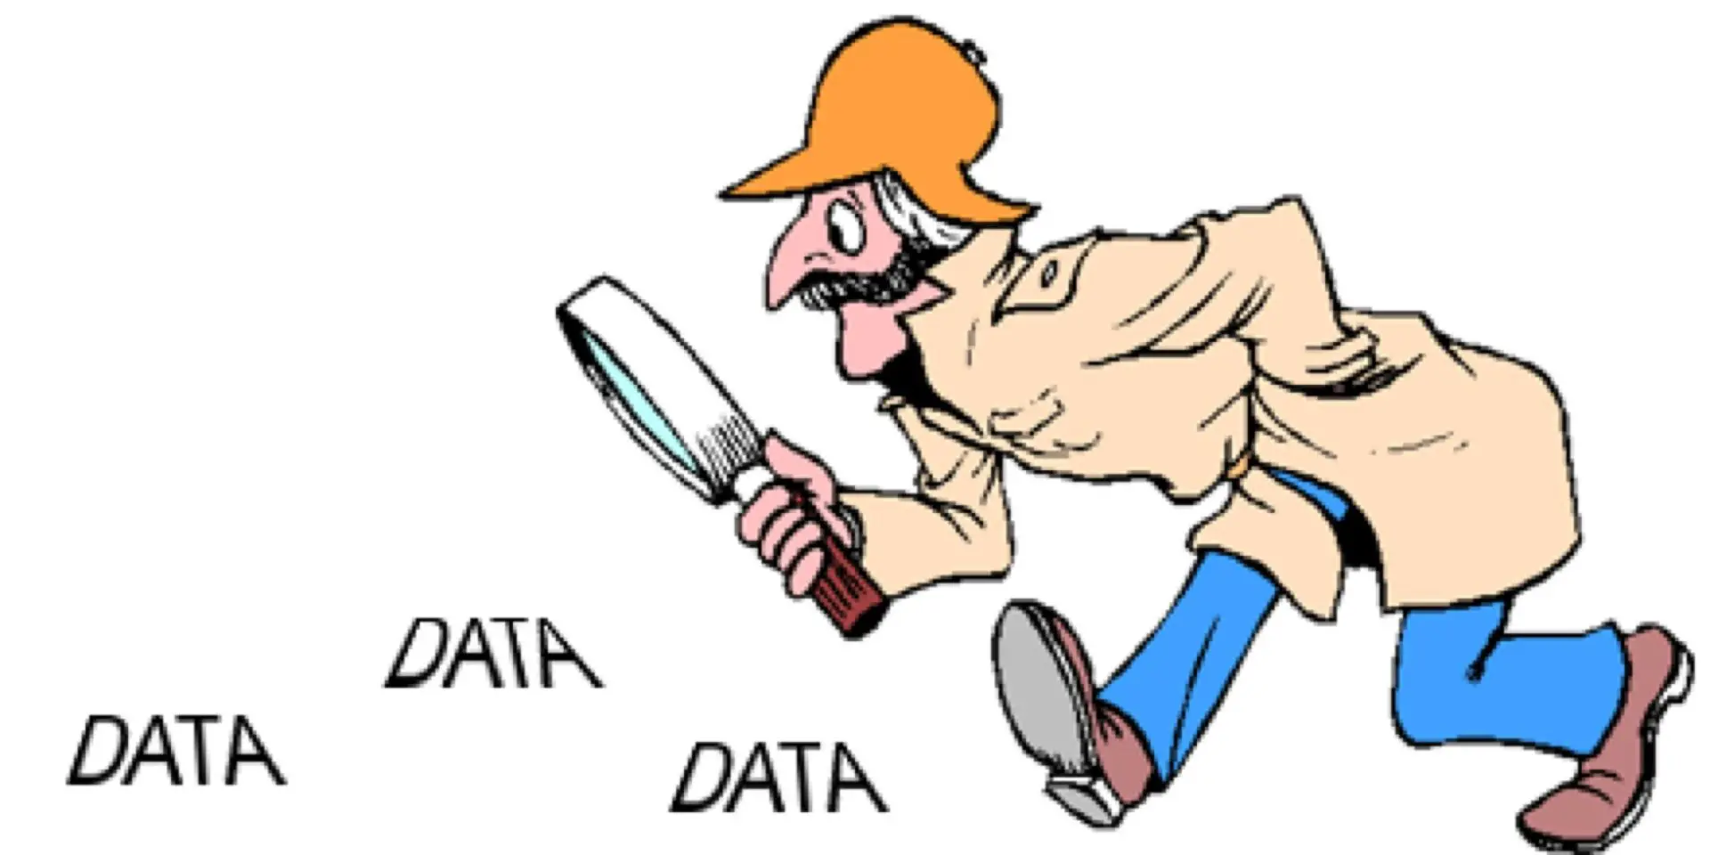
Dissertation project: conducting & writing up an empirical study
What’s an empirical study?
An empirical study provides new insight, by conducting
Data collection & analysis
Secondary data analysis
Meta-analysis

Slide 5
Dissertation project: learning objectives
Communicate effectively
Demonstrate numerical reasoning skills
Be computer literate: skilled in the use of word processing, databases and analytic software packages
Retrieve and organise information effectively. Psychology graduates are familiar with collecting and organising stored information found in library books, journal collections and online, critically evaluating primary and secondary sources
Awareness of ethical issues and work according to current codes of ethics and conduct
Recognise what is required for effective teamwork
Take responsibility for your own learning and skill development

Slide 6
Dissertation project: timeline
May/June ‘25: indicate preferences for topic areas
Late August/September ‘25: supervisor allocation announced
September ‘25: get in touch with supervisor and discuss project options
Sept-Oct ‘24: project preparation, ethics application
‘24-’25: project conducted, write-up
April ‘26: deadline

Slide 7
Detailed Timeline
Overview:
1. Choose research question
2. Identify specific, testable hypothesis
3. Design experiment
4. Apply for Ethics approval
5. Create experiment
6. Collect Data & Write Introduction & Methods
7. Analyse Results
8. Write-up Project in Dissertation (6000 – 8000 words)
Timeline
September/October
October
November*
December - January
January - February
February - March
April ‘25: deadline
*Goal: have experiment ready to launch by December
Notes:
Exciting opportunity!
Get to be independent, flex your research muscles

Slide 8
Detailed Timeline
Plan ahead!
Look at deadlines in other modules
Plan writing/analyses around your schedule & other coursework deadlines
Be realistic! Don’t expect to work on dissertation during exams or when major coursework is due.
Spread out the work across the year
Schedule a chunk of time every week do work on dissertation & COMMIT
i.e., Monday from 1- 4pm
Notes:
Exciting opportunity!
Get to be independent, flex your research muscles

Slide 9
Dissertation project: example topic areas
Animal behaviour – observational
Animal behaviour – experimental
Attention, perception and sensation
Consciousness
Creativity and play
Cognitive neuroscience
Decision making
Language and communication
Learning, memory, and cognitive development
Social cognition and empathy
Social behaviour and interaction
Intergroup relations
Identity and individual differences
Sleep, exercise, and nutrition
Developmental mental health and wellbeing
(e.g. early adversity, neurodevelopment)
Mental health and wellbeing (non-developmental)
Psychology of higher education
Just examples: Final topic areas will be provided in survey

Slide 10
Dissertation project: process
Supervisors and students are matched based on topic rankings
Supervisors generally provide a choice of 2-3 projects for students to choose
2 Projects based on their expertise
1 Psychology Department Questionnaire Database option (without expertise)
Based on project preferences, students will work either individually or in a group

Slide 11
Dissertation project: group work
Great for practicing team work skills
Allows you to collect a larger dataset
Makes it easier to discuss your work with your peers
All assessment is based on your individual work

Slide 12
Dissertation project: engagement
You should take ownership of your project
Be proactive
Once you’re assigned a supervisor, get in touch early on to discuss the dissertation process

Slide 13
Dissertation: Next Steps
You will be asked to fill out a survey in May/June, 2025, including questions like:
General Topic Preference
Preference for data collection or secondary data analysis
Preference for quantitative vs qualitative analysis
You will be assigned a dissertation supervisor who matches your preferences in late August/Early September

Slide 14
Enjoy!
Any Questions?

