Slide 1
Final year dissertation
PSY600 & PSY606

Slide 2
Dissertation project
PSY600: Final Year Research Project
30-credit module (over two semesters)
Module Organiser: Dr Gwen Brekelmans (g.brekelmans@qmul.ac.uk)
Fulfils a core British Psychological Society requirement
Alternative is to write an extended essay (PSY606) in a 15-credit module and take another 15-credit module
→ To graduate with a BPS-accredited degree, you must pass PSY600

Slide 3
PSY606: Extended essay
Systematic/narrative review paper of an area of psychology literature
Think of a longer version of a literature review in a lab report
Can be any area of psychology literature
Supervisor will be allocated based on broad areas of interest
Equivalent of one 15-credit module worth of work
Hence the extra elective!
NOT eligible for BPS membership

Slide 4
Dissertation project: conducting & writing up an empirical study
What’s an empirical study?
An empirical study provides new insight, by conducting
Data collection & analysis
Secondary data analysis
Meta-analysis

Slide 5
Dissertation project: learning objectives
Communicate effectively
Demonstrate numerical reasoning skills
Be computer literate: skilled in the use of word processing, databases and analytic software packages
Retrieve and organise information effectively. Psychology graduates are familiar with collecting and organising stored information found in library books, journal collections and online, critically evaluating primary and secondary sources
Awareness of ethical issues and work according to current codes of ethics and conduct
Recognise what is required for effective teamwork
Take responsibility for your own learning and skill development

Slide 6
Dissertation project: timeline
May ‘24: indicate preferences for topic areas
Late August ‘24: supervisor allocation announced
Late August ‘24: get in touch with supervisor and discuss project options
Sept-Oct ‘24: project preparation, ethics application
‘24-’25: project conducted, write-up
April ‘25: deadline

Slide 7
Detailed Timeline
Overview:
1. Choose research question
2. Identify specific, testable hypothesis
3. Design experiment
4. Apply for Ethics approval
5. Create experiment
6. Collect Data & Write Introduction & Methods
7. Analyse Results
8. Write-up Project in Dissertation (6000 – 8000 words)
Timeline
September/October
October
November*
December - January
January - February
February - March
April ‘25: deadline
*Goal: have experiment ready to launch by December
Notes:
Exciting opportunity!
Get to be independent, flex your research muscles

Slide 8
Detailed Timeline
Plan ahead!
Look at deadlines in other modules
Plan writing/analyses around your schedule & other coursework deadlines
Be realistic! Don’t expect to work on dissertation during exams or when major coursework is due.
Spread out the work across the year
Schedule a chunk of time every week do work on dissertation & COMMIT
i.e., Monday from 1- 4pm
Notes:
Exciting opportunity!
Get to be independent, flex your research muscles

Slide 9
Dissertation project: topic areas
- Cognitive psychology
- Comparative psychology
- Developmental psychology
- Individual differences
- Mental health and Well being
- Social psychology
- Psychology of education

Slide 10
Example topics – Cognitive psychology
These are just examples
Sensory thresholds
Pain perception
Time perception, temporal foresight
Cognition under stress
Consciousness, drowsiness
Decision making (dynamic, moral, risky decision making, decision making under uncertainty, unconscious decisions)
Link between non-verbal aspects of communication and cognition
Face and voice perception, emotion recognition, self referential attention
Identity perception, trait perception
Creativity
Oestrogen and cognition

Slide 11
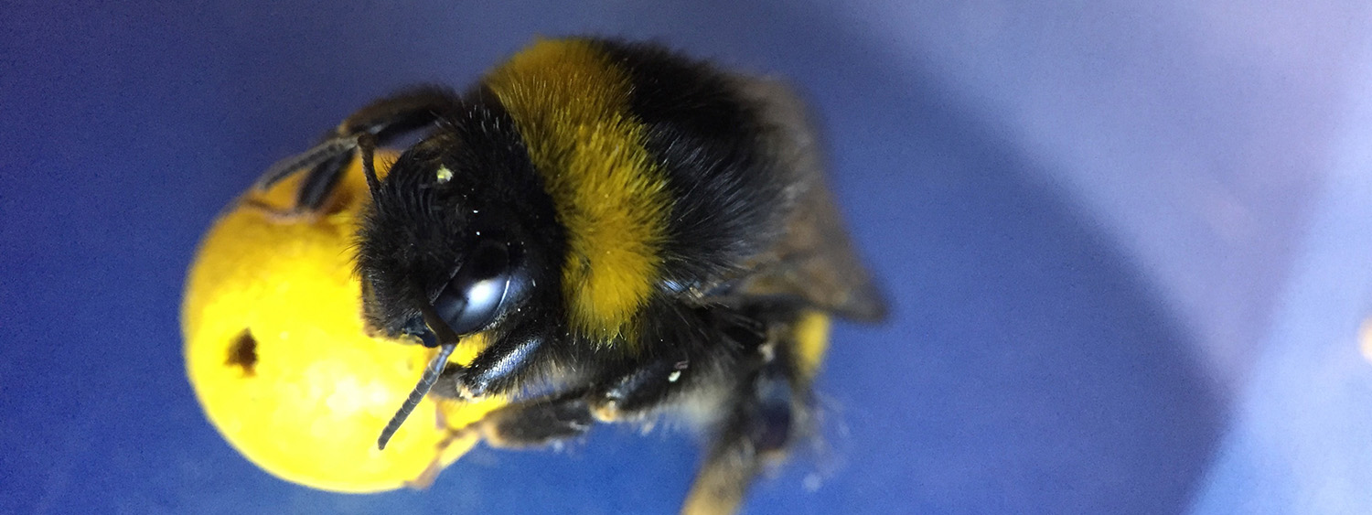
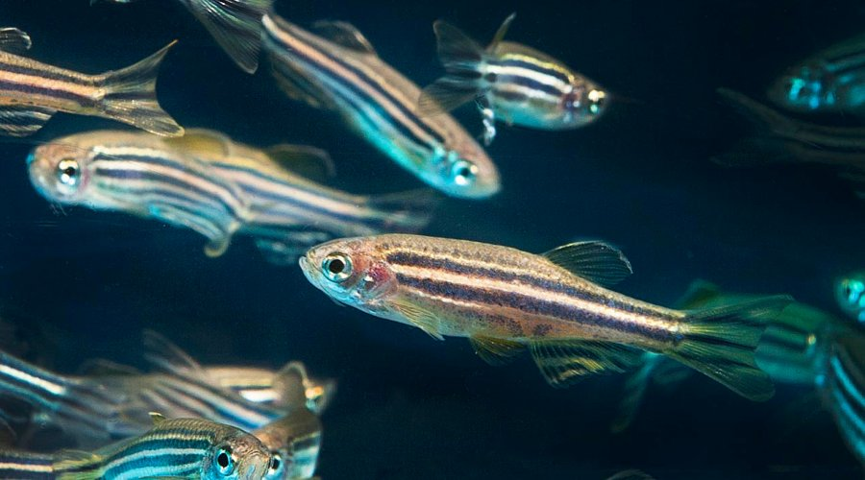
Example topics – Comparative psychology
These are just examples
Awareness and pain in insects
Predispositions in chicks
Imprinting in chicks
Behavioral analysis using zebrafish

Slide 12
Example topics – Developmental psychology
These are just examples
Early cognition
Social preferences
Lateralisation in spontaneous behavior
Identifying predictors of positive development

Slide 13
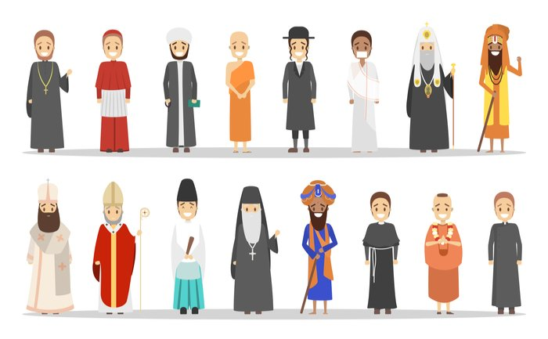
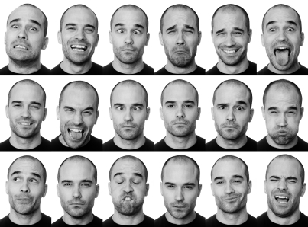
Example topics – Individual differences
These are just examples
Personality and Temperament
Religious beliefs, environmental beliefs
Individual differences in environmental sensitivity
Identifying predictors of future orientation
Individual differences in gesture production and comprehension

Slide 14
Example topics – Mental health and Well being
These are just examples
Mental Health
Resilience
Positive Psychology, including school-based positive psychology
Games and wellbeing
Social psychology of health and well-being
Covid-related mental health
Oestrogen and quality of life/well being
Authenticity
Subjective vitality

Slide 15
Example topics – Social psychology
These are just examples
Groups, identity, self
Social interactions, aggression
Empathy
Social psychology of health and well-being
Social cognition, cognition under stress
Stereotyping/Prejudice
Intergroup Relations
Influence of fear and anger on social cognition
Music and prosocial behaviour
Group bias
Prosocial behaviour

Slide 16
Example topics – Psychology of education
These are just examples
Key predictors of academic performance
Student well being/loneliness
Student mental health during Covid
Student satisfaction at University
Best strategies for remote learning/teaching
Play behaviour
Psychology of games, gamification
Creativity

Slide 17
Dissertation project: process
Supervisors and students are matched based on topic rankings
Supervisors generally provide a choice of 2-3 projects for students to choose
Based on project preferences, students will work either individually or in a group

Slide 18
Dissertation project: group work
Great for practicing team work skills
Allows you to collect a larger dataset
Makes it easier to discuss your work with your peers
All assessment is based on your individual work

Slide 19
Dissertation project: engagement
You should take ownership of your project
Be proactive
Once you’re assigned a supervisor, get in touch early on to discuss the dissertation process

Slide 20
Dissertation: Next Steps
You will be asked to fill out a survey in May, 2024, including questions like:
General Topic Preference
i.e., Social Psychology, Cognitive Psychology
Preference for data collection or secondary data analysis
Preference for quantitative vs qualitative
You will be assigned a dissertation supervisor who matches your preferences in late August/Early September

Slide 21
Enjoy!
Any Questions?

