Slide 2
EU research funding Horizon Europe
30 November 2021
Natalie Nestorowicz (EU Pre-Award Officer)
Grant funding event @ School of Mathematical Sciences

Slide 3
Overview
QM and UK performance under Horizon 2020 (2014-2020)
Overview of Horizon Europe (2021-27)
Structure
Funding Opportunities (Bottom-up)
European Research Council (ERC)
Marie Curie Sklodowska Actions (MSCA)
Additional Resources

Slide 4
QM and UK performance under H2020 Awards
QMUL H2020 awards total €63.47m to date:
€21.44m under European Research Council frontier research (investigator driven).
€9.4m Marie Skłodowska-Curie Actions (MSCA) awards for doctoral training networks (EU partners required)
€13m for individual post doc fellowships.
€17.8m under R&D collaborative schemes (policy-driven call topics). Health most successful, followed by ICT and advanced materials.
UK overall success rate: 14.75%, awarded €7.14bn, 9,802 participations

Slide 5
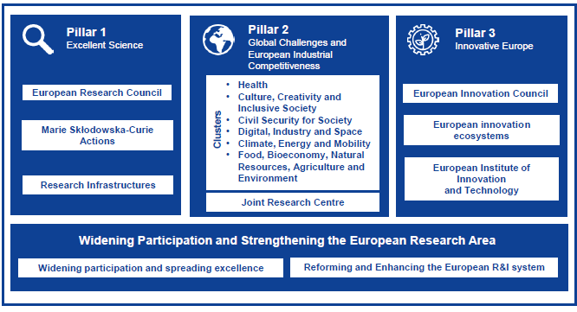
Horizon Europe structure
POLICY DRIVEN
R&D collaborative calls €53.8bn
Scientific excellence
researcher dev & mobility
€24.9bn
Scale up
innovative tech
€13.4bn
R&I capacity building re lower performing countries

Slide 6
European Research Council (ERC)
Established to fund the highest quality research in Europe in any research area.
Encourages researchers to go beyond established frontiers of knowledge and undertake multidisciplinary, highly ambitions, innovative research.
No mobility or nationality requirements
No need for multi-national partnerships or consortium -> PI works on a research topic of own choice, with a team of own choice
Need one host organization located in the EU Member State (MS) or Associated Country (AC)
Provides attractive, long-term funding up to 5 years for PI to gain financial autonomy and attract top team members
BOTTOM-UP, CURIOSITY-LED EXCELLENT RESEARCH

Slide 7
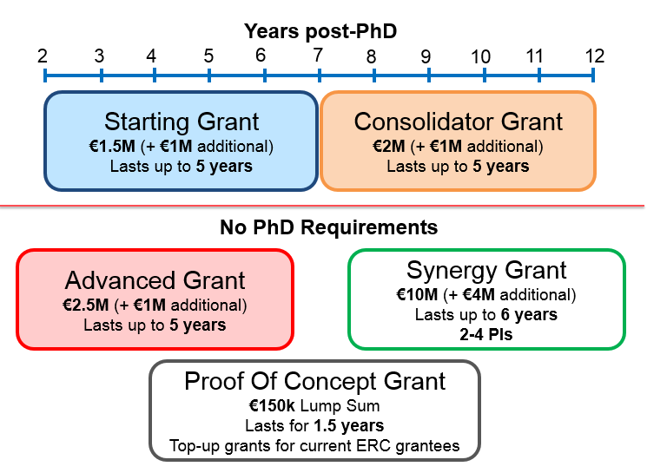
ERC Grant Schemes

Slide 8
ERC Deadlines in 2022
 | Starting Grant | Consolidator Grant | Advanced Grant
Work Programme | 2022 | 2022 | 2022
Call opens | 23/09/2021 | 19/10/2021 | 20/01/2022
Call Deadline | 13/01/2022 | 17/03/2022 | 28/04/2022
Budget €M | 757 | 784 | 561

Slide 9
ERC Resources
ERC website: http://erc.europa.eu/
ERC Classes videos on how to apply to the ERC: https://www.youtube.com/watch?v=xbFbzkVWgCU&list=PLtv6FnsXqnXAYRk6HCErwMxwML0ZKoMcy
UK Research Office National Contact Point for ERC: www.ukro.ac.uk/erc
URKO Webinars on ERC schemes (recordings and presentation slides available): https://www.ukro.ac.uk/erc/Pages/events.aspx
JRMO EU Unit SharePoint Portal with ERC Resources (FAQ, proposal template, guidance notes, etc.): https://qmulprod.sharepoint.com/sites/JRMO-EU-Unit-Portal/SitePages/European-Research-Council-in-Horizon-Europe.aspx
EU Unit Webinar ‘How to prepare a competitive bid with Panel of QM ERC grant holders’ : https://qmulprod.sharepoint.com/sites/JRMO-EU-Unit-Portal/SitePages/Past-Webinars.aspx

Slide 10
Marie Sklodowska-Curie Actions (MSCA)
Key features:
completely bottom-up and open to all areas of research
support the training and career development of researchers through mobility between countries and sectors.
Two most popular MSCA schemes:
MSCA Doctoral Networks (formerly known as ITN in H2020)
MSCA Postdoctoral Fellowships (formerly known as Individual Fellowships in H2020)

Slide 11
MSCA Doctoral Networks (formerly ITN)
Key features:
Aim to support joint research training and doctoral programmes in collaboration between the academic and non-academic sectors to train a new generation of creative and innovative early career researchers
Mobility is key – intersectoral, interdisciplinary and international
Consortium of at least three independent legal entities, each established in a different EU Member State or Horizon Europe Associated Country and with at least one of them established in an EU Member State
Full funding for 10-15 PhD students (depending on doctoral network type) for up to 36 months including living, mobility and family allowances. Project maximum is 48 months
Eligibility :
Early-Stage Researcher (ESR) not already in possession of a doctoral degree and enrolled on a PhD programme.
Researchers of any nationality but they may not have resided or carried out their main activity (work, studies etc.) in the country of their (main) host organisation for more than 12 months in the 36 months immediately before the recruitment date.
next call opens 3 May 2022, Deadline: 15 November 2022

Slide 12
MSCA Postdoctoral Fellowship (formerly IF)
Key features:
Aim to support mobility and career development of researchers in and outside academia.
European Fellowships: 12-24 months
Global Fellowships: 24-36 months (12-24 outgoing phase & 12 months mandatory return phase in Europe)
Secondments worldwide up to 1/3 of the fellowship duration with an optional additional placement of up to 6 months in a non-academic European organisation at the end of the fellowship applicable to both European and Global PF
Eligibility :
A PhD at the time of submission, with no more no-more than 8 years of full-time research experience after PhD
Researchers of any nationality but may not have resided or carried out their main activity (work, studies etc.) in the country of their (main) host organisation for more than 12 months in the 36 months immediately before the call deadline.
next call opens 13 April 2022, Deadline: 14 September 2022

Slide 13
MSCA PF – Why apply?
For supervisors/departments: Opportunity to recruit best & most talented researchers from across the world share/transfer knowledge build up international collaborations create new interdisciplinary/intersectoral links raise international profile fully funded PDRA with additional administrative budget for the host institution | For the fellow: Good salary for fellow and research budget ‘Bottom up’ = any research topic Exposure to different research environment and culture via host and leading academic supervisor and their labs/research groups Option for secondment/short visits, build international relationships Enhanced career development and employability
UK Success rate (2020) average = 15,4% - Europe-wide success rate (14% average)
QMUL 69 fellowships to date, ranked 9th in the UK and 18th in Europe
*UK most successful country in IF 2020 with 311 awards!

Slide 14
MSCA Resources & next steps
MSCA website: https://ec.europa.eu/research/mariecurieactions/
URKO Webinars on MSCA schemes (recordings and presentation slides available): https://www.ukro.ac.uk/mariecurie/Pages/events.aspx
JRMO EU Unit SharePoint Portal with MSCA Resources (proposal template, guidance notes, etc.):
Next steps:
READ Horizon Europe MSCA (2021-22) work programme
Watch EC and UKRO recordings and webinars slides
Plan your research & training project as against EC template criteria, use EC templates for proposal – draft early!
CONTACT EU Unit to discuss your proposal idea and eligibility queries etc.

Slide 15
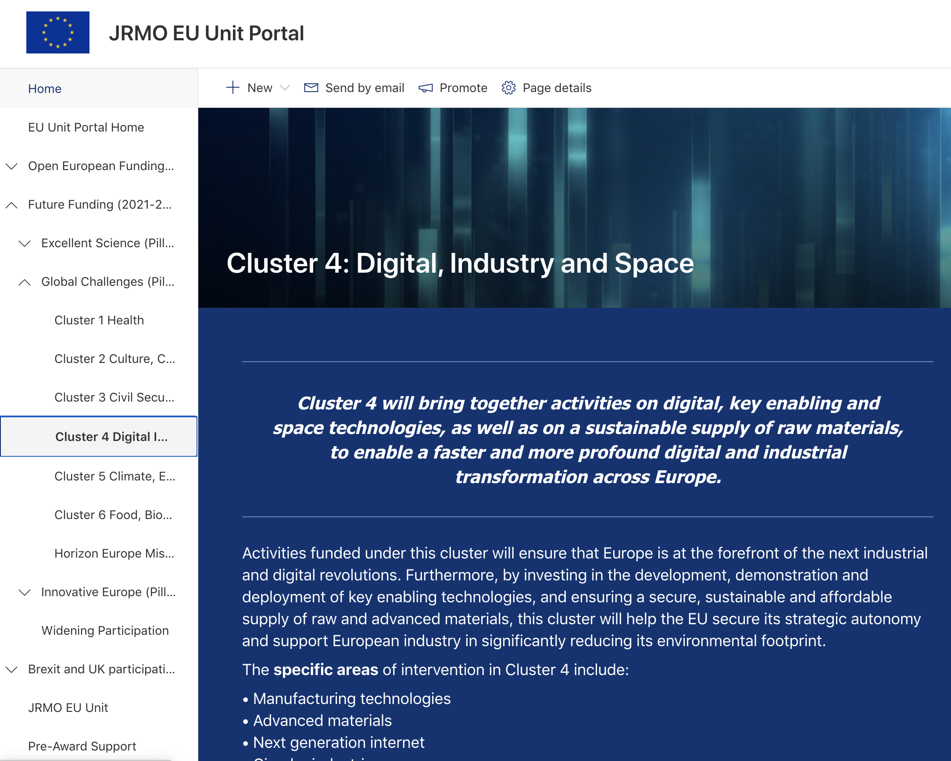
Where to find more information and updates?
Visit our JRMO EU Unit Portal
Open European Funding Calls
Horizon Europe overview
Work programmes with call topics
Guidance notes
News & events
Past & future webinars
Follow us on Twitter @EUQmul
JRMO EU Unit Portal: https://qmulprod.sharepoint.com/sites/JRMO-EU-Unit-Portal/

Slide 16
Thank you for your attention!

