Slide 1
Impact in Mathematics
Queen Mary Impact Team
impact@qmul.ac.uk

Slide 2
What is impact?
The contribution, effect on, or benefit that excellent research makes to:
Culture and society (public understanding, social enrichment)
The economy or commerce (commercialisation, investment)
Health, welfare or the NHS (clinical guidelines, patient benefits)
Policy (change or update)
The environment (conservation or protection initiatives)
Services (organisational effectiveness or practices)
Beyond academia i.e not academic impact
www.qmul.ac.uk/research/research-impact/
@QMULimpact

Slide 3
What is not impact?
Patents
Media interest
Public engagement activities
Collaborations
Presentations (at meetings/events) or dissemination
Impact from the above = demonstrable changes in:
Interest/understanding/behaviour
Processes/policies/priorities/recommendations
www.qmul.ac.uk/research/research-impact/
@QMULimpact

Slide 4
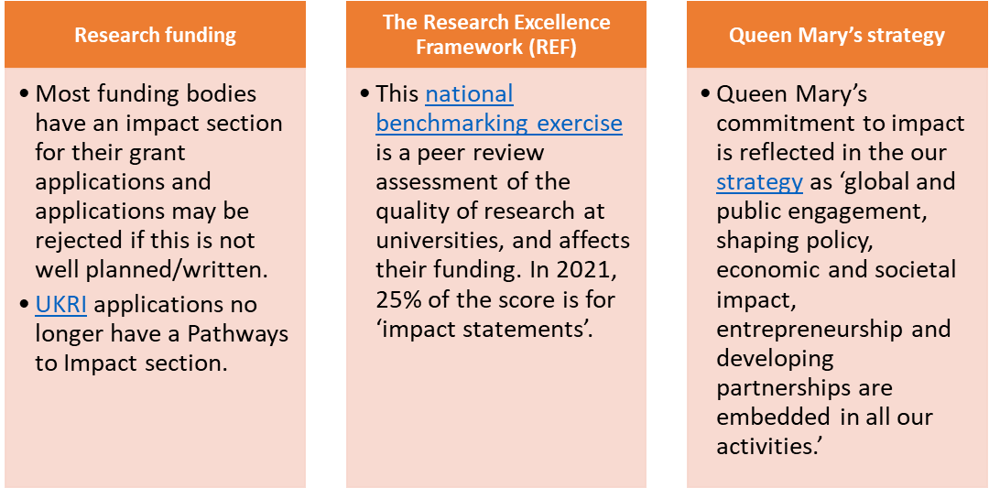
Why is impact important?
UKRI exists to fund the researchers who generate the knowledge that society needs, and the innovators who can turn this knowledge into public benefit.
www.qmul.ac.uk/research/research-impact/
@QMULimpact

Slide 5
Next steps: Support from Queen Mary’s Impact Team
Advice:
Impact drop-ins
1-2-1 support for grant applications
Support:
Relationships with external partners to evidence impact
Raising the profile of QMUL’s impact internally and externally e.g websites, showcases, awards
www.qmul.ac.uk/research/research-impact/
@QMULimpact

Slide 6
Next steps: Support from Queen Mary’s Impact Team
Our team administers the QM Impact Fund programme through UKRI’s Impact Acceleration Account.
Proposals up to £10,000 for small projects and up to £50,000 for large projects; next call October 2021 onwards
For more information about our IAAs please email: impact-acceleration@qmul.ac.uk
www.qmul.ac.uk/research/research-impact/
@QMULimpact

Slide 7
Other Impact Support at QMUL
Business Development Team: identify business and industry partners, support grant applications
Queen Mary Innovation: Proof of Concept funding, licensing and spin out creation
Centre for Public Engagement: advice, funding and training
Events team, Design and Branding team, Widening Participation team, Public Relations team, Centre of the Cell
www.qmul.ac.uk/research/research-impact/
@QMULimpact

Slide 8
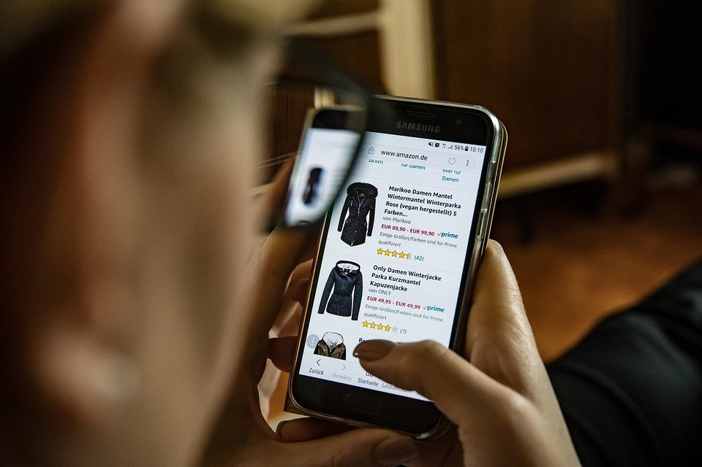
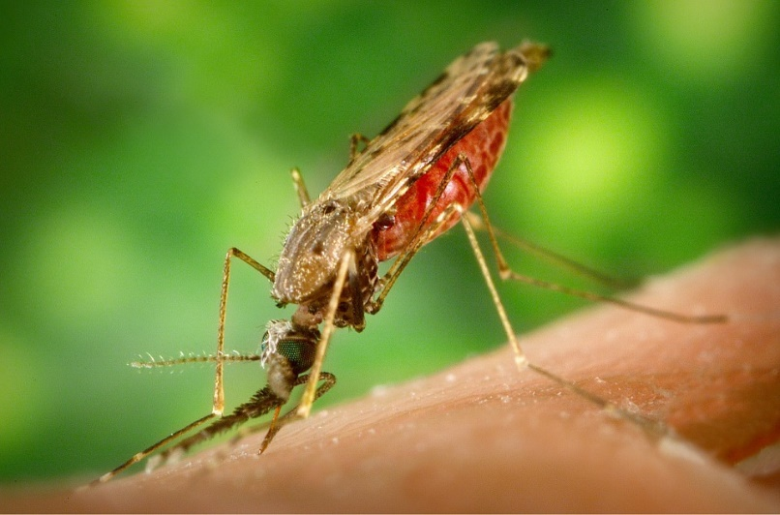
REF 2021 submissions
Tooso
First algorithm to predict visitor intent on e-commerce sites
Creates a personalised browsing experience in real time for its clients
Bought by the billion-dollar technology firm Coveo, resulting in significant investment
Malaria
Advanced modelling used to reveal the most cost-effective interventions to combat malaria
These strategically redirected funds saved thousands of lives and reduced the number of new malaria cases by millions
www.qmul.ac.uk/research/research-impact/
@QMULimpact

Slide 9
Applying Mathematics to Impact
As shown from the two REF case study examples in the previous slide, Mathematics can be applied to many different academic disciplines. As a result it is worth concluding by saying that there are actually many different ways you can achieve impact in Mathematics, even if they don’t necessarily appear obvious at first. And if you’re unsure, just ask!
www.qmul.ac.uk/research/research-impact/
@QMULimpact

Slide 10
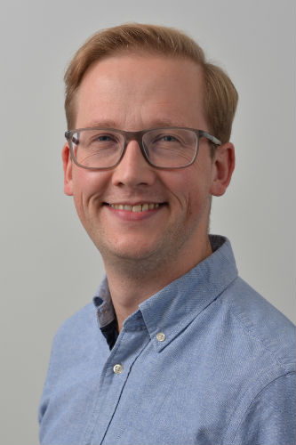
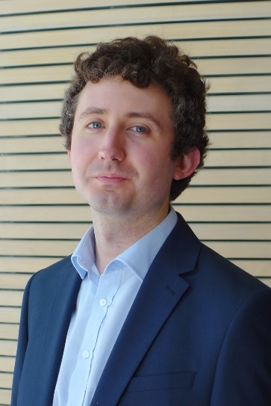
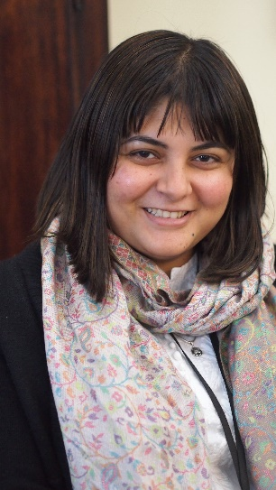
Who’s Who in Queen Mary’s Impact Team
John Moriarty, Impact Lead j.moriarty@qmul.ac.uk
Luke Cridland, Impact Officer
l.cridland@qmul.ac.uk
Reetika Suri, Impact Officer (maternity leave)
r.suri@qmul.ac.uk
www.qmul.ac.uk/research/research-impact/
@QMULimpact

Slide 11
Impact in Mathematics
Queen Mary Impact Team
impact@qmul.ac.uk

