Slide 1
Athena Swan Roadshow:
Institutional Application and Gender Impact Plan

Slide 2
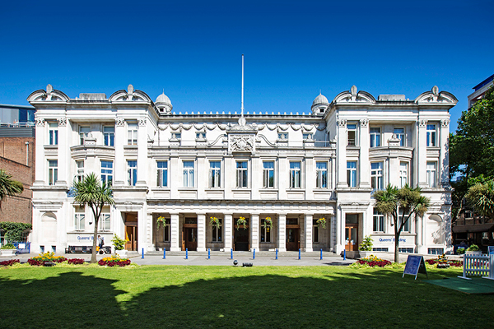
Context
Queen Mary has a long-standing commitment to tackling gender inequalities
At an Institutional level a track record of successful awards, including our first Silver in November 2016.
Silver (Post-May 2015) Institutional Athena Swan submitted to Advance HE January 2022 Round - successfully result communicated awarded in March 2022
The application, in particular the Gender Impact Plan aspect, supports our Strategy 2030 mission to be ‘the most inclusive university of its kind, anywhere’ and our EDI KPIs

Slide 3
Athena Swan submission requirements
To achieve a Silver Institutional Award, Queen Mary had to demonstrate a number of criteria:
Undertake a thorough self-assessment via required qualitative and quantitative data.
Provide a SMART (specific, measurable, achievable, relevant and time-bound) five-year action plan based of the findings of our self-assessment analysis.
Demonstrate organisational structures to deliver against the action plan.
Articulate evidence of impact and progress since the 2016 application.

Slide 4
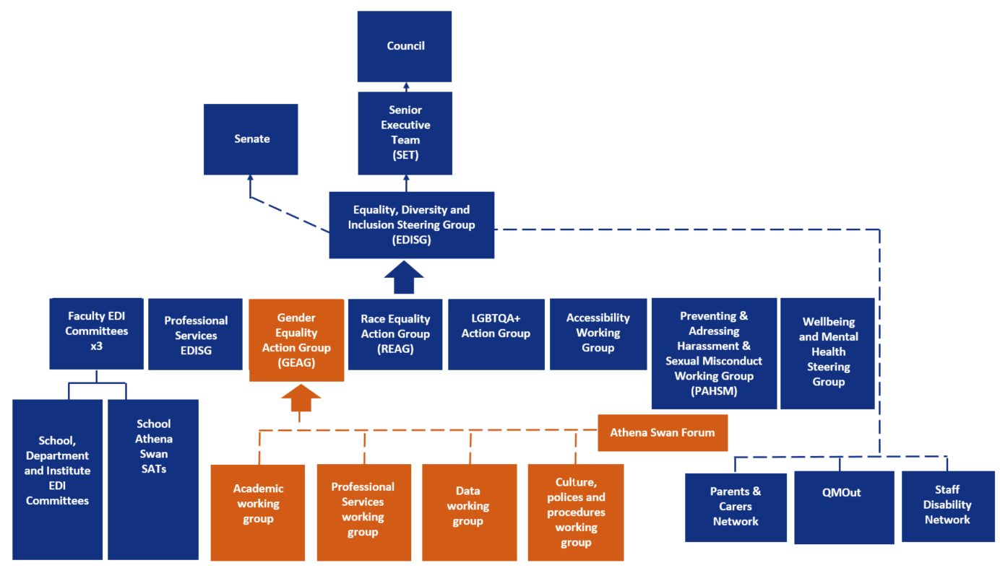
The self-assessment process: governance

Slide 5
The self-assessment process
The self-assessment process for the submission took place over 2019/20-2020/21 and was overseen by the Gender Equality Action Group (GEAG), chaired by the Vice-Principal PCI. The collection and analysis of data and identification of issues was undertaken by four working groups made up of diverse colleagues from across the institution.
The application draws upon an extensive array of quantitative data by gender including by not limited to: students by level of study; staff by profile, grade, contract type and mode; staff recruitment; staff promotion and progression; staff appraisal; REF returns; training; parental leave uptake; senior leadership and committees.
Staff feedback and perceptions were collated from a number of sources including the 2019 Staff Survey, the 2021 Athena Swan Survey, the 2021 Parents and Carers Survey, and 2021 Carers’ focus groups. Narrative has been drafted by the EDI Manager in consultation with GEAG working groups and their chairs, technical experts (HR, QM Academy, Strategic Planning), and academic and professional services staff with significant experience of leading School Athena Swan applications (across all Faculties).

Slide 6
Headline findings
Impact:
Closing gender attainment gap between undergraduate students
Reducing gender pay gap, and closing the median bonus pay gap in 2020
Reducing the overrepresentation of women on Fixed Term Contracts
Increasing the proportion of women at Lecturer level through to Reader
Increasing the diversity of leaders at Board level, with more women than ever before
Promoting a record number of Black and Ethnic Minority women

Slide 7
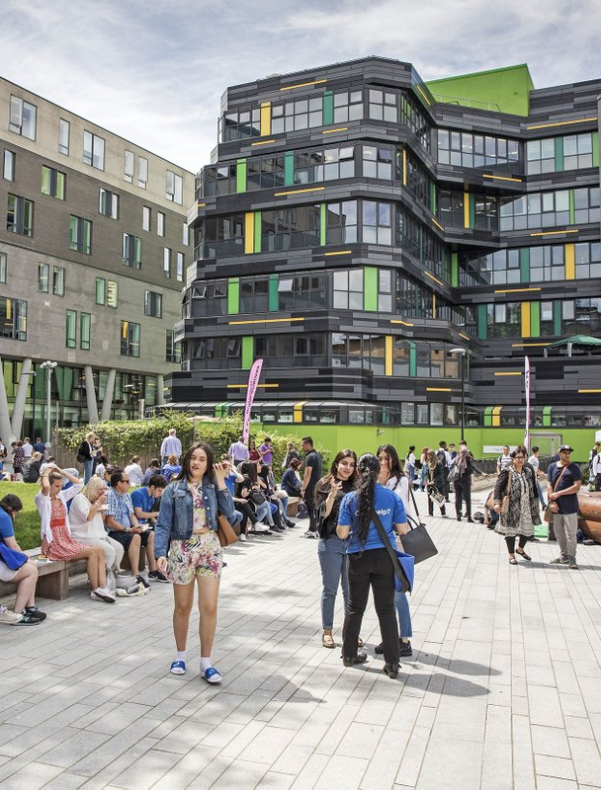
Gender Impact Plan – 2022-2027
The Gender Impact Plan has been developed in accordance with Athena Swan action plan requirements and aligns with issues identified throughout the application. It includes a combination of already planned actions with the gendered element specified and new actions. New actions include:
Piloting Athena Swan in at least two Professional Service Directorates
Providing bespoke support for carers
Undertaking intersectional (gender and ethnicity) pay gap reporting
Building on Schools’ good practice of Returners Schemes to support those returning from parental leave (>3 months)
Scoping suitable models for enhancements for parental leave

Slide 8
Engaging at a Local Level
Read and share the executive summary
If the School currently holds and Athena Swan awards - consider how and which aspects of the Gender Impact Plan could be embedded into action plans, as these are live documents
Review and update EDI action plans that were submitted to EDISG in June 2021 – are there aspects of the Gender Impact Plan that would be suitable to incorporate?
Individuals updating personal details on MyHR – it only takes a few minutes and can be found in the ‘Equal Opportunities’ tab. This information will help inform the work of the Equality, Diversity & Inclusion (EDI) Team, allowing them to better understand staff demographics across the University.

Slide 9
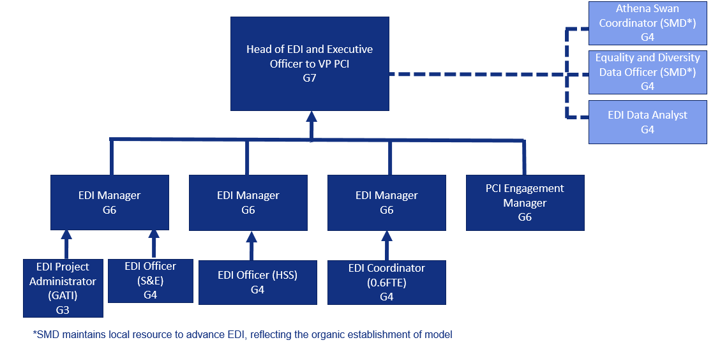
Get in touch!
Eleanor McDavis – Equality, Diversity and Inclusion Manager (until end of April 2022 then new EDI Manager with the gender portfolio starts)
Darren Hunwicks – Equality, Diversity and Inclusion Officer

Slide 10
