Slide 1
Thyroid Examination Revision
Dr Will Ricketts
Clinical Teaching Fellow
with thanks to
Dr Khalid Malik

Slide 2
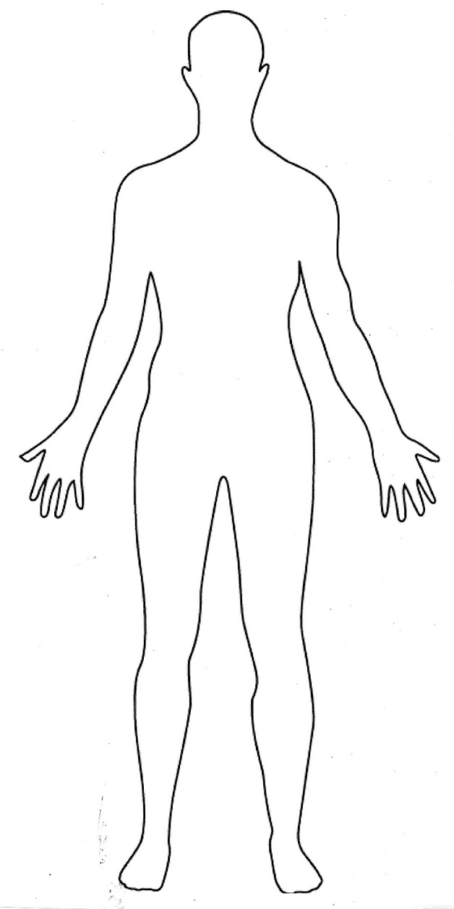
Examination of Thyroid– Basic Structure
Introduction
Inspection
Hands
Arms
Face and Eyes
Thyroid
Inspect
Palpate
Percuss
Auscultate
Lower limbs
Completing the examination

Slide 3
Introduction - WIPER
WASH YOUR HANDS!
Introduce yourself & Consent
Position the patient (seat patient upright with access to examine them from in front and directly behind)
Expose the patient (expose the patients neck fully)
Retreat....

Slide 4
Structure
Introduction
Inspection
Hands
Arms
Face and Eyes
Thyroid
Inspect
Palpate
Percuss
Auscultate
Lower limbs
Completing the examination
Look around the bed/chair for
Medications
Cardiac monitoring – ECG
Observations chart
Well/unwell
Appropriately dressed for room temperature/weather
Hot/sweaty or Cold/shivery
Composure (anxious/fidgety/restless or lethargic/immobile)
Over/underweight
Obvious neck lumps/swellings
Condition of hair (dry, thin?)
Plethora
Eyebrows – loss of outer third
Comment on hoarseness of voice

Slide 5
Structure
Introduction
Inspection
Hands
Arms
Face and Eyes
Thyroid
Inspect
Palpate
Percuss
Auscultate
Lower limbs
Completing the examination
Feel the temperature of the skin
Look for:
Dry/greasy skin
Palmar erythema/sweating
Hypercarotenaemia
Areas of vitiligo
Thyroid acropachy
Oncholysis
Examine for Fine Tremor
Check Radial Pulse

Slide 6
Structure
Introduction
Inspection
Hands
Arms
Face and Eyes
Thyroid
Inspect
Palpate
Percuss
Auscultate
Lower limbs
Completing the examination
Blood Pressure (Ask)
*Pemberton’s Sign
*Proximal Myopathy
*Reflexes
*Can be done at end as part of ‘completing the examination’

Slide 7
Structure
Introduction
Inspection
Hands
Arms
Face and Eyes
Thyroid
Inspect
Palpate
Percuss
Auscultate
Lower limbs
Completing the examination
Face/Head
Puffy face
Thickened skin
Alopecia
Vitiligo
Thin scalp hair
Glossitis

Slide 8
Structure
Introduction
Inspection
Hands
Arms
Face and Eyes
Thyroid
Inspect
Palpate
Percuss
Auscultate
Lower limbs
Completing the examination
Eyes
Inspect for:
Loss/thinning of lateral 1/3 eyebrow
‘Thyroid stare’ – Lid Retraction
Periorbital oedema
Exopthalmos + Complications:
Chemosis
Conjunctivitis
Corneal ulceration
Optic atrophy
Examine for:
Eye movements/Lid Lag
Visual Acuity

Slide 9
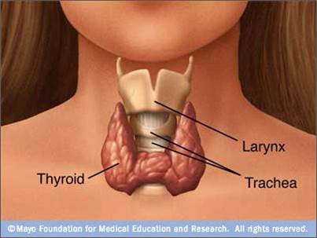
Structure
Introduction
Inspection
Hands
Arms
Face and Eyes
Thyroid
Inspect
Palpate
Percuss
Auscultate
Lower limbs
Completing the examination

Slide 10
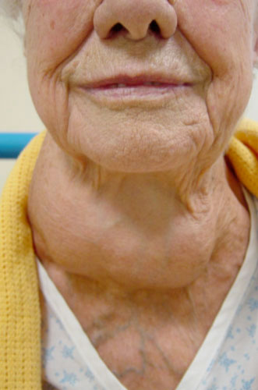
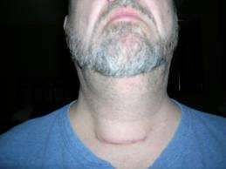
Thyroid – Inspection
Inspect from FRONT AND SIDE for:
Enlargement of the neck/Goitre
Scars/Skin Changes
Dilated Veins
Swallow
Thyroglossal Cyst – “stick out tongue”
Goitre
Thyroidectomy Scar

Slide 11
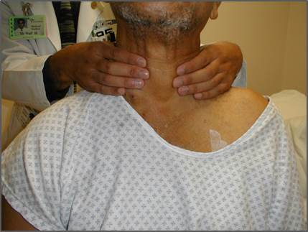
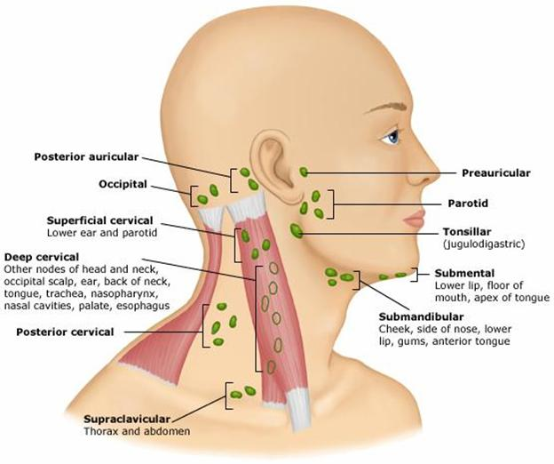
Thyroid – Palpation
Tracheal Deviation
From BEHIND
Palpate both lobes + isthmus consider:
Size
Shape (Smooth vs. Irregular)
Consistency (Hard vs. compressible)
Tenderness (thyroiditis)
Mobility – Swallow
Lymph Nodes

Slide 12
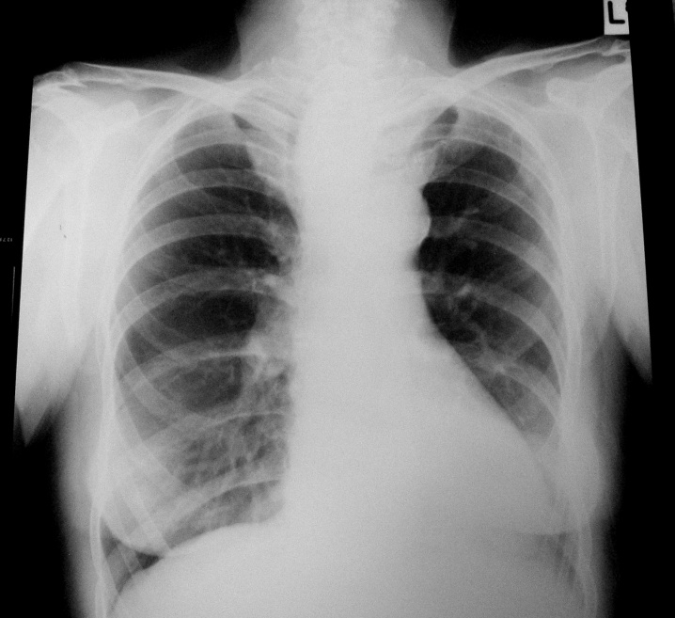
Thyroid – Percussion
The upper part of the manubrium from side to side –
Change from Resonant → Dull = Retrosternal Goitre
Retrosternal Extension

Slide 13
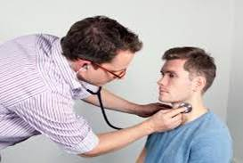
Thyroid – Auscultation
Listen over each lobe for bruits (Graves or hyperthyroidism)

Slide 14
Structure
Introduction
Inspection
Hands
Arms
Face and Eyes
Thyroid
Inspect
Palpate
Percuss
Auscultate
Lower Limbs
Completing the examination
Pre-tibial myxoedema
Non-pitting oedema
Proximal Myopathy
Reflexes

Slide 15
Structure
Introduction
Inspection
Hands
Arms
Face and Eyes
Thyroid
Inspect
Palpate
Percuss
Auscultate
Lower limbs
Completing the examination

Slide 16
Completing the examination
Chest
Inspect for Gynaecomastia – Hyperthyroidism
Auscultate Heart
Look for signs of associated Autoimmune Disease:
Vitiligo
Hyperpigmentation, Postural Hypotension– Addison’s
Type 1 Diabetes
Malnutrition – Coeliac Disease
Thank the patient
WASH YOUR HANDS!!

Slide 17
Examination stations
Instructions in the OSCE:
Examine this patient’s THYROID STATUS =
complete full thyroid examination
Examine this patient’s THYROID GLAND =
Examine neck/thyroid only
Examine this patient’s NECK =
Could be As Above
Could be – Examination of a NECK LUMP
READ THE INSTRUCTIONS CAREFULLY!!

