Slide 1
Respiratory Examination
Dr Will Ricketts
Clinical Teaching Fellow, Bart’s Health NHS Trust
Honorary Lecturer, QMUL
thanks to
Ruth Taylor

Slide 2
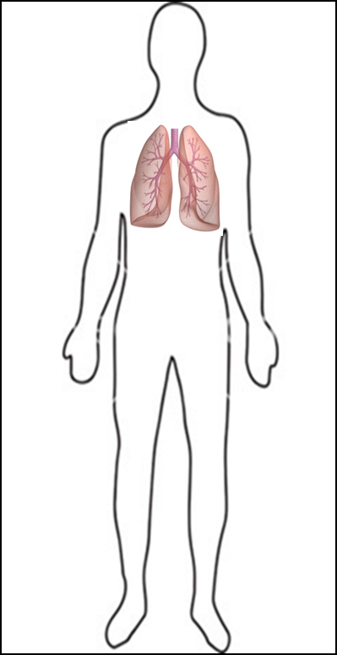
the order...
Introduction
Inspection
Hands
Arms
Face
Neck
Cervical Lymph Nodes
The Chest
Observe
Palpate
Percuss
Auscultate
Completing the examination

Slide 3
Introduction – WIPER
WASH YOUR HANDS
Introduce yourself
Position the patient at 45°
Expose the patient (chest exposed)
Retreat…….

Slide 4
the order…
Introduction
INSPECTION
Hands
Arms
Face
Neck
Cervical Lymph Nodes
The Chest
Observe
Palpate
Percuss
Auscultate
Completing the examination

Slide 5
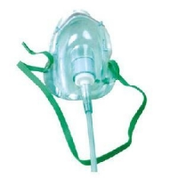
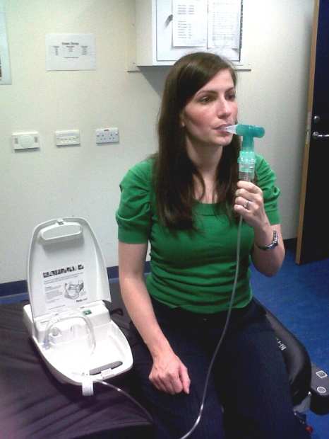
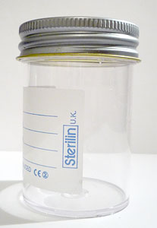
inspection
General inspection from the end of bed
Look around bed for:
Oxygen masks
Nebulisers
Inhalers
Sputum pots
Medications
Sat’s monitor

Slide 6
Inspection (2)
Well/Unwell
Breathing at rest – Comfortable/Dyspnoea
Added Sounds:
Cough
Wheeze
Stridor
Scars
Chest Shape
Chest Movements
Asymmetrical Chest Expansion
Accessory Muscle use
Sub-Costal/Inter-Costal Recession
Peripheral Oedema
Peripheral Cyanosis

Slide 7
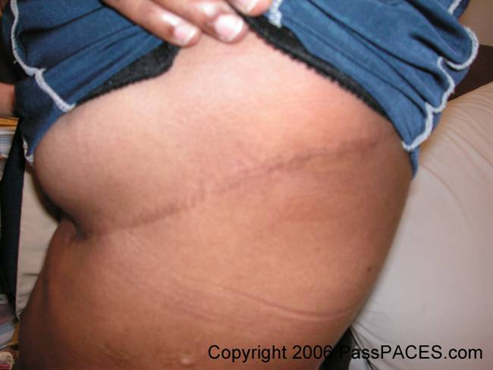
What’s this?
Lateral Thoracotomy Scar

Slide 8
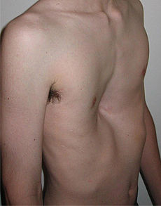
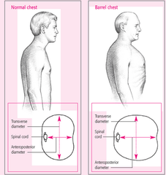
Inspection (3)
Pectus Excavatum
Pectus Carinatum
Barrel Chest

Slide 9
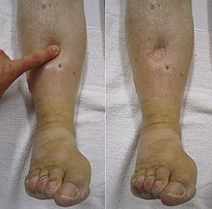
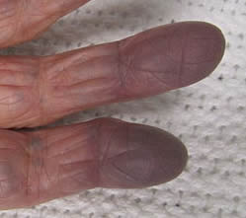
Inspection (4)
Peripheral Oedema
Peripheral Cyanosis

Slide 10
The order….
Introduction
Inspection
HANDS
Arms
Face
Neck
Cervical Lymph Nodes
The Chest
Observe
Palpate Percuss
Auscultate
Completing the examination

Slide 11
Hands – OBSERVE
Peripheral Cyanosis
Blue nail beds
Tar Stains
Clubbing – (ABCDEF)
Asbestosis/Abscess
Bronchiectasis
Bronchial Carcinoma
Cystic Fibrosis
Decreased O₂ (hypoxia)
Empyema
Fibrosis
Clubbing

Slide 12
Hands – OBSERVE (2)
Additional Movements?
Resting tremor
β-agonist use
CO₂ Retention Flap

Slide 13
Hands – PALPATE
Radial pulse
Rate
Rhythm
Character
Bounding = CO₂ Retention
Check Respiratory Rate at same time (whilst patient distracted by pulse check)
Normal ≈ 12-20 bpm
Temperature change
(warm and well perfused?)

Slide 14
The order…
Introduction
Inspection
Hands
ARMS
Face
Neck
Cervical Lymph Nodes
The Chest
Observe
Palpate
Percuss
Auscultate
Completing the examination.

Slide 15
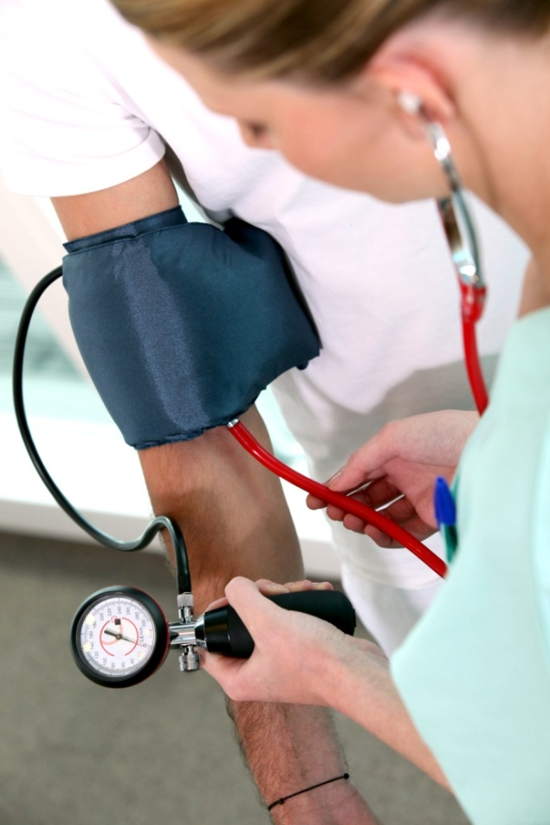
Arms
Ask for blood pressure

Slide 16
THE ORDER…
Introduction
Inspection
Hands
Arms
FACE
Neck
Cervical Lymph Nodes
The Chest
Observe
Palpate
Percuss
Auscultate
Completing the examination.

Slide 17
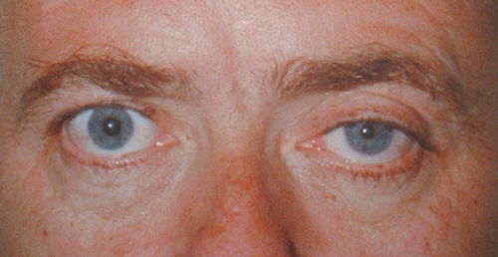
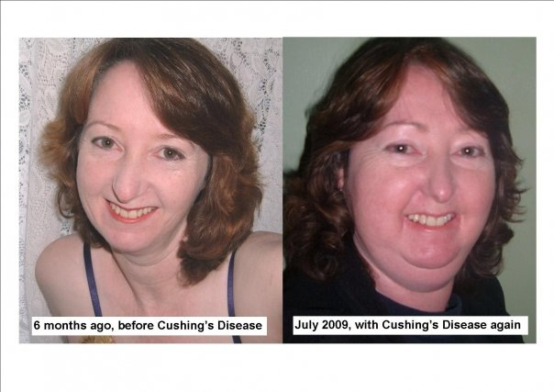
FACE
Horner’s Syndrome
Eyes
Conjunctival Pallor
Horner’s Syndrome
Ptosis
Miosis
Anhidrosis
Possible apical ‘Pancoast’s’ Tumour
Face
Plethora
Cushingoid facies = “Moon Face”
Mouth
Central Cyanosis
Cushingoid Facies

Slide 18
An Aside!
Cushing’s Syndrome
Horner’s Syndrome
Little Jack Horner eSSATT in the corner
There with his sunken eye
His small pupil hid
Under his poor drooping lid
With the side of his face crisp and dry!
eSSATT =
Encephalitis
Stroke
Syrinx
Aneurysm – Carotid (or Dissection)
Tumour
Trauma

Slide 19
The order…
Introduction
Inspection
Hands
Arms
Face
NECK
Cervical Lymph Nodes
The Chest
Observe
Palpate
Percuss
Auscultate
Completing the examination.

Slide 20
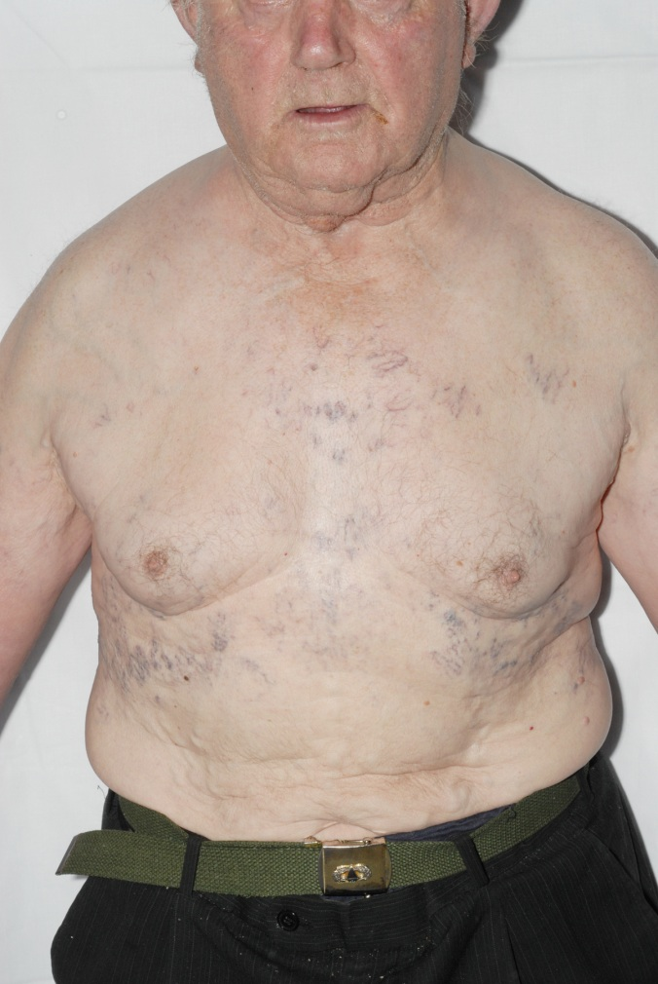
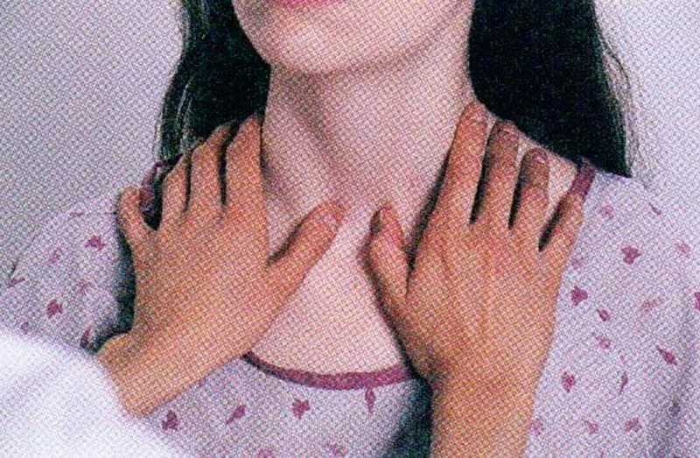
Neck
Observe:
JVP:
Raised ?Cor Pulmonale
Raised + Fixed
?SVC Obstruction
Obvious lymph nodes +/- discharging sinuses
Palpate:
Trachea:
Position
Tug

Slide 21
THE ORDER…
Introduction
Inspection
Hands
Arms
Face
Neck
CERVICAL LYMPH NODES
The Chest
Observe
Palpate
Percuss
Auscultate
Completing the examination.

Slide 22
Neck – palpate cervical lymph nodes
Palpate all Lymph Node Groups – Best done with Finger Tips from Behind
Preauricular
Posterior auricular
Occipital
Posterior cervical chain
Supraclavicular
Submandibular
Submental
Causes
Infection – TB
Malignancy

Slide 23
The order…
Introduction
Inspection
Hands
Arms
Face
Neck
Cervical Lymph Nodes
THE CHEST
Observe – As above
Palpate
Percuss
Auscultate
Completing the examination

Slide 24
chest – palpation
Apex Beat
If Displaced consider:
Pleural effusion
Pneumothorax
Difficult to feel in hyper expansion
Right Ventricular Heave
Cor pulmonale
Chest Expansion
Normal >5cm

Slide 25
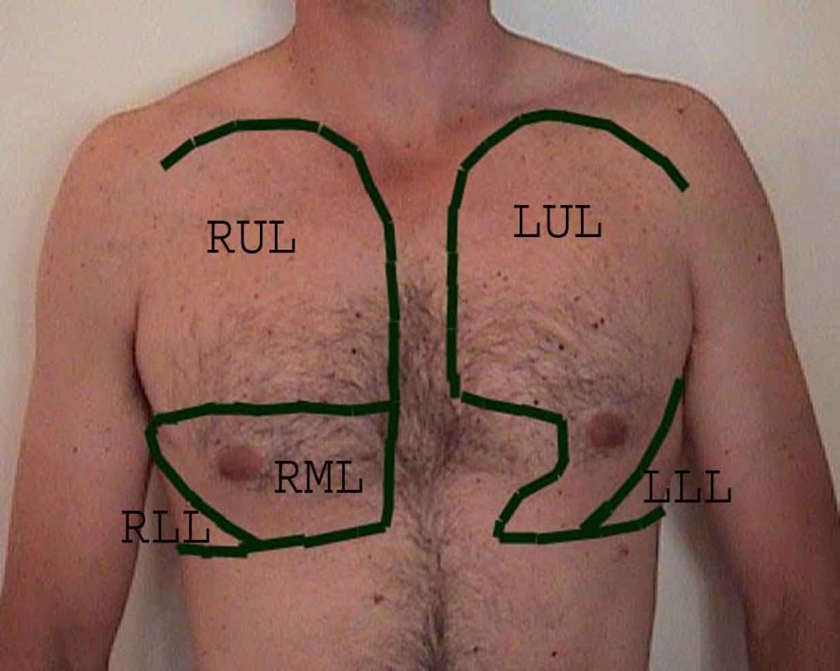
chest – pattern of examination Anterior
Palpate – Tactile Vocal Fremitus (TVF)
Percuss
Auscultate
All performed in same order:
Start anteriorly:
Zig-Zag left/right
Top to bottom
Cover
Upper
Middle Zones
Lower
Compare one side with other
Repeat Laterally & Posteriorly

Slide 26
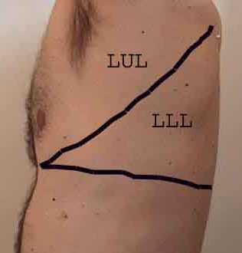
chest – pattern of examination Lateral
Again Compare Sides

Slide 27
chest – palpation tactile vocal fremitus
Palpate with ulnar border of your hand
Ask patient to repeat “Ninety-Nine”
Assess all zones in zig-zag manner
Note if
Increased
Decreased
Absent

Slide 28
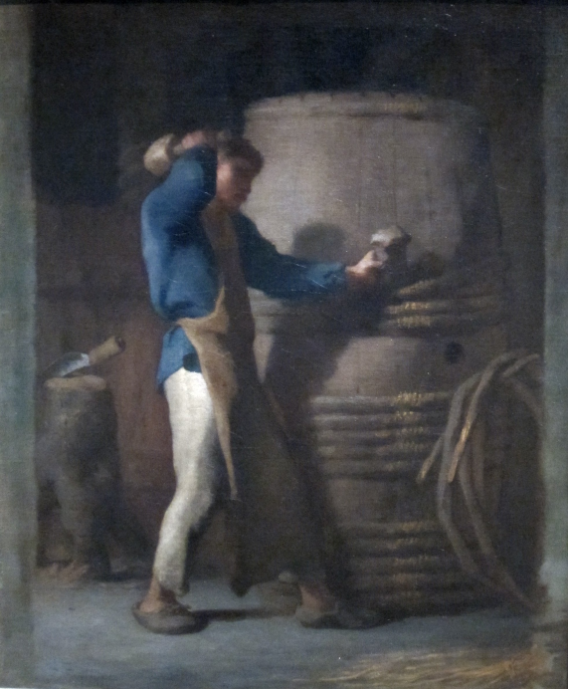
chest – percussion
Place spread fingers of one hand on chest
Rapidly tap and lift off with finger of other
Again zig-zag to compare zones/sides
Clavicles percussed directly
Where did this skill come from?

Slide 29
chest – auscultation
Ask the patient to breathe deeply through their mouth
Auscultate in same pattern as TVF/Percussion
Listen for:
Breath Sounds:
Normal ‘vesicular’
Bronchial
Absent
Added sounds
Wheeze = Expiratory
Crepitations = Inspiratory
Clears on Coughing?
Pleural Rub
Vocal Resonance
“Ninety-Nine” (as per TVF) auscultate in same pattern
No need to repeat if already performed TVF
Listen at your leisure!

Slide 30
BREATH SOUNDS
Vesicular
Bronchial
Breath sounds audible
Throughout inspiration
First 1/3 Expiration
Breath sounds audible
First 2/3 Inspiration
Last 2/3 Expiration
Silence
Silence
Expiration
Inspiration
Inspiration
Expiration
Silence

Slide 31
chest – posterior
Ask patient to sit forward
Position to pull scapulae forward
Repeat examination as per anterior:
Same zig-zag pattern
Palpation
Expansion (x2)
TVF
Percussion
Auscultation
+/- Vocal Resonance

Slide 32
Completing the examination......
Examine:
Sacral Oedema
Gently press lower back
Peripheral Oedema
Gently press feet/shins
Thank the patient
Offer them help getting dressed
WASH YOUR HANDS!!

Slide 33
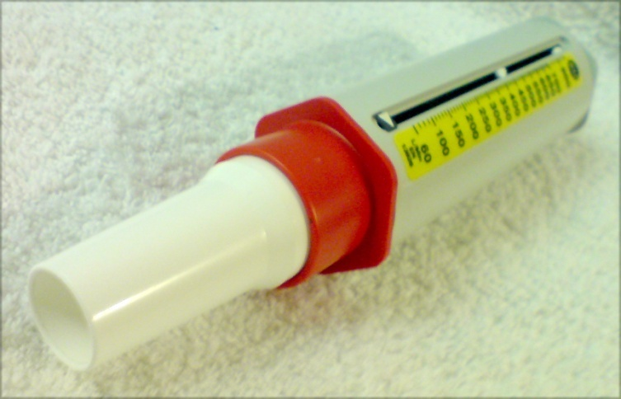
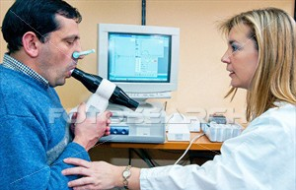
possible additional tests…
Bedside
O₂ Saturations
Temperature
Peak flow
Bloods
FBC, U&E, CRP
Cultures
Arterial Blood Gas (ABG)
Imaging – CXR
“Complex”
Sputum Culture
Spirometry

Slide 34
tying it all together
Sign | Consolidation | Pleural Effusion | Pneumothorax | Fibrosis
Trachea | Central | ?Displaced Away | ?Displaced Away | ?Displaced Towards
Expansion | ⬇ affected side | ⬇ affected side | ⬇ affected side | ⬇
Percussion | Dull (not stony dull) | Stony Dull over the fluid | Hyper resonance if large
Vocal Fremitus | ⬆ affected side | ✗ | ⬇ | ⬆
Breath sounds | Bronchial | ⬇/✗ | ⬇/✗ | Bronchial
Vocal Resonance | ⬆ | ⬇ | ⬇ | ⬆
Additional Sounds | Inspiratory crackles | - | - | Fine inspiratory crackles over affected lobes

Slide 35
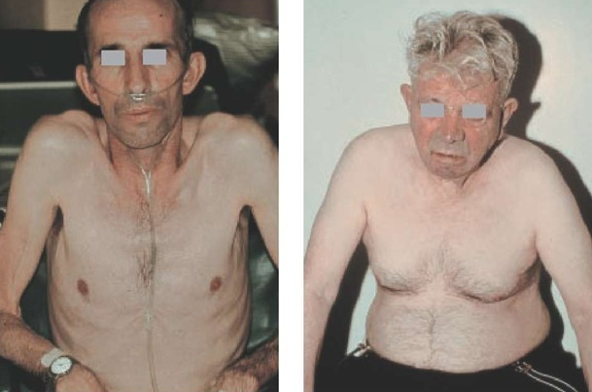
worked example – copd
Inspection
Tachypnoeic
Pursed lip breathing with prolonged expiration
Barrel chest (increased anterior-posterior diameter)
Use of accessory muscles
Hands
Tar staining
Clubbing
Arms
Normal
Face
“Pink puffer”
Neck
JVP Raised 2 cm
Pink Puffer Blue Bloater

Slide 36
worked example – copd
Cervical lymph nodes
No lymphadenopathy
The Chest
Palpate
Reduced Expansion
Hyper inflated chest
Tracheal Tug
TVF – Normal
Percuss – Hyper resonant Throughout
Auscultate
Decreased breath sounds
Early inspiratory crackles
Completion – Mild peripheral oedema

